Slide 1
Quarto PPTX Layouts: Extension Example
Showcasing dynamic layout sizing with .smaller and .smallest David Rieger

Slide 2
1. Section Header (Normal)

Slide 3
1. Section Header Smaller

Slide 4
1. Section Header Smallest

Slide 5
2. Title and Content (Normal)
This is a standard slide (##), triggering the Title and Content layout. Everything is at normal size.
Point A
Point B
Point C

Slide 6
2. Title and Content Smaller
This is the .smaller variant.
Point A
Point B
Point C

Slide 7
2. Title and Content Smallest
This is the .smallest variant.
Point A
Point B
Point C

Slide 8
3. Two Content (Normal)
Left Column
Normal text on the left.
Right Column
Normal text on the right.

Slide 9
3. Two Content Smaller
Left Column
Smaller text on the left.
Right Column
Smaller text on the right.

Slide 10
3. Two Content Smallest
Left Column
Smallest text on the left.
Right Column
Smallest text on the right.

Slide 11
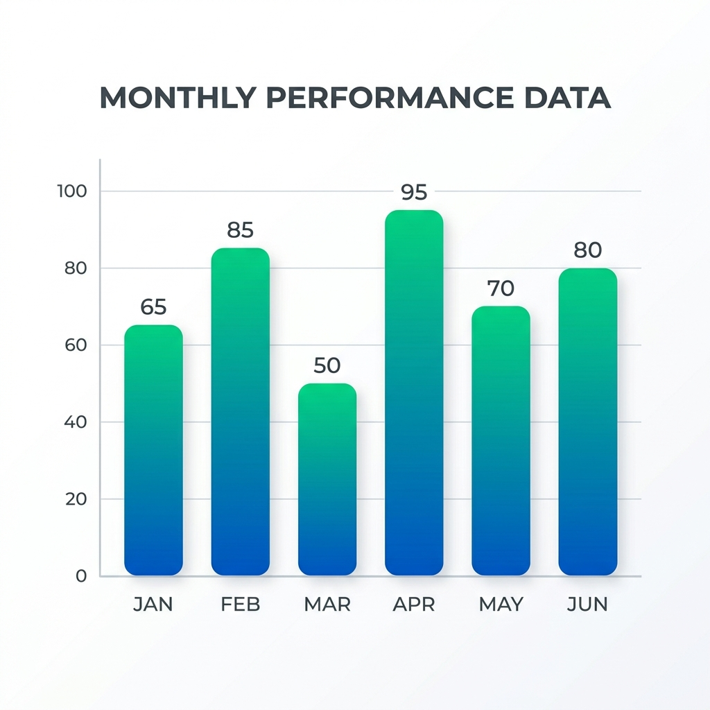
4. Comparison (Normal)
Normal text left.
Normal text right.

Slide 12
4. Comparison Smaller
Smaller text left.
Smaller text right.

Slide 13
4. Comparison Smallest
Smallest text left.
Smallest text right.

Slide 14
5. Content with Caption (Normal)
This slide triggers Content with Caption (single column, text + image).
Normal caption text.

Slide 15
5. Content with Caption Smaller
Smaller caption text.

Slide 16
5. Content with Caption Smallest
Smallest caption text.

