Slide 1
Pandoc Layouts Test
Testing all 7 PowerPoint Slide Layouts Antigravity & David

Slide 2
Section Header Layout

Slide 3
This is a Level 1 header (#), which is above the slide-level of 2 (##). Pandoc uses the Section Header layout for this slide.

Slide 4
Title and Content Layout
This slide triggers the Title and Content layout. It is a standard slide containing only text and lists, and does not match the criteria for any other layout.
Standard slide title (##)
Standard bullet points:
Bullet point A
Bullet point B
Bullet point C

Slide 5
Two Content Layout
This slide triggers the Two Content layout. It has two columns, and neither column contains text followed by non-text.

Slide 6
Left Column
This is the left column containing only text.
Bullet 1
Bullet 2
Right Column
This is the right column also containing only text.
Bullet 3
Bullet 4

Slide 7
Comparison Layout
This slide triggers the Comparison layout. It is a two-column slide where the left column contains text followed by an image (non-text).

Slide 8
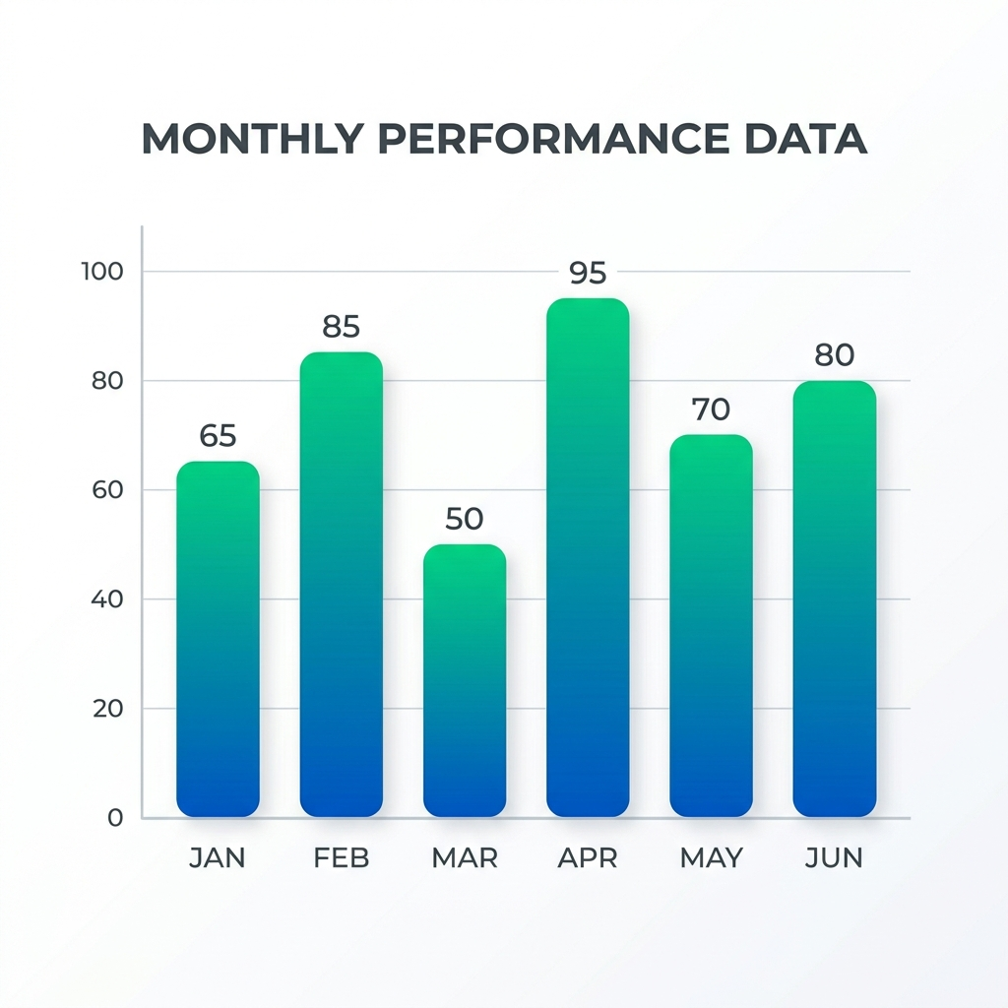
Here is some text in the left column.
Here is the right column content.
Bullet A
Bullet B

Slide 9
Content with Caption Layout
This slide triggers the Content with Caption layout because it is a single-column slide containing text followed by an image.
Here is the caption text explaining the image below:

Slide 10
Notes:
This slide has no title and only contains speaker notes. This triggers the Blank layout since there is no visible slide content.

Slide 12
Section Header mit minimalem Text

Slide 13
Ein einzelner kurzer Satz unter der Überschrift.

Slide 14
Section Header ohne Text

Slide 15
Minimal Two Content (mit kurzem Satz oben)
Ein kurzer Satz oben auf dieser Folie.

Slide 16
Text links.
Text rechts.

Slide 17
Minimal Two Content (ohne Satz oben)
Nur Text links.
Nur Text rechts.

Slide 18
Minimal Comparison (mit kurzem Satz oben)
Ein kurzer Satz oben auf dieser Folie.

Slide 19
Text links.
Text rechts.

Slide 20
Minimal Comparison (ohne Satz oben)
Text links.
Text rechts.

Slide 21
Script Test: Section Header Small

Slide 22
Script Test: Title and Content Normal
This is a normal slide with standard font sizes.
Point 1
Point 2

Slide 23
Script Test: Title and Content Small
This slide should have smaller font sizes, mapped by the python script.
Point 1
Point 2

Slide 24
Script Test: Two Content Normal
Normal Text Left
Normal Text Right

Slide 25
Script Test: Two Content Small
Smaller Text Left
Smaller Text Right

Slide 26
Lua Filter Test: Normal Size
Dieser Text ist in der ganz normalen Standardgröße. Wir verwenden keine speziellen Klassen.

Slide 27
Lua Filter Test: Smaller
Diese Folie hat das Suffix {.smaller} in der Überschrift. Der Lua-Filter sollte dies erkennen und das Layout auf die -6pt Variante verkleinern.

Slide 28
Lua Filter Test: Smallest
Diese Folie nutzt die {.smallest} Klasse. Sie sollte automatisch das -12pt Layout erhalten! Das ist extrem simpel in der Anwendung.

