Slide 1
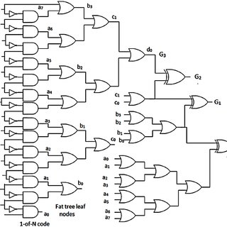
Arithmetic Logic Units
By: David Strikaitis

Slide 2
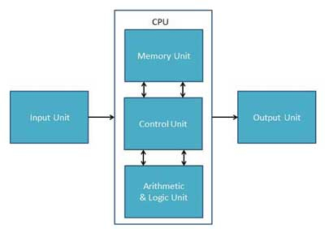
What is an ALU?
Does the mathematical or logical calculations associated with a Central Processing Unit
The main areas of any logical component

Slide 3
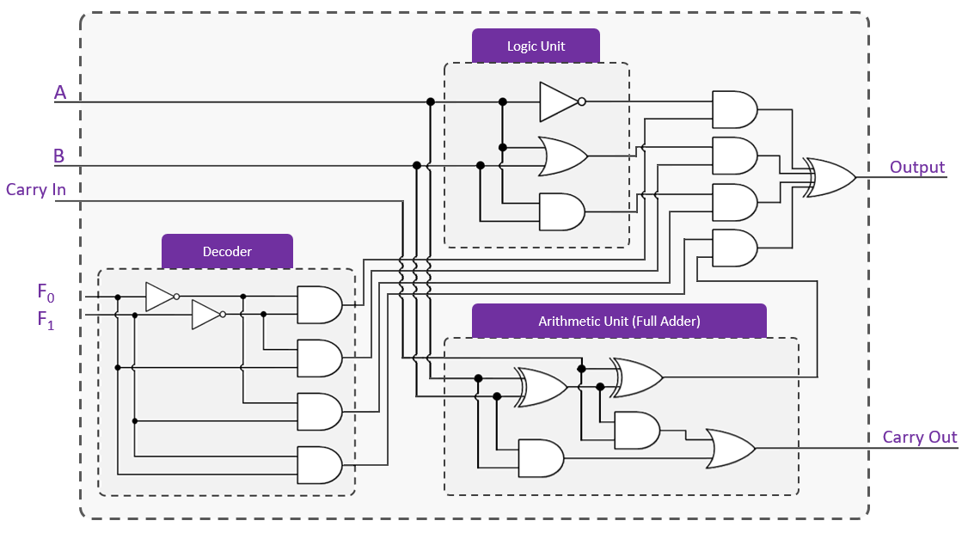
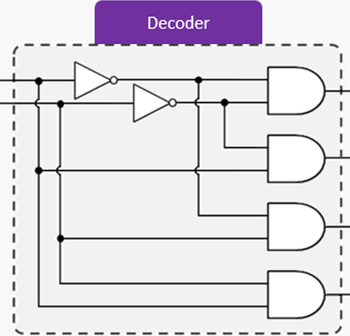
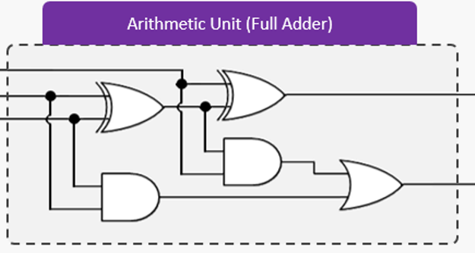
ALU Diagram

Slide 4
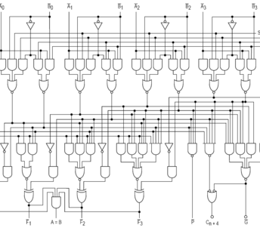
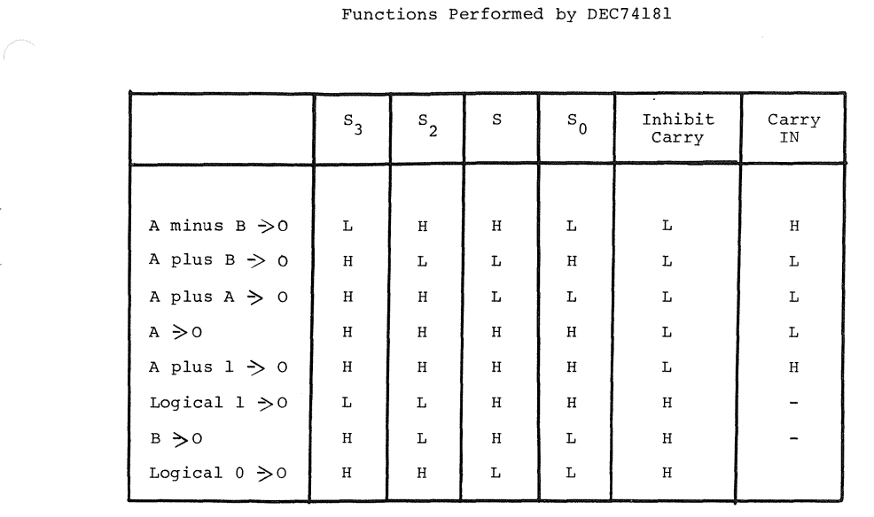
4 Bit ALU

Slide 5



Upscaling
Run it again
More
Bigger

Slide 6
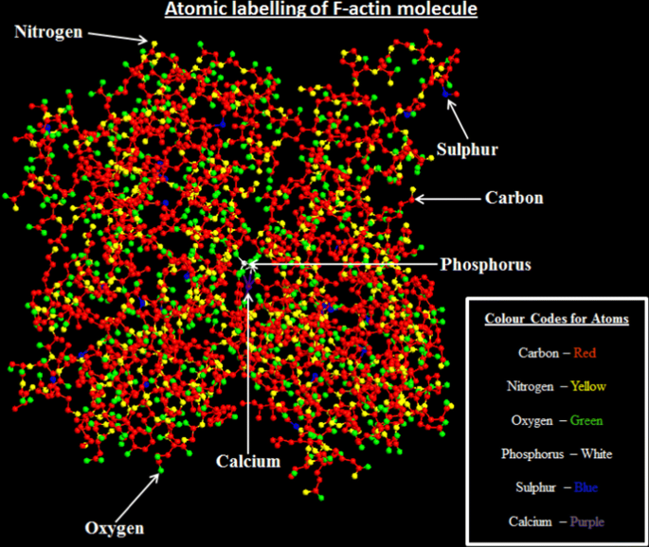
The Future
Actin quantum cellular automata

Slide 7

Conclusion

