Slide 1
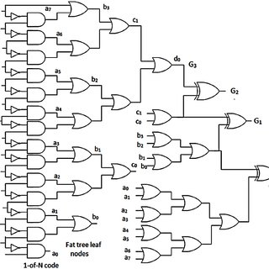
Arithmetic Logic Units
By: David Strikaitis

Slide 2
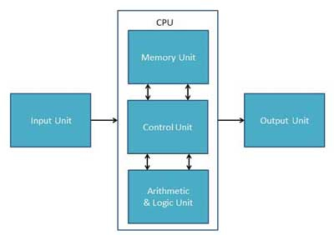
What is an ALU?
Does the mathematical or logical calculations associated with a Central Processing Unit
The main areas of any logical component

