Slide 1
Gene Transcription
Transcription Factor Binding Sites (TFBS)
1
Promoter
Gene
DNA
Enhancer
RNA
TF
TF
RNA Pol II
TF
TF
TF
TF
P300/CBP
Transcription
Complex
P300/CBP
TF
TF
TF
TF
TF
TF
3
2

Slide 2
Nucleosome
with histone modifications
DNA
DNA accessible, active enhancer
DNA
DNA inaccessible, inactive enhancer
H3K27ac
H3K4me1
H3K27me3

Slide 3
Base-State
(j,0)
Hidden States
A
G
C
A
T
T
Observations

Slide 4

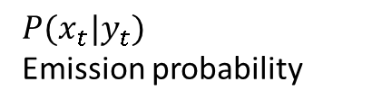


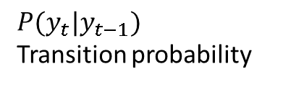







Markov chain
$P(y_{t}|y_{t−1})$ Transition probability
$$y_{1}$$
$$y_{2}$$
$$y_{3}$$
$$y_{4}$$
$$y_{5}$$
Hidden
$P(x_{t}|y_{t})$ Emission probability
$$x_{1}$$
$$x_{2}$$
$$x_{3}$$
T$x_{4}$
$$x_{5}$$
Observed

Slide 5













































Hidden State Machine
Emission Probability
Transition Probability
$$0.2$$
$$1$$
$$2$$
$$a$$
$$b$$
$$a$$
$$b$$
$$a$$
$$1.0$$
$$0.0$$
$$a$$
$$0.8$$
$$0.2$$
$$0.8$$
$$0.8$$
$$1$$
$$0.2$$
$$2$$
$$b$$
$$0.0$$
$$1.0$$
$$b$$
$$0.2$$
$$0.8$$
Example of a Generated Sequence
$$a$$
$$a$$
$$a$$
$$a$$
$$b$$
$$b$$
$$b$$
$$b$$
$b$
$$a$$
$$a$$
$$a$$
$$a$$
Hidden
$$1$$
$$1$$
$$1$$
$$1$$
$$2$$
$$2$$
$$2$$
$$2$$
$$2$$
$$1$$
$$1$$
$$1$$
$$1$$
Observed

Slide 6
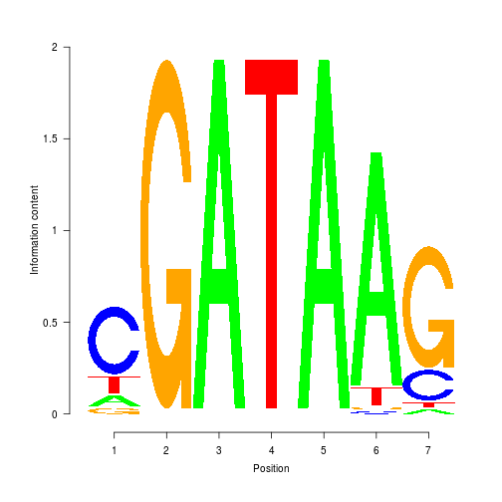




























































Hidden State Machine
Emission Probability
Transition Probability
$$a$$
$$A$$
$$C$$
$$G$$
$$T$$
$$a$$
$$b$$
$$0.2$$
$$a$$
$$b$$
$$A∗$$
$$0. 1$$
$$0.6$$
$$0. 1$$
$$0.2$$
$$a$$
$$0.8$$
$$0.2$$
$$0.8$$
$$C∗$$
$$0.1$$
$$0.05$$
$$0.8$$
$$0.05$$
$$G$$
$$T$$
$$1.0$$
$$A$$
$$C$$
$$G∗$$
$$0.5$$
$$0.3$$
$$0.1$$
$$0.1$$
$$T∗$$
$$0.1$$
$$0.4$$
$$0.2$$
$$0.3$$
$$P\left(x_{t}=T | x_{t−1}=G,y_{t}=a\right)$$
Example of a Generated Sequence
$a$
$$a$$
$$a$$
$$a$$
$$b$$
$$a$$
$a$
$$a$$
$$a$$
Hidden
$$A$$
$$C$$
$$G$$
$$C$$
$$C$$
$$G$$
$$A$$
$$T$$
$$A$$
$$C$$
$G$
$$A$$
$$T$$
Observed
Transcription Factor Binding Site

Slide 7
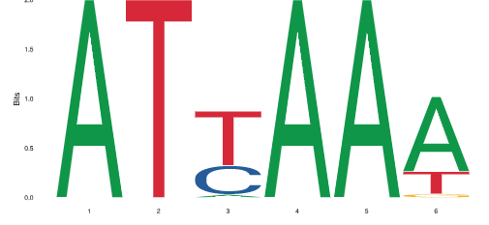
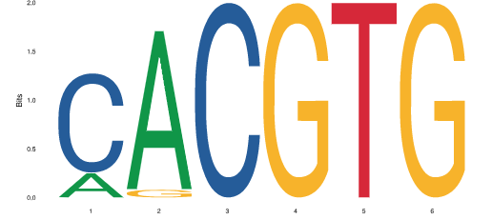
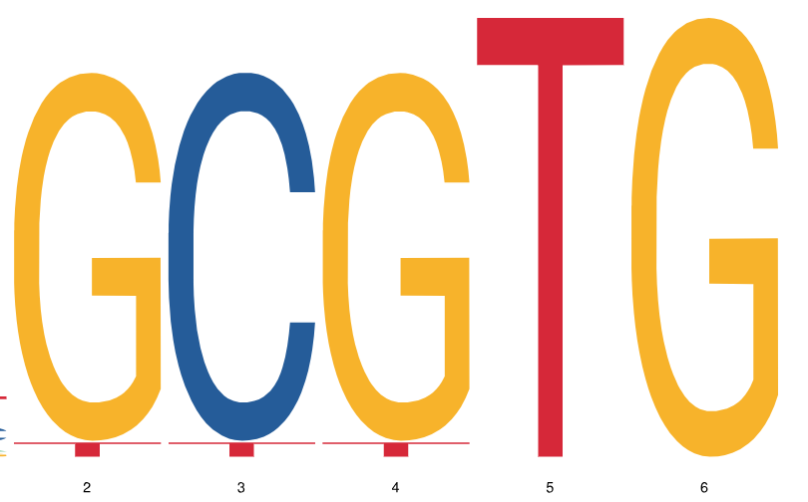





































































































Hidden State Machine
Emission Probability
Transition Probability
$$0.05 0.0 0.05$$
$$a_{1}$$
$$A$$
$$C$$
$$G$$
$$T$$
$$a_{1}$$
$$a_{2}$$
$$b$$
$$c$$
$$d$$
$$0.1$$
$$0.8$$
$${ a}_{1}$$
$$b_{1}$$
$$c_{1}$$
$$d_{1}$$
$$a_{2}$$
$$A$$
$$C$$
$$G$$
$$T$$
$$A∗$$
$$0. 1$$
$$0.6$$
$$0. 1$$
$$0.2$$
$$a_{1}$$
$$0.8$$
$$0.1$$
$$0.05$$
$$0.0$$
$$0.05$$
$$1.0$$
$$C∗$$
$$A∗$$
$$0. 1$$
$$0.6$$
$$0. 1$$
$$0.2$$
$$G$$
$$T$$
$$0.1$$
$$0.05$$
$$0.8$$
$$0.05$$
$$a_{2}$$
$$0. 1$$
$$0.8$$
$$0.0$$
$$0.1$$
$$0.0$$
$$A$$
$$C$$
$$G∗$$
$$C∗$$
$$0.1$$
$$0.05$$
$$0.8$$
$$0.05$$
$$0.5$$
$$0.3$$
$$0.1$$
$$0.1$$
$$0.0 0.1 0.0$$
$$G∗$$
$$0.5$$
$$0.3$$
$$0.1$$
$$0.1$$
$$a_{2}$$
$$b_{2}$$
$${ c}_{2}$$
$$d_{2}$$
$$T∗$$
$$0.1$$
$$0.4$$
$$0.2$$
$$0.3$$
$$0.8$$
$$0.1$$
$$1.0$$
$$T∗$$
$$0.1$$
$$0.4$$
$$0.2$$
$$0.3$$
$$G$$
$$T$$
$$A$$
$$C$$
Example of a Generated Sequence
$a_{1}$
$a_{1}$
$a_{1}$
$a_{1}$
$$b_{1}$$
$a_{1}$
$a_{1}$
$a_{2}$
$${ a}_{2}$$
$$c_{2}$$
$$a_{2}$$
$${ a}_{2}$$
$${ a}_{2}$$
$$A$$
$$C$$
$$T$$
$$T$$
$$A$$
$$T$$
$$T$$
$$A$$
$$A$$
$$A$$
$$C$$
$$T$$
$$T$$
$$C$$
$$C$$
$$A$$
$$C$$
$$G$$
$$T$$
$$G$$
$$C$$
$$G$$
$$A$$

Slide 8














Hidden State Machine
$$(1,0)$$
$$(1,1)$$
$$(1,2)$$
$${ (1,k)}_{ }$$
$$G$$
$$T$$
$$A$$
$$C$$
$$\left(2,0\right)$$
$$(2,1)$$
$$(2,2)$$
$${ (2,k)}_{ }$$
$$G$$
$$T$$
$$A$$
$$C$$
$$(m,0)$$
$$(m,1)$$
$$(m,2)$$
$${ (m,k)}_{ }$$
$$G$$
$$T$$
$$A$$
$$C$$

Slide 9





























































State Machine
$$a$$
$$b$$
$a$
$$a$$
$$a$$
$$a$$
$$b$$
$a$
$$a$$
$$a$$
$$a$$
$$G$$
$$T$$
$$A$$
$$C$$
$$T$$
$$T$$
$$C$$
$$G$$
$$A$$
$$T$$
$$A$$
$$A$$
$$C$$
$$G$$
$$G$$
$$A$$
$$C$$
$$a$$
$$b$$
$$c$$
$$d$$
$a$
$$a$$
$$a$$
$$a$$
$$b$$
$$a$$
$$a$$
$$a$$
$$c$$
$$a$$
$$a$$
$$A$$
$$C$$
$$T$$
$$T$$
$$C$$
$$T$$
$$T$$
$$C$$
$$T$$
$$T$$
$$C$$
$$T$$
$$T$$
$$T$$
$$T$$
$$C$$
$$T$$
$$T$$
$$C$$
$$C$$
$$G$$
$$T$$
$$A$$
$$C$$

Slide 10
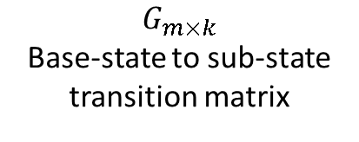
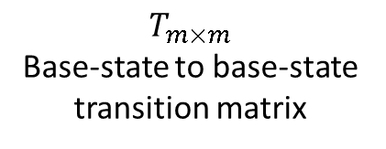

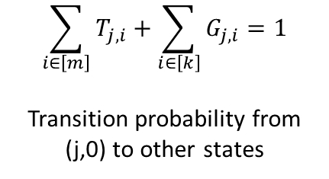
$$T_{m×m}$$
Base-state to base-state transition matrix
$$G_{m×k}$$
Base-state to sub-state transition matrix
$$j$$
$$\sum_{i∈\left[m\right]}{T_{j,i}}+\sum_{i∈\left[k\right]}{G_{j,i}}=1$$
Transition probability from (j,0) to other states

Slide 11
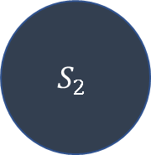

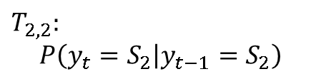
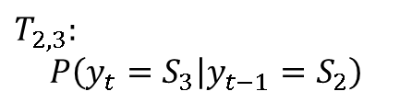
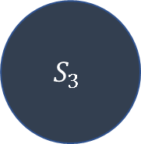
Markov Model
$$S_{1}$$
$$S_{2}$$
$$T_{2,2}:$$
$$P\left(y_{t}=S_{2} | y_{t−1}=S_{2}\right)$$
$$T_{2,3}:$$
$$P\left(y_{t}=S_{3} | y_{t−1}=S_{2}\right)$$
$$S_{3}$$

Slide 12
Sub-State (PWM)
(j,0)
(j,l)
(j,0)
Hidden States
T
C
G
A
T
A
A
G
G
Observations

Slide 13
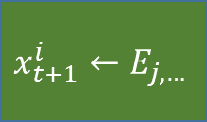



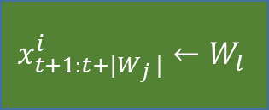

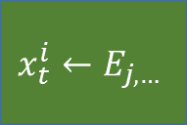


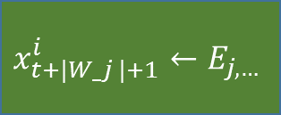



$$y_{t+1:t+\left|W_{j}\right|}^{i}$$
$$y_{t+\left|W_{j}\right|+1}^{i}$$
(j,l)
(j,0)
$$l←G_{j,∗}$$
$$φ=1$$
$$y_{t}^{i}$$
(j,0)
$$φ\sim Bin(F_{j},1)$$
$$x_{t+1:t+|W_{j} |}^{i}←W_{l}$$
$$x_{t+|W_j |+1}^{i}←E_{j,…}$$
$$y_{t+1}^{i}$$
$$φ=0$$
$$x_{t}^{i}←E_{j,…}$$
(j’,0)
$$j′←T_{j,∗}$$
$$x_{t+1}^{i}←E_{j,…}$$

Slide 14
















Forward Algorithm
$$t−|W_{1}|−1$$
$$t−|W_{2}|−1$$
$$t$$
$$t−1$$
$$t$$
$$α_{j,t}$$
$$j$$
$$α_{j,t}$$
$$j$$
Backward Algorithm
$$t$$
$$t−|W_{2}|−1$$
$$t−|W_{1}|−1$$
$$t$$
$$t+1$$
$$β_{j,t}$$
$$j$$
$$β_{j,t}$$
$$j$$

Slide 15









$$t$$
$$t−|W_{2}|−1$$
$$t−|W_{1}|−1$$
$$t$$
$t$+1
$$j$$
$$β_{j,t}$$
$$j$$
$$β_{j,t}$$

Slide 16
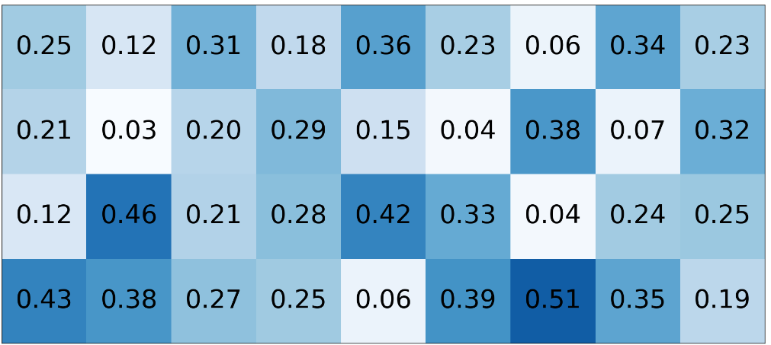
…CGGCTACTCTGTA…
PWM
0
0
0
1
0
0
0
0
0
0
1
0
0
1
0
1
0
0
1
0
0
0
0
0
0
0
1
0
0
1
0
0
1
0
1
0

Slide 17
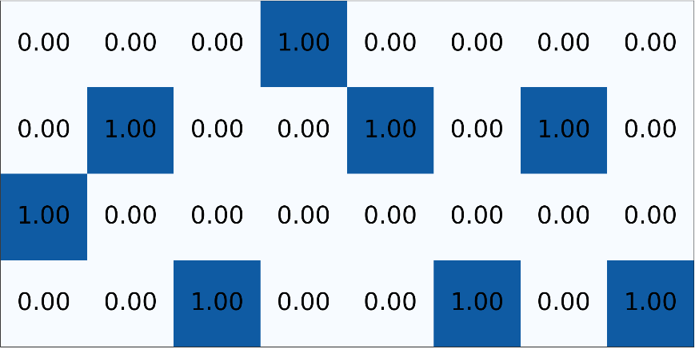
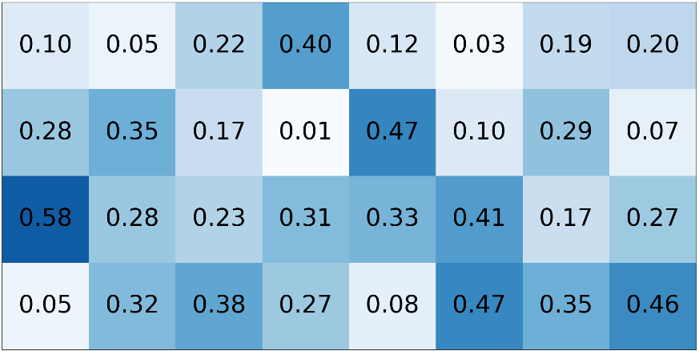
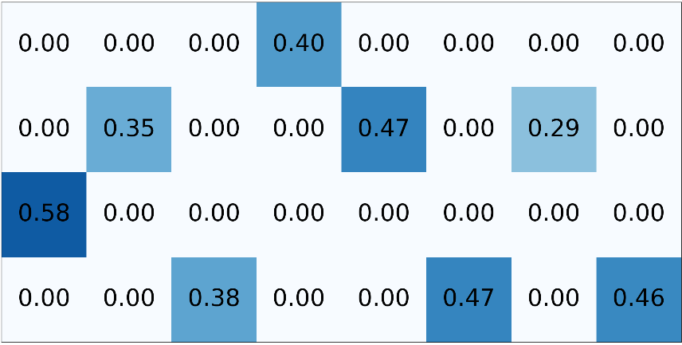
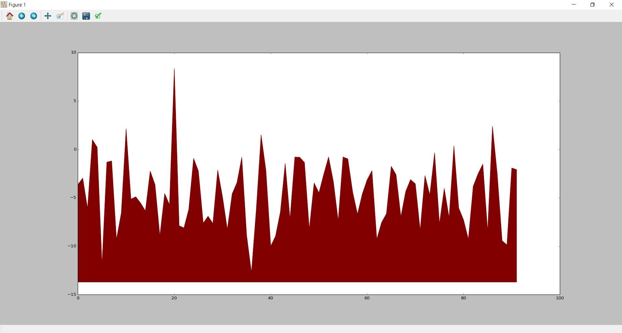
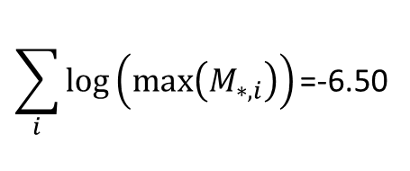
…CGGCTACTCTTA…
One-hot encoding
PWM
M
$$\sum_{i}{log⁡\left(max⁡\left(M_{∗,i}\right)\right)\text{=}\text{−}\text{6}\text{.}\text{50}}$$
Log likelihood of TF binding
Location in sequence

Slide 18
