Slide 1


































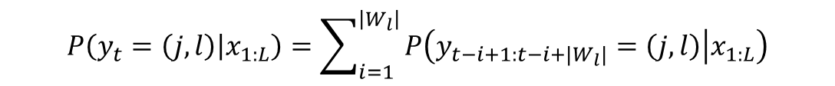
$$G$$
$$T$$
$$A$$
$$A$$
$$T$$
$$T$$
$$A$$
$$C$$
$$A$$
$$G$$
$$T$$
$$C$$
$$A$$
$$G$$
$$T$$
$$A$$
$$A$$
$$T$$
$$T$$
$$A$$
$$C$$
$$A$$
$$G$$
$$T$$
$$C$$
$$A$$
$$G$$
$$T$$
$$A$$
$$A$$
$$T$$
$$T$$
$$A$$
$$C$$
$$A$$
$$G$$
$$T$$
$$C$$
$$A$$
$$G$$
$$T$$
$$A$$
$$A$$
$$T$$
$$T$$
$$A$$
$$C$$
$$A$$
$$G$$
$$T$$
$$C$$
$$A$$
$$G$$
$$T$$
$$A$$
$$A$$
$$T$$
$$T$$
$$A$$
$$C$$
$$A$$
$$G$$
$$T$$
$$C$$
$$A$$
$$t$$
$$P\left(y_{t}=\left(j,l\right) | x_{1:L}\right)=\sum_{i=1}^{\left|W_{l}\right|}{P\left(y_{t−i+1:t−i+|W_{l}|}=\left(j,l\right) | x_{1:L}\right)}$$
Notes:
6 state HOP HMM

Slide 2


































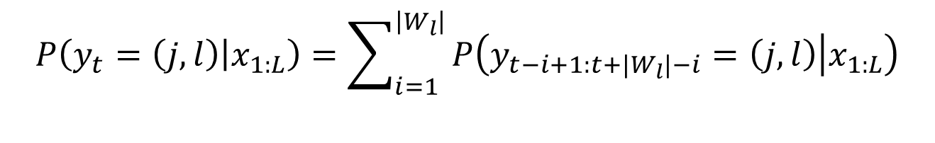







































$$y_{t:t+|W_{l}|}=\left(j,l\right)$$
$$G$$
$$T$$
$$A$$
$$A$$
$$T$$
$$T$$
$$A$$
$$C$$
$$A$$
$$G$$
$$T$$
$$C$$
$$A$$
$$y_{t−1:t+\left|W_{l}\right|−1}=\left(j,l\right)$$
$$G$$
$$T$$
$$A$$
$$A$$
$$T$$
$$T$$
$$A$$
$$C$$
$$A$$
$$G$$
$$T$$
$$C$$
$$A$$
$$y_{t−2:t+\left|W_{l}\right|−2}=\left(j,l\right)$$
$$G$$
$$T$$
$$A$$
$$A$$
$$T$$
$$T$$
$$A$$
$$C$$
$$A$$
$$G$$
$$T$$
$$C$$
$$A$$
$$y_{t−3:t+\left|W_{l}\right|−3}=\left(j,l\right)$$
$$G$$
$$T$$
$$A$$
$$A$$
$$T$$
$$T$$
$$A$$
$$C$$
$$A$$
$$G$$
$$T$$
$$C$$
$$A$$
$$y_{t−4:t+\left|W_{l}\right|−4}=\left(j,l\right)$$
$$G$$
$$T$$
$$A$$
$$A$$
$$T$$
$$T$$
$$A$$
$$C$$
$$A$$
$$G$$
$$T$$
$$C$$
$$A$$
$$t\text{-}4$$
$$t$$
$$t+4$$
$$P\left(y_{t}=\left(j,l\right) | x_{1:L}\right)=\sum_{i=1}^{\left|W_{l}\right|}{P\left(y_{t−i+1:t+|W_{l}|−i}=\left(j,l\right) | x_{1:L}\right)}$$
Notes:
6 state HOP HMM

Slide 3

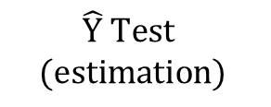








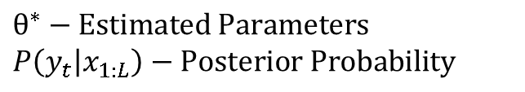


$$Generation$$
$$D→θ−True Parameters$$
$$Synthetic DNA Sequences$$
$$BG_{1}$$
$$BG_{1}$$
$$BG_{1}$$
$$BG_{1}$$
$$TF_{1}^{1}$$
$$BG_{1}$$
$$BG_{1}$$
$$BG_{2}$$
$$BG_{2}$$
$$TF_{2}^{2}$$
$$BG_{2}$$
$$BG_{2}$$
$$BG_{2}$$
$$X Train$$
$$A$$
$$C$$
$$T$$
$$T$$
$$A$$
$$T$$
$$T$$
$$A$$
$$A$$
$$A$$
$$C$$
$$T$$
$$T$$
$$C$$
$$C$$
$$A$$
$$C$$
$$G$$
$$T$$
$$G$$
$$C$$
$$G$$
$$A$$
$$BG_{1}$$
$$BG_{1}$$
$$BG_{1}$$
$$BG_{1}$$
$$TF_{1}^{1}$$
$$BG_{1}$$
$$BG_{1}$$
$$BG_{2}$$
$$BG_{2}$$
$$TF_{2}^{2}$$
$$BG_{2}$$
$$BG_{2}$$
$$BG_{2}$$
$$X Test$$
$$A$$
$$C$$
$$T$$
$$T$$
$$A$$
$$T$$
$$T$$
$$A$$
$$A$$
$$A$$
$$C$$
$$T$$
$$T$$
$$C$$
$$C$$
$$A$$
$$C$$
$$G$$
$$T$$
$$G$$
$$C$$
$$G$$
$$A$$
$$BG_{1}$$
$$BG_{1}$$
$$BG_{1}$$
$$BG_{1}$$
$$TF_{1}^{1}$$
$$BG_{1}$$
$$BG_{1}$$
$$BG_{2}$$
$$BG_{2}$$
$$TF_{2}^{2}$$
$$BG_{2}$$
$$BG_{2}$$
$$BG_{2}$$
$$DNA States$$
$$A$$
$$C$$
$$T$$
$$T$$
$$A$$
$$T$$
$$T$$
$$A$$
$$A$$
$$A$$
$$C$$
$$T$$
$$T$$
$$C$$
$$C$$
$$A$$
$$C$$
$$G$$
$$T$$
$$G$$
$$C$$
$$G$$
$$A$$
$$Y Train$$
$$BG_{1}$$
$$BG_{1}$$
$$BG_{1}$$
$$BG_{1}$$
$$TF_{1}^{1}$$
$$BG_{1}$$
$$BG_{1}$$
$$BG_{2}$$
$$BG_{2}$$
$$TF_{2}^{2}$$
$$BG_{2}$$
$$BG_{2}$$
$$BG_{2}$$
$$A$$
$$C$$
$$T$$
$$T$$
$$A$$
$$T$$
$$T$$
$$A$$
$$A$$
$$A$$
$$C$$
$$T$$
$$T$$
$$C$$
$$C$$
$$A$$
$$C$$
$$G$$
$$T$$
$$G$$
$$C$$
$$G$$
$$A$$
$$Y Test$$
HOP Baum-Welch
$θ^{∗}−Estimated Parameters$
$$P\left(y_{t} | x_{1:L}\right)−Posterior Probability$$
$$X Train$$
HOP Viterbi
$$θ^{∗}$$
$$X Test$$
$$\hat{Y} Test$$
$$(estimation)$$
Notes:
6 state HOP HMM

