Slide 1









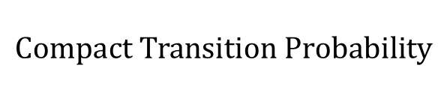



















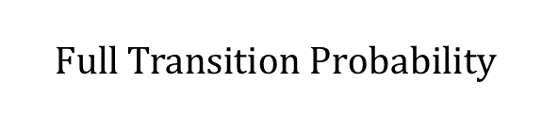


















































































$$Full Transition Probability$$
$$to$$
$$BG_{1}$$
$$BG_{2}$$
$$TF_{1}^{1}$$
$$TF_{2}^{1}$$
$$TF_{3}^{1}$$
$$TF_{1}^{2}$$
$$TF_{2}^{2}$$
$$TF_{3}^{2}$$
$$from$$
Transition Probability
$$Compact Transition Probability$$
$$BG_{1}$$
$$0.8$$
$$0.0$$
$$0.05$$
$$FIXED$$
$$FIXED$$
$$FIXED$$
$$0.1$$
$$0.05$$
$$0$$
$$0$$
$$0$$
$$FIXED$$
$$FIXED$$
$$FIXED$$
$$0.0$$
$$T$$
$$G$$
$$BG_{2}$$
$$0. 1$$
$$0.8$$
$$0$$
$$0$$
$$0$$
$$0.0$$
$$0.1$$
$$to$$
$$BG_{1}$$
$$BG_{2}$$
$$TF_{1}^{∗}$$
$$TF_{2}^{∗}$$
$$TF_{3}^{∗}$$
$$FIXED$$
$$FIXED$$
$$FIXED$$
$$FIXED$$
$$FIXED$$
$$FIXED$$
$$FIXED$$
$$FIXED$$
$$from$$
$$TF_{1}^{1}$$
$$1$$
$$0$$
$$0$$
$$0$$
$$0$$
$$0$$
$$0$$
$$0$$
$$Repack$$
$$BG_{1}$$
$$0.8$$
$$0.1$$
$$0.05$$
$$0.0$$
$$0.05$$
$$FIXED$$
$$FIXED$$
$$FIXED$$
$$FIXED$$
$$FIXED$$
$$FIXED$$
$$FIXED$$
$$FIXED$$
$$TF_{2}^{1}$$
$$1$$
$$0$$
$$0$$
$$0$$
$$0$$
$$0$$
$$0$$
$$0$$
$$FIXED$$
$$FIXED$$
$$FIXED$$
$$FIXED$$
$$FIXED$$
$$FIXED$$
$$FIXED$$
$$FIXED$$
$$BG_{2}$$
$$0. 1$$
$$0.8$$
$$0.0$$
$$0.1$$
$$0.0$$
$$TF_{3}^{1}$$
$$1$$
$$0$$
$$0$$
$$0$$
$$0$$
$$0$$
$$0$$
$$0$$
$$FIXED$$
$$FIXED$$
$$FIXED$$
$$FIXED$$
$$FIXED$$
$$FIXED$$
$$FIXED$$
$$FIXED$$
$$TF_{1}^{2}$$
$$0$$
$$1$$
$$0$$
$$0$$
$$0$$
$$0$$
$$0$$
$$0$$
$$FIXED$$
$$FIXED$$
$$FIXED$$
$$FIXED$$
$$FIXED$$
$$FIXED$$
$$FIXED$$
$$FIXED$$
$$TF_{2}^{2}$$
$$0$$
$$1$$
$$0$$
$$0$$
$$0$$
$$0$$
$$0$$
$$0$$
$$TF_{3}^{2}$$
$$FIXED$$
$$FIXED$$
$$FIXED$$
$$FIXED$$
$$FIXED$$
$$FIXED$$
$$FIXED$$
$$FIXED$$
$$0$$
$$1$$
$$0$$
$$0$$
$$0$$
$$0$$
$$0$$
$$0$$

Slide 2
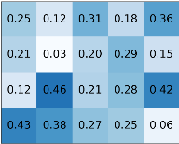


















Hidden State Machine
$$BF_{1}$$
$$(1,0)$$
$$TF_{1}^{1}$$
$$(1,1)$$
$TF_{2}^{1}$
$$(1,1)$$
$TF_{k}^{1}$
$$(1,1)$$
$$G$$
$$T$$
$$A$$
$$C$$
$$BF_{2}$$
$$(2,0)$$
$$TF_{1}^{2}$$
$$(1,1)$$
$$TF_{2}^{2}$$
$$(1,1)$$
$TF_{k}^{2}$
$$(1,1)$$
$$G$$
$$T$$
$$A$$
$$C$$
$$BF_{m}$$
$$(m ,0 )$$
$$TF_{1}^{m}$$
$$(m,1)$$
$TF_{2}^{m}$
$$(1,1)$$
$$TF_{k}^{m}$$
$$(1,1)$$
$$G$$
$$T$$
$$A$$
$$C$$

Slide 3
















Forward Algorithm
$$t−|W_{1}|−1$$
$$t−|W_{2}|−1$$
$$t$$
$$t−1$$
$$t$$
$$α_{j,t}$$
$$j$$
$$α_{j,t}$$
$$j$$
Backward Algorithm
$$t$$
$$t−|W_{2}|−1$$
$$t−|W_{1}|−1$$
$$t$$
$$t+1$$
$$β_{j,t}$$
$$j$$
$$β_{j,t}$$
$$j$$

Slide 4








Backward Algorithm
$$t$$
$$t+1$$
$$β_{j,t}$$
$$j$$
$$β_{j,t}=\sum_{\text{j}\text{′}∈\text{[}\text{m}\text{]}}{β_{\text{j}\text{′}\text{,}\text{t}\text{+}\text{1}}⋅E_{{\text{j}\text{,}\text{x}}_{t+1}}⋅T_{\text{j}\text{,}\text{j}\text{′}}}$$
Forward Algorithm
$$t−1$$
$$t$$
$$α_{j,t}$$
$$j$$
$$α_{j,t}=E_{{\text{j}\text{,}\text{x}}_{t}}⋅\sum_{\text{j}\text{′}∈\text{[}\text{m}\text{]}}{T_{\text{j}\text{′}\text{,}\text{j}}⋅α_{\text{j}\text{′}\text{,}\text{t}\text{−}\text{1}}}$$

Slide 5

…CGGCTACTCTGTA…
PWM
0
0
0
1
0
0
0
0
0
0
1
0
0
1
0
1
0
0
1
0
0
0
0
0
0
0
1
0
0
1
0
0
1
0
1
0

Slide 6
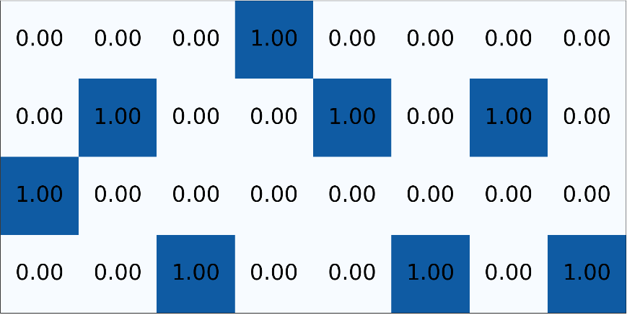
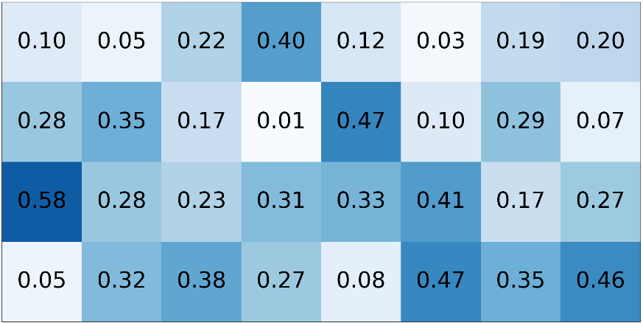
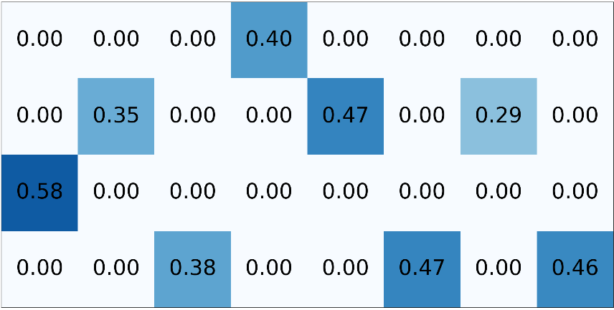
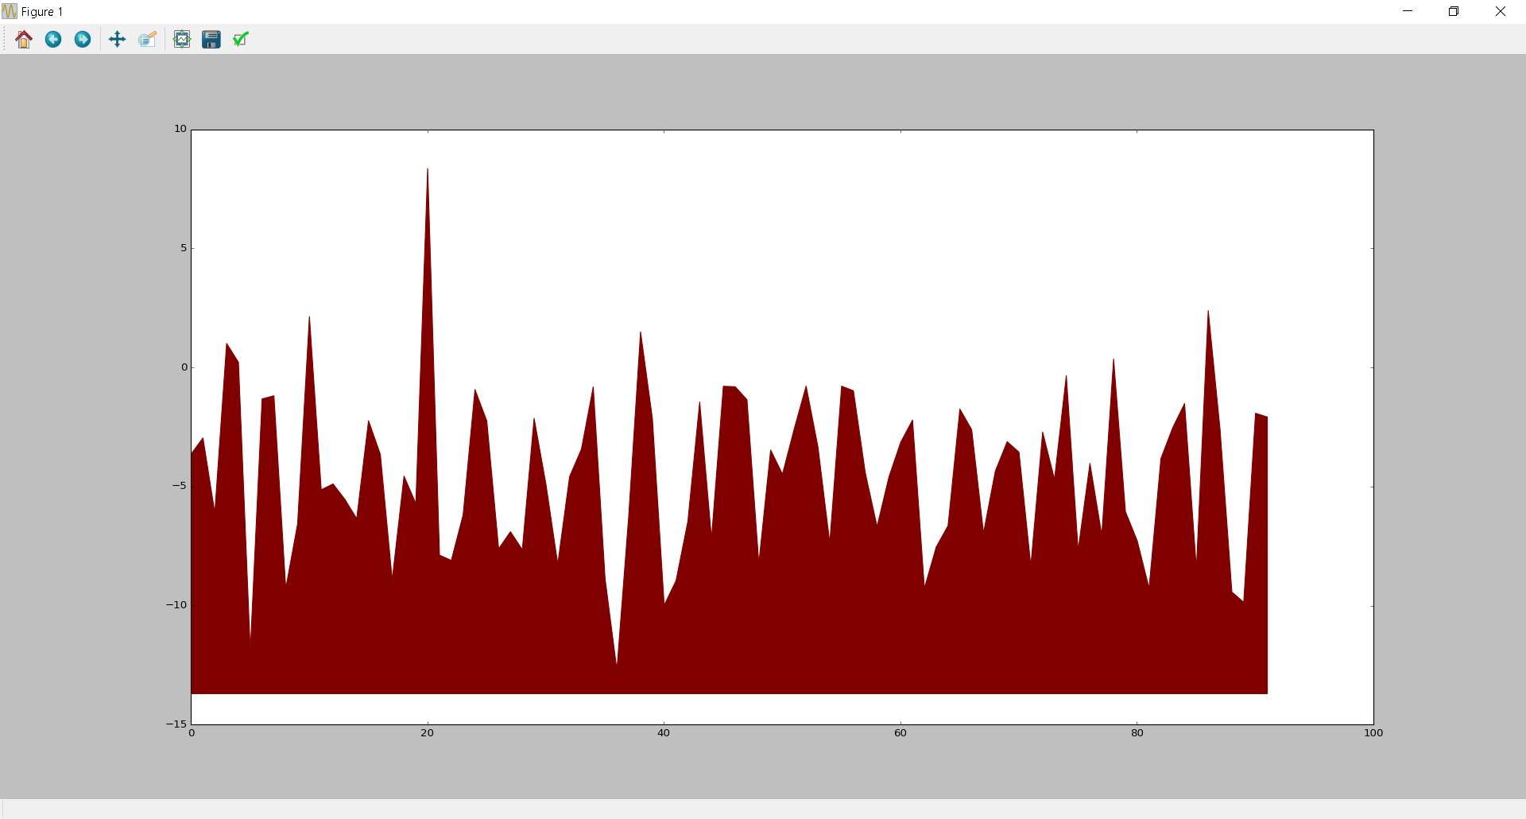
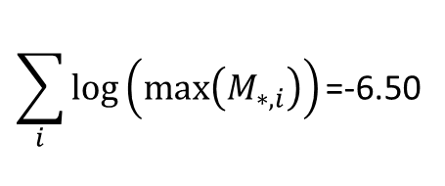
…CGGCTACTCTTA…
One-hot encoding
PWM
M
$$\sum_{i}{log⁡\left(max⁡\left(M_{∗,i}\right)\right)\text{=}\text{−}\text{6}\text{.}\text{50}}$$
Log likelihood of TF binding
Location in sequence

Slide 7
