Slide 1
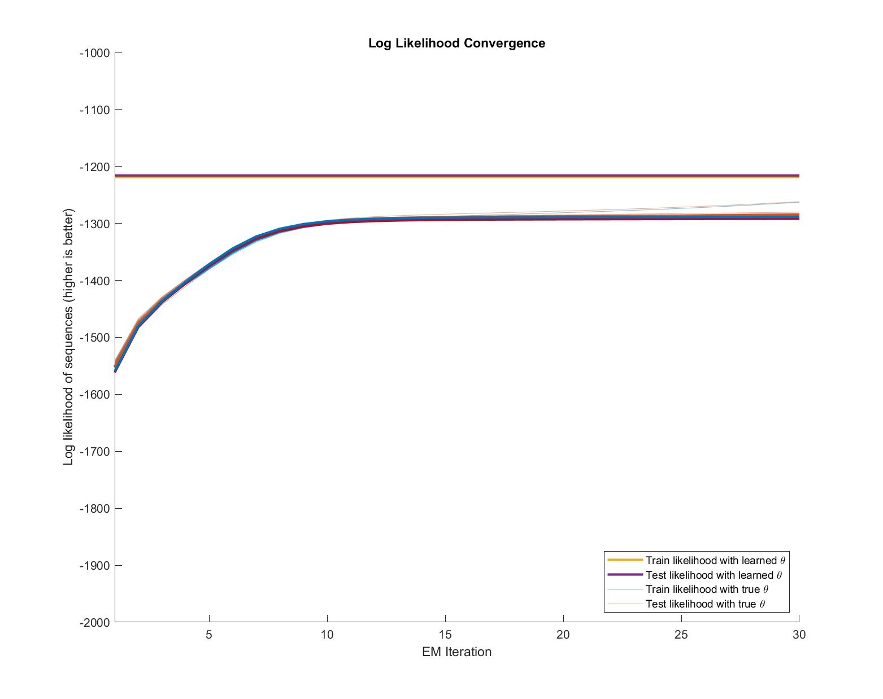
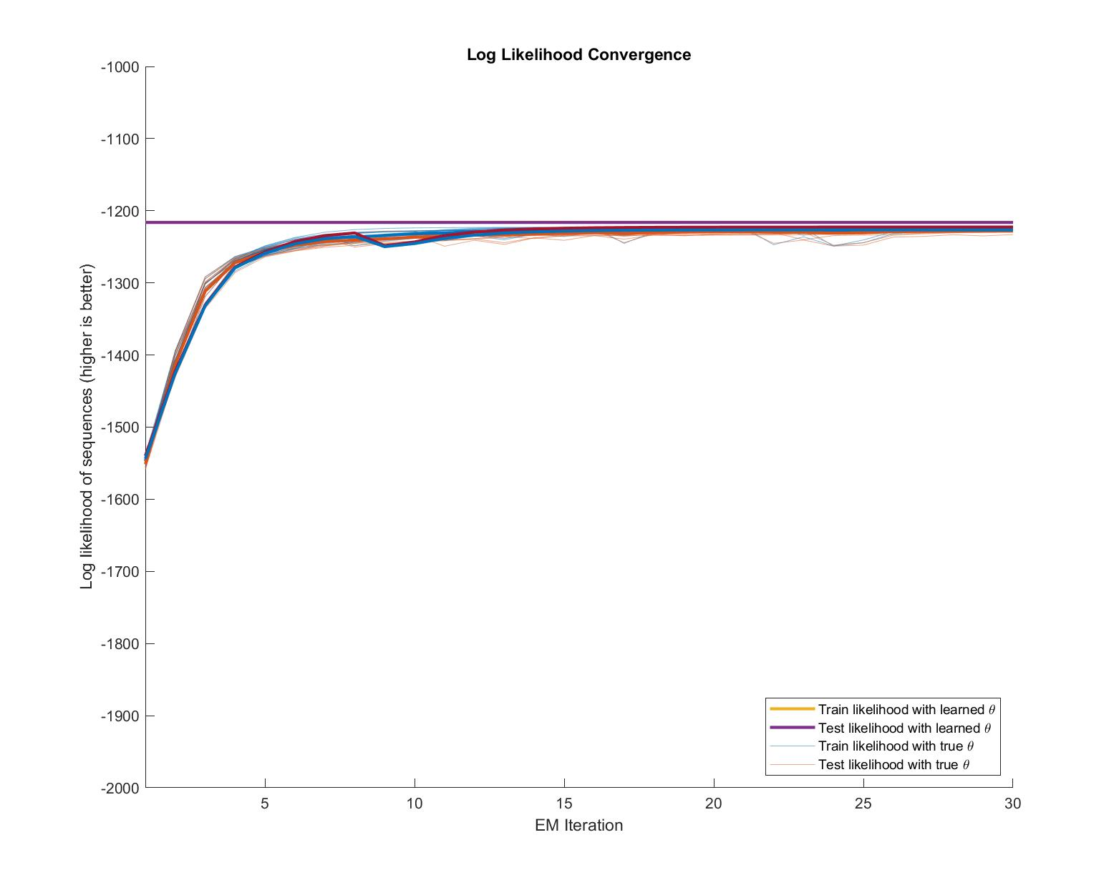
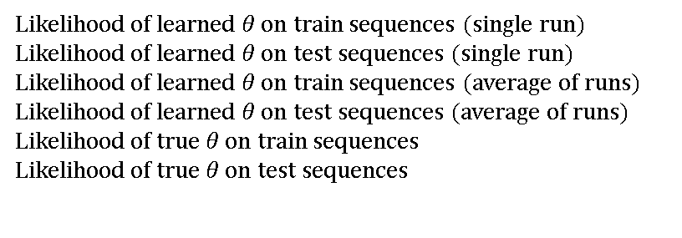

A
Without Regularization
With Regularization
Mean Log Likelihood
$$P_{θ}\left(X\right)$$
Likelihood of learned $θ$ on train sequences (single run)
Likelihood of learned $θ$ on test sequences (single run)
Likelihood of learned $θ$ on train sequences (average of runs)
Likelihood of learned $θ$ on test sequences (average of runs)
Likelihood of true $θ$ on train sequences
Likelihood of true $θ$ on test sequences
EM Iterations
EM Iterations

Slide 2
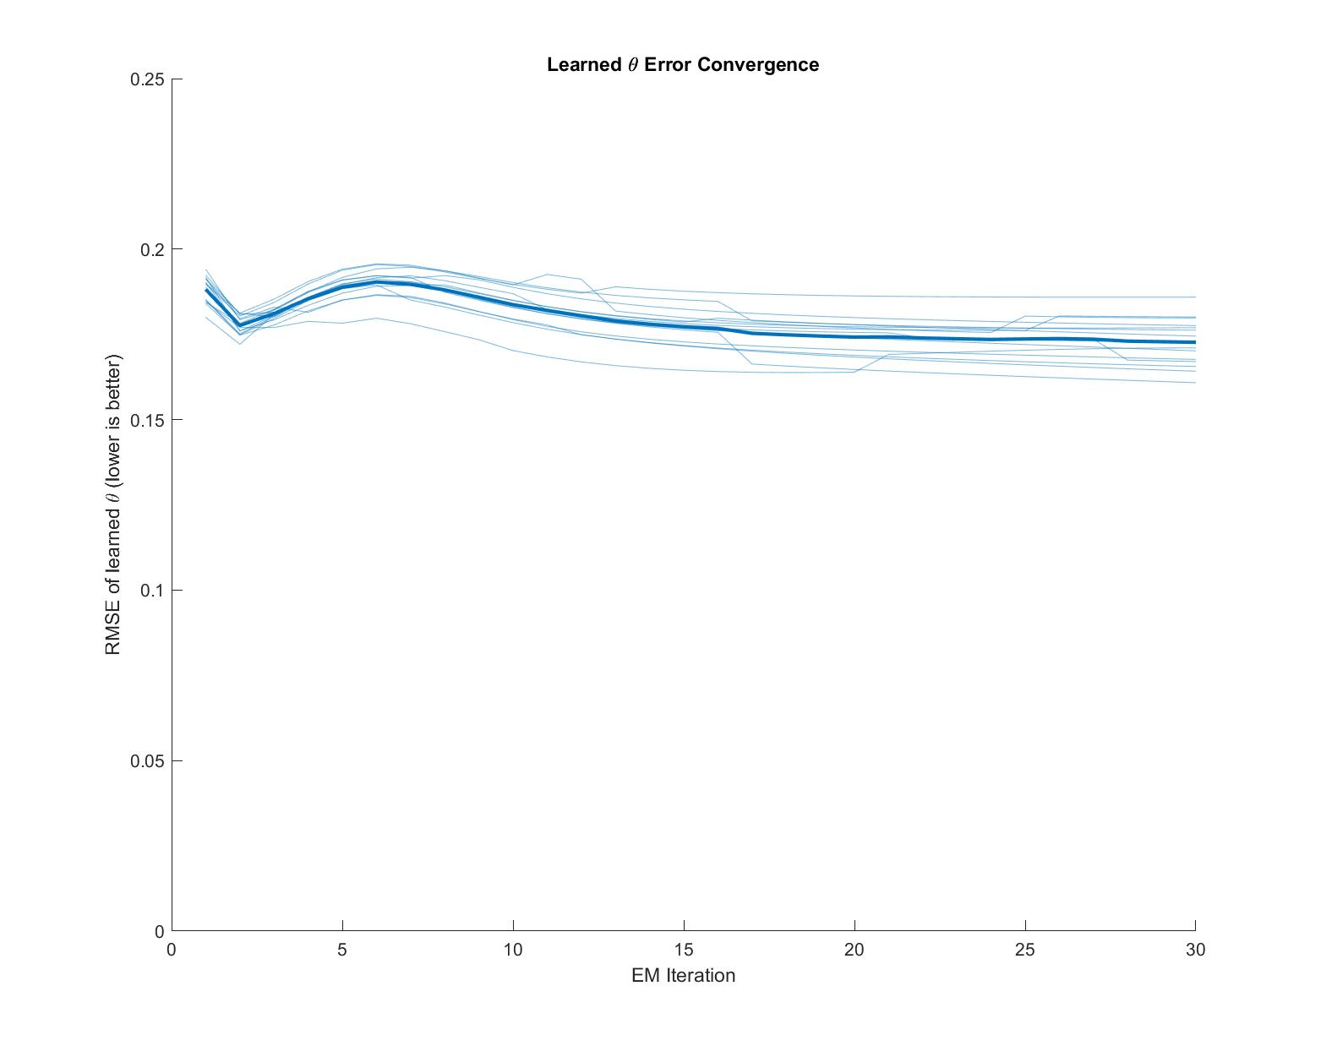
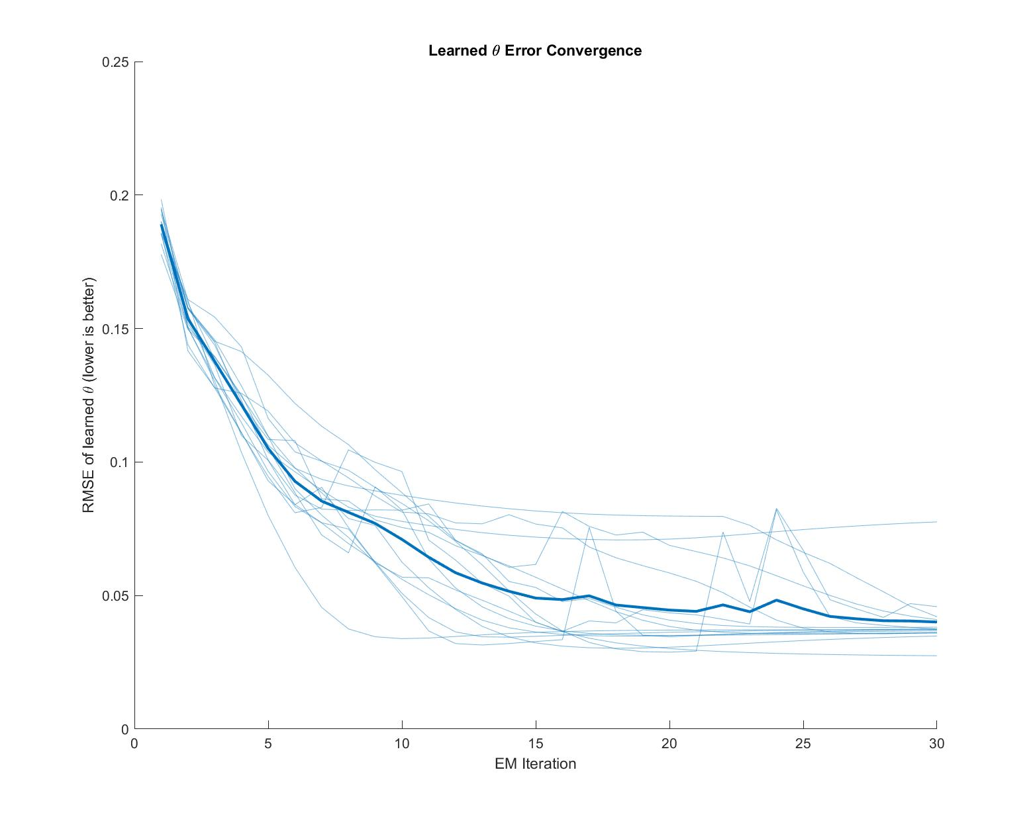
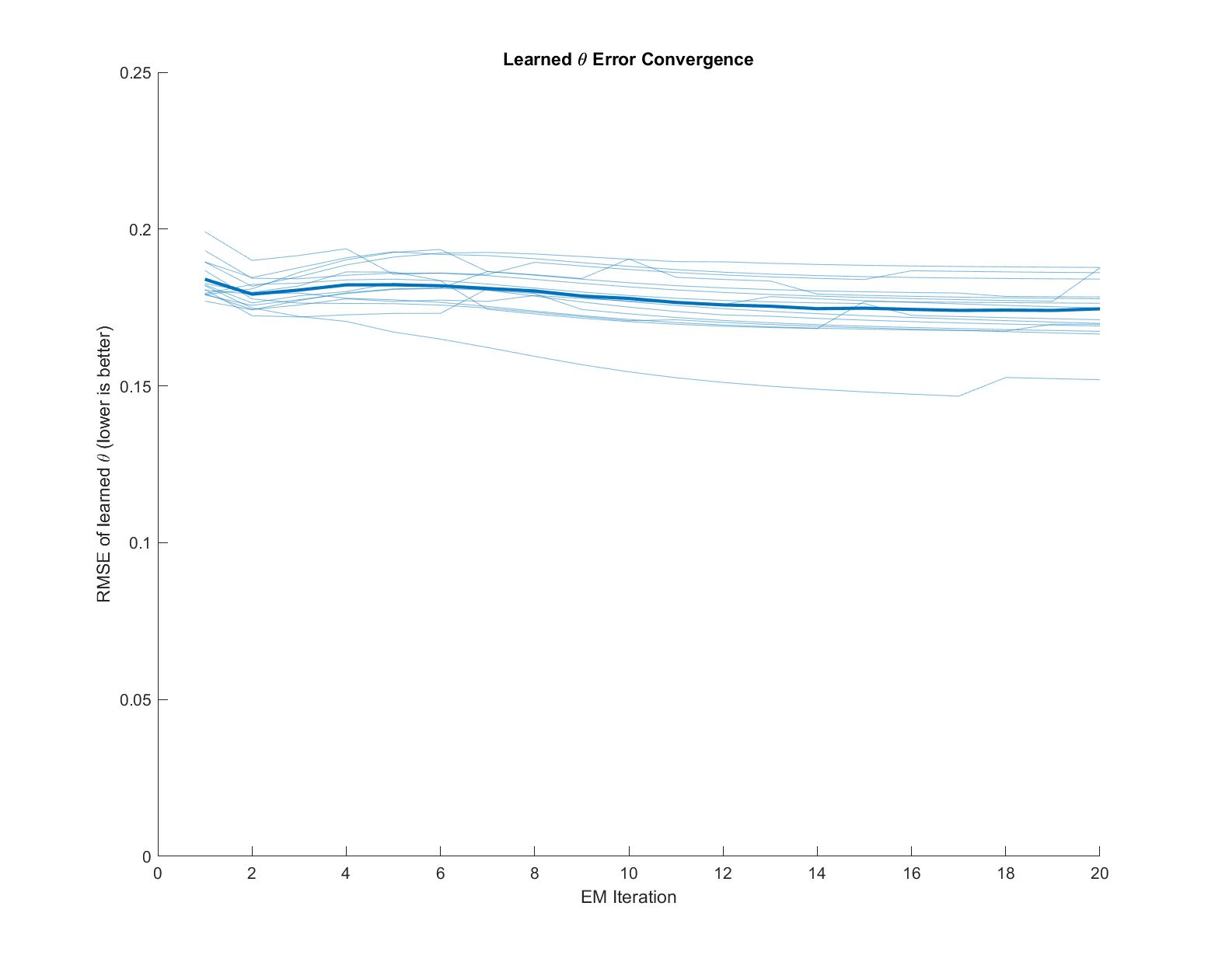
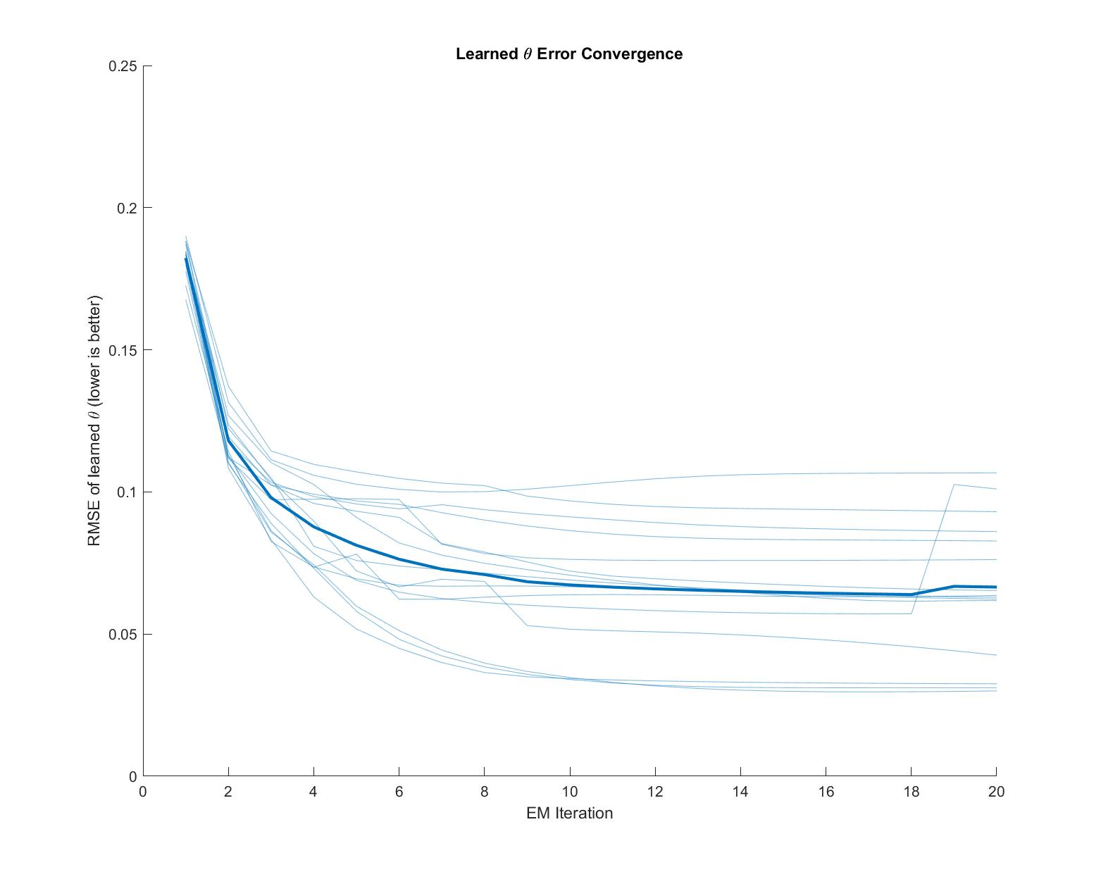
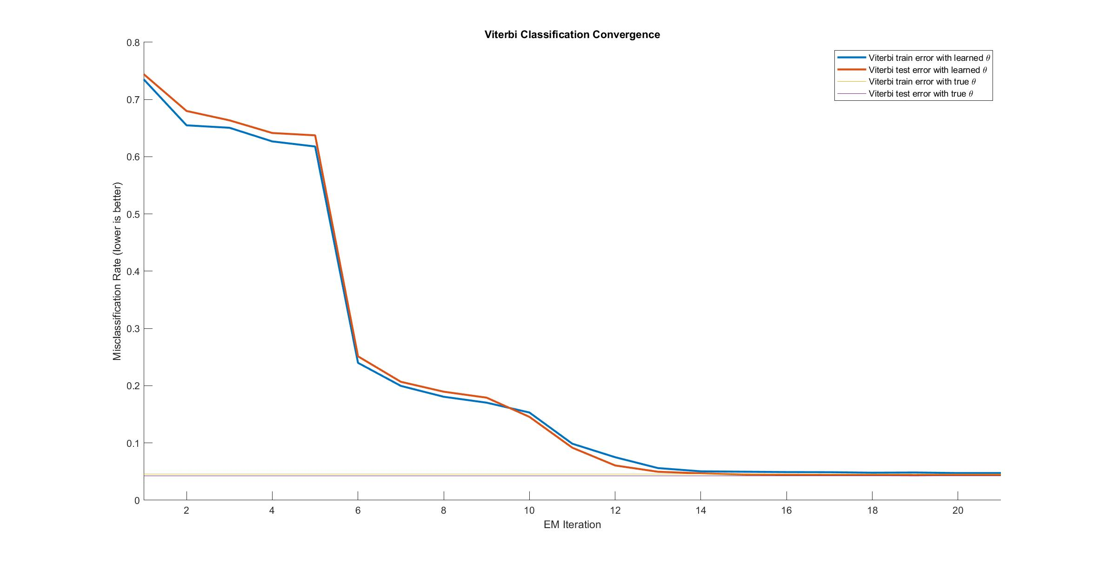
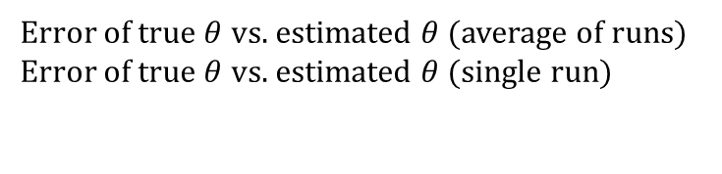
B
Without Regularization
With Regularization
Error of true $θ$ vs. estimated $θ$ (average of runs)
Error of true $θ$ vs. estimated $θ$ (single run)
Root Mean Square Error (RMSE)
EM Iterations
EM Iterations

Slide 3
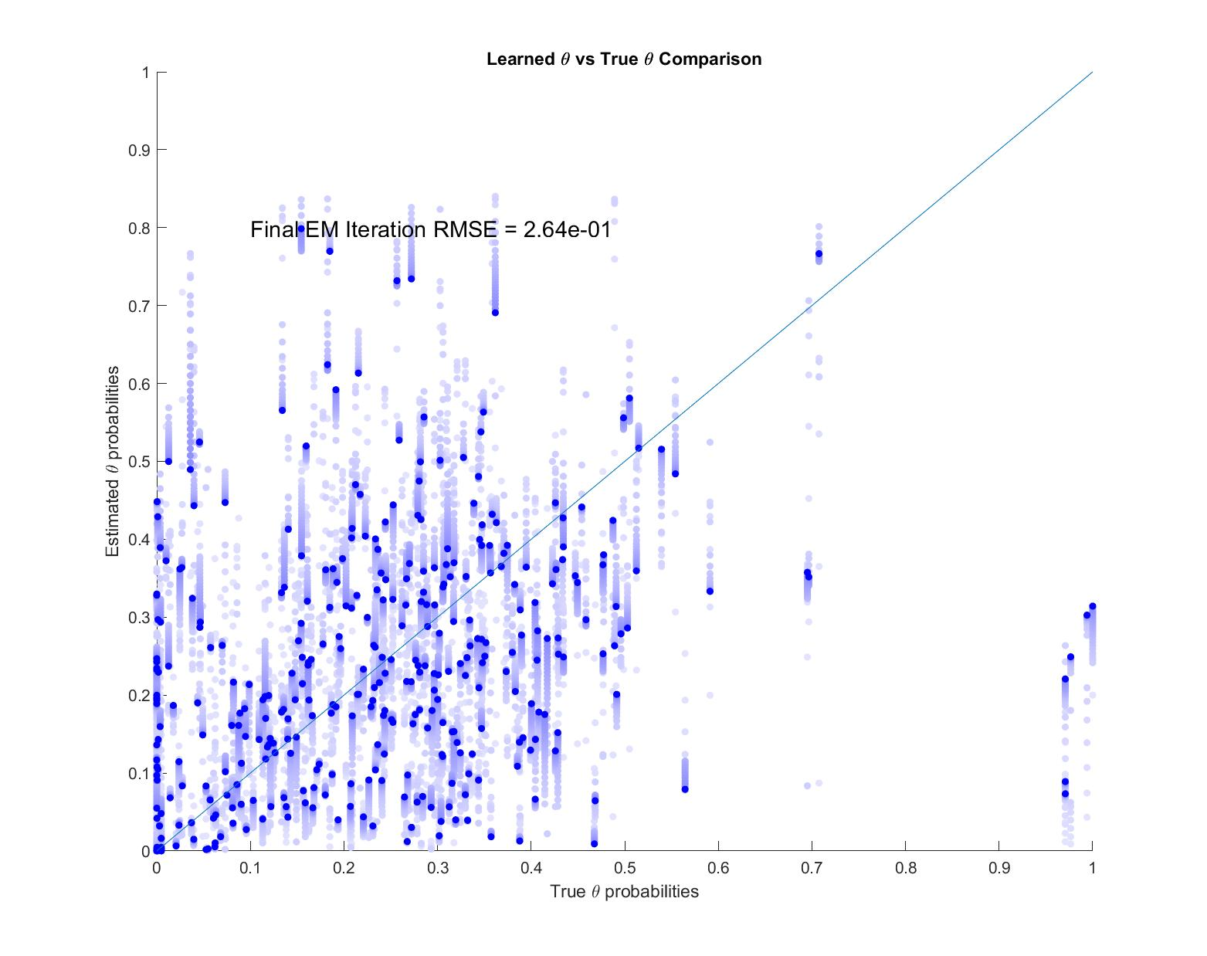
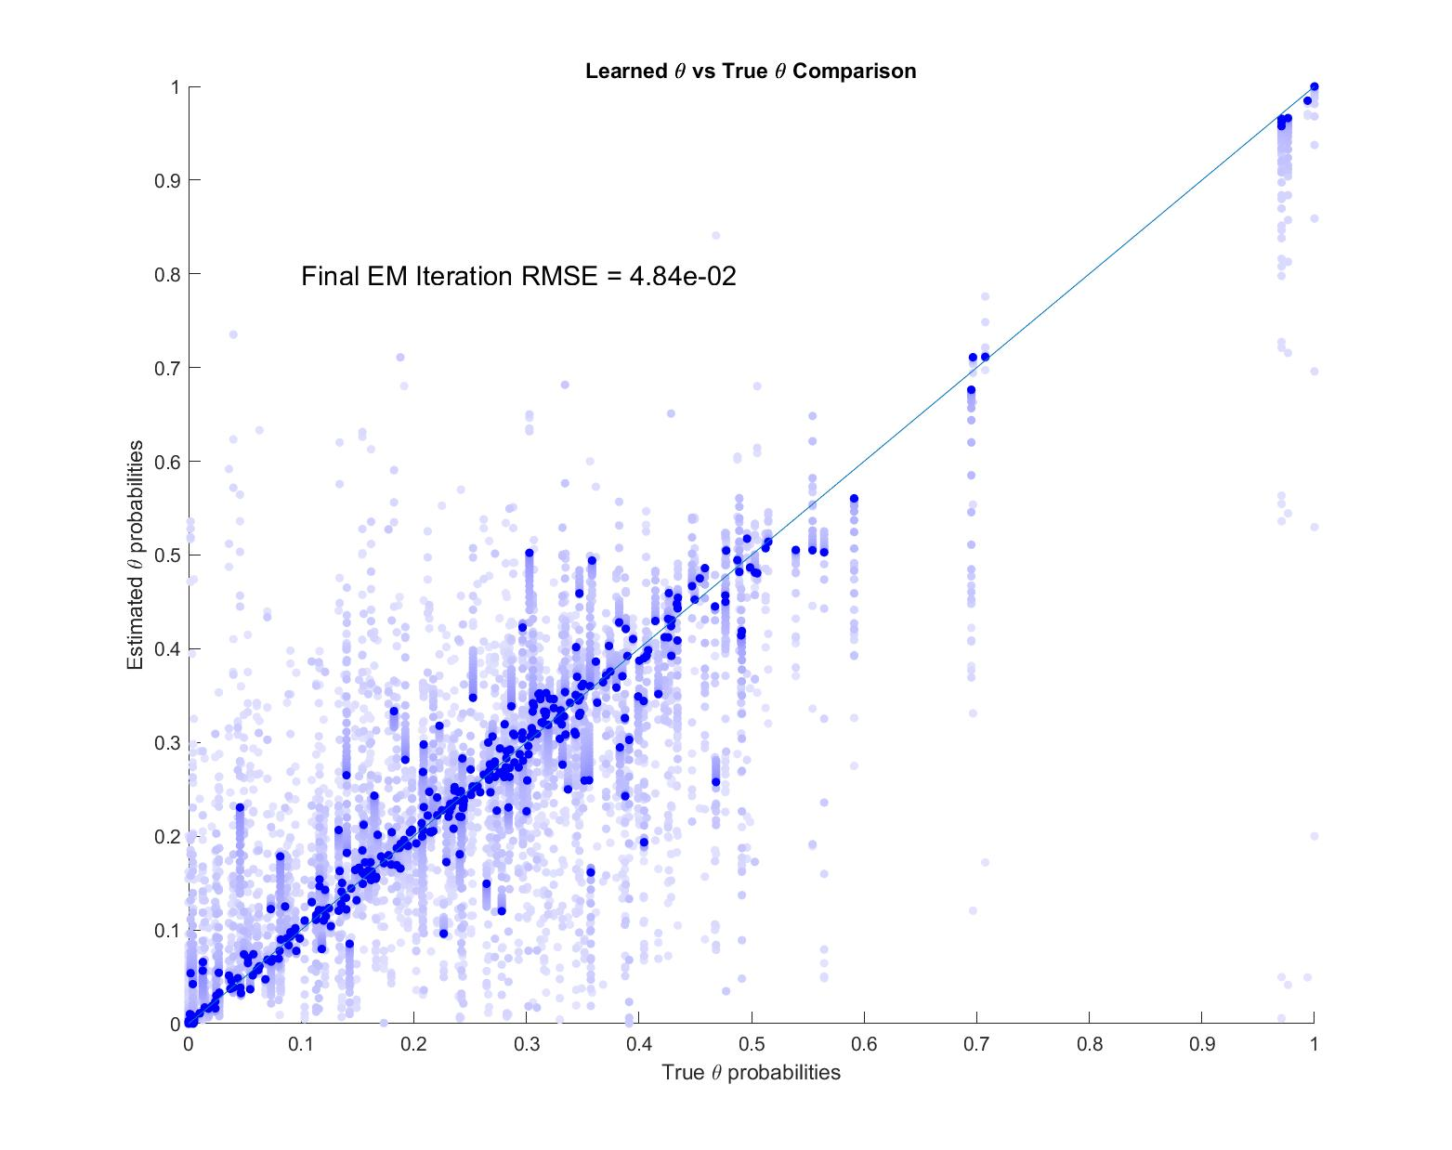
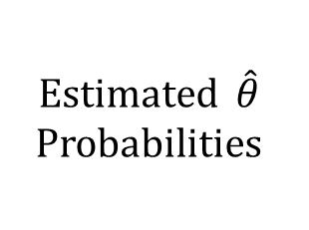
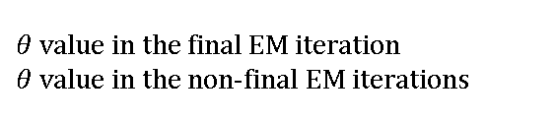


A
Without Regularization
With Regularization
Estimated $\hat{θ}$ Probabilities
$θ$ value in the final EM iteration
$θ$ value in the non-final EM iterations
True $θ$ Probabilities
True $θ$ Probabilities

Slide 4
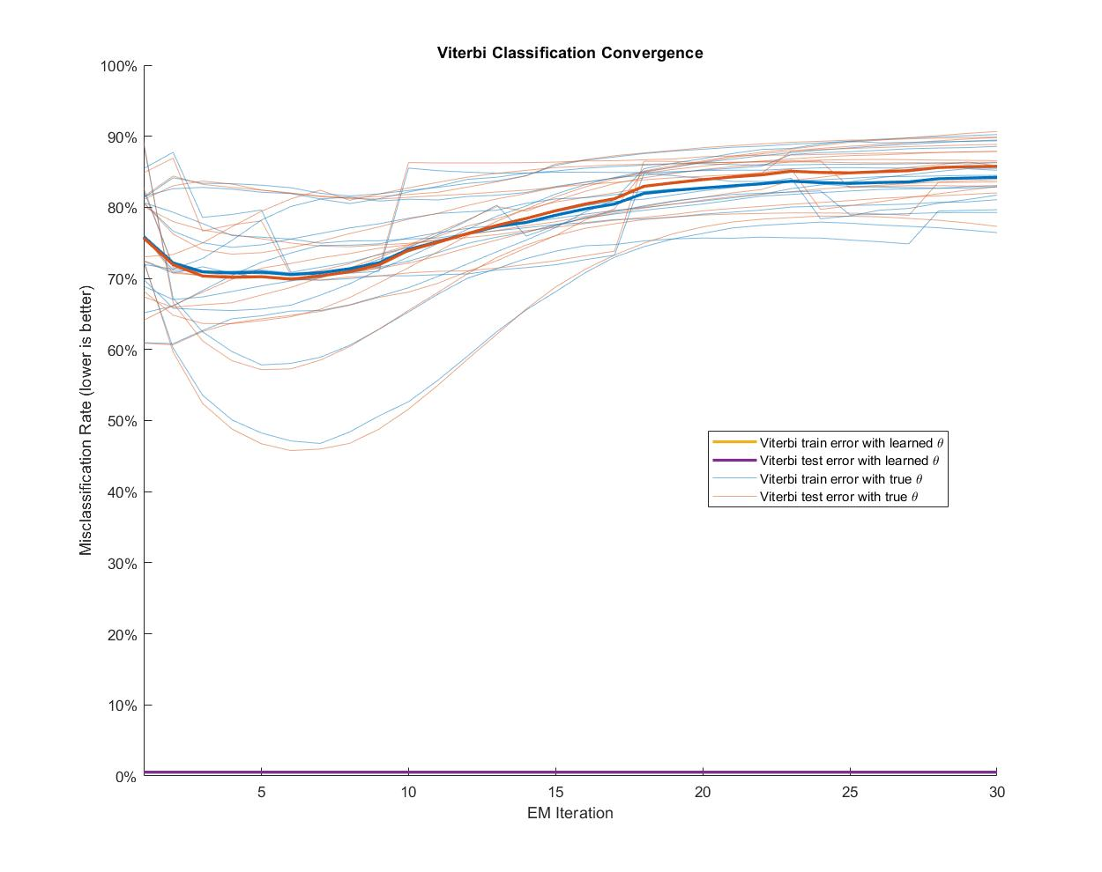
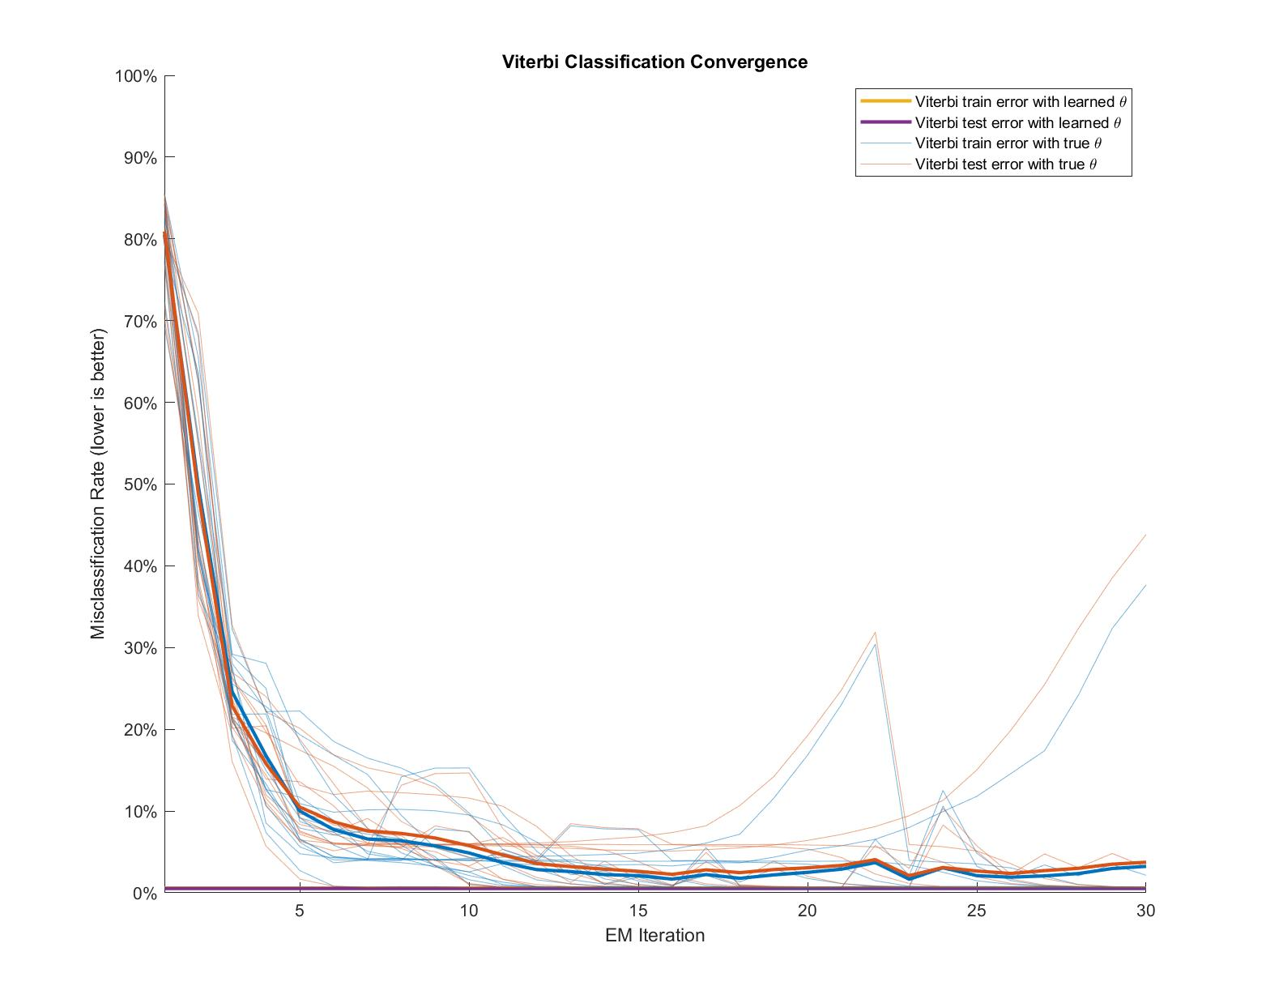
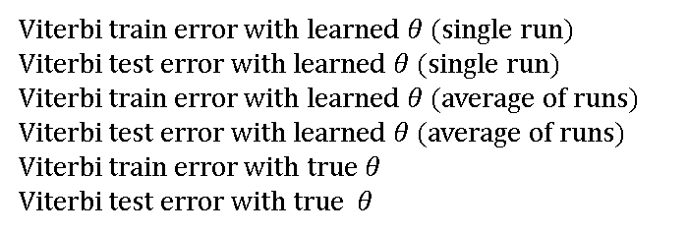
B
Without Regularization
With Regularization
Without Regularization
With Regularization
Misclassification Rate
Viterbi train error with learned $θ$ (single run)
Viterbi test error with learned $θ$ (single run)
Viterbi train error with learned $θ$ (average of runs)
Viterbi test error with learned $θ$ (average of runs)
Viterbi train error with true $θ$
Viterbi test error with true $θ$
EM Iterations
C
EM Iterations
EM Iterations
EM Iterations
EM Iterations

Slide 5
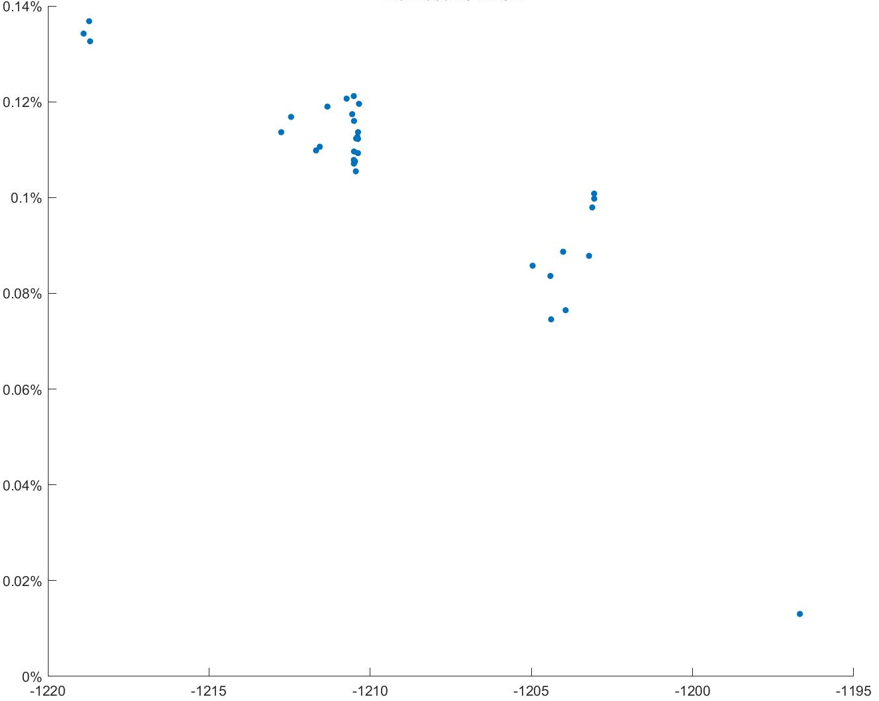
Root Mean Square Error (RMSE)
Log Likelihood

Slide 6
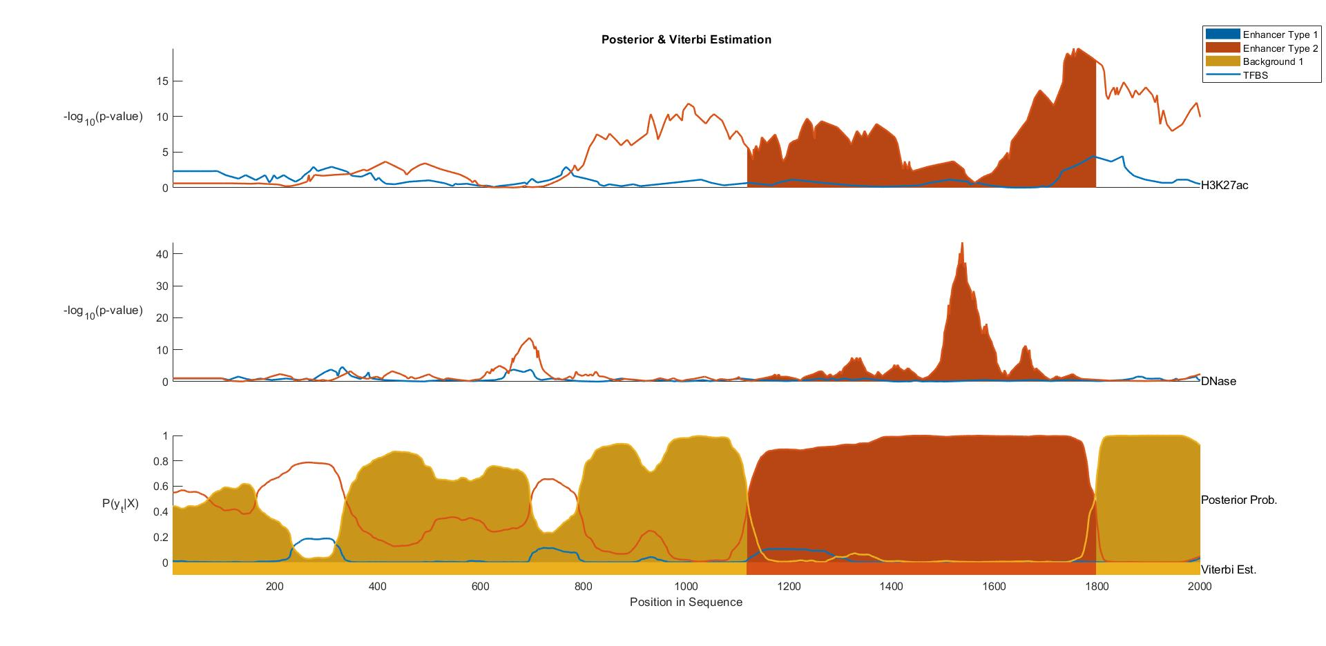
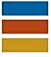
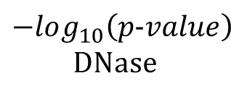

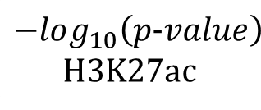
H1 BMP4 Derived Mesendoderm Cultured Cells (E004)
Fetal Adrenal Gland (E080)
Background
$$−log_{10}\left(p−value\right)$$
H3K27ac
$$−log_{10}\left(p−value\right)$$
DNase
$$P\left(y_{t} | X\right)$$
Viterbi Path
Position In DNA Sequence

Slide 7
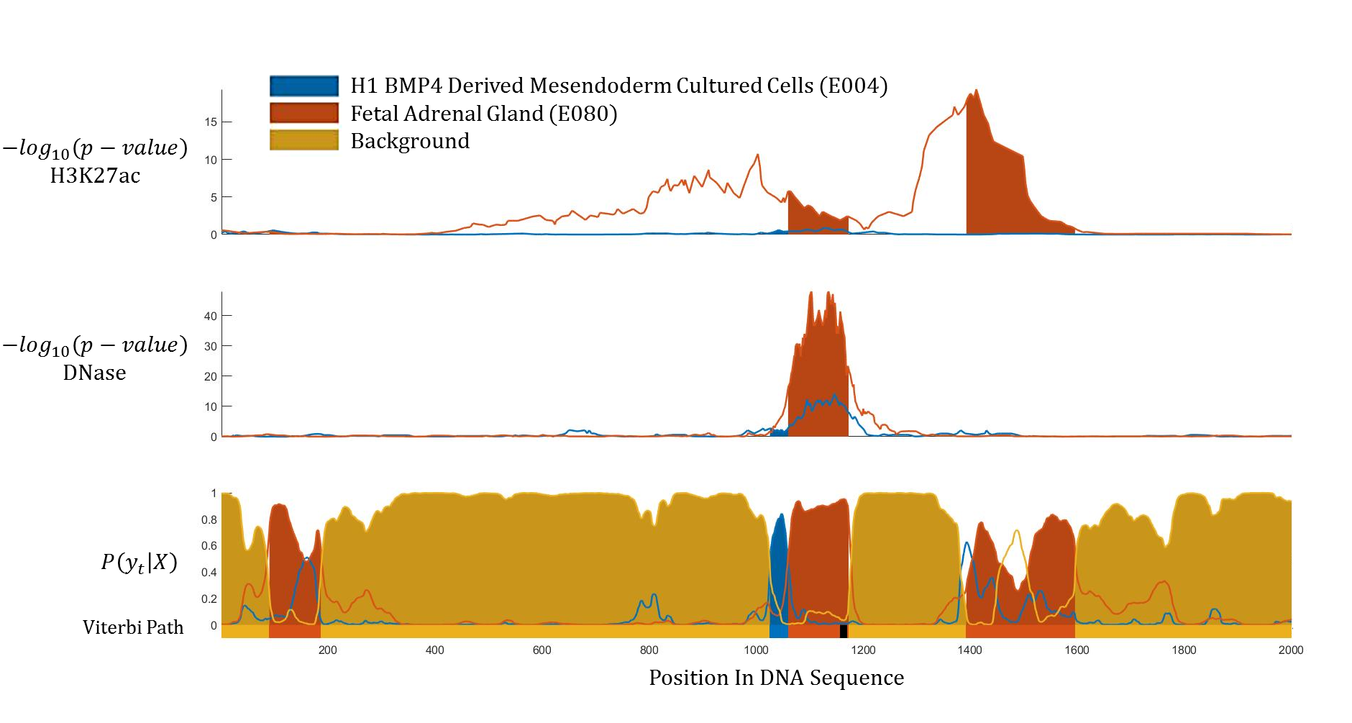



$$−log_{10}\left(p−value\right)$$
H3K27ac
$$−log_{10}\left(p−value\right)$$
DNase
$$P\left(y_{t} | X\right)$$
Viterbi Path
Position In DNA Sequence

Slide 8
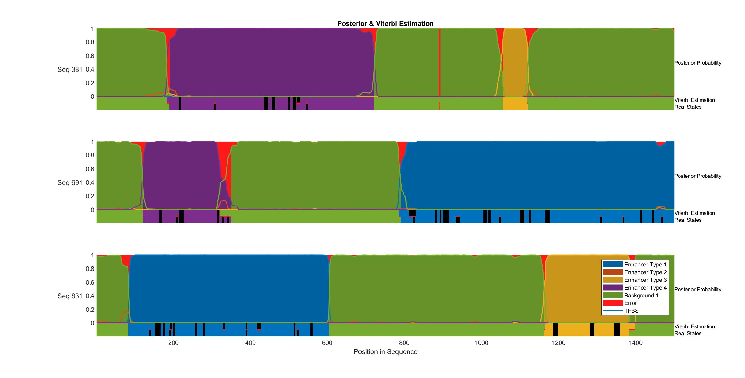
True States and Posterior Probability
Sequence 1
Posterior Probability
Viterbi estimation Real states
Sequence 2
Posterior Probability
Viterbi estimation Real states
Sequence 3
Posterior Probability
Viterbi estimation Real states
Position in Sequence

Slide 9
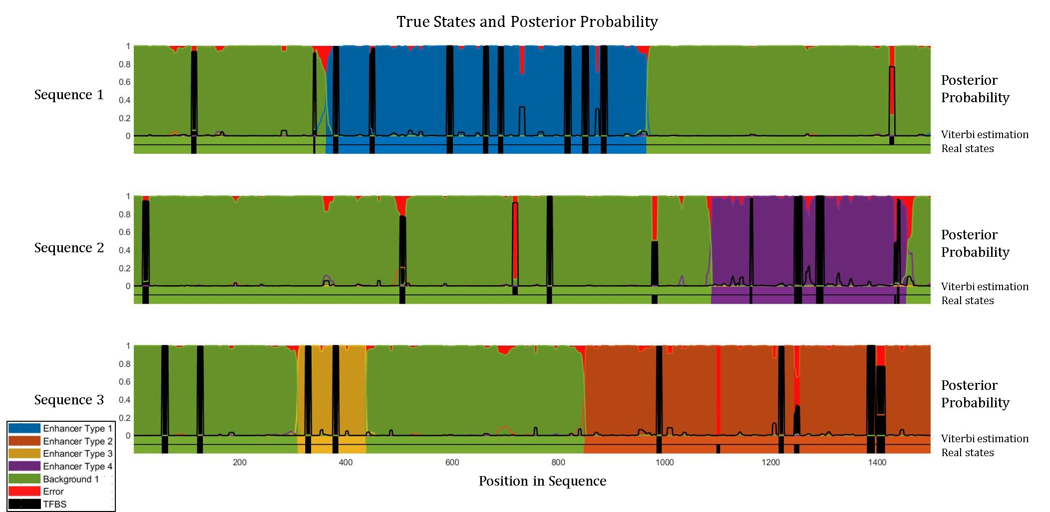
Hidden Sequence Estimation and Posterior Probability
Sequence 1
Posterior Probability
Viterbi estimation Real states
Sequence 2
Posterior Probability
Viterbi estimation Real states
Sequence 3
Posterior Probability
Enhancer 1
Enhancer 2
Enhancer 3
Enhancer 4
Background
Error
TFBS
Viterbi estimation Real states
Position in Sequence

