Slide 1









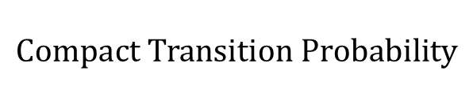



















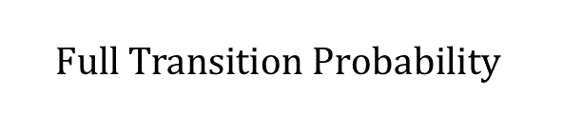




















































































$$Full Transition Probability$$
$$to$$
$$BG_{1}$$
$$BG_{2}$$
$$TF_{1}^{1}$$
$$TF_{2}^{1}$$
$$TF_{3}^{1}$$
$$TF_{1}^{2}$$
$$TF_{2}^{2}$$
$$TF_{3}^{2}$$
$$from$$
Transition Probability
$$Compact Transition Probability$$
$$BG_{1}$$
$$0.8$$
$$0.0$$
$$0.05$$
$$FIXED$$
$$FIXED$$
$$FIXED$$
$$0.1$$
$$0.05$$
$$0$$
$$0$$
$$0$$
$$FIXED$$
$$FIXED$$
$$FIXED$$
$$0.0$$
$$T$$
$$G$$
$$BG_{2}$$
$$0. 1$$
$$0.8$$
$$0$$
$$0$$
$$0$$
$$0.0$$
$$0.1$$
$$to$$
$$BG_{1}$$
$$BG_{2}$$
$$TF_{1}^{∗}$$
$$TF_{2}^{∗}$$
$$TF_{3}^{∗}$$
$$FIXED$$
$$FIXED$$
$$FIXED$$
$$FIXED$$
$$FIXED$$
$$FIXED$$
$$FIXED$$
$$FIXED$$
$$from$$
$$TF_{1}^{1}$$
$$1$$
$$0$$
$$0$$
$$0$$
$$0$$
$$0$$
$$0$$
$$0$$
$$Repack$$
$$BG_{1}$$
$$0.8$$
$$0.1$$
$$0.05$$
$$0.0$$
$$0.05$$
$$FIXED$$
$$FIXED$$
$$FIXED$$
$$FIXED$$
$$FIXED$$
$$FIXED$$
$$FIXED$$
$$FIXED$$
$$TF_{2}^{1}$$
$$1$$
$$0$$
$$0$$
$$0$$
$$0$$
$$0$$
$$0$$
$$0$$
$$FIXED$$
$$FIXED$$
$$FIXED$$
$$FIXED$$
$$FIXED$$
$$FIXED$$
$$FIXED$$
$$FIXED$$
$$BG_{2}$$
$$0. 1$$
$$0.8$$
$$0.0$$
$$0.1$$
$$0.0$$
$$TF_{3}^{1}$$
$$1$$
$$0$$
$$0$$
$$0$$
$$0$$
$$0$$
$$0$$
$$0$$
$$FIXED$$
$$FIXED$$
$$FIXED$$
$$FIXED$$
$$FIXED$$
$$FIXED$$
$$FIXED$$
$$FIXED$$
$$TF_{1}^{2}$$
$$0$$
$$1$$
$$0$$
$$0$$
$$0$$
$$0$$
$$0$$
$$0$$
$$FIXED$$
$$FIXED$$
$$FIXED$$
$$FIXED$$
$$FIXED$$
$$FIXED$$
$$FIXED$$
$$FIXED$$
$$TF_{2}^{2}$$
$$0$$
$$1$$
$$0$$
$$0$$
$$0$$
$$0$$
$$0$$
$$0$$
$$FIXED$$
$$FIXED$$
$$FIXED$$
$$FIXED$$
$$FIXED$$
$$FIXED$$
$$FIXED$$
$$FIXED$$
$$TF_{3}^{2}$$
$$0$$
$$1$$
$$0$$
$$0$$
$$0$$
$$0$$
$$0$$
$$0$$

Slide 2
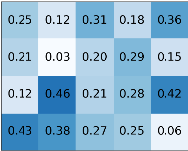


















Hidden State Machine
$$BF_{1}$$
$$(1,0)$$
$$TF_{1}^{1}$$
$$(1,1)$$
$TF_{2}^{1}$
$$(1,1)$$
$TF_{k}^{1}$
$$(1,1)$$
$$G$$
$$T$$
$$A$$
$$C$$
$$BF_{2}$$
$$(2,0)$$
$$TF_{1}^{2}$$
$$(1,1)$$
$$TF_{2}^{2}$$
$$(1,1)$$
$TF_{k}^{2}$
$$(1,1)$$
$$G$$
$$T$$
$$A$$
$$C$$
$$BF_{m}$$
$$(m ,0 )$$
$$TF_{1}^{m}$$
$$(m,1)$$
$TF_{2}^{m}$
$$(1,1)$$
$$TF_{k}^{m}$$
$$(1,1)$$
$$G$$
$$T$$
$$A$$
$$C$$

Slide 3
















Forward Algorithm
$$t−|W_{1}|−1$$
$$t−|W_{2}|−1$$
$$t$$
$$t−1$$
$$t$$
$$α_{j,t}$$
$$j$$
$$α_{j,t}$$
$$j$$
Backward Algorithm
$$t$$
$$t−|W_{2}|−1$$
$$t−|W_{1}|−1$$
$$t$$
$$t+1$$
$$β_{j,t}$$
$$j$$
$$β_{j,t}$$
$$j$$

Slide 4









$$t$$
$$t−|W_{2}|−1$$
$$t−|W_{1}|−1$$
$$t$$
$t$+1
$$j$$
$$β_{j,t}$$
$$j$$
$$β_{j,t}$$

Slide 5

…CGGCTACTCTGTA…
PWM
0
0
0
1
0
0
0
0
0
0
1
0
0
1
0
1
0
0
1
0
0
0
0
0
0
0
1
0
0
1
0
0
1
0
1
0

Slide 6
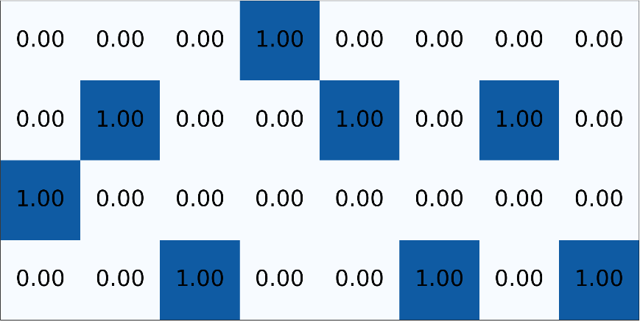
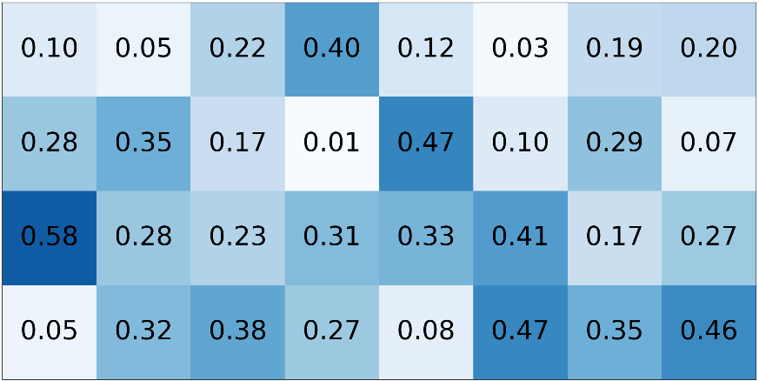
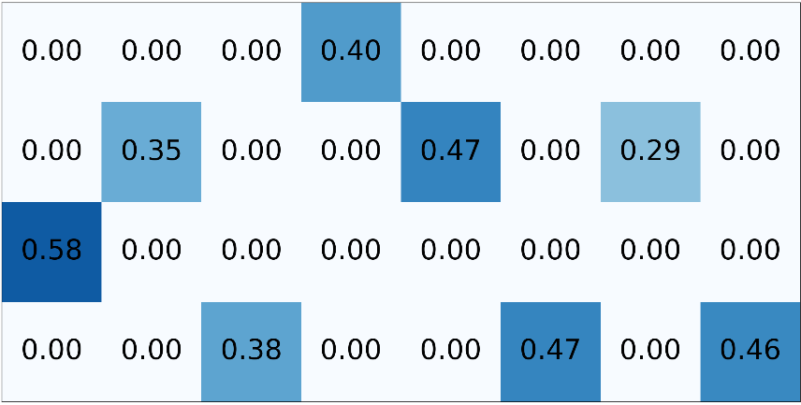
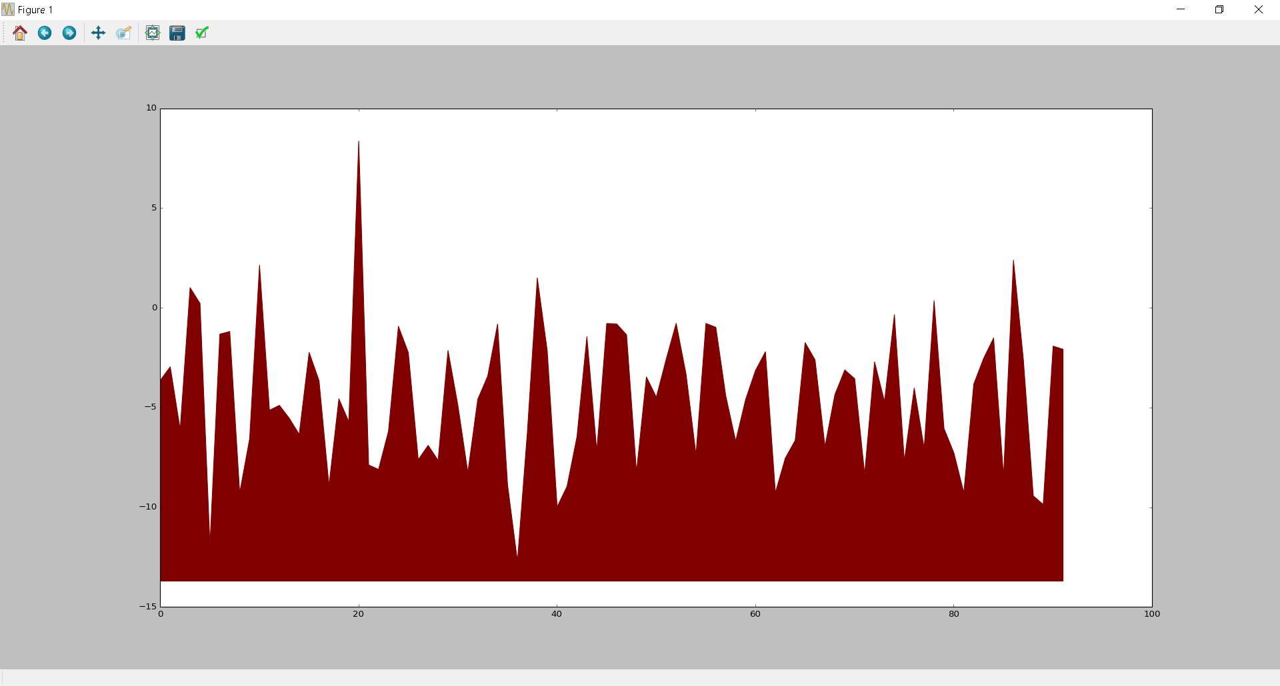
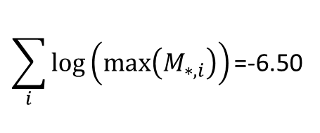
…CGGCTACTCTTA…
One-hot encoding
PWM
M
$$\sum_{i}{log⁡\left(max⁡\left(M_{∗,i}\right)\right)\text{=}\text{−}\text{6}\text{.}\text{50}}$$
Log likelihood of TF binding
Location in sequence

Slide 7
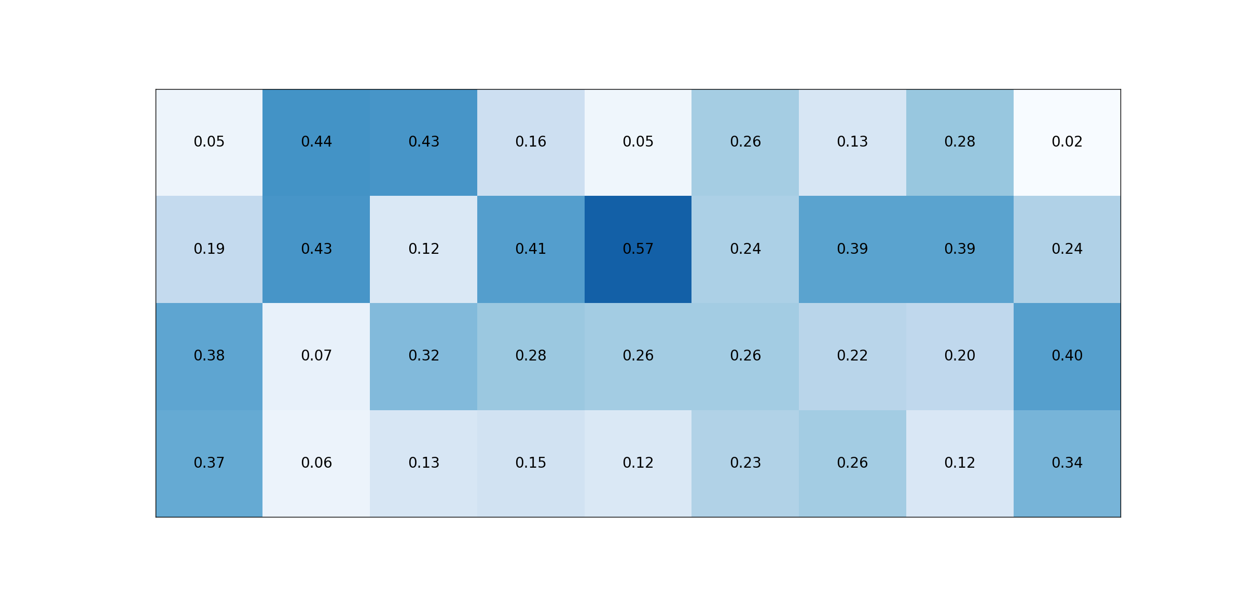
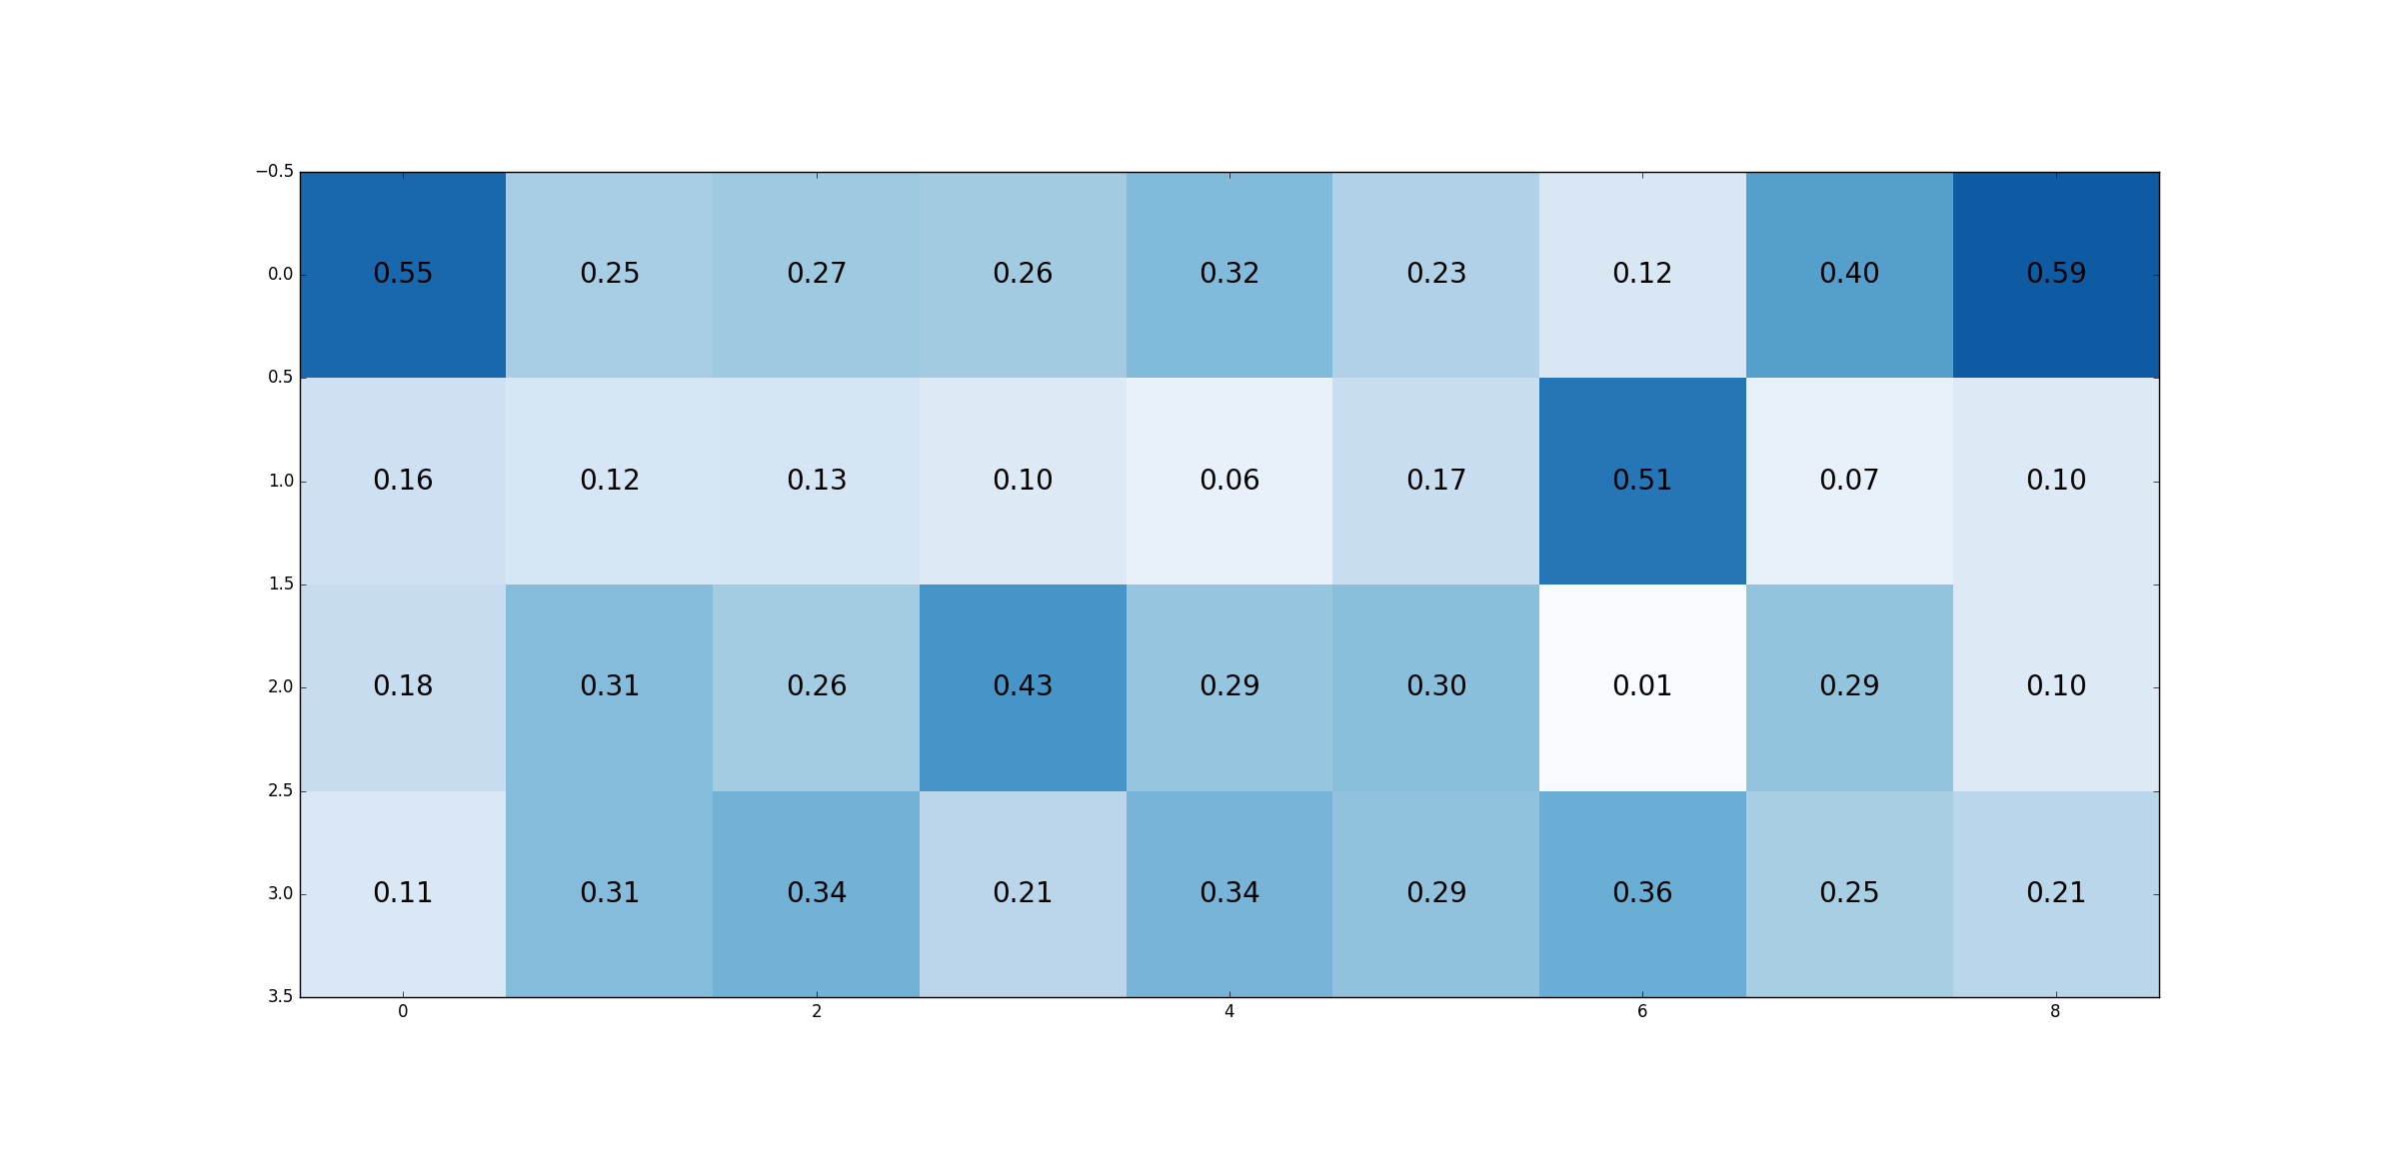

Slide 8
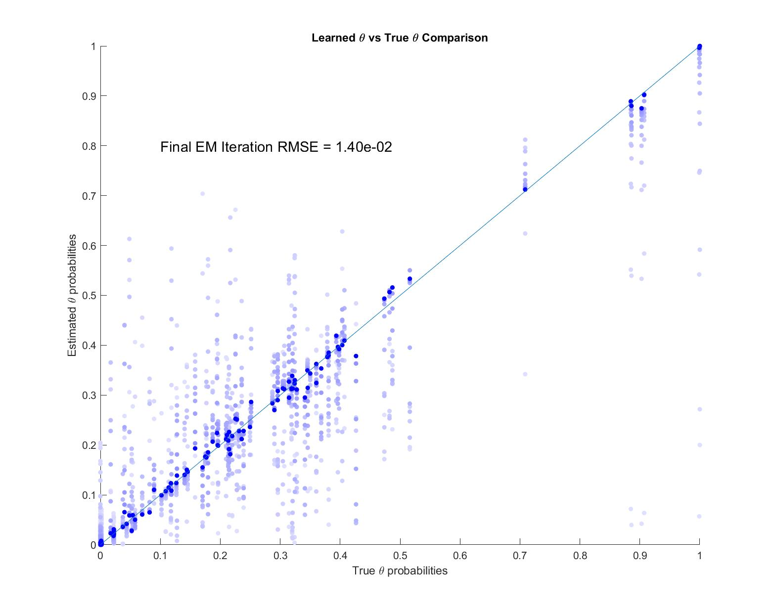



A
Estimated
$θ$ Probabilities
$θ$ value in final EM iteration
$θ$ value during EM iterations
True $θ$ Probabilities

Slide 9
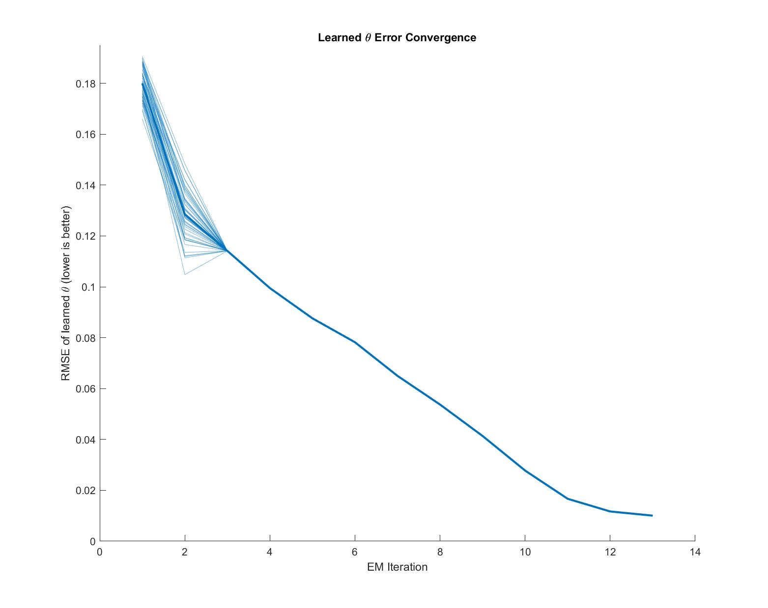
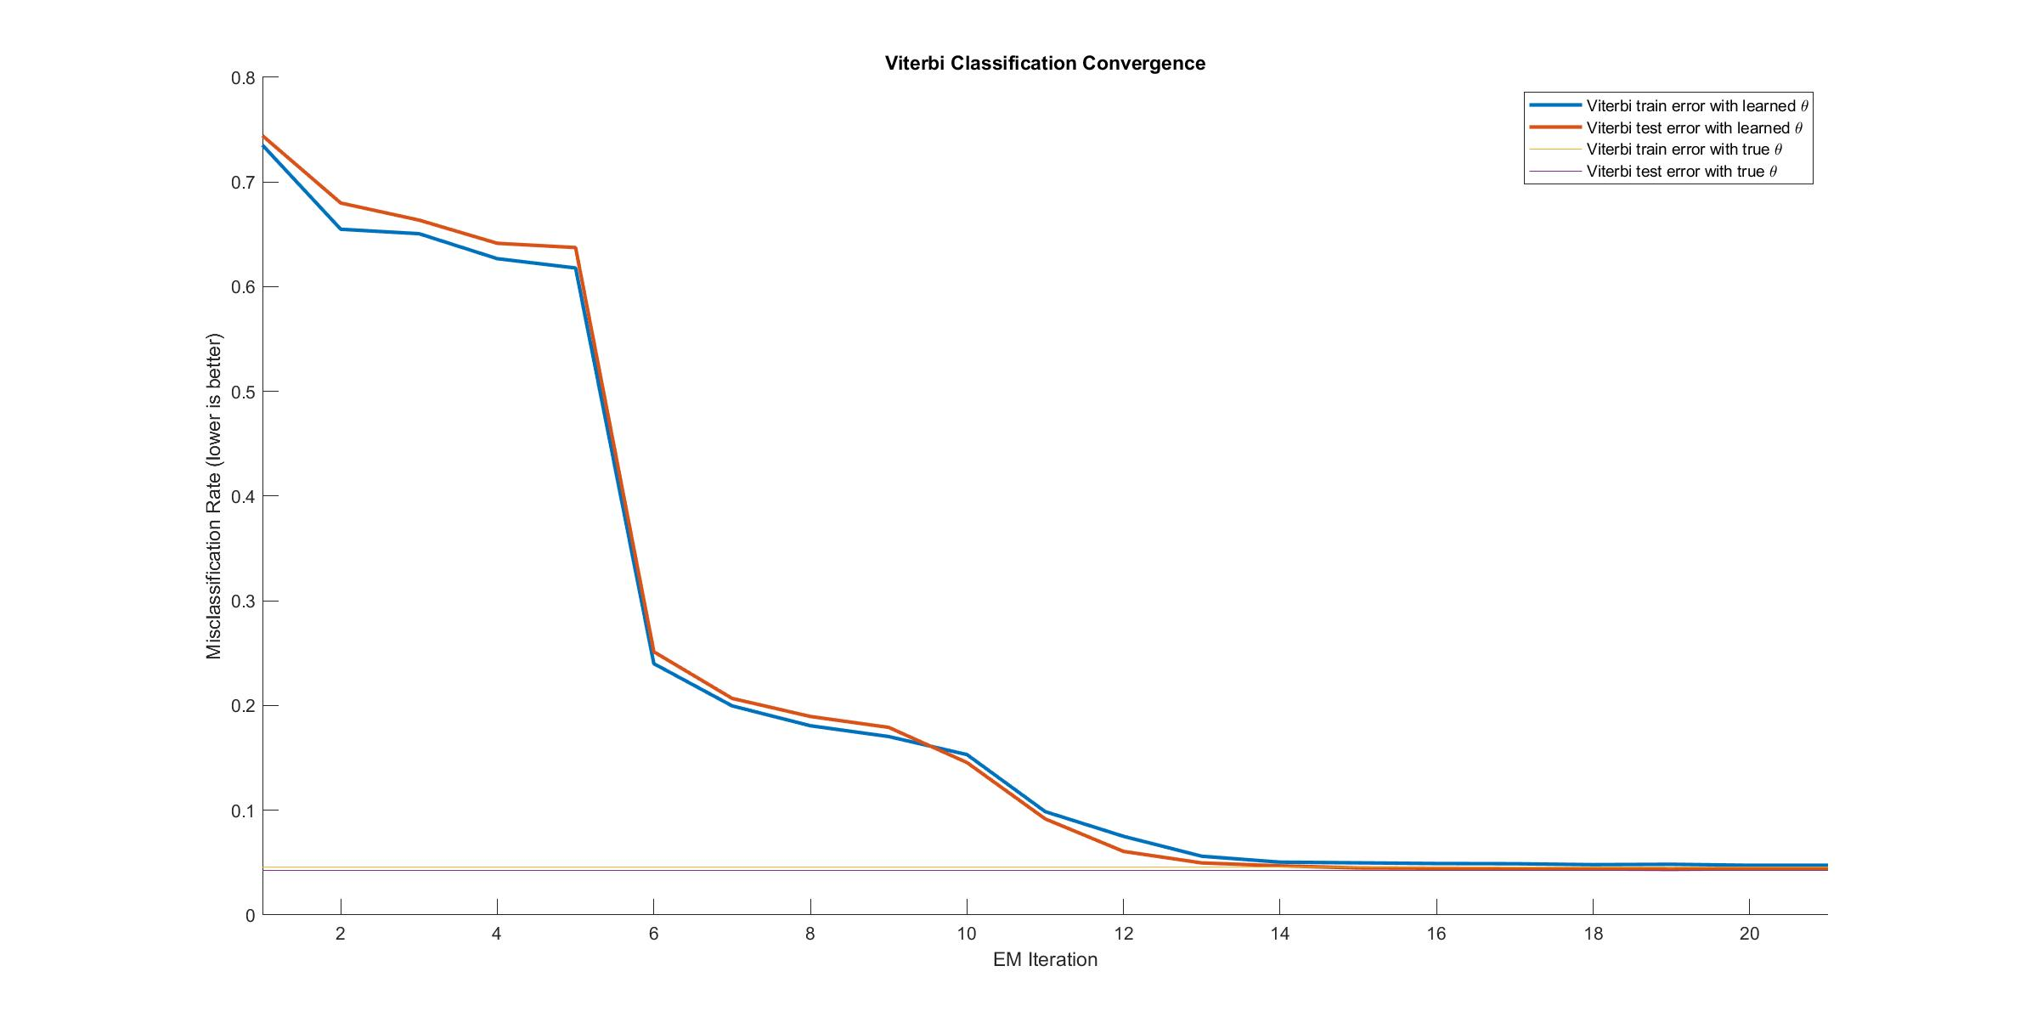
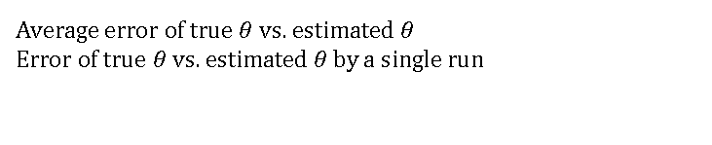
B
Average error of true $θ$ vs. estimated $θ$
Error of true $θ$ vs. estimated $θ$ by a single run
Root Mean Square Error (RMSE)
EM Iterations

Slide 10
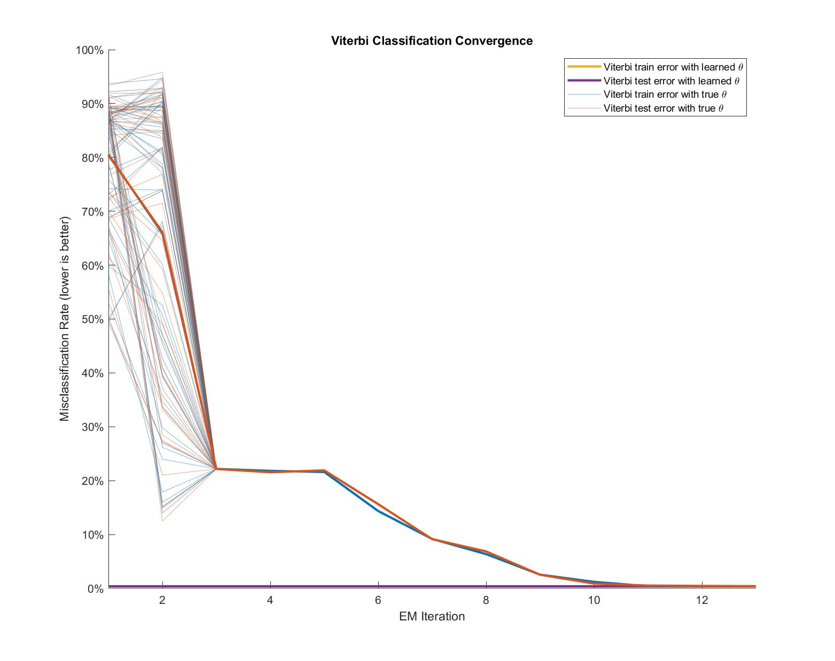
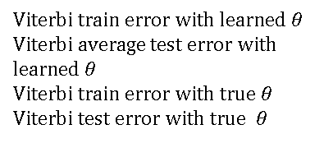
EM Iterations
C
Misclassification Rate
Viterbi train error with learned $θ$
Viterbi average test error with learned $θ$
Viterbi train error with true $θ$
Viterbi test error with true $θ$
EM Iterations

Slide 11
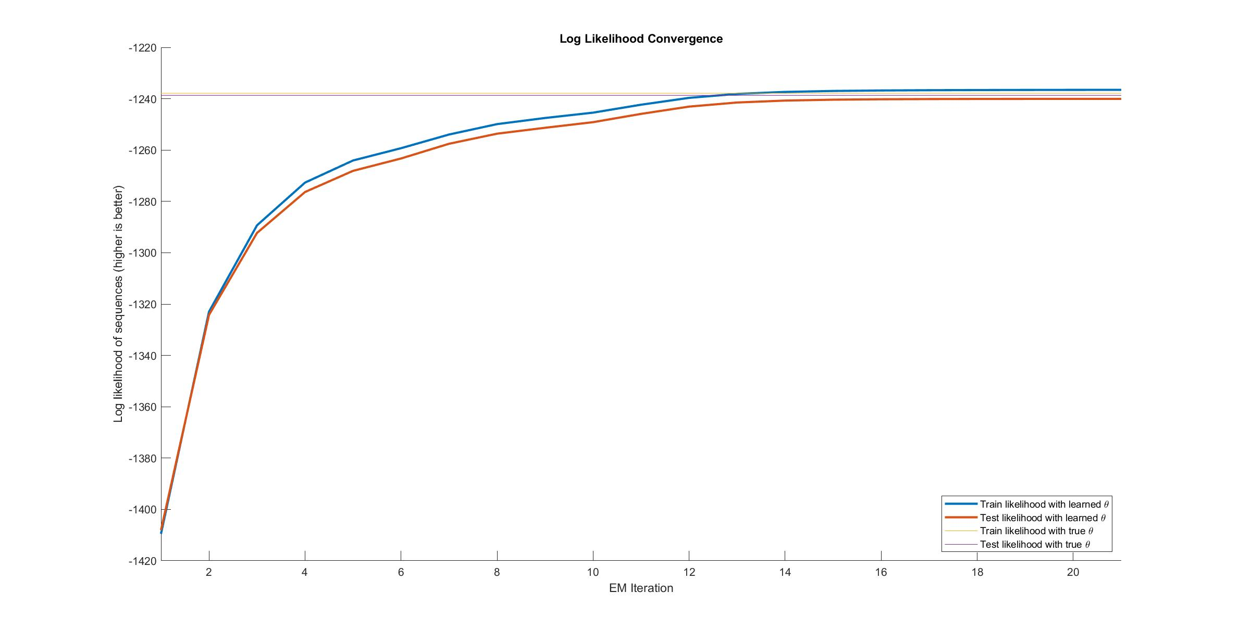
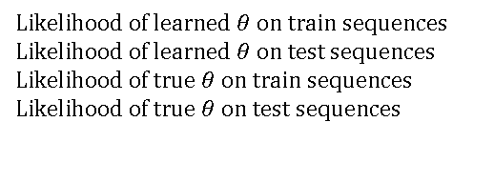

D
Mean Log Likelihood
$$P_{θ}\left(X\right)$$
Likelihood of learned $θ$ on train sequences
Likelihood of learned $θ$ on test sequences
Likelihood of true $θ$ on train sequences
Likelihood of true $θ$ on test sequences
EM Iterations

Slide 12
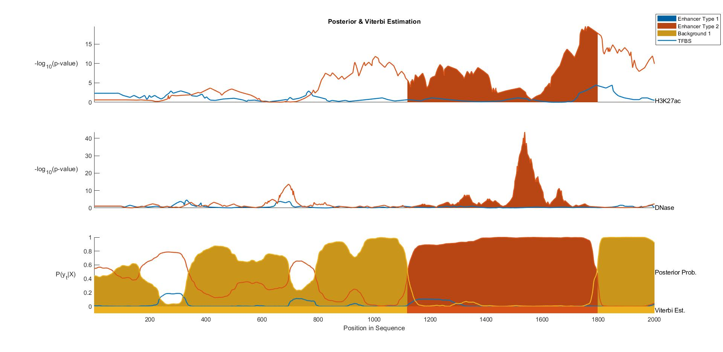
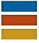
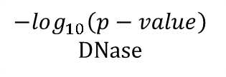

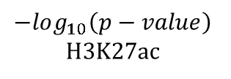
H1 BMP4 Derived Mesendoderm Cultured Cells (E004)
Fetal Adrenal Gland (E080)
Background
$$−log_{10}\left(p−value\right)$$
H3K27ac
$$−log_{10}\left(p−value\right)$$
DNase
$$P\left(y_{t} | X\right)$$
Viterbi Path
Position In DNA Sequence

Slide 13
H1 BMP4 Derived Mesendoderm Cultured Cells (E004)
Fetal Adrenal Gland (E080)
Background
$$−log_{10}\left(p−value\right)$$
H3K27ac
$$−log_{10}\left(p−value\right)$$
DNase
$$P\left(y_{t} | X\right)$$
Viterbi Path
Position In DNA Sequence

