Slide 1
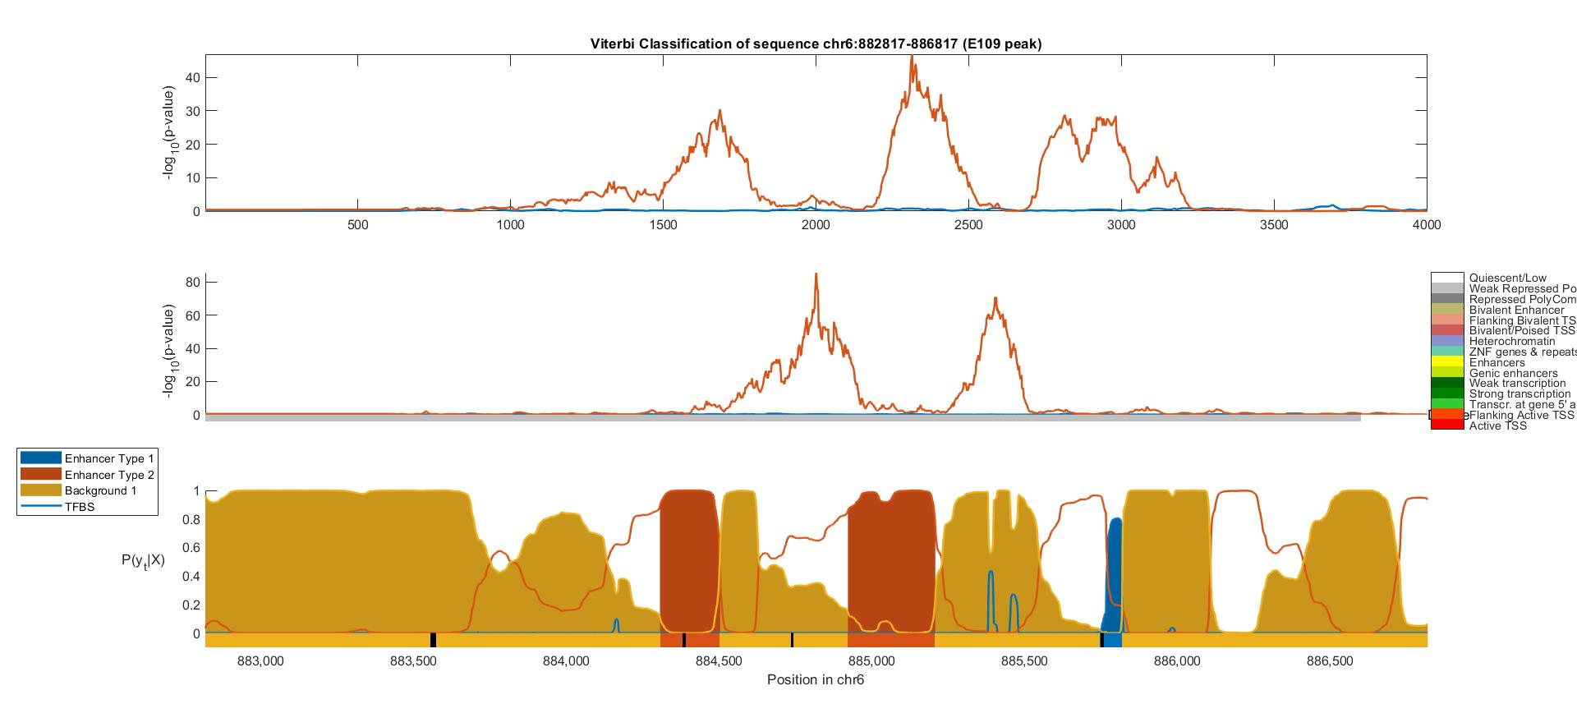
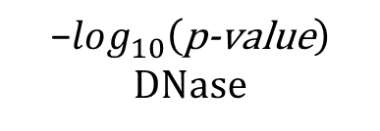

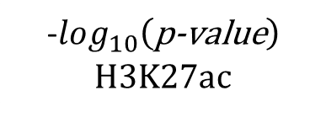
-$log_{10}\left(\text{p}\text{−}\text{value}\right)$
H3K27ac
$$\text{−}log_{10}\left(\text{p}\text{−}\text{value}\right)$$
DNase
ChromHMM
$$P\left(y_{t} | X\right)$$
Viterbi Path
Position In DNA Sequence

Slide 2
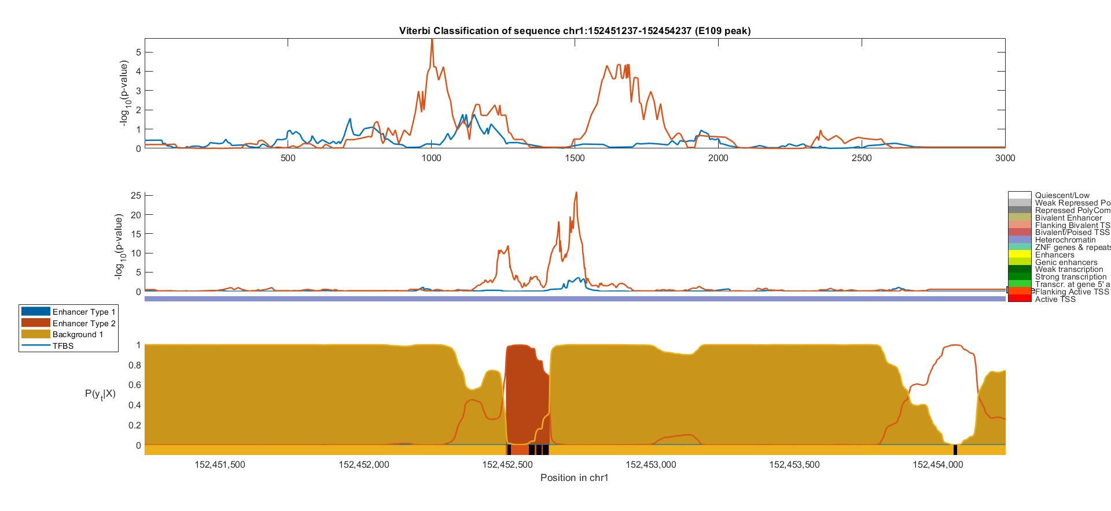



-$log_{10}\left(\text{p}\text{−}\text{value}\right)$
H3K27ac
$$\text{−}log_{10}\left(\text{p}\text{−}\text{value}\right)$$
DNase
ChromHMM
$$P\left(y_{t} | X\right)$$
Viterbi Path
Position In DNA Sequence

Slide 3
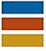
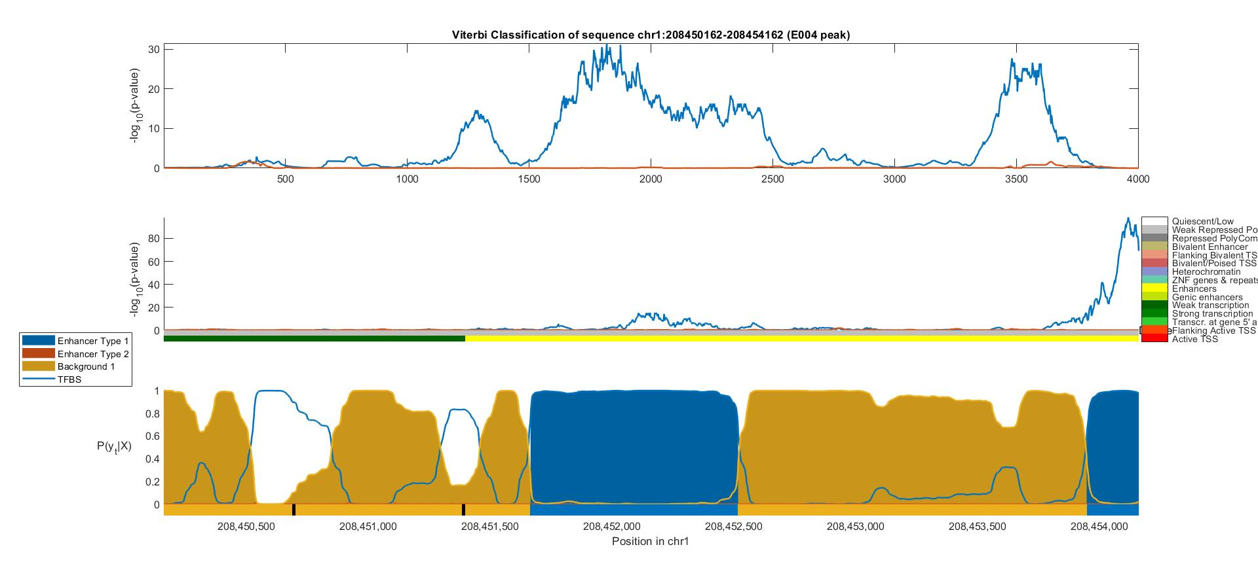
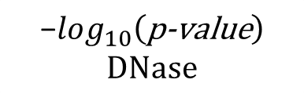

H1 BMP4 Derived Mesendoderm Cultured Cells (E004)
Fetal Adrenal Gland (E080)
Background
-$log_{10}\left(\text{p}\text{−}\text{value}\right)$
H3K27ac
$$\text{−}log_{10}\left(\text{p}\text{−}\text{value}\right)$$
DNase
ChromHMM
$$P\left(y_{t} | X\right)$$
Viterbi Path
Position In DNA Sequence

Slide 4
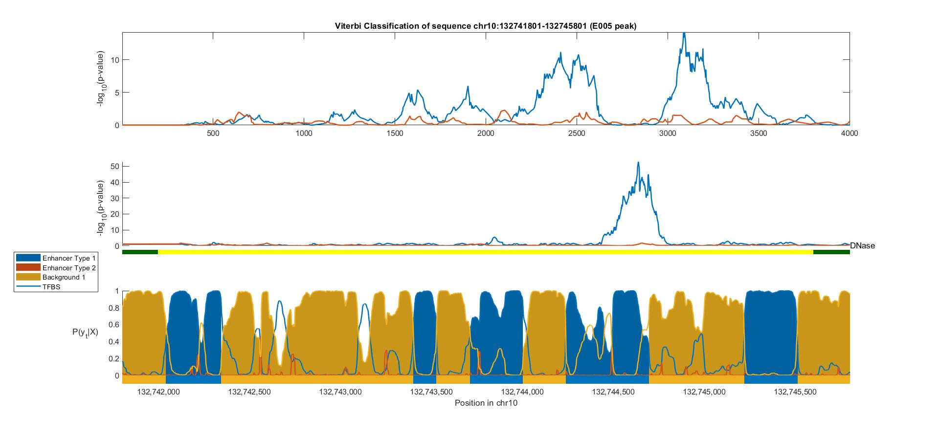
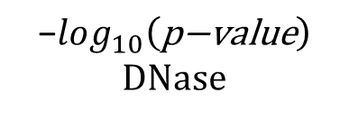

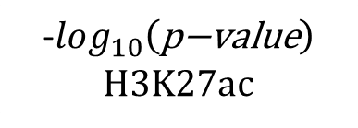
H1 BMP4 Derived Mesendoderm Cultured Cells (E004)
Fetal Adrenal Gland (E080)
Background
-$log_{10}\left(\text{p}\text{−}\text{value}\right)$
H3K27ac
$$\text{−}log_{10}\left(\text{p}\text{−}\text{value}\right)$$
DNase
$$P\left(y_{t} | X\right)$$
Viterbi Path
Position In DNA Sequence

Slide 5
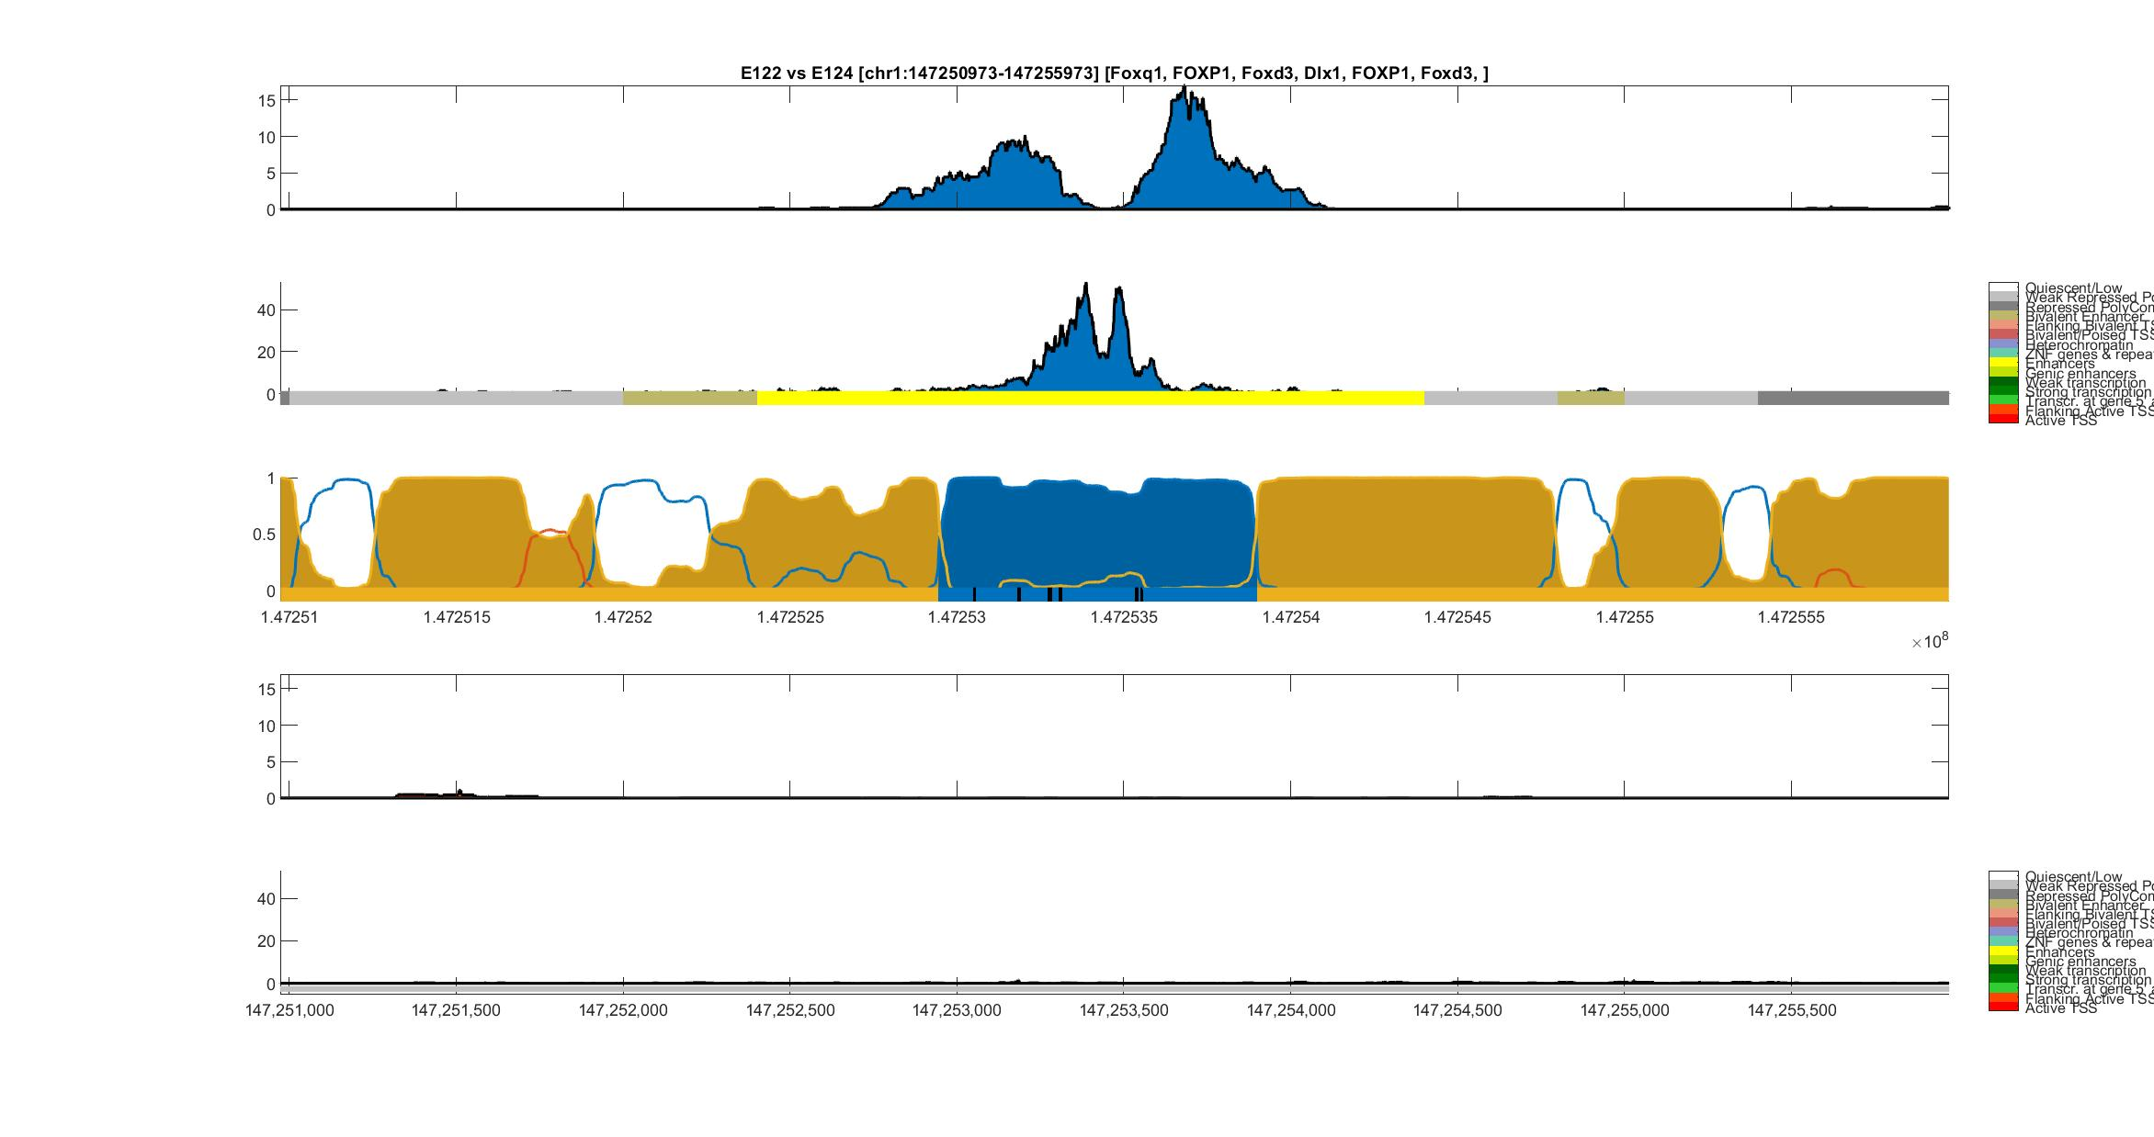
Umbilical Vein Endothelial (E122) vs Monocyte (E124)
H3K27ac
Umbilical Vein Endothelial
DNase-I
Umbilical Vein Endothelial
ChromHMM
Posterior Probability
HOP-HMM
Viterbi Path
FOXQ1
FOXD3
FOXD3
FOXP1
DIX1
FOXP1
H3K27ac
Monocyte
DNase-I
Monocyte
ChromHMM
hg19:chr1

Slide 6
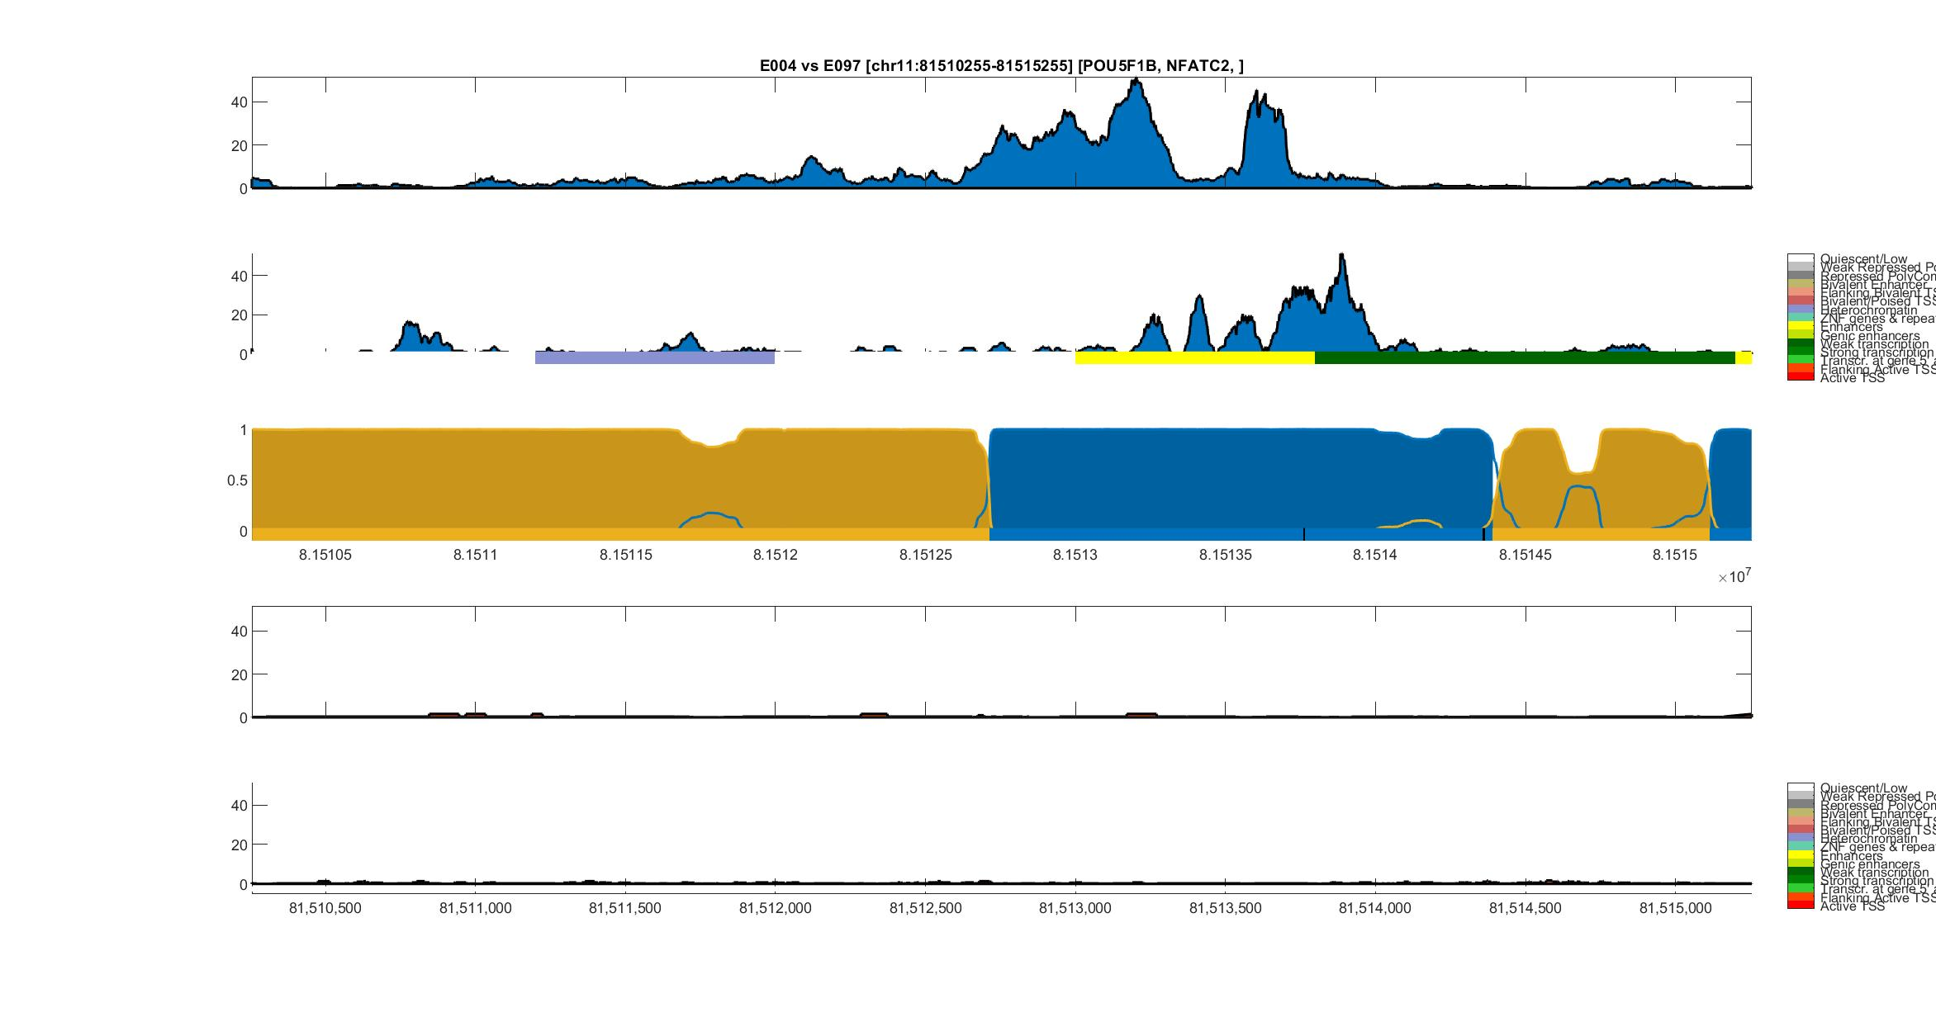
Mesendoderm (E004) vs Ovary (E097)
H3K27ac
Mesendoderm
DNase-I
Mesendoderm
ChromHMM
Posterior Probability
HOP-HMM
Viterbi Path
POU5F1B
NFATC2
H3K27ac
Ovary
DNase-I
Ovary
ChromHMM
hg19:chr11

Slide 7
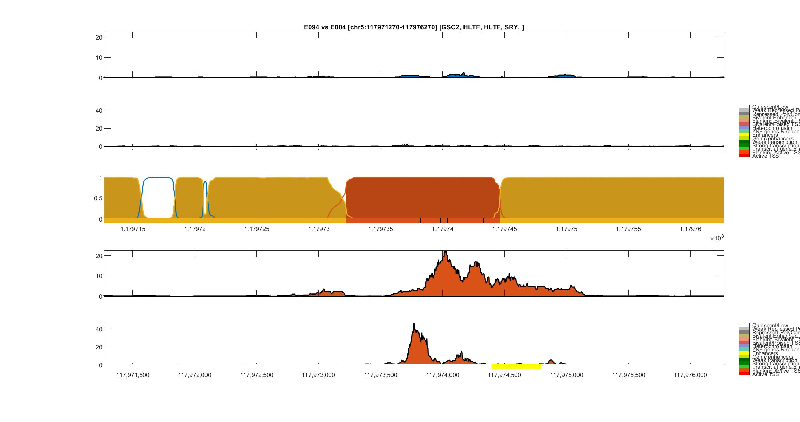
Gastric (E094) vs Mesendoderm (E004)
H3K27ac
Gastric
DNase-I
Gastric
ChromHMM
Posterior Probability
HOP-HMM
Viterbi Path
GSC2
HLTF
HLTF
SRY
H3K27ac
Mesendoderm
DNase-I
Mesendoderm
ChromHMM
hg19:chr5

