Slide 1








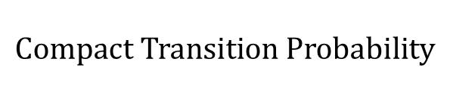



















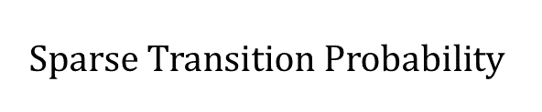















































































$$Sparse Transition Probability$$
$$to$$
$$BG_{1}$$
$$BG_{2}$$
$$TF_{1}^{1}$$
$$TF_{2}^{1}$$
$$TF_{3}^{1}$$
$$TF_{1}^{2}$$
$$TF_{2}^{2}$$
$$TF_{3}^{2}$$
$$from$$
Transition Probability
$$Compact Transition Probability$$
$$BG_{1}$$
$$0.8$$
$$0.1$$
$$0.05$$
$$0.0$$
$$0.05$$
$$0$$
$$0$$
$$0$$
$$BG_{2}$$
$$0. 1$$
$$0.8$$
$$0$$
$$0$$
$$0$$
$$0.0$$
$$0.1$$
$$0.0$$
$$T$$
$$G$$
$$to$$
$$BG_{1}$$
$$BG_{2}$$
$$TF_{1}^{∗}$$
$$TF_{2}^{∗}$$
$$TF_{3}^{∗}$$
$$TF_{1}^{1}$$
$$1$$
$$0$$
$$0$$
$$0$$
$$0$$
$$0$$
$$0$$
$$0$$
$$from$$
$$Compact$$
$$BG_{1}$$
$$0.8$$
$$0.1$$
$$0.05$$
$$0.0$$
$$0.05$$
$$TF_{2}^{1}$$
$$1$$
$$0$$
$$0$$
$$0$$
$$0$$
$$0$$
$$0$$
$$0$$
$$BG_{2}$$
$$0. 1$$
$$0.8$$
$$0.0$$
$$0.1$$
$$0.0$$
$$TF_{3}^{1}$$
$$1$$
$$0$$
$$0$$
$$0$$
$$0$$
$$0$$
$$0$$
$$0$$
$$TF_{1}^{2}$$
$$0$$
$$1$$
$$0$$
$$0$$
$$0$$
$$0$$
$$0$$
$$0$$
$$TF_{2}^{2}$$
$$0$$
$$1$$
$$0$$
$$0$$
$$0$$
$$0$$
$$0$$
$$0$$
$$TF_{3}^{2}$$
$$0$$
$$1$$
$$0$$
$$0$$
$$0$$
$$0$$
$$0$$
$$0$$

Slide 2
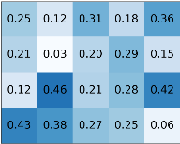


















Hidden State Machine
$$BF_{1}$$
$$(1,0)$$
$$TF_{1}^{1}$$
$$(1,1)$$
$TF_{2}^{1}$
$$(1,1)$$
$TF_{k}^{1}$
$$(1,1)$$
$$G$$
$$T$$
$$A$$
$$C$$
$$BF_{2}$$
$$(2,0)$$
$$TF_{1}^{2}$$
$$(1,1)$$
$$TF_{2}^{2}$$
$$(1,1)$$
$TF_{k}^{2}$
$$(1,1)$$
$$G$$
$$T$$
$$A$$
$$C$$
$$BF_{m}$$
$$(m ,0 )$$
$$TF_{1}^{m}$$
$$(m,1)$$
$TF_{2}^{m}$
$$(1,1)$$
$$TF_{k}^{m}$$
$$(1,1)$$
$$G$$
$$T$$
$$A$$
$$C$$

Slide 3
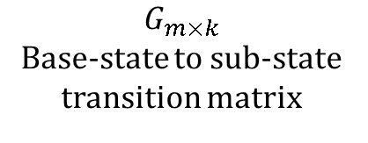
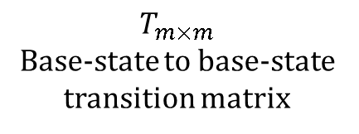

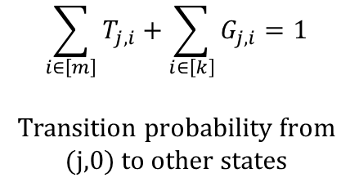
$$T_{m×m}$$
Base-state to base-state transition matrix
$$G_{m×k}$$
Base-state to sub-state transition matrix
$$j$$
$$\sum_{i∈\left[m\right]}{T_{j,i}}+\sum_{i∈\left[k\right]}{G_{j,i}}=1$$
Transition probability from (j,0) to other states

Slide 4
















Forward Algorithm
$$t−|W_{1}|−1$$
$$t−|W_{2}|−1$$
$$t$$
$$t−1$$
$$t$$
$$α_{j,t}$$
$$j$$
$$α_{j,t}$$
$$j$$
Backward Algorithm
$$t$$
$$t−|W_{2}|−1$$
$$t−|W_{1}|−1$$
$$t$$
$$t+1$$
$$β_{j,t}$$
$$j$$
$$β_{j,t}$$
$$j$$

Slide 5









$$t$$
$$t−|W_{2}|−1$$
$$t−|W_{1}|−1$$
$$t$$
$t$+1
$$j$$
$$β_{j,t}$$
$$j$$
$$β_{j,t}$$

Slide 6

…CGGCTACTCTGTA…
PWM
0
0
0
1
0
0
0
0
0
0
1
0
0
1
0
1
0
0
1
0
0
0
0
0
0
0
1
0
0
1
0
0
1
0
1
0

Slide 7
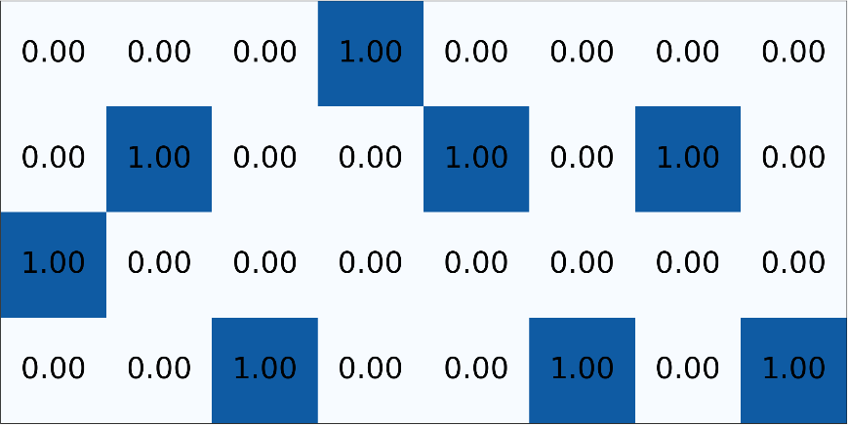
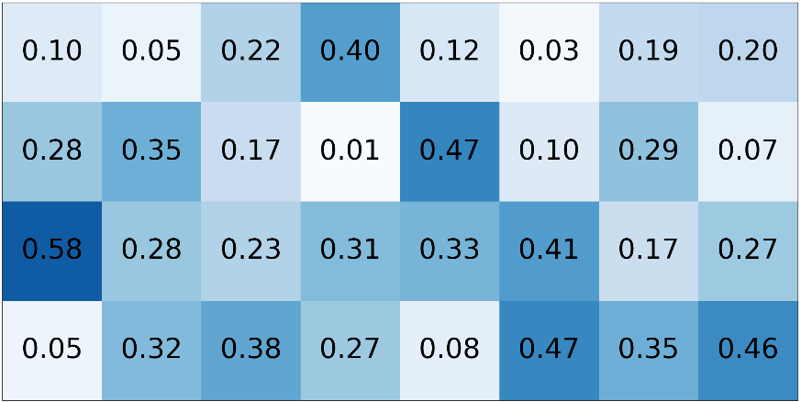
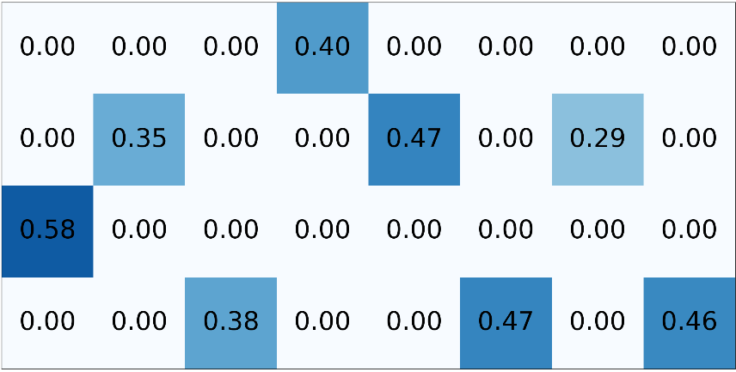
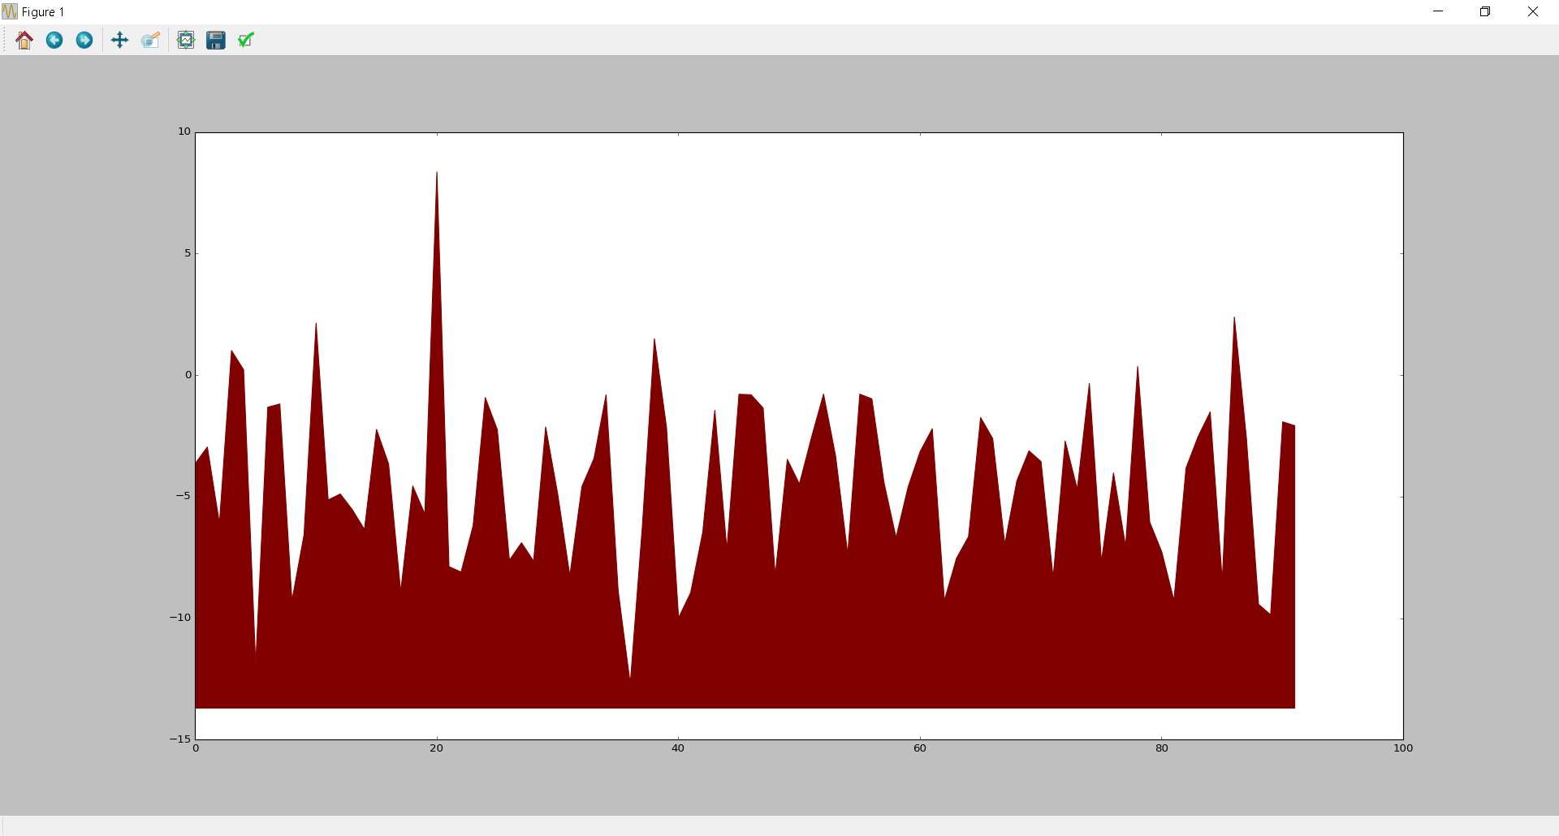
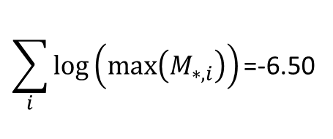
…CGGCTACTCTTA…
One-hot encoding
PWM
M
$$\sum_{i}{log⁡\left(max⁡\left(M_{∗,i}\right)\right)\text{=}\text{−}\text{6}\text{.}\text{50}}$$
Log likelihood of TF binding
Location in sequence

Slide 8
