Slide 1
Transcription Factor Binding Sites (TFBS)
A
Promoter
Gene
DNA
Enhancer
RNA
TF
TF
RNA Pol II
TF
TF
TF
TF
P300/CBP
Transcription
Complex
P300/CBP
TF
TF
TF
TF
TF
TF
B
C

Slide 2
Transcription Factor Binding Sites (TFBS)
A
Promoter
Gene
DNA
Enhancer
TF
TF
TF
TF
B
TF
TF
TF
TF
TF
Transcription Initiation
Complex
RNA
TF
TF
RNA Pol II
TF
TF
TF
TF
p300/CBP
p300/CBP
TF
TF
TF
TF
TF
TF
C
D

Slide 3
Nucleosome
with histone modifications
DNA
Accessible DNA, active enhancer
DNA
Inaccessible DNA, inactive enhancer
H3K27ac
H3K4me1
H3K27me3

Slide 4




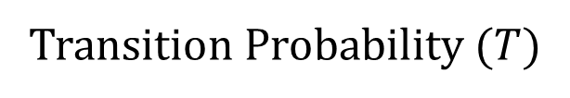












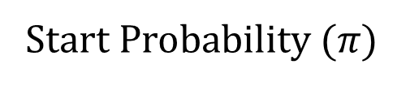































Markov State Machine
Transition Probability ($T$)
Start Probability ($π)$
A
B
$$to$$
$$a$$
$$b$$
$$c$$
C
$$a$$
$$b$$
$$c$$
$$0.15$$
$$0.0$$
$$from$$
$$0.1$$
$$0.2$$
$$0.1$$
$$0.2$$
$$a$$
$$b$$
$$c$$
$$a$$
$$0.8$$
$$0.2$$
$$0.0$$
$$0.4$$
$$0.3$$
$$0.3$$
$$0.8$$
$$0.7$$
$$0.75$$
$$0.4$$
$$0.3$$
$$0.3$$
$$b$$
$$0.1$$
$$0.7$$
$$0.2$$
$$c$$
$$0.15$$
$$0.1$$
$$0.75$$
$$P\left(y_{t}=c | y_{t−1}=b\right)$$
D
Example of a Markov Chain
$$a$$
$$a$$
$$a$$
$$a$$
$$b$$
$$b$$
$$b$$
$$c$$
$c$
$$c$$
$$c$$
$$a$$
$$a$$
Notes:
3 state Markov model

Slide 5
















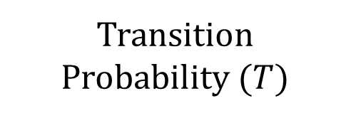









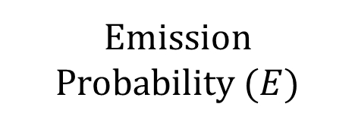


























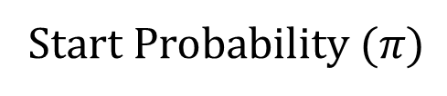










Emission Probability ($E$)
Transition Probability ($T$)
Hidden State Machine
Start Probability ($π)$
A
$$0.4$$
$$0.2$$
$$0.6$$
B
$$1$$
$$2$$
C
$$to$$
$$a$$
$$b$$
D
$$a$$
$$b$$
$$observed$$
$$from$$
$$a$$
$$b$$
$$hidden$$
$$0.8$$
$$0.8$$
$$a$$
$$0.8$$
$$0.2$$
$$a$$
$$0.8$$
$$0.2$$
$$0.4$$
$$0.6$$
$$1$$
$$2$$
$$0.2$$
$$1$$
$$2$$
$$b$$
$$0.1$$
$$0.9$$
$$b$$
$$0.2$$
$$0.8$$
$$P\left(x_{t}=1 | y_{t}=b\right)$$
$$P\left(y_{t}=a | y_{t−1}=b\right)$$
E
Example of a Generated Sequence
$$a$$
$$a$$
$$a$$
$$a$$
$$b$$
$$b$$
$$b$$
$$b$$
$$a$$
$$a$$
$$a$$
$$a$$
$$a$$
Hidden
$1$
$1$
$$2$$
$1$
$2$
$2$
$$1$$
$2$
$2$
$1$
$1$
$1$
$$1$$
Observed
Notes:
2 States HMM

Slide 6
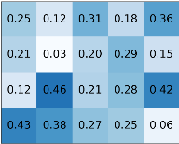


















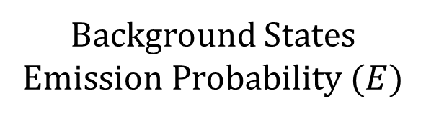


































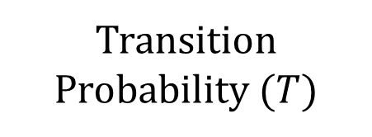
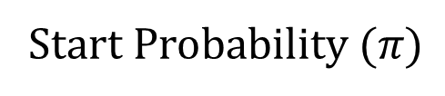







Hidden State Machine
Background States Emission Probability ($E$)
Transition Probability ($T$)
Start Probability ($π)$
A
$$0.9$$
$$0.1$$
B
$$A$$
$$C$$
$$G$$
$$T$$
C
$$to$$
$$BG$$
$$TF$$
D
$$BG$$
$$TF$$
$$0.2$$
$$observed$$
$$from$$
$$hidden$$
$$0.8$$
$$BG$$
$$TF$$
$$0.05$$
$$BG$$
$$BG$$
$$0.8$$
$$0.2$$
$$0.9$$
$$0.1$$
$$0. 1$$
$$0.6$$
$$0. 1$$
$$0.2$$
$$0.95$$
$$TF$$
$$0.95$$
$$0.05$$
$$G$$
$$T$$
$$A$$
$$C$$
$$Single Variable$$
$$Emission$$
$$PWM$$
$$Emission$$
Example of a Generated Sequence
E
$$BG$$
$$BG$$
$$BG$$
$$BG$$
$$TF$$
$$BG$$
$$BG$$
$$BG$$
$$BG$$
Hidden
$$A$$
$$C$$
$$G$$
$$C$$
$$T$$
$$C$$
$$A$$
$$G$$
$$A$$
$$C$$
$G$
$$A$$
$$T$$
Observed
Transcription Factor Binding Site
Notes:
2 States Structured HMM

Slide 7


















































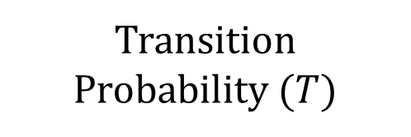


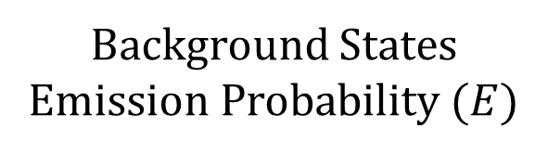














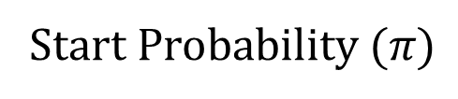
Hidden State Machine
Background States Emission Probability ($E$)
Transition Probability ($T$)
Start Probability ($π)$
A
$$1$$
B
$$BG$$
$$A$$
$$C$$
$$G$$
$$T$$
C
$$to$$
$$BG$$
$$TF$$
D
$$BG$$
$$TF$$
$$0.2$$
$$from$$
$$0.8$$
$$BG$$
$$TF$$
$$BG$$
$$0.8$$
$$0.2$$
$$FIXED$$
$$FIXED$$
$A$?
$$0. 1$$
$$0.6$$
$$0. 1$$
$$0.2$$
$$1$$
$$0$$
$$TF$$
$$FIXED$$
$$FIXED$$
$C$?
$$0.1$$
$$0.05$$
$$0.8$$
$$0.05$$
$$1$$
$$0$$
$$G$$
$$T$$
$$1$$
$$A$$
$$C$$
$$Single Variable$$
$$Emission$$
$G$?
$$0.5$$
$$0.3$$
$$0.1$$
$$0.1$$
$$PWM$$
$$Emission$$
$T$?
$$0.1$$
$$0.4$$
$$0.2$$
$$0.3$$
$$P\left(x_{t}=T | x_{t−1}=G,y_{t}=BG\right)$$
E
Example of a Generated Sequence
$$BG$$
$$BG$$
$$BG$$
$$BG$$
$$TF$$
$$BG$$
$$BG$$
$$BG$$
$$BG$$
Hidden
$$A$$
$$C$$
$$G$$
$$C$$
$$T$$
$$C$$
$$A$$
$$G$$
$$A$$
$$C$$
$G$
$$A$$
$$T$$
Observed
Notes:
2 state HOP-HMM

Slide 8

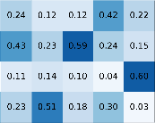
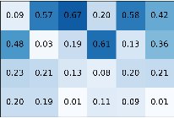































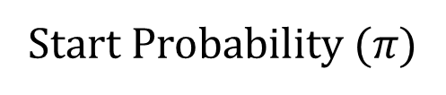









































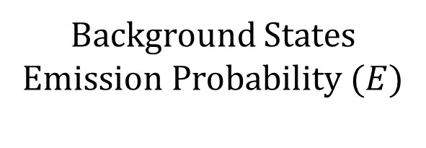


































































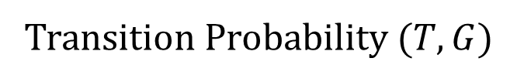
Background States Emission Probability ($E$)
Hidden State Machine
Start Probability ($π)$
A
$$0.5$$
$$0.05$$
$$0.0$$
$$0.05$$
B
C
$$BG_{1}$$
$$BG_{2}$$
$$TF_{1}^{1}$$
$$…$$
$$TF_{3}^{2}$$
Enhancer
Type I
$$0.1$$
$$BG_{1}$$
$$TF_{1}^{1}$$
$$TF_{2}^{1}$$
$$TF_{3}^{1}$$
$$BG_{1}$$
$$A$$
$$C$$
$$G$$
$$T$$
$$0.8$$
$$FIXED$$
$$FIXED$$
$$0.5$$
$$0.5$$
$$0$$
$$…$$
$$0$$
$$1$$
$$A∗$$
$$BG_{2}$$
$$A$$
$$C$$
$$G$$
$$T$$
$$G$$
$$T$$
$$0. 1$$
$$0.6$$
$$0. 1$$
$$0.2$$
$$A$$
$$C$$
$A$?
$$0. 1$$
$$0.6$$
$$0. 1$$
$$0.2$$
$$C∗$$
$$0.1$$
$$0.05$$
$$0.8$$
$$0.05$$
Transition Probability ($T,G$)
$$0.5$$
$C$?
$$0.1$$
$$0.05$$
$$0.8$$
$$0.05$$
$$T$$
$$G$$
$$G∗$$
$$0.5$$
$$0.3$$
$$0.1$$
$$0.1$$
Enhancer
Type II
$$BG_{2}$$
$$TF_{1}^{2}$$
$$TF_{2}^{2}$$
$$TF_{3}^{2}$$
D
$$to$$
$$0.8$$
$G$?
$$0.5$$
$$0.3$$
$$0.1$$
$$0.1$$
$$BG_{1}$$
$$BG_{2}$$
$$TF_{1}^{∗}$$
$$TF_{2}^{∗}$$
$$TF_{3}^{∗}$$
$$T∗$$
$$0.1$$
$$0.4$$
$$0.2$$
$$0.3$$
$$from$$
$$0.1$$
$$1$$
$$G$$
$$T$$
$T$?
$$0.1$$
$$0.4$$
$$0.2$$
$$0.3$$
$$BG_{1}$$
$$0.8$$
$$0.1$$
$$0.05$$
$$0.0$$
$$0.05$$
$$A$$
$$C$$
$$BG_{2}$$
$$0. 1$$
$$0.8$$
$$0.0$$
$$0.1$$
$$0.0$$
$$P\left(y_{t}={TF}_{2}^{2} | y_{t−1}=BG_{2}\right)$$
Example of a Generated Sequence
E
$$BG_{1}$$
$$BG_{1}$$
$$BG_{1}$$
$$BG_{1}$$
$$TF_{1}^{1}$$
$$BG_{1}$$
$$BG_{1}$$
$$BG_{2}$$
$$BG_{2}$$
$$TF_{2}^{1}$$
$$BG_{2}$$
$$BG_{2}$$
$$BG_{2}$$
Hidden
$$A$$
$$C$$
$$T$$
$$T$$
$$A$$
$$T$$
$$T$$
$$A$$
$$A$$
$$A$$
$$C$$
$$T$$
$$T$$
$$C$$
$$C$$
$$A$$
$$C$$
$$G$$
$$T$$
$$G$$
$$C$$
$$G$$
$$A$$
Observed
Notes:
6 state HOP HMM

