Slide 1
HOP-HMM
David Taub

Slide 2
Outlines
Gene regulation
TFBS & PWMs
HMM
HOP-HMM
Results

Slide 3
Enhancer
Promoter
Gene
DNA
TF
TF
Transcription Factor Binding Sites

Slide 4
Enhancer
Promoter
Gene
DNA
TF
TF
TF
TF

Slide 5
TF
TF
TF
TF
TF

Slide 6
TF
TF
TF
TF
TF

Slide 7
TF
TF
TF
TF
TF
TF

Slide 8
Transcription Initiation
Complex
TF
TF
TF
p300/CBP
TF
TF
TF

Slide 9
TF
RNA Pol II
TF
TF
p300/CBP
TF
TF
TF

Slide 10
Transcription
RNA
TF
RNA Pol II
TF
TF
p300/CBP
TF
TF
TF

Slide 11
TFBS & PWMs
Enhancer
DNA
TF
TF
Transcription Factor Binding Sites

Slide 12
TFBS & PWMs
…CGAGCTACTTTATTAAGACATTACGTTACAGAGATAA…
Enhancer
DNA
TF
TF
Transcription Factor Binding Sites

Slide 13
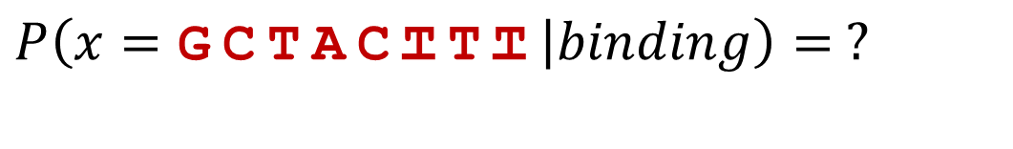
TFBS & PWMs
…CGAGCTACTTTATTAAGACATTACGTTACAGAGATAA…
$$P\left(x=\text{GCTACTTT} | binding\right)= ?$$

Slide 14
TFBS & PWMs
…CGAGCTACTTTATTAAGACATTACGTTACAGAGATAA…
$$P\left(x=\text{GCTACTTT} | binding\right)= ?$$
other binding sites
(ChIP-seq)
ACTACTTT
CCGACTTT
GTAACTCA
GGGAGGCT
GTGGCGCT
GGAACGTG
GCTACTTT

Slide 15
TFBS & PWMs
…CGAGCTACTTTATTAAGACATTACGTTACAGAGATAA…
$$P\left(x=\text{GCTACTTT} | binding\right)= ?$$
other binding sites
(ChIP-seq)
A:10260001
C:13306030
G:52011301
T:02200445
ACTACTTT
CCGACTTT
GTAACTCA
GGGAGGCT
GTGGCGCT
GGAACGTG
GCTACTTT

Slide 16
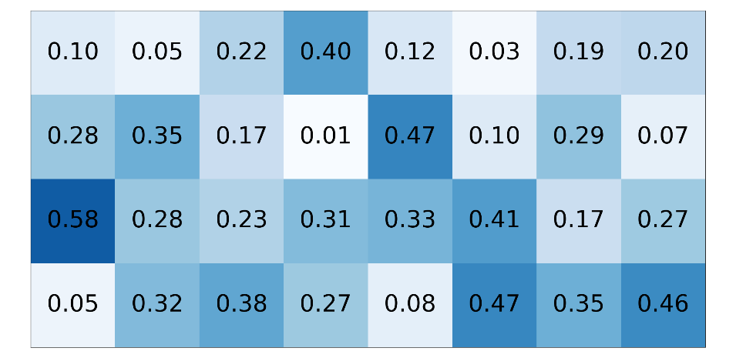
TFBS & PWMs
…CGAGCTACTTTATTAAGACATTACGTTACAGAGATAA…
$$P\left(x=\text{GCTACTTT} | binding\right)= ?$$
other binding sites
(ChIP-seq)
PWM (W)
A:10260001
C:13306030
G:52011301
T:02200445
ACTACTTT
CCGACTTT
GTAACTCA
GGGAGGCT
GTGGCGCT
GGAACGTG
GCTACTTT

Slide 17
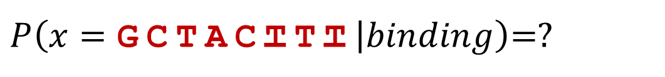
TFBS & PWMs
…CGAGCTACTTTATTAAGACATTACGTTACAGAGATAA…
$P\left(x=\text{GCTACTTT} | binding\right)$=?
PWM (W)

Slide 18
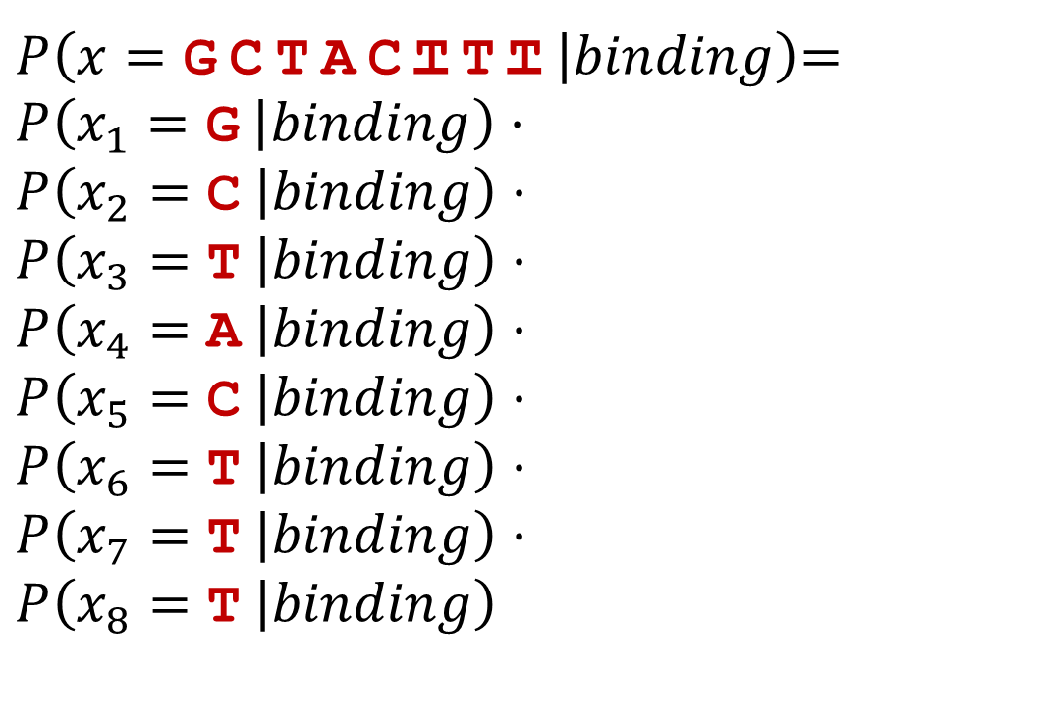
TFBS & PWMs
…CGAGCTACTTTATTAAGACATTACGTTACAGAGATAA…
$P\left(x=\text{GCTACTTT} | binding\right)$=
$$P\left(x_{1}=\text{G} | binding\right)⋅$$
$$P\left(x_{2}=\text{C} | binding\right)⋅$$
$$P\left(x_{3}=\text{T} | binding\right)⋅$$
$$P\left(x_{4}=\text{A} | binding\right)⋅$$
$$P\left(x_{5}=\text{C} | binding\right)⋅$$
$$P\left(x_{6}=\text{T} | binding\right)⋅$$
$$P\left(x_{7}=\text{T} | binding\right)⋅$$
$$P\left(x_{8}=\text{T} | binding\right)$$
positional independence assumption
PWM (W)

Slide 19

TFBS & PWMs
…CGAGCTACTTTATTAAGACATTACGTTACAGAGATAA…
$P\left(x=\text{GCTACTTT} | binding\right)$=
$$0.58⋅0.35⋅0.38⋅0.40⋅$$
$$0.47⋅0.47⋅0.35⋅0.46=\text{0}\text{.}\text{001079}$$
PWM (W)

Slide 20
TFBS & PWMs
…CGAGCTACTTTATTAAGACATTACGTTACAGAGATAA…
$P\left(x=\text{GCTACTTT} | binding\right)$=
$$0.58⋅0.35⋅0.38⋅0.40⋅$$
$$0.47⋅0.47⋅0.35⋅0.46=\text{0}\text{.}\text{001079}$$
PWM (W)
Small number,
log likelihood is more convenient

Slide 21
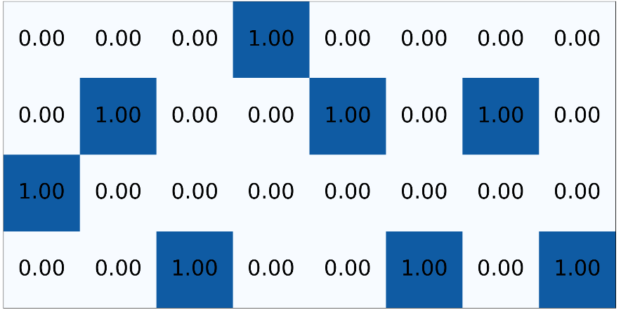

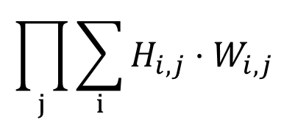
Using PWMs
…CGACTCCGTATA…
One-hot encoding (H)
PWM (W)
$$\prod_{j}{\sum_{i}{H_{i,j}}⋅W_{i,j}}$$
*

Slide 22
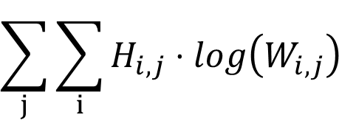

Using PWMs
…CGACTCCGTATA…
One-hot encoding (H)
PWM (W)
$$\sum_{j}{\sum_{i}{H_{i,j}}⋅log\left(W_{i,j}\right) }$$
*
$$log$$

Slide 23
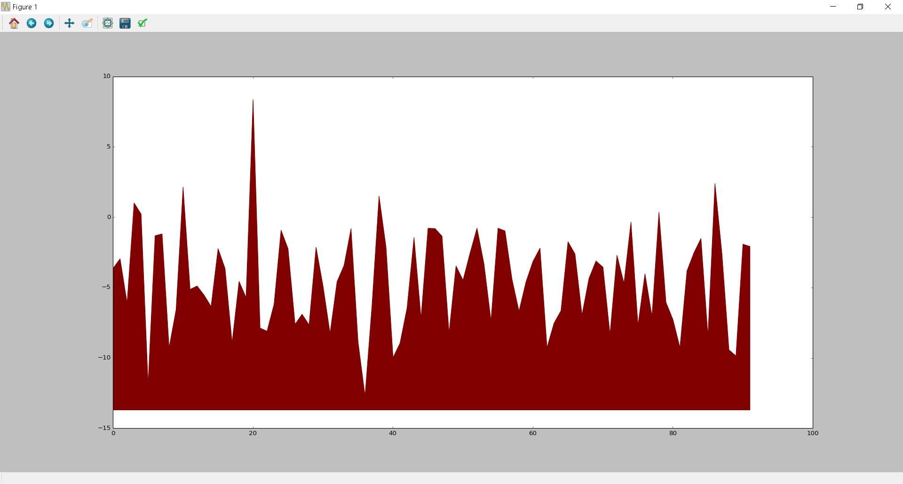
Using PWMs
…CGACTCCGTATA…
One-hot encoding (H)
PWM (W)
$$\sum_{j}{\sum_{i}{H_{i,j}}⋅log\left(W_{i,j}\right) }$$
*
$$log$$
Log likelihood of TF binding
Location in sequence

Slide 24


















Hidden Markov Model
Markov State Machine
$$0.4$$
$$0.2$$
$$0.6$$
$$0.8$$
$$a$$
$$b$$
$$0.8$$
$$0.2$$
Example of a Generated Sequence
$$a$$
$$a$$
$$a$$
$$a$$
$$b$$
$$b$$
$$b$$
$$b$$
$$a$$
$$a$$
$$a$$
$$a$$
$$a$$
States

Slide 25

















Hidden Markov Model
Hidden State Machine
$$0.4$$
$$0.2$$
$$0.6$$
$$0.8$$
$$a$$
$$b$$
$$0.8$$
$$1$$
$$2$$
$$0.2$$
$$1$$
$$2$$
Example of a Generated Sequence
$$a$$
$$a$$
$$a$$
$$a$$
$$b$$
$$b$$
$$b$$
$$b$$
$$a$$
$$a$$
$$a$$
$$a$$
$$a$$
Hidden
$1$
$1$
$$2$$
$1$
$2$
$2$
$$1$$
$2$
$2$
$1$
$1$
$1$
$$1$$
Observed

Slide 26






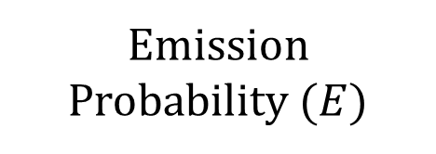




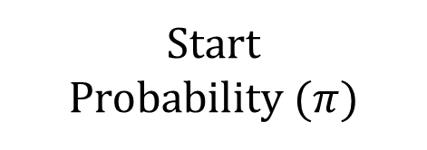
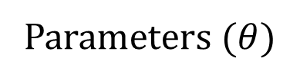


















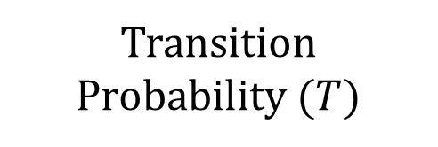




Hidden Markov Model
Parameters ($θ$)
Emission Probability ($E$)
Transition Probability ($T$)
Start
Probability ($π)$
Hidden State Machine
$$0.4$$
$$0.2$$
$$0.6$$
$$1$$
$$2$$
$$to$$
$$a$$
$$b$$
$$a$$
$$b$$
$$observed$$
$$from$$
$$a$$
$$b$$
$$hidden$$
$$0.8$$
$$0.8$$
$$a$$
$$0.8$$
$$0.2$$
$$a$$
$$0.8$$
$$0.2$$
$$0.4$$
$$0.6$$
$$1$$
$$2$$
$$0.2$$
$$1$$
$$2$$
$$b$$
$$0.1$$
$$0.9$$
$$b$$
$$0.2$$
$$0.8$$
Example of a Generated Sequence
$$a$$
$$a$$
$$a$$
$$a$$
$$b$$
$$b$$
$$b$$
$$b$$
$$a$$
$$a$$
$$a$$
$$a$$
$$a$$
Hidden
$1$
$1$
$$2$$
$1$
$2$
$2$
$$1$$
$2$
$2$
$1$
$1$
$1$
$$1$$
Observed

Slide 27




Hidden Markov Model
Parameters ($θ$)
Emission Probability ($E$)
Transition Probability ($T$)
Start
Probability ($π)$
Hidden State Machine
$$0.4$$
$$0.2$$
$$0.6$$
$$1$$
$$2$$
$$to$$
$$a$$
$$b$$
$$a$$
$$b$$
$$observed$$
$$from$$
$$a$$
$$b$$
$$hidden$$
$$0.8$$
$$0.8$$
$$a$$
$$0.8$$
$$0.2$$
$$a$$
$$0.8$$
$$0.2$$
$$0.4$$
$$0.6$$
$$1$$
$$2$$
$$0.2$$
$$1$$
$$2$$
$$b$$
$$0.1$$
$$0.9$$
$$b$$
$$0.2$$
$$0.8$$
$$P\left(x_{t}=1 | y_{t}=b\right)$$
Example of a Generated Sequence
$$a$$
$$a$$
$$a$$
$$a$$
$$b$$
$$b$$
$$b$$
$$b$$
$$a$$
$$a$$
$$a$$
$$a$$
$$a$$
Hidden
$1$
$1$
$$2$$
$1$
$2$
$2$
$$1$$
$2$
$2$
$1$
$1$
$1$
$$1$$
Observed

Slide 28



Hidden Markov Model
Parameters ($θ$)
Emission Probability ($E$)
Transition Probability ($T$)
Start
Probability ($π)$
Hidden State Machine
$$0.4$$
$$0.2$$
$$0.6$$
$$1$$
$$2$$
$$to$$
$$a$$
$$b$$
$$a$$
$$b$$
$$observed$$
$$from$$
$$a$$
$$b$$
$$hidden$$
$$0.8$$
$$0.8$$
$$a$$
$$0.8$$
$$0.2$$
$$a$$
$$0.8$$
$$0.2$$
$$0.4$$
$$0.6$$
$$1$$
$$2$$
$$0.2$$
$$1$$
$$2$$
$$b$$
$$0.1$$
$$0.9$$
$$b$$
$$0.2$$
$$0.8$$
$$P\left(y_{t}=a | y_{t−1}=b\right)$$
Example of a Generated Sequence
$$a$$
$$a$$
$$a$$
$$a$$
$$b$$
$$b$$
$$b$$
$$b$$
$$a$$
$$a$$
$$a$$
$$a$$
$$a$$
Hidden
$1$
$1$
$$2$$
$1$
$2$
$2$
$$1$$
$2$
$2$
$1$
$1$
$1$
$$1$$
Observed

Slide 29
TODO
Likelihood
Postirior
Baum-Welch Algo

Slide 30
Enhancer
DNA
TF
TF

Slide 31
Background 1
Background 2
DNA
TF
TF
Transcription Factor Binding Sites

Slide 32

































DNA
TF
TF
$$BG_{2}$$
$$BG_{2}$$
$$BG_{1}$$
$$BG_{1}$$
$$BG_{1}$$
$$TF_{1}^{1}$$
$$BG_{1}$$
$$BG_{1}$$
$$BG_{1}$$
$$BG_{1}$$
$$TF_{2}^{1}$$
$$BG_{1}$$
$$BG_{1}$$
$$BG_{2}$$
$$BG_{2}$$
Hidden
$$A$$
$$A$$
$$C$$
$$T$$
$$T$$
$$A$$
$$T$$
$$T$$
$$A$$
$$A$$
$$A$$
$$C$$
$$T$$
$$T$$
$$C$$
$$C$$
$$A$$
$$C$$
$$G$$
$$T$$
$$G$$
$$C$$
$$G$$
$$A$$
$$A$$
Observed

Slide 33




























$$BG_{2}$$
$$BG_{2}$$
$$BG_{1}$$
$$BG_{1}$$
$$BG_{1}$$
$$TF_{1}^{1}$$
$$BG_{1}$$
$$BG_{1}$$
$$BG_{1}$$
$$BG_{1}$$
$$TF_{2}^{1}$$
$$BG_{1}$$
$$BG_{1}$$
$$BG_{2}$$
$$BG_{2}$$
Hidden
$$A$$
$$A$$
$$C$$
$$T$$
$$T$$
$$A$$
$$T$$
$$T$$
$$A$$
$$A$$
$$A$$
$$C$$
$$T$$
$$T$$
$$C$$
$$C$$
$$A$$
$$C$$
$$G$$
$$T$$
$$G$$
$$C$$
$$G$$
$$A$$
$$A$$
Observed

