Slide 1


































$$BG_{2}$$
$$BG_{2}$$
$$BG_{1}$$
$$BG_{1}$$
$$BG_{1}$$
$$TF_{1}^{1}$$
$$BG_{1}$$
$$BG_{1}$$
$$BG_{1}$$
$$BG_{1}$$
$$TF_{2}^{1}$$
$$BG_{1}$$
$$BG_{1}$$
$$BG_{2}$$
$$BG_{2}$$
Hidden
$$A$$
$$A$$
$$C$$
$$T$$
$$T$$
$$A$$
$$T$$
$$T$$
$$A$$
$$A$$
$$A$$
$$C$$
$$T$$
$$T$$
$$C$$
$$C$$
$$A$$
$$C$$
$$G$$
$$T$$
$$G$$
$$C$$
$$G$$
$$A$$
$$A$$
Observed

Slide 2
























Hidden State Machine
$$0.5$$
$$0.05$$
$$0.0$$
$$0.05$$
$$0.1$$
$$0.8$$
$$BG_{1}$$
$$TF_{1}^{1}$$
$$TF_{2}^{1}$$
$$TF_{3}^{1}$$
$$1$$
$$G$$
$$T$$
$$A$$
$$C$$
$$0.5$$
$$0.8$$
$$BG_{2}$$
$$TF_{1}^{2}$$
$$TF_{2}^{2}$$
$$TF_{3}^{2}$$
$$0.1$$
$$1$$
$$G$$
$$T$$
$$A$$
$$C$$
$$BG_{2}$$
$$BG_{2}$$
$$BG_{1}$$
$$BG_{1}$$
$$BG_{1}$$
$$TF_{1}^{1}$$
$$BG_{1}$$
$$BG_{1}$$
$$BG_{1}$$
$$BG_{1}$$
$$TF_{2}^{1}$$
$$BG_{1}$$
$$BG_{1}$$
$$BG_{2}$$
$$BG_{2}$$
Hidden
$$A$$
$$A$$
$$C$$
$$T$$
$$T$$
$$A$$
$$T$$
$$T$$
$$A$$
$$A$$
$$A$$
$$C$$
$$T$$
$$T$$
$$C$$
$$C$$
$$A$$
$$C$$
$$G$$
$$T$$
$$G$$
$$C$$
$$G$$
$$A$$
$$A$$
Observed

Slide 3
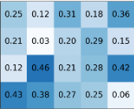
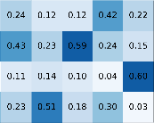
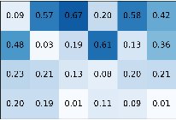
Hidden State Machine
$$0.5$$
$$0.05$$
$$0.0$$
$$0.05$$
$$0.1$$
$$0.8$$
$$BG_{1}$$
$$TF_{1}^{1}$$
$$TF_{2}^{1}$$
$$TF_{3}^{1}$$
$$1$$
$$G$$
$$T$$
$$A$$
$$C$$
$$0.5$$
$$0.8$$
$$BG_{2}$$
$$TF_{1}^{2}$$
$$TF_{2}^{2}$$
$$TF_{3}^{2}$$
$$0.1$$
$$1$$
$$G$$
$$T$$
$$A$$
$$C$$
PWMs
$$BG_{2}$$
$$BG_{2}$$
$$BG_{1}$$
$$BG_{1}$$
$$BG_{1}$$
$$TF_{1}^{1}$$
$$BG_{1}$$
$$BG_{1}$$
$$BG_{1}$$
$$BG_{1}$$
$$TF_{2}^{1}$$
$$BG_{1}$$
$$BG_{1}$$
$$BG_{2}$$
$$BG_{2}$$
Hidden
$$A$$
$$A$$
$$C$$
$$T$$
$$T$$
$$A$$
$$T$$
$$T$$
$$A$$
$$A$$
$$A$$
$$C$$
$$T$$
$$T$$
$$C$$
$$C$$
$$A$$
$$C$$
$$G$$
$$T$$
$$G$$
$$C$$
$$G$$
$$A$$
$$A$$
Observed

Slide 4


















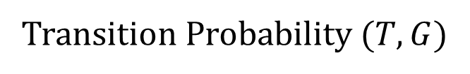














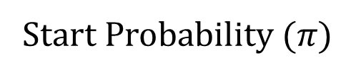













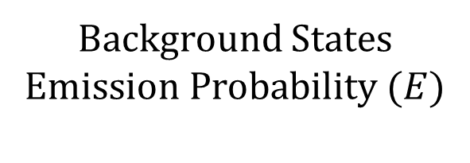





Background States Emission Probability ($E$)
Hidden State Machine
Start Probability ($π)$
$$0.5$$
$$0.05$$
$$0.0$$
$$0.05$$
$$A$$
$$C$$
$$G$$
$$T$$
$$BG_{1}$$
$$BG_{2}$$
$$TF_{1}^{1}$$
$$…$$
$$TF_{3}^{2}$$
$$0.1$$
$$observed$$
$$BG_{1}$$
$$TF_{1}^{1}$$
$$TF_{2}^{1}$$
$$TF_{3}^{1}$$
$$hidden$$
$$0.8$$
$$0.5$$
$$0.5$$
$$FIXED$$
$$FIXED$$
$$BG_{1}$$
$$0. 1$$
$$0.6$$
$$0. 1$$
$$0.2$$
$$0$$
$$…$$
$$0$$
$$1$$
$$G$$
$$T$$
$$A$$
$$C$$
$$BG_{2}$$
$$0.5$$
$$0.3$$
$$0.1$$
$$0.1$$
Transition Probability ($T,G$)
$$0.5$$
$$T$$
$$G$$
$$BG_{2}$$
$$TF_{1}^{2}$$
$$TF_{2}^{2}$$
$$TF_{3}^{2}$$
$$to$$
$$BG_{1}$$
$$BG_{2}$$
$$TF_{1}^{∗}$$
$$TF_{2}^{∗}$$
$$TF_{3}^{∗}$$
$$0.8$$
$$from$$
$$0.1$$
$$1$$
$$G$$
$$T$$
$$BG_{1}$$
$$0.8$$
$$0.1$$
$$0.05$$
$$0.05$$
$$0.0$$
$$A$$
$$C$$
PWMs
$$BG_{2}$$
$$0. 1$$
$$0.8$$
$$0.0$$
$$0.0$$
$$0.1$$
$$BG_{2}$$
$$BG_{2}$$
$$BG_{1}$$
$$BG_{1}$$
$$BG_{1}$$
$$TF_{1}^{1}$$
$$BG_{1}$$
$$BG_{1}$$
$$BG_{1}$$
$$BG_{1}$$
$$TF_{2}^{1}$$
$$BG_{1}$$
$$BG_{1}$$
$$BG_{2}$$
$$BG_{2}$$
Hidden
$$A$$
$$A$$
$$C$$
$$T$$
$$T$$
$$A$$
$$T$$
$$T$$
$$A$$
$$A$$
$$A$$
$$C$$
$$T$$
$$T$$
$$C$$
$$C$$
$$A$$
$$C$$
$$G$$
$$T$$
$$G$$
$$C$$
$$G$$
$$A$$
$$A$$
Observed

Slide 5


Background States Emission Probability ($E$)
Hidden State Machine
Start Probability ($π)$
$$0.5$$
$$0.05$$
$$0.0$$
$$0.05$$
$$A$$
$$C$$
$$G$$
$$T$$
$$BG_{1}$$
$$BG_{2}$$
$$TF_{1}^{1}$$
$$…$$
$$TF_{3}^{2}$$
$$0.1$$
$$observed$$
$$BG_{1}$$
$$TF_{1}^{1}$$
$$TF_{2}^{1}$$
$$TF_{3}^{1}$$
$$hidden$$
$$0.8$$
$$0.5$$
$$0.5$$
$$FIXED$$
$$FIXED$$
$$BG_{1}$$
$$0. 1$$
$$0.6$$
$$0. 1$$
$$0.2$$
$$0$$
$$…$$
$$0$$
$$1$$
$$G$$
$$T$$
$$A$$
$$C$$
$$BG_{2}$$
$$0.5$$
$$0.3$$
$$0.1$$
$$0.1$$
Transition Probability ($T,G$)
$$0.5$$
$$T$$
$$G$$
$$BG_{2}$$
$$TF_{1}^{2}$$
$$TF_{2}^{2}$$
$$TF_{3}^{2}$$
$$to$$
$$BG_{1}$$
$$BG_{2}$$
$$TF_{1}^{∗}$$
$$TF_{2}^{∗}$$
$$TF_{3}^{∗}$$
$$0.8$$
$$from$$
$$0.1$$
$$1$$
$$G$$
$$T$$
$$BG_{1}$$
$$0.8$$
$$0.1$$
$$0.05$$
$$0.05$$
$$0.0$$
$$A$$
$$C$$
PWMs
$$BG_{2}$$
$$0. 1$$
$$0.8$$
$$0.0$$
$$0.0$$
$$0.1$$
$$P\left(y_{t}={TF}_{2}^{1} | y_{t−1}=BG_{1}\right)$$
$$BG_{2}$$
$$BG_{2}$$
$$BG_{1}$$
$$BG_{1}$$
$$BG_{1}$$
$$TF_{1}^{1}$$
$$BG_{1}$$
$$BG_{1}$$
$$BG_{1}$$
$$BG_{1}$$
$$TF_{2}^{1}$$
$$BG_{1}$$
$$BG_{1}$$
$$BG_{2}$$
$$BG_{2}$$
Hidden
$$A$$
$$A$$
$$C$$
$$T$$
$$T$$
$$A$$
$$T$$
$$T$$
$$A$$
$$A$$
$$A$$
$$C$$
$$T$$
$$T$$
$$C$$
$$C$$
$$A$$
$$C$$
$$G$$
$$T$$
$$G$$
$$C$$
$$G$$
$$A$$
$$A$$
Observed

Slide 6


Background States Emission Probability ($E$)
Hidden State Machine
Start Probability ($π)$
$$0.5$$
$$0.05$$
$$0.0$$
$$0.05$$
$$A$$
$$C$$
$$G$$
$$T$$
$$BG_{1}$$
$$BG_{2}$$
$$TF_{1}^{1}$$
$$…$$
$$TF_{3}^{2}$$
$$0.1$$
$$observed$$
$$BG_{1}$$
$$TF_{1}^{1}$$
$$TF_{2}^{1}$$
$$TF_{3}^{1}$$
$$hidden$$
$$0.8$$
$$0.5$$
$$0.5$$
$$FIXED$$
$$FIXED$$
$$BG_{1}$$
$$0. 1$$
$$0.6$$
$$0. 1$$
$$0.2$$
$$0$$
$$…$$
$$0$$
$$1$$
$$G$$
$$T$$
$$A$$
$$C$$
$$BG_{2}$$
$$0.5$$
$$0.3$$
$$0.1$$
$$0.1$$
Transition Probability ($T,G$)
$$0.5$$
$$T$$
$$G$$
$$BG_{2}$$
$$TF_{1}^{2}$$
$$TF_{2}^{2}$$
$$TF_{3}^{2}$$
$$to$$
$$BG_{1}$$
$$BG_{2}$$
$$TF_{1}^{∗}$$
$$TF_{2}^{∗}$$
$$TF_{3}^{∗}$$
$$from$$
$$0.1$$
$$1$$
$$G$$
$$T$$
$$BG_{1}$$
$$0.8$$
$$0.1$$
$$0.05$$
$$0.05$$
$$0.0$$
$$A$$
$$C$$
PWMs
$$BG_{2}$$
$$0. 1$$
$$0.8$$
$$0.0$$
$$0.0$$
$$0.1$$
$$P\left(y_{t}={BG}_{2}^{ } | y_{t−1}=BG_{1}\right)$$
$$BG_{2}$$
$$BG_{2}$$
$$BG_{1}$$
$$BG_{1}$$
$$BG_{1}$$
$$TF_{1}^{1}$$
$$BG_{1}$$
$$BG_{1}$$
$$BG_{1}$$
$$BG_{1}$$
$$TF_{2}^{1}$$
$$BG_{1}$$
$$BG_{1}$$
$$BG_{2}$$
$$BG_{2}$$
Hidden
$$A$$
$$A$$
$$C$$
$$T$$
$$T$$
$$A$$
$$T$$
$$T$$
$$A$$
$$A$$
$$A$$
$$C$$
$$T$$
$$T$$
$$C$$
$$C$$
$$A$$
$$C$$
$$G$$
$$T$$
$$G$$
$$C$$
$$G$$
$$A$$
$$A$$
Observed

Slide 7







Background States Emission Probability ($E$)
Hidden State Machine
Start Probability ($π)$
$$0.5$$
$$0.05$$
$$0.0$$
$$0.05$$
$$A$$
$$C$$
$$G$$
$$T$$
$$BG_{1}$$
$$BG_{2}$$
$$TF_{1}^{1}$$
$$…$$
$$TF_{3}^{2}$$
$$0.1$$
$$observed$$
$$BG_{1}$$
$$TF_{1}^{1}$$
$$TF_{2}^{1}$$
$$TF_{3}^{1}$$
$$hidden$$
$$0.8$$
$$0.5$$
$$0.5$$
$$FIXED$$
$$FIXED$$
$$BG_{1}$$
$$0. 1$$
$$0.6$$
$$0. 1$$
$$0.2$$
$$0$$
$$…$$
$$0$$
$$1$$
$$G$$
$$T$$
$$A$$
$$C$$
$$BG_{2}$$
$$0.5$$
$$0.3$$
$$0.1$$
$$0.1$$
Transition Probability ($T,G$)
$$0.5$$
$$T$$
$$G$$
$$BG_{2}$$
$$TF_{1}^{2}$$
$$TF_{2}^{2}$$
$$TF_{3}^{2}$$
$$to$$
$$BG_{1}$$
$$BG_{2}$$
$$TF_{1}^{∗}$$
$$TF_{2}^{∗}$$
$$TF_{3}^{∗}$$
$$0.8$$
$$from$$
$$0.1$$
$$1$$
$$G$$
$$T$$
$$BG_{1}$$
$$0.8$$
$$0.1$$
$$0.05$$
$$0.05$$
$$0.0$$
$$A$$
$$C$$
PWMs
$$BG_{2}$$
$$0. 1$$
$$0.8$$
$$0.0$$
$$0.0$$
$$0.1$$
$$P\left(x_{t:t+|W_{2}|} | y_{t:t+|W_{2}|}=TF_{2}^{1}\right)$$
$$BG_{2}$$
$$BG_{2}$$
$$BG_{1}$$
$$BG_{1}$$
$$BG_{1}$$
$$TF_{1}^{1}$$
$$BG_{1}$$
$$BG_{1}$$
$$BG_{1}$$
$$BG_{1}$$
$$TF_{2}^{1}$$
$$BG_{1}$$
$$BG_{1}$$
$$BG_{2}$$
$$BG_{2}$$
Hidden
$$A$$
$$A$$
$$C$$
$$T$$
$$T$$
$$A$$
$$T$$
$$T$$
$$A$$
$$A$$
$$A$$
$$C$$
$$T$$
$$T$$
$$C$$
$$C$$
$$A$$
$$C$$
$$G$$
$$T$$
$$G$$
$$C$$
$$G$$
$$A$$
$$A$$
Observed

Slide 8

Background States Emission Probability ($E$)
Hidden State Machine
Start Probability ($π)$
$$0.5$$
$$0.05$$
$$0.0$$
$$0.05$$
$$A$$
$$C$$
$$G$$
$$T$$
$$BG_{1}$$
$$BG_{2}$$
$$TF_{1}^{1}$$
$$…$$
$$TF_{3}^{2}$$
$$0.1$$
$$observed$$
$$BG_{1}$$
$$TF_{1}^{1}$$
$$TF_{2}^{1}$$
$$TF_{3}^{1}$$
$$hidden$$
$$0.8$$
$$0.5$$
$$0.5$$
$$FIXED$$
$$FIXED$$
$$BG_{1}$$
$$0. 1$$
$$0.6$$
$$0. 1$$
$$0.2$$
$$0$$
$$…$$
$$0$$
$$1$$
$$G$$
$$T$$
$$A$$
$$C$$
$$BG_{2}$$
$$0.5$$
$$0.3$$
$$0.1$$
$$0.1$$
Transition Probability ($T,G$)
$$0.5$$
$$T$$
$$G$$
$$BG_{2}$$
$$TF_{1}^{2}$$
$$TF_{2}^{2}$$
$$TF_{3}^{2}$$
$$to$$
$$BG_{1}$$
$$BG_{2}$$
$$TF_{1}^{∗}$$
$$TF_{2}^{∗}$$
$$TF_{3}^{∗}$$
$$0.8$$
$$from$$
$$0.1$$
$$1$$
$$G$$
$$T$$
$$BG_{1}$$
$$0.8$$
$$0.1$$
$$0.05$$
$$0.05$$
$$0.0$$
$$A$$
$$C$$
PWMs
$$BG_{2}$$
$$0. 1$$
$$0.8$$
$$0.0$$
$$0.0$$
$$0.1$$
$$Order=1$$
$$BG_{2}$$
$$BG_{2}$$
$$BG_{1}$$
$$BG_{1}$$
$$BG_{1}$$
$$TF_{1}^{1}$$
$$BG_{1}$$
$$BG_{1}$$
$$BG_{1}$$
$$BG_{1}$$
$$TF_{2}^{1}$$
$$BG_{1}$$
$$BG_{1}$$
$$BG_{2}$$
$$BG_{2}$$
Hidden
$$A$$
$$A$$
$$C$$
$$T$$
$$T$$
$$A$$
$$T$$
$$T$$
$$A$$
$$A$$
$$A$$
$$C$$
$$T$$
$$T$$
$$C$$
$$C$$
$$A$$
$$C$$
$$G$$
$$T$$
$$G$$
$$C$$
$$G$$
$$A$$
$$A$$
Observed

Slide 9






























































Background States Emission Probability ($E$)
Hidden State Machine
Start Probability ($π)$
$$0.5$$
$$0.05$$
$$0.0$$
$$0.05$$
$$BG_{1}$$
$$BG_{2}$$
$$TF_{1}^{1}$$
$$…$$
$$TF_{3}^{2}$$
$$0.1$$
$$BG_{1}$$
$$TF_{1}^{1}$$
$$TF_{2}^{1}$$
$$TF_{3}^{1}$$
$$BG_{1}$$
$$A$$
$$C$$
$$G$$
$$T$$
$$0.8$$
$$0.5$$
$$0.5$$
$$FIXED$$
$$FIXED$$
$$0$$
$$…$$
$$0$$
$$1$$
$$A∗$$
$$BG_{2}$$
$$A$$
$$C$$
$$G$$
$$T$$
$$G$$
$$T$$
$$A$$
$$C$$
$A$?
$$0. 1$$
$$0.6$$
$$0. 1$$
$$0.2$$
$$C∗$$
Transition Probability ($T,G$)
$$0.5$$
$C$?
$$0.1$$
$$0.05$$
$$0.8$$
$$0.05$$
$$T$$
$$G$$
$$G∗$$
$$BG_{2}$$
$$TF_{1}^{2}$$
$$TF_{2}^{2}$$
$$TF_{3}^{2}$$
$$to$$
$$BG_{1}$$
$$BG_{2}$$
$$TF_{1}^{∗}$$
$$TF_{2}^{∗}$$
$$TF_{3}^{∗}$$
$$0.8$$
$$T∗$$
$G$?
$$0.5$$
$$0.3$$
$$0.1$$
$$0.1$$
$$from$$
$$0.1$$
$$1$$
$$G$$
$$T$$
$T$?
$$0.1$$
$$0.4$$
$$0.2$$
$$0.3$$
$$BG_{1}$$
$$0.8$$
$$0.1$$
$$0.05$$
$$0.05$$
$$0.0$$
$$A$$
$$C$$
$$BG_{2}$$
$$0. 1$$
$$0.8$$
$$0.0$$
$$0.0$$
$$0.1$$
$$Order=2$$
$$BG_{2}$$
$$BG_{2}$$
$$BG_{1}$$
$$BG_{1}$$
$$BG_{1}$$
$$TF_{1}^{1}$$
$$BG_{1}$$
$$BG_{1}$$
$$BG_{1}$$
$$BG_{1}$$
$$TF_{2}^{1}$$
$$BG_{1}$$
$$BG_{1}$$
$$BG_{2}$$
$$BG_{2}$$
Hidden
$$A$$
$$A$$
$$C$$
$$T$$
$$T$$
$$A$$
$$T$$
$$T$$
$$A$$
$$A$$
$$A$$
$$C$$
$$T$$
$$T$$
$$C$$
$$C$$
$$A$$
$$C$$
$$G$$
$$T$$
$$G$$
$$C$$
$$G$$
$$A$$
$$A$$
Observed

Slide 10





Background States Emission Probability ($E$)
Hidden State Machine
Start Probability ($π)$
$$0.5$$
$$0.05$$
$$0.0$$
$$0.05$$
$$BG_{1}$$
$$BG_{2}$$
$$TF_{1}^{1}$$
$$…$$
$$TF_{3}^{2}$$
$$0.1$$
$$BG_{1}$$
$$TF_{1}^{1}$$
$$TF_{2}^{1}$$
$$TF_{3}^{1}$$
$$BG_{1}$$
$$A$$
$$C$$
$$G$$
$$T$$
$$0.8$$
$$0.5$$
$$0.5$$
$$FIXED$$
$$FIXED$$
$$0$$
$$…$$
$$0$$
$$1$$
$$A∗$$
$$BG_{2}$$
$$A$$
$$C$$
$$G$$
$$T$$
$$G$$
$$T$$
$$A$$
$$C$$
$A$?
$$0. 1$$
$$0.6$$
$$0. 1$$
$$0.2$$
$$C∗$$
Transition Probability ($T,G$)
$$0.5$$
$C$?
$$0.1$$
$$0.05$$
$$0.8$$
$$0.05$$
$$T$$
$$G$$
$$G∗$$
$$BG_{2}$$
$$TF_{1}^{2}$$
$$TF_{2}^{2}$$
$$TF_{3}^{2}$$
$$to$$
$$BG_{1}$$
$$BG_{2}$$
$$TF_{1}^{∗}$$
$$TF_{2}^{∗}$$
$$TF_{3}^{∗}$$
$$0.8$$
$$T∗$$
$G$?
$$0.5$$
$$0.3$$
$$0.1$$
$$0.1$$
$$from$$
$$0.1$$
$$1$$
$$G$$
$$T$$
$T$?
$$0.1$$
$$0.4$$
$$0.2$$
$$0.3$$
$$BG_{1}$$
$$0.8$$
$$0.1$$
$$0.05$$
$$0.05$$
$$0.0$$
$$A$$
$$C$$
$$BG_{2}$$
$$0. 1$$
$$0.8$$
$$0.0$$
$$0.0$$
$$0.1$$
$$P\left(x_{t}=A | y_{t}=BG_{2},x_{t−1}=A\right)$$
$$Order=2$$
$$BG_{2}$$
$$BG_{2}$$
$$BG_{1}$$
$$BG_{1}$$
$$BG_{1}$$
$$TF_{1}^{1}$$
$$BG_{1}$$
$$BG_{1}$$
$$BG_{1}$$
$$BG_{1}$$
$$TF_{2}^{1}$$
$$BG_{1}$$
$$BG_{1}$$
$$BG_{2}$$
$$BG_{2}$$
Hidden
$$A$$
$$A$$
$$C$$
$$T$$
$$T$$
$$A$$
$$T$$
$$T$$
$$A$$
$$A$$
$$A$$
$$C$$
$$T$$
$$T$$
$$C$$
$$C$$
$$A$$
$$C$$
$$G$$
$$T$$
$$G$$
$$C$$
$$G$$
$$A$$
$$A$$
Observed

Slide 11
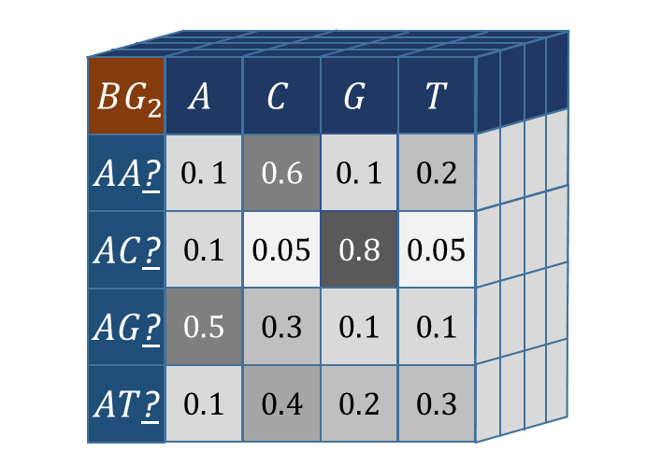
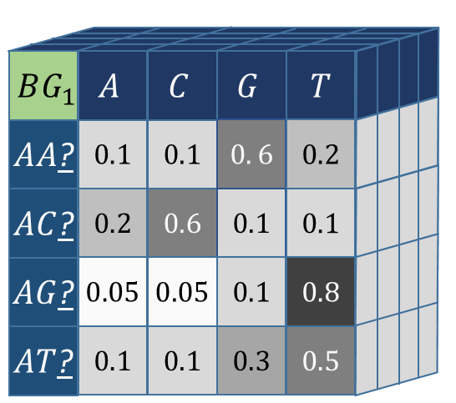

Background States Emission Probability ($E$)
Hidden State Machine
Start Probability ($π)$
$$0.5$$
$$0.05$$
$$0.0$$
$$0.05$$
$$BG_{1}$$
$$BG_{2}$$
$$TF_{1}^{1}$$
$$…$$
$$TF_{3}^{2}$$
$$0.1$$
$$0.8$$
$$BG_{1}$$
$$TF_{1}^{1}$$
$$TF_{2}^{1}$$
$$TF_{3}^{1}$$
$$0.5$$
$$0.5$$
$$FIXED$$
$$FIXED$$
$$0$$
$$…$$
$$0$$
$$1$$
$$G$$
$$T$$
$$A$$
$$C$$
Transition Probability ($T,G$)
$$0.5$$
$$T$$
$$G$$
$$BG_{2}$$
$$TF_{1}^{2}$$
$$TF_{2}^{2}$$
$$TF_{3}^{2}$$
$$to$$
$$BG_{1}$$
$$BG_{2}$$
$$TF_{1}^{∗}$$
$$TF_{2}^{∗}$$
$$TF_{3}^{∗}$$
$$0.8$$
$$from$$
$$0.1$$
$$1$$
$$G$$
$$T$$
$$BG_{1}$$
$$0.8$$
$$0.1$$
$$0.05$$
$$0.05$$
$$0.0$$
$$A$$
$$C$$
$$BG_{2}$$
$$0. 1$$
$$0.8$$
$$0.0$$
$$0.0$$
$$0.1$$
$$Order=3$$
$$BG_{2}$$
$$BG_{2}$$
$$BG_{1}$$
$$BG_{1}$$
$$BG_{1}$$
$$TF_{1}^{1}$$
$$BG_{1}$$
$$BG_{1}$$
$$BG_{1}$$
$$BG_{1}$$
$$TF_{2}^{1}$$
$$BG_{1}$$
$$BG_{1}$$
$$BG_{2}$$
$$BG_{2}$$
Hidden
$$A$$
$$A$$
$$C$$
$$T$$
$$T$$
$$A$$
$$T$$
$$T$$
$$A$$
$$A$$
$$A$$
$$C$$
$$T$$
$$T$$
$$C$$
$$C$$
$$A$$
$$C$$
$$G$$
$$T$$
$$G$$
$$C$$
$$G$$
$$A$$
$$A$$
Observed

Slide 12





Background States Emission Probability ($E$)
Hidden State Machine
Start Probability ($π)$
$$0.5$$
$$0.05$$
$$0.0$$
$$0.05$$
$$BG_{1}$$
$$BG_{2}$$
$$TF_{1}^{1}$$
$$…$$
$$TF_{3}^{2}$$
$$0.1$$
$$0.8$$
$$BG_{1}$$
$$TF_{1}^{1}$$
$$TF_{2}^{1}$$
$$TF_{3}^{1}$$
$$0.5$$
$$0.5$$
$$FIXED$$
$$FIXED$$
$$0$$
$$…$$
$$0$$
$$1$$
$$G$$
$$T$$
$$A$$
$$C$$
Transition Probability ($T,G$)
$$0.5$$
$$T$$
$$G$$
$$BG_{2}$$
$$TF_{1}^{2}$$
$$TF_{2}^{2}$$
$$TF_{3}^{2}$$
$$to$$
$$BG_{1}$$
$$BG_{2}$$
$$TF_{1}^{∗}$$
$$TF_{2}^{∗}$$
$$TF_{3}^{∗}$$
$$0.8$$
$$from$$
$$0.1$$
$$1$$
$$G$$
$$T$$
$$BG_{1}$$
$$0.8$$
$$0.1$$
$$0.05$$
$$0.05$$
$$0.0$$
$$A$$
$$C$$
$$BG_{2}$$
$$0. 1$$
$$0.8$$
$$0.0$$
$$0.0$$
$$0.1$$
$$P\left(x_{t}=T | y_{t}=BG_{1},x_{t−1,t−2}=AC\right)$$
$$BG_{2}$$
$$BG_{2}$$
$$BG_{1}$$
$$BG_{1}$$
$$BG_{1}$$
$$TF_{1}^{1}$$
$$BG_{1}$$
$$BG_{1}$$
$$BG_{1}$$
$$BG_{1}$$
$$TF_{2}^{1}$$
$$BG_{1}$$
$$BG_{1}$$
$$BG_{2}$$
$$BG_{2}$$
Hidden
$$A$$
$$A$$
$$C$$
$$T$$
$$T$$
$$A$$
$$T$$
$$T$$
$$A$$
$$A$$
$$A$$
$$C$$
$$T$$
$$T$$
$$C$$
$$C$$
$$A$$
$$C$$
$$G$$
$$T$$
$$G$$
$$C$$
$$G$$
$$A$$
$$A$$
Observed

Slide 13
Posterior Probability

Slide 14
Posterior Probability
What is it?
Calculation
HOP-HMM Adaptations

Slide 15
































Posterior Probability- What is it?
$$x_{1:L}$$
$$C$$
$$A$$
$$C$$
$$G$$
$$T$$
$$G$$
$$T$$
$$T$$
$$A$$
$$G$$
$$A$$
$$T$$
$$T$$
$$A$$
$$A$$
$$G$$
$$C$$
$$A$$
$$C$$
$$G$$
$$T$$
$$G$$
$$T$$
$$A$$
$$A$$
$$G$$
$$C$$
$$A$$
$$C$$
$$G$$
$$T$$
$$G$$

Slide 16
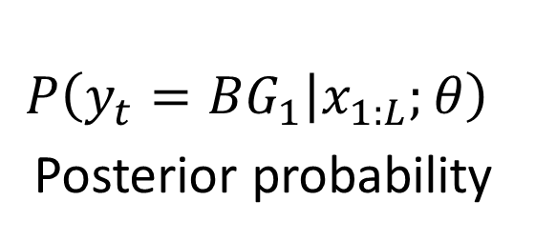


Posterior Probability- What is it?
$$x_{1:L}$$
$$C$$
$$A$$
$$C$$
$$G$$
$$T$$
$$G$$
$$T$$
$$T$$
$$A$$
$$G$$
$$A$$
$$T$$
$$T$$
$$A$$
$$A$$
$$G$$
$$C$$
$$A$$
$$C$$
$$G$$
$$T$$
$$G$$
$$T$$
$$A$$
$$A$$
$$G$$
$$C$$
$$A$$
$$C$$
$$G$$
$$T$$
$$G$$
$$P$$
$$P\left(y_{t}=BG_{1} | x_{1:L};θ\right)$$
Posterior probability
$$t$$

Slide 17
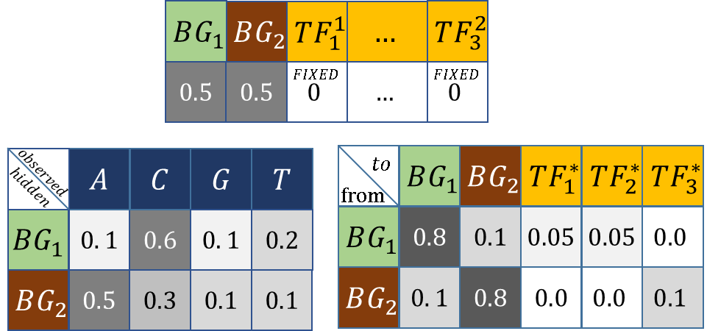
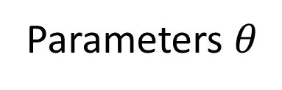
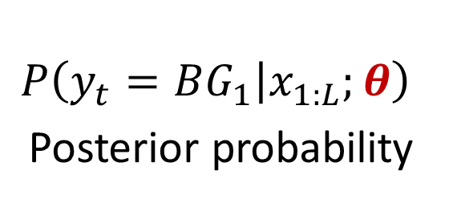
Posterior Probability- What is it?
$$x_{1:L}$$
$$C$$
$$A$$
$$C$$
$$G$$
$$T$$
$$G$$
$$T$$
$$T$$
$$A$$
$$G$$
$$A$$
$$T$$
$$T$$
$$A$$
$$A$$
$$G$$
$$C$$
$$A$$
$$C$$
$$G$$
$$T$$
$$G$$
$$T$$
$$A$$
$$A$$
$$G$$
$$C$$
$$A$$
$$C$$
$$G$$
$$T$$
$$G$$
Given:
$$P$$
Parameters $θ$
$$P\left(y_{t}=BG_{1} | x_{1:L};θ\right)$$
Posterior probability
$$t$$

Slide 18
Posterior Probability
$$P\left(y_{t}=BG_{1} | x_{1:L};θ\right)$$
Posterior probability

Slide 19
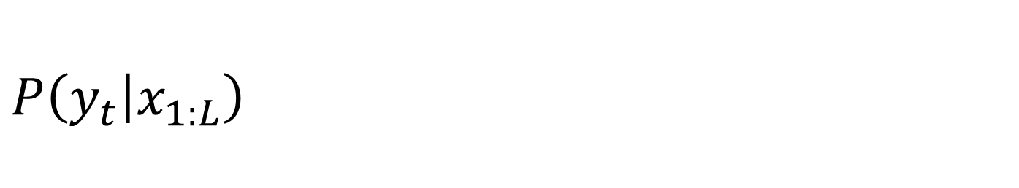
Posterior Probability - Calculation
$$P\left(y_{t} | x_{1:L}\right)$$

Slide 20
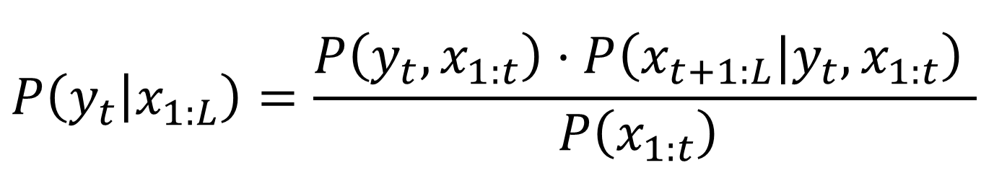
Posterior Probability - Calculation
$$P\left(y_{t} | x_{1:L}\right)=\frac{P\left(y_{t},x_{1:t}\right)⋅P\left({x_{t+1:L}|y}_{t},x_{1:t}\right) }{P\left(x_{1:t}\right) }$$

Slide 21

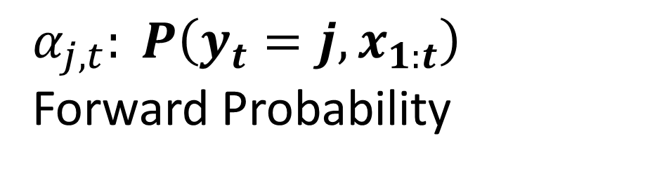
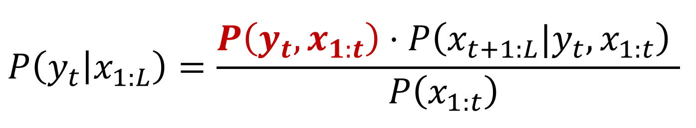



Posterior Probability - Calculation
$$P\left(y_{t} | x_{1:L}\right)=\frac{P\left(y_{t},x_{1:t}\right)⋅P\left({x_{t+1:L}|y}_{t},x_{1:t}\right) }{P\left(x_{1:t}\right) }$$
Forward Algorithm
$α_{j,t}: P\left(y_{t}=j,x_{1:t}\right)$ Forward Probability
$$t\text{−}1$$
$$t$$
$$α_{j,t}$$
$$j$$

Slide 22
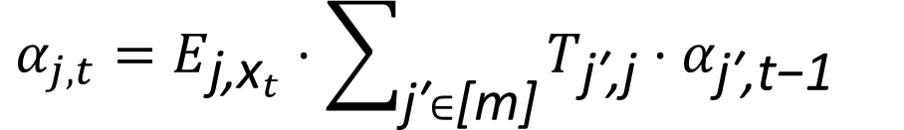
Posterior Probability - Calculation
$$P\left(y_{t} | x_{1:L}\right)=\frac{P\left(y_{t},x_{1:t}\right)⋅P\left({x_{t+1:L}|y}_{t},x_{1:t}\right) }{P\left(x_{1:t}\right) }$$
Forward Algorithm
$α_{j,t}: P\left(y_{t}=j,x_{1:t}\right)$ Forward Probability
$$t\text{−}1$$
$$t$$
$$α_{j,t}$$
$$j$$
$$α_{j,t}=E_{{\text{j}\text{,}\text{x}}_{t}}⋅\sum_{\text{j}\text{′}∈\text{[}\text{m}\text{]}}{T_{\text{j}\text{′}\text{,}\text{j}}⋅α_{\text{j}\text{′}\text{,}\text{t}\text{−}\text{1}}}$$

Slide 23


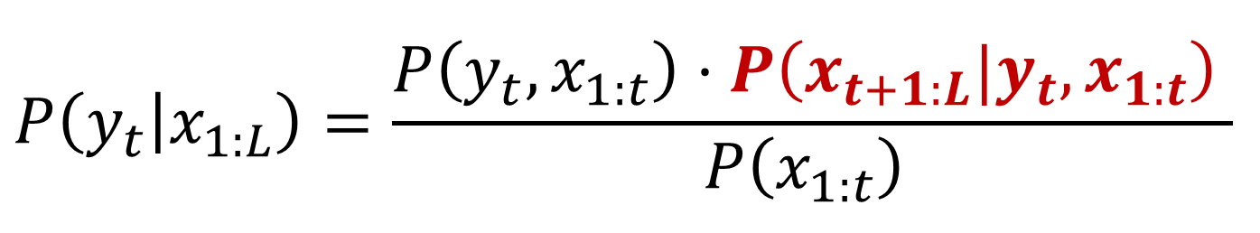



Posterior Probability - Calculation
$$P\left(y_{t} | x_{1:L}\right)=\frac{P\left(y_{t},x_{1:t}\right)⋅P\left({x_{t+1:L}|y}_{t},x_{1:t}\right) }{P\left(x_{1:t}\right) }$$
Backward Algorithm
$$β_{j,t}:P\left({x_{t+1:L}|y}_{t}\right)$$
Backward Probability
$$t$$
$$t\text{+}1$$
$$β_{j,t}$$
$$j$$

Slide 24
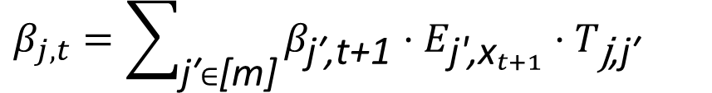
Posterior Probability - Calculation
$$P\left(y_{t} | x_{1:L}\right)=\frac{P\left(y_{t},x_{1:t}\right)⋅P\left({x_{t+1:L}|y}_{t},x_{1:t}\right) }{P\left(x_{1:t}\right) }$$
Backward Algorithm
$$β_{j,t}:P\left({x_{t+1:L}|y}_{t}\right)$$
Backward Probability
$$t$$
$$t\text{+}1$$
$$β_{j,t}$$
$$j$$
$$β_{j,t}=\sum_{\text{j}\text{′}∈\text{[}\text{m}\text{]}}{β_{\text{j}\text{′}\text{,}\text{t}\text{+}\text{1}}⋅E_{{\text{j}\text{′}\text{,}\text{x}}_{t+1}}⋅T_{\text{j}\text{,}\text{j}\text{′}}}$$

Slide 25






Posterior Probability
$$BG_{1}$$
$$BG_{1}$$
$$BG_{1}$$
$$BG_{1}$$
$$BG_{1}$$
$$BG_{1}$$
$$C$$
$$T$$
$$A$$
$$C$$
$$T$$
$$T$$
$$P\left(y_{t} | x_{1:L}\right)=\frac{P\left(y_{t},x_{1:t}\right)⋅P\left({x_{t+1:L}|y}_{t},x_{1:t}\right) }{P\left(x_{1:t}\right) }$$
Backward Algorithm
$$β_{j,t}:P\left({x_{t+1:L}|y}_{t}\right)$$
Backward Probability
$$t$$
$$t\text{+}1$$
$$β_{j,t}$$
$$j$$
$$β_{j,t}=\sum_{\text{j}\text{′}∈\text{[}\text{m}\text{]}}{β_{\text{j}\text{′}\text{,}\text{t}\text{+}\text{1}}⋅E_{{\text{j}\text{′}\text{,}\text{x}}_{t+1}}⋅T_{\text{j}\text{,}\text{j}\text{′}}}$$

Slide 26
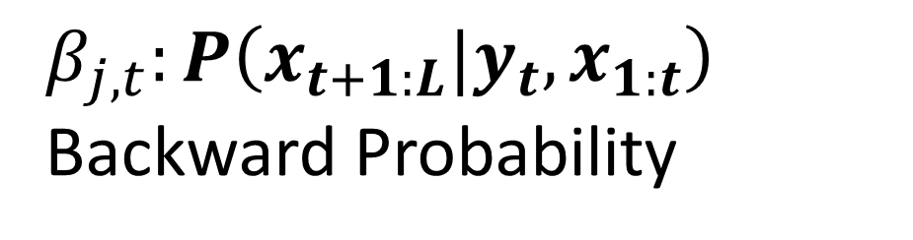
Posterior Probability (HOP-HMM)
$$BG_{1}$$
$$BG_{1}$$
$$BG_{1}$$
$$BG_{1}$$
$$BG_{1}$$
$$BG_{1}$$
$$C$$
$$T$$
$$A$$
$$C$$
$$T$$
$$T$$
$$P\left(y_{t} | x_{1:L}\right)=\frac{P\left(y_{t},x_{1:t}\right)⋅P\left({x_{t+1:L}|y}_{t},x_{1:t}\right) }{P\left(x_{1:t}\right) }$$
Backward Algorithm
$$β_{j,t}:P\left({x_{t+1:L}|y}_{t},x_{1:t}\right)$$
Backward Probability
$$t$$
$$t\text{+}1$$
$$β_{j,t}$$
$$j$$
$$β_{j,t}=\sum_{\text{j}\text{′}∈\text{[}\text{m}\text{]}}{β_{\text{j}\text{′}\text{,}\text{t}\text{+}\text{1}}⋅E_{{\text{j}\text{′}\text{,}\text{x}}_{t+1}}⋅T_{\text{j}\text{,}\text{j}\text{′}}}$$

Slide 27
Posterior Probability (HOP-HMM)
$$BG_{1}$$
$$BG_{1}$$
$$BG_{1}$$
$$BG_{1}$$
$$BG_{1}$$
$$BG_{1}$$
$$C$$
$$T$$
$$A$$
$$C$$
$$T$$
$$T$$
$$P\left(y_{t} | x_{1:L}\right)=\frac{P\left(y_{t},x_{1:t}\right)⋅P\left({x_{t+1:L}|y}_{t},x_{1:t}\right) }{P\left(x_{1:t}\right) }$$
Backward Algorithm
$$β_{j,t}:P\left({x_{t+1:L}|y}_{t},x_{1:t}\right)$$
Backward Probability
$$t$$
$$t\text{+}1$$
$$β_{j,t}$$
$$j$$
$$β_{j,t}=\sum_{\text{j}\text{′}∈\text{[}\text{m}\text{]}}{β_{\text{j}\text{′}\text{,}\text{t}\text{+}\text{1}}⋅E_{{\text{j}\text{′}\text{,}\text{x}}_{t+1}}⋅T_{\text{j}\text{,}\text{j}\text{′}}}$$

Slide 28


















Forward Algorithm
$$t\text{−}|W_{1}|\text{−}1$$
$$t\text{−}|W_{2}|\text{−}1$$
$$t$$
$$t\text{−}1$$
$$t$$
$$α_{j,t}$$
$$j$$
$$α_{j,t}$$
$$j$$
Backward Algorithm
$$t$$
$$t\text{−}|W_{2}|\text{−}1$$
$$t\text{−}|W_{1}|\text{−}1$$
$$t$$
$$t\text{+}1$$
$$β_{j,t}$$
$$j$$
$$β_{j,t}$$
$$j$$

Slide 29
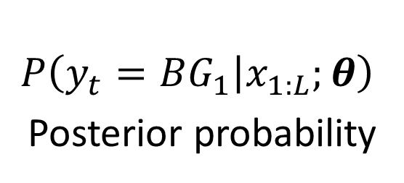
EM (Baum-Welch)
$$x_{1:L}$$
$$C$$
$$A$$
$$C$$
$$G$$
$$T$$
$$G$$
$$T$$
$$T$$
$$A$$
$$G$$
$$A$$
$$T$$
$$T$$
$$A$$
$$A$$
$$G$$
$$C$$
$$A$$
$$C$$
$$G$$
$$T$$
$$G$$
$$T$$
$$A$$
$$A$$
$$G$$
$$C$$
$$A$$
$$C$$
$$G$$
$$T$$
$$G$$
E-step
M-step
$$P$$
$$P\left(y_{t}=BG_{1} | x_{1:L};θ\right)$$
Posterior probability
$$t$$
Parameters $θ$

Slide 30
EM (Baum-Welch)
$$x_{1:L}$$
$$C$$
$$A$$
$$C$$
$$G$$
$$T$$
$$G$$
$$T$$
$$T$$
$$A$$
$$G$$
$$A$$
$$T$$
$$T$$
$$A$$
$$A$$
$$G$$
$$C$$
$$A$$
$$C$$
$$G$$
$$T$$
$$G$$
$$T$$
$$A$$
$$A$$
$$G$$
$$C$$
$$A$$
$$C$$
$$G$$
$$T$$
$$G$$
E-step
M-step
$$P$$
$$P\left(y_{t}=BG_{1} | x_{1:L};θ\right)$$
Posterior probability
$$t$$
Parameters $θ$

Slide 31
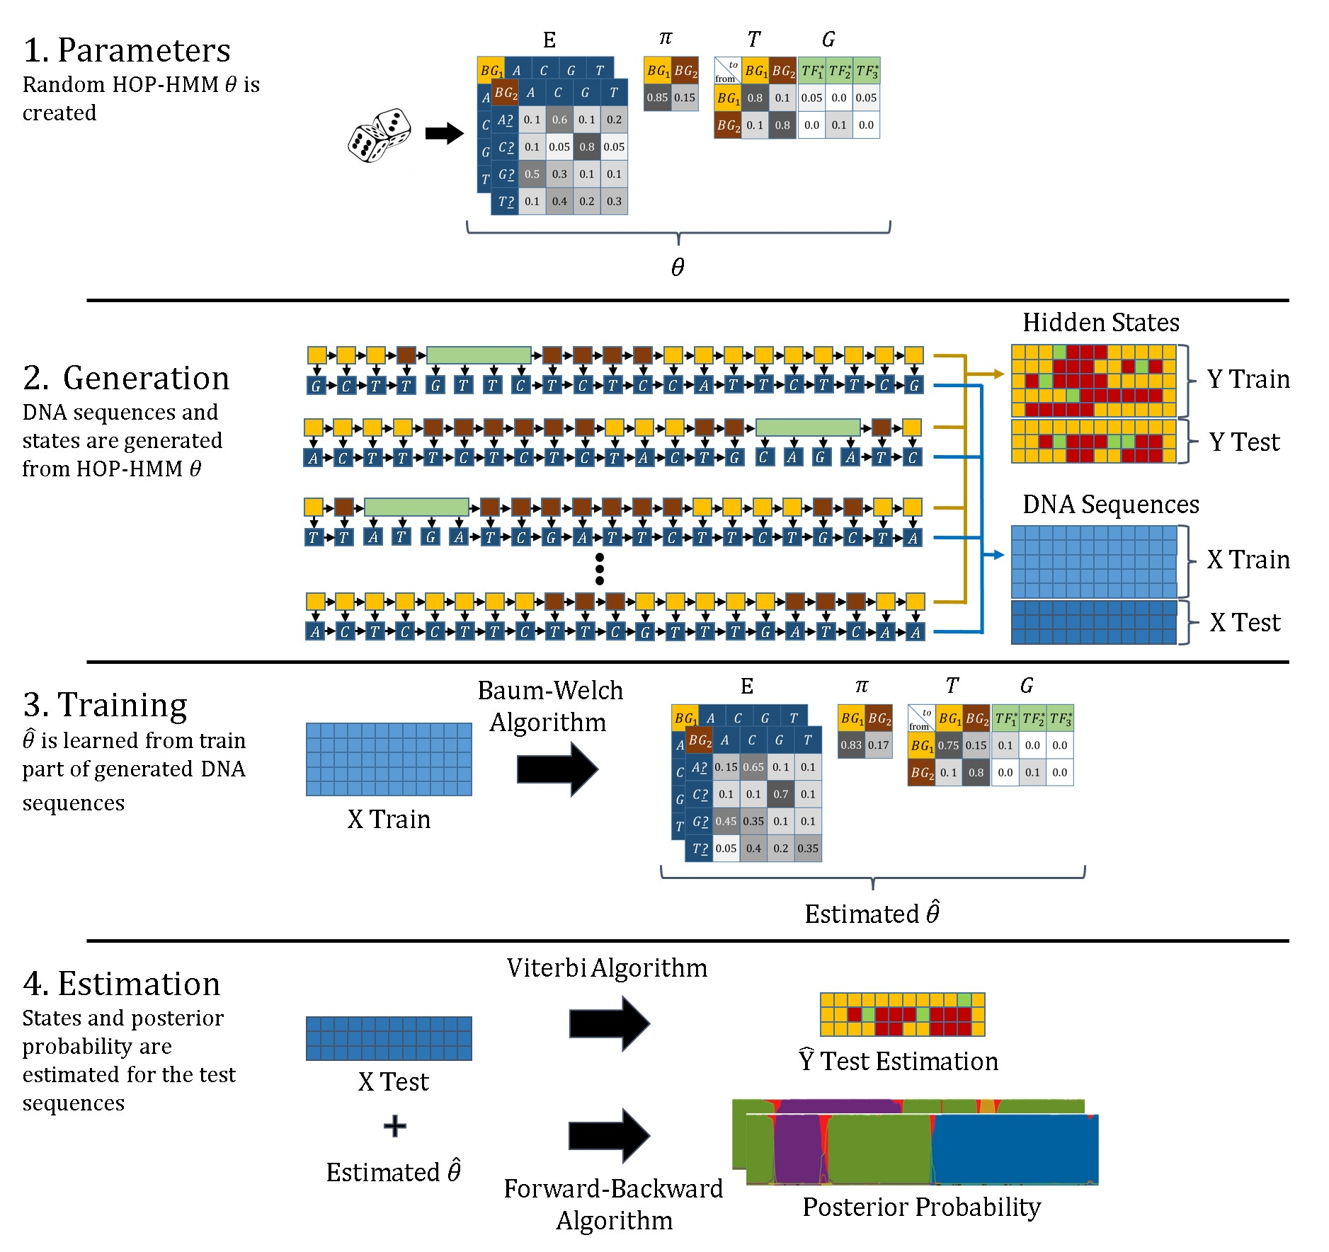

Slide 32
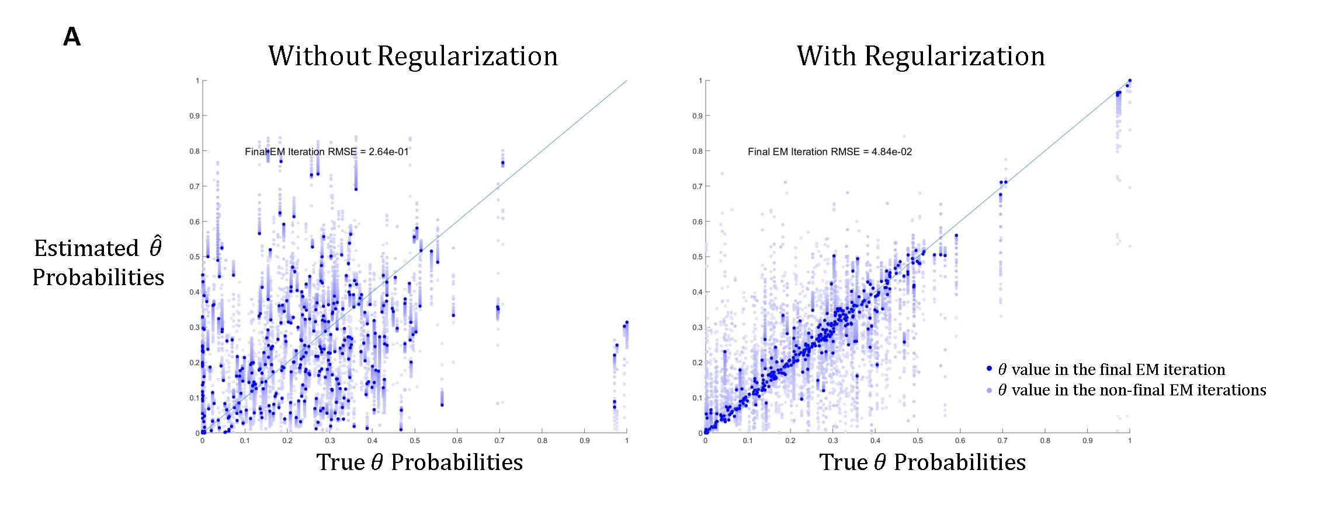
EM Regularization

Slide 33
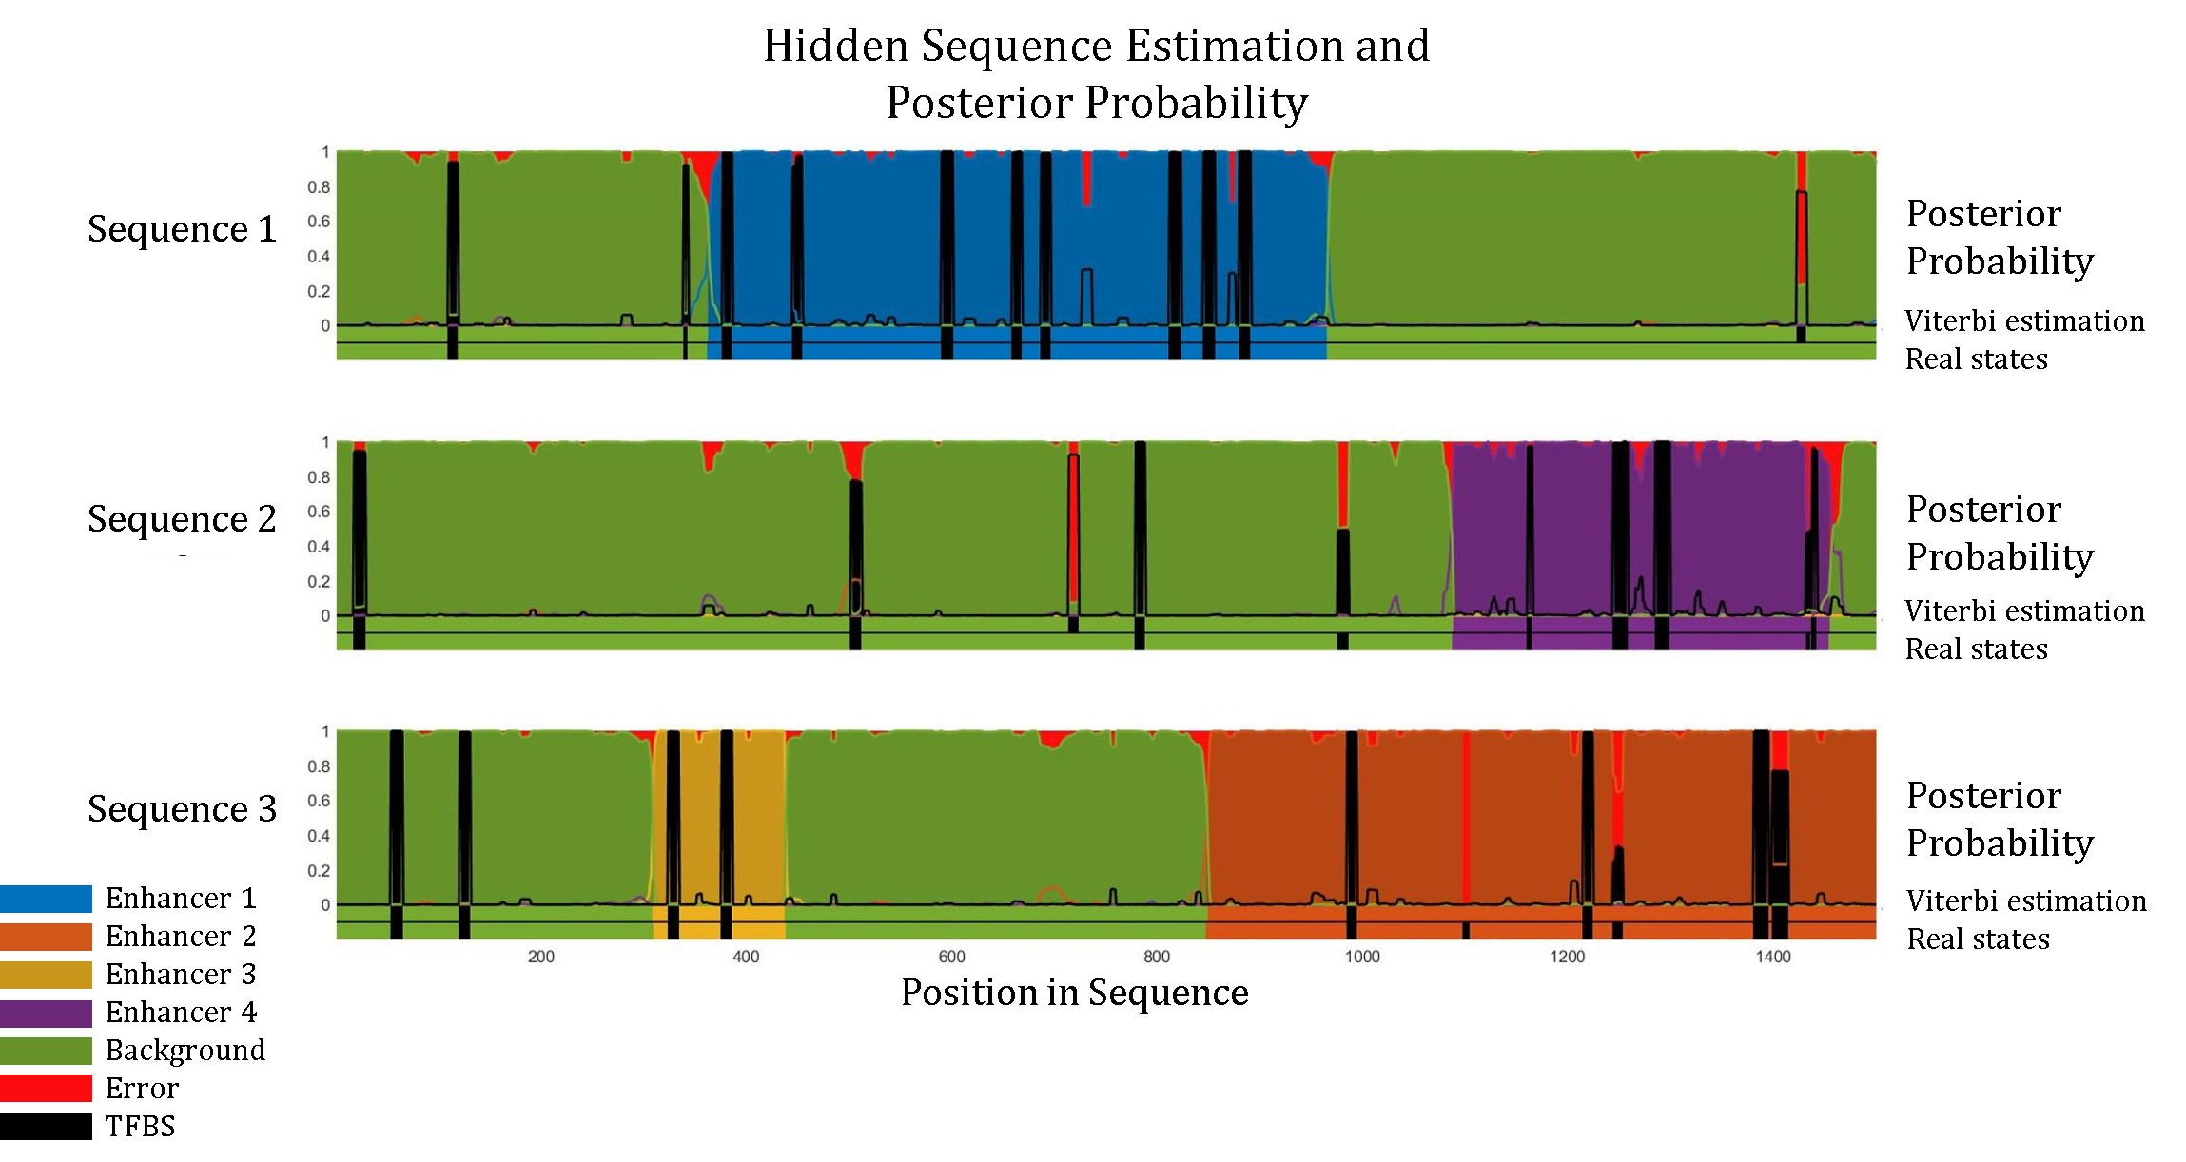

Slide 34
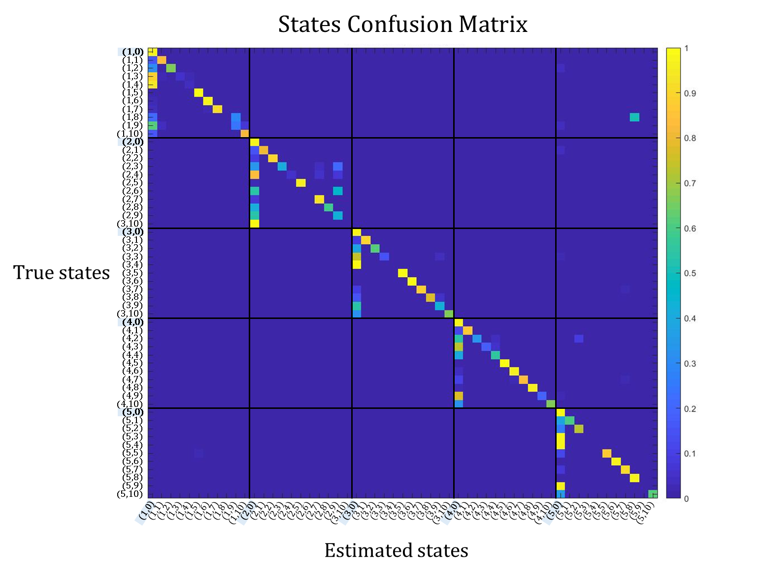

Slide 35
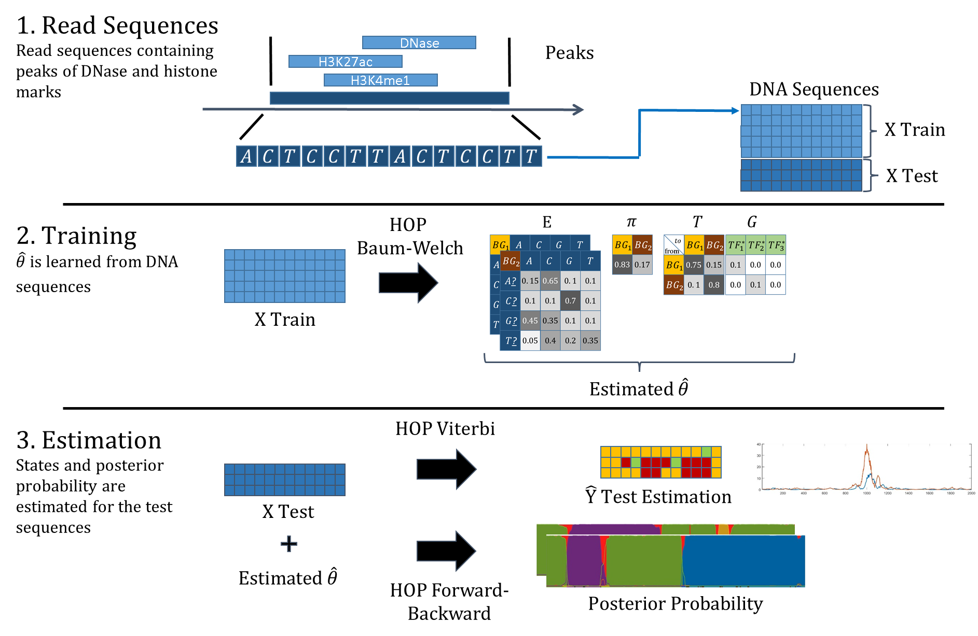

Slide 36
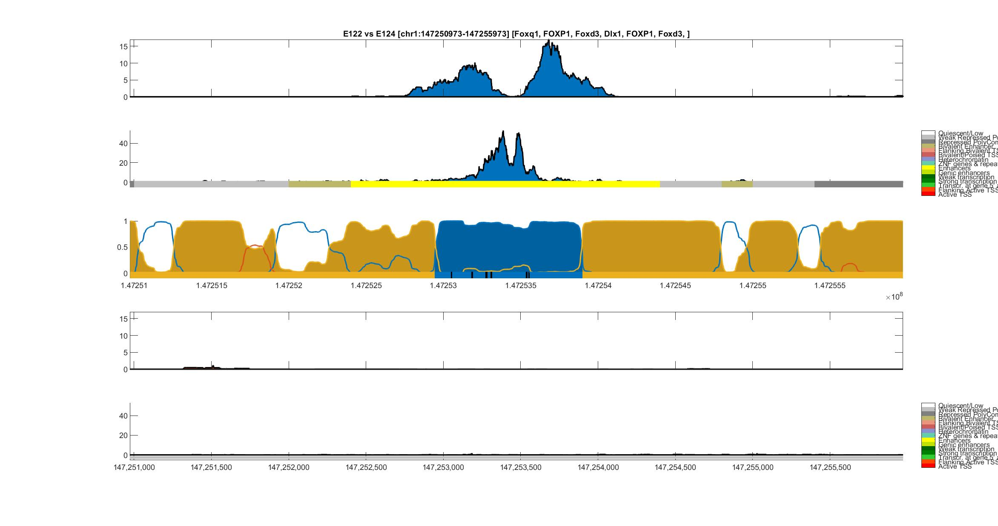
Umbilical Vein Endothelial (E122) vs Monocyte (E124)
H3K27ac
Umbilical Vein
Endothelial
DNase-I
ChromHMM
HOP-HMM
Prediction
Posterior
Probability
Viterbi Path
H3K27ac
Monocyte
DNase-I
ChromHMM
hg19:chr1

Slide 37
Umbilical Vein Endothelial (E122) vs Monocyte (E124)
H3K27ac
Umbilical Vein
Endothelial
DNase-I
ChromHMM
HOP-HMM
Prediction
Posterior
Probability
FOXQ1
FOXD3
FOXD3
Viterbi Path
FOXP1
DIX1
FOXP1
H3K27ac
Monocyte
DNase-I
ChromHMM
hg19:chr1

Slide 38
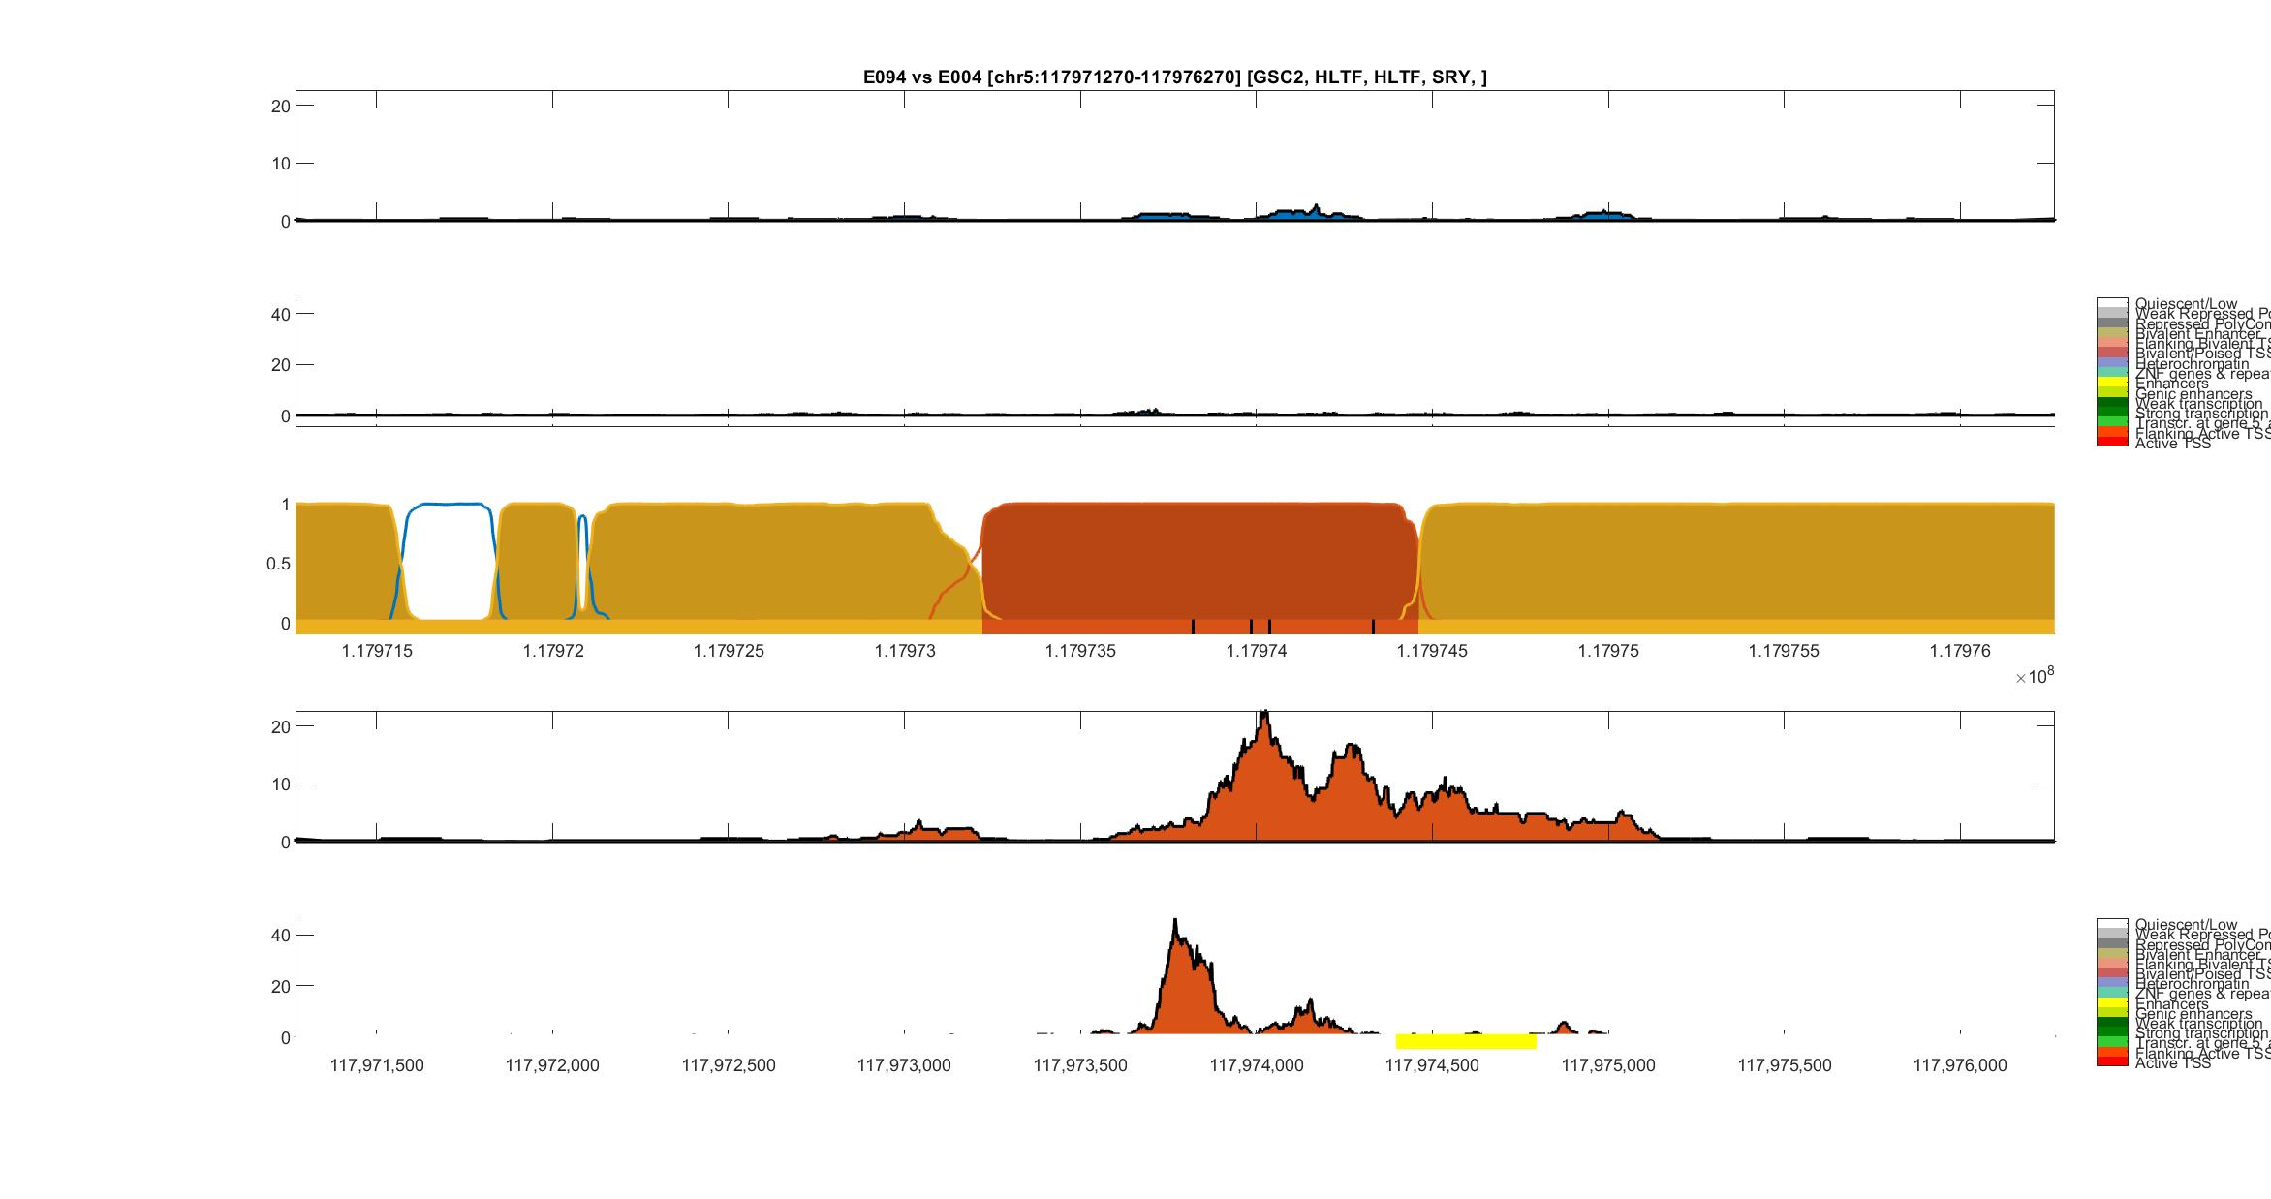
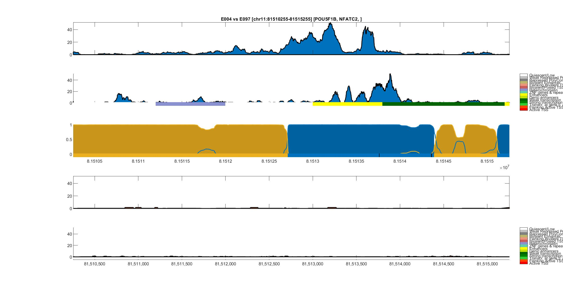
Gastric (E094) vs Mesendoderm (E004)
H3K27ac
Gastric
DNase-I
ChromHMM
HOP-HMM
Prediction
Posterior Prob.
GSC2
HLTF
HLTF
SRY
Viterbi Path
H3K27ac
Mesendoderm
DNase-I
ChromHMM
hg19:chr5

Slide 39
Mesendoderm (E004) vs Ovary (E097)
H3K27ac
Mesendoderm
DNase-I
ChromHMM
HOP-HMM Prediction
Posterior Probability
POU5F1B
NFATC2
Viterbi Path
H3K27ac
Ovary
DNase-I
ChromHMM
hg19:chr11
HOP-HMM Legend
Mesendoderm State
Ovary State
Background State
Transcription Factor States

