Slide 1
High-Order and PWM Based Hidden Markov Model (HOP-HMM)

Slide 2
Part 1: Background
Generative Models
HMM
Baum-Welch Algorithm

Slide 3
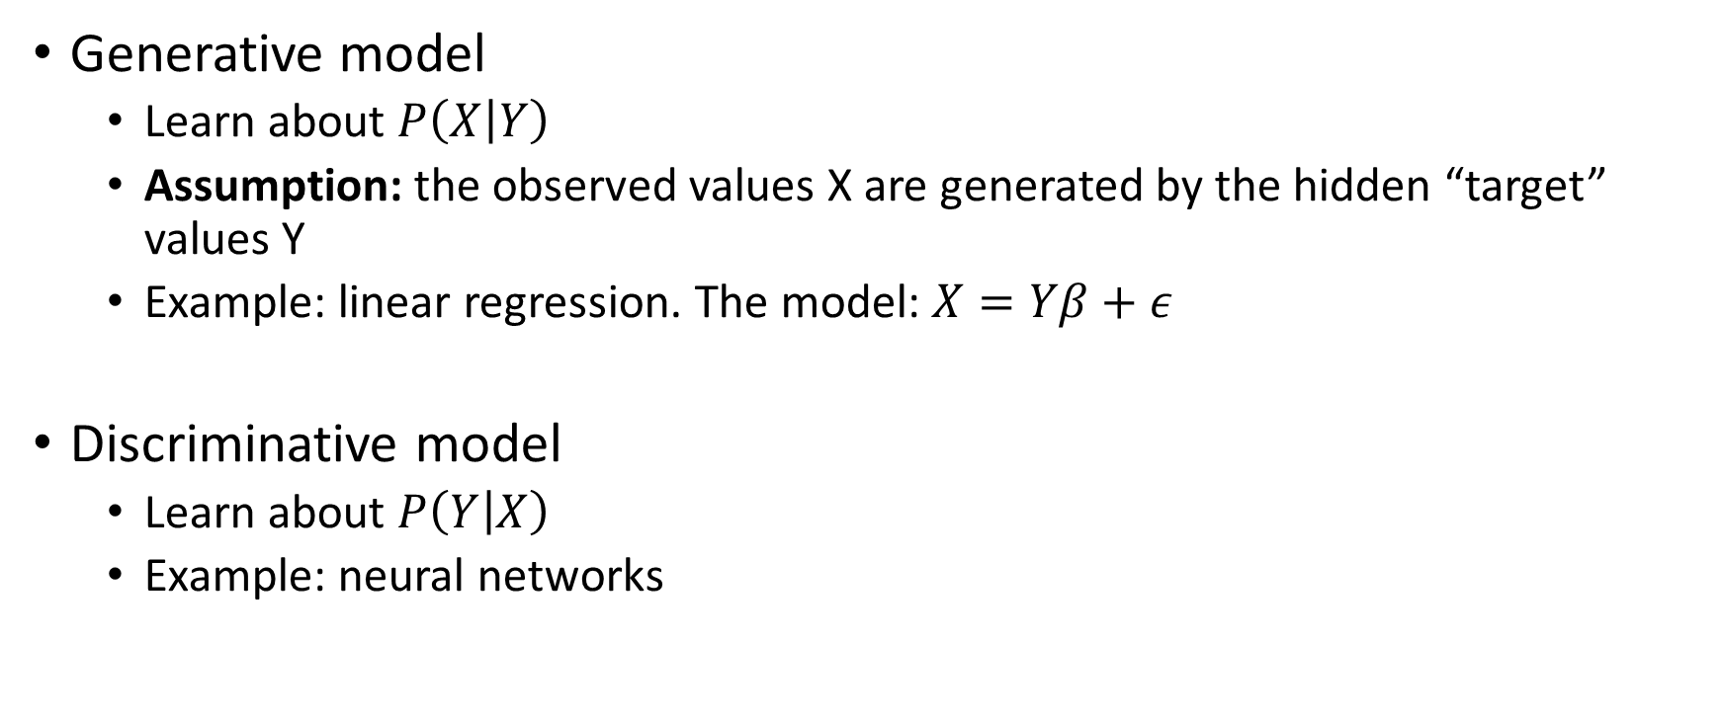
Generative vs Discriminative Models
Generative model
Learn about $P\left(X | Y\right)$
Assumption: the observed values X are generated by the hidden “target” values Y
Example: linear regression. The model: $X=Yβ+ε$
Discriminative model
Learn about $P\left(Y | X\right)$
Example: neural networks

Slide 4
Hidden Markov Model (HMM)
Ge
Ge
En
En
En
Ge
Hidden States (Y)
A
G
C
A
T
T
Observations (X)

Slide 5

Emission Distribution (E)
$E_{ij}=P(x_{t}=j|y_{t}=i)$
 | A | C | G | T
En | 0.23 | 0.22 | 0.27 | 0.28
Ge | 0.33 | 0.32 | 0.01 | 0.33
Ge
Ge
En
En
En
Ge
Hidden States (Y)
A
G
C
A
T
T
Observations (X)

Slide 6

Transition Distribution (T)
 | En | Ge
En | 0.90 | 0.10
Ge | 0.05 | 0.95
$T_{ij}=P(y_{t}=j|y_{t−1}=i)$
Ge
Ge
En
En
En
Ge
Hidden States (Y)
A
G
C
A
T
T
Observations (X)

Slide 7


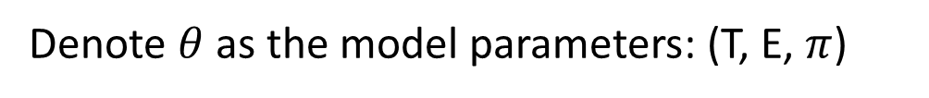
Starting Hidden State ($π$)
En | 0.60
Ge | 0.40
$π_{i}=P(y_{1}=j)$
Ge
Ge
En
En
En
Ge
Hidden States (Y)
A
G
C
A
T
T
Observations (X)
Denote $θ$ as the model parameters: (T, E, $π$)

Slide 8
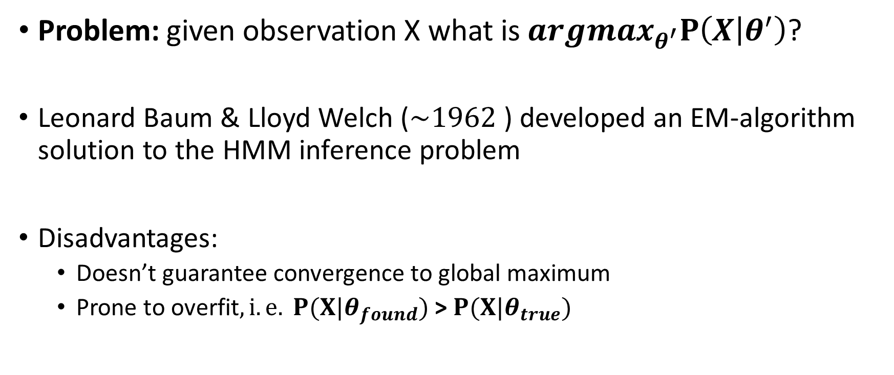
Baum-Welch Algorithm
Problem: given observation X what is $argmax_{θ^{′}}P\left(X | θ^{′}\right)$?
Leonard Baum & Lloyd Welch ($\sim 1962$) developed an EM-algorithm solution to the HMM inference problem
Disadvantages:
Doesn’t guarantee convergence to global maximum
Prone to overfit$, i.e. P(X|θ_{found})$ > $P(X|θ_{true})$

Slide 9
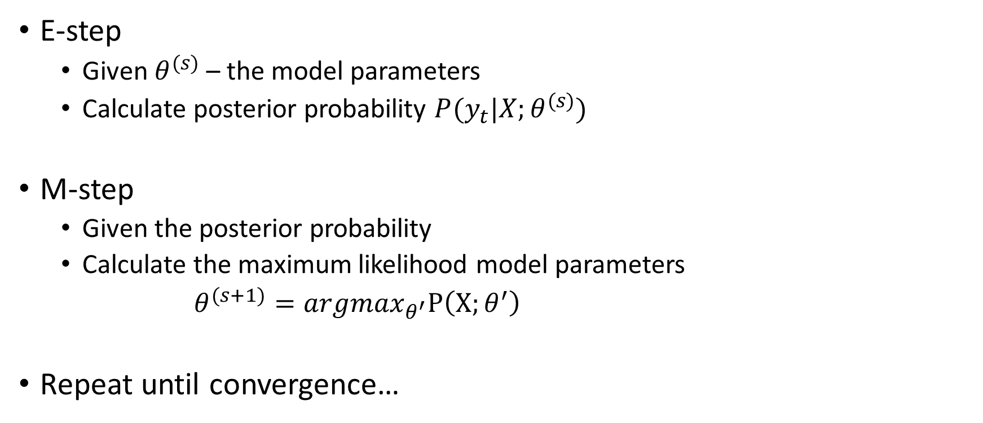
Baum-Welch Algorithm
E-step
Given $θ^{(s)}$ – the model parameters
Calculate posterior probability $P(y_{t}|X;θ^{(s)})$
M-step
Given the posterior probability
Calculate the maximum likelihood model parameters
$θ^{(s+1)}=argmax_{θ^{′}}P\left(X;θ^{′}\right)$
Repeat until convergence…

Slide 10

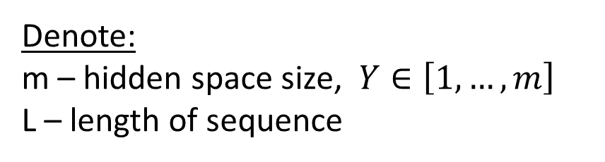




E-step - Forward Algorithm
$$α_{j,t}=P\left(y_{t}=j,x_{1},…{,x}_{t}\right)$$
Dynamic programming:
$$α_{j,t}=\sum_{i=1}^{m}{α_{i,t−1}⋅T_{i,j}⋅E_{j,x_{t}}}$$
$$α_{j,1}=π_{j}⋅E_{j,x_{1}}$$
$t$-1
$$t$$
$$j$$
$$α_{j,t}$$
Denote:
m – hidden space size, $Y∈\left[1,…,m\right]$
L – length of sequence

Slide 11





E-step - Backwards Algorithm
$$β_{j,t}=P\left(y_{t}=j,x_{t+1},…{,x}_{L}\right)$$
Dynamic programming:
$$β_{j,t−1}=\sum_{i=1}^{m}{β_{i,t}⋅T_{j,i}⋅E_{i,x_{t}}}$$
$$β_{j,L}=1/m$$
$$t$$
$t$+1
$$j$$
$$β_{j,t}$$
Denote:
m – hidden space size, $Y∈\left[1,…,m\right]$
L – length of sequence

Slide 12
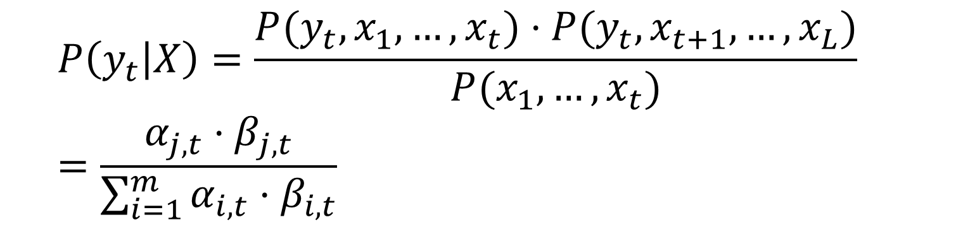
Posterior Probability
$$P\left(y_{t} | X\right)=\frac{P(y_{t},x_{1},…,x_{t})⋅P(y_{t},x_{t+1},…,x_{L})}{P(x_{1},…,x_{t})}$$
$$=\frac{α_{j,t}⋅β_{j,t}}{\sum_{i=1}^{m}{α_{i,t}⋅β_{i,t}}}$$
On the board:
M-step

Slide 13
Part 2: HOP-HMM
Enhancers and ML previous work
HOP-HMM
“HOP-Baum-Welch Algorithm”

Slide 14
Enhancers Sequences Separation
Motifs enrichment
Neph s. et al. Nature, 2012
Kheradpour et al. Genome Research, 2013
K-mer frequencies
Inbar’s master with Tommy
kmer-SVM: Beer M. et al. Genome Research, 2011
Other complex features
DeepSEA: Troyanskaya O. et al. Nature, 2015
Basset: Rinn J. et al. Genome Research, 2016

Slide 15


Slide 16
HMM
Ge
Ge
En
En
En
Ge
Hidden States (Y)
A
G
C
A
T
T
Observations (X)

Slide 17
HMM
Hidden states can change freely
Ge
Ge
En
En
En
Ge
Hidden States (Y)
A
G
C
A
T
T
Observations (X)

Slide 18

HMM $→$ HOP-HMM
Hidden states transition options
Ge
En
EnFl
Pro
Tel
Flnk

Slide 19
HMM $→$ HOP-HMM
Base States
Sub States
Hidden states transition options
(1,0)
(1,1)
(1,2)
(1,3)
(1,n)
Ge
En
(2,0)
(2,1)
(2,2)
(2,3)
(2,n)
EnFl
Pro
(3,0)
(3,1)
(3,2)
(3,3)
(3,n)
Tel
Flnk
(m,0)
(m,1)
(m,2)
(m,3)
(m,n)

Slide 20
HMM
Emission depends only on hidden state
Ge
Ge
En
En
En
Ge
Hidden States (Y)
A
G
C
A
T
T
Observations (X)

Slide 21
HMM $→$ HOP-HMM
Base-states emission depends on hidden state and k previous observations
Base-State
(j,0)
Hidden States (Y)
A
G
C
A
T
T
Observations (X)
k=3

Slide 22
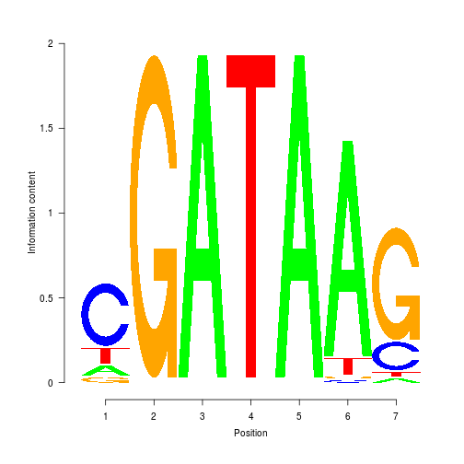
HMM $→$ HOP-HMM
Sub-states emission: PWM
Base-State
Sub-State (PWM)
Base-State
(j,0)
(j,l)
(j,0)
Hidden States (Y)
A
C
G
A
T
A
A
G
T
Observations (X)

Slide 23
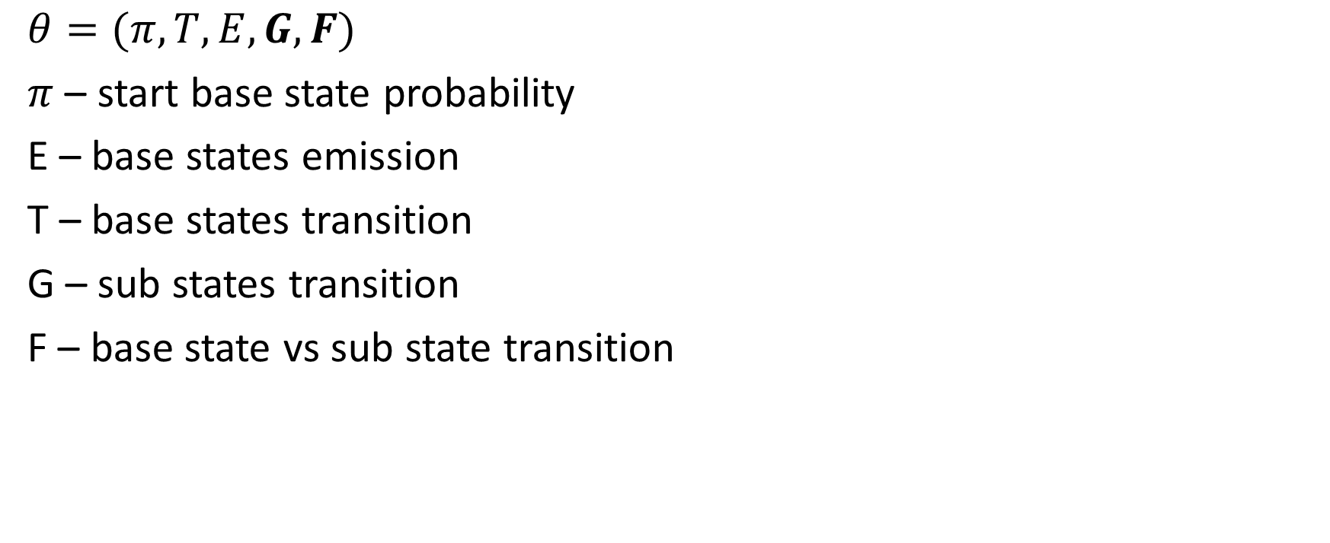
Model Parameters
Base States
Sub States
$$θ=(π, T,E,G,F)$$
$π$ – start base state probability
E – base states emission
T – base states transition
G – sub states transition
F – base state vs sub state transition
(1,0)
(1,1)
(1,2)
(1,3)
(1,n)
(2,0)
(2,1)
(2,2)
(2,3)
(2,n)
(3,0)
(3,1)
(3,2)
(3,3)
(3,n)
(m,0)
(m,1)
(m,2)
(m,3)
(m,n)

Slide 24
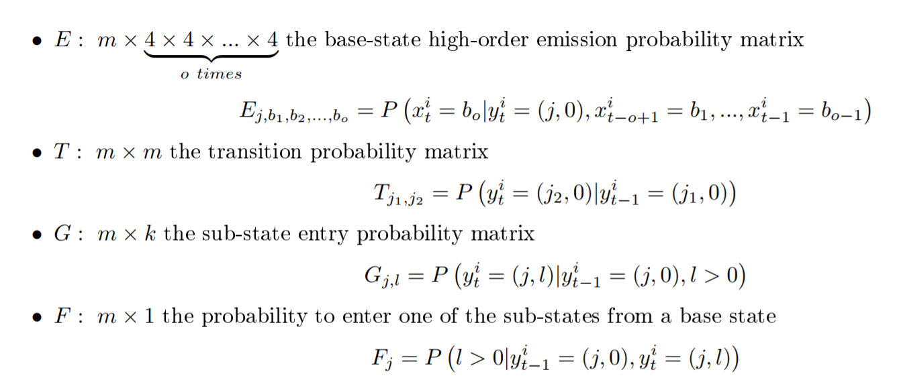
Model Parameters

Slide 25
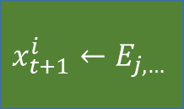



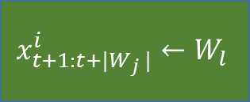

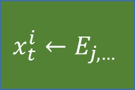


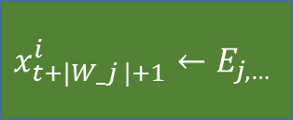



$$y_{t+1:t+\left|W_{j}\right|}^{i}$$
$$y_{t+\left|W_{j}\right|+1}^{i}$$
(j,l)
(j,0)
$$l←G_{j,∗}$$
$$φ=1$$
$$y_{t}^{i}$$
(j,0)
$$φ\sim Bin(F_{j},1)$$
$$x_{t+1:t+|W_{j} |}^{i}←W_{l}$$
$$x_{t+|W_j |+1}^{i}←E_{j,…}$$
$$y_{t+1}^{i}$$
$$φ=0$$
$$x_{t}^{i}←E_{j,…}$$
(j’,0)
$$j′←T_{j,∗}$$
$$x_{t+1}^{i}←E_{j,…}$$

Slide 26









E-step - HOP Forward Algorithm
$$t−|W_{2}|−1$$
$$t$$
$t$-1
$$t$$
$$j$$
$$α_{j,t}$$
$$j$$
$$α_{j,t}$$
$$t−|W_{1}|−1$$

Slide 27









E-step - HOP Backwards Algorithm
$$t$$
$$t−|W_{2}|−1$$
$$t$$
$t$+1
$$j$$
$$β_{j,t}$$
$$j$$
$$β_{j,t}$$
$$t−|W_{1}|−1$$
On the board:
M-step

