Slide 1
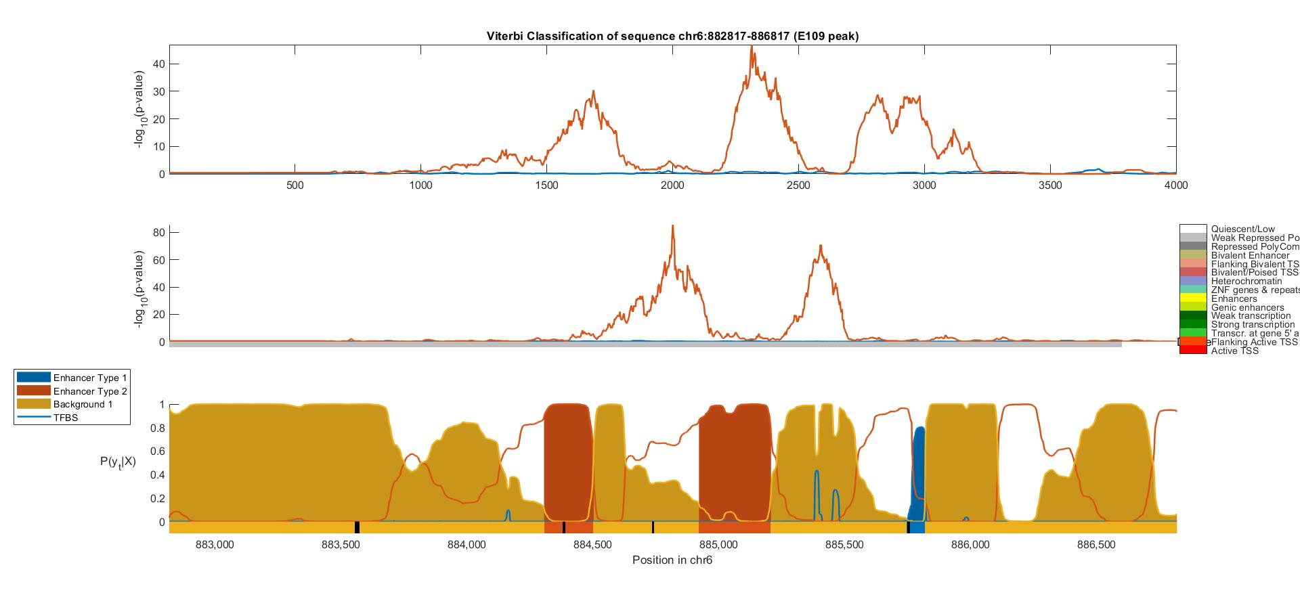
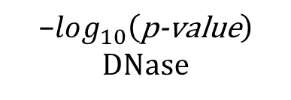

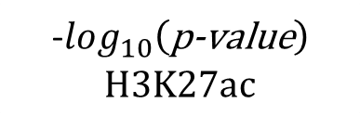
-$log_{10}\left(\text{p}\text{−}\text{value}\right)$
H3K27ac
$$\text{−}log_{10}\left(\text{p}\text{−}\text{value}\right)$$
DNase
ChromHMM
$$P\left(y_{t} | X\right)$$
Viterbi Path
Position In DNA Sequence

Slide 2
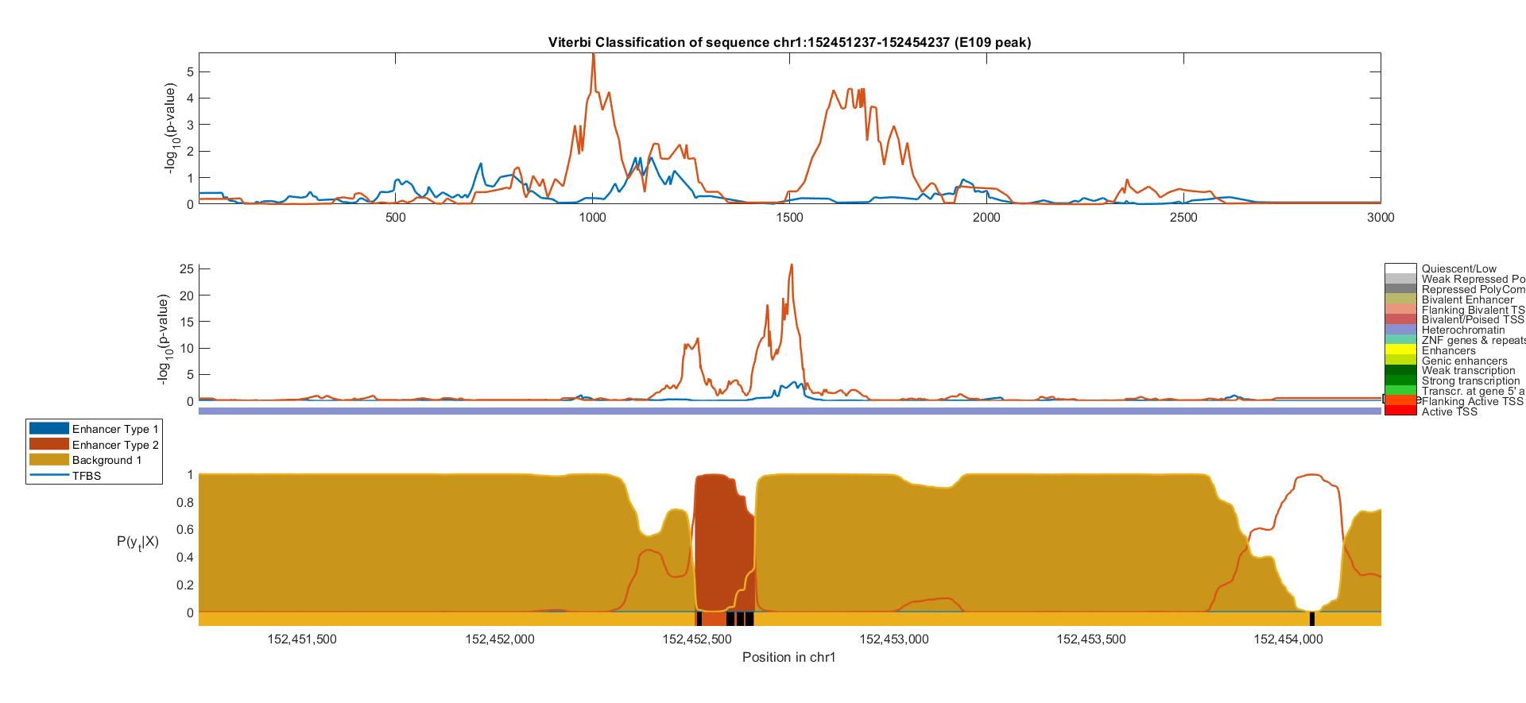



-$log_{10}\left(\text{p}\text{−}\text{value}\right)$
H3K27ac
$$\text{−}log_{10}\left(\text{p}\text{−}\text{value}\right)$$
DNase
ChromHMM
$$P\left(y_{t} | X\right)$$
Viterbi Path
Position In DNA Sequence

Slide 3
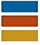
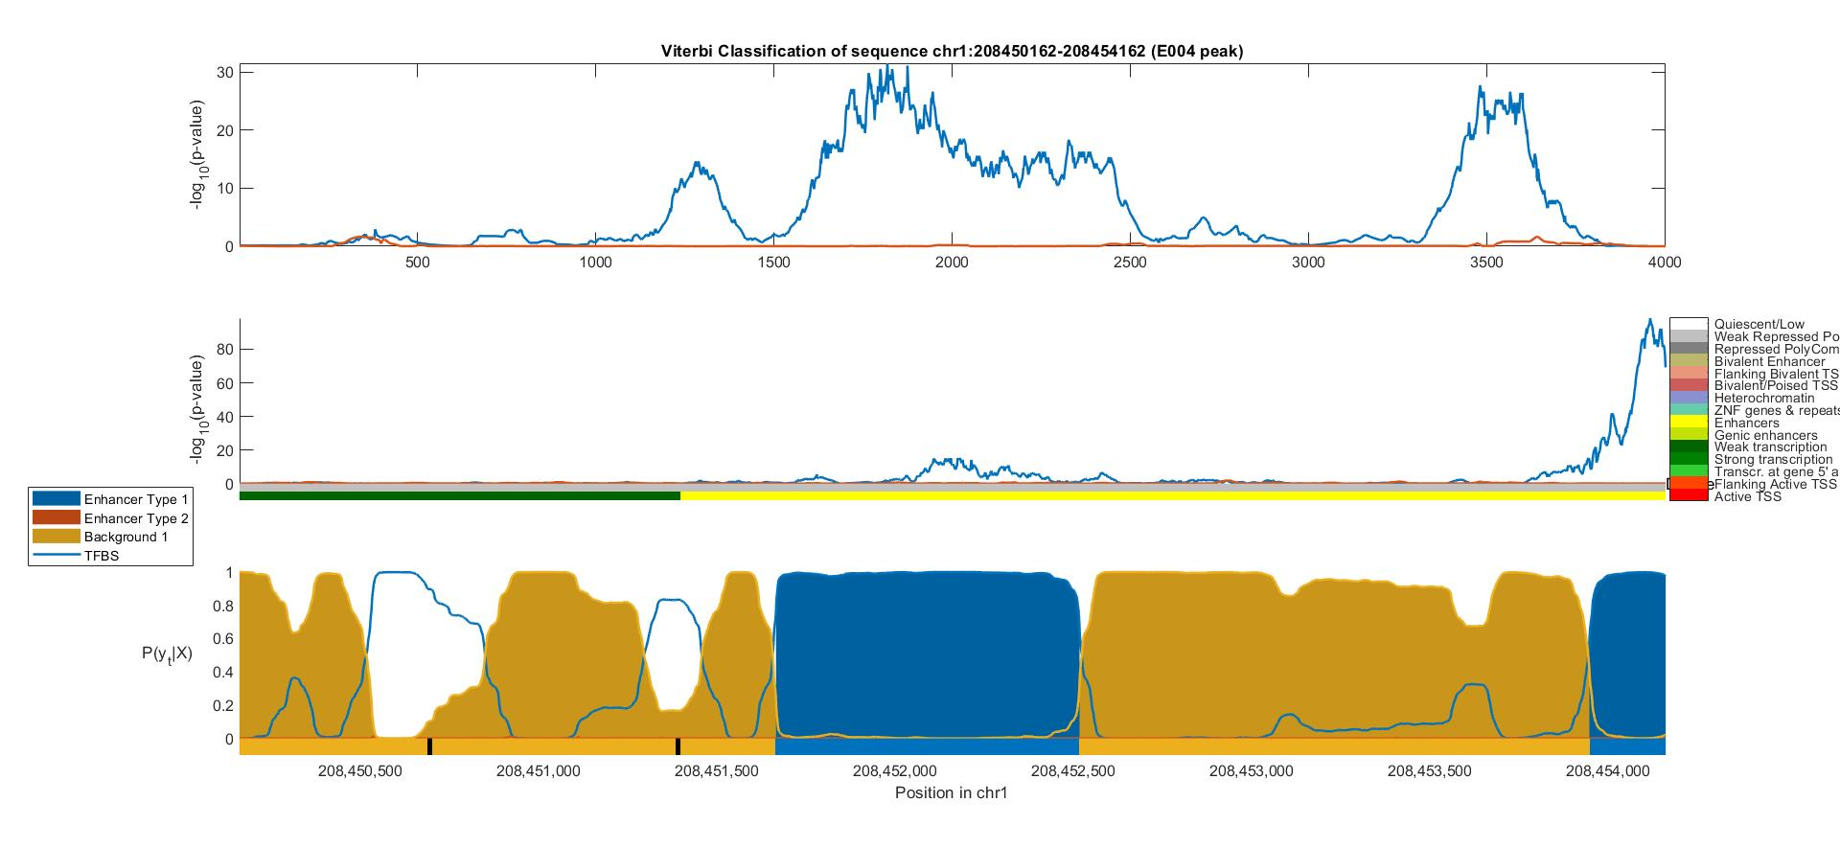
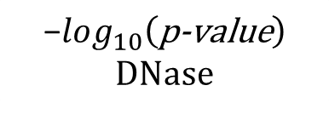

H1 BMP4 Derived Mesendoderm Cultured Cells (E004)
Fetal Adrenal Gland (E080)
Background
-$log_{10}\left(\text{p}\text{−}\text{value}\right)$
H3K27ac
$$\text{−}log_{10}\left(\text{p}\text{−}\text{value}\right)$$
DNase
ChromHMM
$$P\left(y_{t} | X\right)$$
Viterbi Path
Position In DNA Sequence

Slide 4
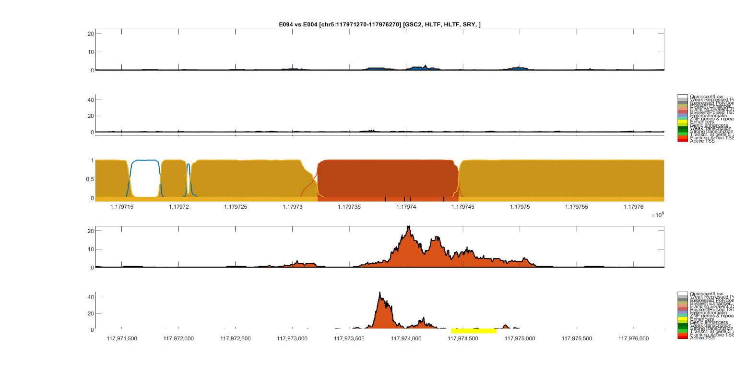
Umbilical Vein Endothelial State
Monocytes State
Background State
Transcription Factor States
Quiescent / Low
Weak Repressed PolyComb
Repressed PolyComb
Bivalent Enhancer
Flanking Bivalent TSS / Enhancer
Bivalent / Poised TSS
Heterochromatin
ZNF genes & repeats
Enhancers
Genic enhancers
Weak transcription
Strong transcription
Transcription at gene 5' and 3'
Flanking Active TSS
Active TSS

Slide 5
ChromHMM 15-States Legend
Quiescent / Low
Weak Repressed PolyComb
Repressed PolyComb
Bivalent Enhancer
Flanking Bivalent TSS / Enhancer
Bivalent / Poised TSS
Heterochromatin
ZNF genes & repeats
Enhancers
Genic enhancers
Weak transcription
Strong transcription
Transcription at gene 5' and 3'
Flanking Active TSS
Active TSS
HOP-HMM Legend
Enhancer Type I State
Enhancer Type II State
Background State
Transcription Factor States

Slide 6
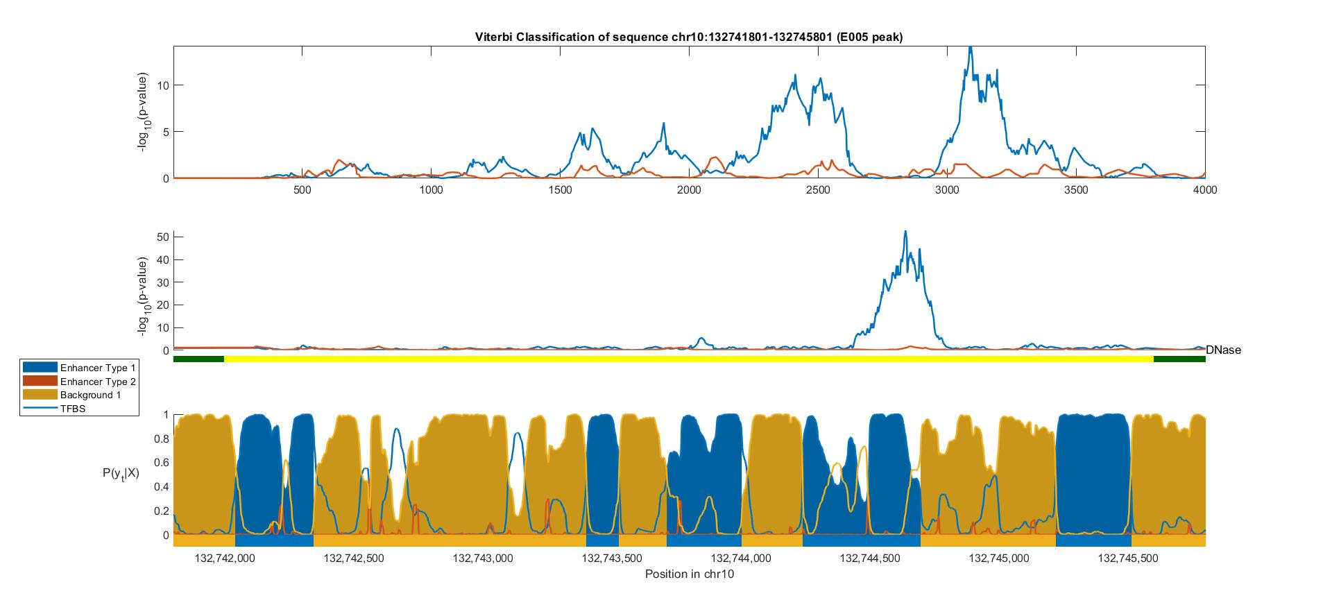
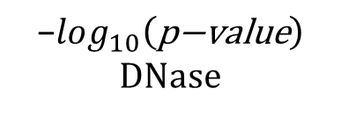

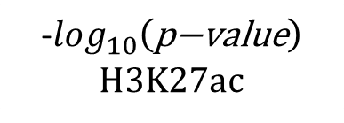
H1 BMP4 Derived Mesendoderm Cultured Cells (E004)
Fetal Adrenal Gland (E080)
Background
-$log_{10}\left(\text{p}\text{−}\text{value}\right)$
H3K27ac
$$\text{−}log_{10}\left(\text{p}\text{−}\text{value}\right)$$
DNase
$$P\left(y_{t} | X\right)$$
Viterbi Path
Position In DNA Sequence

Slide 7
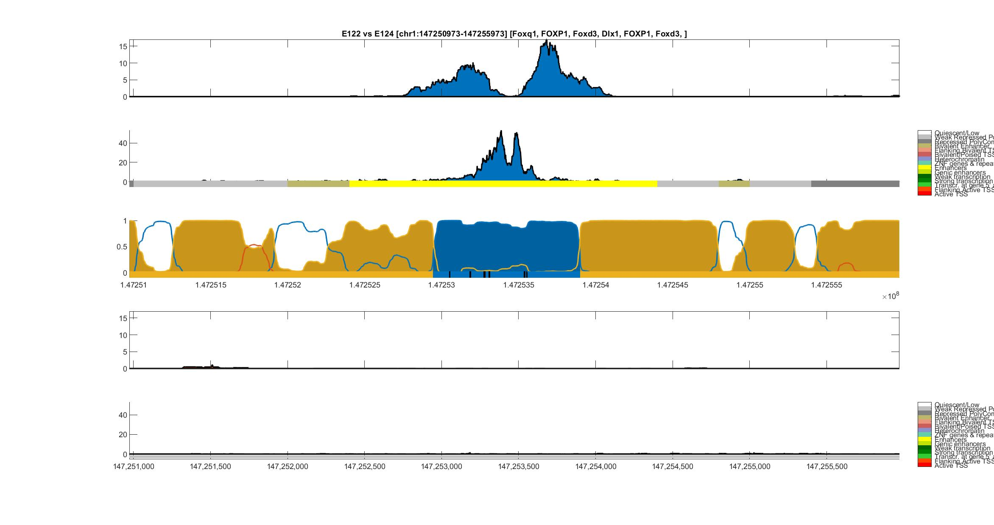
Umbilical Vein Endothelial (E122) vs Monocyte (E124)
H3K27ac
Umbilical Vein
Endothelial
DNase-I
ChromHMM
HOP-HMM Prediction
Posterior Probability
FOXQ1
FOXD3
FOXD3
Viterbi Path
FOXP1
DIX1
FOXP1
H3K27ac
Monocyte
DNase-I
ChromHMM
hg19:chr1
HOP-HMM Legend
Umbilical Vein Endothelial State
Monocytes State
Background State
Transcription Factor States

Slide 8
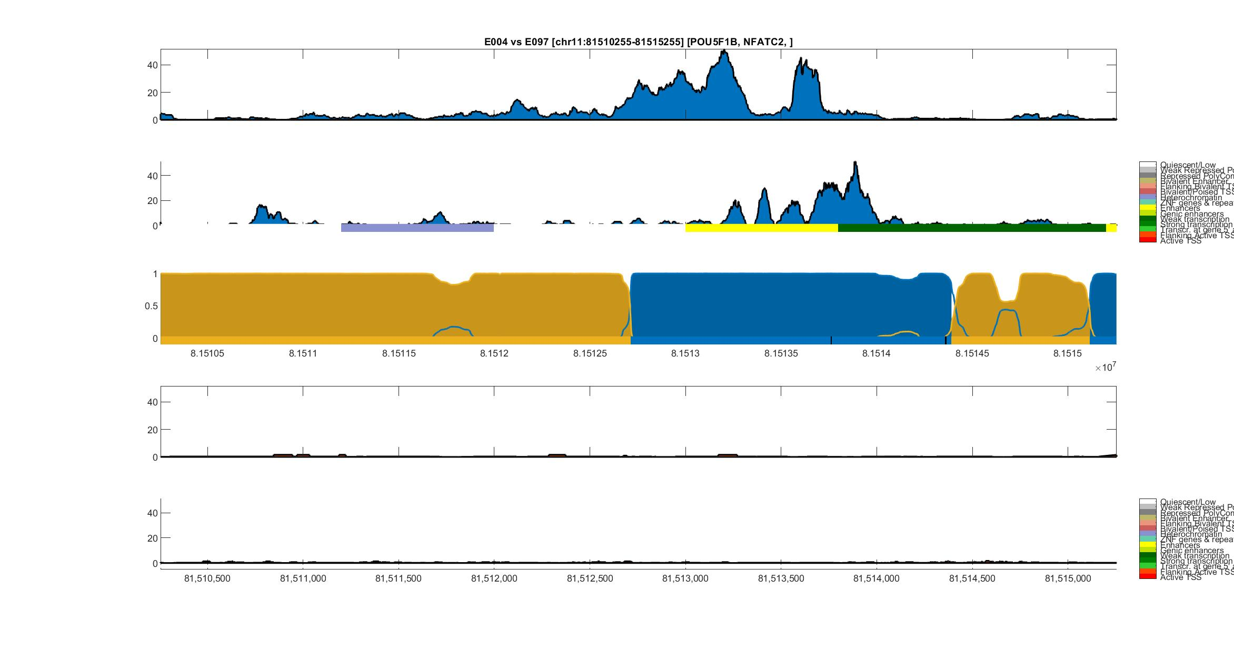
Mesendoderm (E004) vs Ovary (E097)
H3K27ac
Mesendoderm
DNase-I
ChromHMM
HOP-HMM Prediction
Posterior Probability
POU5F1B
NFATC2
Viterbi Path
H3K27ac
Ovary
DNase-I
ChromHMM
hg19:chr11
HOP-HMM Legend
Mesendoderm State
Ovary State
Background State
Transcription Factor States

Slide 9

Gastric (E094) vs Mesendoderm (E004)
H3K27ac
Gastric
DNase-I
ChromHMM
HOP-HMM
Prediction
Posterior Prob.
GSC2
HLTF
HLTF
SRY
Viterbi Path
H3K27ac
Mesendoderm
DNase-I
ChromHMM
hg19:chr5

Slide 10
HOP-HMM Legend
ChromHMM 15-States Legend
Weak transcription
Strong transcription
Transcription at gene
Flanking Active TSS
Active TSS
Enhancer Type I State
Enhancer Type II State
Background State
Transcription Factor States
Quiescent / Low
Weak Repressed PolyComb
Repressed PolyComb
Bivalent Enhancer
Flanking Bivalent TSS / Enh.
Bivalent / Poised TSS
Heterochromatin
ZNF genes & repeats
Enhancers
Genic enhancers

Slide 11
Umbilical Vein Endothelial (E122) vs Monocyte (E124)
H3K27ac
Umbilical Vein
Endothelial
DNase-I
ChromHMM
HOP-HMM
Prediction
Posterior Probability
FOXQ1
FOXD3
FOXD3
Viterbi Path
FOXP1
DIX1
FOXP1
H3K27ac
Monocyte
DNase-I
ChromHMM
hg19:chr1
Mesendoderm (E004) vs Ovary (E097)
H3K27ac
Mesendoderm
DNase-I
ChromHMM
HOP-HMM
Prediction
Posterior Probability
POU5F1B
NFATC2
Viterbi Path
H3K27ac
Ovary
DNase-I
ChromHMM
hg19:chr11
Gastric (E094) vs Mesendoderm (E004)
ChromHMM 15-States Legend
H3K27ac
Quiescent / Low
Weak Repressed PolyComb
Repressed PolyComb
Bivalent Enhancer
Flanking Bivalent TSS / Enh.
Bivalent / Poised TSS
Heterochromatin
ZNF genes & repeats
Enhancers
Genic enhancers
Weak transcription
Strong transcription
Transcription at gene
Flanking Active TSS
Active TSS
Gastric
DNase-I
ChromHMM
HOP-HMM
Prediction
Posterior
Probability
GSC2
HLTF
HLTF
SRY
Viterbi Path
H3K27ac
Mesendoderm
HOP-HMM Legend
DNase-I
Enhancer Type I State
Enhancer Type II State
Background State
Transcription Factor States
ChromHMM
hg19:chr5

