Slide 1
Enhancer Structure
…CGAGCTACTTTATTAAGACATTACGTTACAGAGATAA…
TF

Slide 2
Enhancer Structure
…CGAGCTACTTTATTAAGACATTACGTTACAGAGATAA…
TF
No Binding

Slide 3

Enhancer Structure
…CGAGCTACTTTATTAAGACATTACGTTACAGAGATAA…
TF
Binding

Slide 4
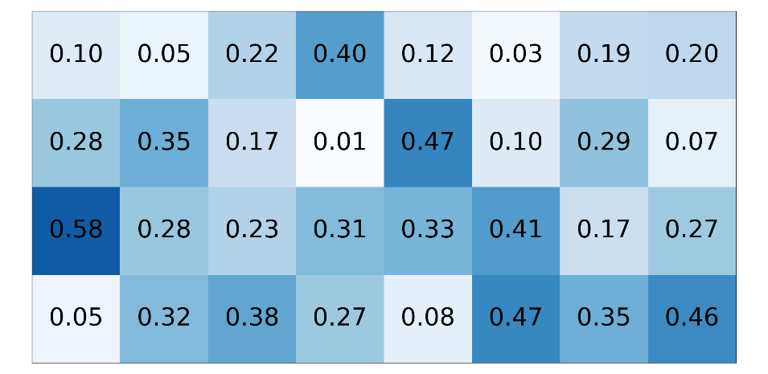
Enhancer Structure
…CGAGCTACTTTATTAAGACATTACGTTACAGAGATAA…
other binding sites
(ChIP-seq)
PWM (W)
ACTACTTT
CCGACTTT
GTAACTCA
GGGAGGCT
GTGGCGCT
GGAACGTG
…
GCTACTTT
A
C
G
T

Slide 5
























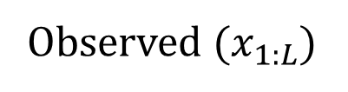











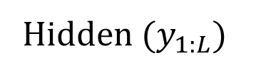










Hidden Markov Model
Hidden State Machine
$$0.4$$
$$0.4$$
$$0.6$$
$$0.2$$
$$0.6$$
$$0.2$$
$$BG$$
$$EN$$
Heart Enhancer
$$0.8$$
$$0.8$$
$$0.8$$
$$0.8$$
DNA
$$0.2$$
$$G$$
$$T$$
$$0.2$$
$$G$$
$$T$$
$$A$$
$$C$$
$$A$$
$$C$$
Example of a Generated Sequence
$$BG$$
$$BG$$
$$BG$$
$$BG$$
$$EN$$
$$EN$$
$$EN$$
$$EN$$
$$BG$$
$$BG$$
$$BG$$
$$BG$$
$$BG$$
Hidden ($y_{1:L}$)
$A$
$C$
$$G$$
$A$
$T$
$C$
$$T$$
$C$
$A$
$A$
$$G$$
$$T$$
$$A$$
Observed ($x_{1:L}$)

Slide 6

















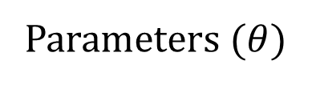













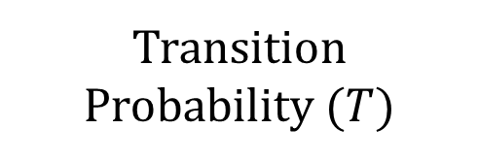










Hidden Markov Model
Parameters ($θ$)
Background States Emission Probability ($E$)
Transition Probability ($T$)
Start
Probability ($π)$
Hidden State Machine
$$0.4$$
$$0.4$$
$$0.6$$
$$0.2$$
$$0.6$$
$$to$$
$$0.2$$
$$A$$
$$C$$
$$G$$
$$T$$
$$BG$$
$$EN$$
$$BG$$
$$EN$$
$$BG$$
$$EN$$
$$observed$$
$$from$$
$$0.8$$
$$hidden$$
$$0.8$$
$$0.8$$
$$0.8$$
$$BG$$
$$0. 1$$
$$0.6$$
$$0. 1$$
$$0.2$$
$$BG$$
$$0.8$$
$$0.2$$
$$0.4$$
$$0.6$$
$$0.2$$
$$G$$
$$T$$
$$0.2$$
$$G$$
$$T$$
$$EN$$
$$0.5$$
$$0.3$$
$$0.1$$
$$0.1$$
$$EN$$
$$0.2$$
$$0.8$$
$$A$$
$$C$$
$$A$$
$$C$$
Example of a Generated Sequence
$$BG$$
$$BG$$
$$BG$$
$$BG$$
$$EN$$
$$EN$$
$$EN$$
$$EN$$
$$BG$$
$$BG$$
$$BG$$
$$BG$$
$$BG$$
Hidden ($y_{1:L}$)
$A$
$C$
$$G$$
$A$
$T$
$C$
$$T$$
$C$
$A$
$A$
$$G$$
$$T$$
$$A$$
Observed ($x_{1:L}$)

Slide 7
Hidden Markov Models
$$0.4$$
$$0.4$$
$$0.6$$
$$0.2$$
$$0.6$$
$$0.2$$
$$0.8$$
$$BG$$
$$EN$$
$$0.8$$
$$0.8$$
$$0.8$$
$$0.2$$
$$G$$
$$T$$
$$0.2$$
$$G$$
$$T$$
$$A$$
$$C$$
$$A$$
$$C$$
Enhancer
Enhancer
DNA

Slide 8






Hidden Markov Models
$$0.4$$
$$0.2$$
$$0.4$$
$$0.2$$
$$0.8$$
$$BG$$
$$EN_{1}$$
$$EN_{2}$$
$$EN_{3}$$
$$0.8$$
$$G$$
$$T$$
$$G$$
$$T$$
$$G$$
$$T$$
$$G$$
$$T$$
$$A$$
$$C$$
$$A$$
$$C$$
$$A$$
$$C$$
$$A$$
$$C$$
Enhancer 2
Enhancer 3
Enhancer 1
DNA

Slide 9
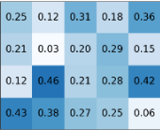
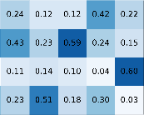
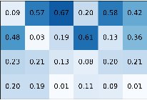
























Hidden Markov Model + TF States
$$0.5$$
$$0.05$$
$$0.0$$
$$0.05$$
$$0.1$$
$$0.8$$
$$EN$$
$$TF_{1}^{1}$$
$$TF_{2}^{1}$$
$$TF_{3}^{1}$$
$$1$$
$$G$$
$$T$$
$$A$$
$$C$$
$$0.5$$
$$0.8$$
$$BG$$
$$TF_{1}^{2}$$
$$TF_{2}^{2}$$
$$TF_{3}^{2}$$
$$0.1$$
$$1$$
$$G$$
$$T$$
$$A$$
$$C$$
PWMs
Enhancer
Enhancer
DNA

Slide 10































Hidden Markov Model + TF States
$$0.5$$
$$0.05$$
$$0.0$$
$$0.05$$
$$0.1$$
$$0.8$$
$$EN_{1}$$
$$TF_{1}^{1}$$
$$TF_{2}^{1}$$
$$TF_{3}^{1}$$
$$1$$
$$G$$
$$T$$
$$A$$
$$C$$
$$0.5$$
$$0.05$$
$$0.0$$
$$0.05$$
$$0.1$$
$$0.8$$
$$EN_{2}$$
$$TF_{1}^{1}$$
$$TF_{2}^{1}$$
$$TF_{3}^{1}$$
$$1$$
$$G$$
$$T$$
$$A$$
$$C$$
$$0.5$$
$$0.8$$
$$BG$$
$$TF_{1}^{2}$$
$$TF_{2}^{2}$$
$$TF_{3}^{2}$$
$$0.1$$
$$G$$
$$T$$
$$A$$
$$C$$
Enhancer 2
Enhancer 1
DNA

Slide 11
Hidden Markov Model + TF States
$$0.5$$
$$0.05$$
$$0.0$$
$$0.05$$
$$0.1$$
$$0.8$$
$$EN$$
$$TF_{1}^{1}$$
$$TF_{2}^{1}$$
$$TF_{3}^{1}$$
$$1$$
$$G$$
$$T$$
$$A$$
$$C$$
$$0.5$$
$$0.8$$
$$BG$$
$$TF_{1}^{2}$$
$$TF_{2}^{2}$$
$$TF_{3}^{2}$$
$$0.1$$
$$1$$
$$G$$
$$T$$
$$A$$
$$C$$
PWMs
Enhancer
Enhancer
DNA

Slide 12





















Hidden State Machine
$$0.5$$
$$0.05$$
$$0.0$$
$$0.05$$
$$0.1$$
$$0.8$$
$$EN$$
$$TF_{1}^{1}$$
$$TF_{2}^{1}$$
$$TF_{3}^{1}$$
$$1$$
Enhancer
$$G$$
$$T$$
$$A$$
$$C$$
DNA
$$0.5$$
$$0.8$$
$$BG$$
$$TF_{1}^{2}$$
$$TF_{2}^{2}$$
$$TF_{3}^{2}$$
$$0.1$$
$$1$$
$$G$$
$$T$$
$$A$$
$$C$$
PWMs

Slide 13









































Hidden State Machine
$$0.5$$
$$0.05$$
$$0.0$$
$$0.05$$
$$0.1$$
$$0.8$$
$$EN$$
$$TF_{1}^{1}$$
$$TF_{2}^{1}$$
$$TF_{3}^{1}$$
$$1$$
Enhancer
$$G$$
$$T$$
$$A$$
$$C$$
DNA
$$0.5$$
$$0.8$$
$$BG$$
$$TF_{1}^{2}$$
$$TF_{2}^{2}$$
$$TF_{3}^{2}$$
$$0.1$$
$$1$$
$$G$$
$$T$$
$$A$$
$$C$$
PWMs
$$BG$$
$$BG$$
$$EN$$
$$EN$$
$$EN$$
$$TF_{1}^{1}$$
$$EN$$
$$EN$$
$$EN$$
$$EN$$
$$TF_{2}^{1}$$
$$EN$$
$$EN$$
$$BG$$
$$BG$$
$$y_{1:L}$$
$$A$$
$$A$$
$$C$$
$$T$$
$$T$$
$$A$$
$$T$$
$$T$$
$$A$$
$$A$$
$$A$$
$$C$$
$$T$$
$$T$$
$$C$$
$$C$$
$$A$$
$$C$$
$$G$$
$$T$$
$$G$$
$$C$$
$$G$$
$$A$$
$$A$$
$$x_{1:L}$$

Slide 14















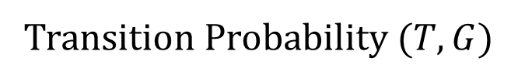













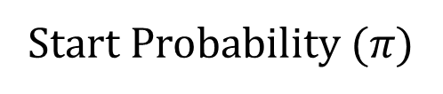




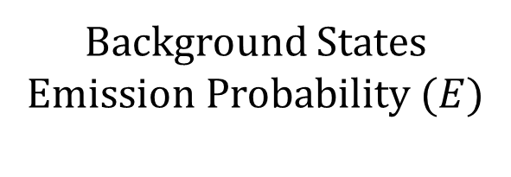
















Background States Emission Probability ($E$)
Hidden State Machine
Start Probability ($π)$
$$0.5$$
$$0.05$$
$$0.0$$
$$0.05$$
$$A$$
$$C$$
$$G$$
$$T$$
$$EN$$
$$BG$$
$$TF_{1}^{1}$$
$$…$$
$$TF_{3}^{2}$$
$$0.1$$
$$observed$$
$$EN$$
$$TF_{1}^{1}$$
$$TF_{2}^{1}$$
$$TF_{3}^{1}$$
$$hidden$$
$$0.8$$
$$0.5$$
$$0.5$$
$$FIXED$$
$$FIXED$$
$$EN$$
$$0. 1$$
$$0.6$$
$$0. 1$$
$$0.2$$
$$0$$
$$…$$
$$0$$
$$1$$
$$G$$
$$T$$
$$A$$
$$C$$
$$BG$$
$$0.5$$
$$0.3$$
$$0.1$$
$$0.1$$
Transition Probability ($T,G$)
$$0.5$$
$$T$$
$$G$$
$$BG$$
$$TF_{1}^{2}$$
$$TF_{2}^{2}$$
$$TF_{3}^{2}$$
$$to$$
$$EN$$
$$BG$$
$$TF_{1}^{∗}$$
$$TF_{2}^{∗}$$
$$TF_{3}^{∗}$$
$$0.8$$
$$from$$
$$0.1$$
$$1$$
$$G$$
$$T$$
$$EN$$
$$0.8$$
$$0.1$$
$$0.05$$
$$0.05$$
$$0.0$$
$$A$$
$$C$$
PWMs
$$BG$$
$$0. 1$$
$$0.8$$
$$0.0$$
$$0.0$$
$$0.1$$
$$BG$$
$$BG$$
$$EN$$
$$EN$$
$$EN$$
$$TF_{1}^{1}$$
$$EN$$
$$EN$$
$$EN$$
$$EN$$
$$TF_{2}^{1}$$
$$EN$$
$$EN$$
$$BG$$
$$BG$$
$$y_{1:L}$$
$$A$$
$$A$$
$$C$$
$$T$$
$$T$$
$$A$$
$$T$$
$$T$$
$$A$$
$$A$$
$$A$$
$$C$$
$$T$$
$$T$$
$$C$$
$$C$$
$$A$$
$$C$$
$$G$$
$$T$$
$$G$$
$$C$$
$$G$$
$$A$$
$$A$$
$$x_{1:L}$$

Slide 15


Background States Emission Probability ($E$)
Hidden State Machine
Start Probability ($π)$
$$0.5$$
$$0.05$$
$$0.0$$
$$0.05$$
$$A$$
$$C$$
$$G$$
$$T$$
$$EN$$
$$BG$$
$$TF_{1}^{1}$$
$$…$$
$$TF_{3}^{2}$$
$$0.1$$
$$observed$$
$$EN$$
$$TF_{1}^{1}$$
$$TF_{2}^{1}$$
$$TF_{3}^{1}$$
$$hidden$$
$$0.8$$
$$0.5$$
$$0.5$$
$$FIXED$$
$$FIXED$$
$$EN$$
$$0. 1$$
$$0.6$$
$$0. 1$$
$$0.2$$
$$0$$
$$…$$
$$0$$
$$1$$
$$G$$
$$T$$
$$A$$
$$C$$
$$BG$$
$$0.5$$
$$0.3$$
$$0.1$$
$$0.1$$
Transition Probability ($T,G$)
$$0.5$$
$$T$$
$$G$$
$$BG$$
$$TF_{1}^{2}$$
$$TF_{2}^{2}$$
$$TF_{3}^{2}$$
$$to$$
$$EN$$
$$BG$$
$$TF_{1}^{∗}$$
$$TF_{2}^{∗}$$
$$TF_{3}^{∗}$$
$$0.8$$
$$from$$
$$0.1$$
$$1$$
$$G$$
$$T$$
$$EN$$
$$0.8$$
$$0.1$$
$$0.05$$
$$0.05$$
$$0.0$$
$$A$$
$$C$$
PWMs
$$BG$$
$$0. 1$$
$$0.8$$
$$0.0$$
$$0.0$$
$$0.1$$
$$P\left(y_{t}={TF}_{2}^{1} | y_{t−1}=EN\right)$$
$$BG$$
$$BG$$
$$EN$$
$$EN$$
$$EN$$
$$TF_{1}^{1}$$
$$EN$$
$$EN$$
$$EN$$
$$EN$$
$$TF_{2}^{1}$$
$$EN$$
$$EN$$
$$BG$$
$$BG$$
$$y_{1:L}$$
$$A$$
$$A$$
$$C$$
$$T$$
$$T$$
$$A$$
$$T$$
$$T$$
$$A$$
$$A$$
$$A$$
$$C$$
$$T$$
$$T$$
$$C$$
$$C$$
$$A$$
$$C$$
$$G$$
$$T$$
$$G$$
$$C$$
$$G$$
$$A$$
$$A$$
$$x_{1:L}$$

Slide 16


Background States Emission Probability ($E$)
Hidden State Machine
Start Probability ($π)$
$$0.5$$
$$0.05$$
$$0.0$$
$$0.05$$
$$A$$
$$C$$
$$G$$
$$T$$
$$EN$$
$$BG$$
$$TF_{1}^{1}$$
$$…$$
$$TF_{3}^{2}$$
$$0.1$$
$$observed$$
$$EN$$
$$TF_{1}^{1}$$
$$TF_{2}^{1}$$
$$TF_{3}^{1}$$
$$hidden$$
$$0.8$$
$$0.5$$
$$0.5$$
$$FIXED$$
$$FIXED$$
$$EN$$
$$0. 1$$
$$0.6$$
$$0. 1$$
$$0.2$$
$$0$$
$$…$$
$$0$$
$$1$$
$$G$$
$$T$$
$$A$$
$$C$$
$$BG$$
$$0.5$$
$$0.3$$
$$0.1$$
$$0.1$$
Transition Probability ($T,G$)
$$0.5$$
$$T$$
$$G$$
$$BG$$
$$TF_{1}^{2}$$
$$TF_{2}^{2}$$
$$TF_{3}^{2}$$
$$to$$
$$EN$$
$$BG$$
$$TF_{1}^{∗}$$
$$TF_{2}^{∗}$$
$$TF_{3}^{∗}$$
$$0.8$$
$$from$$
$$0.1$$
$$1$$
$$G$$
$$T$$
$$EN$$
$$0.8$$
$$0.1$$
$$0.05$$
$$0.05$$
$$0.0$$
$$A$$
$$C$$
PWMs
$$BG$$
$$0. 1$$
$$0.8$$
$$0.0$$
$$0.0$$
$$0.1$$
$$P\left(y_{t}={EN}_{ }^{ } | y_{t−1}=BG\right)$$
$$BG$$
$$BG$$
$$EN$$
$$EN$$
$$EN$$
$$TF_{1}^{1}$$
$$EN$$
$$EN$$
$$EN$$
$$EN$$
$$TF_{2}^{1}$$
$$EN$$
$$EN$$
$$BG$$
$$BG$$
$$y_{1:L}$$
$$A$$
$$A$$
$$C$$
$$T$$
$$T$$
$$A$$
$$T$$
$$T$$
$$A$$
$$A$$
$$A$$
$$C$$
$$T$$
$$T$$
$$C$$
$$C$$
$$A$$
$$C$$
$$G$$
$$T$$
$$G$$
$$C$$
$$G$$
$$A$$
$$A$$
$$x_{1:L}$$

Slide 17







Background States Emission Probability ($E$)
Hidden State Machine
Start Probability ($π)$
$$0.5$$
$$0.05$$
$$0.0$$
$$0.05$$
$$A$$
$$C$$
$$G$$
$$T$$
$$EN$$
$$BG$$
$$TF_{1}^{1}$$
$$…$$
$$TF_{3}^{2}$$
$$0.1$$
$$observed$$
$$EN$$
$$TF_{1}^{1}$$
$$TF_{2}^{1}$$
$$TF_{3}^{1}$$
$$hidden$$
$$0.8$$
$$0.5$$
$$0.5$$
$$FIXED$$
$$FIXED$$
$$EN$$
$$0. 1$$
$$0.6$$
$$0. 1$$
$$0.2$$
$$0$$
$$…$$
$$0$$
$$1$$
$$G$$
$$T$$
$$A$$
$$C$$
$$BG$$
$$0.5$$
$$0.3$$
$$0.1$$
$$0.1$$
Transition Probability ($T,G$)
$$0.5$$
$$T$$
$$G$$
$$BG$$
$$TF_{1}^{2}$$
$$TF_{2}^{2}$$
$$TF_{3}^{2}$$
$$to$$
$$EN$$
$$BG$$
$$TF_{1}^{∗}$$
$$TF_{2}^{∗}$$
$$TF_{3}^{∗}$$
$$0.8$$
$$from$$
$$0.1$$
$$1$$
$$G$$
$$T$$
$$EN$$
$$0.8$$
$$0.1$$
$$0.05$$
$$0.05$$
$$0.0$$
$$A$$
$$C$$
PWMs
$$BG$$
$$0. 1$$
$$0.8$$
$$0.0$$
$$0.0$$
$$0.1$$
$$P\left(x_{t:t+|W_{2}|} | y_{t:t+|W_{2}|}=TF_{2}^{1}\right)$$
$$BG$$
$$BG$$
$$EN$$
$$EN$$
$$EN$$
$$TF_{1}^{1}$$
$$EN$$
$$EN$$
$$EN$$
$$EN$$
$$TF_{2}^{1}$$
$$EN$$
$$EN$$
$$BG$$
$$BG$$
$$y_{1:L}$$
$$A$$
$$A$$
$$C$$
$$T$$
$$T$$
$$A$$
$$T$$
$$T$$
$$A$$
$$A$$
$$A$$
$$C$$
$$T$$
$$T$$
$$C$$
$$C$$
$$A$$
$$C$$
$$G$$
$$T$$
$$G$$
$$C$$
$$G$$
$$A$$
$$A$$
$$x_{1:L}$$

Slide 18

Background States Emission Probability ($E$)
Hidden State Machine
Start Probability ($π)$
$$0.5$$
$$0.05$$
$$0.0$$
$$0.05$$
$$A$$
$$C$$
$$G$$
$$T$$
$$EN$$
$$BG$$
$$TF_{1}^{1}$$
$$…$$
$$TF_{3}^{2}$$
$$0.1$$
$$observed$$
$$EN$$
$$TF_{1}^{1}$$
$$TF_{2}^{1}$$
$$TF_{3}^{1}$$
$$hidden$$
$$0.8$$
$$0.5$$
$$0.5$$
$$FIXED$$
$$FIXED$$
$$EN$$
$$0. 1$$
$$0.6$$
$$0. 1$$
$$0.2$$
$$0$$
$$…$$
$$0$$
$$1$$
$$G$$
$$T$$
$$A$$
$$C$$
$$BG$$
$$0.5$$
$$0.3$$
$$0.1$$
$$0.1$$
Transition Probability ($T,G$)
$$0.5$$
$$T$$
$$G$$
$$BG$$
$$TF_{1}^{2}$$
$$TF_{2}^{2}$$
$$TF_{3}^{2}$$
$$to$$
$$EN$$
$$BG$$
$$TF_{1}^{∗}$$
$$TF_{2}^{∗}$$
$$TF_{3}^{∗}$$
$$0.8$$
$$from$$
$$0.1$$
$$1$$
$$G$$
$$T$$
$$EN$$
$$0.8$$
$$0.1$$
$$0.05$$
$$0.05$$
$$0.0$$
$$A$$
$$C$$
PWMs
$$BG$$
$$0. 1$$
$$0.8$$
$$0.0$$
$$0.0$$
$$0.1$$
$$Order=1$$
$$BG$$
$$BG$$
$$EN$$
$$EN$$
$$EN$$
$$TF_{1}^{1}$$
$$EN$$
$$EN$$
$$EN$$
$$EN$$
$$TF_{2}^{1}$$
$$EN$$
$$EN$$
$$BG$$
$$BG$$
$$y_{1:L}$$
$$A$$
$$A$$
$$C$$
$$T$$
$$T$$
$$A$$
$$T$$
$$T$$
$$A$$
$$A$$
$$A$$
$$C$$
$$T$$
$$T$$
$$C$$
$$C$$
$$A$$
$$C$$
$$G$$
$$T$$
$$G$$
$$C$$
$$G$$
$$A$$
$$A$$
$$x_{1:L}$$

Slide 19



































Background States Emission Probability ($E$)
Hidden State Machine
Start Probability ($π)$
$$0.5$$
$$0.05$$
$$0.0$$
$$0.05$$
$$EN$$
$$BG$$
$$TF_{1}^{1}$$
$$…$$
$$TF_{3}^{2}$$
$$0.1$$
$$EN$$
$$TF_{1}^{1}$$
$$TF_{2}^{1}$$
$$TF_{3}^{1}$$
$$EN$$
$$A$$
$$C$$
$$G$$
$$T$$
$$0.8$$
$$0.5$$
$$0.5$$
$$FIXED$$
$$FIXED$$
$$0$$
$$…$$
$$0$$
$$1$$
$$A∗$$
$$BG$$
$$A$$
$$C$$
$$G$$
$$T$$
$$G$$
$$T$$
$$A$$
$$C$$
$A$?
$$0. 1$$
$$0.6$$
$$0. 1$$
$$0.2$$
$$C∗$$
Transition Probability ($T,G$)
$$0.5$$
$C$?
$$0.1$$
$$0.05$$
$$0.8$$
$$0.05$$
$$T$$
$$G$$
$$G∗$$
$$BG$$
$$TF_{1}^{2}$$
$$TF_{2}^{2}$$
$$TF_{3}^{2}$$
$$to$$
$$EN$$
$$BG$$
$$TF_{1}^{∗}$$
$$TF_{2}^{∗}$$
$$TF_{3}^{∗}$$
$$0.8$$
$$T∗$$
$G$?
$$0.5$$
$$0.3$$
$$0.1$$
$$0.1$$
$$from$$
$$0.1$$
$$1$$
$$G$$
$$T$$
$T$?
$$0.1$$
$$0.4$$
$$0.2$$
$$0.3$$
$$EN$$
$$0.8$$
$$0.1$$
$$0.05$$
$$0.05$$
$$0.0$$
$$A$$
$$C$$
$$BG$$
$$0. 1$$
$$0.8$$
$$0.0$$
$$0.0$$
$$0.1$$
$$Order=2$$
$$BG$$
$$BG$$
$$EN$$
$$EN$$
$$EN$$
$$TF_{1}^{1}$$
$$EN$$
$$EN$$
$$EN$$
$$EN$$
$$TF_{2}^{1}$$
$$EN$$
$$EN$$
$$BG$$
$$BG$$
$$y_{1:L}$$
$$A$$
$$A$$
$$C$$
$$T$$
$$T$$
$$A$$
$$T$$
$$T$$
$$A$$
$$A$$
$$A$$
$$C$$
$$T$$
$$T$$
$$C$$
$$C$$
$$A$$
$$C$$
$$G$$
$$T$$
$$G$$
$$C$$
$$G$$
$$A$$
$$A$$
$$x_{1:L}$$

Slide 20
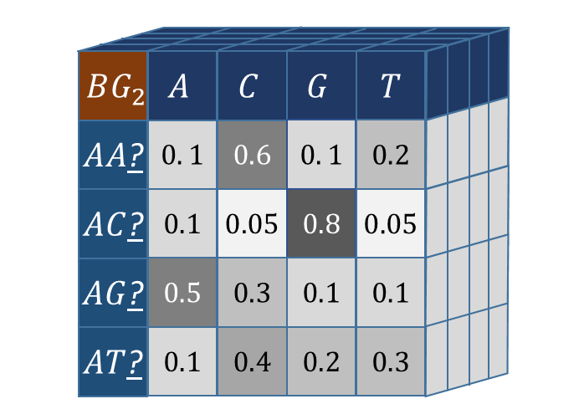
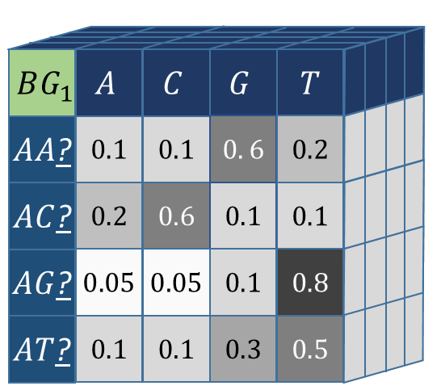



Background States Emission Probability ($E$)
Hidden State Machine
Start Probability ($π)$
$$0.5$$
$$0.05$$
$$0.0$$
$$0.05$$
$$EN$$
$$BG$$
$$TF_{1}^{1}$$
$$…$$
$$TF_{3}^{2}$$
$$0.1$$
$$0.8$$
$$EN$$
$$TF_{1}^{1}$$
$$TF_{2}^{1}$$
$$TF_{3}^{1}$$
$$BG$$
$$0.5$$
$$0.5$$
$$FIXED$$
$$FIXED$$
$$0$$
$$…$$
$$0$$
$$1$$
$$G$$
$$T$$
$$EN$$
$$A$$
$$C$$
Transition Probability ($T,G$)
$$0.5$$
$$T$$
$$G$$
$$BG$$
$$TF_{1}^{2}$$
$$TF_{2}^{2}$$
$$TF_{3}^{2}$$
$$to$$
$$EN$$
$$BG$$
$$TF_{1}^{∗}$$
$$TF_{2}^{∗}$$
$$TF_{3}^{∗}$$
$$0.8$$
$$from$$
$$0.1$$
$$1$$
$$G$$
$$T$$
$$EN$$
$$0.8$$
$$0.1$$
$$0.05$$
$$0.05$$
$$0.0$$
$$A$$
$$C$$
$$BG$$
$$0. 1$$
$$0.8$$
$$0.0$$
$$0.0$$
$$0.1$$
$$Order=3$$
$$BG$$
$$BG$$
$$EN$$
$$EN$$
$$EN$$
$$TF_{1}^{1}$$
$$EN$$
$$EN$$
$$EN$$
$$EN$$
$$TF_{2}^{1}$$
$$EN$$
$$EN$$
$$BG$$
$$BG$$
$$y_{1:L}$$
$$A$$
$$A$$
$$C$$
$$T$$
$$T$$
$$A$$
$$T$$
$$T$$
$$A$$
$$A$$
$$A$$
$$C$$
$$T$$
$$T$$
$$C$$
$$C$$
$$A$$
$$C$$
$$G$$
$$T$$
$$G$$
$$C$$
$$G$$
$$A$$
$$A$$
$$x_{1:L}$$

Slide 21






Background States Emission Probability ($E$)
Hidden State Machine
Start Probability ($π)$
$$0.5$$
$$0.05$$
$$0.0$$
$$0.05$$
$$EN$$
$$BG$$
$$TF_{1}^{1}$$
$$…$$
$$TF_{3}^{2}$$
$$0.1$$
$$0.8$$
$$EN$$
$$TF_{1}^{1}$$
$$TF_{2}^{1}$$
$$TF_{3}^{1}$$
$$BG$$
$$0.5$$
$$0.5$$
$$FIXED$$
$$FIXED$$
$$0$$
$$…$$
$$0$$
$$1$$
$$G$$
$$T$$
$$EN$$
$$A$$
$$C$$
Transition Probability ($T,G$)
$$0.5$$
$$T$$
$$G$$
$$BG$$
$$TF_{1}^{2}$$
$$TF_{2}^{2}$$
$$TF_{3}^{2}$$
$$to$$
$$EN$$
$$BG$$
$$TF_{1}^{∗}$$
$$TF_{2}^{∗}$$
$$TF_{3}^{∗}$$
$$0.8$$
$$from$$
$$0.1$$
$$1$$
$$G$$
$$T$$
$$EN$$
$$0.8$$
$$0.1$$
$$0.05$$
$$0.05$$
$$0.0$$
$$A$$
$$C$$
$$BG$$
$$0. 1$$
$$0.8$$
$$0.0$$
$$0.0$$
$$0.1$$
$$Order=3$$
$$P\left(x_{t}=T | y_{t}=EN,x_{t−2:t−1}=AC\right)$$
$$BG$$
$$BG$$
$$EN$$
$$EN$$
$$EN$$
$$TF_{1}^{1}$$
$$EN$$
$$EN$$
$$EN$$
$$EN$$
$$TF_{2}^{1}$$
$$EN$$
$$EN$$
$$BG$$
$$BG$$
$$y_{1:L}$$
$$A$$
$$A$$
$$C$$
$$T$$
$$T$$
$$A$$
$$T$$
$$T$$
$$A$$
$$A$$
$$A$$
$$C$$
$$T$$
$$T$$
$$C$$
$$C$$
$$A$$
$$C$$
$$G$$
$$T$$
$$G$$
$$C$$
$$G$$
$$A$$
$$A$$
$$x_{1:L}$$

Slide 22
Enhancer Structure
Enhancers vs non-enhancer
  Have TF binding sites
  Have different dinucleotide and kmer frequencies
Tissue-specific enhancers of different tissues
  Have different TF binding sites
Enhancer
DNA

Slide 23


Enhancer Structure
Enhancers vs non-enhancer
  Have TF binding sites
  Have different dinucleotide and kmer frequencies
Tissue-specific enhancers of different tissues
  Have different TF binding sites
$$EN$$
$$TF_{ }^{ }$$
Enhancer
DNA

Slide 24






Enhancer Structure
$$BG$$
$$EN$$
Enhancers vs non-enhancer
  Have TF binding sites
  Have different dinucleotide and kmer frequencies
Tissue-specific enhancers of different tissues
  Have different TF binding sites
$$EN$$
$$C$$
$$T$$
$$T$$
Enhancer
DNA

Slide 25
ההקדמה קקה. מה המוטיבציה? למה שיהיה לנו אכפת?
מודלים קיי-מרים - מבוסס על רצף
דיפ-סי מבוסס בעיקר על כרומטין
אלכס סטארק - התפלגות זוגות באנהנסרים
המוטיבציה ל-PWM עוברת דרך עימוד. חושף אותך לכיוונים לא רצויים.
״ההסתברות שהרצף הזה הוא ביינדינג סייט״??
אז איך נעשה את זה?
דרך מקובלת לתאר רצפים היא באמצעות מודלים מרקוביים, שנרצה לשנות כדי לתאר את הסיטואציה שלנו.
מה מבדיל בין אנהנסרים לרקמות שונות?
מה מבדיל בין אנהנסרים ללא אנהנסרים?

Slide 26
תיקון מכנה בחישוב הפוסטריור
לא ברור מה מבנה ההרצאה. מה ההגיון הפנימי שלה. למה סדר השקפים הוא כזה ולא אחר.
למשל קודם לשערך פרמטרים כשחבוי נצפה, ורק אז לדבר על שערוך מדאטה חלקי.
מה גודל המודל מלא (אם היית פורש אותו)? כמה פרמטרים? כמה מהם אתה לומד?
במקום Error לכתוב Misclassification או False
תיאור הדאטה (סינתטי ואמיתי) - כמה רצפים? אורך?
האם המוטיבים מתאימים לביולוגיה?
למה אומר ש״לא עובד״ על דאטה אמיתי?

Slide 27
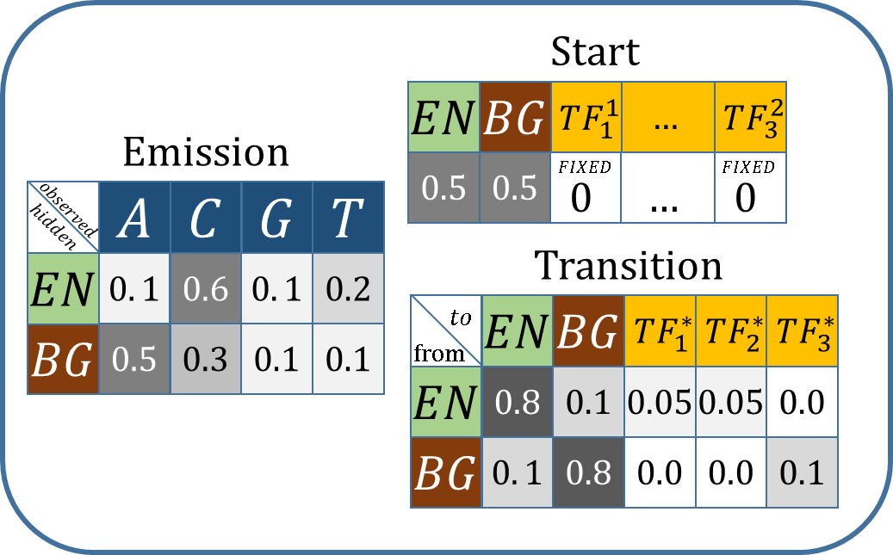









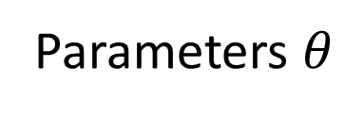






















Parameters Estimation
$$C$$
$$A$$
$$C$$
$$G$$
$$T$$
$$G$$
$$T$$
$$T$$
$$A$$
$$G$$
$$A$$
$$T$$
$$T$$
$$A$$
$$A$$
$$G$$
$$C$$
$$A$$
$$C$$
$$G$$
$$T$$
$$G$$
$$T$$
$$A$$
$$A$$
$$G$$
$$C$$
$$A$$
$$C$$
$$G$$
$$T$$
$$x_{1:L}$$
Parameters $θ$

Slide 28














































































Parameters Estimation
What if we had Y?
$$BG$$
$$BG$$
$$BG$$
$$BG$$
$$BG$$
$$BG$$
$$BG$$
$$EN$$
$$EN$$
$$EN$$
$$EN$$
$$EN$$
$$EN$$
$$EN$$
$$EN$$
$$EN$$
$$EN$$
$$EN$$
$$EN$$
$$EN$$
$$EN$$
$$EN$$
$$EN$$
$$BG$$
$$BG$$
$$BG$$
$$BG$$
$BG$
$$BG$$
$BG$
$BG$
$$y_{1:L}$$
$$C$$
$$A$$
$$C$$
$$G$$
$$T$$
$$G$$
$$T$$
$$T$$
$$A$$
$$G$$
$$A$$
$$T$$
$$T$$
$$A$$
$$A$$
$$G$$
$$C$$
$$A$$
$$C$$
$$G$$
$$T$$
$$G$$
$$T$$
$$A$$
$$A$$
$$G$$
$$C$$
$$A$$
$$C$$
$$G$$
$$T$$
$$x_{1:L}$$
Parameters $θ$
Start
$$EN$$
$$BG$$
$$TF_{1}^{1}$$
$$…$$
$$TF_{3}^{2}$$
Emission
$$0.5$$
$$0.5$$
$$FIXED$$
$$FIXED$$
$$0$$
$$…$$
$$0$$
$$observed$$
$$A$$
$$C$$
$$G$$
$$T$$
$$hidden$$
Transition
$$EN$$
$$0. 1$$
$$0.6$$
$$0. 1$$
$$0.2$$
$$to$$
$$EN$$
$$BG$$
$$TF_{1}^{∗}$$
$$TF_{2}^{∗}$$
$$TF_{3}^{∗}$$
$$BG$$
$$0.5$$
$$0.3$$
$$0.1$$
$$0.1$$
$$from$$
$$EN$$
$$0.8$$
$$0.1$$
$$0.05$$
$$0.05$$
$$0.0$$
$$BG$$
$$0. 1$$
$$0.8$$
$$0.0$$
$$0.0$$
$$0.1$$

Slide 29

Parameters Estimation
$$BG$$
$$BG$$
$$BG$$
$$BG$$
$$BG$$
$$BG$$
$$BG$$
$$EN$$
$$EN$$
$$EN$$
$$EN$$
$$EN$$
$$EN$$
$$EN$$
$$EN$$
$$EN$$
$$EN$$
$$EN$$
$$EN$$
$$EN$$
$$EN$$
$$EN$$
$$EN$$
$$BG$$
$$BG$$
$$BG$$
$$BG$$
$BG$
$$BG$$
$BG$
$BG$
$$y_{1:L}$$
$$C$$
$$A$$
$$C$$
$$G$$
$$T$$
$$G$$
$$T$$
$$T$$
$$A$$
$$G$$
$$A$$
$$T$$
$$T$$
$$A$$
$$A$$
$$G$$
$$C$$
$$A$$
$$C$$
$$G$$
$$T$$
$$G$$
$$T$$
$$A$$
$$A$$
$$G$$
$$C$$
$$A$$
$$C$$
$$G$$
$$T$$
$$x_{1:L}$$
Parameters $θ$

Slide 30
Parameters Estimation
$$BG$$
$$BG$$
$$BG$$
$$BG$$
$$BG$$
$$BG$$
$$BG$$
$$EN$$
$$EN$$
$$EN$$
$$EN$$
$$EN$$
$$EN$$
$$EN$$
$$EN$$
$$EN$$
$$EN$$
$$EN$$
$$EN$$
$$EN$$
$$EN$$
$$EN$$
$$EN$$
$$BG$$
$$BG$$
$$BG$$
$$BG$$
$BG$
$$BG$$
$BG$
$BG$
$$y_{1:L}$$
$$C$$
$$A$$
$$C$$
$$G$$
$$T$$
$$G$$
$$T$$
$$T$$
$$A$$
$$G$$
$$A$$
$$T$$
$$T$$
$$A$$
$$A$$
$$G$$
$$C$$
$$A$$
$$C$$
$$G$$
$$T$$
$$G$$
$$T$$
$$A$$
$$A$$
$$G$$
$$C$$
$$A$$
$$C$$
$$G$$
$$T$$
$$x_{1:L}$$
counting
Parameters $θ$
1/14=0.07
0.07

Slide 31
Parameters Estimation
But we don’t have Y…
$$C$$
$$A$$
$$C$$
$$G$$
$$T$$
$$G$$
$$T$$
$$T$$
$$A$$
$$G$$
$$A$$
$$T$$
$$T$$
$$A$$
$$A$$
$$G$$
$$C$$
$$A$$
$$C$$
$$G$$
$$T$$
$$G$$
$$T$$
$$A$$
$$A$$
$$G$$
$$C$$
$$A$$
$$C$$
$$G$$
$$T$$
$$x_{1:L}$$
Parameters $θ$

Slide 32
Parameters Estimation
Posterior probability!
$$y_{1:L}$$
$$C$$
$$A$$
$$C$$
$$G$$
$$T$$
$$G$$
$$T$$
$$T$$
$$A$$
$$G$$
$$A$$
$$T$$
$$T$$
$$A$$
$$A$$
$$G$$
$$C$$
$$A$$
$$C$$
$$G$$
$$T$$
$$G$$
$$T$$
$$A$$
$$A$$
$$G$$
$$C$$
$$A$$
$$C$$
$$G$$
$$T$$
$$x_{1:L}$$
Parameters $θ$

Slide 33



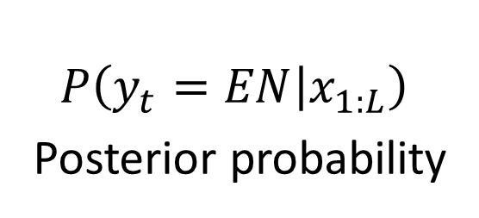

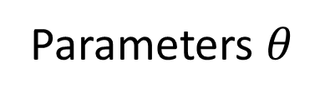

Posterior Probability- What is it?
$$y_{1:L}$$
$$C$$
$$A$$
$$C$$
$$G$$
$$T$$
$$G$$
$$T$$
$$T$$
$$A$$
$$G$$
$$A$$
$$T$$
$$T$$
$$A$$
$$A$$
$$G$$
$$C$$
$$A$$
$$C$$
$$G$$
$$T$$
$$G$$
$$T$$
$$A$$
$$A$$
$$G$$
$$C$$
$$A$$
$$C$$
$$G$$
$$T$$
$$x_{1:L}$$
$$P$$
$$1$$
$$0$$
$$t$$
$$0$$
$$P\left(y_{t}=EN | x_{1:L}\right)$$
Posterior probability
$$L$$
Parameters $θ$

Slide 34
Posterior Probability- What is it?
$$y_{1:L}$$
$$C$$
$$A$$
$$C$$
$$G$$
$$T$$
$$G$$
$$T$$
$$T$$
$$A$$
$$G$$
$$A$$
$$T$$
$$T$$
$$A$$
$$A$$
$$G$$
$$C$$
$$A$$
$$C$$
$$G$$
$$T$$
$$G$$
$$T$$
$$A$$
$$A$$
$$G$$
$$C$$
$$A$$
$$C$$
$$G$$
$$T$$
$$x_{1:L}$$
“counting” becomes expected value
$$P$$
$$1$$
$$0$$
$$t$$
$$0$$
$$P\left(y_{t}=EN | x_{1:L}\right)$$
Posterior probability
$$L$$
Parameters $θ$

Slide 35
Posterior Probability- What is it?
$$y_{1:L}$$
$$C$$
$$A$$
$$C$$
$$G$$
$$T$$
$$G$$
$$T$$
$$T$$
$$A$$
$$G$$
$$A$$
$$T$$
$$T$$
$$A$$
$$A$$
$$G$$
$$C$$
$$A$$
$$C$$
$$G$$
$$T$$
$$G$$
$$T$$
$$A$$
$$A$$
$$G$$
$$C$$
$$A$$
$$C$$
$$G$$
$$T$$
$$x_{1:L}$$
“counting” becomes expected value
$$P$$
$$1$$
$$0$$
$$t$$
$$0$$
$$P\left(y_{t}=EN | x_{1:L}\right)$$
Posterior probability
$$L$$
forward-backward algorithm
Parameters $θ$

Slide 36
Posterior Probability- What is it?
$$y_{1:L}$$
$$C$$
$$A$$
$$C$$
$$G$$
$$T$$
$$G$$
$$T$$
$$T$$
$$A$$
$$G$$
$$A$$
$$T$$
$$T$$
$$A$$
$$A$$
$$G$$
$$C$$
$$A$$
$$C$$
$$G$$
$$T$$
$$G$$
$$T$$
$$A$$
$$A$$
$$G$$
$$C$$
$$A$$
$$C$$
$$G$$
$$T$$
$$x_{1:L}$$
M-step
“counting” becomes expected value
$$P$$
$$1$$
$$0$$
$$t$$
$$0$$
$$P\left(y_{t}=EN | x_{1:L}\right)$$
Posterior probability
$$L$$
forward-backward algorithm
Parameters $θ$
E-step

Slide 37
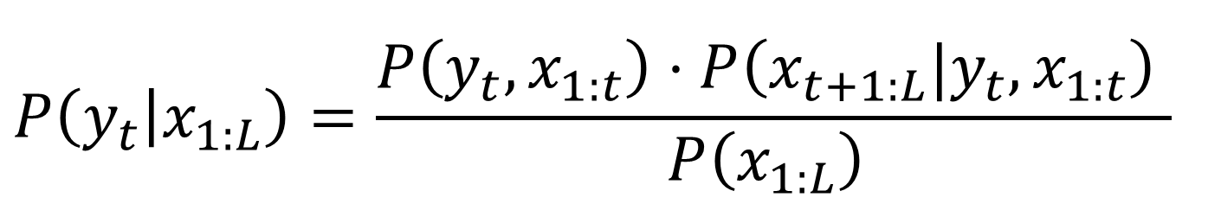
Forward-Backward Algorithm
$$P\left(y_{t} | x_{1:L}\right)=\frac{P\left(y_{t},x_{1:t}\right)⋅P\left({x_{t+1:L}|y}_{t},x_{1:t}\right) }{P\left(x_{1:L}\right) }$$

Slide 38

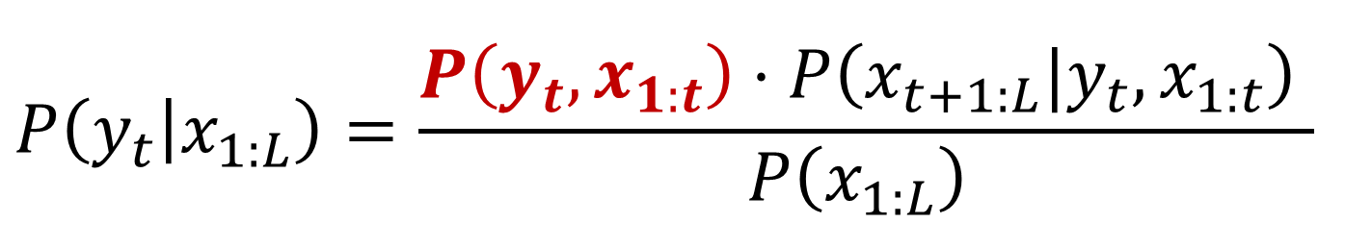


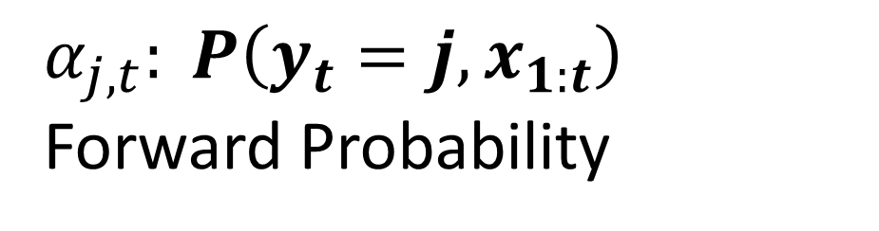

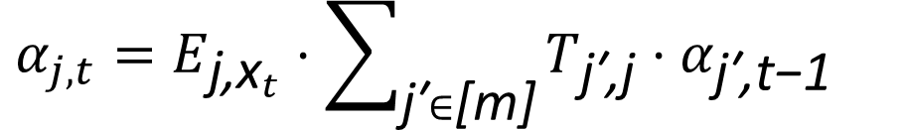
Forward-Backward Algorithm
$$P\left(y_{t} | x_{1:L}\right)=\frac{P\left(y_{t},x_{1:t}\right)⋅P\left({x_{t+1:L}|y}_{t},x_{1:t}\right) }{P\left(x_{1:L}\right) }$$
Forward Algorithm
$α_{j,t}: P\left(y_{t}=j,x_{1:t}\right)$ Forward Probability
$$t\text{−}1$$
$$t$$
$$α_{j,t}$$
$$j$$
$$α_{j,t}=E_{{\text{j}\text{,}\text{x}}_{t}}⋅\sum_{\text{j}\text{′}∈\text{[}\text{m}\text{]}}{T_{\text{j}\text{′}\text{,}\text{j}}⋅α_{\text{j}\text{′}\text{,}\text{t}\text{−}\text{1}}}$$

Slide 39
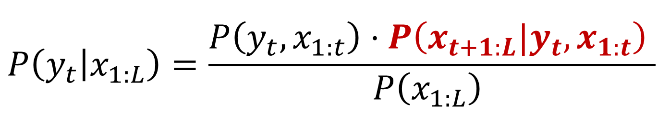


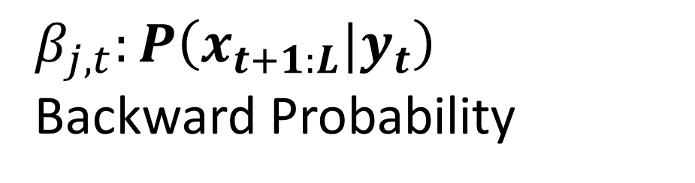
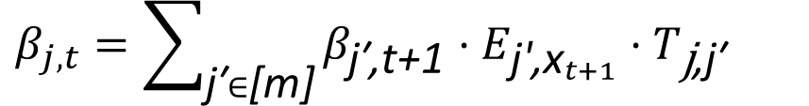


Forward-Backward Algorithm
$$P\left(y_{t} | x_{1:L}\right)=\frac{P\left(y_{t},x_{1:t}\right)⋅P\left({x_{t+1:L}|y}_{t},x_{1:t}\right) }{P\left(x_{1:L}\right) }$$
$$β_{j,t}:P\left({x_{t+1:L}|y}_{t}\right)$$
Backward Probability
$$t$$
$$t\text{+}1$$
$$β_{j,t}$$
$$j$$
$$β_{j,t}=\sum_{\text{j}\text{′}∈\text{[}\text{m}\text{]}}{β_{\text{j}\text{′}\text{,}\text{t}\text{+}\text{1}}⋅E_{{\text{j}\text{′}\text{,}\text{x}}_{t+1}}⋅T_{\text{j}\text{,}\text{j}\text{′}}}$$

Slide 40


















Forward Algorithm
$$t\text{−}|W_{1}|\text{−}1$$
$$t\text{−}|W_{2}|\text{−}1$$
$$t$$
$$t\text{−}1$$
$$t$$
$$α_{j,t}$$
$$j$$
$$α_{j,t}$$
$$j$$
Backward Algorithm
$$t$$
$$t\text{−}|W_{2}|\text{−}1$$
$$t\text{−}|W_{1}|\text{−}1$$
$$t$$
$$t\text{+}1$$
$$β_{j,t}$$
$$j$$
$$β_{j,t}$$
$$j$$

Slide 41

Most Likely Annotation
$$y_{1:L}$$
$$C$$
$$A$$
$$C$$
$$G$$
$$T$$
$$G$$
$$T$$
$$T$$
$$A$$
$$G$$
$$A$$
$$T$$
$$T$$
$$A$$
$$A$$
$$G$$
$$C$$
$$A$$
$$C$$
$$G$$
$$T$$
$$G$$
$$T$$
$$A$$
$$A$$
$$G$$
$$C$$
$$A$$
$$C$$
$$G$$
$$T$$
$$x_{1:L}$$
$$P$$
$$1$$
$$0$$
$$t$$
$$0$$
$$P\left(y_{t} | x_{1:L}\right)$$

Slide 42


Most Likely Annotation
$$BG$$
$$BG$$
$$BG$$
$$BG$$
$$BG$$
$$BG$$
$$BG$$
$$EN$$
$$EN$$
$$EN$$
$$EN$$
$$EN$$
$$EN$$
$$EN$$
$$EN$$
$$EN$$
$$EN$$
$$EN$$
$$EN$$
$$EN$$
$$EN$$
$$EN$$
$$EN$$
$$BG$$
$$BG$$
$$BG$$
$$BG$$
$BG$
$$BG$$
$BG$
$BG$
$$y_{1:L}$$
$$C$$
$$A$$
$$C$$
$$G$$
$$T$$
$$G$$
$$T$$
$$T$$
$$A$$
$$G$$
$$A$$
$$T$$
$$T$$
$$A$$
$$A$$
$$G$$
$$C$$
$$A$$
$$C$$
$$G$$
$$T$$
$$G$$
$$T$$
$$A$$
$$A$$
$$G$$
$$C$$
$$A$$
$$C$$
$$G$$
$$T$$
$$x_{1:L}$$
$$P$$
$$1$$
Viterbi Path
$$0$$
$$t$$
$$0$$
$$argmax_{y_{1:L}}P\left(y_{1:L} | x_{1:L}\right)$$

Slide 43
Most Likely Annotation
$$BG$$
$$BG$$
$$BG$$
$$BG$$
$$BG$$
$$BG$$
$$BG$$
$$EN$$
$$EN$$
$$EN$$
$$EN$$
$$EN$$
$$EN$$
$$EN$$
$$EN$$
$$EN$$
$$EN$$
$$EN$$
$$EN$$
$$EN$$
$$EN$$
$$EN$$
$$EN$$
$$BG$$
$$BG$$
$$BG$$
$$BG$$
$BG$
$$BG$$
$BG$
$BG$
$$y_{1:L}$$
$$C$$
$$A$$
$$C$$
$$G$$
$$T$$
$$G$$
$$T$$
$$T$$
$$A$$
$$G$$
$$A$$
$$T$$
$$T$$
$$A$$
$$A$$
$$G$$
$$C$$
$$A$$
$$C$$
$$G$$
$$T$$
$$G$$
$$T$$
$$A$$
$$A$$
$$G$$
$$C$$
$$A$$
$$C$$
$$G$$
$$T$$
$$x_{1:L}$$
Discussion:
max posterior vs Viterbi algorithm
$$P$$
$$1$$
Viterbi Path
$$0$$
$$t$$
$$0$$
$$argmax_{y_{1:L}}P\left(y_{1:L} | x_{1:L}\right)$$

Slide 44
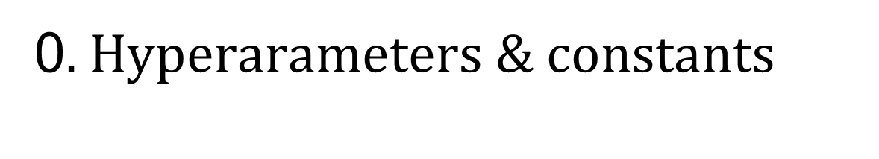
0. $Hyperarameters \& constants$
PWMs – 25 random TFs
Number of base states – 5 (4 enhancers, 1 background)
Length of sequences – 1500
Number of sequences – 500 (85% train, 15% test)
Order – 3 (emission depends on 2 previous emissions)
Max EM iterations – 40
EM Repeats – 10

Slide 45
0. $Hyperarameters \& constants$
PWMs – 50 random TFs
Number of base states – 3 (enhancer 1, enhancer2, background)
Length of sequences - 1500
Number of sequences – 500 (85% train, 15% test)
Order – 3 (emission depends on 2 previous emissions)

Slide 46
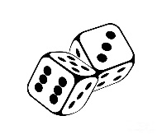
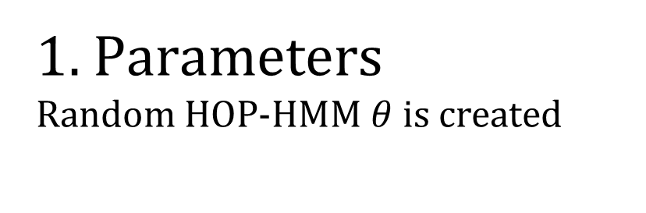
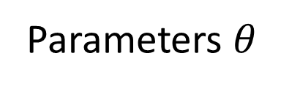
1. $Parameters$
Random HOP-HMM $θ$ is created
Parameters $θ$

Slide 47
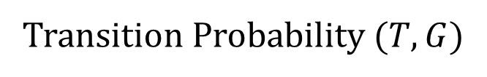
























































































Background States Emission Probability ($E$)
Start Probability ($π)$
Transition Probability ($T,G$)
$$T$$
$$G$$
$$EN_{1}$$
$$EN_{2}$$
$$EN_{3}$$
$$EN_{4}$$
$$BG$$
$$to$$
$$EN$$
$$BG$$
$$TF_{1}^{∗}$$
$$…$$
$$TF_{3}^{∗}$$
$$BG$$
$$from$$
$$0.05$$
$$0.05$$
$$0.05$$
$$0.05$$
$$0.8$$
$$EN$$
$$0.8$$
$$0.1$$
$$0.05$$
$$0.0$$
$$EN$$
$$BG$$
$$0. 1$$
$$0.8$$
$$0.0$$
$$0.1$$
$$EN_{1}$$
$$EN_{2}$$
$$EN_{3}$$
$$EN_{4}$$
$$BG$$
$$TF_{1}^{∗}$$
$$…$$
$$…$$
$$TF_{3}^{∗}$$
$$EN_{1}$$
$$0.9$$
$$0.01$$
$$0.01$$
$$0.01$$
$$0.06$$
$$0.01$$
$$0.01$$
$$0.01$$
$$0.06$$
$$EN_{2}$$
$$0.01$$
$$0.9$$
$0.0$1
$0.0$1
$$0.05$$
$$0.9$$
$0.0$1
$0.0$1
$$0.05$$
$$EN_{3}$$
$$0.01$$
$$0.02$$
$$0.9$$
$$0.01$$
$$0.06$$
$$0.02$$
$$0.9$$
$$0.01$$
$$0.06$$
$$EN_{4}$$
$$0.03$$
$0.0$1
$$0.01$$
$$0.9$$
$$0.05$$
$0.0$1
$$0.01$$
$$0.9$$
$$0.05$$
$$BG$$
$$0.03$$
$0.0$3
$$0.02$$
$$0.02$$
$$0.9$$
$0.0$3
$$0.02$$
$$0.02$$
$$0.9$$

Slide 48



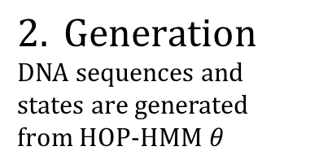

$$2. Generation$$
DNA sequences and states are generated from HOP-HMM $θ$
$$Y Train$$
$$G$$
$$C$$
$$T$$
$$T$$
$$G$$
$$T$$
$$T$$
$$C$$
$$T$$
$$C$$
$$T$$
$$C$$
$$C$$
$$A$$
$$T$$
$$T$$
$$C$$
$$T$$
$$T$$
$$C$$
$$G$$
$$Y Test$$
$$A$$
$$C$$
$$T$$
$$T$$
$$T$$
$$C$$
$$T$$
$$C$$
$$T$$
$$C$$
$$T$$
$$A$$
$$C$$
$$T$$
$$G$$
$$C$$
$$A$$
$$G$$
$$A$$
$$T$$
$$C$$
$$T$$
$$T$$
$$A$$
$$T$$
$$G$$
$$A$$
$$T$$
$$C$$
$$G$$
$$A$$
$$T$$
$$T$$
$$C$$
$$T$$
$$T$$
$$C$$
$$T$$
$$G$$
$$C$$
$$T$$
$$A$$
$$X Train$$
$$X Test$$
$$A$$
$$C$$
$$T$$
$$C$$
$$C$$
$$T$$
$$T$$
$$C$$
$$T$$
$$T$$
$$C$$
$$G$$
$$T$$
$$T$$
$$T$$
$$G$$
$$A$$
$$T$$
$$C$$
$$A$$
$$A$$

Slide 49
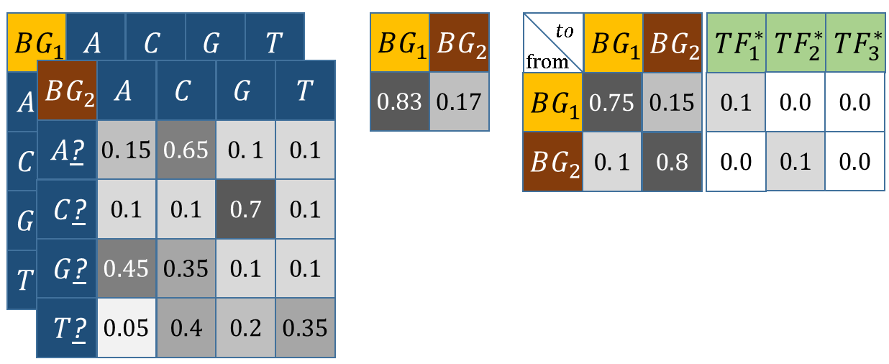


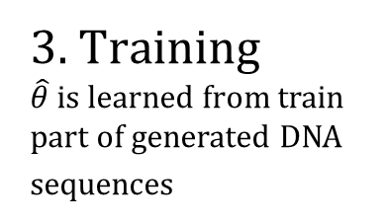



3. $Training$
$\hat{θ}$ is learned from train part of generated DNA sequences
Baum-Welch
Algorithm
E
$$π$$
$$T$$
$$G$$
$$X Train$$
$$Estimated \hat{θ}$$

Slide 50
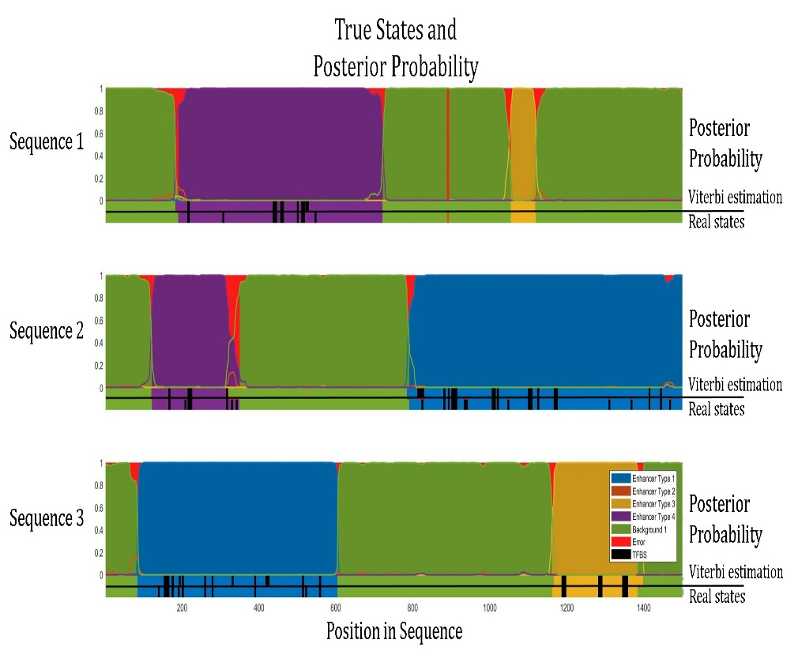




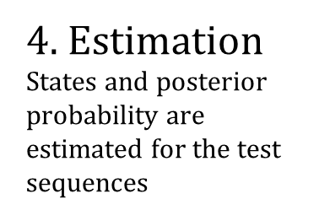
4. $Estimation$
States and posterior probability are estimated for the test sequences
Viterbi Algorithm
$$\hat{Y} Test Estimation$$
$$X Test$$
$$Estimated \hat{θ}$$
Forward-Backward
Algorithm
$$Posterior Probability$$

Slide 51
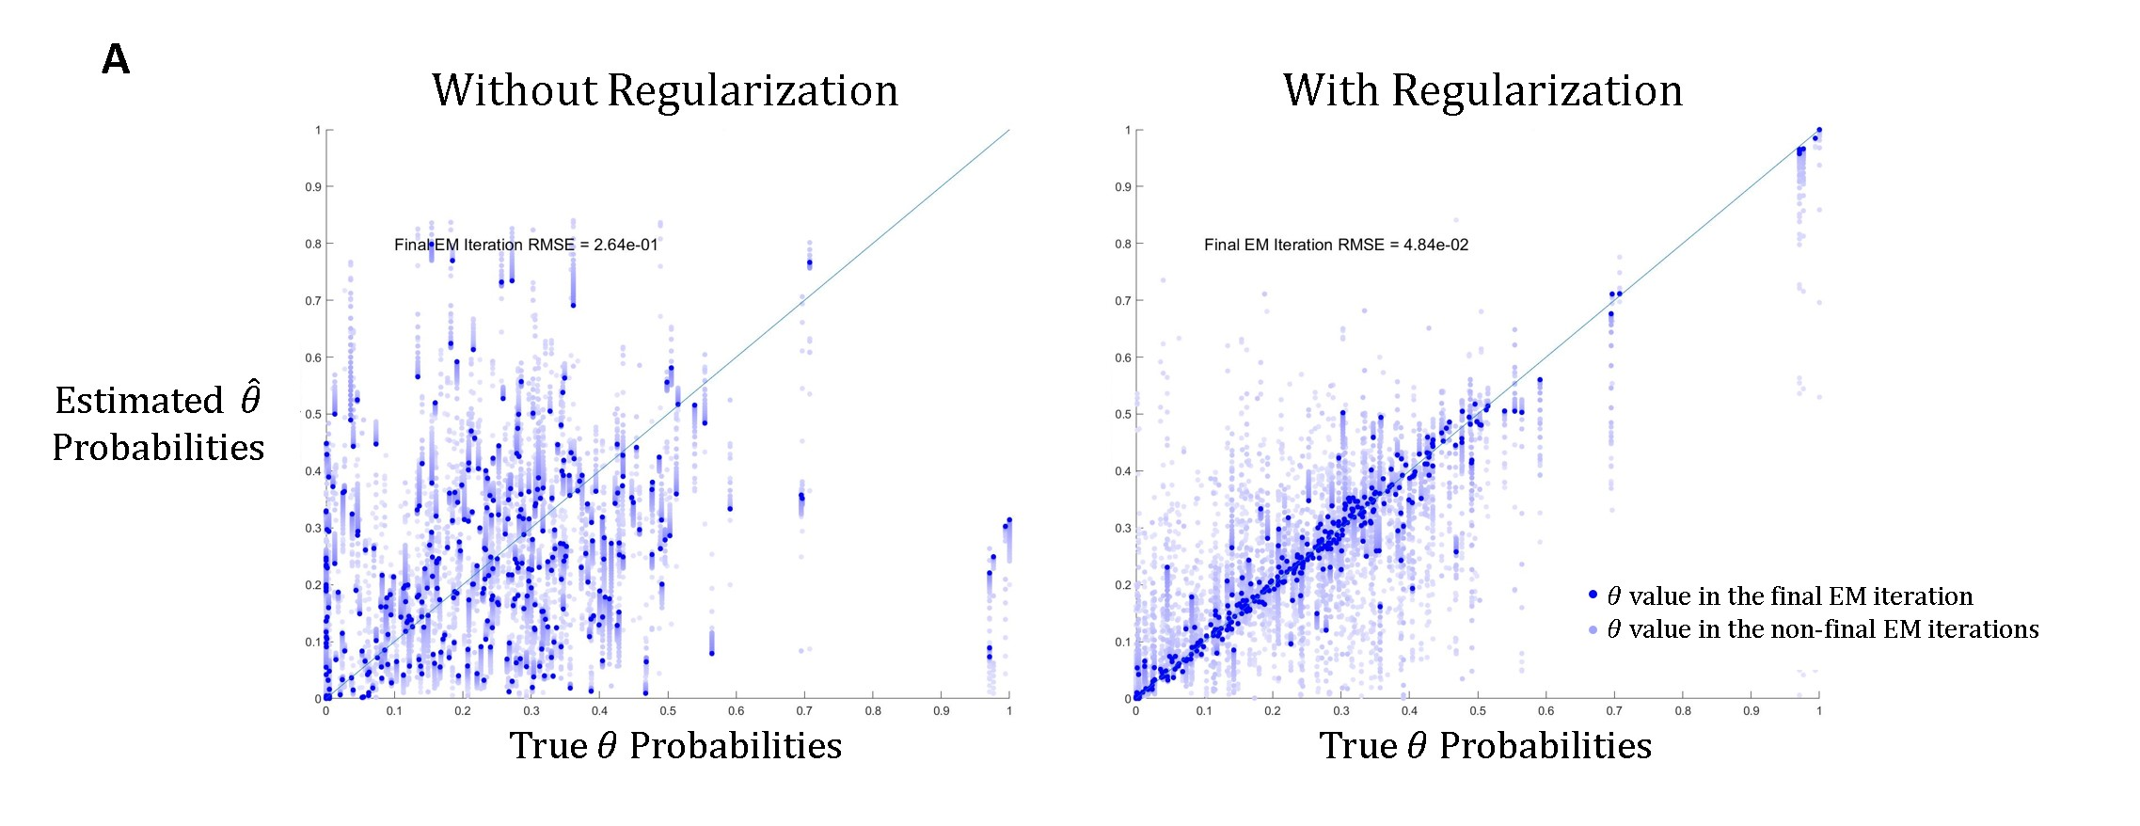
EM Regularization

Slide 52
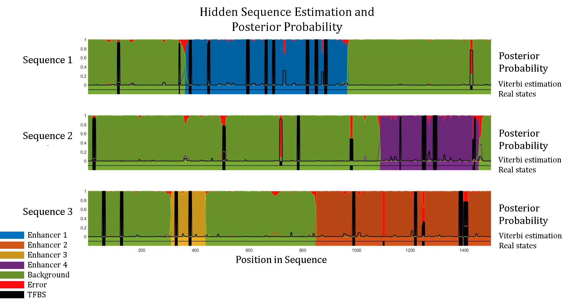

Slide 53
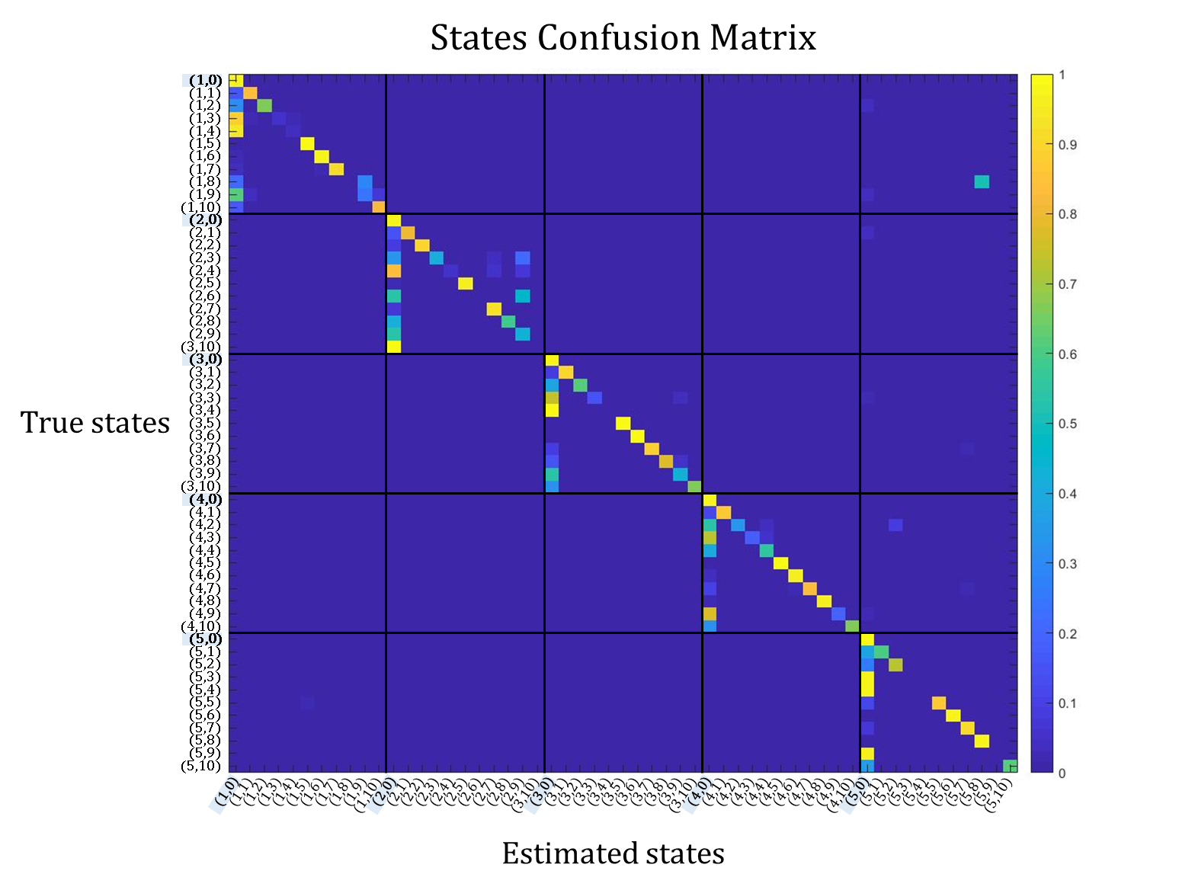

Slide 54
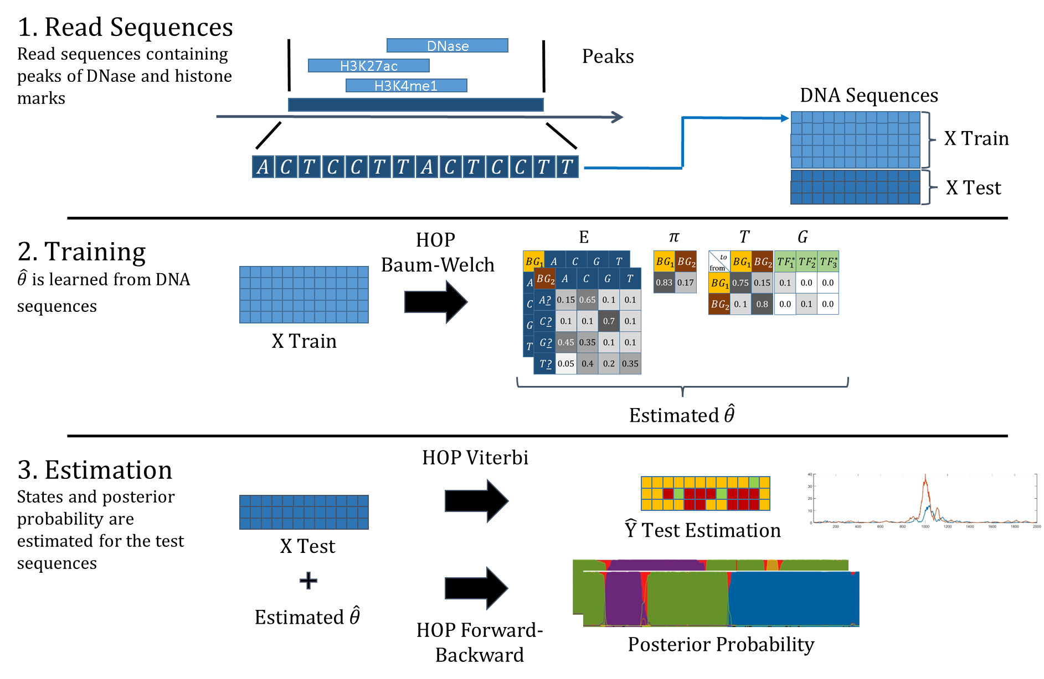

Slide 55
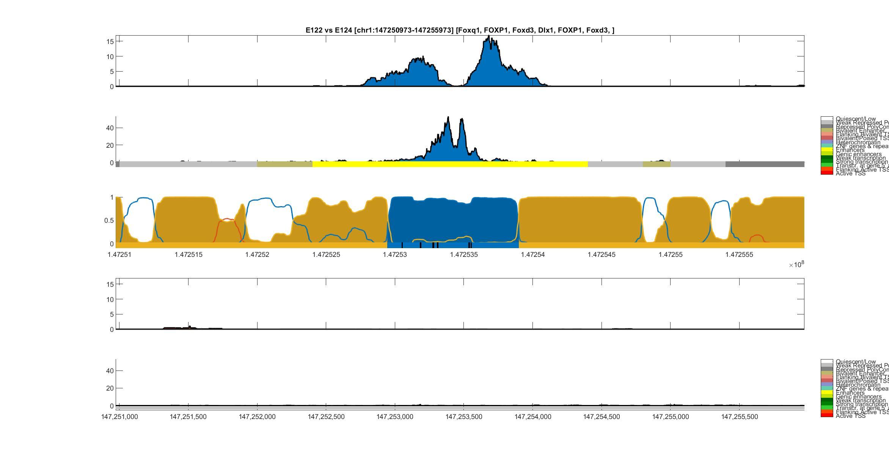
Umbilical Vein Endothelial (E122) vs Monocyte (E124)
H3K27ac
Umbilical Vein
Endothelial
DNase-I
ChromHMM
HOP-HMM
Prediction
Posterior
Probability
Viterbi Path
H3K27ac
Monocyte
DNase-I
ChromHMM
hg19:chr1

Slide 56
Umbilical Vein Endothelial (E122) vs Monocyte (E124)
H3K27ac
Umbilical Vein
Endothelial
DNase-I
ChromHMM
HOP-HMM
Prediction
Posterior
Probability
FOXQ1
FOXD3
FOXD3
Viterbi Path
FOXP1
DIX1
FOXP1
H3K27ac
Monocyte
DNase-I
ChromHMM
hg19:chr1
Monocytes-CD14+ RO01746 Primary Cells. Code: E124
HUVEC Umbilical Vein Endothelial Primary Cells. Code: E122
Notes:
FOX proteins - embryonic development

Slide 57
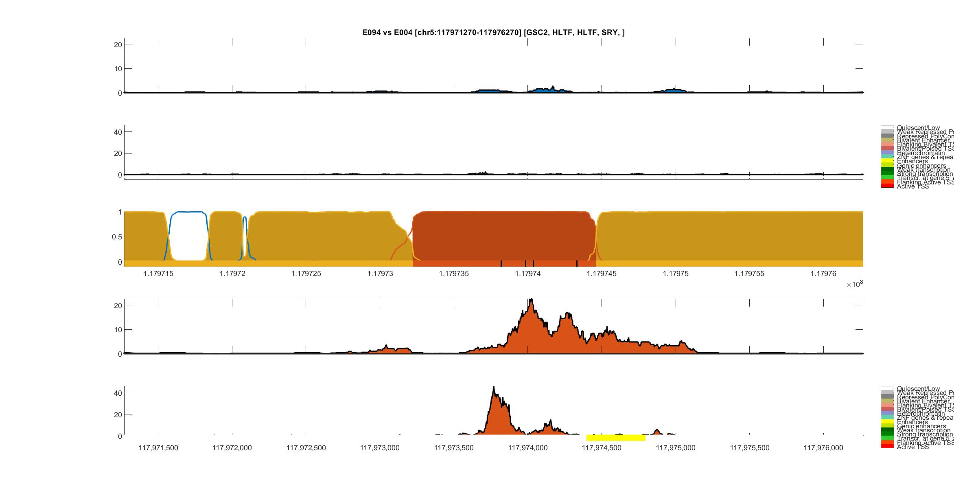
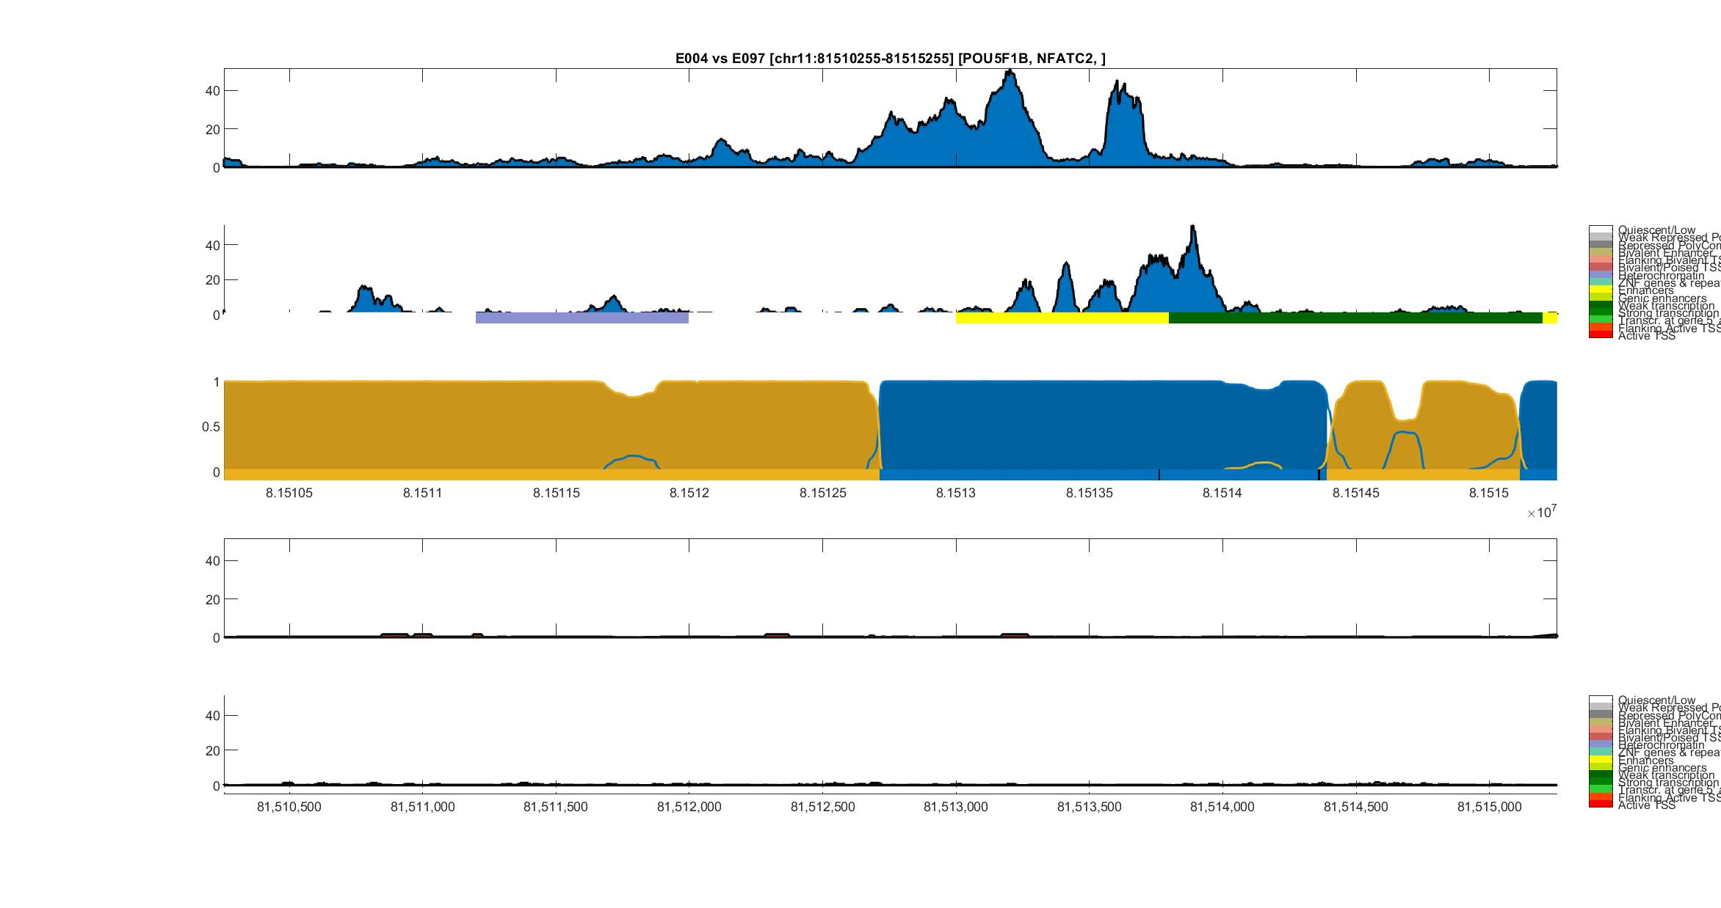
Gastric (E094) vs Mesendoderm (E004)
H3K27ac
Gastric
DNase-I
ChromHMM
HOP-HMM
Prediction
Posterior
Probability
GSC2
HLTF
HLTF
SRY
Viterbi Path
H3K27ac
Mesendoderm
DNase-I
ChromHMM
hg19:chr5
Gastric. Code: E094
H1 BMP4 Derived Mesendoderm Cultured Cells. Code: E004
Notes:
SRY – sex determining
Mesendoderm – first stage cells in embryo

Slide 58
Mesendoderm (E004) vs Ovary (E097)
H3K27ac
Mesendoderm
DNase-I
ChromHMM
HOP-HMM
Prediction
Posterior
Probability
POU5F1B
NFATC2
Viterbi Path
H3K27ac
Ovary
DNase-I
ChromHMM
hg19:chr11
H1 BMP4 Derived Mesendoderm Cultured Cells. Code: E004

