Slide 1
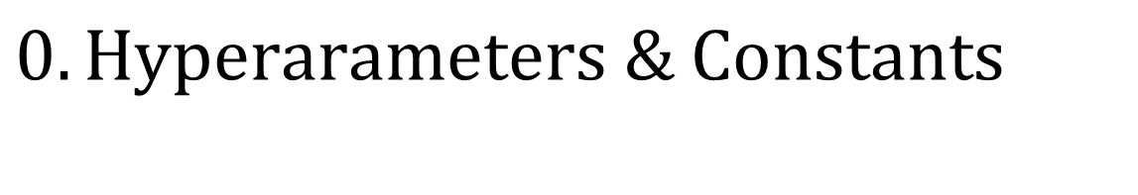
$$0.Hyperarameters \& Constants$$
PWMs – 25 random TFs from JASPAR 2018
Number of base states – 5 (4 enhancers, 1 background)
Length of sequences – 1500
Number of sequences – 500 (85% train, 15% test)
Order – 3 (emission depends on 2 previous emissions)
Max EM iterations – 40
EM Repeats – 10
575 learned parameters
Khan et al., 2018

Slide 2
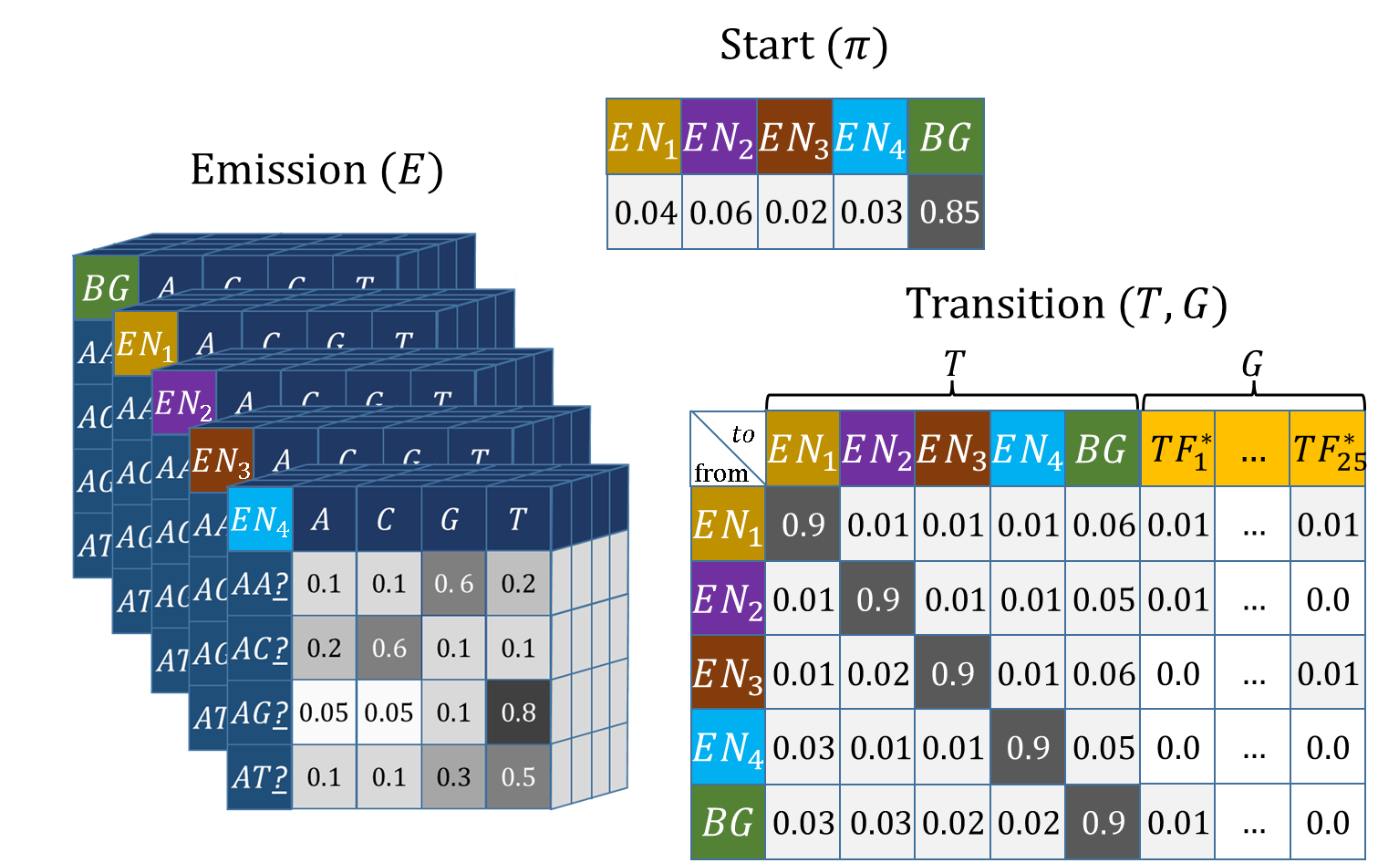

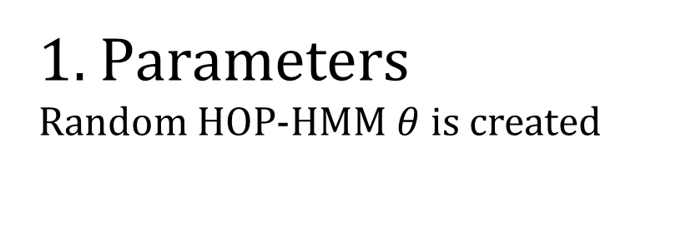

1. $Parameters$
Random HOP-HMM $θ$ is created
Parameters $θ$

Slide 3
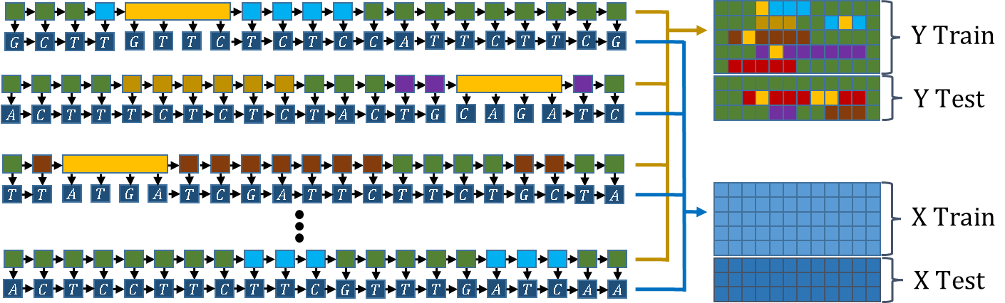


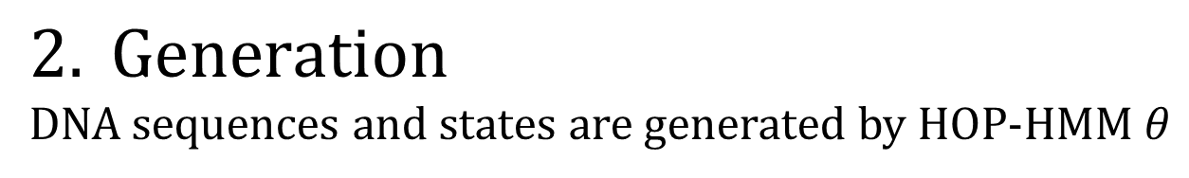


$$2. Generation$$
DNA sequences and states are generated by HOP-HMM $θ$
$$Y Train$$
$$G$$
$$C$$
$$T$$
$$T$$
$$G$$
$$T$$
$$T$$
$$C$$
$$T$$
$$C$$
$$T$$
$$C$$
$$C$$
$$A$$
$$T$$
$$T$$
$$C$$
$$T$$
$$T$$
$$C$$
$$G$$
$$Y Test$$
$$A$$
$$C$$
$$T$$
$$T$$
$$T$$
$$C$$
$$T$$
$$C$$
$$T$$
$$C$$
$$T$$
$$A$$
$$C$$
$$T$$
$$G$$
$$C$$
$$A$$
$$G$$
$$A$$
$$T$$
$$C$$
$$T$$
$$T$$
$$A$$
$$T$$
$$G$$
$$A$$
$$T$$
$$C$$
$$G$$
$$A$$
$$T$$
$$T$$
$$C$$
$$T$$
$$T$$
$$C$$
$$T$$
$$G$$
$$C$$
$$T$$
$$A$$
$$X Train$$
$$X Test$$
$$A$$
$$C$$
$$T$$
$$C$$
$$C$$
$$T$$
$$T$$
$$C$$
$$T$$
$$T$$
$$C$$
$$G$$
$$T$$
$$T$$
$$T$$
$$G$$
$$A$$
$$T$$
$$C$$
$$A$$
$$A$$

Slide 4
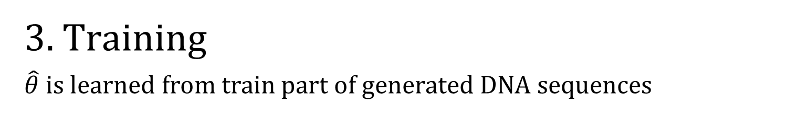


3. $Training$
$\hat{θ}$ is learned from train part of generated DNA sequences
Baum-Welch
Algorithm
$$X Train$$
Estimated $\hat{θ}$

Slide 5
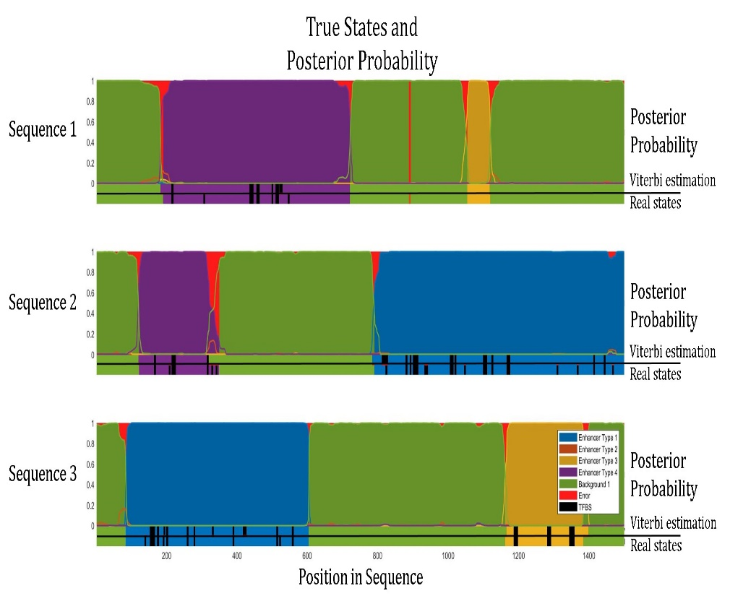




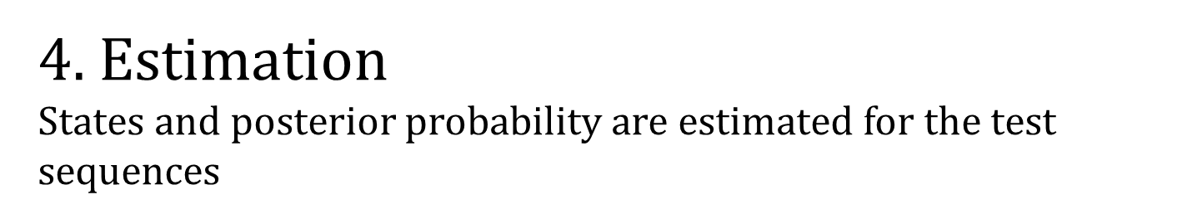
4. $Estimation$
States and posterior probability are estimated for the test sequences
$$X Test$$
Viterbi Algorithm
$$\hat{Y} Test Estimation (Viterbi paths)$$
Forward-Backward
Algorithm
$$Posterior Probability$$
Estimated $\hat{θ}$

Slide 6
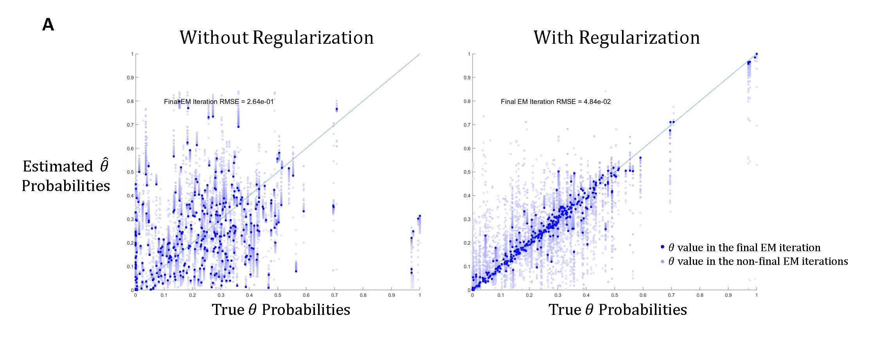
EM Regularization

Slide 7
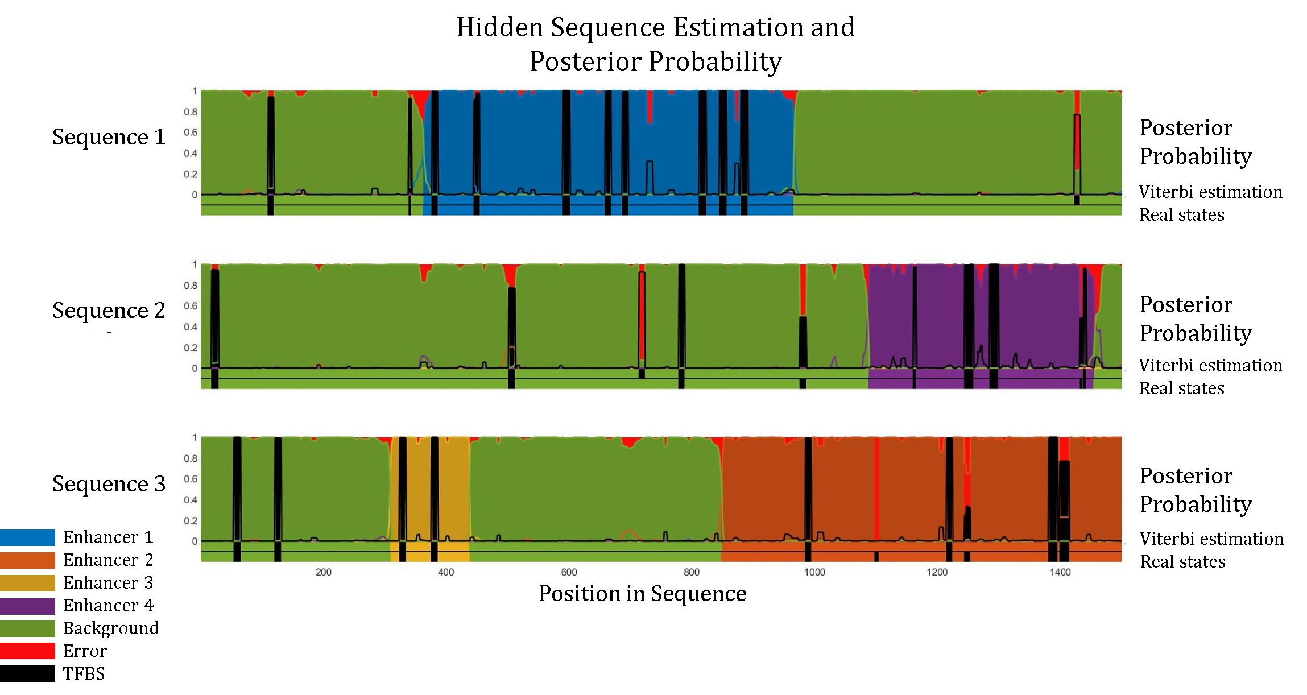

Slide 8
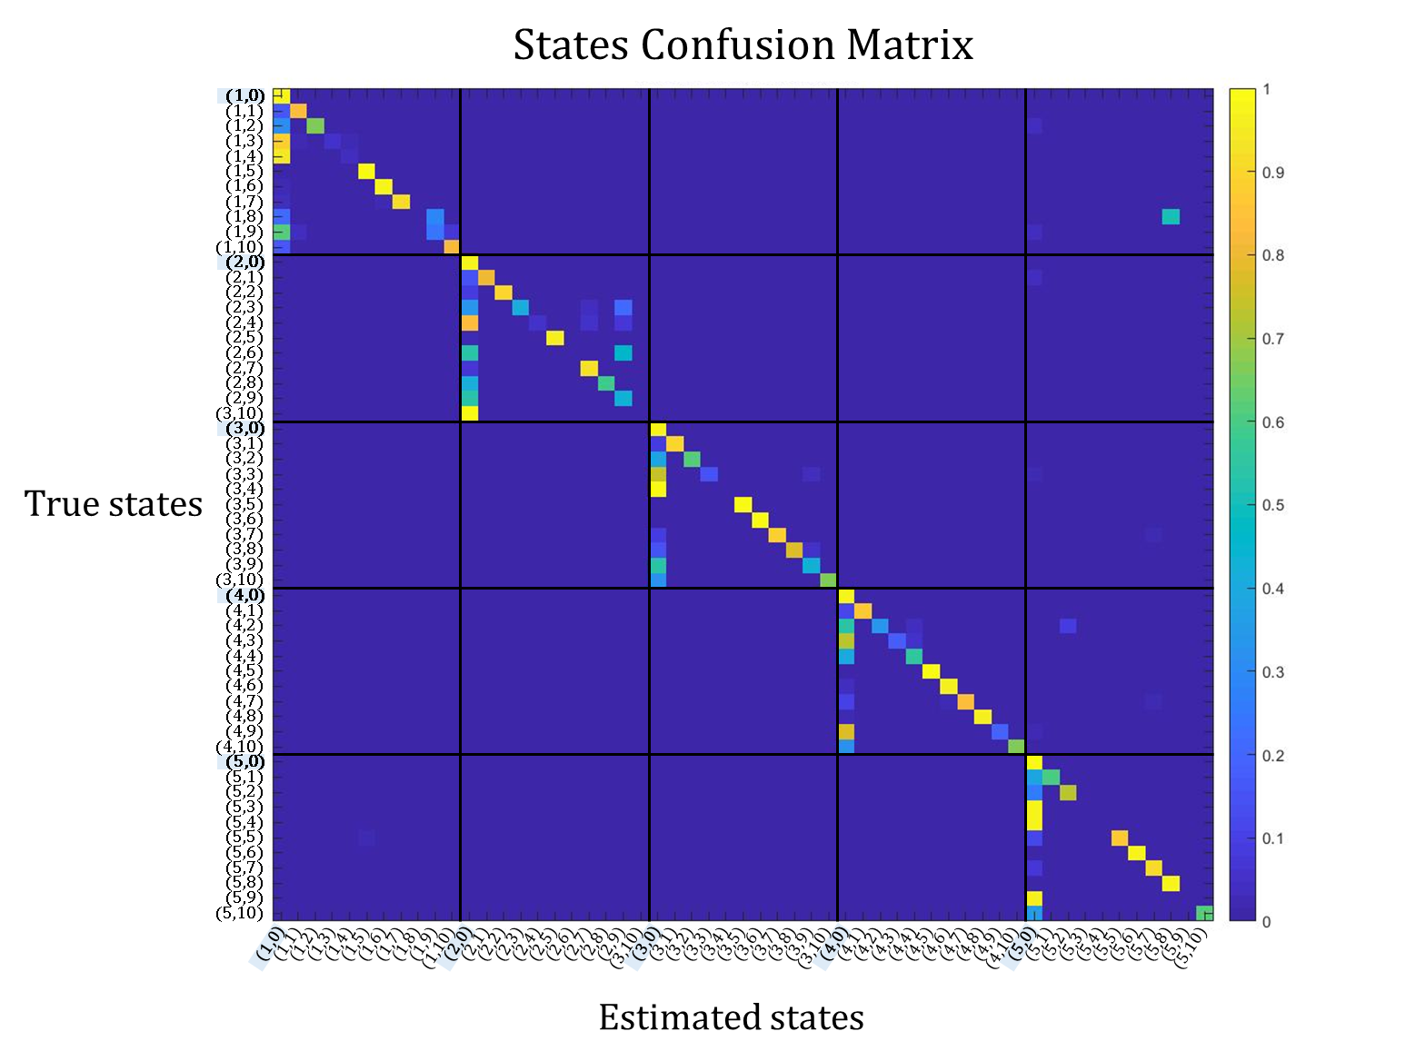

Slide 9
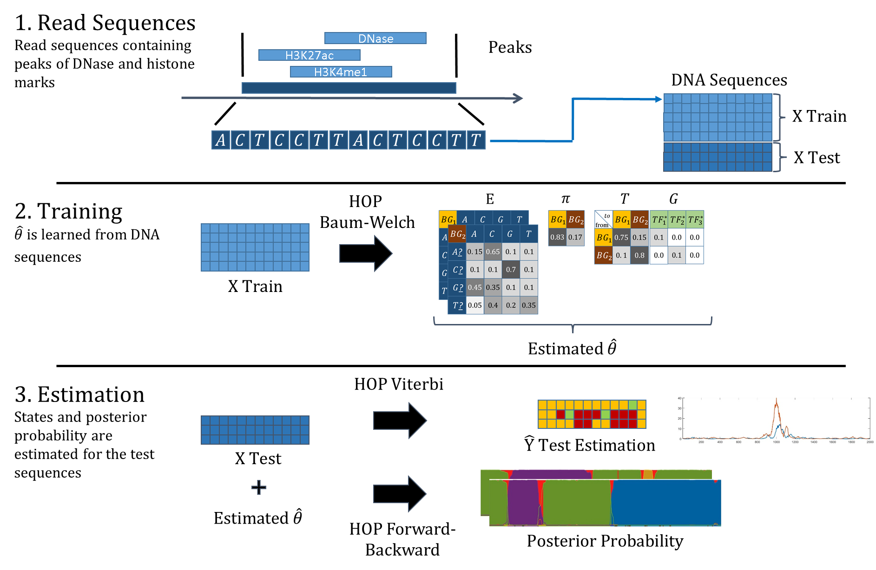

Slide 10
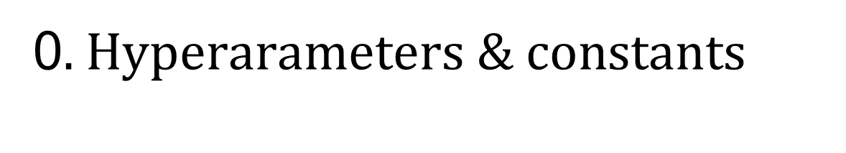
0. $Hyperarameters \& constants$
PWMs – 50 random TFs
Number of base states – 3 (enhancer 1, enhancer2, background)
Length of sequences - 1500
Number of sequences – 500 (85% train, 15% test)
Order – 3 (emission depends on 2 previous emissions)

Slide 11
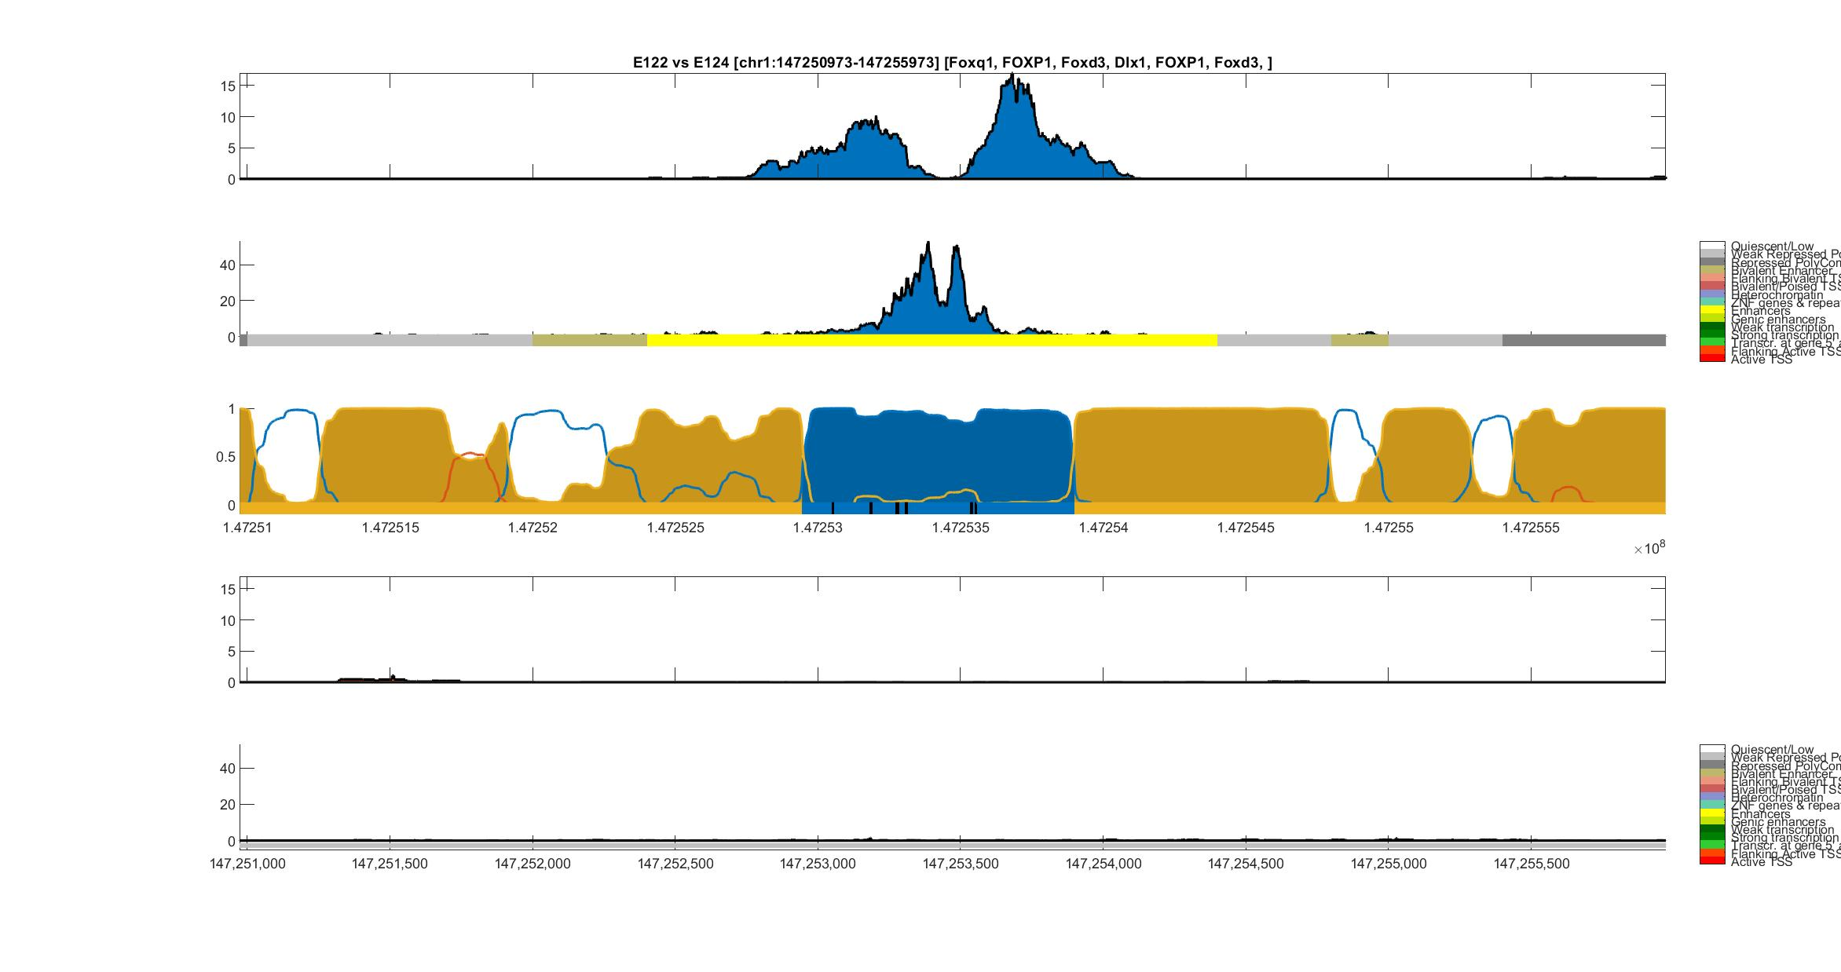
Umbilical Vein Endothelial (E122) vs Monocyte (E124)
H3K27ac
Umbilical Vein
Endothelial
DNase-I
ChromHMM
HOP-HMM
Prediction
Posterior
Probability
Viterbi Path
H3K27ac
Monocyte
DNase-I
ChromHMM
hg19:chr1

Slide 12
Umbilical Vein Endothelial (E122) vs Monocyte (E124)
H3K27ac
Umbilical Vein
Endothelial
DNase-I
ChromHMM
HOP-HMM
Prediction
Posterior
Probability
FOXQ1
FOXD3
FOXD3
Viterbi Path
FOXP1
DIX1
FOXP1
H3K27ac
Monocyte
DNase-I
ChromHMM
hg19:chr1
Monocytes-CD14+ RO01746 Primary Cells. Code: E124
HUVEC Umbilical Vein Endothelial Primary Cells. Code: E122
Notes:
FOX proteins - embryonic development

Slide 13
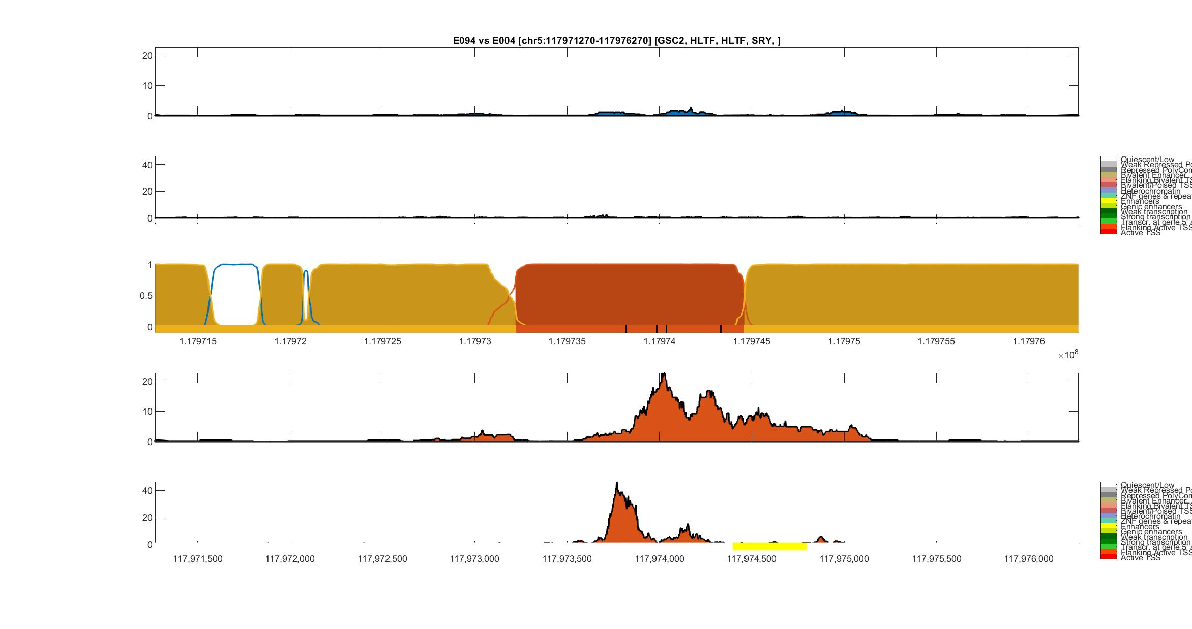
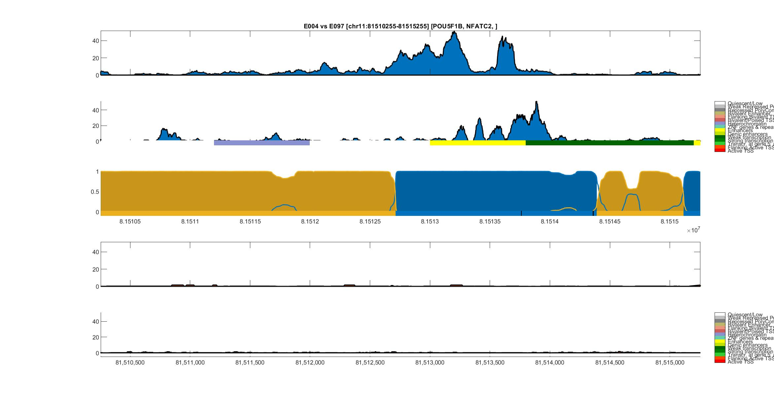
Gastric (E094) vs Mesendoderm (E004)
H3K27ac
Gastric
DNase-I
ChromHMM
HOP-HMM
Prediction
Posterior
Probability
GSC2
HLTF
HLTF
SRY
Viterbi Path
H3K27ac
Mesendoderm
DNase-I
ChromHMM
hg19:chr5
Gastric. Code: E094
H1 BMP4 Derived Mesendoderm Cultured Cells. Code: E004
Notes:
SRY – sex determining
Mesendoderm – first stage cells in embryo

Slide 14
Mesendoderm (E004) vs Ovary (E097)
H3K27ac
Mesendoderm
DNase-I
ChromHMM
HOP-HMM
Prediction
Posterior
Probability
POU5F1B
NFATC2
Viterbi Path
H3K27ac
Ovary
DNase-I
ChromHMM
hg19:chr11
H1 BMP4 Derived Mesendoderm Cultured Cells. Code: E004

