Slide 1



































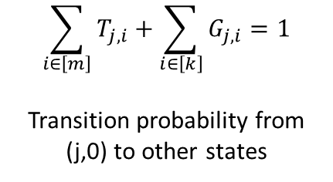









































































$$\sum_{i∈\left[m\right]}{T_{j,i}}+\sum_{i∈\left[k\right]}{G_{j,i}}=1$$
Transition probability from (j,0) to other states
$$to$$
$$BG_{1}$$
$$BG_{2}$$
$$TF_{1}^{1}$$
$$TF_{2}^{1}$$
$$TF_{3}^{1}$$
$$TF_{1}^{2}$$
$$TF_{2}^{2}$$
$$TF_{3}^{2}$$
$$from$$
Transition Probability
$$BG_{1}$$
$$0.8$$
$$0.1$$
$$0.05$$
$$0.0$$
$$0.05$$
$$0$$
$$0$$
$$0$$
$$BG_{2}$$
$$0. 1$$
$$0.8$$
$$0$$
$$0$$
$$0$$
$$0.0$$
$$0.1$$
$$0.0$$
$$T$$
$$G$$
$$to$$
$$BG_{1}$$
$$BG_{2}$$
$$TF_{1}^{∗}$$
$$TF_{2}^{∗}$$
$$TF_{3}^{∗}$$
$$TF_{1}^{1}$$
$$1$$
$$0$$
$$0$$
$$0$$
$$0$$
$$0$$
$$0$$
$$0$$
$$from$$
$$Compact$$
$$BG_{1}$$
$$0.8$$
$$0.1$$
$$0.05$$
$$0.0$$
$$0.05$$
$$TF_{2}^{1}$$
$$1$$
$$0$$
$$0$$
$$0$$
$$0$$
$$0$$
$$0$$
$$0$$
$$BG_{2}$$
$$0. 1$$
$$0.8$$
$$0.0$$
$$0.1$$
$$0.0$$
$$TF_{3}^{1}$$
$$1$$
$$0$$
$$0$$
$$0$$
$$0$$
$$0$$
$$0$$
$$0$$
$$TF_{1}^{2}$$
$$0$$
$$1$$
$$0$$
$$0$$
$$0$$
$$0$$
$$0$$
$$0$$
$$TF_{2}^{2}$$
$$0$$
$$1$$
$$0$$
$$0$$
$$0$$
$$0$$
$$0$$
$$0$$
$$TF_{3}^{2}$$
$$0$$
$$1$$
$$0$$
$$0$$
$$0$$
$$0$$
$$0$$
$$0$$
$$BG_{2}$$
$$BG_{2}$$
$$BG_{2}$$

Slide 2
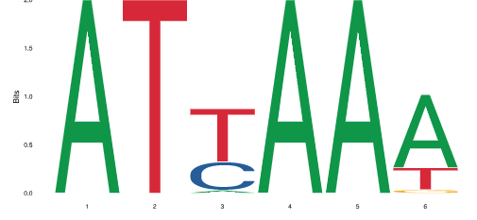
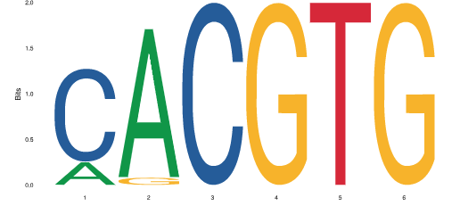
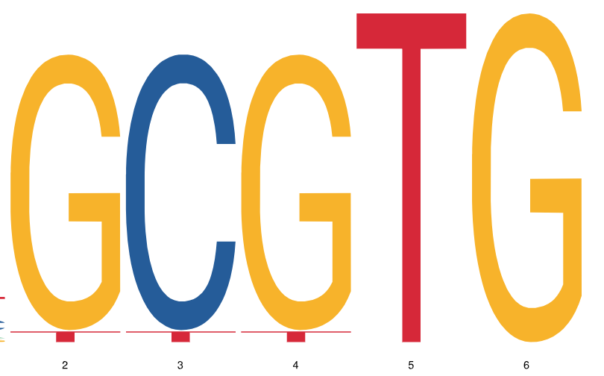




















Hidden State Machine
$$(1,0)$$
$$(1,1)$$
$$(1,2)$$
$${ (1,k)}_{ }$$
$$G$$
$$T$$
$$A$$
$$C$$
$$\left(2,0\right)$$
$$(2,1)$$
$$(2,2)$$
$${ (2,k)}_{ }$$
$$G$$
$$T$$
$$A$$
$$C$$
$$(m,0)$$
$$(m,1)$$
$$(m,2)$$
$${ (m,k)}_{ }$$
$$G$$
$$T$$
$$A$$
$$C$$

Slide 3
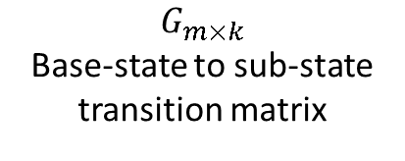
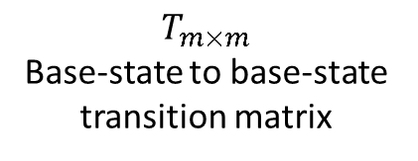

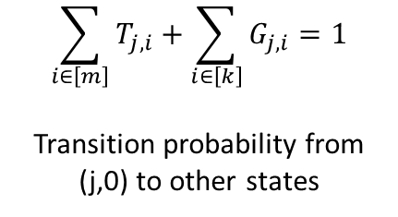
$$T_{m×m}$$
Base-state to base-state transition matrix
$$G_{m×k}$$
Base-state to sub-state transition matrix
$$j$$
$$\sum_{i∈\left[m\right]}{T_{j,i}}+\sum_{i∈\left[k\right]}{G_{j,i}}=1$$
Transition probability from (j,0) to other states

Slide 4
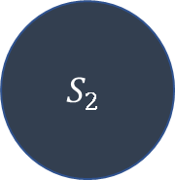

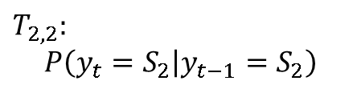
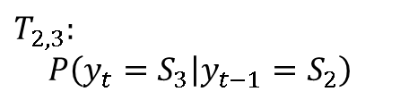

Markov Model
$$S_{1}$$
$$S_{2}$$
$$T_{2,2}:$$
$$P\left(y_{t}=S_{2} | y_{t−1}=S_{2}\right)$$
$$T_{2,3}:$$
$$P\left(y_{t}=S_{3} | y_{t−1}=S_{2}\right)$$
$$S_{3}$$

Slide 5
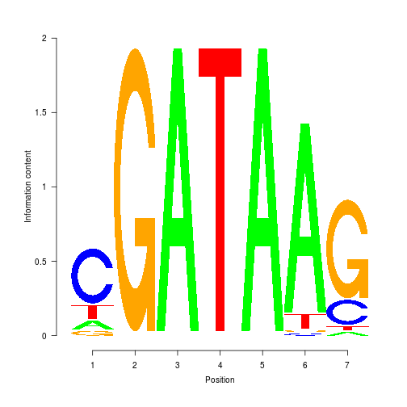
Sub-State (PWM)
(j,0)
(`)
(j,0)
Hidden States
T
C
G
A
T
A
A
G
G
Observations

Slide 6
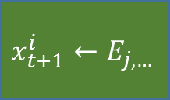



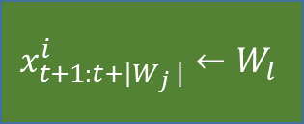

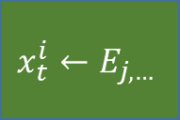


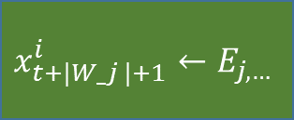



$$y_{t+1:t+\left|W_{j}\right|}^{i}$$
$$y_{t+\left|W_{j}\right|+1}^{i}$$
(j,l)
(j,0)
$$l←G_{j,∗}$$
$$φ=1$$
$$y_{t}^{i}$$
(j,0)
$$φ\sim Bin(F_{j},1)$$
$$x_{t+1:t+|W_{j} |}^{i}←W_{l}$$
$$x_{t+|W_j |+1}^{i}←E_{j,…}$$
$$y_{t+1}^{i}$$
$$φ=0$$
$$x_{t}^{i}←E_{j,…}$$
(j’,0)
$$j′←T_{j,∗}$$
$$x_{t+1}^{i}←E_{j,…}$$

Slide 7
















Forward Algorithm
$$t−|W_{1}|−1$$
$$t−|W_{2}|−1$$
$$t$$
$$t−1$$
$$t$$
$$α_{j,t}$$
$$j$$
$$α_{j,t}$$
$$j$$
Backward Algorithm
$$t$$
$$t−|W_{2}|−1$$
$$t−|W_{1}|−1$$
$$t$$
$$t+1$$
$$β_{j,t}$$
$$j$$
$$β_{j,t}$$
$$j$$

Slide 8









$$t$$
$$t−|W_{2}|−1$$
$$t−|W_{1}|−1$$
$$t$$
$t$+1
$$j$$
$$β_{j,t}$$
$$j$$
$$β_{j,t}$$

Slide 9
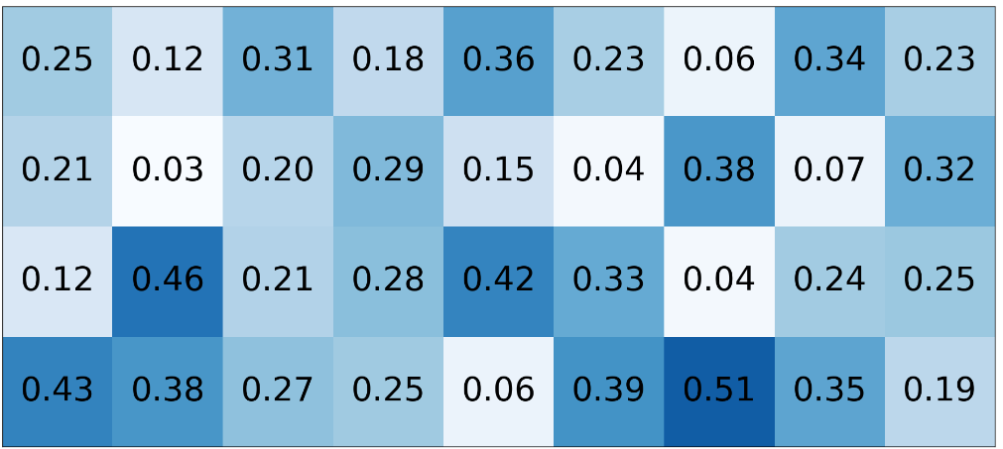
…CGGCTACTCTGTA…
PWM
0
0
0
1
0
0
0
0
0
0
1
0
0
1
0
1
0
0
1
0
0
0
0
0
0
0
1
0
0
1
0
0
1
0
1
0

Slide 10
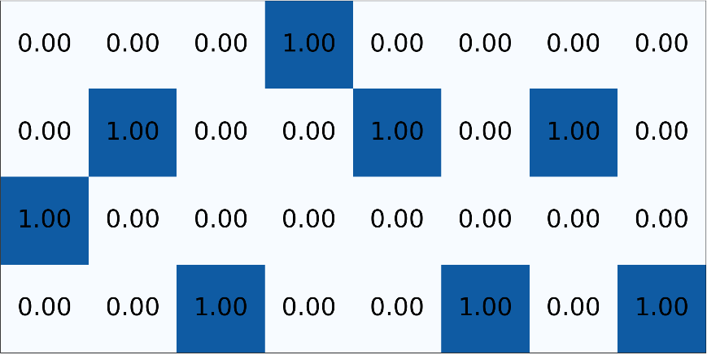
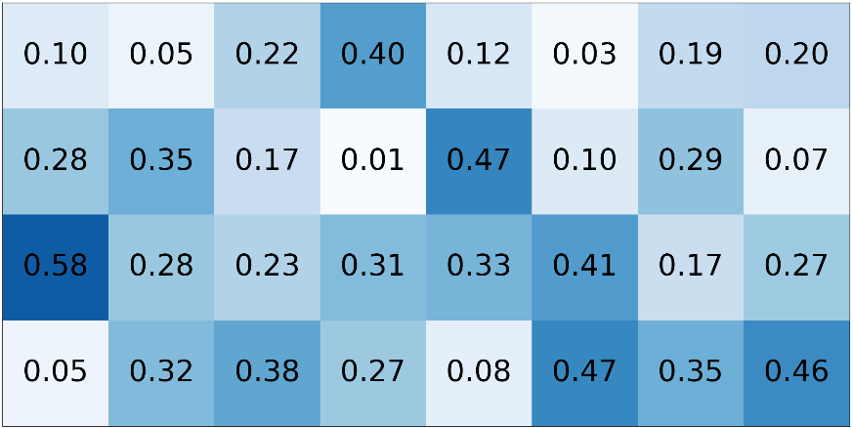
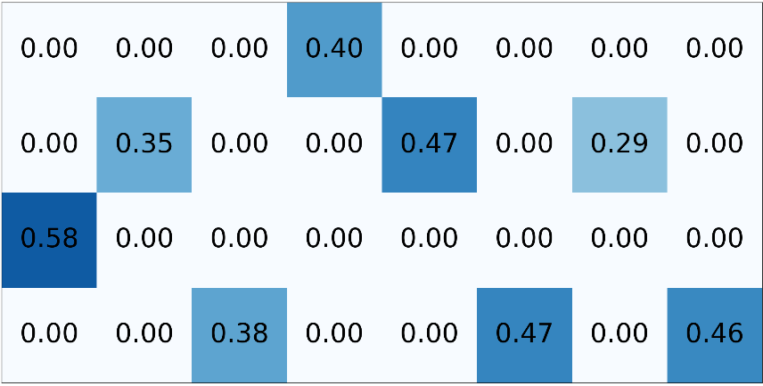
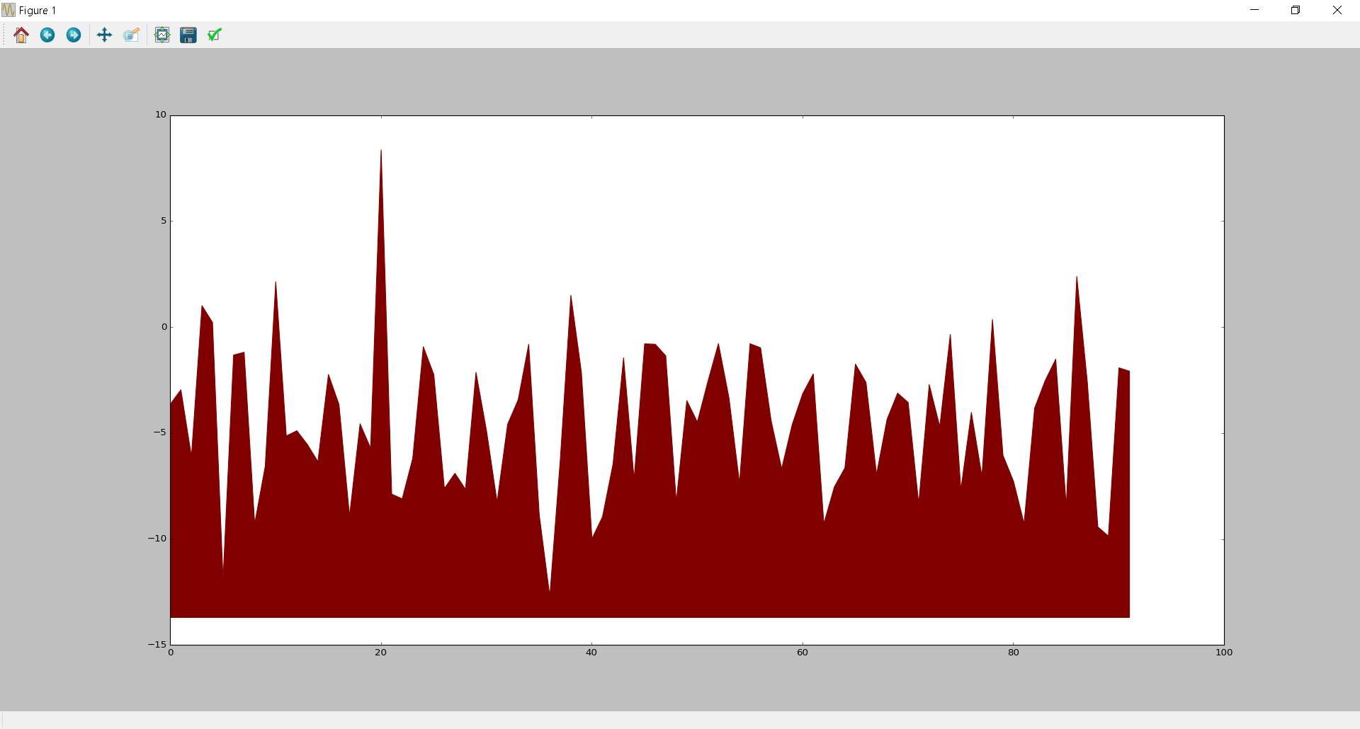
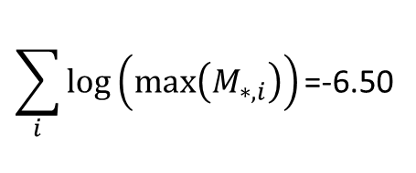
…CGGCTACTCTTA…
One-hot encoding
PWM
M
$$\sum_{i}{log⁡\left(max⁡\left(M_{∗,i}\right)\right)\text{=}\text{−}\text{6}\text{.}\text{50}}$$
Log likelihood of TF binding
Location in sequence

Slide 11
