Slide 1
HOP-HMM
David Taub

Slide 2
Outlines
Gene regulation
TFBS & PWMs
HMM
HOP-HMM
Results

Slide 3
Enhancer
Promoter
Gene
DNA
TF
TF
Transcription Factor Binding Sites (TFBS)

Slide 4
Enhancer
Promoter
Gene
DNA
TF
TF
TF
TF

Slide 5
TF
TF
TF
TF
TF

Slide 6
TF
TF
TF
TF
TF

Slide 7
TF
TF
TF
TF
TF
TF

Slide 8
Transcription Initiation
Complex
TF
TF
TF
p300/CBP
TF
TF
TF

Slide 9
TF
RNA Pol II
TF
TF
p300/CBP
TF
TF
TF

Slide 10
Transcription
RNA
TF
RNA Pol II
TF
TF
p300/CBP
TF
TF
TF

Slide 11
TFBS & PWMs
Enhancer
DNA
TF
TF
Transcription Factor Binding Sites (TFBS)

Slide 12
TFBS & PWMs
…CGAGCTACTTTATTAAGACATTACGTTACAGAGATAA…
Enhancer
DNA
TF
TF
Transcription Factor Binding Sites (TFBS)

Slide 13
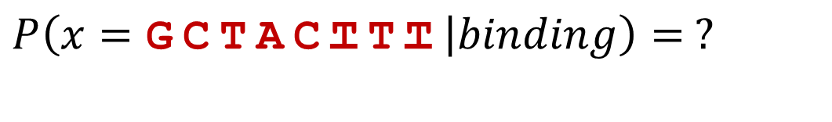
TFBS & PWMs
…CGAGCTACTTTATTAAGACATTACGTTACAGAGATAA…
$$P\left(x=\text{GCTACTTT} | binding\right)= ?$$

Slide 14
TFBS & PWMs
…CGAGCTACTTTATTAAGACATTACGTTACAGAGATAA…
$$P\left(x=\text{GCTACTTT} | binding\right)= ?$$
other binding sites
(ChIP-seq)
ACTACTTT
CCGACTTT
GTAACTCA
GGGAGGCT
GTGGCGCT
GGAACGTG
GCTACTTT

Slide 15
TFBS & PWMs
…CGAGCTACTTTATTAAGACATTACGTTACAGAGATAA…
$$P\left(x=\text{GCTACTTT} | binding\right)= ?$$
other binding sites
(ChIP-seq)
A:10260001
C:13306030
G:52011301
T:02200445
ACTACTTT
CCGACTTT
GTAACTCA
GGGAGGCT
GTGGCGCT
GGAACGTG
GCTACTTT

Slide 16
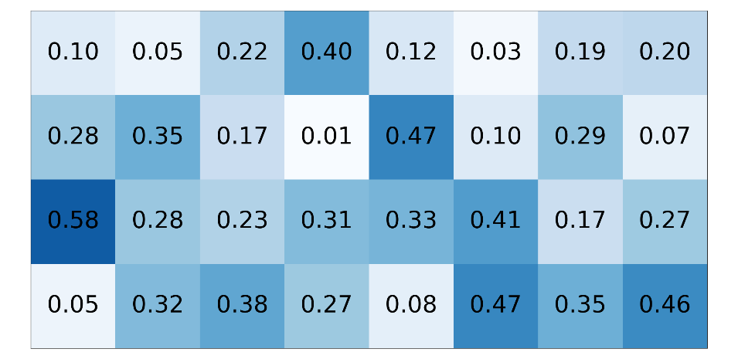
TFBS & PWMs
…CGAGCTACTTTATTAAGACATTACGTTACAGAGATAA…
$$P\left(x=\text{GCTACTTT} | binding\right)= ?$$
other binding sites
(ChIP-seq)
PWM (W)
A:10260001
C:13306030
G:52011301
T:02200445
ACTACTTT
CCGACTTT
GTAACTCA
GGGAGGCT
GTGGCGCT
GGAACGTG
GCTACTTT

Slide 17
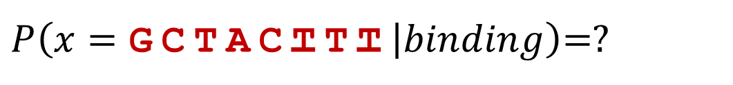
TFBS & PWMs
…CGAGCTACTTTATTAAGACATTACGTTACAGAGATAA…
$P\left(x=\text{GCTACTTT} | binding\right)$=?
PWM (W)

Slide 18
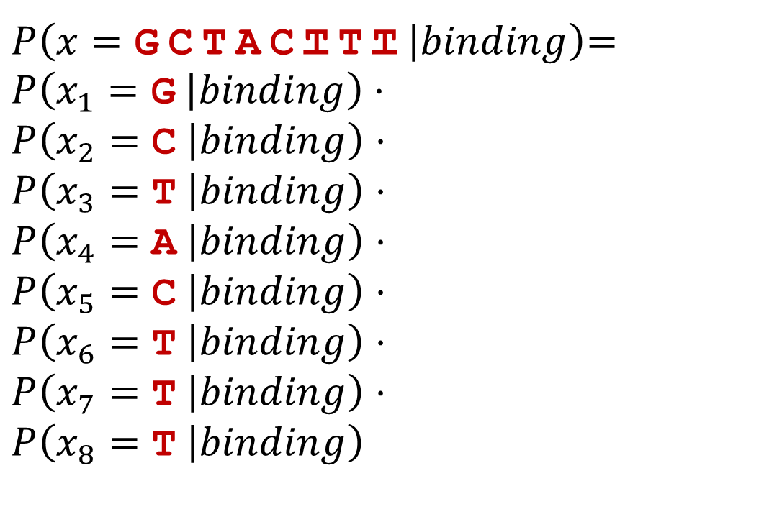
TFBS & PWMs
…CGAGCTACTTTATTAAGACATTACGTTACAGAGATAA…
$P\left(x=\text{GCTACTTT} | binding\right)$=
$$P\left(x_{1}=\text{G} | binding\right)⋅$$
$$P\left(x_{2}=\text{C} | binding\right)⋅$$
$$P\left(x_{3}=\text{T} | binding\right)⋅$$
$$P\left(x_{4}=\text{A} | binding\right)⋅$$
$$P\left(x_{5}=\text{C} | binding\right)⋅$$
$$P\left(x_{6}=\text{T} | binding\right)⋅$$
$$P\left(x_{7}=\text{T} | binding\right)⋅$$
$$P\left(x_{8}=\text{T} | binding\right)$$
positional independence assumption
PWM (W)

Slide 19

TFBS & PWMs
…CGAGCTACTTTATTAAGACATTACGTTACAGAGATAA…
$P\left(x=\text{GCTACTTT} | binding\right)$=
$$0.58⋅0.35⋅0.38⋅0.40⋅$$
$$0.47⋅0.47⋅0.35⋅0.46=\text{0}\text{.}\text{001079}$$
PWM (W)

Slide 20
TFBS & PWMs
…CGAGCTACTTTATTAAGACATTACGTTACAGAGATAA…
$P\left(x=\text{GCTACTTT} | binding\right)$=
$$0.58⋅0.35⋅0.38⋅0.40⋅$$
$$0.47⋅0.47⋅0.35⋅0.46=\text{0}\text{.}\text{001079}$$
PWM (W)
Small number,
log likelihood is more convenient

Slide 21
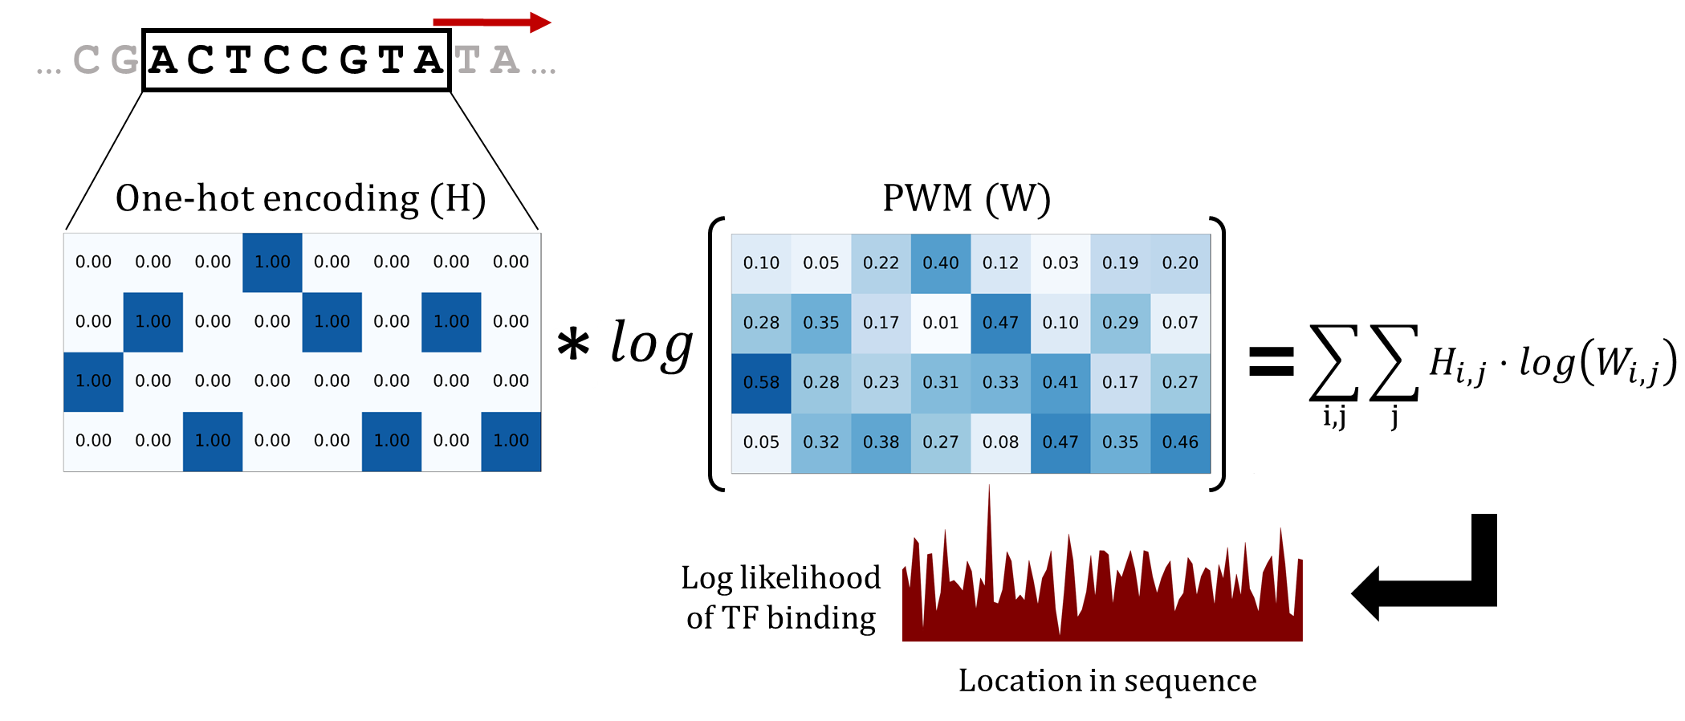
Using PWMs

Slide 22



































HMM
Hidden State Machine
$$0.4$$
$$0.2$$
$$0.6$$
$$0.8$$
$$a$$
$$b$$
$$0.8$$
$$1$$
$$2$$
$$0.2$$
$$1$$
$$2$$
Example of a Generated Sequence
$$a$$
$$a$$
$$a$$
$$a$$
$$b$$
$$b$$
$$b$$
$$b$$
$$a$$
$$a$$
$$a$$
$$a$$
$$a$$
Hidden
$1$
$1$
$$2$$
$1$
$2$
$2$
$$1$$
$2$
$2$
$1$
$1$
$1$
$$1$$
Observed

Slide 23




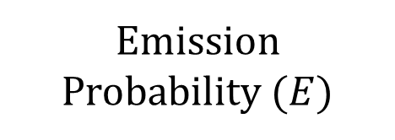



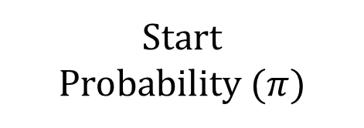
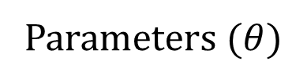















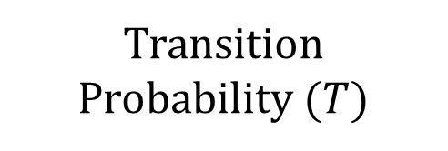




HMM
Parameters ($θ$)
Emission Probability ($E$)
Transition Probability ($T$)
Start
Probability ($π)$
Hidden State Machine
$$0.4$$
$$0.2$$
$$0.6$$
$$1$$
$$2$$
$$to$$
$$a$$
$$b$$
$$a$$
$$b$$
$$observed$$
$$from$$
$$a$$
$$b$$
$$hidden$$
$$0.8$$
$$0.8$$
$$a$$
$$0.8$$
$$0.2$$
$$a$$
$$0.8$$
$$0.2$$
$$0.4$$
$$0.6$$
$$1$$
$$2$$
$$0.2$$
$$1$$
$$2$$
$$b$$
$$0.1$$
$$0.9$$
$$b$$
$$0.2$$
$$0.8$$
Example of a Generated Sequence
$$a$$
$$a$$
$$a$$
$$a$$
$$b$$
$$b$$
$$b$$
$$b$$
$$a$$
$$a$$
$$a$$
$$a$$
$$a$$
Hidden
$1$
$1$
$$2$$
$1$
$2$
$2$
$$1$$
$2$
$2$
$1$
$1$
$1$
$$1$$
Observed

Slide 24




HMM
Parameters ($θ$)
Emission Probability ($E$)
Transition Probability ($T$)
Start
Probability ($π)$
Hidden State Machine
$$0.4$$
$$0.2$$
$$0.6$$
$$1$$
$$2$$
$$to$$
$$a$$
$$b$$
$$a$$
$$b$$
$$observed$$
$$from$$
$$a$$
$$b$$
$$hidden$$
$$0.8$$
$$0.8$$
$$a$$
$$0.8$$
$$0.2$$
$$a$$
$$0.8$$
$$0.2$$
$$0.4$$
$$0.6$$
$$1$$
$$2$$
$$0.2$$
$$1$$
$$2$$
$$b$$
$$0.1$$
$$0.9$$
$$b$$
$$0.2$$
$$0.8$$
$$P\left(x_{t}=1 | y_{t}=b\right)$$
Example of a Generated Sequence
$$a$$
$$a$$
$$a$$
$$a$$
$$b$$
$$b$$
$$b$$
$$b$$
$$a$$
$$a$$
$$a$$
$$a$$
$$a$$
Hidden
$1$
$1$
$$2$$
$1$
$2$
$2$
$$1$$
$2$
$2$
$1$
$1$
$1$
$$1$$
Observed

Slide 25


HMM
Parameters ($θ$)
Emission Probability ($E$)
Transition Probability ($T$)
Start
Probability ($π)$
Hidden State Machine
$$0.4$$
$$0.2$$
$$0.6$$
$$1$$
$$2$$
$$to$$
$$a$$
$$b$$
$$a$$
$$b$$
$$observed$$
$$from$$
$$a$$
$$b$$
$$hidden$$
$$0.8$$
$$0.8$$
$$a$$
$$0.8$$
$$0.2$$
$$a$$
$$0.8$$
$$0.2$$
$$0.4$$
$$0.6$$
$$1$$
$$2$$
$$0.2$$
$$1$$
$$2$$
$$b$$
$$0.1$$
$$0.9$$
$$b$$
$$0.2$$
$$0.8$$
$$P\left(y_{t}=a | y_{t−1}=b\right)$$
Example of a Generated Sequence
$$a$$
$$a$$
$$a$$
$$a$$
$$b$$
$$b$$
$$b$$
$$b$$
$$a$$
$$a$$
$$a$$
$$a$$
$$a$$
Hidden
$1$
$1$
$$2$$
$1$
$2$
$2$
$$1$$
$2$
$2$
$1$
$1$
$1$
$$1$$
Observed

Slide 26
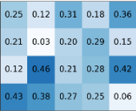
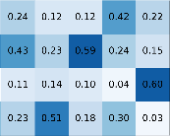
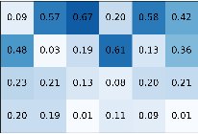
































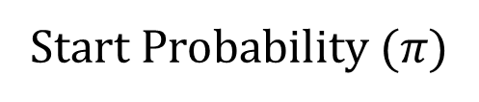










































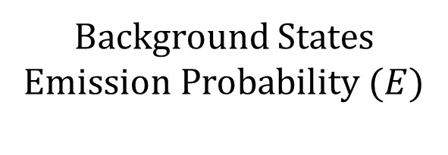


































































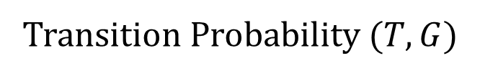
Background States Emission Probability ($E$)
Hidden State Machine
Start Probability ($π)$
A
$$0.5$$
$$0.05$$
$$0.0$$
$$0.05$$
B
C
$$BG_{1}$$
$$BG_{2}$$
$$TF_{1}^{1}$$
$$…$$
$$TF_{3}^{2}$$
Enhancer
Type I
$$0.1$$
$$BG_{1}$$
$$TF_{1}^{1}$$
$$TF_{2}^{1}$$
$$TF_{3}^{1}$$
$$BG_{1}$$
$$A$$
$$C$$
$$G$$
$$T$$
$$0.8$$
$$FIXED$$
$$FIXED$$
$$0.5$$
$$0.5$$
$$0$$
$$…$$
$$0$$
$$1$$
$$A∗$$
$$BG_{2}$$
$$A$$
$$C$$
$$G$$
$$T$$
$$G$$
$$T$$
$$0. 1$$
$$0.6$$
$$0. 1$$
$$0.2$$
$$A$$
$$C$$
$A$?
$$0. 1$$
$$0.6$$
$$0. 1$$
$$0.2$$
$$C∗$$
$$0.1$$
$$0.05$$
$$0.8$$
$$0.05$$
Transition Probability ($T,G$)
$$0.5$$
$C$?
$$0.1$$
$$0.05$$
$$0.8$$
$$0.05$$
$$T$$
$$G$$
$$G∗$$
$$0.5$$
$$0.3$$
$$0.1$$
$$0.1$$
Enhancer
Type II
$$BG_{2}$$
$$TF_{1}^{2}$$
$$TF_{2}^{2}$$
$$TF_{3}^{2}$$
D
$$to$$
$$0.8$$
$G$?
$$0.5$$
$$0.3$$
$$0.1$$
$$0.1$$
$$BG_{1}$$
$$BG_{2}$$
$$TF_{1}^{∗}$$
$$TF_{2}^{∗}$$
$$TF_{3}^{∗}$$
$$T∗$$
$$0.1$$
$$0.4$$
$$0.2$$
$$0.3$$
$$from$$
$$0.1$$
$$1$$
$$G$$
$$T$$
$T$?
$$0.1$$
$$0.4$$
$$0.2$$
$$0.3$$
$$BG_{1}$$
$$0.8$$
$$0.1$$
$$0.05$$
$$0.0$$
$$0.05$$
$$A$$
$$C$$
$$BG_{2}$$
$$0. 1$$
$$0.8$$
$$0.0$$
$$0.1$$
$$0.0$$
$$P\left(y_{t}={TF}_{2}^{2} | y_{t−1}=BG_{2}\right)$$
Example of a Generated Sequence
E
$$BG_{1}$$
$$BG_{1}$$
$$BG_{1}$$
$$BG_{1}$$
$$TF_{1}^{1}$$
$$BG_{1}$$
$$BG_{1}$$
$$BG_{2}$$
$$BG_{2}$$
$$TF_{2}^{2}$$
$$BG_{2}$$
$$BG_{2}$$
$$BG_{2}$$
Hidden
$$A$$
$$C$$
$$T$$
$$T$$
$$A$$
$$T$$
$$T$$
$$A$$
$$A$$
$$A$$
$$C$$
$$T$$
$$T$$
$$C$$
$$C$$
$$A$$
$$C$$
$$G$$
$$T$$
$$G$$
$$C$$
$$G$$
$$A$$
Observed

Slide 27
Background States Emission Probability ($E$)
Hidden State Machine
Start Probability ($π)$
A
$$0.5$$
$$0.05$$
$$0.0$$
$$0.05$$
B
C
$$BG_{1}$$
$$BG_{2}$$
$$TF_{1}^{1}$$
$$…$$
$$TF_{3}^{2}$$
Enhancer
Type I
$$0.1$$
$$BG_{1}$$
$$TF_{1}^{1}$$
$$TF_{2}^{1}$$
$$TF_{3}^{1}$$
$$BG_{1}$$
$$A$$
$$C$$
$$G$$
$$T$$
$$0.8$$
$$FIXED$$
$$FIXED$$
$$0.5$$
$$0.5$$
$$0$$
$$…$$
$$0$$
$$1$$
$$A∗$$
$$BG_{2}$$
$$A$$
$$C$$
$$G$$
$$T$$
$$G$$
$$T$$
$$0. 1$$
$$0.6$$
$$0. 1$$
$$0.2$$
$$A$$
$$C$$
$A$?
$$0. 1$$
$$0.6$$
$$0. 1$$
$$0.2$$
$$C∗$$
$$0.1$$
$$0.05$$
$$0.8$$
$$0.05$$
Transition Probability ($T,G$)
$$0.5$$
$C$?
$$0.1$$
$$0.05$$
$$0.8$$
$$0.05$$
$$T$$
$$G$$
$$G∗$$
$$0.5$$
$$0.3$$
$$0.1$$
$$0.1$$
Enhancer
Type II
$$BG_{2}$$
$$TF_{1}^{2}$$
$$TF_{2}^{2}$$
$$TF_{3}^{2}$$
D
$$to$$
$$0.8$$
$G$?
$$0.5$$
$$0.3$$
$$0.1$$
$$0.1$$
$$BG_{1}$$
$$BG_{2}$$
$$TF_{1}^{∗}$$
$$TF_{2}^{∗}$$
$$TF_{3}^{∗}$$
$$T∗$$
$$0.1$$
$$0.4$$
$$0.2$$
$$0.3$$
$$from$$
$$0.1$$
$$1$$
$$G$$
$$T$$
$T$?
$$0.1$$
$$0.4$$
$$0.2$$
$$0.3$$
$$BG_{1}$$
$$0.8$$
$$0.1$$
$$0.05$$
$$0.0$$
$$0.05$$
$$A$$
$$C$$
$$BG_{2}$$
$$0. 1$$
$$0.8$$
$$0.0$$
$$0.1$$
$$0.0$$
$$P\left(y_{t}={TF}_{2}^{2} | y_{t−1}=BG_{2}\right)$$
Example of a Generated Sequence
E
$$BG_{1}$$
$$BG_{1}$$
$$BG_{1}$$
$$BG_{1}$$
$$TF_{1}^{1}$$
$$BG_{1}$$
$$BG_{1}$$
$$BG_{2}$$
$$BG_{2}$$
$$TF_{2}^{2}$$
$$BG_{2}$$
$$BG_{2}$$
$$BG_{2}$$
Hidden
$$A$$
$$C$$
$$T$$
$$T$$
$$A$$
$$T$$
$$T$$
$$A$$
$$A$$
$$A$$
$$C$$
$$T$$
$$T$$
$$C$$
$$C$$
$$A$$
$$C$$
$$G$$
$$T$$
$$G$$
$$C$$
$$G$$
$$A$$
Observed

