Slide 1
High-Order and PWM Based Hidden Markov Model (HOP-HMM)
David Ariel Guided by Prof. Tommy Kaplan
The Hebrew University of Jerusalem (HUJI)

Slide 2
Enhancers - Biological Background
Enhancers - Biological Background
Epigenetic Story & Genetic Story
HMM

Slide 3
Enhancers
DNA regions of 50-1500 bp (usually around 500 bp)
Non-coding
If active, they enhance the chance of a gene to be transcribed
Promotor
Gene
DNA
TATA Box
Enhancer

Slide 4
Transcription
Transcription Factor Binding Sites (TFBS)
Promotor
Gene
DNA
TATA Box
Enhancer

Slide 5
Transcription – Bended DNA
Promotor
Gene
TATA Box
Enhancer

Slide 6
Transcription – Initiation
Promotor
TATA Binding Protein
Coactivators
Gene
P300/CBP
TATA Box
TF
TF
TF
Transcription Factors
(different types)
Enhancer
Cohesin

Slide 7
Transcription – Initiation
Promotor
Gene
TATA Binding Protein
P300/CBP
Transcription Complex
TF
TF
TF
Cohesin
Enhancer

Slide 8
Transcription – Initiation
Promotor
Gene
RNA Pol II
TATA Binding Protein
P300/CBP
Transcription Complex
TF
TF
TF
General Transcription Factors (GTFs)
Cohesin
Enhancer

Slide 9
Transcription – Start
Promotor
Gene
RNA Pol II
TATA Binding Protein
P300/CBP
Transcription Complex
TF
TF
TF
Cohesin
Enhancer

Slide 10
Transcription
RNA
Promotor
Gene
RNA Pol II
TATA Binding Protein
P300/CBP
Transcription Complex
TF
TF
TF
Cohesin
Enhancer

Slide 11
Notes:
Enhancers can be up to hundreds of kilo bases upstream or downstream relative to their target gene
Transcription complex = mediator complex + preinitiation complex + coactivators + TFs + more …

Slide 12
Accessibility
DNA
Enhancer (active)
Nucleosome
Nucleosome
H3K27ac
H3K4me1
H3K27me3

Slide 13
Accessibility
DNA
Enhancer (inactive)
Nucleosome
Nucleosome
H3K27ac
H3K4me1
H3K27me3

Slide 14

Tissue-Specific Enhancers
Some TFs are present only in specific tissues:
Less TF present in tissue$→$ Enhancer is less active
Enhancers must be accessible to be active, i.e. in a cleavage

Slide 15
Epigenetic Story & Genetic Story
Enhancers - Biological Background
Epigenetic Story & Genetic Story
HMM

Slide 16
How do biologist find enhancers?
Accessibility (DNase)
Evolutionary conserved regions
ChIP-seq
TFs
P300 / CPB
Histones modifications

Slide 17
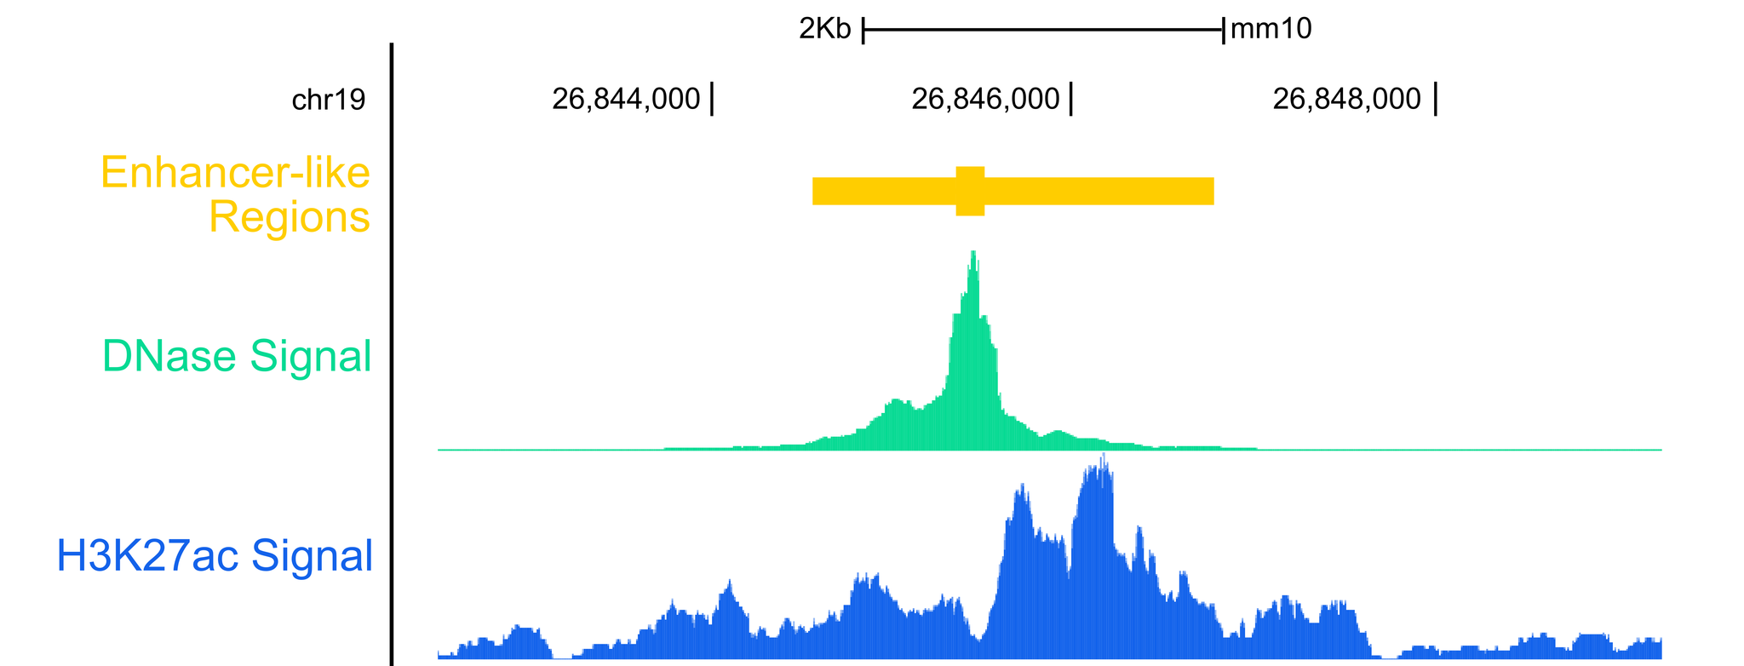
Epigenetic Story
Many works did the following:
Tissue sample -> Epigenetic data -> Classification algorithm -> Enhancers

Slide 18

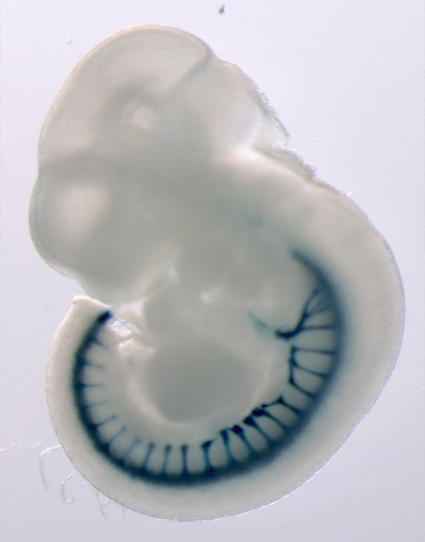
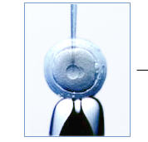
Genetic Story
Mouse Egg Microinjection
Enhancer sequence + reporter gene (LacZ)
CACTTCACAAGAGGGGAGTCACCAGGCCCG
CTTCCTGCCCCCTCCTCGCCCAGCCTCACG
Embryo Images (day 11.5)

Slide 19

Enhancer Sequence
Outcome
CACTTCACAAGAGGGGAGTCACCAGGCCCG
CTTCCTGCCCCCTCCTCGCCCAGCCTCACG
GTGCTCACACGTCCCCGTCGAGGGGAGCCG
CGGCAGCCCTCGGACTCCCAGCCCCGGCTC
ATCTTCTATCCTTCCCTCCCAGGCCCTAAG
TCCCCGGGCTGCGGTGCGGGCCGGCGATCT
CTGAGCTTCCTGCAGGCGCTGCGGCGCGCG
CTCCCACCGTTCCCTCCCCCTCGCGCTCGG
GTTACAGGTTAATGAAATGCTCGTTTTCCT
CAGTCATTTGTTTTGTTTTCCTGCAAAGTT
CTGATAAGTAGCTAACCAACGAAGCTTGTA
ATTACAATCTTACAGAAACCGGGCCGATCT
GTATATAAATCTCACCATCCAATTACAAGA
TGTAATAATTTTGCACTCAAGCTGGTAATG
AGGTCTAATACTCGTGCATGCGATAATCCC
CTCTGGATGCTGGCTTGATCAGATGTTGGC
TTTGTAATTAGACGGGCAGAAAATCATTAT
TTCATGTTCAAATAGAAAATGAGGTTGGTG

Slide 20
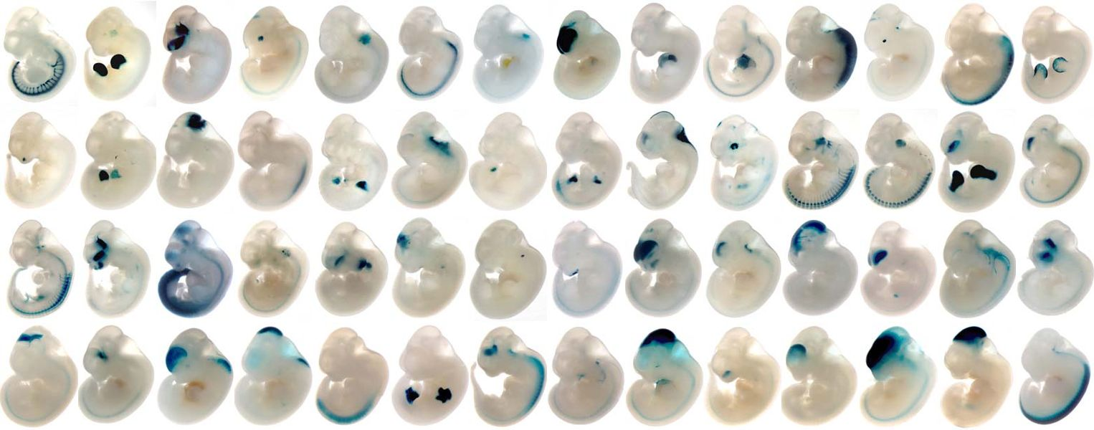
Genetic Story…

Slide 21
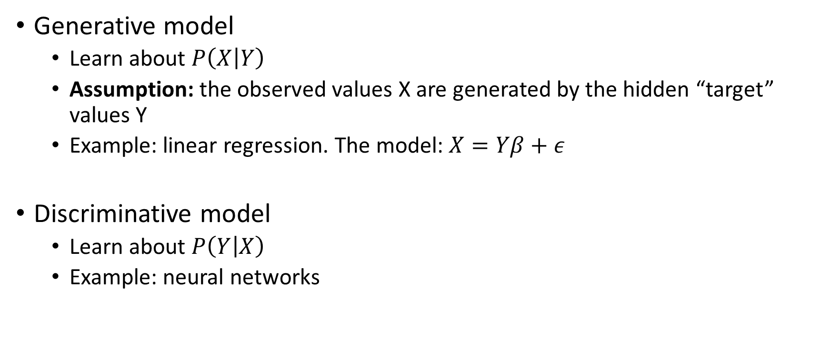
Generative vs Discriminative Models
Generative model
Learn about $P\left(X | Y\right)$
Assumption: the observed values X are generated by the hidden “target” values Y
Example: linear regression. The model: $X=Yβ+ε$
Discriminative model
Learn about $P\left(Y | X\right)$
Example: neural networks

Slide 22
Hidden Markov Model (HMM)
Ge
Ge
En
En
En
Ge
Hidden States (Y)
A
G
C
A
T
T
Observations (X)

Slide 23

Emission Distribution (E)
$E_{ij}=P(x_{t}=j|y_{t}=i)$
 | A | C | G | T
En | 0.23 | 0.22 | 0.27 | 0.28
Ge | 0.33 | 0.32 | 0.01 | 0.33
Ge
Ge
En
En
En
Ge
Hidden States (Y)
A
G
C
A
T
T
Observations (X)

Slide 24

Transition Distribution (T)
 | En | Ge
En | 0.90 | 0.10
Ge | 0.05 | 0.95
$T_{ij}=P(y_{t}=j|y_{t−1}=i)$
Ge
Ge
En
En
En
Ge
Hidden States (Y)
A
G
C
A
T
T
Observations (X)

Slide 25


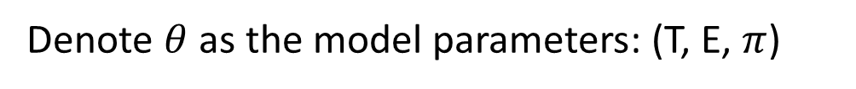
Starting Hidden State ($π$)
En | 0.60
Ge | 0.40
$π_{i}=P(y_{1}=j)$
Ge
Ge
En
En
En
Ge
Hidden States (Y)
A
G
C
A
T
T
Observations (X)
Denote $θ$ as the model parameters: (T, E, $π$)

Slide 26
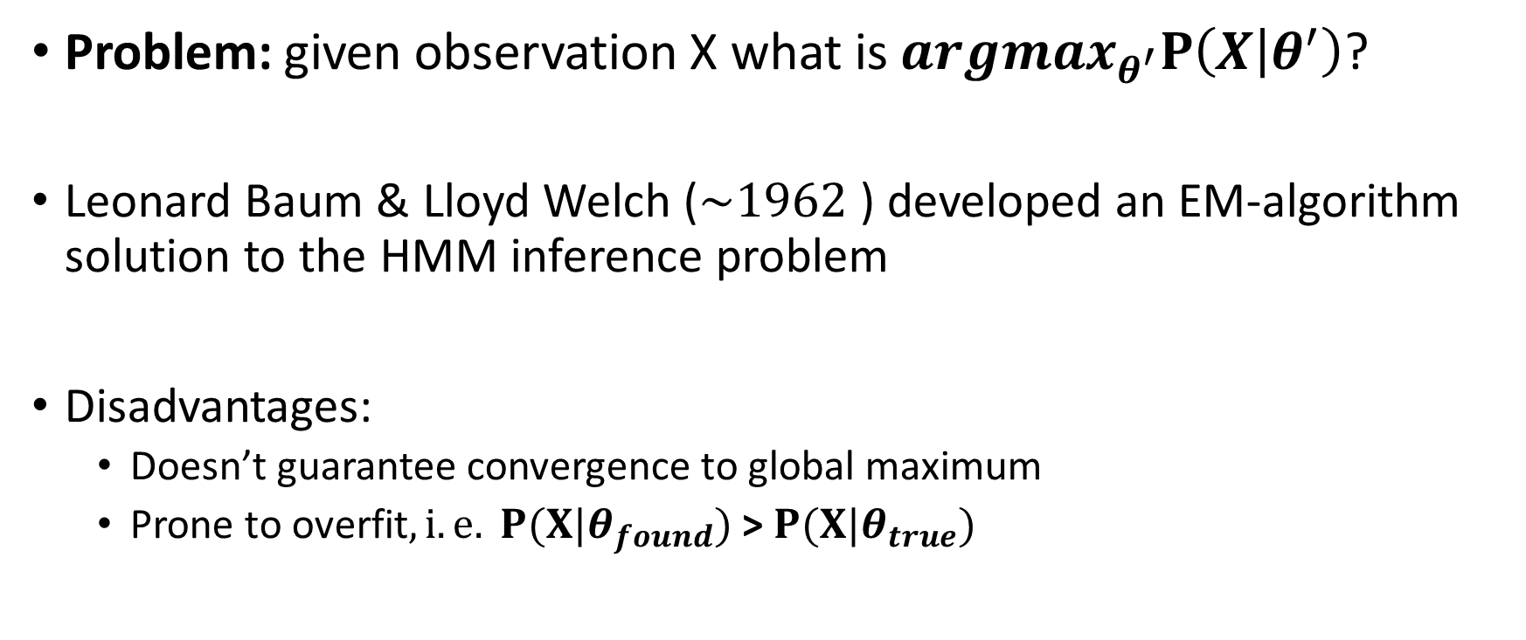
Baum-Welch Algorithm
Problem: given observation X what is $argmax_{θ^{′}}P\left(X | θ^{′}\right)$?
Leonard Baum & Lloyd Welch ($\sim 1962$) developed an EM-algorithm solution to the HMM inference problem
Disadvantages:
Doesn’t guarantee convergence to global maximum
Prone to overfit$, i.e. P(X|θ_{found})$ > $P(X|θ_{true})$

Slide 27
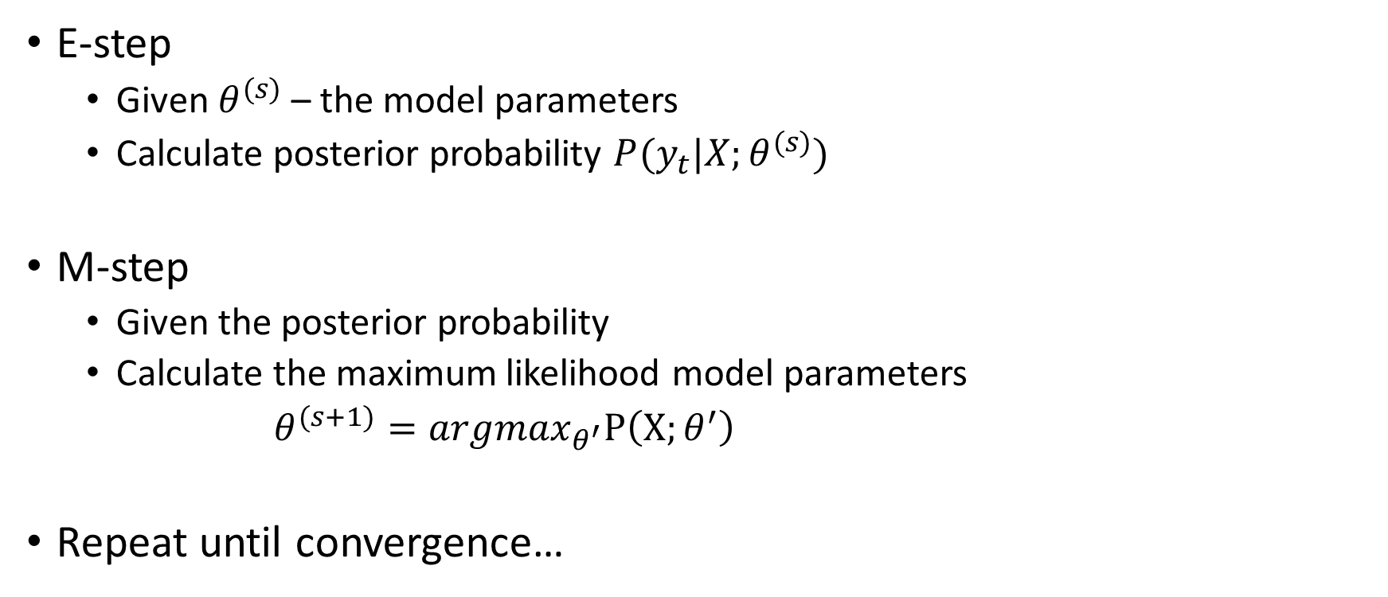
Baum-Welch Algorithm
E-step
Given $θ^{(s)}$ – the model parameters
Calculate posterior probability $P(y_{t}|X;θ^{(s)})$
M-step
Given the posterior probability
Calculate the maximum likelihood model parameters
$θ^{(s+1)}=argmax_{θ^{′}}P\left(X;θ^{′}\right)$
Repeat until convergence…

Slide 28

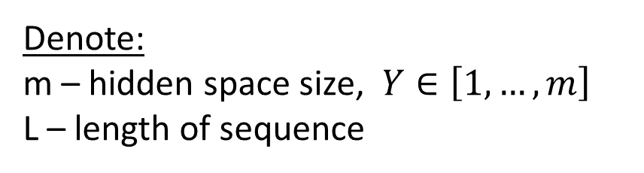
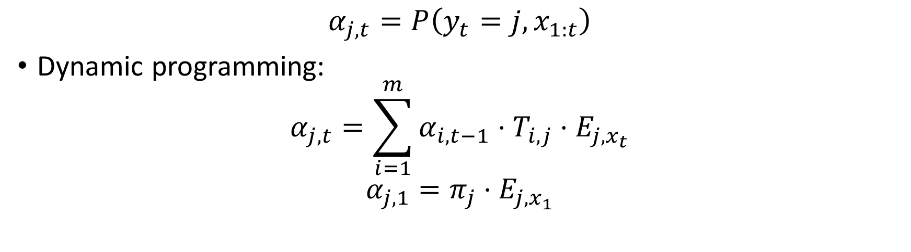



E-step - Forward Algorithm
$$α_{j,t}=P\left(y_{t}=j,x_{1:t}\right)$$
Dynamic programming:
$$α_{j,t}=\sum_{i=1}^{m}{α_{i,t−1}⋅T_{i,j}⋅E_{j,x_{t}}}$$
$$α_{j,1}=π_{j}⋅E_{j,x_{1}}$$
$t$-1
$$t$$
$$j$$
$$α_{j,t}$$
Denote:
m – hidden space size, $Y∈\left[1,…,m\right]$
L – length of sequence

Slide 29

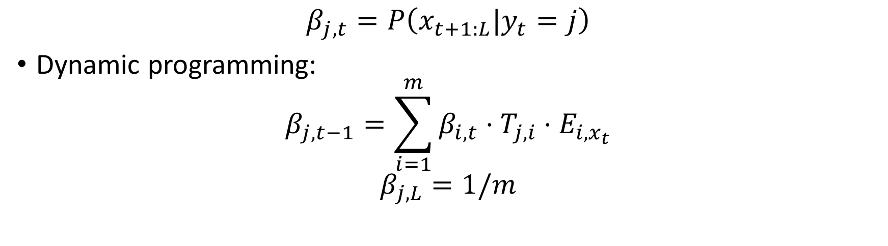



E-step - Backwards Algorithm
$$β_{j,t}=P\left(x_{t+1:L}|y_{t}=j\right)$$
Dynamic programming:
$$β_{j,t−1}=\sum_{i=1}^{m}{β_{i,t}⋅T_{j,i}⋅E_{i,x_{t}}}$$
$$β_{j,L}=1/m$$
$$t$$
$t$+1
$$j$$
$$β_{j,t}$$
Denote:
m – hidden space size, $Y∈\left[1,…,m\right]$
L – length of sequence

Slide 30
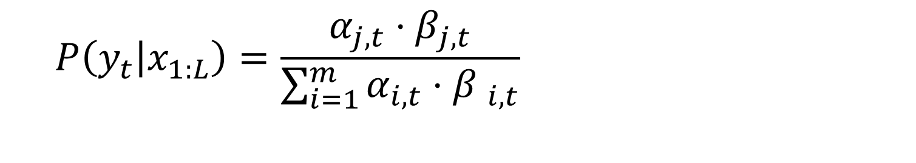
Posterior Probability
On the board:
M-step
$$P\left(y_{t} | x_{1:L}\right)=\frac{α_{j,t}⋅β_{j,t}}{\sum_{i=1}^{m}{α_{i,t}⋅{β }_{i,t}}}$$

Slide 31

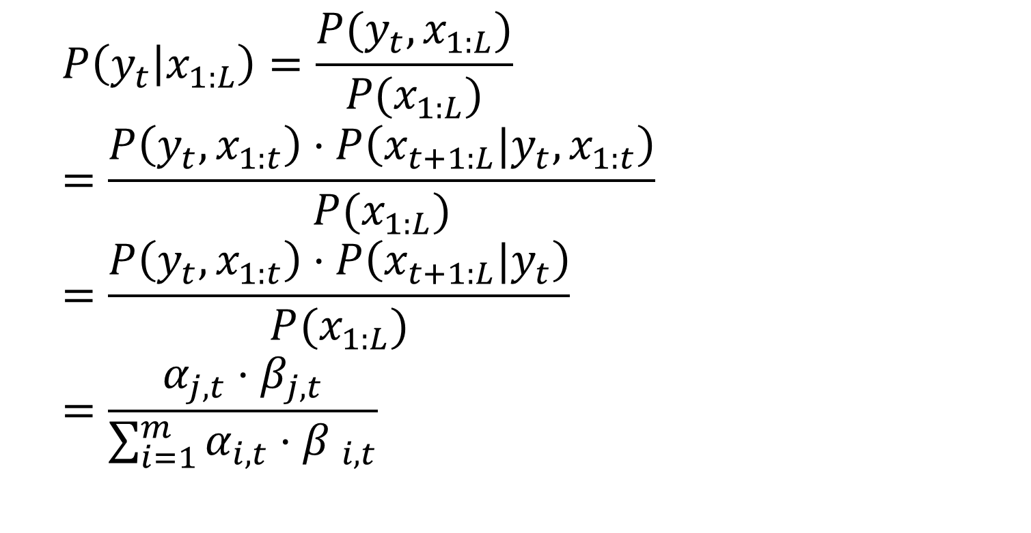
Posterior Probability
\\ Conditional probability definition
_{\\ Chain rule}
\\ $x_{t+1:L}$ _{is independent to}$x_{1:t}$
\\ Define previously
$$P\left(y_{t} | x_{1:L}\right)=\frac{P(y_{t},x_{1:L})}{P(x_{1:L})} =\frac{P\left(y_{t},x_{1:t}\right)⋅P\left(x_{t+1:L}|y_{t},x_{1:t}\right)}{P(x_{1:L})}$$
$$=\frac{P\left(y_{t},x_{1:t}\right)⋅P\left(x_{t+1:L}|y_{t}\right)}{P(x_{1:L})}$$
$$=\frac{α_{j,t}⋅β_{j,t}}{\sum_{i=1}^{m}{α_{i,t}⋅{β }_{i,t}}}$$

Slide 32
Part 2: HOP-HMM
Enhancers and ML previous work
HOP-HMM
“HOP-Baum-Welch Algorithm”

Slide 33
Enhancers Sequences Separation
Motifs enrichment
Neph s. et al. Nature, 2012
Kheradpour et al. Genome Research, 2013
K-mer frequencies
Inbar’s master with Tommy
kmer-SVM: Beer M. et al. Genome Research, 2011
Other complex features
DeepSEA: Troyanskaya O. et al. Nature, 2015
Basset: Rinn J. et al. Genome Research, 2016

Slide 34
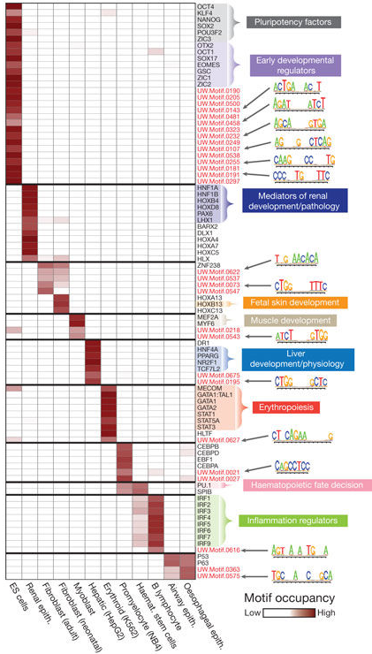
Neph s. et al. Nature, 2012

Slide 35
HMM
Ge
Ge
En
En
En
Ge
Hidden States (Y)
A
G
C
A
T
T
Observations (X)

Slide 36
HMM
Hidden states can change freely
Ge
Ge
En
En
En
Ge
Hidden States (Y)
A
G
C
A
T
T
Observations (X)

Slide 37

HMM $→$ HOP-HMM
Hidden states transition options
Ge
En
EnFl
Pro
Tel
Flnk

Slide 38
HMM $→$ HOP-HMM
Base States
Sub States
Hidden states transition options
(1,0)
(1,1)
(1,2)
(1,3)
(1,n)
Ge
En
(2,0)
(2,1)
(2,2)
(2,3)
(2,n)
EnFl
Pro
(3,0)
(3,1)
(3,2)
(3,3)
(3,n)
Tel
Flnk
(m,0)
(m,1)
(m,2)
(m,3)
(m,n)

Slide 39
HMM
Emission depends only on hidden state
Ge
Ge
En
En
En
Ge
Hidden States (Y)
A
G
C
A
T
T
Observations (X)

Slide 40
HMM $→$ HOP-HMM
Base-states emission depends on hidden state and k previous observations
Base-State
(j,0)
Hidden States (Y)
A
G
C
A
T
T
Observations (X)
k=3

Slide 41
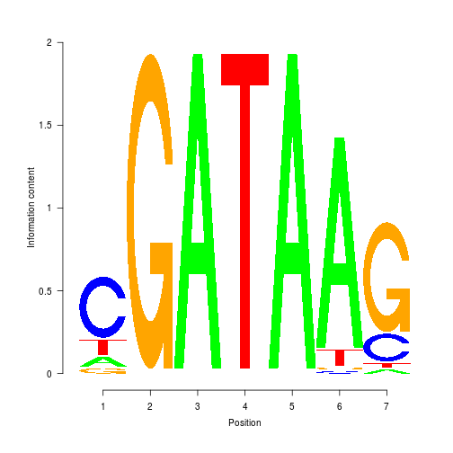
HMM $→$ HOP-HMM
Sub-states emission: PWM
Base-State
Sub-State (PWM)
Base-State
(j,0)
(j,l)
(j,0)
Hidden States (Y)
A
C
G
A
T
A
A
G
T
Observations (X)

Slide 42
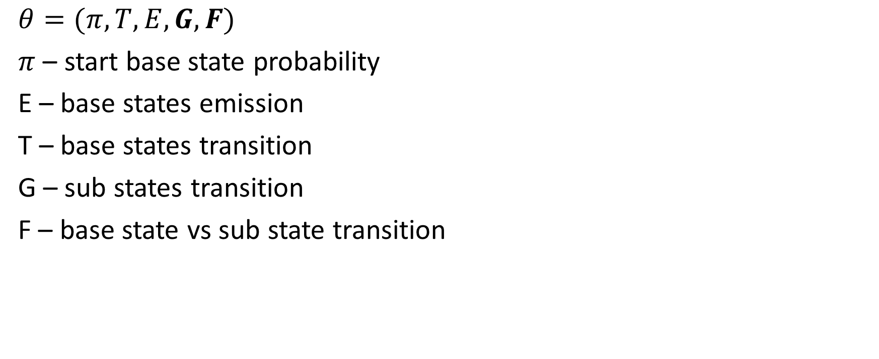
Model Parameters
Base States
Sub States
$$θ=(π, T,E,G,F)$$
$π$ – start base state probability
E – base states emission
T – base states transition
G – sub states transition
F – base state vs sub state transition
(1,0)
(1,1)
(1,2)
(1,3)
(1,n)
(2,0)
(2,1)
(2,2)
(2,3)
(2,n)
(3,0)
(3,1)
(3,2)
(3,3)
(3,n)
(m,0)
(m,1)
(m,2)
(m,3)
(m,n)

Slide 43
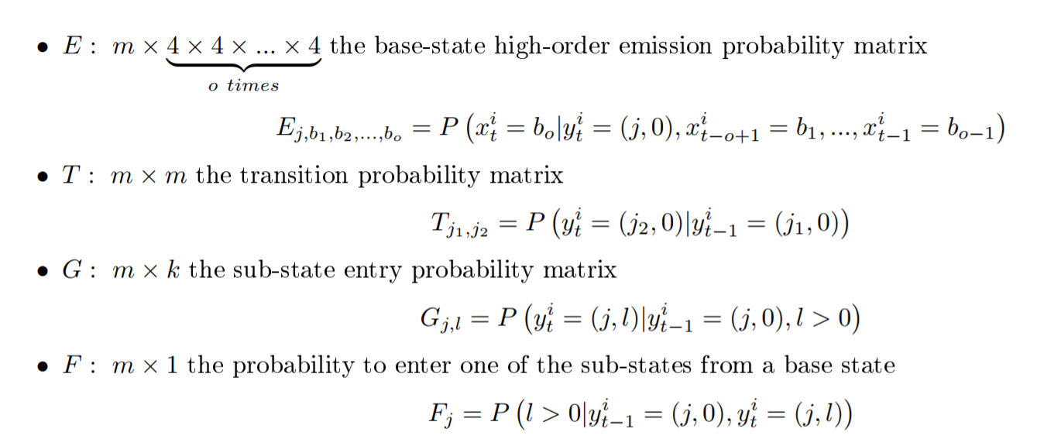
Model Parameters

Slide 44
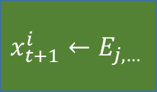



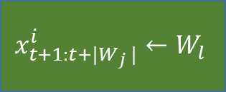

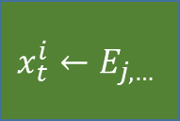


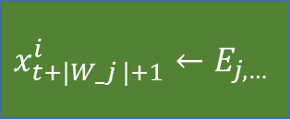



$$y_{t+1:t+\left|W_{j}\right|}^{i}$$
$$y_{t+\left|W_{j}\right|+1}^{i}$$
(j,l)
(j,0)
$$l←G_{j,∗}$$
$$φ=1$$
$$y_{t}^{i}$$
(j,0)
$$φ\sim Bin(F_{j},1)$$
$$x_{t+1:t+|W_{j} |}^{i}←W_{l}$$
$$x_{t+|W_j |+1}^{i}←E_{j,…}$$
$$y_{t+1}^{i}$$
$$φ=0$$
$$x_{t}^{i}←E_{j,…}$$
(j’,0)
$$j′←T_{j,∗}$$
$$x_{t+1}^{i}←E_{j,…}$$

Slide 45









E-step - HOP Forward Algorithm
$$t−|W_{2}|−1$$
$$t$$
$t$-1
$$t$$
$$j$$
$$α_{j,t}$$
$$j$$
$$α_{j,t}$$
$$t−|W_{1}|−1$$

Slide 46









E-step - HOP Backwards Algorithm
$$t$$
$$t−|W_{2}|−1$$
$$t$$
$t$+1
$$j$$
$$β_{j,t}$$
$$j$$
$$β_{j,t}$$
$$t−|W_{1}|−1$$
On the board:
M-step

