Slide 1
Activation functions
Neural Networks

Slide 2
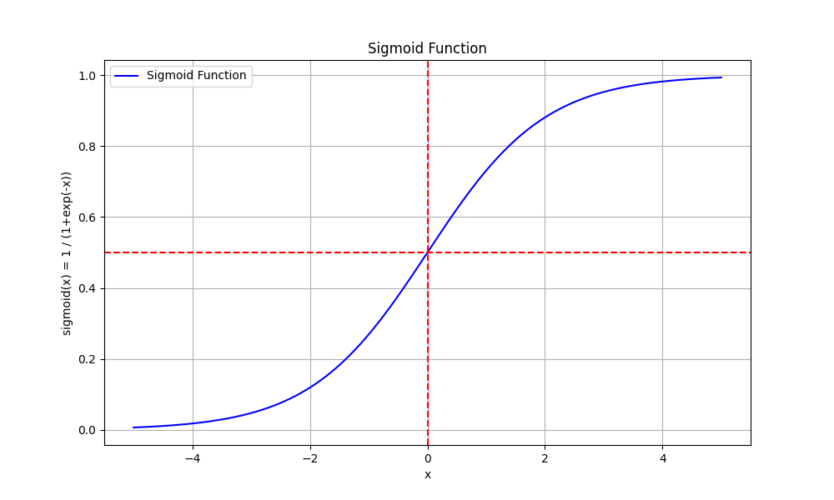
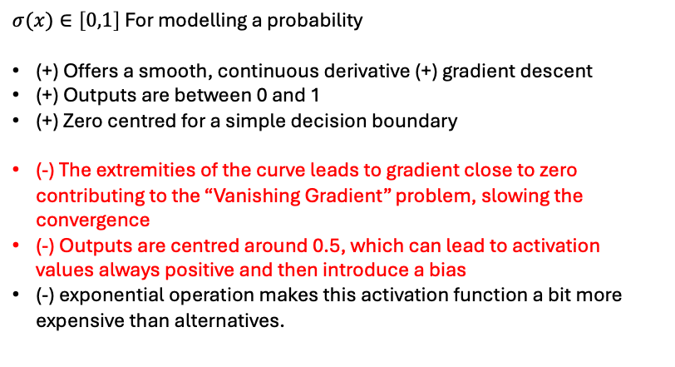
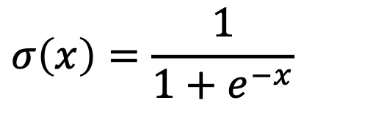

Sigmoid function
$$σ\left(x\right)=\frac{1}{1+e^{−x}}$$
$σ(x)∈\left[0,1\right]$ For modelling a probability
(+) Offers a smooth, continuous derivative (+) gradient descent
(+) Outputs are between 0 and 1
(+) Zero centred for a simple decision boundary
(-) The extremities of the curve leads to gradient close to zero contributing to the “Vanishing Gradient” problem, slowing the convergence
(-) Outputs are centred around 0.5, which can lead to activation values always positive and then introduce a bias
(-) exponential operation makes this activation function a bit more expensive than alternatives.
$$σ′\left(x\right)=σ(x)(1−σ\left(x\right))$$

Slide 3
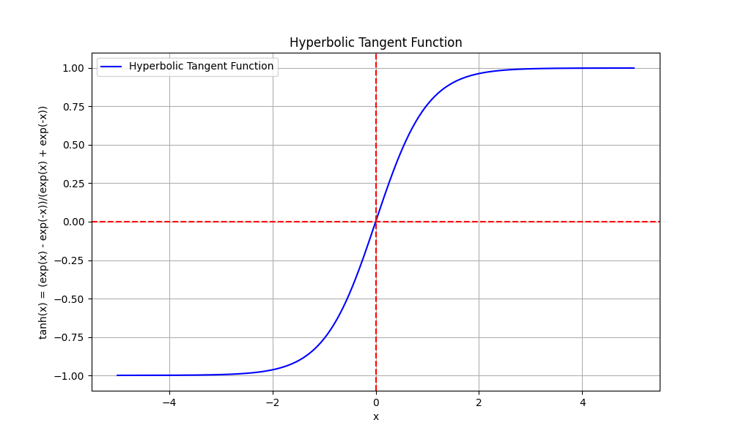
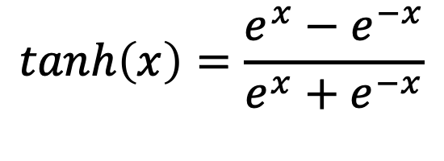

Hyperbolic tangent function
$$tanh\left(x\right)=\frac{e^{x}−e^{−x}}{e^{x}+e^{−x}}$$
(+) Outputs are between -1 and 1 which allows a better distribution of the activation values around zero
(+) Offers a smooth, continuous derivative (+) gradient descent
(+) Zero centred for a simple decision boundary
(+) Outputs are centred around 0. This helps to centre the data and reduce the bias which may lead to a faster convergence
(-) The extremities of the curve leads to gradient close to zero contributing to the “Vanishing Gradient” problem. But this saturation is - compared to sigmoid function – more symmetric around zero which can help maintaining more stable gradients.
(-) exponential operation makes this activation function a bit more expensive than alternatives.
$$tanh^{′\left(x\right)}=1−tanh^{2}(x)$$

Slide 4
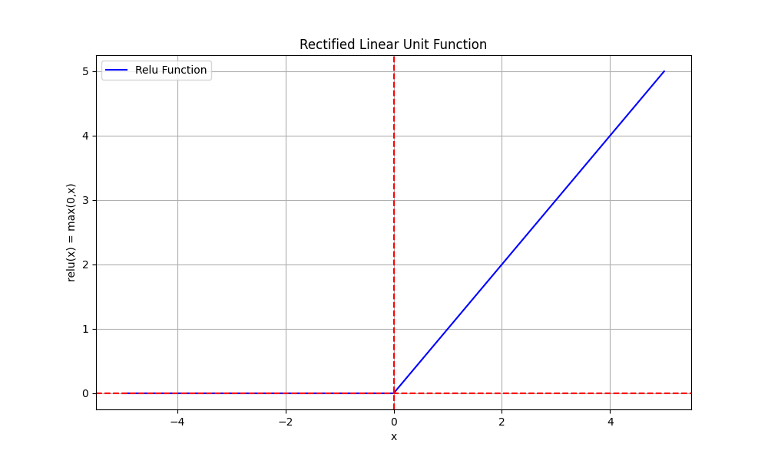
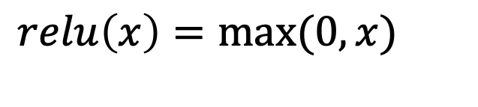

Relu function
$$relu\left(x\right)=max⁡(0, x)$$
(+) Converges faster and computationally cheaper
(+) Simple, non-saturating gradient pas zero enables deeper networks (i.e. more layers)
(-) Poor initialization weights and high learning rate can lead to “dying” Relu (inactive neurons, only output zero because the weighted input is always negative for our training instances) which can slow down the performance of the model and slower the convergence. Used pertinent weights initialisations, adequate learning rates and use variances of Relu can avoid this issue.
$$\frac{dy}{dx}=1$$

Slide 5
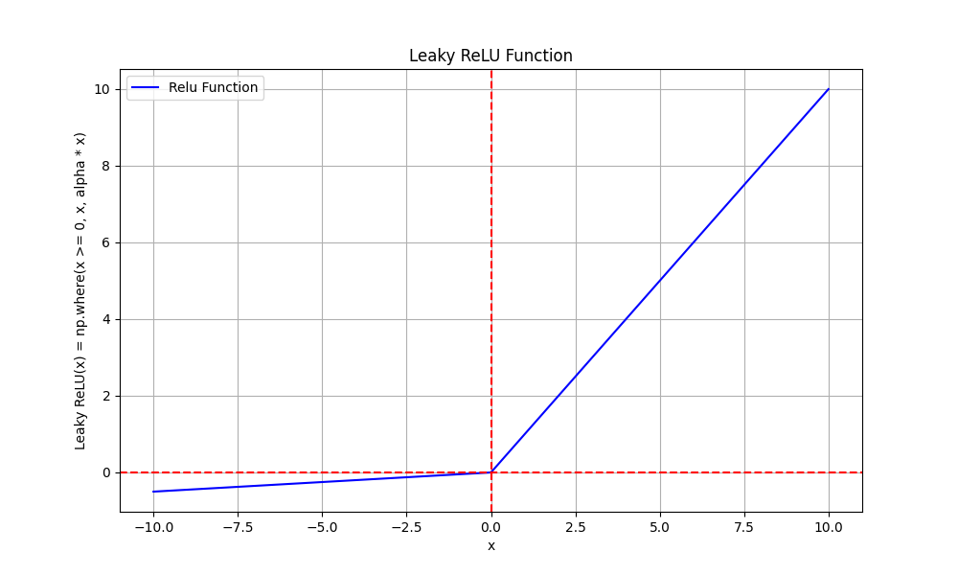
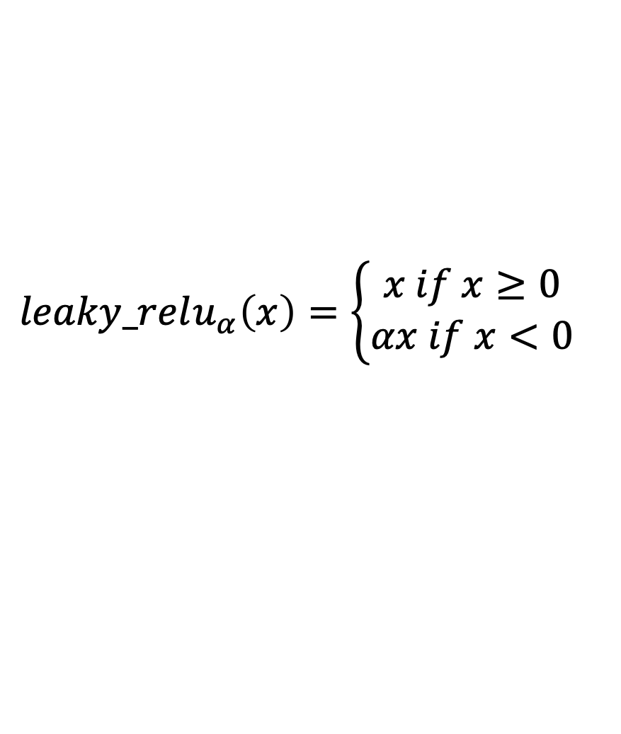
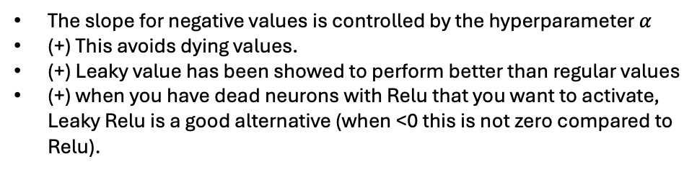
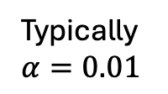
Leaky Relu
$$leaky_relu_{α}\left(x\right)=\left\{\begin{aligned}x if x≥0 \\ αx if x<0\end{aligned}\right.$$
Typically $α=0.01$
The slope for negative values is controlled by the hyperparameter $α$
(+) This avoids dying values.
(+) Leaky value has been showed to perform better than regular values
(+) when you have dead neurons with Relu that you want to activate, Leaky Relu is a good alternative (when <0 this is not zero compared to Relu).
Notes:
If w

Slide 6
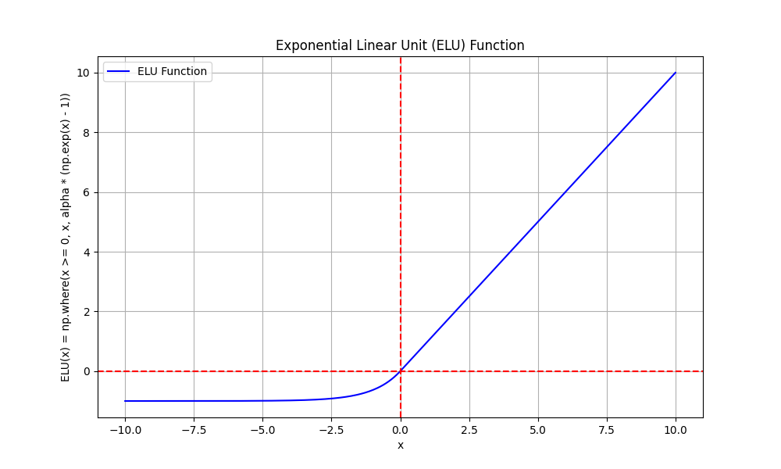
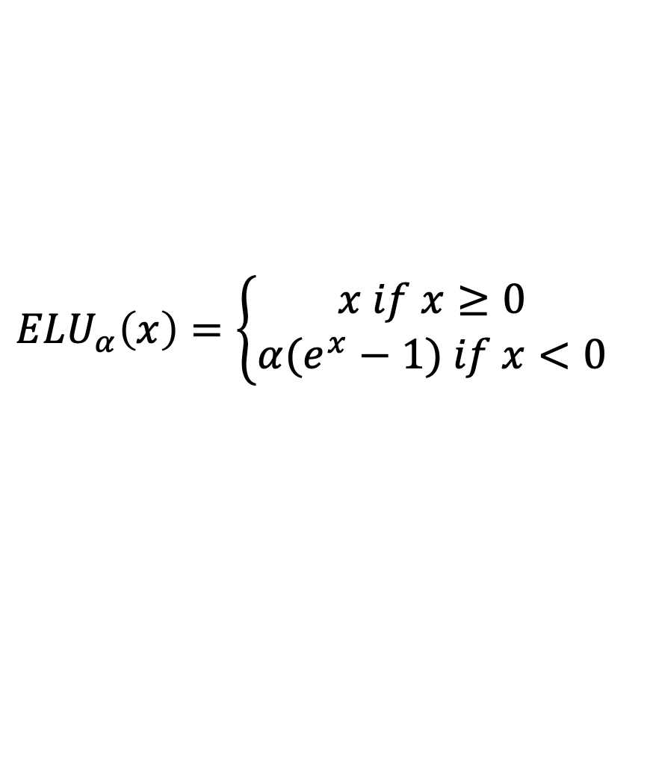
Exponential Linear Unit (ELU)
$$ELU_{α}\left(x\right)=\left\{\begin{aligned}x if x≥0 \\ α(e^{x}−1) if x<0\end{aligned}\right.$$
(-) Still an issue of “Vanishing Gradient” for large negative numbers
(-) slow to compute du to the exponentiation

Slide 7
What to pick-up ?
Layers | Issue | Activation function
Hidden layers |  | Relu, Leaky Relu, ELU
Output layers | Regression | No need any output activation function
 | Binary classification | Sigmoid
 | Multiclass classification | Softmax

Slide 8
Appendices

Slide 9


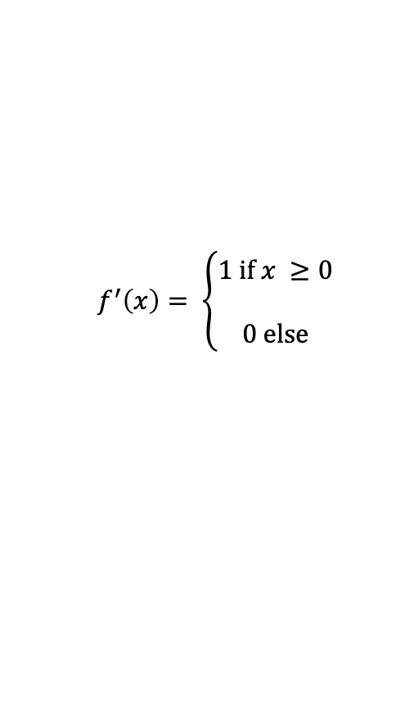
Neural Network
Relu function
Relu Gradient
$$f\left(x\right)=max(0, x)$$
$$f^{′}\left(x\right)= \left\{\begin{aligned}1 if x ≥0 \\ \\ 0 else\end{aligned}\right.$$
$$f^{′}\left(x\right)=1_{\{x ≥0\}}$$

Slide 10
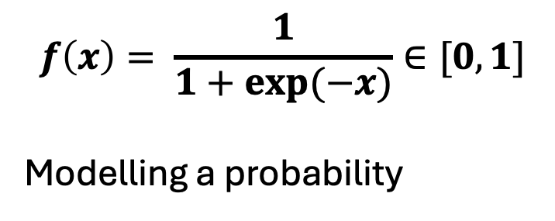
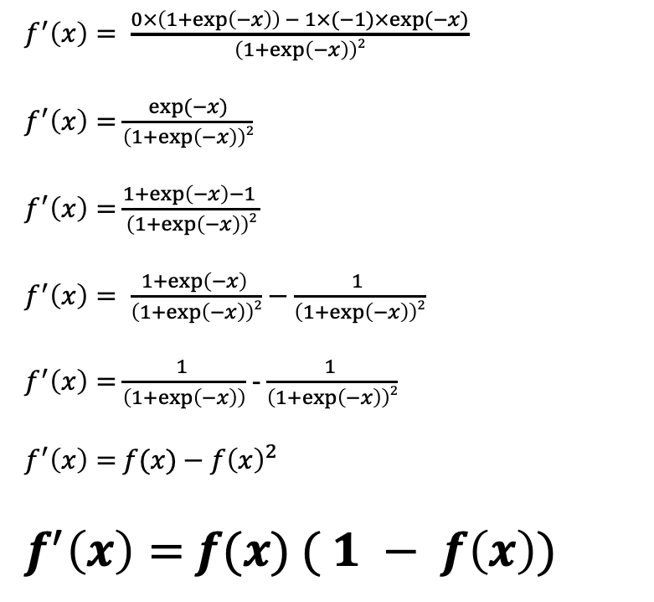
Neural Network
Sigmoid function
$f^{′}\left(x\right)= \frac{0×\left(1+\exp\left(−x\right)\right) − 1×(−1)×exp⁡(−x)}{\left(1+\exp\left(−x\right)\right)2}$
$f^{′}\left(x\right)=$ $\frac{exp⁡(−x)}{\left(1+\exp\left(−x\right)\right)2}$
$f^{′}\left(x\right)=$ $\frac{1+\exp\left(−x\right)−1 }{\left(1+\exp\left(−x\right)\right)2}$
$f^{′}\left(x\right)= \frac{1+\exp\left(−x\right) }{\left(1+\exp\left(−x\right)\right)2}$ $−$ $\frac{1 }{\left(1+\exp\left(−x\right)\right)2}$
$f^{′}\left(x\right)=$ $\frac{1 }{\left(1+\exp\left(−x\right)\right)}$ - $\frac{1 }{\left(1+\exp\left(−x\right)\right)2}$
$f^{′}\left(x\right)=$ $f(x)$ $− f{\left(x\right)}^{2}$
$f^{′}\left(x\right)=$ $f(x)$ $( 1 − f\left(x\right))$
$$f\left(x\right)= \frac{1}{1+exp⁡(−x)}∈[0,1]$$
Modelling a probability
Sigmoid Gradient

Slide 11
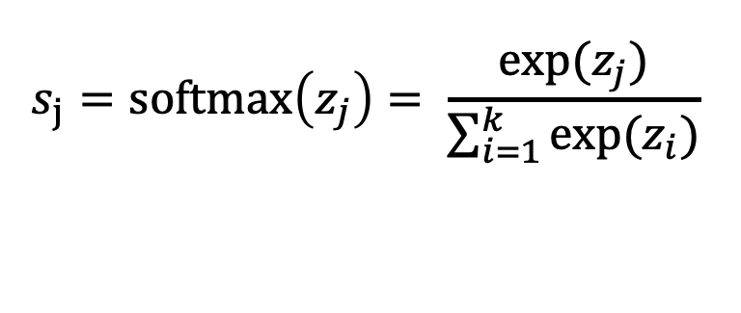
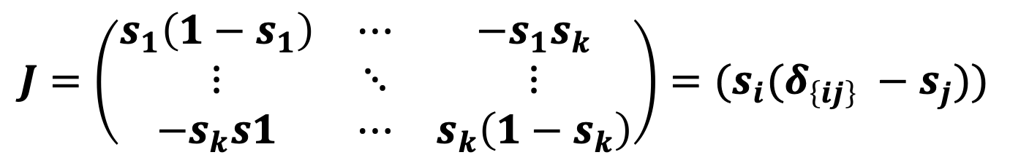
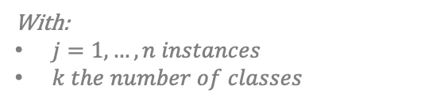
Neural Network
Softmax function (generalization of the sigmoid function)
$$s_{j}=softmax\left(z_{j}\right)= \frac{exp⁡(z_{j})}{\sum_{i=1}^{k}{exp⁡(z_{i})}}$$
With:
$j=1,…,n instances$
$k the number of classes$
Softmax Gradient
$${J=\left(\begin{matrix}s_{1}\left(1−s_{1}\right) & ⋯ & {−s}_{1}s_{k} \\ ⋮ & ⋱ & ⋮ \\ −s_{k}s1 & ⋯ & s_{k}\left(1−s_{k}\right)\end{matrix}\right)=(s}_{i}(δ_{\left\{ij\right\}} −s_{j}))$$
$${where δ}_{\left\{ij\right\}} is the Kronecker delta$$

Slide 12
Neural Network
Softmax function (generalization of the sigmoid function)
$$s_{j}=softmax\left(z_{j}\right)= \frac{exp⁡(z_{j})}{\sum_{i=1}^{k}{exp⁡(z_{i})}}$$
With:
$j=1,…,n instances$
$k the number of classes$
Softmax Gradient
$${J=\left(\begin{matrix}s_{1}\left(1−s_{1}\right) & ⋯ & {−s}_{1}s_{k} \\ ⋮ & ⋱ & ⋮ \\ −s_{k}s1 & ⋯ & s_{k}\left(1−s_{k}\right)\end{matrix}\right)=(s}_{i}(δ_{\left\{ij\right\}} −s_{j}))$$
$${where δ}_{\left\{ij\right\}} is the Kronecker delta$$

