Slide 1
Attention
Notes:
Traitement automatique du language naturel

Slide 2



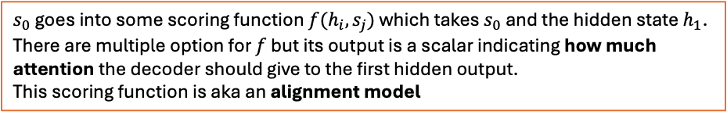


Attention
Attention Mechanism
$s_{0}$goes into some scoring function $f(h_{i}, s_{j})$ which takes $s_{0}$ and the hidden state $h_{1}$. There are multiple option for $f$ but its output is a scalar indicating how much attention the decoder should give to the first hidden output.
This scoring function is aka an alignment model
f
f
f
f
$$h_{1}$$
$$h_{2}$$
$$h_{3}$$
$$h_{4}$$
$$s_{0}$$
$$The$$
$$battery$$
$$is$$
$$dead$$
e.g. Encoder Bidirectional

Slide 3



Attention
Attention Mechanism
How much ”attention” should each encoder hidden state be given for this decoder timestep.
Attention Scores
$$f(h_{1},s_{0})$$
$$f(h_{2},s_{0})$$
$$f(h_{3},s_{0})$$
$$f(h_{4},s_{0})$$
f
f
f
f
$$h_{1}$$
$$h_{2}$$
$$h_{3}$$
$$h_{4}$$
$$s_{0}$$
$$The$$
$$battery$$
$$is$$
$$dead$$
e.g. Encoder Bidirectional

Slide 4

Attention
Attention Mechanism
How much ”attention” should each encoder hidden state be given for this decoder timestep.
Attention Scores
In this example, the first hidden state $h_{1}$ gets the most attention because of its higher score and the last hidden state the least.
$$90$$
$$57$$
$$23$$
$$9$$
f
f
f
f
$$h_{1}$$
$$h_{2}$$
$$h_{3}$$
$$h_{4}$$
$$s_{0}$$
$$The$$
$$battery$$
$$is$$
$$dead$$
e.g. Encoder Bidirectional

Slide 5





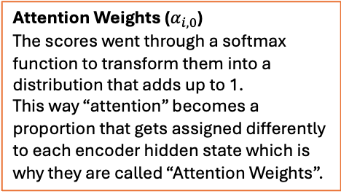



Attention
Attention Mechanism
$$α_{1,0}$$
$$α_{2,0}$$
$$α_{3,0}$$
$$α_{4,0}$$
Attention Weights ($α_{i,0}$)
The scores went through a softmax function to transform them into a distribution that adds up to 1.
This way “attention” becomes a proportion that gets assigned differently to each encoder hidden state which is why they are called “Attention Weights”.
SOFTMAX
$$f(h_{1},s_{0})$$
$$f(h_{2},s_{0})$$
$$f(h_{3},s_{0})$$
$$f(h_{4},s_{0})$$
f
f
f
f
$$h_{1}$$
$$h_{2}$$
$$h_{3}$$
$$h_{4}$$
$$s_{0}$$
$$The$$
$$battery$$
$$is$$
$$dead$$
e.g. Encoder Bidirectional

Slide 6



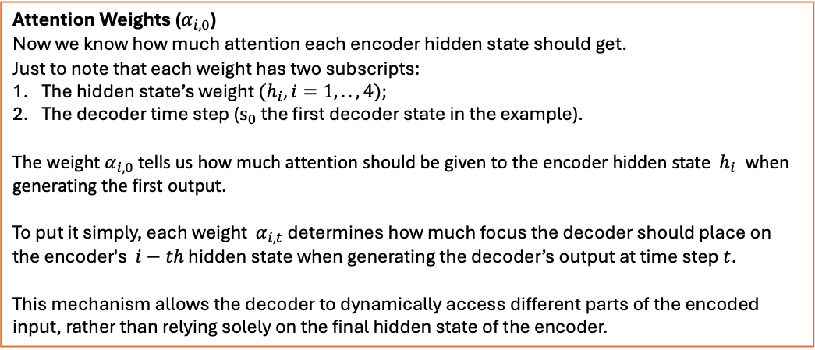

Attention
Attention Mechanism
Attention Weights ($α_{i,0}$)
Now we know how much attention each encoder hidden state should get.
Just to note that each weight has two subscripts:
The hidden state’s weight ${(h}_{i}, i=1,..,4);$
The decoder time step ($s_{0}$ the first decoder state in the example).
The weight $α_{i,0}$ tells us how much attention should be given to the encoder hidden state $h_{i}$​ when generating the first output.
To put it simply, each weight $α_{i,t}$determines how much focus the decoder should place on the encoder's $i−th$ hidden state when generating the decoder’s output at time step $t$.
This mechanism allows the decoder to dynamically access different parts of the encoded input, rather than relying solely on the final hidden state of the encoder.
$$.70$$
$$.10$$
$$.05$$
$$.15$$
SOFTMAX
$$f(h_{1},s_{0})$$
$$f(h_{2},s_{0})$$
$$f(h_{3},s_{0})$$
$$f(h_{4},s_{0})$$
f
f
f
f
$$h_{1}$$
$$h_{2}$$
$$h_{3}$$
$$h_{4}$$
$$s_{0}$$
$$The$$
$$battery$$
$$is$$
$$dead$$
e.g. Encoder Bidirectional

Slide 7





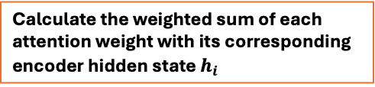

Attention
Attention Mechanism
Calculate the weighted sum of each attention weight with its corresponding encoder hidden state $h_{i}$
$$α_{1,0}$$
$$α_{2,0}$$
$$α_{3,0}$$
$$α_{4,0}$$
$$c_{j}=Σ_{i}α_{i,j}h_{i}$$
SOFTMAX
scalar
vector
$$f(h_{1},s_{0})$$
$$f(h_{2},s_{0})$$
$$f(h_{3},s_{0})$$
$$f(h_{4},s_{0})$$
$c_{0}=α_{1,0}h_{1}+α_{2,0}h_{2}$+ $α_{3,0}h_{3}$ $+α_{4,0}h_{4}$
f
f
f
f
$$h_{1}$$
$$h_{2}$$
$$h_{3}$$
$$h_{4}$$
$$s_{0}$$
$$The$$
$$battery$$
$$is$$
$$dead$$
e.g. Encoder Bidirectional

Slide 8


Attention
Attention Mechanism
$$α_{1,0}$$
$$α_{2,0}$$
$$α_{3,0}$$
$$α_{4,0}$$
$$c_{j}=Σ_{i}α_{i,j}h_{i}$$
SOFTMAX
$$az$$
That concludes one complete decoding time step using attention.
$$f(h_{1},s_{0})$$
$$f(h_{2},s_{0})$$
$$f(h_{3},s_{0})$$
$$f(h_{4},s_{0})$$
f
f
f
f
$$h_{1}$$
$$h_{2}$$
$$h_{3}$$
$$h_{4}$$
$$s_{0}$$
$$The$$
$$battery$$
$$is$$
$$dead$$
<start>
e.g. Encoder Bidirectional
Concat context vector with embedding of input token.

Slide 9


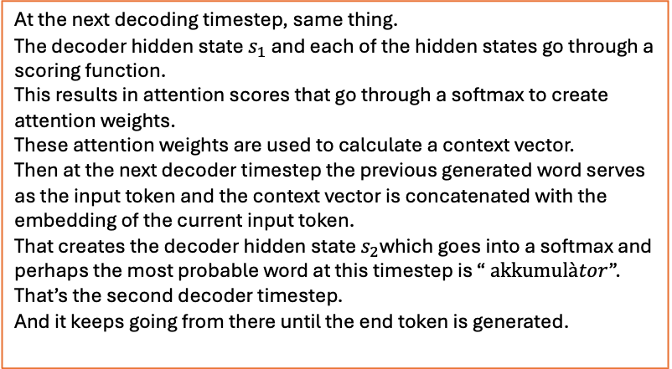









Attention
Attention Mechanism
$$α_{1,1}$$
$$α_{2,1}$$
$$α_{3,1}$$
$$α_{4,1}$$
$$c_{j}=Σ_{i}α_{i,j}h_{i}$$
At the next decoding timestep, same thing.
The decoder hidden state $s_{1}$ and each of the hidden states go through a scoring function.
This results in attention scores that go through a softmax to create attention weights.
These attention weights are used to calculate a context vector.
Then at the next decoder timestep the previous generated word serves as the input token and the context vector is concatenated with the embedding of the current input token.
That creates the decoder hidden state $s_{2}$which goes into a softmax and perhaps the most probable word at this timestep is “ $akkumulàtor$”.
That’s the second decoder timestep.
And it keeps going from there until the end token is generated.
SOFTMAX
$$f(h_{1},s_{1})$$
$$f(h_{2},s_{1})$$
$$f(h_{3},s_{1})$$
$$f(h_{4},s_{1})$$
$$az$$
$$akkumulàtor$$
f
f
f
f
$$s_{2}$$
$$h_{1}$$
$$h_{2}$$
$$h_{3}$$
$$h_{4}$$
$$s_{0}$$
$$s_{1}$$
$$The$$
$$battery$$
$$is$$
$$dead$$
<start>
$$az$$
e.g. Encoder Bidirectional
Concat context vector with embedding of input token.

Slide 10









Attention
Attention Mechanism
$$α_{1,3}$$
$$α_{2,3}$$
$$α_{3,3}$$
$$α_{4,3}$$
$$c_{j}=Σ_{i}α_{i,j}h_{i}$$
SOFTMAX
$$f(h_{1},s_{3})$$
$$f(h_{2},s_{3})$$
$$f(h_{3},s_{3})$$
$$f(h_{4},s_{3})$$
$$az$$
$$akkumulàtor$$
$$lemeur\text{ü}\text{lt}$$
$$<end>$$
f
f
f
f
$$s_{4}$$
$$h_{1}$$
$$h_{2}$$
$$h_{3}$$
$$h_{4}$$
$$s_{0}$$
$$s_{1}$$
$$The$$
$$battery$$
$$is$$
$$dead$$
<start>
$$az$$
$$akkumulàtor$$
$$lemeur\text{ü}\text{lt}$$
e.g. Encoder Bidirectional
Concatenate

Slide 11

Attention
Attention Mechanism
Some scoring functions f aka an alignment model
Additive / Bahdanau Attention
$$f\left(h_{i},s_{j}\right)=v^{T}tanh⁡(Wh_{i}+Us_{j})$$
Feedforward NN
Here the encoder hidden state and the current decoder state are each multiply by a set of weights W and U then summed this is why it is called “additive”.
This is then run through a tanh non-linearity and multiply by another vector v to turn it into a scalar.
So, the scoring function here is a feed for a NN trained via back propagation.
The way the context vector is incorporated into the decoder is the way we’ve been doing it in the example, that is the context vector concatenated with the input token embedding before being fed to the RNN.
Note: the original paper by Bahdanau and colleagues used GRU in a bi-directional encoder.

Slide 12
Attention
Attention Mechanism
Some scoring functions f aka an alignment model
In essence, there are more learnable weights involved which allows the model to learn which encoder states are more important given the current decoder hidden state.
So, for example, if we’re training a model to translate from English where the verb comes before the object to Japanese where the verb comes after the object, the model can now learn to place more attention on different parts of the source sentence to make that distinction. This is why the scoring function is aka alignment model.
The collection of encoder hidden states becomes a type of memory for the decoder to access.

Slide 13


Attention
Attention Mechanism
Some scoring functions f aka an alignment model
Multiplicative / Luong Attention (2 possibilities)
$$f\left(h_{i},s_{j}\right)=s_{j}^{T}h_{i}$$
$$f\left(h_{i},s_{j}\right)=s_{j}^{T}{Wh}_{i}$$
Uses a stacked LSTM for both the encoder and the decoder.
The multiplicative attention does not concatenate anything with the input embedding.
The input embedding is taken solely.

Slide 14





















Attention
Attention Mechanism
Some scoring functions f aka an alignment model
Multiplicative / Luong Attention (2 possibilities)
$$f\left(h_{i},s_{j}\right)=s_{j}^{T}h_{i}$$
$$α_{1,0}$$
$$α_{2,0}$$
$$α_{3,0}$$
$$α_{4,0}$$
$$c_{j}=Σ_{i}α_{i,j}h_{i}$$
$$f\left(h_{i},s_{j}\right)=s_{j}^{T}{Wh}_{i}$$
SOFTMAX
$$f(h_{1},s_{0})$$
$$f(h_{2},s_{0})$$
$$f(h_{3},s_{0})$$
$$f(h_{4},s_{0})$$
f
$$az$$
f
f
$${\hat{S}}_{1}=tanh⁡(W[c_{1};s_{1}])$$
f
+
$$tanh$$
Use current hidden state for scoring.
$$h_{1}$$
$$h_{2}$$
$$h_{3}$$
$$h_{4}$$
$$s_{1}$$
$$s_{2}$$
$$s_{0}$$
$$s_{1}$$
$$s_{0}$$
$$s_{1}$$
Optionally, ${\hat{S}}_{1}$can be combined with the input.
$$The$$
$$battery$$
$$is$$
$$dead$$
$$<start>$$
$$az$$

Slide 15
Attention
Attention Mechanism
Some scoring functions f aka an alignment model
Multiplicative / Luong Attention (2 possibilities)
$$f\left(h_{i},s_{j}\right)=s_{j}^{T}h_{i}$$
$$α_{1,0}$$
$$α_{2,0}$$
$$α_{3,0}$$
$$α_{4,0}$$
$$c_{j}=Σ_{i}α_{i,j}h_{i}$$
$$f\left(h_{i},s_{j}\right)=s_{j}^{T}{Wh}_{i}$$
SOFTMAX
$$f(h_{1},s_{0})$$
$$f(h_{2},s_{0})$$
$$f(h_{3},s_{0})$$
$$f(h_{4},s_{0})$$
f
$$az$$
f
f
$${\hat{S}}_{1}=tanh⁡(W[c_{1};s_{1}])$$
f
+
$$tanh$$
Global attention considers all the encoder hidden states which can be computationally expensive for long sequences.
$$h_{1}$$
$$h_{2}$$
$$h_{3}$$
$$h_{4}$$
$$s_{1}$$
$$s_{2}$$
$$s_{0}$$
$$s_{1}$$
$$s_{0}$$
$$s_{1}$$
$$The$$
$$battery$$
$$is$$
$$dead$$
$$<start>$$
$$az$$

Slide 16
Attention
Attention Mechanism
Some scoring functions f aka an alignment model
Multiplicative / Luong Attention (2 possibilities)
$$f\left(h_{i},s_{j}\right)=s_{j}^{T}h_{i}$$
$$α_{1,0}$$
$$α_{2,0}$$
$$α_{3,0}$$
$$α_{4,0}$$
$$c_{j}=Σ_{i}α_{i,j}h_{i}$$
$$f\left(h_{i},s_{j}\right)=s_{j}^{T}{Wh}_{i}$$
SOFTMAX
$$f(h_{1},s_{0})$$
$$f(h_{2},s_{0})$$
$$f(h_{3},s_{0})$$
$$f(h_{4},s_{0})$$
f
$$az$$
f
f
$${\hat{S}}_{1}=tanh⁡(W[c_{1};s_{1}])$$
+
Local attention considers the encoder hidden states within a fixed window but allows the aligned position (i.e. the centre of the window) to either follow the decoder timestep or be learned.
f
$$tanh$$
$$h_{1}$$
$$h_{2}$$
$$h_{3}$$
$$h_{4}$$
$$s_{1}$$
$$s_{2}$$
$$s_{0}$$
$$s_{1}$$
$$s_{0}$$
$$s_{1}$$
$$The$$
$$battery$$
$$is$$
$$dead$$
$$<start>$$
$$az$$
Notes:
Attention mechanism:
The decoder hidden state and each encoder state are used to create attention weights.
These weights are used to create a context vector.
The context vector is used to help generate the decoder next output.
And the attention mechanism has trainable weights which allowws the model to learn
which hidden states to pay more attention to based on the current decoder state.

