Slide 1
The Chain Rule

Slide 2
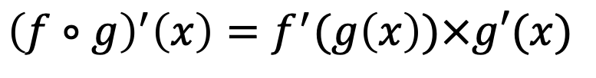
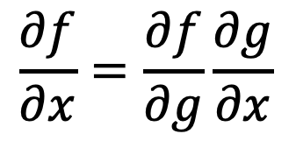
The chain rule definition
The chain rule is a fundamental rule in calculus that describes how to differentiate a composite function.
$$x →g(x)→f(g\left(x\right))$$
If a function $f$ depends on $g$, which itself depends on $x$, then the derivative of $f$ with respect to $x$ is given by the product of the derivative of $f$ with respect to $g$ and the derivative of $g$ with respect to $x$:
$$\frac{∂f}{∂x}=\frac{∂f}{∂g}\frac{∂g}{∂x}$$
This equation is equivalent to the mathematical formula:
$${\left(f∘g\right)}^{′}\left(x\right)=f^{′}(g\left(x\right))×g′(x)$$

Slide 3


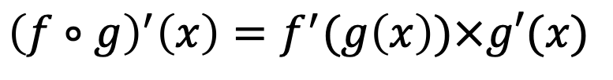
The chain rule definition
Demonstration (1/2):
$${\left(f∘g\right)}^{′}\left(x\right)=f^{′}(g\left(x\right))×g′(x)$$
$${\left(f∘g\right)}^{′}\left(x\right)=\lim_{∆x→0}{\frac{\left(f∘g\right)\left(x+∆x\right)−\left(f∘g\right)\left(x\right)}{∆x}=\lim_{∆x→0}{\frac{f(g\left(\left(x+∆x\right)\right)−f(g\left(x\right))}{∆x}}}$$
Let’s introduce:
$$∆u=g\left(x+∆x\right)−g(x)$$
$${\left(f∘g\right)}^{′}\left(x\right)=\lim_{∆x→0}\frac{f(g\left(\left(x+∆x\right)\right)−f(g\left(x\right))}{∆u}×\frac{Δu}{Δx}$$
Let’s notice that:
$$g is differentiable, therefore it is continuous$$
$$\lim_{∆x→0}{g\left(x+∆x\right)=g(x)⇔}\lim_{∆x→0}{(\left(g(x)+∆x\right)−g\left(x\right))=0⇔\lim_{∆x→0}{∆u=0}⇔∆x→0⇒∆u→0 }$$

Slide 4



The chain rule definition
Demonstration (2/2):
$${\left(f∘g\right)}^{′}\left(x\right)=f^{′}(g\left(x\right))×g′(x)$$
By definition:
$$∆u+g(x)=g\left(x+∆x\right)$$
$$f\left(g\left(x+∆x\right))−f(g\left(x\right)\right)=f\left(g\left(x\right)+∆u\right)−f(g\left(x\right))$$
If now we put:
$$u=g(x)$$
$$f\left(g\left(x+∆x\right))−f(g\left(x\right)\right)=f\left(u+∆u\right)−f(u)$$
$${\left(f∘g\right)}^{′}\left(x\right)=\lim_{∆x→0}\frac{f(g\left(\left(x+∆x\right)\right)−f(g\left(x\right))}{∆u}×\frac{Δu}{Δx}=\lim_{∆u→0}{\frac{f\left(u+∆u\right)−f(u)}{∆u}}×\frac{∆u}{∆x}$$
$$\lim_{∆u→0}{\frac{f\left(u+∆u\right)−f(u)}{∆u}}=f^{′}\left(u\right)=f′(g\left(x\right))$$
$$\lim_{∆x→0}{\frac{Δu}{∆x}}=\lim_{∆x→0}{\frac{g\left(x+∆x\right)−g(x)}{∆x}=g′(x)}$$
CQFD

