Slide 1
Gibbs Sampling

Slide 2
Gibbs sampling
The most famous Monte-Carlo Markov Chain (MCMC) algorithm
MCMC comes from Monte Carlo Markov Chain.
Monte Carlo because we simulate samples to infer the target distribution.
Markov Chain because the next samples depends on the last sample.

Slide 3
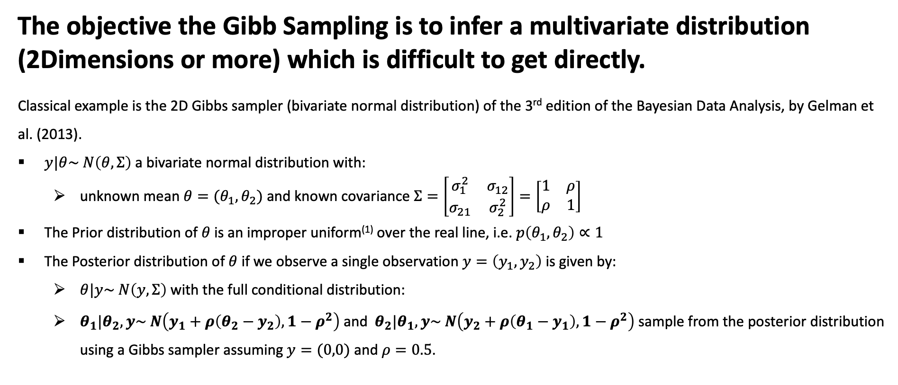
Gibbs sampling
The objective the Gibb Sampling is to infer a multivariate distribution (2Dimensions or more) which is difficult to get directly.
Classical example is the 2D Gibbs sampler (bivariate normal distribution) of the 3rd edition of the Bayesian Data Analysis, by Gelman et al. (2013).
$y|θ\sim N\left(θ, Σ\right)$a bivariate normal distribution with:
unknown mean $θ=(θ_{1},θ_{2})$ and known covariance $Σ=\left[\begin{matrix}σ_{1}^{2} & σ_{12} \\ σ_{21} & σ_{2}^{2}\end{matrix}\right]=\left[\begin{matrix}1 & ρ \\ ρ & 1\end{matrix}\right]$
The Prior distribution of $θ$ is an improper uniform⁽¹⁾ over the real line, i.e. $p\left(θ_{1},θ_{2}\right)∝1$
The Posterior distribution of $θ$ if we observe a single observation $y=\left(y_{1},y_{2}\right)$ is given by:
$θ|y\sim N\left(y, Σ\right)$with the full conditional distribution:
$θ_{1}|θ_{2},y\sim N\left(y_{1}+ρ\left(θ_{2}−y_{2}\right), 1−ρ^{2}\right)$ and $θ_{2}|θ_{1},y\sim N\left(y_{2}+ρ\left(θ_{1}−y_{1}\right), 1−ρ^{2}\right)$ sample from the posterior distribution using a Gibbs sampler assuming $y=(0,0)$ and $ρ=0.5$.
(1) When there is no information about the prior, we use an improper uniform

Slide 4

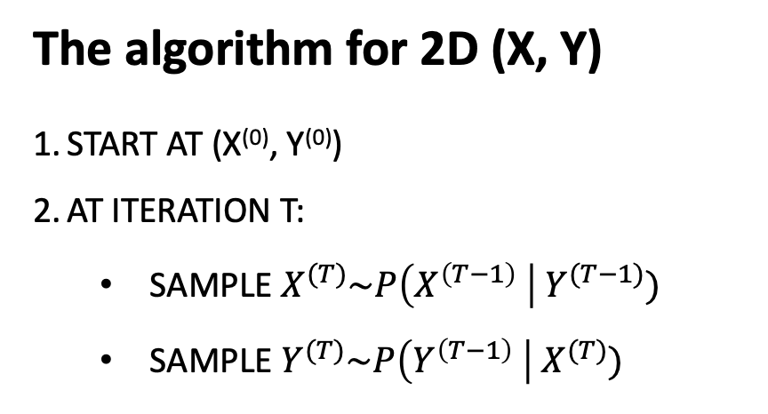




Gibbs sampling
The algorithm for 2D (X, Y)
START AT (X⁽⁰⁾, Y⁽⁰⁾)
AT ITERATION T:
SAMPLE $X^{(T)}\sim P\left(X^{\left(T−1\right)} \right|{ Y}^{(T−1)})$
SAMPLE $Y^{(T)}\sim P\left(Y^{\left(T−1\right)} \right|{ X}^{(T)})$
$$\left(2\right)(X^{\left(1\right)},Y^{\left(0\right)})$$
$$\left(1\right)(X^{\left(0\right)},Y^{\left(0\right)})$$
$$\left(5\right)(X^{\left(2\right)},Y^{\left(2\right)})$$
$$\left(3\right)(X^{\left(1\right)},Y^{\left(1\right)})$$
$$\left(4\right)(X^{\left(2\right)},Y^{\left(1\right)})$$

Slide 5
Gibbs sampling
The objective the Gibb Sampling is to infer a multivariate distribution (2Dimensions or more) which is difficult to get directly.
import numpy as np
# generate samples from a multivariate normal distribution.
# mean = [0, 0]
# cov = [[1, 0.5], [0.5, 1]]
# size = 1000
automatic_sample = np.random.multivariate_normal([0, 0], [[1, 0.5], [0.5, 1]], 1000)
import matplotlib.pyplot as plt
# Create a scatter plot to show the ascending ellipse
# of the bivariate normal distribution
plt.scatter(automatic_sample[:, 0], automatic_sample[:, 1], alpha=0.5)
# Add horizontal and vertical lines at the origin
plt.axhline(0, color='black',linewidth=0.5)
plt.axvline(0, color='black',linewidth=0.5)
# Add grid
plt.grid(color = 'gray', linestyle = '--', linewidth = 0.5)
# Add labels and title
plt.xlabel('Y_1')
plt.ylabel('Y_2')
plt.title('Samples from a Multivariate Normal Distribution with Orthogonal Reference')
# Show plot
plt.show()

Slide 6
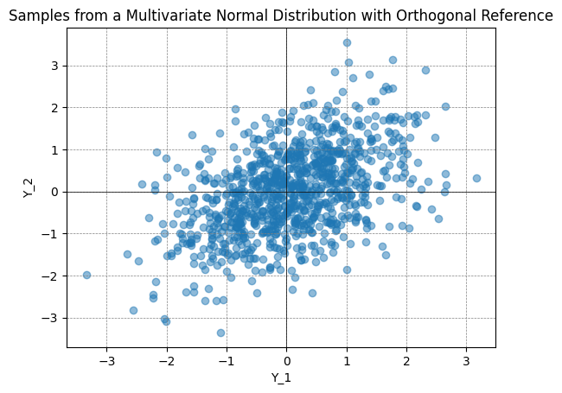
Gibbs sampling
The objective the Gibb Sampling is to infer a multivariate distribution (2Dimensions or more) which is difficult to get directly.

Slide 7
Gibbs sampling
The objective the Gibb Sampling is to infer a multivariate distribution (2Dimensions or more) which is difficult to get directly.
# Reminder from conditional probability of 2D normal distribution N(mu, sigma):
# f(y2 | y1) = N(mu_2 + rho * sigma_2/sigma_1 * (y1 - mu_1), sigma_2^2 * (1 - rho^2))
# where mu_1, mu_2 are the means of the marginal distributions
# sigma_1, sigma_2 are the standard deviations of the marginal distributions
# In our case mu_1 = 0, mu_2 = 0, sigma_1 = sigma_2 = 1, sigma_21 = sigma12 = rho = 0.5
# So, the conditional mean mu_2 + rho * sigma_2/sigma_1 * (y1 - mu_1)
# simplifies to rho * y1 i.e. 0.5 * y1
# and the conditional variance sigma_2^2 * (1 - rho^2) simplifies to 0.75
# Gibbs sampling uses the last sample to generate the next one.
samples = {'x' : [1], 'y': [-1]}
num_samples = 1000
for _ in range(num_samples):
curr_x = samples['x'][-1]
new_x = np.random.normal(curr_x * 0.5, np.sqrt(0.75))
new_y = np.random.normal(new_x * 0.5, np.sqrt(0.75))
samples['x'].append(new_x)
samples['y'].append(new_y)
import matplotlib.pyplot as plt
# Create a scatter plot
plt.scatter(samples['x'], samples['y'], alpha=0.5)
# Add horizontal and vertical lines at the origin
plt.axhline(0, color='black',linewidth=0.5)
plt.axvline(0, color='black',linewidth=0.5)
# Add grid
plt.grid(color = 'gray', linestyle = '--', linewidth = 0.5)
# Add labels and title
plt.xlabel('Y_1')
plt.ylabel('Y_2')
plt.title('Samples from a Multivariate Normal Distribution with Orthogonal Reference')
# Show plot
plt.show()

Slide 8
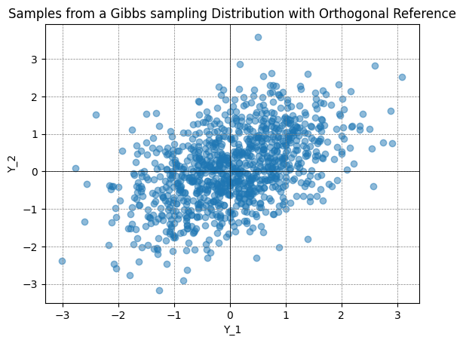
Gibbs sampling
The objective the Gibb Sampling is to infer a multivariate distribution (2Dimensions or more) which is difficult to get directly.
Notes:
# Note that the as a MCMC algorithm, the Gibbs sampler is not guaranteed to converge to the true distribution.
# and the samples generated by the Gibbs sampler are not independent.

Slide 9
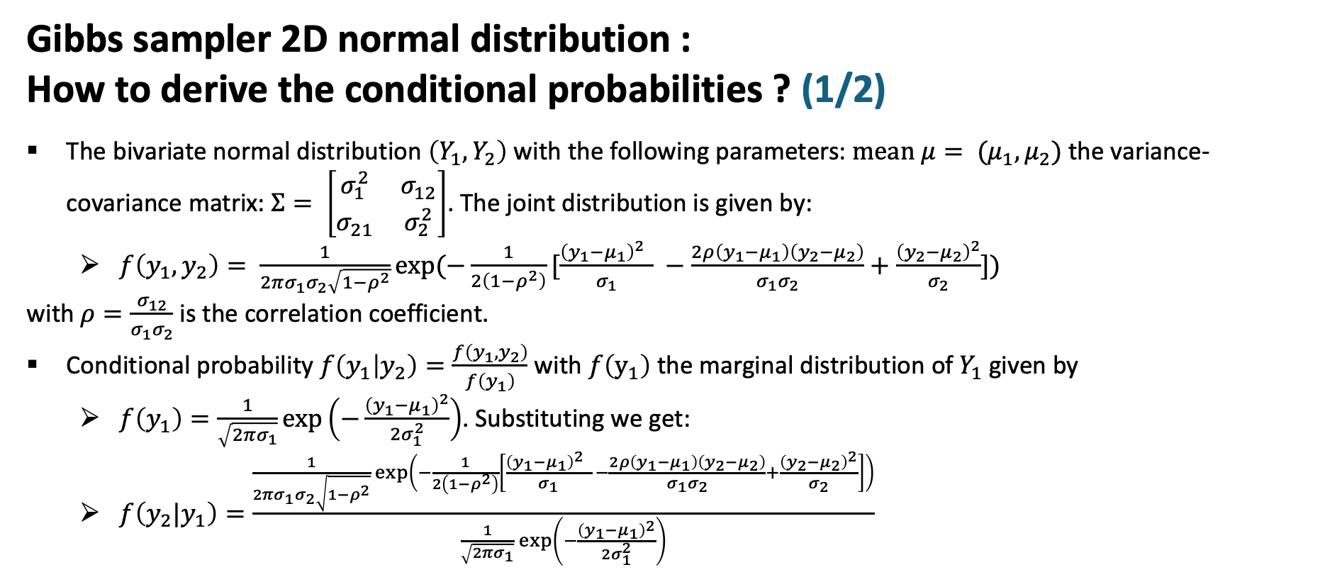
Gibbs sampling
Gibbs sampler 2D normal distribution :
How to derive the conditional probabilities ? (1/2)
The bivariate normal distribution $\left(Y_{1},Y_{2}\right)$ with the following parameters: $mean μ= {(μ}_{1},μ_{2})$the variance-covariance matrix: $Σ= \left[\begin{matrix}σ_{1}^{2} & σ_{12} \\ σ_{21} & σ_{2}^{2}\end{matrix}\right]$. The joint distribution is given by:
$f\left(y_{1},y_{2}\right)= \frac{1}{2πσ_{1}σ_{2}\sqrt{1−ρ^{2}}}exp⁡(−\frac{1}{2\left(1−ρ^{2}\right)}[\frac{{\left(y_{1}−μ_{1}\right)}^{2} }{σ_{1}} −\frac{2ρ\left(y_{1}−μ_{1}\right)\left(y_{2}−μ_{2}\right)}{σ_{1}σ_{2}}+\frac{{\left(y_{2}−μ_{2}\right)}^{2}}{σ_{2}}])$
with $ρ=\frac{σ_{12}}{σ_{1}σ_{2}}$ is the correlation coefficient.
Conditional probability $f\left(y_{1} | y_{2}\right)=\frac{f\left(y_{1},y_{2}\right)}{f\left(y_{1}\right)}$ with $f\left(y_{1}\right)$ the marginal distribution of $Y_{1}$given by
$f\left(y_{1}\right)=\frac{1}{\sqrt{2πσ_{1}}}\exp\left(−\frac{{\left(y_{1}−μ_{1}\right)}^{2}}{2σ_{1}^{2}}\right)$. Substituting we get:
$f\left(y_{2}|y_{1}\right)=\frac{\frac{1}{2πσ_{1}σ_{2}\sqrt{1−ρ^{2}}}\exp\left(−\frac{1}{2\left(1−ρ^{2}\right)}\left[\frac{{\left(y_{1}−μ_{1}\right)}^{2} }{σ_{1}} −\frac{2ρ\left(y_{1}−μ_{1}\right)\left(y_{2}−μ_{2}\right)}{σ_{1}σ_{2}}+\frac{{\left(y_{2}−μ_{2}\right)}^{2}}{σ_{2}}\right]\right)}{\frac{1}{\sqrt{2πσ_{1}}}\exp\left(−\frac{{\left(y_{1}−μ_{1}\right)}^{2}}{2σ_{1}^{2}}\right)}$

Slide 10
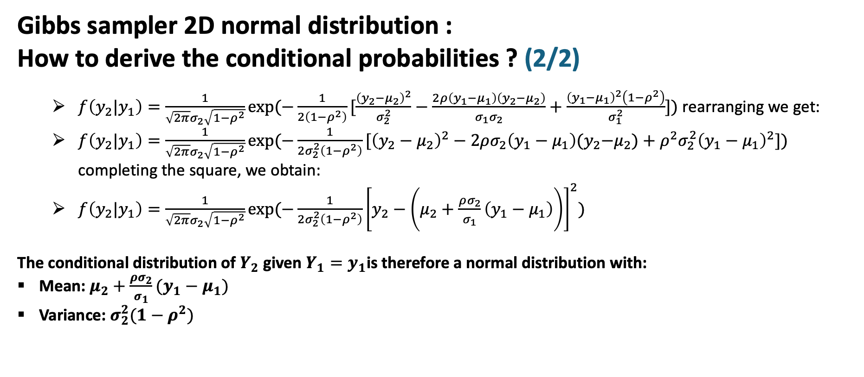
Gibbs sampling
Gibbs sampler 2D normal distribution :
How to derive the conditional probabilities ? (2/2)
$f\left(y_{2}|y_{1}\right)=\frac{1}{\sqrt{2π}σ_{2}\sqrt{1−ρ^{2}}}exp⁡(−\frac{1}{2\left(1−ρ^{2}\right)}[\frac{{\left(y_{2}−μ_{2}\right)}^{2}}{σ_{2}^{2}}−\frac{2ρ\left(y_{1}−μ_{1}\right)\left(y_{2}−μ_{2}\right)}{σ_{1}σ_{2}}+\frac{{\left(y_{1}−μ_{1}\right)}^{2}\left(1−ρ^{2}\right)}{σ_{1}^{2}}])$ rearranging we get:
$f\left(y_{2}|y_{1}\right)=\frac{1}{\sqrt{2π}σ_{2}\sqrt{1−ρ^{2}}}exp⁡(−\frac{1}{2σ_{2}^{2}\left(1−ρ^{2}\right)}[{\left(y_{2}−μ_{2}\right)}^{2}−2ρσ_{2}\left(y_{1}−μ_{1}\right){(y}_{2}−μ_{2})+ρ^{2}σ_{2}^{2}{\left(y_{1}−μ_{1}\right)}^{2}])$ completing the square, we obtain:
$f\left(y_{2}|y_{1}\right)=\frac{1}{\sqrt{2π}σ_{2}\sqrt{1−ρ^{2}}}exp⁡(−\frac{1}{2σ_{2}^{2}\left(1−ρ^{2}\right)}{\left[y_{2}−\left(μ_{2}+\frac{ρσ_{2}}{σ_{1}}\left(y_{1}−μ_{1}\right)\right)\right]}^{2})$
The conditional distribution of $Y_{2}$ given $Y_{1}=y_{1}$is therefore a normal distribution with:
Mean: $μ_{2}+\frac{ρσ_{2}}{σ_{1}}(y_{1}−μ_{1})$
Variance: $σ_{2}^{2}(1−ρ^{2})$

