Slide 1
Language Models (LM)
Notes:
Traitement automatique du language naturel

Slide 2
Language Models
She spent the day swimming in the ______.
With highest probability we can predict “lake”, “ocean”
Language is predictable, some sequences are more probable than others.

Slide 3
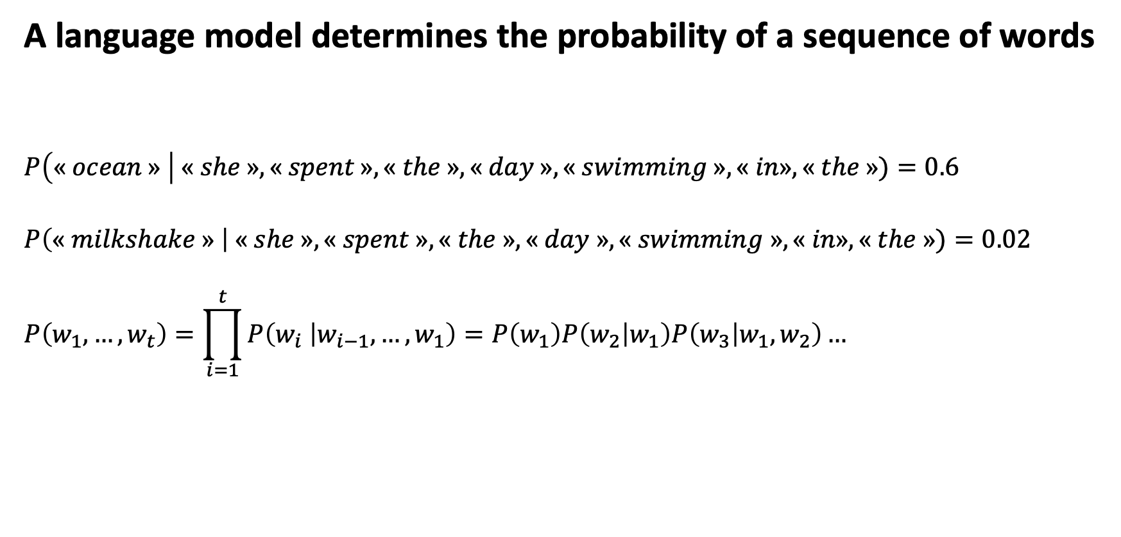
Language Models
A language model determines the probability of a sequence of words
$$P\left(« ocean » \right| « she », « spent », « the », « day », « swimming »,« in», « the »)=0.6$$
$$P\left(« milkshake » \right| « she », « spent », « the », « day », « swimming »,« in», « the »)=0.02$$
$$P\left(w_{1},…,w_{t}\right)=\prod_{i=1}^{t}{P\left(w_{i} | w_{i−1},…,w_{1}\right)}=P\left(w_{1}\right)P\left(w_{2} | w_{1}\right)P\left(w_{3} | w_{1},w_{2}\right)…$$

Slide 4
Language Models
A language model determines the probability of a sequence of words
Speech recognition
Translation
Auto correct / completion
Text generation

Slide 5
Language Models
How to train an RNN based language model ?
Training is self-supervised
Corpus segmented into pieces such as chunks or sentences or paragraphs or documents…
Each piece is now one training example

Slide 6























Language Models
How to train an RNN based language model ?
$$y_{t=1}$$
CCE Loss : the higher the $\hat{y}\left[« swan »\right] the lower the loss$
The softmax gives a probability for each word of the vocabulary of being the next
Use next word in the sequence as target (y) for current time step.
For example, at t=1 we use the word “swam” as the target.
“swan” can be its word embedding or its index in the vocabulary.
And we continue for the rest of the sentence.
Note:
At time step 3 we feed the RNN with the word “in” and the hidden state is “She swam”.
The output is the probability distribution of each word of the vocabulary of being next in the sequence.
Then we calculate the loss and ignore the output itself. And instead feed the network the correct next word in the sequence “the”.
This technique is called Teacher Forcing
$L_{t=1}=−log⁡\hat{y}[« swan »]$ ${… L}_{t=4}=−log⁡\hat{y}[« in »]$.
…“hit”, “swan”, “ran”…
${\hat{y}}_{t=1}=$[…0.6, 0.02, 0.1…]
$${\hat{y}}_{t=1}$$
$${\hat{y}}_{t=2}$$
$${\hat{y}}_{t=3}$$
$${\hat{y}}_{t=4}$$
$$o_{t=1}$$
$$o_{t=2}$$
$$o_{t=3}$$
$$o_{t=4}$$
V
V
V
V
$$0$$
$$0$$
$$0$$
$$0$$
$$h_{t=0}$$
$$h_{t=1}$$
$$h_{t=1}$$
$$h_{t=2}$$
$$h_{t=2}$$
$$h_{t=3}$$
$$h_{t=3}$$
$$h_{t=4}$$
W
W
W
U
U
U
U
$$X_{t=1}$$
$$X_{t=2}$$
$$X_{t=3}$$
$$X_{t=4}$$
“She”
[0.00154, 0.58..]
“swam”
[0.0445, 0.078..]
“in”
[0.0021, 0.008..]
“the”
[0.1821, 0.082..]

Slide 7





Language Models
Once the RNN is trained, Text generation is straight forward
The softmax gives a probability for each word of the vocabulary of being the next
« $The »$
« $cat »$
« $knocked »$
« $over »$
$${\hat{y}}_{t=1}$$
$${\hat{y}}_{t=2}$$
$${\hat{y}}_{t=3}$$
$${\hat{y}}_{t=4}$$
$$o_{t=1}$$
$$o_{t=2}$$
$$o_{t=3}$$
$$o_{t=4}$$
Autoregressive Generation
V
V
V
V
$$0$$
$$0$$
$$0$$
$$0$$
$$h_{t=0}$$
$$h_{t=1}$$
$$h_{t=1}$$
$$h_{t=2}$$
$$h_{t=2}$$
$$h_{t=3}$$
$$h_{t=3}$$
$$h_{t=4}$$
…
W
W
W
U
U
U
U
$$X_{t=1}$$
$$X_{t=2}$$
$$X_{t=3}$$
$$X_{t=4}$$
<Start>
[0.00154, 0.58..]
“The”
[0.0445, 0.078..]
“cat”
[0.0021, 0.008..]
“knowcked”
[0.1821, 0.082..]

Slide 8
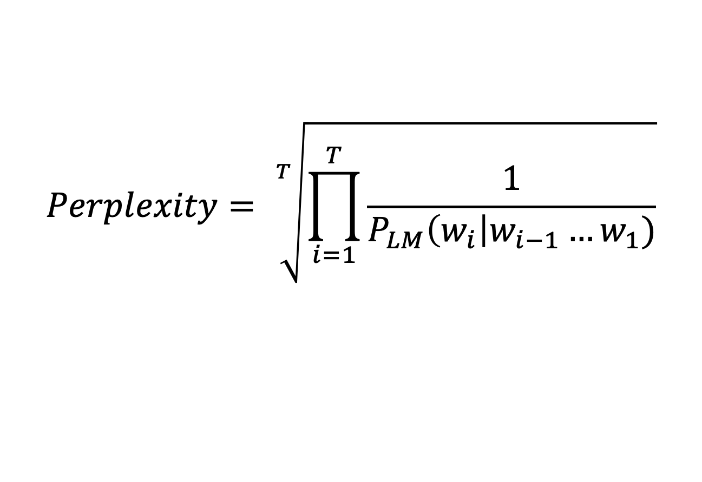
Language Models
Once the RNN is trained, how do we evaluate the Language Model ?
$$Perplexity= \sqrt[T]{\prod_{i=1}^{T}{\frac{1}{P_{LM}\left(w_{i}\right|w_{i−1}…w_{1})}}}$$
Inverse probability of the test set (entire test corpus)
The lower the score, the better.

Slide 9
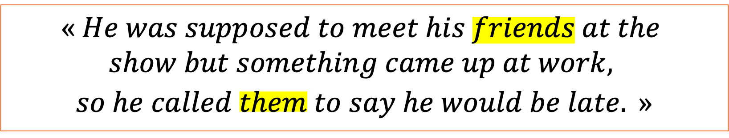
Language Models
Long-Range dependencies
$$« He was supposed to meet his friends at the$$
$$show but something came up at work,$$
$$so he called them to say he would be late. »$$
“them” is dependent of “friends” but this is where simple RNN became struggling

Slide 10









Language Models
Long-Range dependencies
Issue with Simple RNNs, earlier signal may weaken over time
$$0$$
$$0$$
$$0$$
$$0$$
$$h_{t=0}$$
$$h_{t=1}$$
$$h_{t=2}$$
$$h_{t=3}$$
$$X_{t=1}$$
$$X_{t=2}$$
$$X_{t=3}$$
$$X_{t=4}$$
Vanishing / Exploding gradients during training.
Repeated multiplication during BPTT can lead to network either ceasing to learn or becoming unstable.

Slide 11
Language Models
Long-Range dependencies
A simple RNN often has a hard time modelling long-range dependencies.
A few remedies:
Batch normalization
Careful weight initialization
Gradient clipping for exploding gradients
Or use a different cell architecture…

