Slide 1
Long Short-Term Memory (LSTM)
Notes:
Traitement automatique du language naturel

Slide 2











Long Short-Term Memory
$${\hat{y}}_{t=1}$$
$${\hat{y}}_{t=2}$$
$${\hat{y}}_{t=3}$$
$${\hat{y}}_{t=4}$$
Each cell contains gates (NN layers) controlling information flow.
$$h_{t=1}$$
$$h_{t=2}$$
$$h_{t=3}$$
$$X_{t=1}$$
$$X_{t=2}$$
$$X_{t=3}$$
$$X_{t=4}$$
“The”
[0.00154, 0.58..]
“dog”
[0.0445, 0.078..]
“looked”
[0.0021, 0.008..]
“guilty”
[0.1821, 0.082..]

Slide 3






















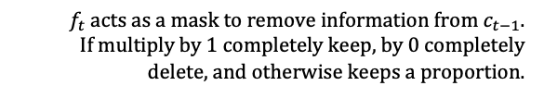



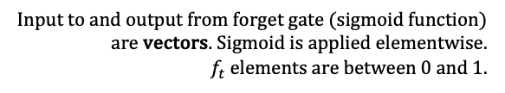






LSTM Cell
Each cell contains gates (NN layers) controlling information flow.
$$h_{t}$$
$$h_{t} for the current$$
$$time step output$$
$\tilde{c}$new information available for adding to cell state.
$i_{t}$ acts as a mask to determine which new information to add to cell state $c_{t−1}$.
$i_{t}×\tilde{c}$gates the flow of new information. It determines which information to add to the previous cell state.
Cell states from the previous time step serves as an additional memory that stores long term information.
$$c_{t−1}$$
$$⊙$$
$$+$$
$$c_{t}=f_{t}⊙c_{t−1}+i_{t}⊙c_{t−1}$$
$$⊙$$
$$tanh⁡(c_{t})$$
$f_{t}$ acts as a mask to remove information from $c_{t−1}$.
If multiply by 1 completely keep, by 0 completely delete, and otherwise keeps a proportion.
$$f_{t}$$
$$i_{t}$$
$$o_{t}$$
$$⊙$$
$$\tilde{c}$$
forget gate
input gate
cell update
output gate
Input to and output from forget gate (sigmoid function) are vectors. Sigmoid is applied elementwise.
$f_{t}$ elements are between 0 and 1.
$$f_{t}=σ({W_{f}h}_{t−1}+{U_{f}X}_{t})$$
$$i_{t}=σ({W_{i}h}_{t−1}+{U_{i}X}_{t})$$
$$\tilde{c}=tanh({W_{c}h}_{t−1}+{U_{c}X}_{t})$$
$$o_{t}=σh({W_{o}h}_{t−1}+{U_{o}X}_{t})$$
$$W_{f}$$
$$U_{f}$$
$$W_{i}$$
$$U_{i}$$
$$W_{c}$$
$$U_{c}$$
$$W_{o}$$
$$U_{o}$$
$$h_{t−1}$$
$$h_{t} for the next$$
$$time step output$$
$$X_{t}$$
$$h_{t}=o_{t}⊙{tanh⁡(c}_{t})$$
Complete flow of a LSTM cell. It can learn long-range dependencies through 4 NN which can learn which information to remove, to add, to carry forward

Slide 4
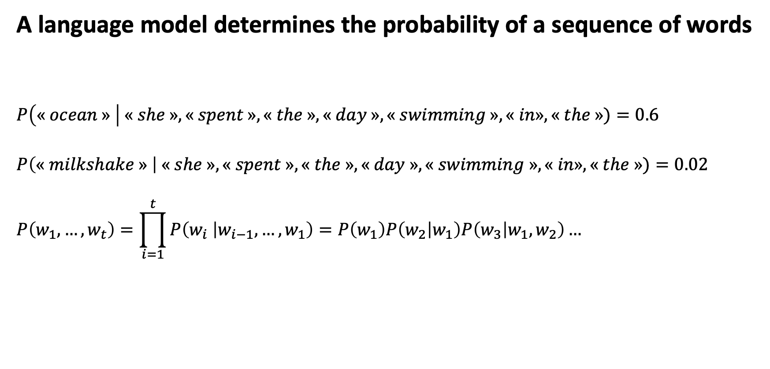
Language Models
A language model determines the probability of a sequence of words
$$P\left(« ocean » \right| « she », « spent », « the », « day », « swimming »,« in», « the »)=0.6$$
$$P\left(« milkshake » \right| « she », « spent », « the », « day », « swimming »,« in», « the »)=0.02$$
$$P\left(w_{1},…,w_{t}\right)=\prod_{i=1}^{t}{P\left(w_{i} | w_{i−1},…,w_{1}\right)}=P\left(w_{1}\right)P\left(w_{2} | w_{1}\right)P\left(w_{3} | w_{1},w_{2}\right)…$$

Slide 5
Language Models
A language model determines the probability of a sequence of words
Speech recognition
Translation
Auto correct / completion
Text generation

Slide 6
Language Models
How to train a RNN based language model ?
Training is self-supervised
Corpus segmented into pieces such as chunks or sentences or paragraphs or documents…
Each piece is now one training example

Slide 7






















Language Models
How to train a RNN based language model ?
$$y_{t=1}$$
CCE Loss : the higher the $\hat{y}\left[« swan »\right] the lower the loss$
The softmax gives a probability for each word of the vocabulary of being the next
Use next word in the sequence as target (y) for current time step.
For example, at t=1 we use the word “swam” as the target.
“swan” can be its word embedding or its index in the vocabulary.
And we continue for the rest of the sentence.
Note:
At time step 3 we feed the RNN with the word “in” and the hidden state is “She swam”.
The output is the probability distribution of each word of the vocabulary of being next in the sequence.
Then we calculate the loss and ignore the output itself. And instead feed the network the correct next word in the sequence “the”.
This technique is called Teacher Forcing
$L_{t=1}=−log⁡\hat{y}[« swan »]$ ${… L}_{t=4}=−log⁡\hat{y}[« in »]$.
…“hit”, “swan”, “ran”…
${\hat{y}}_{t=1}=$[…0.6, 0.02, 0.1…]
$${\hat{y}}_{t=1}$$
$${\hat{y}}_{t=2}$$
$${\hat{y}}_{t=3}$$
$${\hat{y}}_{t=4}$$
$$o_{t=1}$$
$$o_{t=2}$$
$$o_{t=3}$$
$$o_{t=4}$$
V
V
V
V
$$0$$
$$0$$
$$0$$
$$0$$
$$h_{t=0}$$
$$h_{t=1}$$
$$h_{t=1}$$
$$h_{t=2}$$
$$h_{t=2}$$
$$h_{t=3}$$
$$h_{t=3}$$
$$h_{t=4}$$
W
W
W
U
U
U
U
$$X_{t=1}$$
$$X_{t=2}$$
$$X_{t=3}$$
$$X_{t=4}$$
“She”
[0.00154, 0.58..]
“swam”
[0.0445, 0.078..]
“in”
[0.0021, 0.008..]
“the”
[0.1821, 0.082..]

Slide 8





Language Models
Once the RNN is trained, Text generation is straight forward
The softmax gives a probability for each word of the vocabulary of being the next
« $The »$
« $cat »$
« $knocked »$
« $over »$
$${\hat{y}}_{t=1}$$
$${\hat{y}}_{t=2}$$
$${\hat{y}}_{t=3}$$
$${\hat{y}}_{t=4}$$
$$o_{t=1}$$
$$o_{t=2}$$
$$o_{t=3}$$
$$o_{t=4}$$
Autoregressive Generation
V
V
V
V
$$0$$
$$0$$
$$0$$
$$0$$
$$h_{t=0}$$
$$h_{t=1}$$
$$h_{t=1}$$
$$h_{t=2}$$
$$h_{t=2}$$
$$h_{t=3}$$
$$h_{t=3}$$
$$h_{t=4}$$
…
W
W
W
U
U
U
U
$$X_{t=1}$$
$$X_{t=2}$$
$$X_{t=3}$$
$$X_{t=4}$$
<Start>
[0.00154, 0.58..]
“The”
[0.0445, 0.078..]
“cat”
[0.0021, 0.008..]
“knowcked”
[0.1821, 0.082..]

Slide 9
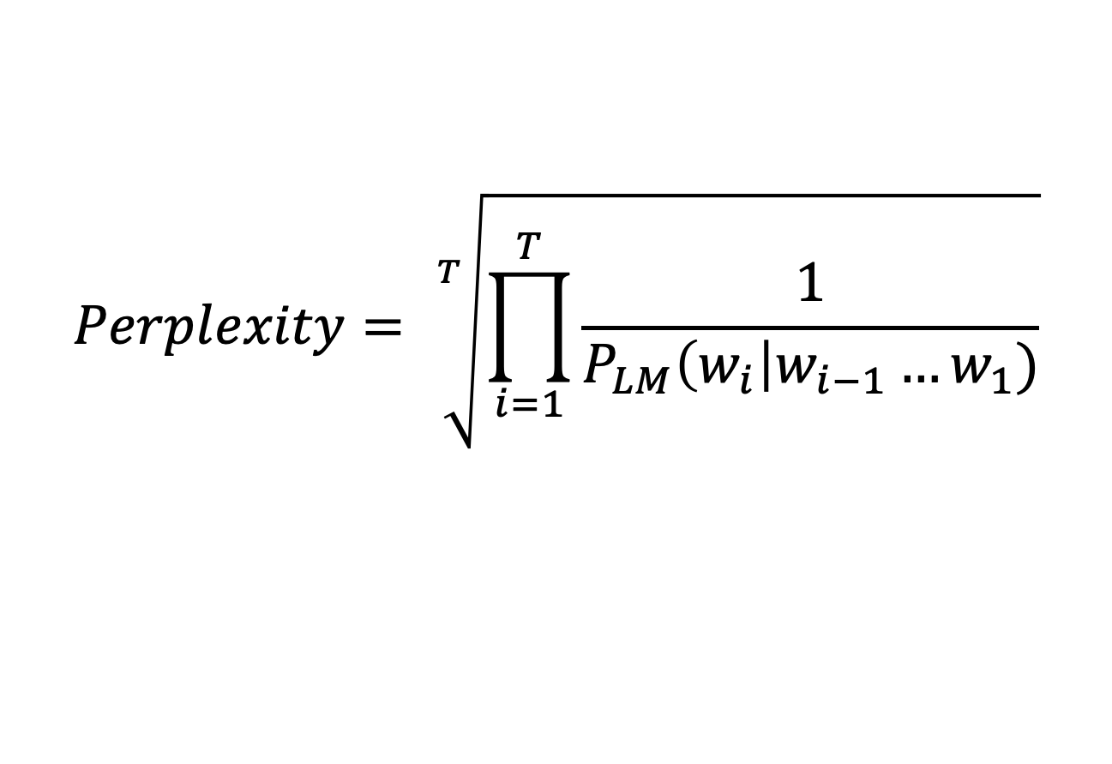
Language Models
Once the RNN is trained, how do we evaluate the Language Model ?
$$Perplexity= \sqrt[T]{\prod_{i=1}^{T}{\frac{1}{P_{LM}\left(w_{i}\right|w_{i−1}…w_{1})}}}$$
Inverse probability of the test set (entire test corpus)
The lower the score, the better.

Slide 10
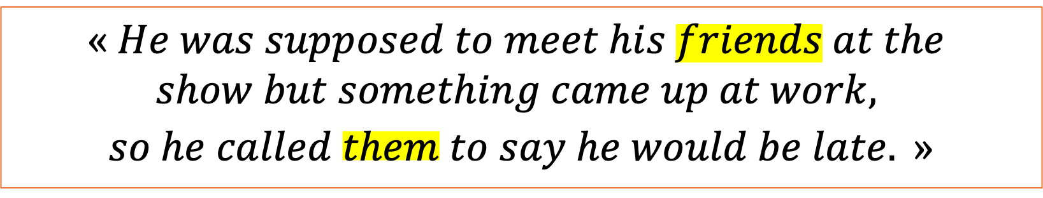
Language Models
Long-Range dependencies
$$« He was supposed to meet his friends at the$$
$$show but something came up at work,$$
$$so he called them to say he would be late. »$$
“them” is dependent of “friends” but this is where simple RNN became struggling

Slide 11









Language Models
Long-Range dependencies
Issue with Simple RNNs, earlier signal may weaken over time
$$0$$
$$0$$
$$0$$
$$0$$
$$h_{t=0}$$
$$h_{t=1}$$
$$h_{t=2}$$
$$h_{t=3}$$
$$X_{t=1}$$
$$X_{t=2}$$
$$X_{t=3}$$
$$X_{t=4}$$
Vanishing / Exploding gradients during training.
Repeated multiplication during BPTT can lead to network either ceasing to learn or becoming unstable.

Slide 12
Language Models
Long-Range dependencies
A simple RNN often has a hard time modelling long-range dependencies.
A few remedies:
Batch normalization
Careful weight initialization
Gradient clipping for exploding gradients
Or use a different cell architecture…

