Slide 1
Introduction to Neural Network

Slide 2

Neural Network as a function
Input
f
Output
Where f is the function
Notes:
See the neural networks as a function.

Slide 3

Neural Network as a function
X = 3
f(x , w) = x . w
3
10
W = 1
f(x , w) – Target =
3 – 10 = -7
The goal is to adjust W to match the target value or get as close as possible.
Notes:
Imagine you have two input values x and w respectively equal to 3 and 1. Your function makes the product and so result in 3. But your target is to get 10. Are your close ? No so you will need to modify your parameter which is W.

Slide 4
Neural Network as a function
X = 3
f(x , w) = x . w
3
10
W = 1
f(x , w) – target = 3 – 10 = -7
X is the feature given by the experience
W is the weight
The goal is to adjust W to match the target value or get as close as possible.
Notes:
Imagine you have two input values x and w respectively equal to 3 and 1. Your function makes the product and so result in 3. But your target is to get 10. Are your close ? No so you will need to modify your parameter which is W.

Slide 5
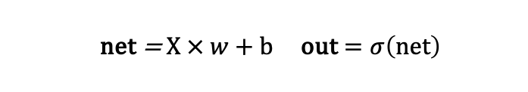

Perceptron with a single input
Perceptron is a model composed a single neuron that takes one or several inputs (below on input) and weight and sum the input(s) and then apply an activation function $σ$in order to produce an output.
x
_{w}
$Loss= (target − out)$²
net
out
_{b}
Forward Pass
net = $X × w$ + b out $=σ\left(net\right)$
A neuron is also called a unit or a node.
Note: in general, we have more than one input feature.
Notes:
net est le signal d’entrée
out est le signal de sortie

Slide 6
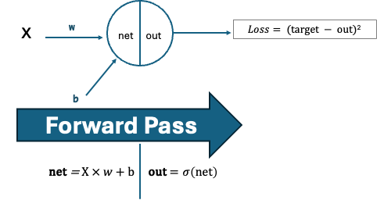
Perceptron with a single input
The output of a Neural Network (NN) is just a function
It means that we can chain and compose layers of units into NN to approximate even more complex functions.
If a function transform input into outputs, then layers of units working together can help us to find more complex transformations between input and outputs.
For example: transformation of an input image into a label output describing what's the image.

Slide 7
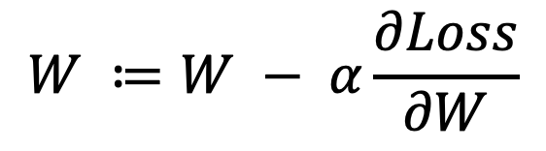
Perceptron
How do we find the optimal w and b that minimize the loss ?
In our simplified example we could test different values, but the computer needs a rule and an ending step for every cases.
If we can figure out how changing W affects the Loss and specifically how it can lower the Loss then, we can use this information to adjust W accordingly.
We do have this information ☺
We can use the derivative of the Loss function with respect to W to measure its sensitivity to W.
This fundamental of Artificial Intelligence is called the Gradient descent and we will see an example just after.
$$W ≔W − α\frac{∂Loss}{∂W}$$

Slide 8
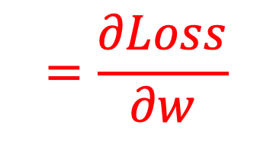
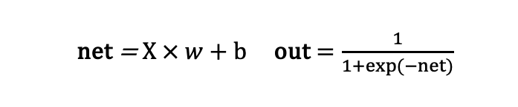
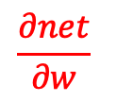
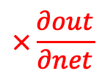
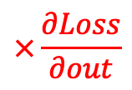

Perceptron with a single input
How do we find the optimal w and b that minimize the loss ?
In the case of NN the Gradient is computed thanks to the Chain rule
x
_{w}
$Loss= (target−out)$²
net
out
_{b}
$$=\frac{∂Loss}{∂w}$$
$$\frac{∂net}{∂w}$$
$$×\frac{∂out}{∂net}$$
$$×\frac{∂Loss}{∂out}$$
BACKPROPAGATION
net = $X × w$ + b out $=\frac{1}{1+exp⁡(−net)}$
Note: the dimensions of the gradient correspond to the dimensions of the “derivator” :
dLoss/dw will have the same dimension as w.

Slide 9
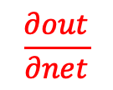
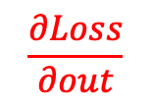
Perceptron with a single input
How do we find the optimal w and b that minimize the loss ?
Gradient descent
x
_{w}
$Loss= (target−out)$²
net
out
_{b}
?
?
?
$$\frac{∂net}{∂w}$$
$$\frac{∂out}{∂net}$$
$$\frac{∂Loss}{∂out}$$
BACKPROPAGATION
net = $X × w$ + b out $=\frac{1}{1+exp⁡(−net)}$

Slide 10









Perceptron with a single input
How do we find the optimal w and b that minimize the loss ?
Gradient descent
x
_{w}
$Loss= (target−out)$²
net
out
_{b}
$$\frac{∂Loss}{∂out}$$
$$−2(target −out)$$
?
?
?
$$\frac{∂net}{∂w}$$
$$\frac{∂out}{∂net}$$
$$\frac{∂Loss}{∂out}$$
$$\frac{∂out}{∂net}$$
$$out(1 −out)$$
BACKPROPAGATION
$$=$$
$$\frac{∂net}{∂w}$$
$$x$$
net = $X × w$ + b out $=\frac{1}{1+exp⁡(−net)}$
$$\frac{∂net}{∂b}$$
$$1$$

Slide 11
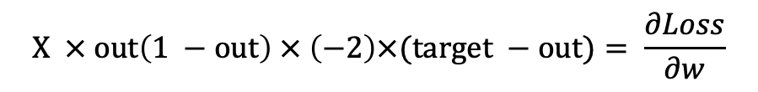
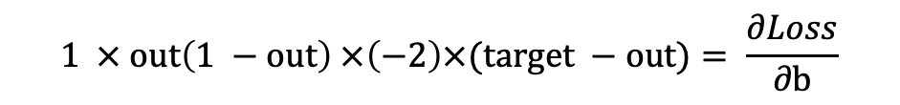
Perceptron with a single input
How do we find the optimal w and b that minimize the loss ?
In the case of NN the Gradient is computed thanks to the Chain rule
x
_{w}
$Loss= (target−out)$²
net
out
_{b}
$$=\frac{∂Loss}{∂w}$$
$$\frac{∂net}{∂w}$$
$$×\frac{∂out}{∂net}$$
$$×\frac{∂Loss}{∂out}$$
$$X × out\left(1 −out\right) × \left(−2\right)×(target −out)= \frac{∂Loss}{∂w}$$
$$1 × out\left(1 −out\right) ×\left(−2\right)×(target −out)= \frac{∂Loss}{∂b}$$

Slide 12

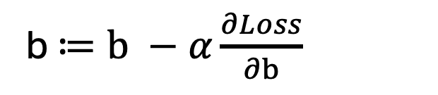
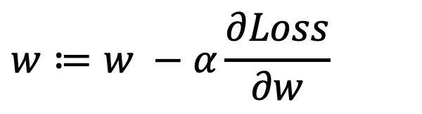
Perceptron with a single input
Now we update W and b
x
_{w}
$Loss= (target−out)$²
net
out
_{b}
$$w≔w −α\frac{∂Loss}{∂w}$$
b $≔b −α\frac{∂Loss}{∂b}$

Slide 13
Perceptron with a single input
We repeat the Forward Pass with the new W and b
x
_{w}
$Loss= (target−out)$²
net
out
_{b}
Forward Pass
net = $X × w$ + b out $=σ\left(net\right)$
BACKPROPAGATION
The loss has decreased, and we iterate the updates of the weights and bias and the Forward Pass.

Slide 14
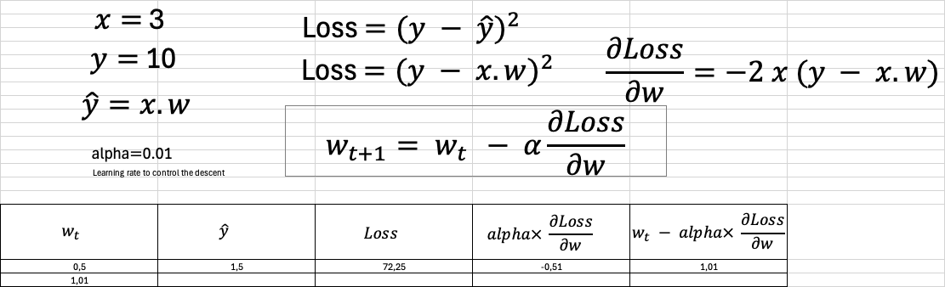
Perceptron with a single input
How do we find¹ the optimal w that minimize the loss ?
Gradient descent
¹ For simplicity, we have only taken w and not b

Slide 15
Perceptron with two inputs

Slide 16

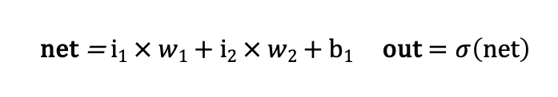
Perceptron
Two inputs and a single neuron with an activation function sigma
i₁
_{w1}
net
out
$Loss= (target−out)$²
i₂
_{w2}
_{b1}
Forward Pass
net = $i1 × w1$ + $i2 × w2$ + b₁ out $=σ\left(net\right)$
A neuron is also called a unit or a node.

Slide 17

Perceptron
How do we find the optimal w₁, w₂ and b₁ that minimize the loss ?
i₁
_{w1}
net
out
$Loss= (target−out)$²
i₂
_{w2}
_{b1}
BACKPROPAGATION

Slide 18
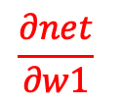
Perceptron
How do we find the optimal w₁, w₂ and b₁ that minimize the loss ?
i₁
_{w1}
net
out
$Loss= (target−out)$²
i₂
_{w2}
_{b1}
?
?
?
$$\frac{∂net}{∂w1}$$
$$\frac{∂out}{∂net}$$
$$\frac{∂Loss}{∂out}$$
Gradient
BACKPROPAGATION

Slide 19

Perceptron
How do we find the optimal w₁, w₂ and b₁ that minimize the loss ?
i₁
_{w1}
net
out
$Loss= (target−out)$²
i₂
_{w2}
_{b1}
?
?
?
$$\frac{∂net}{∂w1}$$
$$\frac{∂out}{∂net}$$
$$\frac{∂Loss}{∂out}$$
Gradient
BACKPROPAGATION

Slide 20







Perceptron
How do we find the optimal w₁, w₂ and b₁ that minimize the loss ?
i₁
_{w1}
net
out
$Loss= (target−out)$²
i₂
_{w2}
_{b1}
?
?
?
$$\frac{∂net}{∂w1}$$
$$\frac{∂out}{∂net}$$
$$\frac{∂Loss}{∂out}$$
Gradient
$$\frac{∂Loss}{∂out}$$
$$−2(target −out)$$
BACKPROPAGATION
$$\frac{∂out}{∂net}$$
$$out(1 −out)$$
$$\frac{∂net}{∂w1}$$
$$x$$

Slide 21
Perceptron
How do we find the optimal w₁, w₂ and b₁ that minimize the loss ?
i₁
_{w1}
net
out
$Loss= (target−out)$²
i₂
_{w2}
The process
_{b1}
set w to some initial value(s)

Slide 22
Neural Networks with multiple layers I

Slide 23
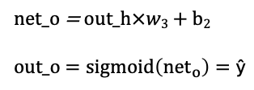
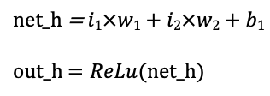

Neural Network
i₁
_{w1}
_{w3}
net_h
out_h
net_o
out_o
$Loss= (target_{o}−out_{o})$²
i₂
_{w2}
_{b1}
_{b2}
Input layer
Hidden layer
Output layer
net_h = $i1×w1+i2×w2+b1$
out_h $=ReLu(net_h)$
net_o = $out_h×w3$ + b₂
out_o $=sigmoid\left({net}_{o}\right)=\text{ŷ}$
Forward Pass

Slide 24
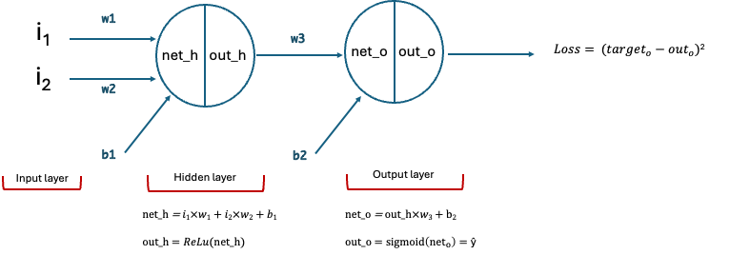



Neural Network
Gradient
$\frac{∂Loss}{∂out_o} =−2×(target − out_o$)
$\frac{∂out_o}{∂net_o}$= out_o$\left(1−{out}_{o}\right)$
$\frac{∂net_o}{∂w3}$ = out_h
THE CHAIN RULE
$\frac{∂Loss}{∂w3}= \frac{∂Loss}{∂out_o} ×\frac{∂out_o}{∂net_o}×\frac{∂net_o}{∂w3}$ = $−2×(target − out_o$) $× \text{out}\text{_}\text{o} (1−out_o)$ $× out_h$
$\frac{∂Loss}{∂b2}= \frac{∂Loss}{∂out_o} ×\frac{∂out_o}{∂net_o}×\frac{∂net_o}{∂b2}\text{=}−2×(target − out_o\text{)}× \text{out}\text{_}\text{o} (1−out_o) ×$ 1

Slide 25
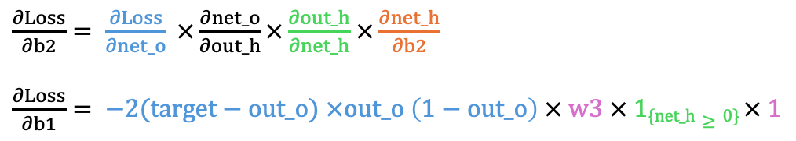

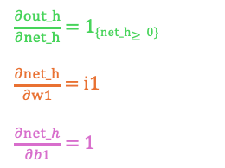
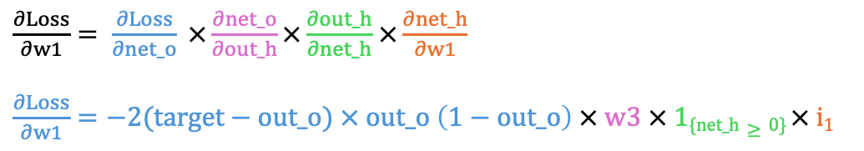
Neural Network
Gradient
CHAIN RULE
$\frac{∂Loss}{∂w1}= \frac{∂Loss}{∂net_o} ×\frac{∂net_o}{∂out_h}×\frac{∂out_h}{∂net_h}$ $×\frac{∂net_h}{∂w1}$
$\frac{∂Loss}{∂w1}=−2$($target−out_o$)$× \text{out}\text{_}\text{o} \left(1−out_o\right) × w3 × \text{1}\text{\{}\text{net}\text{_}\text{h}≥0\text{\}} × i1$
$\frac{∂out_h}{∂net_h}$ = 1_{{net_h}$≥0$}
$\frac{∂net_h}{∂w1}$ = i1
$\frac{∂net_h}{∂b1}$ = 1
$$\frac{∂net_o}{∂out_h}=w3$$
$\frac{∂Loss}{∂w2}= −2$($target−out_o$) $×\text{out}\text{_}\text{o} \left(1−out_o\right) × w3 × \text{1}\text{\{}\text{net}\text{_}\text{h}≥0\text{\}} × i2$
$\frac{∂Loss}{∂b2}= \frac{∂Loss}{∂net_o} ×\frac{∂net_o}{∂out_h}×\frac{∂out_h}{∂net_h}$ $×\frac{∂net_h}{∂b2}$
$\frac{∂Loss}{∂b1}= −2$($target−out_o$) $×\text{out}\text{_}\text{o} \left(1−out_o\right) × w3 × \text{1}\text{\{}\text{net}\text{_}\text{h}≥0\text{\}} × 1$

Slide 26
Neural Networks with multiple layers II

Slide 27

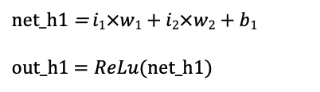


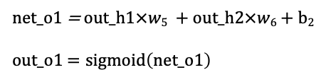
Neural Network
Layers
Combining neurons in a neural network. Vertical combination of units gives a layer.
i₁
_{w1}
_{w5}
net_o1
out_o1
$Loss1= (target_{o1} − out_{o1})$²
net_h1
out_h1
_{w2}
_{w6}
_{w3}
_{w7}
i₂
_{w4}
_{w8}
$$Loss2= \left(target_{o2} − out_{o2}\right)2$$
net_h2
out_h2
net_o2
out_o2
_{b1}
_{b2}
$$Loss=Loss1+Loss2$$
Input layer
Hidden layer with 2 units
Output layer
net_h1 = $i1×w1+i2×w2+b1$
out_h1 $=ReLu(net_h1)$
net_o1 = $out_h1×w5$ + $out_h2×w6$ + b₂
out_o1 $=sigmoid\left(net_o1\right)$

Slide 28
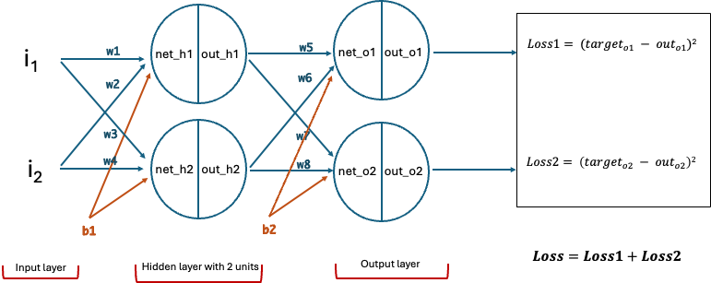
Neural Network
Layers
Combining neurons in a neural network. Vertical combination of units gives a layer.
We only have two inputs features so each neuron of the hidden layer will have two weights.
In this example, the bias is the same for each neuron of the input hidden layer and the same for each neuron of the output hidden layer. Weights have been introduced for the output layer.
This is a "two-layer network" because by convention, the Input layer is not counted.

Slide 29
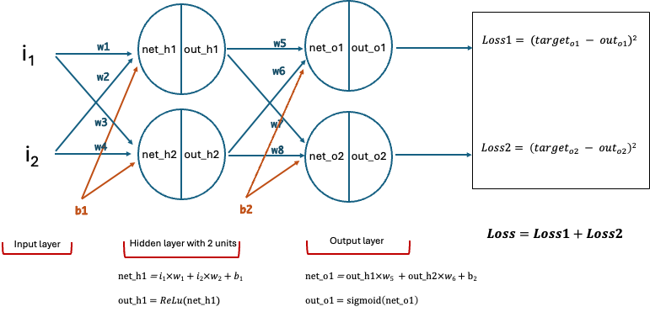

Neural Network
Gradient
$$\frac{∂Loss1}{∂w1}$$
BACKPROPAGATION + CHAIN RULE
$$\frac{∂Loss1}{∂w1}=\frac{∂Loss1}{∂out_o1} ×\frac{∂out_o1}{∂net_o1} ×\frac{∂net_o1}{∂out_h1} ×\frac{∂out_h1}{∂net_h1}×\frac{∂net_h1}{∂w1}$$
$$\frac{∂Loss1}{∂w1}=\text{−2}\text{(}{target}_{o1}− out_o1\text{)}×out_o1(1−out_o1)×\frac{∂net_o1}{∂out_h1} ×\frac{∂out_h1}{∂net_h1}×\frac{∂net_h1}{∂w1}$$
$$\frac{∂Loss1}{∂w1}=\text{−2}\text{(}{target}_{o1}− out_o1\text{)}×out_o1(1−out_o1)×\frac{∂net_o1}{∂out_h1} ×\frac{∂out_h1}{∂net_h1}×\frac{∂net_h1}{∂w1}$$
$$\frac{∂Loss1}{∂w1}=\text{−2}\text{(}{target}_{o1}− out_o1\text{)}×out_o1(1−out_o1)×w5 ×\frac{∂out_h1}{∂net_h1}×\frac{∂net_h1}{∂w1}$$
$$\frac{∂Loss1}{∂w1}=\text{−2}\text{(}{target}_{o1}− out_o1\text{)}×out_o1(1−out_o1)×w5 ×\frac{∂out_h1}{∂net_h1}×\frac{∂net_h1}{∂w1}$$
$\frac{∂Loss1}{∂w1}=\text{−2}\text{(}{target}_{o1}− out_o1\text{)}×out_o1(1−out_o1)×w5 ×$ $1_{\{net_h1>0\}}×i1$
$\frac{∂Loss1}{∂w1}=\text{−2}\text{(}{target}_{o1}− out_o1\text{)}×out_o1(1−out_o1)×w5 ×$ $1_{\{net_h1>0\}}×\frac{∂net_h1}{∂w1}$
Symmetrically
$\frac{∂Loss1}{∂w1}=\text{−2}\text{(}{target}_{o1}− out_o1\text{)}×out_o1(1−out_o1)×w5 ×$ $1_{\{net_h1>0\}}×\frac{∂net_h1}{∂w1}$
$\frac{∂Loss2}{∂w4}=\text{−2}\text{(}{target}_{o\text{2}}− out_o2)×out_o2(1−out_o2)×w8 ×$ $1_{\{net_h2>0\}}×i$2

Slide 30

Neural Network
Gradient
$$\frac{∂Loss1}{∂w2}$$
BACKPROPAGATION + CHAIN RULE
$\frac{∂Loss1}{∂w2}= \frac{∂Loss1}{∂net_h1} ×\frac{∂net_h1}{∂w2}$
$$\frac{∂Loss1}{∂w2}=\text{−2}\text{(}{target}_{o1}− out_o1\text{)}× out_o1(1−out_o1)×w5×1\{net_h1≥0\})×i2$$
Symmetrically
$\frac{∂Loss2}{∂w3}=\text{−2}\text{(}{target}_{o\text{2}}− out_o2)× out_o2(1−out_o2)×w8×1\{net_h2≥0\})×i$₁
From previously we know that:
$$\frac{∂Loss1}{∂net_h1}=\text{−2}\text{(}{target}_{o1}− out_o1\text{)}× out_o1(1−out_o1)×w5×1\{net_h1≥0\}$$

Slide 31

Neural Network
Gradient
$$\frac{∂Loss1}{∂w3}$$
BACKPROPAGATION + CHAIN RULE
$\frac{∂Loss1}{∂w3}=\frac{∂Loss1}{∂net_o1} ×\frac{∂net_o1}{∂out_h2}×\frac{∂out_h2}{∂net_h2}$ $×\frac{∂net_h2}{∂w3}$
$\frac{∂Loss1}{∂w3}=\text{−2}\text{(}{target}_{o1}− out_o1\text{)}× out_o1(1−out_o1)×\frac{∂net_o1}{∂out_h2}×\frac{∂out_h2}{∂net_h2}$ $×\frac{∂net_h2}{∂w3}$
$\frac{∂Loss1}{∂w3}=\text{−2}\text{(}{target}_{o1}− out_o1\text{)}× out_o1(1−out_o1)×w6×\frac{∂out_h2}{∂net_h2}$ $×\frac{∂net_h2}{∂w3}$
$\frac{∂Loss1}{∂w3}=\text{−2}\text{(}{target}_{o1}− out_o1\text{)}× out_o1(1−out_o1)×w6×1\{net_h2$ $>0\}$ $×\frac{∂net_h2}{∂w3}$
$\frac{∂Loss1}{∂w3}=\text{−2}\text{(}{target}_{o1}− out_o1\text{)}× out_o1(1−out_o1)×w6×1\{net_h2$ $>0\}$ $× i1$
Symmetrically
$\frac{∂Loss2}{∂w2}=\text{−2}\text{(}{target}_{o\text{2}}− out_o2)× out_o2(1−out_o2)×w7×1\{net_h$₁ $>0\}$ $× i2$

Slide 32

Neural Network
Gradient
$$\frac{∂Loss1}{∂w4}$$
BACKPROPAGATION + CHAIN RULE
$\frac{∂Loss1}{∂w4}= \frac{∂Loss1}{∂net_o1} ×\frac{∂net_o1}{∂out_h2}×\frac{∂out_h2}{∂net_h2}$ $×\frac{∂net_h2}{∂w4}$
$$\frac{∂Loss1}{∂w4}=\text{−2}\text{(}{target}_{o1}− out_o1\text{)}× out_o1(1−out_o1)×w6×1\{net_h2 >0\} ×i2$$
Symmetrically
$\frac{∂Loss2}{∂w1}=\text{−2}\text{(}{target}_{o\text{2}}− out_o2)× out_o2(1−out_o2)×w7×1\{net_h\text{1} >0\} ×i$₁

Slide 33

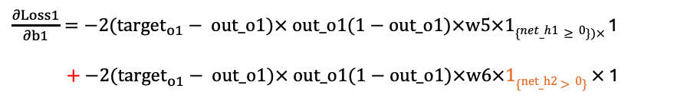

Neural Network
Gradient
$$\frac{∂Loss1}{∂b1}$$
BACKPROPAGATION + CHAIN RULE
$$\frac{∂Loss1}{∂b1}= \frac{∂Loss1}{∂net_h1} ×\frac{∂net_h1}{∂b1}+\frac{∂Loss1}{∂net_h2} ×\frac{∂net_h2}{∂b1}$$
$\frac{∂Loss1}{∂b1}=\text{−2}\text{(}{target}_{o1}− out_o1\text{)}× out_o1(1−out_o1)×w5×1\{net_h1≥0\})×$1
$+\text{−2}\text{(}{target}_{o1}− out_o1\text{)}× out_o1(1−out_o1)×w6×1\{net_h2$ $>0\}$ $×$ 1
$\frac{∂Loss1}{∂b1}=\text{−2}\text{(}{target}_{o1}− out_o1\text{)}× out_o1(1−out_o1)×(w5×1\{net_h1≥0\}) +w6×1\{net_h2$ $>0\}$ $)$
Symmetrically
$\frac{∂Loss2}{∂b1}=\text{−2}\text{(}{target}_{o\text{2}}− out_o2)× out_o2(1−out_o2)×(w8×1\{net_h2≥0\}) +w7×1\{net_h$₁ $>0\}$ $)$

Slide 34



Neural Network
Gradient
$$\frac{∂Loss1}{∂w1}$$
BACKPROPAGATION + CHAIN RULE
$$\frac{∂Loss1}{∂w5}=\frac{∂Loss1}{∂out_o1} ×\frac{∂out_o1}{∂net_o1} ×\frac{∂net_o1}{∂w5}$$
$$\frac{∂Loss1}{∂w5}=\text{−2}\text{(}{target}_{o1}− out_o1\text{)}×out_o1(1−out_o1)×out_h1$$
$$\frac{∂Loss1}{∂w5}=\text{−2}\text{(}{target}_{o1}− out_o1\text{)}×out_o1(1−out_o1)×out_h1$$
Symmetrically
$\frac{∂Loss2}{∂w8}=\text{−2}\text{(}{target}_{o\text{2}}− out_o2)×out_o2(1−out_o2)×out_h$2

Slide 35
Neural Network
Gradient
$$\frac{∂Loss1}{∂b1}$$
BACKPROPAGATION + CHAIN RULE
$$\frac{∂Loss1}{∂w6}=\frac{∂Loss1}{∂out_o1} ×\frac{∂out_o1}{∂net_o1} ×\frac{∂net_o1}{∂w6}$$
$$\frac{∂Loss1}{∂w6}=\text{−2}\text{(}{target}_{o1}− out_o1\text{)}×out_o1(1−out_o1)×out_h2$$
$$\frac{∂Loss1}{∂w6}=\text{−2}\text{(}{target}_{o1}− out_o1\text{)}×out_o1(1−out_o1)×out_h2$$
Symmetrically
$\frac{∂Loss2}{∂w7}=\text{−2}\text{(}{target}_{o\text{2}}− out_o2)×out_o2(1−out_o2)×out_h$1

Slide 36


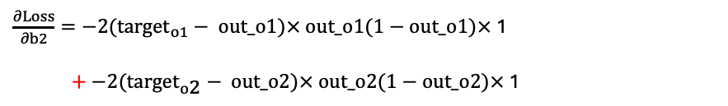

Neural Network
Gradient
$$\frac{∂Loss}{∂b2}$$
BACKPROPAGATION + CHAIN RULE
$$\frac{∂Loss}{∂b2}= \frac{∂Loss1}{∂b2}+\frac{∂Loss2}{∂b2}$$
$$\frac{∂Loss}{∂b2}= \frac{∂Loss1}{∂net_o1} ×\frac{∂net_o1}{∂b2}+\frac{∂Loss2}{∂net_o2} ×\frac{∂net_o2}{∂b2}$$
$\frac{∂Loss}{∂b2}=\text{−2}\text{(}{target}_{o1}− out_o1\text{)}× out_o1(1−out_o1)×$1
$+\text{−2}\text{(}{target}_{o\text{2}}− out_o2)× out_o2(1−out_o2)×$1
$$\frac{∂Loss}{∂b2}=\text{−2}\text{(}{target}_{o1}− out_o1\text{)}× out_o1(1−out_o1) +\text{−2}\text{(}{target}_{o\text{2}}− out_o2)× out_o2(1−out_o2)$$

Slide 37
Neural Network
Gradient
BACKPROPAGATION SUMMARY
$\frac{∂Loss1}{∂w1}=\text{−2}\text{(}{target}_{o1}− out_o1\text{)}×out_o1(1−out_o1)×w5 ×$ $1_{\{net_h1>0\}}×i1$
$$\frac{∂Loss1}{∂w2}=\text{−2}\text{(}{target}_{o1}− out_o1\text{)}× out_o1(1−out_o1)×w5×1\{net_h1≥0\})×i2$$
$\frac{∂Loss1}{∂w3}=\text{−2}\text{(}{target}_{o1}− out_o1\text{)}× out_o1(1−out_o1)×w6×1\{net_h2$ $>0\}$ $× i1$
$$\frac{∂Loss1}{∂w4}=\text{−2}\text{(}{target}_{o1}− out_o1\text{)}× out_o1(1−out_o1)×w6×1\{net_h2 >0\} ×i2$$
$\frac{∂Loss1}{∂b1}=\text{−2}\text{(}{target}_{o1}− out_o1\text{)}× out_o1(1−out_o1)×(w5×1\{net_h1≥0\}) +w6×1\{net_h2$ $>0\}$ $)$
$$\frac{∂Loss1}{∂w5}=\text{−2}\text{(}{target}_{o1}− out_o1\text{)}×out_o1(1−out_o1)×out_h1$$
$\frac{∂Loss2}{∂w1}=\text{−2}\text{(}{target}_{o\text{2}}− out_o2)× out_o2(1−out_o2)×w7×1\{net_h\text{1} >0\} ×i$₁
$$\frac{∂Loss1}{∂w6}=\text{−2}\text{(}{target}_{o1}− out_o1\text{)}×out_o1(1−out_o1)×out_h2$$
$\frac{∂Loss2}{∂w2}=\text{−2}\text{(}{target}_{o\text{2}}− out_o2)× out_o2(1−out_o2)×w7×1\{net_h$₁ $>0\}$ $× i2$
$\frac{∂Loss2}{∂w8}=\text{−2}\text{(}{target}_{o\text{2}}− out_o2)×out_o2(1−out_o2)×out_h$2
$\frac{∂Loss2}{∂w3}=\text{−2}\text{(}{target}_{o\text{2}}− out_o2)× out_o2(1−out_o2)×w8×1\{net_h2≥0\})×i$₁
$\frac{∂Loss2}{∂w7}=\text{−2}\text{(}{target}_{o\text{2}}− out_o2)×out_o2(1−out_o2)×out_h$1
$\frac{∂Loss2}{∂w4}=\text{−2}\text{(}{target}_{o\text{2}}− out_o2)×out_o2(1−out_o2)×w8 ×$ $1_{\{net_h2>0\}}×i$2
$$\frac{∂Loss}{∂b2}=\text{−2}\text{(}{target}_{o1}− out_o1\text{)}× out_o1(1−out_o1) +\text{−2}\text{(}{target}_{o\text{2}}− out_o2)× out_o2(1−out_o2)$$
$\frac{∂Loss2}{∂b1}=\text{−2}\text{(}{target}_{o\text{2}}− out_o2)× out_o2(1−out_o2)×(w8×1\{net_h2≥0\}) +w7×1\{net_h$₁ $>0\}$ $)$

Slide 38
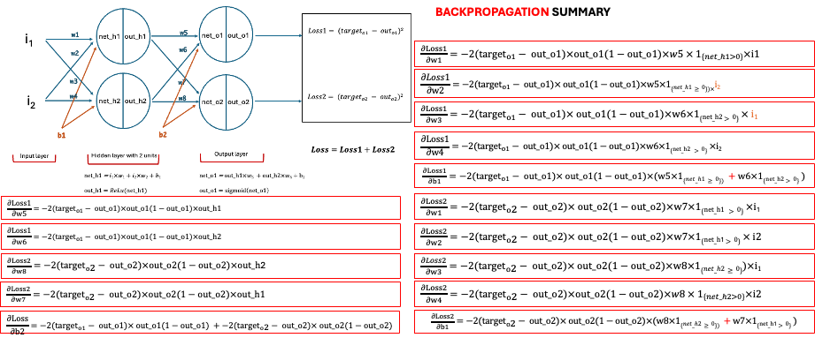
Neural Network
BACKPROPAGATION SUMMARY
We can find an easy way !
NumPy matrix is the solution ☺
Too complicated
Too analytic

Slide 39

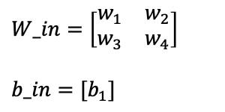
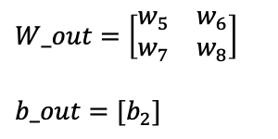
Neural Network
Matrix Chain rule to update $W_out$, b$_out$:
$\frac{∂Loss}{∂W_out}=$ $\frac{∂Loss}{∂out_o}∗$ $\frac{∂out_o}{∂net_o}∗\frac{∂net_o}{∂W_out}$
$\frac{∂Loss}{∂b_out}=$ $\frac{∂Loss}{∂out_o}∗$ $\frac{∂out_o}{∂net_o}∗\frac{∂net_o}{∂b_out}$
$$\frac{∂Loss}{∂out_o}=\frac{∂{\left(target −out_o\right)}^{2}}{∂out_o}=−2 (target −out)$$
$$\frac{∂out_o}{∂net_o}=\frac{∂\left(sigmoid(net_o)\right)}{∂net_o}=sigmoid_derivative\left(net_o\right)$$
$$\frac{∂net_o}{∂W_out}=\frac{∂(linear(W_out.out_h+b_out))}{∂W_out}=out_h=relu(net_h)$$
$$\frac{∂net_o}{∂b_out}=\frac{∂(linear(W_out.out_h+b_out))}{∂b_out}=1$$
$$\frac{∂Loss}{∂W_out}=−2 (target −out)∗sigmoid_derivative\left(net_o\right)∗out_h$$
$$\frac{∂Loss}{∂b_out}=−2 (target −out)∗sigmoid_derivative\left(net_o\right)∗1$$
BACKPROPAGATION
$$W_in=\left[\begin{matrix}w_{1} & w_{2} \\ w_{3} & w_{4}\end{matrix}\right]$$
$$b_in={[b}_{1}]$$
$$W_out=\left[\begin{matrix}w_{5} & w_{6} \\ w_{7} & w_{8}\end{matrix}\right]$$
$$b_out={[b}_{2}]$$

Slide 40

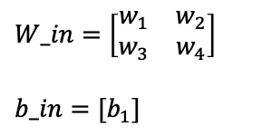
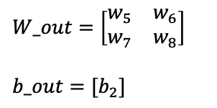
Neural Network
Matrix Chain rule to update $W_in$, b$_in$:
$\frac{∂Loss}{∂W_in}=$ $\frac{∂Loss}{∂out_o}∗$ $\frac{∂out_o}{∂net_o}∗\frac{∂net_o}{∂out_h}∗\frac{∂out_h}{∂net_h}∗\frac{∂net_h}{∂W_in}$
$\frac{∂Loss}{∂b_in}=$ $\frac{∂Loss}{∂out_o}∗$ $\frac{∂out_o}{∂net_o}∗\frac{∂net_o}{∂out_h}∗\frac{∂out_h}{∂net_h}∗\frac{∂net_h}{∂b_in}$
$$\frac{∂Loss}{∂out_o}∗ \frac{∂out_o}{∂net_o}=−2 \left(target −out\right)∗sigmoid_derivative\left(net_o\right)$$
$$\frac{∂net_o}{∂out_h}=\frac{∂\left(linear(W_out.out_h+b_out)\right)}{∂out_h}=W_out$$
$$\frac{∂out_h}{∂net_h}=\frac{∂(reLU(net_h))}{∂net_h}=reLU_derivative(net_h)$$
$$\frac{∂net_h}{∂W_in}=\frac{∂(linear(W_in.X+b_in))}{∂W_in}=X$$
$$\frac{∂net_h}{∂b_in}=\frac{∂(linear(W_in.X+b_in))}{∂b_in}=1$$
$$\frac{∂Loss}{∂W_in}=−2 (target −out)∗sigmoid_derivative\left(net_o\right)∗W_out∗reLU_derivative(net_h)∗X$$
$$\frac{∂Loss}{∂b_in}=−2 (target −out)∗sigmoid_derivative\left(net_o\right)∗W_out∗reLU_derivative(net_h)∗1$$
BACKPROPAGATION
$$W_in=\left[\begin{matrix}w_{1} & w_{2} \\ w_{3} & w_{4}\end{matrix}\right]$$
$$b_in={[b}_{1}]$$
$$W_out=\left[\begin{matrix}w_{5} & w_{6} \\ w_{7} & w_{8}\end{matrix}\right]$$
$$b_out={[b}_{2}]$$

Slide 41
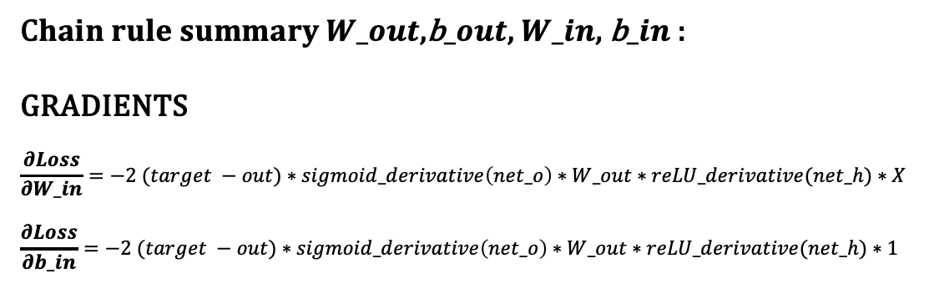
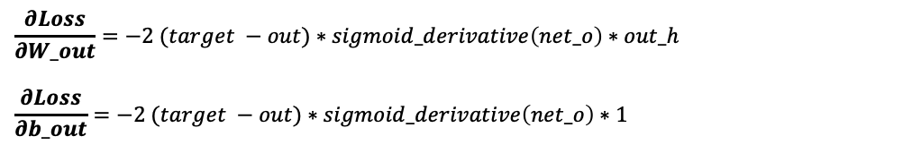
Neural Network
BACKPROPAGATION
C$hain rule summary W_out\text{,}\text{b}_out\text{,} W_in$, b$_in$:
GRADIENTS
$$\frac{∂Loss}{∂W_in}=−2 (target −out)∗sigmoid_derivative\left(net_o\right)∗W_out∗reLU_derivative(net_h)∗X$$
$$\frac{∂Loss}{∂b_in}=−2 (target −out)∗sigmoid_derivative\left(net_o\right)∗W_out∗reLU_derivative(net_h)∗1$$
$$\frac{∂Loss}{∂W_out}=−2 (target −out)∗sigmoid_derivative\left(net_o\right)∗out_h$$
$$\frac{∂Loss}{∂b_out}=−2 (target −out)∗sigmoid_derivative\left(net_o\right)∗1$$
$$W_in=\left[\begin{matrix}w_{1} & w_{2} \\ w_{3} & w_{4}\end{matrix}\right]$$
$$b_in={[b}_{1}]$$
$$W_out=\left[\begin{matrix}w_{5} & w_{6} \\ w_{7} & w_{8}\end{matrix}\right]$$
$$b_out={[b}_{2}]$$

Slide 42
Neural Networks with multiple layers III

Slide 43





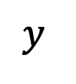




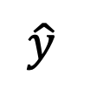





Neural Network
Categorical Cross Entropy is a generalization of Binary Cross Entropy
Softmax is a generalization of the sigmoid function
Multiclass Classification Network
Combining neurons in a neural network. Vertical combination of units gives a layer.
$$b_{h}^{1}$$
net_h1
out_h1
$x1_{}$
$$b_{h}^{2}$$
$$b_{o}^{1}$$
S
O
F
T
M
A
X
$$Σ$$
$x2_{}$
net_h1
out_h1
$$b_{h}^{3}$$
$$b_{o}^{2}$$
$$\hat{y}$$
$$L_{CCE}$$
$$y$$
$x3_{}$
$$Σ$$
net_h1
out_h1
$$b_{h}^{4}$$
$$W_in$$
$W_$out
Input layer
net_h1
out_h1
Output layer
Hidden layer with 4 units
SOFTMAX is used for more than 2 classes.
But we use it here to get used of it for next NLP usage.

Slide 44

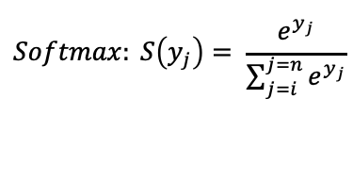
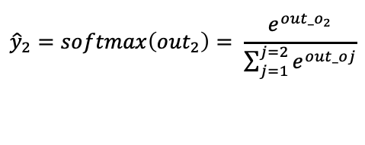

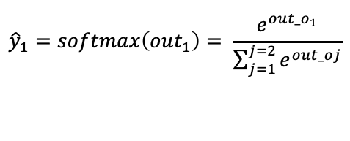
Neural Network
Categorical Cross Entropy is a generalization of Binary Cross Entropy
Softmax is a generalization of the sigmoid function
Multiclass Classification Network
Combining neurons in a neural network. Vertical combination of units gives a layer.
$$b_{h}^{1}$$
net_h1
out_h1
$x1_{}$
$$b_{h}^{2}$$
$$b_{o}^{1}$$
$$out_o1$$
$${\hat{y}}_{1}=softmax\left(out_{1}\right)= \frac{e^{out_o_{1}}}{\sum_{j=1}^{j=2}{e^{out_oj}}}$$
$x2_{}$
net_h1
out_h1
$$b_{h}^{3}$$
$$b_{o}^{2}$$
$x3_{}$
$$out_o2$$
$${\hat{y}}_{2}=softmax\left(out_{2}\right)= \frac{e^{out_o_{2}}}{\sum_{j=1}^{j=2}{e^{out_oj}}}$$
net_h1
out_h1
$$b_{h}^{4}$$
$$W_in$$
$W_$out
Input layer
net_h1
out_h1
Output layer
Hidden layer with 4 units
$$Softmax: S\left(y_{j}\right)= \frac{e^{y_{j}}}{\sum_{j=i}^{j=n}{e^{y_{j}}}}$$

Slide 45
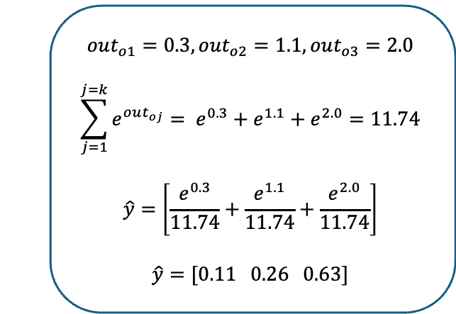
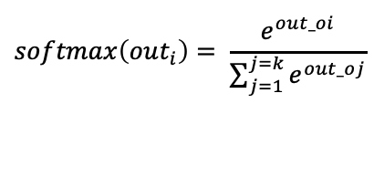
Neural Network
Categorical Cross Entropy is a generalization of Binary Cross Entropy
Softmax is a generalization of the sigmoid function
Multiclass Classification Network
Combining neurons in a neural network. Vertical combination of units gives a layer.
$$b_{h}^{1}$$
$$softmax\left(out_{i}\right)= \frac{e^{out_oi}}{\sum_{j=1}^{j=k}{e^{out_oj}}}$$
net_h1
out_h1
$x1_{}$
$$b_{h}^{2}$$
$$b_{o}^{1}$$
S
O
F
T
M
A
X
out_h1
$$out_o1$$
$$out_{o1}=0.3, out_{o2}=1.1, out_{o3}=2.0$$
$$\sum_{j=1}^{j=k}{e^{out_{oj}}}= e^{0.3}+e^{1.1}+e^{2.0}=11.74$$
$$\hat{y}=\left[\frac{e^{0.3}}{11.74}+\frac{e^{1.1}}{11.74}+\frac{e^{2.0}}{11.74}\right]$$
$\hat{y}=[0.11 0.26 0.63]$
$x2_{}$
net_h1
$$b_{h}^{3}$$
$$b_{o}^{2}$$
$x3_{}$
net_h1
out_h1
$$out_o2$$
$$b_{h}^{4}$$
$$W_in$$
$W_$out
Input layer
net_h1
out_h1
Output layer
Hidden layer with 4 units
Source: NLPDemystified.org

Slide 46
Neural Network
A deep learning model is a directed acyclic graph of layers.
The most common instance is a linear pile of layers which to a single input, associate a unique output.
But there is a variety of networks topology such as:
Two-branches networks;
Multihead networks;
Inception blocks.
The network topology defines the space hypothesis (i.e. the space of possibilities).
“The machine learning is the search for useful representations of certain input data within a predefined space of possibilities, relying on a feedback signal.
Choosing a network topology restricts the space of possibilities to a series of specific operations.
The objective is to research the good set of values for the weight's tensors manipulated for these operations.
Choose the good architecture of a network is more an art than a science.
Once the architecture is determined you must choose the loss function (to minimize; represents the measure of success of the task to accomplish) and the optimizer (how the network will be updated).
Source: NLPDemystified.org

Slide 47
Neural Network
Keras library (https://keras.io)
Keras is a model-level library providing construction blocks of high level for deep learning models.
Keras does not manage low level operations such as tensors transformation.
Keras relies on specialized and optimized libraries which are used as backend engines. Keras codes can be run on all these backend engines as it is.
Keras is distributed under the permissive MIT software license, which means it can be used freely in commercial projects.
Keras is compatible with all versions of Python.
Keras works with central unit of treatment (CPU) or on a graphic processor unit (GPU).
Keras
Backend engines:
TensorFlow from google www.tensorflow.org (recommended with Keras)
CNTK: Microsoft Cognitive Toolkit. https://github.com/Microsoft/CNTK
Theano is developed by the MILA laboratory of Montreal University http://deeplearning.net/software/theano
Pytorch
TensorFlow, CNTK, Theano…
CUDA / CuDNN
BLAS / Eigen
When TensorFlow is run on a CPU, it equips itself with a specialized low-level library for tensor operations called Eigen.
On a GPU, TensorFlow integrates a well-optimized library of operations for deep learning called the NVIDIA CUDA Deep Neural Network (CuDNN) library.
GPU
CPU
Fig. The software and hardware stack for deep learning
Source: NLPDemystified.org

Slide 48
Pytorch tutorial Create tensors
import torch x = torch.rand(4,3) print(x)
tensor([[0.1955, 0.9651, 0.2215],
[0.0145, 0.3625, 0.3286],
[0.4321, 0.9224, 0.1897],
[0.6365, 0.4051, 0.7484]])

Slide 49
Pytorch tutorial Create tensors
import torch # reshape with view: print(x.view(2,6))
tensor([[0.1955, 0.9651, 0.2215, 0.0145, 0.3625, 0.3286],
[0.4321, 0.9224, 0.1897, 0.6365, 0.4051, 0.7484]])

Slide 50
Pytorch tutorial Create tensors
import torch # reshape with view: # -1 detect the correct dimension print(x.view(3,-1))
tensor([[0.1955, 0.9651, 0.2215, 0.0145],
[0.3625, 0.3286, 0.4321, 0.9224],
[0.1897, 0.6365, 0.4051, 0.7484]])
print(x.size())
torch.Size([4, 3])

Slide 51
Pytorch tutorial Create tensors
import torch # reshape with view: # -1 detect the correct dimension print(x.view(3,-1))
tensor([[0.1955, 0.9651, 0.2215, 0.0145],
[0.3625, 0.3286, 0.4321, 0.9224],
[0.1897, 0.6365, 0.4051, 0.7484]])
print(x.size())
torch.Size([4, 3])

Slide 52
Pytorch tutorial Conversion type
import torch a = torch.ones(5)
print(f"conversion torch to numpy {type(a.numpy())}") print(f"conversion numpy to torch {type(torch.from_numpy(a.numpy()))}")
conversion torch to numpy <class 'numpy.ndarray'>
conversion numpy to torch <class 'torch.Tensor'>

Slide 53
Pytorch tutorial Work with GPU cuda
print(torch.cuda.is_available()) False
# on Windows if "cuda" is available, specify your cuda device and create then a tensor on GPU:
if torch.cuda.is_available(): device = torch.device("cuda") x = torch.rand(1,1)

Slide 54
Pytorch tutorial Neural Network
import torch
# if we need tracking the gradients add requires_grad x = torch.ones(5, requires_grad=True)
print(x) # tensor([1., 1., 1., 1., 1.], requires_grad=True)

Slide 55
Pytorch tutorial Neural Network – Forward pass
import torch
x = torch.ones(5, requires_grad=True)
# Forward pass: y = x + 2
print(y)
tensor([3., 3., 3., 3., 3.], grad_fn=<AddBackward0>)

Slide 56
Pytorch tutorial Neural Network – Forward pass
import torch
z = 2*y**2
print(z) # tensor([18., 18., 18., 18., 18.], grad_fn=<MulBackward0>)
# The we consider the mean (could be the loss in a NN) z = z.mean()
print(z) # tensor(18., grad_fn=<MeanBackward0>)

Slide 57
Pytorch tutorial Neural Network – Backward pass
import torch
# The next command works when z is a scalar and does: backward propagation i.e.
# - gradients computations for tensors with requires_grad=True,
# - use chain rule and element-wise differentiation,
# - store the gradients in x.grad. z.backward()
# gradients are stored in x.grad (dz/dx) print(f"x.grad: {x.grad}") # tensor([2.4000, 2.4000, 2.4000, 2.4000, 2.4000])

Slide 58
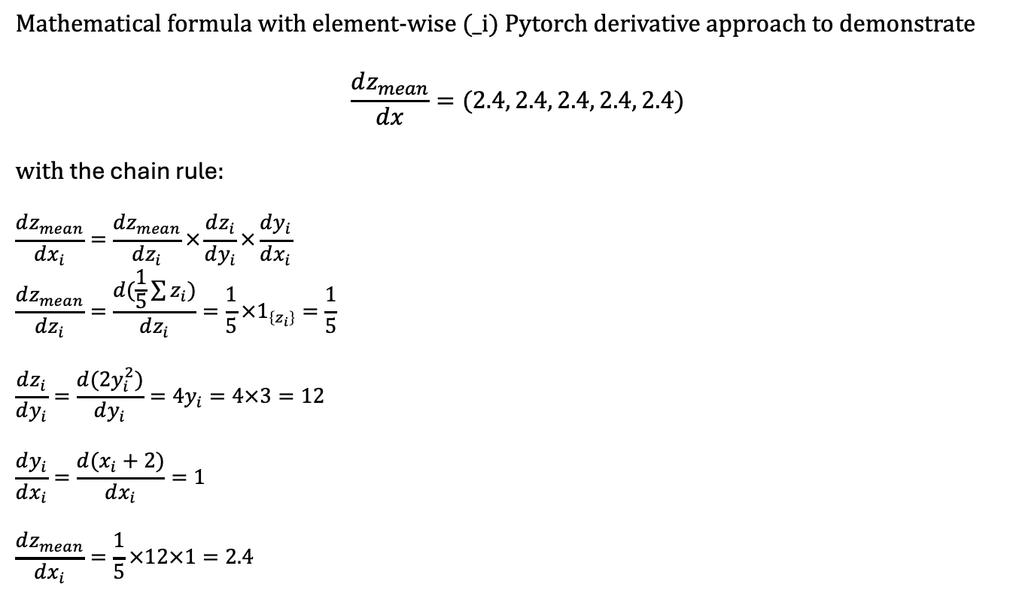
Pytorch tutorial Neural Network – Backward pass
Mathematical formula with element-wise (_i) Pytorch derivative approach to demonstrate
$$\frac{dz_{mean}}{dx}=(2.4, 2.4, 2.4, 2.4, 2.4)$$
with the chain rule:
$$\frac{dz_{mean}}{dx_{i}}=\frac{dz_{mean}}{dz_{i}}×\frac{dz_{i}}{dy_{i}}×\frac{dy_{i}}{dx_{i}}$$
$$\frac{dz_{mean}}{dz_{i}}=\frac{d(\frac{1}{5}\sum{z_{i}})}{dz_{i}}=\frac{1}{5}×1_{\left\{z_{i}\right\}}=\frac{1}{5}$$
$$\frac{dz_{i}}{dy_{i}}=\frac{d(2y_{i}^{2})}{dy_{i}}=4y_{i}=4×3=12$$
$$\frac{dy_{i}}{dx_{i}}=\frac{d(x_{i}+2)}{dx_{i}}=1$$
$$\frac{dz_{mean}}{dx_{i}}=\frac{1}{5}×12×1=2.4$$

Slide 59
Pytorch tutorial Neural Network – Backward pass
import torch
# when z is not a scalar we add gradient=torch.ones_like(z): z.backward(gradient=torch.ones_like(z))

Slide 60
Pytorch tutorial Neural Network – detach grad to stop tracking the gradients
# Method 1
print(x, x.requires_grad_(False))
# Method 2
x = torch.randn(3, requires_grad=True) print(x, x.detach())
# Method 3
x = torch.randn(3, requires_grad=True) with torch.no_grad(): y = x + 2 print(y)

Slide 61
Pytorch tutorial Neural Network – Avoid gradients accumulation grad.zero!()
# Important: to think about weights.grad.zero_() # otherwise weights.grad will increment during the training weights = torch.ones(4, requires_grad=True) for epoch in range(3): model_output = (weights*3).sum() model_output.backward() print(weights.grad) weights.grad.zero_()
# tensor([3., 3., 3., 3.]) # tensor([3., 3., 3., 3.]) # tensor([3., 3., 3., 3.])
Notes:
If not use:
# tensor([3., 3., 3., 3.]) # tensor([6., 6., 6., 6.]) # tensor([9., 9., 9., 9.])

Slide 62
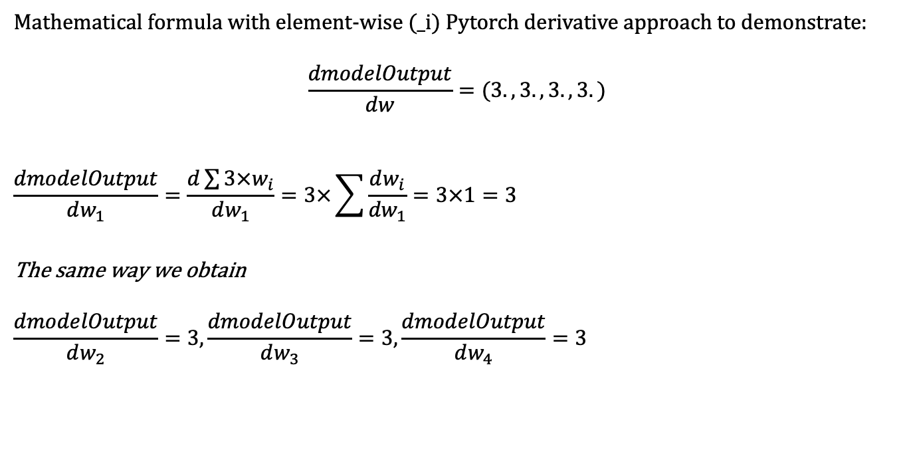
Pytorch tutorial Neural Network – Backward pass
Mathematical formula with element-wise (_i) Pytorch derivative approach to demonstrate:
$$\frac{dmodelOutput}{dw}=(3., 3., 3., 3.)$$
$$\frac{dmodelOutput}{dw_{1}}=\frac{d\sum{{3×w}_{i}}}{dw_{1}}=3×\sum{\frac{dw_{i}}{{dw}_{1}}=3×1}=3$$
The same way we obtain
$$\frac{dmodelOutput}{dw_{2}}=3, \frac{dmodelOutput}{dw_{3}}=3, \frac{dmodelOutput}{dw_{4}}=3$$

Slide 63
Pytorch tutorial Neural Network – Optimizer SGD
# Important: to think about weights.grad.zero_() # otherwise weights.grad will increment during the training weights = torch.ones(4, requires_grad=True) for epoch in range(3): model_output = (weights*3).sum() model_output.backward() print(weights.grad) weights.grad.zero_()
# tensor([3., 3., 3., 3.]) # tensor([3., 3., 3., 3.]) # tensor([3., 3., 3., 3.])

Slide 64
Pytorch tutorial Neural Network – Optimizer SGD
import torch x = torch.tensor(1.0) y = torch.tensor(2.0) w = torch.tensor(1.0, requires_grad=True) # forward pass and compute the loss y_hat = w * x loss = (y_hat - y)**2 # backward pass loss.backward() print(f"w_grad: {w.grad}")
w_grad: -2.0 # dL/dy_hat * dy_hat/dw = d(y_hat-y)**2/dy_hat * d(w*x)/dw = 2(y_hat-y) * x = 2(1-2)1

Slide 65
Pytorch tutorial Neural Network – Optimizer SGD
import torch x = torch.tensor(1.0) y = torch.tensor(2.0) w = torch.tensor(1.0, requires_grad=True) # forward pass and compute the loss y_hat = w * x loss = (y_hat - y)**2 # backward pass loss.backward() print(f"w_grad: {w.grad}")
w_grad: -2.0 # dL/dy_hat * dy_hat/dw = d(y_hat-y)**2/dy_hat * d(w*x)/dw = 2(y_hat-y) * x = 2(1-2)1

