Slide 1
Naive Bayes Classifier
Based on NLPDemystified.org

Slide 2
Naive Bayes Classifier
Fast and Simple Text Classification

Slide 3

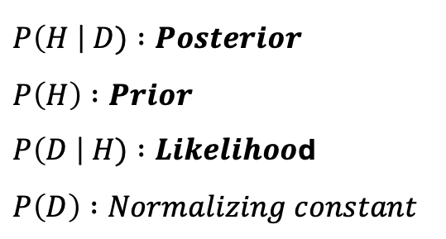
Naive Bayes Classifier
Bayes’ Theorem:
$$P\left(H \right| D)= \frac{P\left(H\right)× P\left(D \right| H)}{P(D)}$$
$H:Hypothesis$
$D:Data$
$P\left(H \right| D) :Posterior$
$P\left(H\right) :Prior$
$P\left(D \right| H) :Likelihoo$d
$P\left(D\right) :Normalizing constant$
Notes:
P(A intersection B) = P(B intersection A)
P(A | B) = P(A intersection B) / P(B)
P(B | A) = P(A intersection B) / P(A)
P(A | B) x P(A) = P(B | A) x P(B)
P(A | B) = P(B) x P(B | A) / P(A)
CQFD

Slide 4
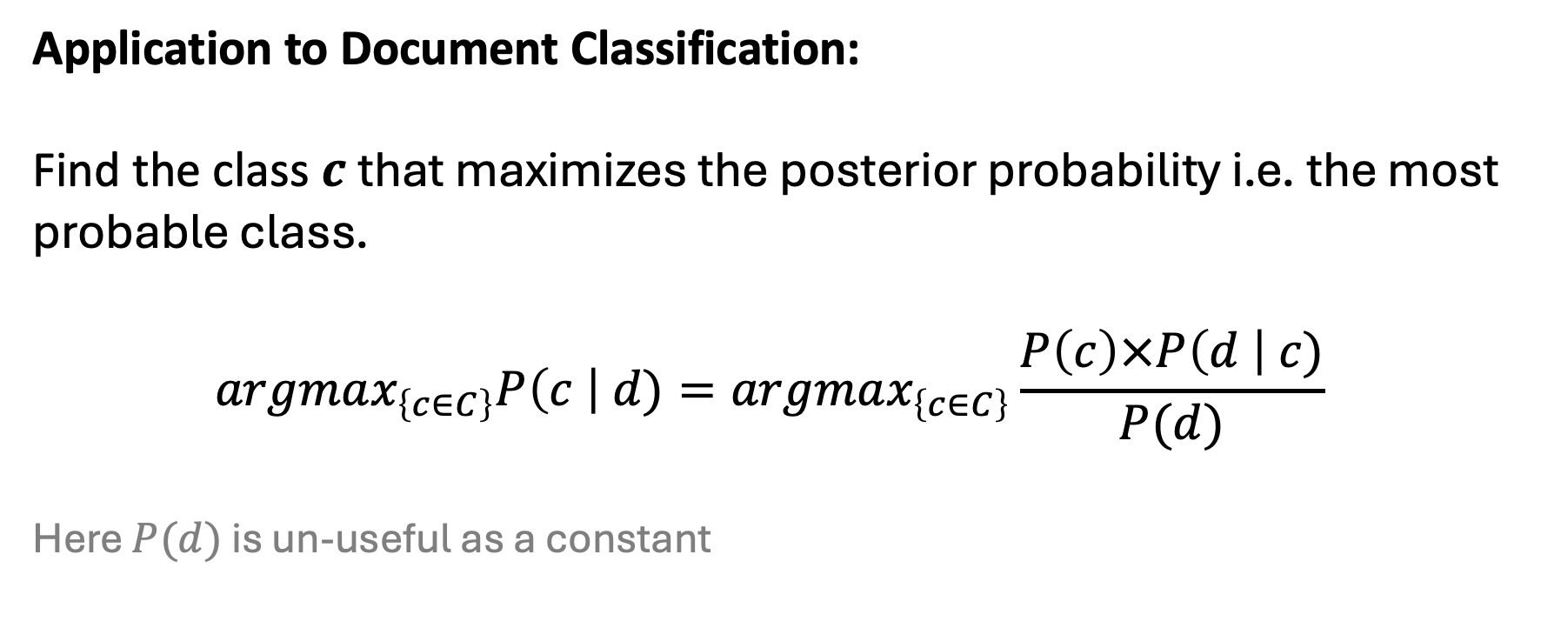
Naive Bayes Classifier
Application to Document Classification:
Find the class $c$ that maximizes the posterior probability i.e. the most probable class.
$$argmax_{\left\{c∈C\right\}}P\left(c \right| d)=argmax_{\left\{c∈C\right\}}\frac{P\left(c\right)×P\left(d \right| c)}{P(d)}$$
Here $P(d)$ is un-useful as a constant

Slide 5
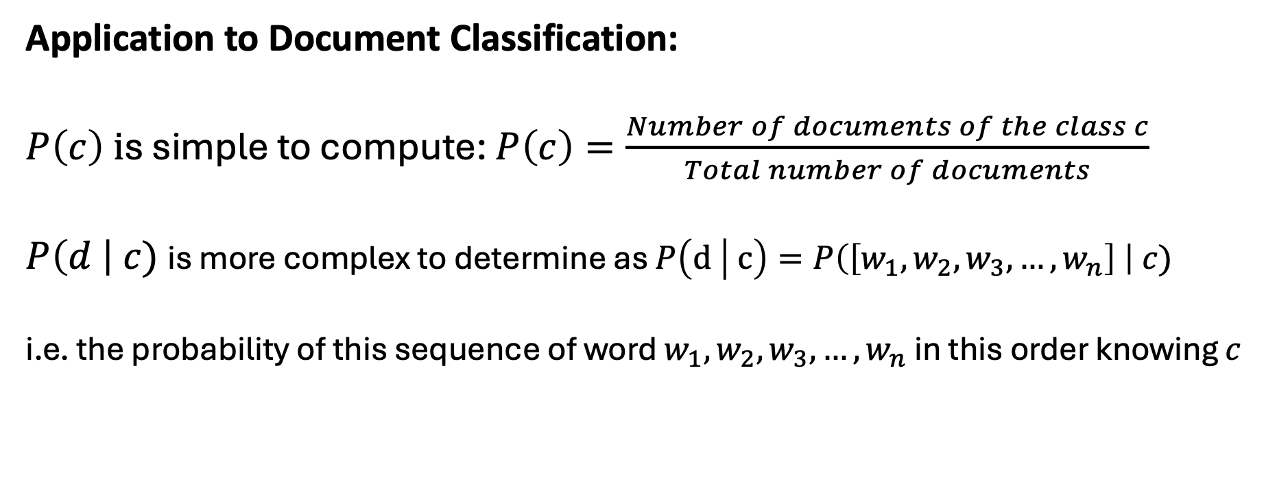
Naive Bayes Classifier
Application to Document Classification:
$P\left(c\right) i$s simple to compute: $P\left(c\right)=\frac{Number of documents of the class c}{Total number of documents}$
$P\left(d \right| c)$ is more complex to determine as $P\left(d | c\right)=P\left(\left[w_{1},w_{2},w_{3},…,w_{n}\right] \right| c)$
i.e. the probability of this sequence of word $w_{1},w_{2},w_{3},…,w_{n}$ in this order knowing $c$

Slide 6
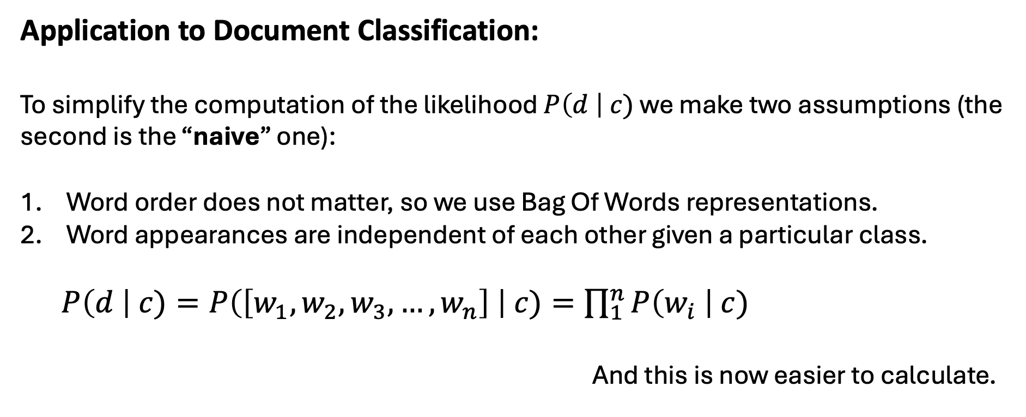
Naive Bayes Classifier
Application to Document Classification:
To simplify the computation of the likelihood $P\left(d \right| c)$ we make two assumptions (the second is the “naive” one):
Word order does not matter, so we use Bag Of Words representations.
Word appearances are independent of each other given a particular class.
$P\left(d \right| c)=P\left(\left[w_{1},w_{2},w_{3},…,w_{n}\right] \right| c)=\prod_{1}^{n}{P\left(w_{i} \right| c)}$
And this is now easier to calculate.
Notes:
With the naive approach despite “Thank” and “you” are correlated we assume they are not.

Slide 7
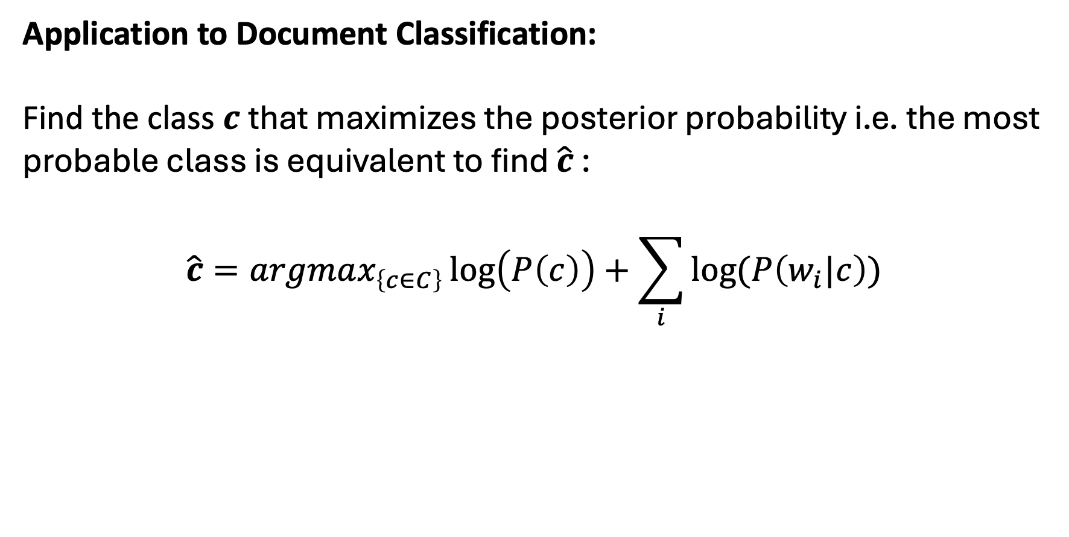
Naive Bayes Classifier
Application to Document Classification:
Find the class $c$ that maximizes the posterior probability i.e. the most probable class is equivalent to find $\hat{c}$ :
$$\hat{c}=argmax_{\left\{c∈C\right\}}\log\left(P\left(c\right)\right)+\sum_{i}{log⁡(P\left(w_{i}|c\right))}$$

Slide 8
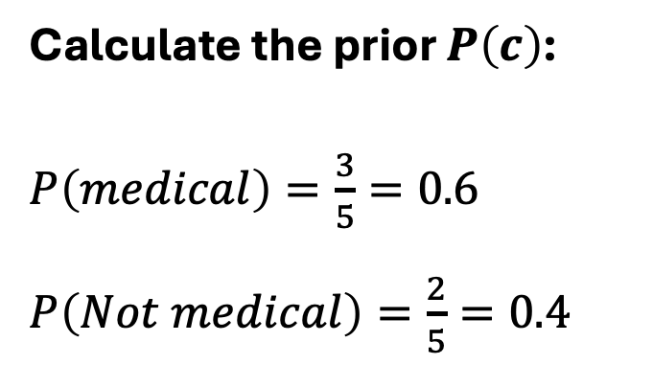
Naive Bayes Classifier
Application to Document Classification:
Document | Class
“Beyond the pandemic” | Medical
“Compelling jumble of philosophy” | Not medical
“Vaccine rollout enters second phase” | Medical
“Man regains sight with implant” | Medical
“My toilet is haunted” | Not medical
Calculate the prior $P\left(c\right)$:
$P\left(medical\right)=\frac{3}{5}=0.6$
$P\left(Not medical\right)=\frac{2}{5}=0.4$

Slide 9
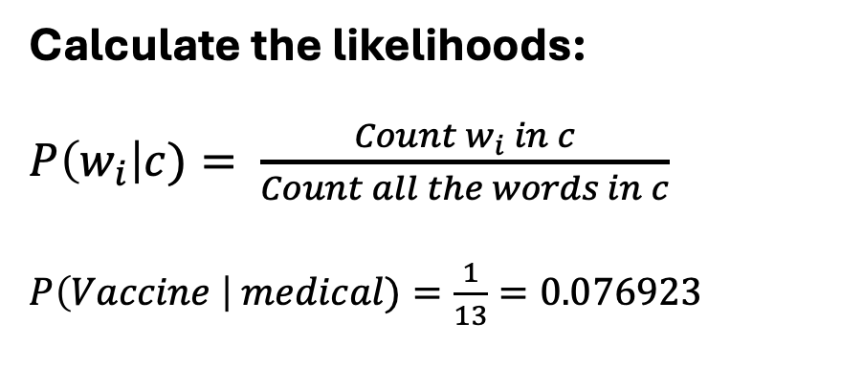
Naive Bayes Classifier
Application to Document Classification:
Document | Class
“Beyond the pandemic” | Medical
“Compelling jumble of philosophy” | Not medical
“Vaccine rollout enters second phase” | Medical
“Man regains sight with implant” | Medical
“My toilet is haunted” | Not medical
Calculate the likelihoods:
$P\left(w_{i}\right|c)= \frac{Count w_{i} in c}{Count all the words in c}$
$P\left(Vaccine \right| medical)=\frac{1}{13}=0.076923$

Slide 10
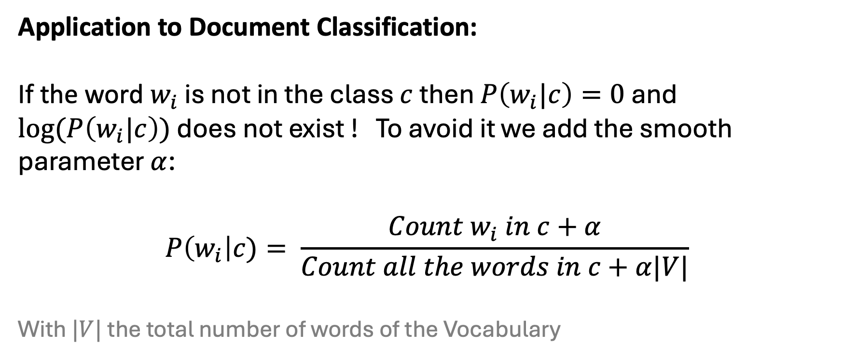
Naive Bayes Classifier
Application to Document Classification:
If the word $w_{i}$ is not in the class $c$ then $P\left(w_{i}|c\right)=0$ and $log⁡(P\left(w_{i}|c\right))$ does not exist ! To avoid it we add the smooth parameter $α$:
$$P\left(w_{i}\right|c)= \frac{Count w_{i} in c+α}{Count all the words in c+α|V|}$$
With $|V|$ the total number of words of the Vocabulary

Slide 11
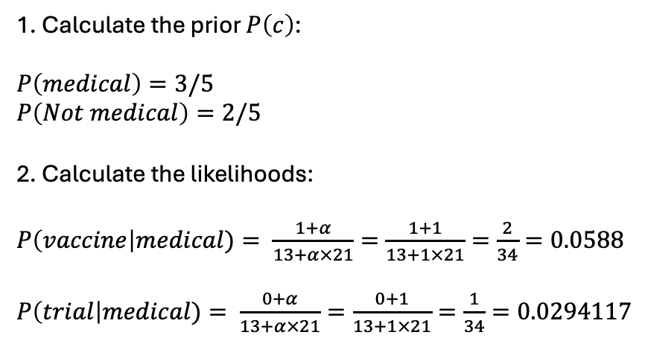
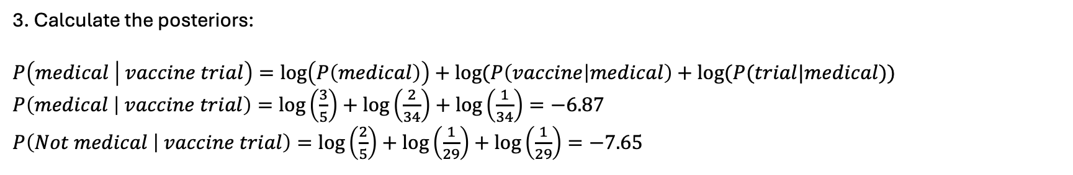
Naive Bayes Classifier
Let’s now classify the document « vaccine trial »
Document | Class
“Beyond the pandemic” | Medical
“Compelling jumble of philosophy” | Not medical
“Vaccine rollout enters second phase” | Medical
“Man regains sight with implant” | Medical
“My toilet is haunted” | Not medical
1. Calculate the prior $P\left(c\right)$:
$P\left(medical\right)=3/5$
$P\left(Not medical\right)=2/5$
2. Calculate the likelihoods:
$P\left(vaccine\right|medical)= \frac{1+α}{13+α×21}=\frac{1+1}{13+1×21}=\frac{2}{34}=0.0588$
$P\left(trial\right|medical)= \frac{0+α}{13+α×21}=\frac{0+1}{13+1×21}=\frac{1}{34}=0.0294117$
3. Calculate the posteriors:
$P\left(medical | vaccine trial\right)=\log\left(P\left(medical\right)\right)+log⁡(P\left(vaccine | medical\right)+log⁡(P(trial|medical))$
$P\left(medical | vaccine trial\right)=\log\left(\frac{3}{5}\right)+\log\left(\frac{2}{34}\right)+\log\left(\frac{1}{34}\right)=−6.87$
$P\left(Not medical | vaccine trial\right)=\log\left(\frac{2}{5}\right)+\log\left(\frac{1}{29}\right)+\log\left(\frac{1}{29}\right)=−7.65$

Slide 12
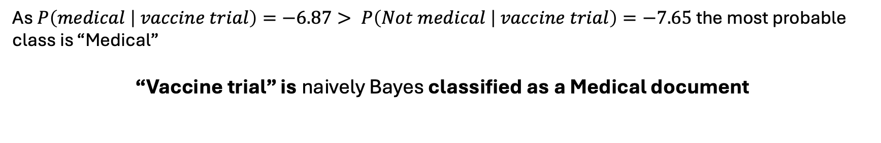
Naive Bayes Classifier
Application to Document Classification:
As $P\left(medical | vaccine trial\right)=−6.87> P\left(Not medical | vaccine trial\right)=−7.65$ the most probable class is “Medical”
“Vaccine trial” is naively Bayes classified as a Medical document

Slide 13
Naive Bayes Classifier
Application to Document Classification:
# Create a Bunch object to store the documents and the classes.
# Bunch() is more used in NLP than pd.DataFrame()
from sklearn.utils import Bunch
documents = ["Beyond the pandemic",
"Compelling jumble of philosophy",
"Vaccine rollout enters second phase",
"Man regains sight with implant",
"My toilet is haunted"]
classes = ["Medical",
"Not Medical",
"Medical",
"Medical",
"Not Medical"]
data = Bunch(documents=documents, classes=classes)
def prior(class_to_filter) -> float:
"""Returns the prior P(c) of the c class"""
nb_documents = len(data.documents)
nb_class_occurrences = sum(1 for classe in data.classes
if classe == class_to_filter)
p = nb_class_occurrences / nb_documents
return p
prior("Medical"), prior("Not Medical")
(0.6, 0.4)

Slide 14
Naive Bayes Classifier
Application to Document Classification:
def vocabulary_class(class_to_filter) -> list:
"Returns the list of the words in the class"
documents_filters = [doc for doc, classe
in zip(data.documents, data.classes)
if classe == class_to_filter]
vocab_class = ' '.join([doc.lower() for doc
in documents_filters]).split(' ‘)
return vocab_class
print(vocabulary_class('Medical'))
['beyond', 'the', 'pandemic', 'vaccine', 'rollout', 'enters’,
'second', 'phase', 'man', 'regains', 'sight', 'with', 'implant']
def p_likelihood(word, class_to_filter, alpha=1) -> float:
"""Takes a word and a class and return the likelihood p(word | class)"""
from collections import Counter
# count all w in c
all_w_in_c = len(vocabulary_class(class_to_filter))
# count w_i in c
wi_in_c = Counter(vocabulary_class(class_to_filter))[word.lower()]
p = (wi_in_c + alpha) / (all_w_in_c + alpha * v)
return p
p_likelihood('Vaccine', 'Medical')
0.058823529411764705
p_likelihood('trial', 'Medical’)
0.029411764705882353

Slide 15
Naive Bayes Classifier
Application to Document Classification:
def p_likelihood(word, class_to_filter, alpha=1) -> float:
"""Takes a word and a class and return the likelihood p(word | class)"""
from collections import Counter
# count all w in c
all_w_in_c = len(vocabulary_class(class_to_filter))
# count w_i in c
wi_in_c = Counter(vocabulary_class(class_to_filter))[word.lower()]
p = (wi_in_c + alpha) / (all_w_in_c + alpha * v)
return p
p_likelihood('Vaccine', 'Medical')
0.058823529411764705
p_likelihood('trial', 'Not Medical’)
0.034482758620689655
def predict(document, classes):
"""Predict the class of a document"""
words = document.split(' ‘)
max_prob = float('-inf’)
predicted_class = None
for classe in classes:
prob = np.log(prior(classe))
for word in words:
prob += np.log(p_likelihood(word, classe))
if prob > max_prob:
max_prob = prob
print(f"max_prob: {round(max_prob,2)}")
predicted_class = classe
return predicted_class
# Document to test
test_document = "vaccine trial"
# Predict the class of the document to test
predicted_class = predict(test_document, ["Medical", "Not Medical"])
print(f”The document '{test_document}’ belongs to the class '{predicted_class}’. »)
max_prob: -6.87
The document 'vaccine trial’ belongs to the class 'Medical'.

Slide 16
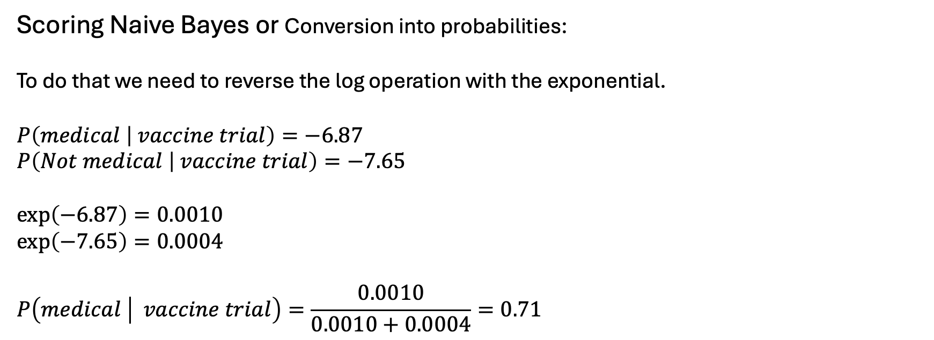
Naive Bayes Classifier
Application to Document Classification:
Scoring Naive Bayes or Conversion into probabilities:
To do that we need to reverse the log operation with the exponential.
$$P\left(medical | vaccine trial\right)=−6.87$$
$$P\left(Not medical | vaccine trial\right)=−7.65$$
$$\exp\left(−6.87\right)=0.0010$$
$$\exp\left(−7.65\right)=0.0004$$
$$P\left(medical | vaccine trial\right)=\frac{0.0010}{0.0010+0.0004}=0.71$$

Slide 17
Naive Bayes Classifier
Application to Document Classification: fetch_20newsgroup dataset
# The packages
import matplotlib.pyplot as plt
import numpy as np
import pandas as pd
import spacy
from sklearn import metrics
from sklearn import model_selection
from sklearn.datasets import fetch_20newsgroups
from sklearn.dummy import DummyClassifier
from sklearn.feature_extraction.text import TfidfVectorizer
from sklearn.metrics import confusion_matrix, ConfusionMatrixDisplay
from sklearn.model_selection import train_test_split
from sklearn.naive_bayes import MultinomialNB
from sklearn.pipeline import Pipeline
# Load the data. Remove headers, footers, and quotes from training set and split.
filtered_training_corpus = fetch_20newsgroups(subset='train’,
remove=('headers', 'footers', 'quotes’))
train_data, val_data, train_labels, val_labels = train_test_split(filtered_training_corpus.data,
filtered_training_corpus.target,
train_size=0.8,
random_state=1)

Slide 18
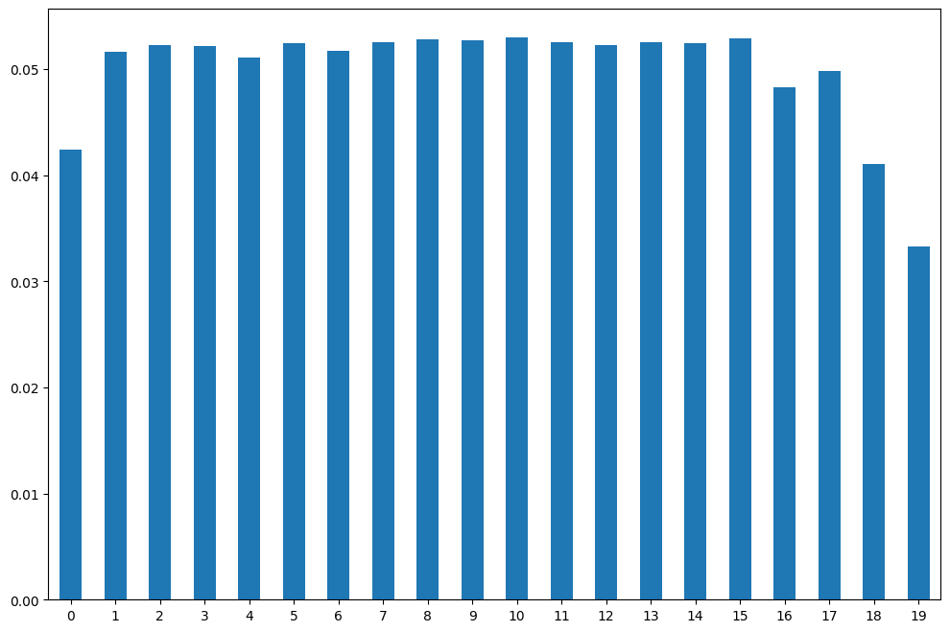
Naive Bayes Classifier
Application to Document Classification: fetch_20newsgroup dataset
# When starting, it's a good idea to check the target distribution.
# In our case, the target is balanced.
bins, counts = np.unique(training_corpus.target, return_counts=True)
freq_series = pd.Series(counts/len(training_corpus.data))
plt.figure(figsize=(12, 8))
ax = freq_series.plot(kind='bar')
ax.set_xticklabels(bins, rotation=0)
plt.show()
Notes:
# These are the possible topics a post can belong to.
training_corpus.target_names
['alt.atheism',
'comp.graphics',
'comp.os.ms-windows.misc',
'comp.sys.ibm.pc.hardware',
'comp.sys.mac.hardware',
'comp.windows.x',
'misc.forsale',
'rec.autos',
'rec.motorcycles',
'rec.sport.baseball',
'rec.sport.hockey',
'sci.crypt',
'sci.electronics',
'sci.med',
'sci.space',
'soc.religion.christian',
'talk.politics.guns',
'talk.politics.mideast',
'talk.politics.misc',
'talk.religion.misc']

Slide 19
Naive Bayes Classifier
Application to Document Classification: fetch_20newsgroup dataset
# The pre-processing step
# Load the spaCy English model
nlp = spacy.load('en_core_web_sm’)
# Define the pipeline without ‘ner’ and ‘parser’
unwanted_pipes = ['ner', 'parser']
# Further remove stop words and take the lemma instead of token text.
def spacy_tokenizer(doc):
with nlp.disable_pipes(*unwanted_pipes):
return [t.lemma_ for t in nlp(doc) if \
not t.is_punct and \
not t.is_space and \
not t.is_stop and \
t.is_alpha]
# Vectorization of the training dataset:
vectorizer = TfidfVectorizer(tokenizer=spacy_tokenizer)
train_feature_vects = vectorizer.fit_transform(train_data)
# Check the number of features now.
print('Number of training features: {}'.format(len(train_feature_vects[0].toarray().flatten())))
Number of training features: 42803

Slide 20
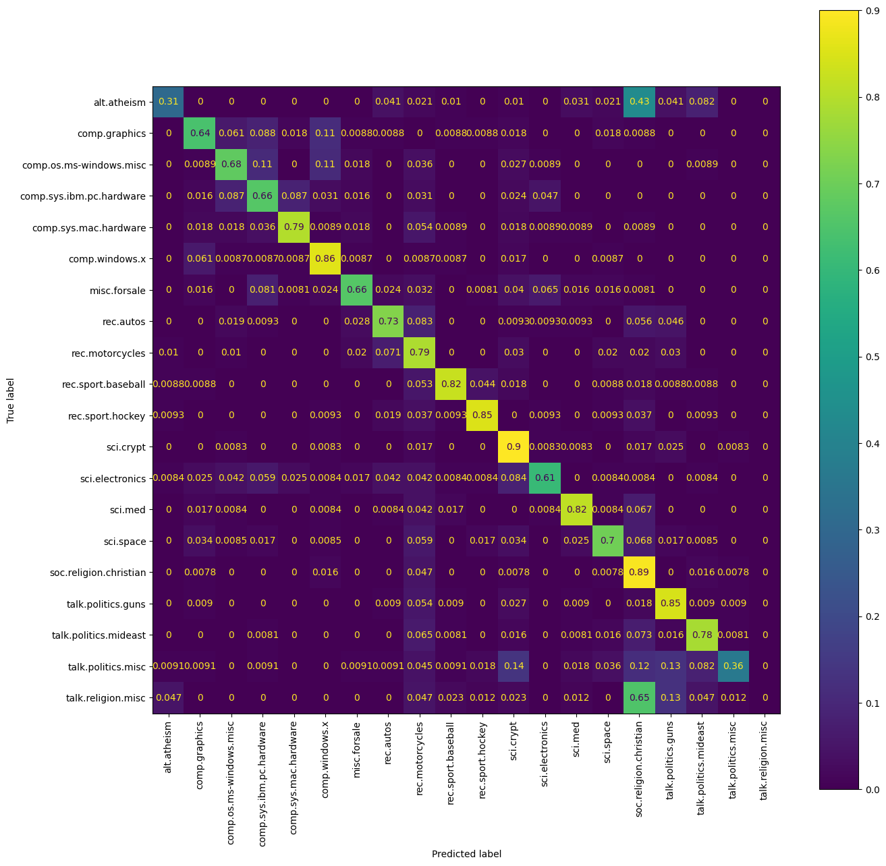
Naive Bayes Classifier
Application to Document Classification: fetch_20newsgroup dataset
# Instantiate a classifier with the default settings.
nb_classifier = MultinomialNB()
# Train the model:
nb_classifier.fit(train_feature_vects, train_labels)
# nb_classifier.get_params()
# Classifier performance on the train dataset
print('Training F1 score with fewer features: {}'.format(metrics.f1_score(train_labels, train_preds, average='macro')))
Training F1 score with fewer features: 0.839229137359691
# Check the classifier performance on the validation dataset
val_feature_vects = vectorizer.transform(val_data)
val_preds = nb_classifier.predict(val_feature_vects)
print('Validation F1 score with fewer features: {}'.format(metrics.f1_score(val_labels, val_preds, average='macro')))
Validation F1 score with fewer features: 0.673409559015635
# creates and displays a normalized confusion matrix for a classifier.:
fig, ax = plt.subplots(figsize=(15, 15))
disp = ConfusionMatrixDisplay.from_estimator(nb_classifier,
val_feature_vects,
val_labels, normalize='true’,
display_labels=filtered_training_corpus.target_names,
xticks_rotation='vertical', ax=ax)

Slide 21
Naive Bayes Classifier
Application to Document Classification: fetch_20newsgroup dataset
Normalized Confusion Matrix
In a normalized confusion matrix, the values are expressed as proportions or percentages rather than absolute numbers. This allows for better comparison of performance across different classes, especially if the classes are imbalanced.
Interpreting the Coefficients
Main Diagonal: The values on the main diagonal (from top-left to bottom-right) represent the proportions of true predictions (true positives) for each class. A value close to 1 indicates that the model correctly predicts this class most of the time.
Off-Diagonal: The values off the main diagonal represent the proportions of false predictions. For example, the value at row i and column j (where i ≠ j) indicates the proportion of instances of class i that were incorrectly predicted as belonging to class j.
Rows: Each row represents the actual instances of a class. The sum of the values in a row equals 1 (or 100% if expressed as percentages).
Columns: Each column represents the predictions of a class. The sum of the values in a column is also equal to 1 (or 100%).
Example:
For ‘alt.atheism’, the proportions of true predictions is only equal to 31%. The class was more predict (43%) as ‘soc.religion.christian’.

Slide 22
Naive Bayes Classifier
Application to Document Classification: fetch_20newsgroup dataset
# The classification report.
print(metrics.classification_report(val_labels,
val_preds,
target_names=filtered_training_corpus.target_names))
precision recall f1-score support
alt.atheism 1.00 0.09 0.17 97
comp.graphics 0.73 0.50 0.59 114
comp.os.ms-windows.misc 0.74 0.63 0.68 112
comp.sys.ibm.pc.hardware 0.56 0.69 0.61 127
comp.sys.mac.hardware 0.83 0.71 0.76 112
comp.windows.x 0.69 0.87 0.77 115
misc.forsale 0.87 0.60 0.71 124
rec.autos 0.76 0.63 0.69 108
rec.motorcycles 0.47 0.70 0.56 99
rec.sport.baseball 0.96 0.76 0.85 113
rec.sport.hockey 0.83 0.83 0.83 108
sci.crypt 0.57 0.89 0.69 120
sci.electronics 0.82 0.52 0.64 119
sci.med 0.89 0.71 0.79 119
sci.space 0.86 0.59 0.70 118
soc.religion.christian 0.24 0.94 0.38 128
# A few observations:
# Atheism has a perfect precision score but terrible recall, signalling that # the model was right when it classified something as under atheism, but # missed the vast majority in the corpus.

Slide 23
Naive Bayes Classifier
Application to Document Classification: fetch_20newsgroup dataset
# Tuning the hyperparameter alpha to improve the model:
# The alpha values to try.
params = {'alpha': [0.01, 0.1, 0.5, 1.0, 10.0,],}
# Instantiate the search with the model we want to try and fit it on the training data.
multinomial_nb_grid = model_selection.GridSearchCV(MultinomialNB(),
param_grid=params,
scoring='f1_macro’,
n_jobs=-1,
cv=5,
verbose=5)
multinomial_nb_grid.fit(train_feature_vects, train_labels)
Fitting 5 folds for each of 5 candidates, totalling 25 fits [CV 1/5] END ........................alpha=0.01;, score=0.737 total time= 0.0s [CV 4/5] END .........................alpha=0.1;, score=0.737 total time= 0.0s [CV 2/5] END ........................alpha=0.01;, score=0.738 total time= 0.0s [CV 3/5] END ........................alpha=0.01;, score=0.735 total time= 0.0s [CV 5/5] END .........................alpha=0.1;, score=0.741 total time= 0.0s [CV 4/5] END ........................alpha=0.01;, score=0.744 total time= 0.0s [CV 1/5] END .........................alpha=0.5;, score=0.690 total time= 0.0s [CV 2/5] END .........................alpha=0.5;, score=0.703 total time= 0.0s [CV 3/5] END .........................alpha=0.5;, score=0.674 total time= 0.1s [CV 4/5] END .........................alpha=0.5;, score=0.699 total time= 0.1s [CV 5/5] END ........................alpha=0.01;, score=0.768 total time= 0.1s [CV 1/5] END .........................alpha=0.1;, score=0.718 total time= 0.1s [CV 5/5] END .........................alpha=0.5;, score=0.706 total time= 0.1s [CV 2/5] END .........................alpha=1.0;, score=0.685 total time= 0.0s [CV 1/5] END .........................alpha=1.0;, score=0.679 total time= 0.1s [CV 4/5] END .........................alpha=1.0;, score=0.684 total time= 0.0s [CV 3/5] END .........................alpha=1.0;, score=0.658 total time= 0.1s [CV 5/5] END .........................alpha=1.0;, score=0.686 total time= 0.0s [CV 1/5] END ........................alpha=10.0;, score=0.596 total time= 0.0s [CV 2/5] END .........................alpha=0.1;, score=0.735 total time= 0.0s [CV 3/5] END

Slide 24
Naive Bayes Classifier
Application to Document Classification: fetch_20newsgroup dataset
print('Best parameter value(s): {}'.format(multinomial_nb_grid.best_params_))
Best parameter value(s): {'alpha': 0.01}
best_nb_classifier = multinomial_nb_grid.best_estimator_
val_preds = best_nb_classifier.predict(val_feature_vects)
print('Validation F1 score with fewer features: {}'.format(metrics.f1_score(val_labels, val_preds,
average='macro’)))
Validation F1 score with fewer features: 0.7343805683794756
# we can use the function below to view the most commonly occurring words in # each category.:
def show_top_words(classifier, vectorizer, categories, top_n):
feature_names = np.asarray(vectorizer.get_feature_names_out())
for i, category in enumerate(categories):
prob_sorted = classifier.feature_log_prob_[i, :].argsort()[::-1]
print("%s: %s" % (category, " ".join(feature_names[prob_sorted[:top_n]])))
show_top_words(best_nb_classifier,
vectorizer,
filtered_training_corpus.target_names, 10)
alt.atheism: god religion atheist people think say atheism post belief believe comp.graphics: file graphic image thank program format look know color need comp.os.ms-windows.misc: window file driver problem use program card thank font do comp.sys.ibm.pc.hardware: drive card controller bus scsi monitor ide mb thank pc comp.sys.mac.hardware: mac apple drive problem monitor card thank work simms quadra comp.windows.x: x window server widget motif application use run thank
[…]

Slide 25
Naive Bayes Classifier
Application to Document Classification: fetch_20newsgroup dataset
# Create the final Naïve Bayes Model
# Create the text classification pipeline with TF-IDF vectorization and a Naïve Bayes Classifier
text_classifier = Pipeline([
('vectorizer', TfidfVectorizer(tokenizer=spacy_tokenizer)),
('classifier', MultinomialNB(alpha=0.01))
])
# Train the model
text_classifier.fit(filtered_training_corpus.data, filtered_training_corpus.target)
# Download the test dataset
filtered_test_corpus = fetch_20newsgroups(subset='test', remove=('headers', 'footers', 'quotes’))
# Pass the raw test data directly to the classifier
test_preds = text_classifier.predict(filtered_test_corpus.data)
fig, ax = plt.subplots(figsize=(15, 15))
ConfusionMatrixDisplay.from_predictions(filtered_test_corpus.target,
test_preds, normalize='true’,
display_labels=filtered_test_corpus.target_names, xticks_rotation='vertical', ax=ax)
plt.show()

Slide 26
Naive Bayes Classifier
Application to Document Classification: fetch_20newsgroup dataset
# The function classify_text takes a trained classifier and a text document, predicts the class probabilities, and returns the most probable class along with its probability.
def classify_text(clf, doc, labels=None):
probas = clf.predict_proba([doc]).flatten()
max_proba_idx = np.argmax(probas)
if labels:
most_proba_class = labels[max_proba_idx]
else:
most_proba_class = max_proba_idx
return (most_proba_class, probas[max_proba_idx])
# Predictions:
# Post from r/medicine.
s = "Hello everyone so am doing my thesis on Ischemic heart disease have been using online articles and textbooks mostly Harrisons internal med. could u recommended me some source specifically books where i can get more about in depth knowledge on IHD."
classify_text(text_classifier, s, filtered_test_corpus.target_names)
('sci.med', np.float64(0.7210299189355043))

Slide 27
Naive Bayes Classifier
Dummy classifier: guess the most frequent class
# Utility:
# A factice classifier is often used as a baseline for comparison with more sophisticated models.
# If a more complex model can not overpass the factice classifier performance, this can indicate problems with the data.
from sklearn.dummy import DummyClassifier
# Initialize a Factice classifier.
dummy_clf = DummyClassifier(strategy="most_frequent")
# Train a dummy classifier which just guesses the most frequent class.
dummy_clf.fit(train_feature_vects, train_labels)
# Evaluate the classifier.
dummy_clf.score(val_feature_vects, val_labels)

