Slide 1
Introduction to Neural Network

Slide 2
Optimizers

Slide 3
A bit of vocabulary: epochs vs iterations
Epoch
An epoch is a complete pass through the entire training dataset.
In other words, an epoch means that each training example has been seen once by the model. For example, if you have 1000 training examples and you set a batch size of 100, one epoch will consist of 10 iterations (1000 / 100).
Iteration
An iteration is a single update of the model's weights.
In the context of batch training, an iteration corresponds to a weight update after processing a batch of data.
For example, if you have 1000 training examples and a batch size of 100, one epoch will consist of 10 iterations.

Slide 4
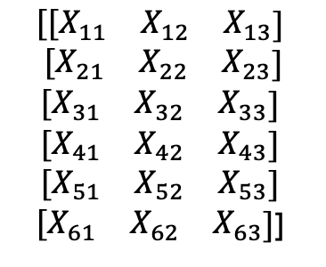
Gradient descent types
Plain or Batch Gradient Descent (BGD)
Pass the entire dataset through the network for each iteration
(-) Can be too slow due to large data before calculating a loss.
BGD converges smoothly.
$$\begin{matrix}{[[X}_{11} & X_{12} & X_{13}\end{matrix}]$$
$$\begin{matrix} {[X}_{21} & X_{22} & X_{23}\end{matrix}]$$
$$\begin{matrix}{[X}_{31} & X_{32} & X_{33}\end{matrix}]$$
$$\begin{matrix}{[X}_{41} & X_{42} & X_{43}\end{matrix}]$$
$$\begin{matrix}{[X}_{51} & X_{52} & X_{53}\end{matrix}]$$
$\begin{matrix}{[X}_{61} & X_{62} & X_{63}\end{matrix}]$]

Slide 5
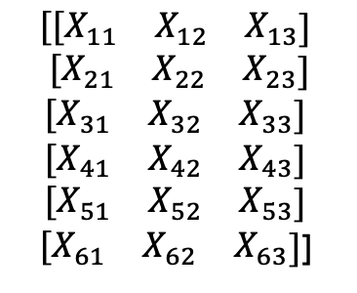
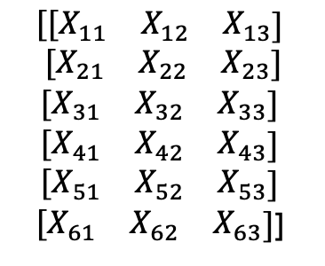
Gradient descent types
Stochastic Gradient Descent (SGD)
Process one random entry from the dataset for each iteration
(+) quicker, avoid loading all data into memory,
(-) has an erratic convergence. Jumps around, harder to converge.
Mini-batch Stochastic Gradient Descent
Select a random batch of samples for each iteration. Less erratic convergence than in SGD. Takes advantage of hardware matrix operations.
After shuffling the data and chosen the batch size (meta parameter typically ranging from 32 to 512) , the dataset is divided in batches and each batch is learnt (one iteration each time) till we end the epoch. Then same process: reshuffle... Till the number of iterations is reached.
$$\begin{matrix}{[[X}_{11} & X_{12} & X_{13}\end{matrix}]$$
$$\begin{matrix} {[X}_{21} & X_{22} & X_{23}\end{matrix}]$$
$$\begin{matrix}{[X}_{31} & X_{32} & X_{33}\end{matrix}]$$
$$\begin{matrix}{[X}_{41} & X_{42} & X_{43}\end{matrix}]$$
$$\begin{matrix}{[X}_{51} & X_{52} & X_{53}\end{matrix}]$$
$\begin{matrix}{[X}_{61} & X_{62} & X_{63}\end{matrix}]$]
$$\begin{matrix}{[[X}_{11} & X_{12} & X_{13}\end{matrix}]$$
$$\begin{matrix} {[X}_{21} & X_{22} & X_{23}\end{matrix}]$$
$$\begin{matrix}{[X}_{31} & X_{32} & X_{33}\end{matrix}]$$
$$\begin{matrix}{[X}_{41} & X_{42} & X_{43}\end{matrix}]$$
$$\begin{matrix}{[X}_{51} & X_{52} & X_{53}\end{matrix}]$$
$\begin{matrix}{[X}_{61} & X_{62} & X_{63}\end{matrix}]$]

Slide 6
Gradient descent types
Mini-batch Stochastic Gradient Descent
from torch.utils.data import DataLoader, TensorDataset
# Convert data to PyTorch tensors
X_tensor = torch.tensor(X)
y_tensor = torch.tensor(y)
# Create a DataLoader to manage the mini-batches
batch_size = 32
dataset = TensorDataset(X_tensor, y_tensor)
dataloader = DataLoader(dataset, batch_size=batch_size, shuffle=True)
…
num_epochs = 100
for epoch in range(num_epochs):
for batch_X, batch_y in dataloader:
optimizer.zero_grad()
out = model(batch_X)
loss = criterion(out, batch_y)
loss.backward() optimizer.step()
print(f"Epoch {epoch + 1}/{num_epochs}, Loss: {loss.item()}")

Slide 7

The Learning rate $α$
The learning rate is a scaler value. It is an hyperparameter that controls the step size at each iteration while moving toward a minimum of the loss function. It determines how much to adjust the model's parameters (weights) with respect to the estimated error each time the model's weights are updated.
If the learning rate is too small, the convergence is too slow, and if the learning rate is too large, there is a risk of missing the convergence. One way to avoid that is to test many learning rates. And rather than doing it manually, we can use the following search techniques to find the good balance:
Grid search: search over a fixed set of values. Simple but laborious and time-consuming,
Random search: try random points in a search space. Tends to find good combinations with fewer tries (most popular).
Bayesian optimization: looks at the result of past tries and tries to predict which regions of the search space will give better results. Can find better hyperparameter in less time. May provide an edge when short training time is critical.

Slide 8

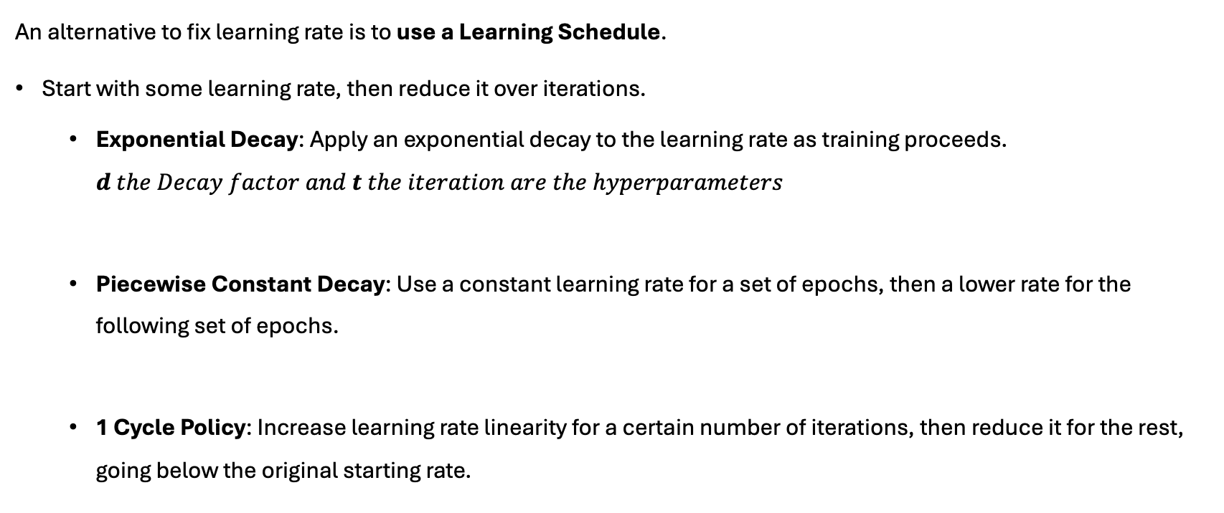

The Learning rate $α$
An alternative to fix learning rate is to use a Learning Schedule.
Start with some learning rate, then reduce it over iterations.
Exponential Decay: Apply an exponential decay to the learning rate as training proceeds. $d the Decay factor and t the iteration are the hyperparameters$
Piecewise Constant Decay: Use a constant learning rate for a set of epochs, then a lower rate for the following set of epochs.
1 Cycle Policy: Increase learning rate linearity for a certain number of iterations, then reduce it for the rest, going below the original starting rate.
$$α_{t}=αe^{−dt}$$
lr
epochs
lr
iterations

Slide 9
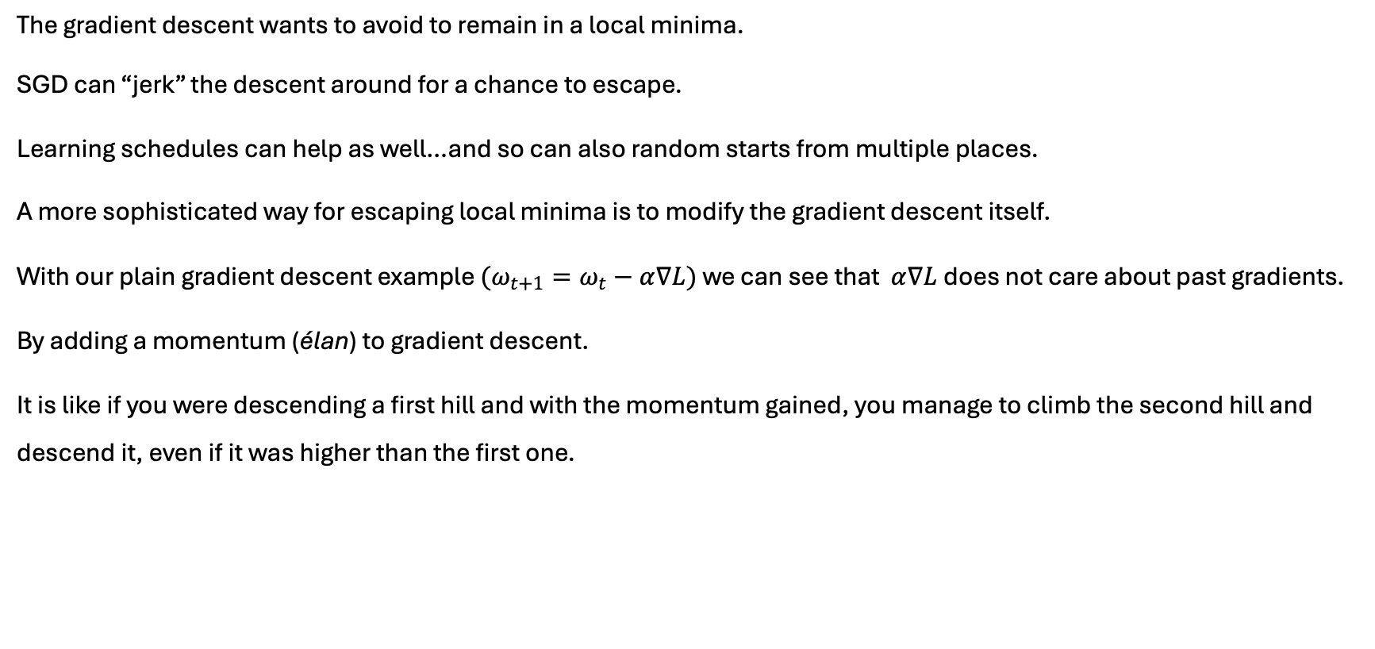
Escaping Local Minima
The gradient descent wants to avoid to remain in a local minima.
SGD can “jerk” the descent around for a chance to escape.
Learning schedules can help as well…and so can also random starts from multiple places.
A more sophisticated way for escaping local minima is to modify the gradient descent itself.
With our plain gradient descent example $(ω_{t+1}=ω_{t}−α∇L)$ we can see that $α∇L$does not care about past gradients.
By adding a momentum (élan) to gradient descent.
It is like if you were descending a first hill and with the momentum gained, you manage to climb the second hill and descend it, even if it was higher than the first one.

Slide 10
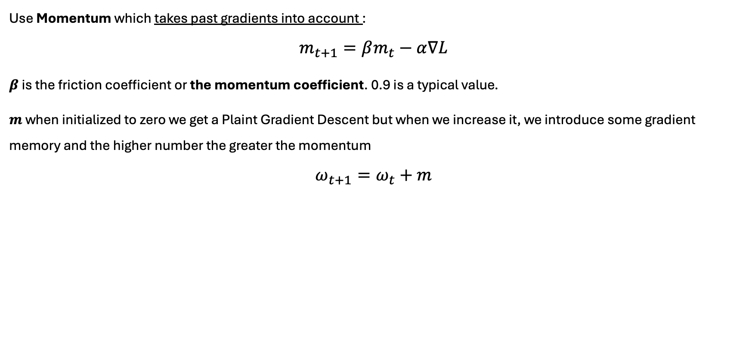
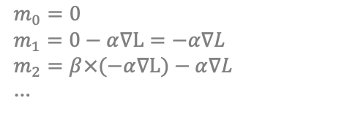
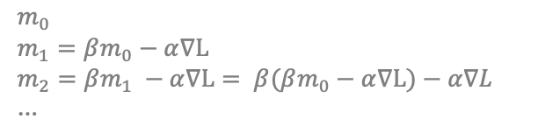
Adding some Momentum
Use Momentum which takes past gradients into account :
$$m_{t+1}=βm_{t}−α∇L$$
$β$ is the friction coefficient or the momentum coefficient. 0.9 is a typical value.
$m$ when initialized to zero we get a Plaint Gradient Descent but when we increase it, we introduce some gradient memory and the higher number the greater the momentum
$$ω_{t+1}=ω_{t}+m$$
$$m_{0}$$
$$m_{1}=βm_{0}−α∇L$$
$$m_{2}=βm_{1} −α∇L= β(βm_{0}−α∇L)−α∇L$$
…
$$m_{0}=0$$
$$m_{1}=0−α∇L=−α∇L$$
$$m_{2}=β×(−α∇L)−α∇L$$
…
Notes:
Momentum en français : "Quantité de mouvement" ou "élan", une technique pour accélérer et stabiliser la convergence en utilisant les gradients passés.
Quantité de mouvement / Élan :
Le Momentum en descente de gradient est une technique qui utilise les gradients passés pour accélérer et stabiliser le processus de convergence.
En ajoutant une fraction des gradients précédents aux gradients actuels, l'algorithme peut continuer à se déplacer dans la même direction, ce qui aide à traverser les ravins et les plateaux de la surface de perte plus efficacement.
Le coefficient beta contrôle la contribution des gradients précédents dans la mise à jour actuelle des poids.

Slide 11
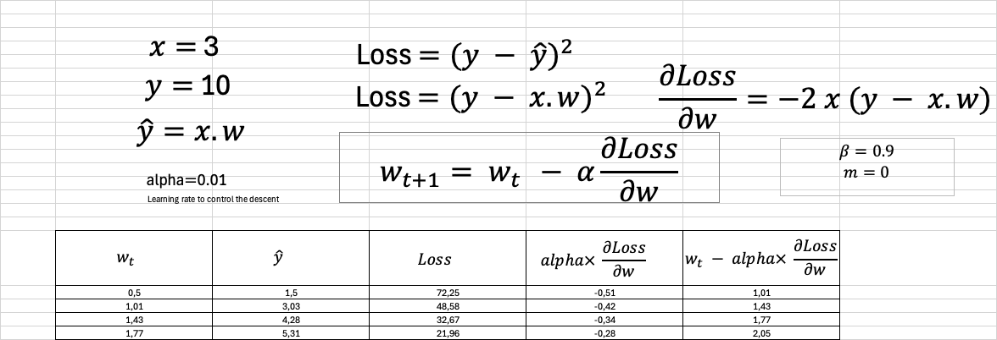
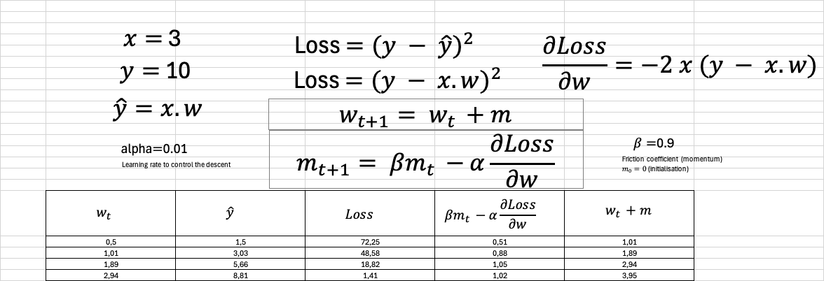
Adding some Momentum
Comparisons Plain Gradient Descent vs Momentum
Plain Gradient Descent
In 4 steps, the Momentum is faster than Plain Gradient descent.
Momentum
Notes:
Momentum en français : "Quantité de mouvement" ou "élan", une technique pour accélérer et stabiliser la convergence en utilisant les gradients passés.
Quantité de mouvement / Élan :
Le Momentum en descente de gradient est une technique qui utilise les gradients passés pour accélérer et stabiliser le processus de convergence.
En ajoutant une fraction des gradients précédents aux gradients actuels, l'algorithme peut continuer à se déplacer dans la même direction, ce qui aide à traverser les ravins et les plateaux de la surface de perte plus efficacement.
Le coefficient beta contrôle la contribution des gradients précédents dans la mise à jour actuelle des poids.

Slide 12
Adding some Momentum
Momentum can also dampen oscillations by averaging out the gradients in all directions.
With a friction coefficient of 0.9, Momentum will average the 10 last gradients reducing the impacts of the individual gradients by smoothing (lissant) them, pushing the gradients along the sides to zero while maintaining an acceleration in the middle This help to stabilize the convergence by reducing the oscillations.
Another way to deal with oscillations is to dampen (atténuer) the larger ones for a given weights this leads to another optimizer called Root Mean Square Propagation (RMSProp).
RMSProp adapts the learning rate for each parameter of the model. RMSProp is in the family of the adaptative optimizer. RMSProp is particularly useful for problems where gradients can vary considerably in magnitude.

Slide 13
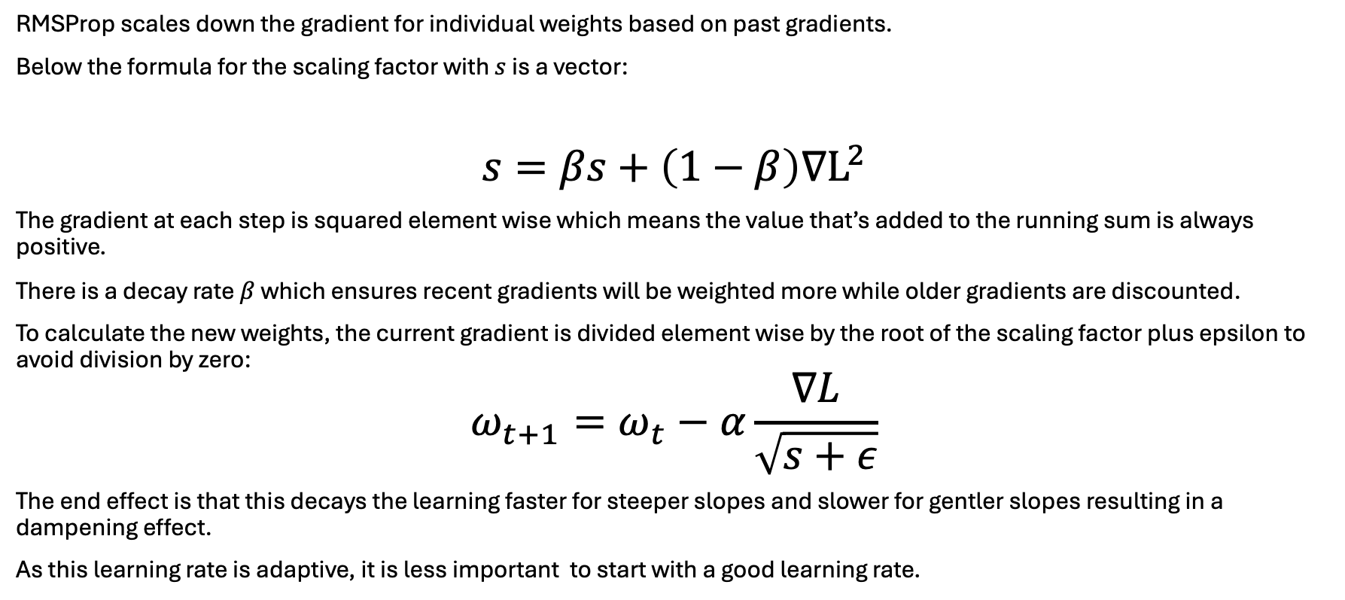

Adaptative optimizer RMSProp
RMSProp scales down the gradient for individual weights based on past gradients.
Below the formula for the scaling factor with $s$ is a vector:
$$s=βs+\left(1−β\right)∇L^{2}$$
The gradient at each step is squared element wise which means the value that’s added to the running sum is always positive.
There is a decay rate $β$ which ensures recent gradients will be weighted more while older gradients are discounted.
To calculate the new weights, the current gradient is divided element wise by the root of the scaling factor plus epsilon to avoid division by zero:
$$ω_{t+1}=ω_{t}−α\frac{∇L}{\sqrt{s+ε}}$$
The end effect is that this decays the learning faster for steeper slopes and slower for gentler slopes resulting in a dampening effect.
As this learning rate is adaptive, it is less important to start with a good learning rate.
$$ε common values are: {[10}^{−7},…,{10}^{−10}]$$
Notes:
decays (décroît)
steeper slopes (pentes raides)
gentler slopes (pentes douces)
dampening effect (effet d’amortissement)

Slide 14
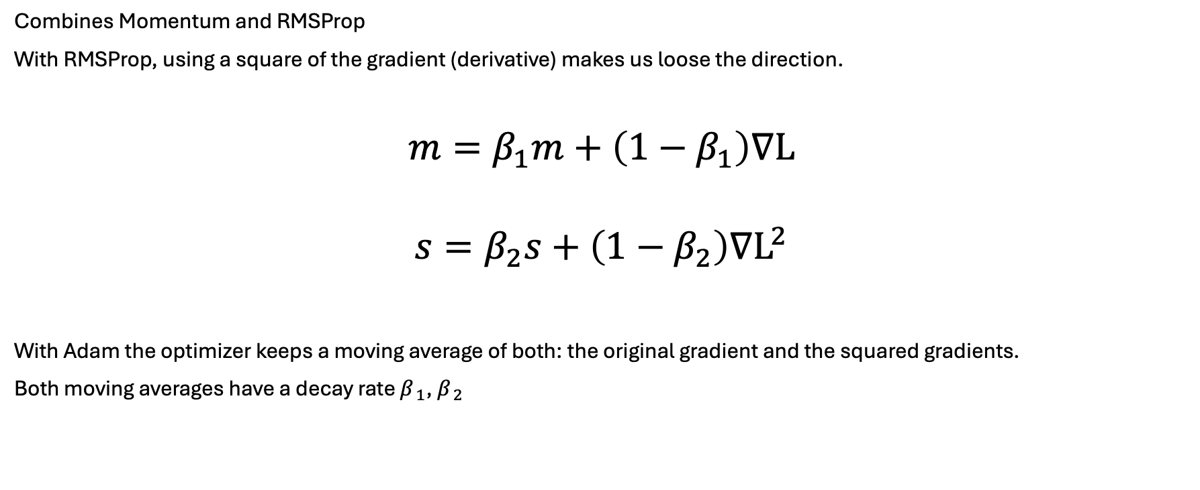
Adaptative Moment Estimation: Adam
Combines Momentum and RMSProp
With RMSProp, using a square of the gradient (derivative) makes us loose the direction.
$$m=β_{1}m+\left(1−β_{1}\right)∇L$$
$$s=β_{2}s+\left(1−β_{2}\right)∇L^{2}$$
With Adam the optimizer keeps a moving average of both: the original gradient and the squared gradients.
Both moving averages have a decay rate $β_{ 1}$, $β_{ 2}$
Notes:
Decay: diminution, réduction, décroissance.
Cela signifie que le taux d'apprentissage diminue plus rapidement pour les pentes plus raides (où les gradients sont plus grands) et plus lentement pour les pentes plus douces (où les gradients sont plus petits).

Slide 15

Adaptative Moment Estimation: Adam
$β_{1}$ is typically set to 0.9 and $β_{2}$ is typically set to 0.999
$$m=β_{1}m+\left(1−β_{1}\right)∇L$$
$$s=β_{2}s+\left(1−β_{2}\right)∇L^{2}$$
The weight update step is then $m$
$$ω_{t+1}=ω_{t}−α\frac{m}{\sqrt{s+ε}}$$
It is an average of average.
Notes:
Decay: diminution, réduction, décroissance.
Cela signifie que le taux d'apprentissage diminue plus rapidement pour les pentes plus raides (où les gradients sont plus grands) et plus lentement pour les pentes plus douces (où les gradients sont plus petits).

Slide 16
Adaptive optimizers
Others adaptive others Nesterov Accelerated Gradient (NAG), Nadam (NAG + Adam), Adamax.
In practice, start with RMSProp or Adam and if it does work move to NAG or Nadam.
In fact, local minima are rarely a problem, with a complex surface, most minima are often “good enough” for generalization.
Notes:
Decay: diminution, réduction, décroissance.
Cela signifie que le taux d'apprentissage diminue plus rapidement pour les pentes plus raides (où les gradients sont plus grands) et plus lentement pour les pentes plus douces (où les gradients sont plus petits).

