Slide 1
Recurrent Neural Networks (RNN)
Notes:
Traitement automatique du language naturel

Slide 2
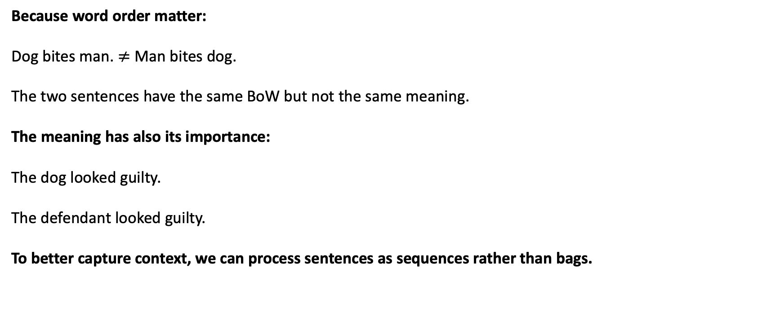
Recurrent Neural Networks
Because word order matter:
Dog bites man. $≠$ Man bites dog.
The two sentences have the same BoW but not the same meaning.
The meaning has also its importance:
The dog looked guilty.
The defendant looked guilty.
To better capture context, we can process sentences as sequences rather than bags.

Slide 3


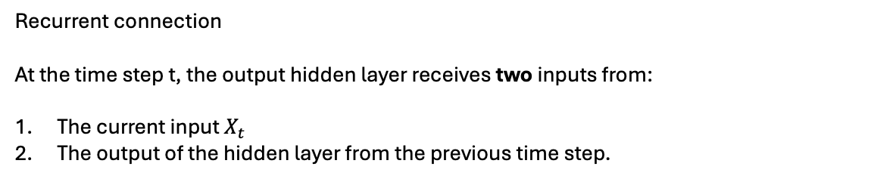





Recurrent Neural Networks
Process sentences as sequences with Recurrent Neural Network.
Simple Recurrent Neural Network
$$y_{t}$$
The target
$$L_{t}$$
The loss (binary cross-entropy, categorical cross entropy…)
$${\hat{y}}_{t}$$
The prediction
Activation function (sigmoid, softmax…)
$$o_{t}$$
The output layer
Recurrent connection
At the time step t, the output hidden layer receives two inputs from:
The current input $X_{t}$
The output of the hidden layer from the previous time step.
$$h_{t−1}$$
$$h_{t}$$
The hidden layer
$${ X}_{t}$$
Notes:
Ambiguity (Ambiguïté)
Phrase exemple : "I saw the banker with the telescope."
Explication : This sentence is ambiguous because it can mean either that the banker is using a telescope or that the speaker saw the banker using a telescope.
Polysemy (Polysémie)
Phrase exemple : "The bank robbery was quick."
Explication : The word "bank" can mean either a financial institution or the side of a river.
Homonymy (Homonymie)
Phrase exemple : "The bass was too loud."
Explication : The word "bass" can refer to either a type of fish or a low-frequency sound.
Synonymy (Synonymie)
Phrase exemple : "The cat is on the couch."
Explication : The word "couch" can be replaced with "sofa" without changing the meaning of the sentence, but an NLP model must understand that these words are synonyms.
Context Dependency (Dépendance au contexte)
Phrase exemple : "I am going to the bank."
Explication : The word "bank" can mean either a financial institution or the side of a river, depending on the context.
Idioms (Expressions idiomatiques)
Phrase exemple : "It's raining cats and dogs."
Explication : This idiomatic expression means it is raining heavily, but literally, it makes no sense.
Sarcasm (Sarcasme)
Phrase exemple : "Oh great, it's raining again."
Explication : Sarcasm is difficult for NLP models to detect because it relies on tone and context, which are not always obvious in written text.
Negation (Négation)
Phrase exemple : "I did not say I would come."
Explication : Negation can reverse the meaning of a sentence, which can be challenging for an NLP model to interpret correctly.
Coreference Resolution (Résolution de coréférence)
Phrase exemple : "Mary said she would come."
Explication : The pronoun "she" refers to "Mary," and an NLP model must understand this coreference to interpret the sentence correctly.
Named Entity Recognition (Reconnaissance d'entités nommées)
Phrase exemple : "Paris is the capital of France."
Explication : An NLP model must identify "Paris" as a city and "France" as a country, which can be challenging due to the variability of proper names.

Slide 4
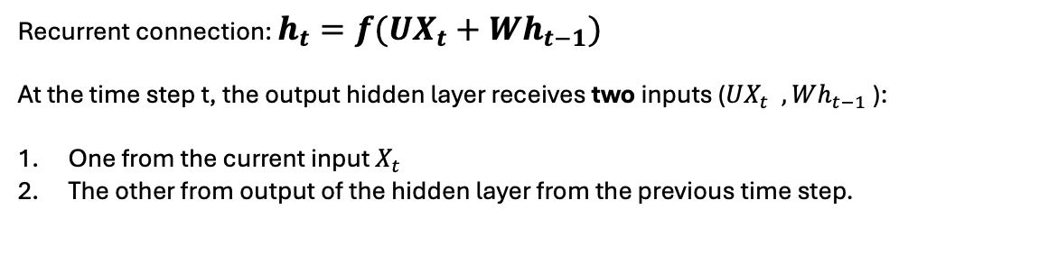
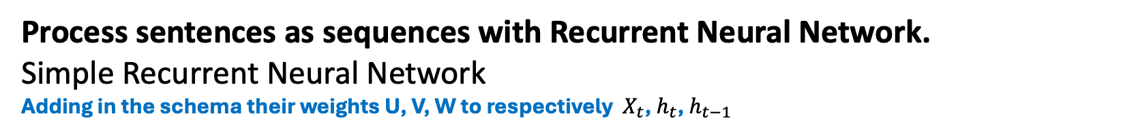

Recurrent Neural Networks
Process sentences as sequences with Recurrent Neural Network.
Simple Recurrent Neural Network
Adding in the schema their weights U, V, W to respectively ${ X}_{t}$, $h_{t}$, $h_{t−1}$
$$y_{t}$$
The target
$$L_{t}$$
The loss (binary cross-entropy, categorical cross entropy…)
$${\hat{y}}_{t}$$
The prediction ${\hat{y}}_{t}={g(o}_{t})=g\left(Vh_{t}\right)$
($g$the activation function could be a sigmoid, a softmax…)
$$o_{t}$$
The output layer
V
Recurrent connection: $h_{t}={f(UX}_{t}+Wh_{t−1})$
At the time step t, the output hidden layer receives two inputs (${UX}_{t} , Wh_{t−1}$):
One from the current input $X_{t}$
The other from output of the hidden layer from the previous time step.
W
$$h_{t}$$
$$h_{t−1}$$
The hidden layer
U
$${ X}_{t}$$
Note: for simplification, the bias are not mentioned here
Notes:
Ambiguity (Ambiguïté)
Phrase exemple : "I saw the banker with the telescope."
Explication : This sentence is ambiguous because it can mean either that the banker is using a telescope or that the speaker saw the banker using a telescope.
Polysemy (Polysémie)
Phrase exemple : "The bank robbery was quick."
Explication : The word "bank" can mean either a financial institution or the side of a river.
Homonymy (Homonymie)
Phrase exemple : "The bass was too loud."
Explication : The word "bass" can refer to either a type of fish or a low-frequency sound.
Synonymy (Synonymie)
Phrase exemple : "The cat is on the couch."
Explication : The word "couch" can be replaced with "sofa" without changing the meaning of the sentence, but an NLP model must understand that these words are synonyms.
Context Dependency (Dépendance au contexte)
Phrase exemple : "I am going to the bank."
Explication : The word "bank" can mean either a financial institution or the side of a river, depending on the context.
Idioms (Expressions idiomatiques)
Phrase exemple : "It's raining cats and dogs."
Explication : This idiomatic expression means it is raining heavily, but literally, it makes no sense.
Sarcasm (Sarcasme)
Phrase exemple : "Oh great, it's raining again."
Explication : Sarcasm is difficult for NLP models to detect because it relies on tone and context, which are not always obvious in written text.
Negation (Négation)
Phrase exemple : "I did not say I would come."
Explication : Negation can reverse the meaning of a sentence, which can be challenging for an NLP model to interpret correctly.
Coreference Resolution (Résolution de coréférence)
Phrase exemple : "Mary said she would come."
Explication : The pronoun "she" refers to "Mary," and an NLP model must understand this coreference to interpret the sentence correctly.
Named Entity Recognition (Reconnaissance d'entités nommées)
Phrase exemple : "Paris is the capital of France."
Explication : An NLP model must identify "Paris" as a city and "France" as a country, which can be challenging due to the variability of proper names.

Slide 5











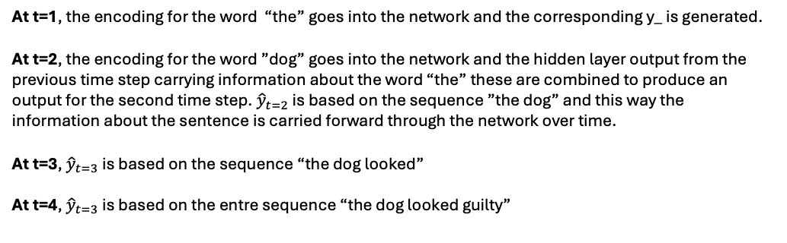
Recurrent Neural Networks
Process sentences as sequences with Recurrent Neural Network.
Example sentence: “The dog looked guilty”
RNN at different time step
Generated from ”The dog”
The RNN algorithm
$${\hat{y}}_{t=1}$$
$${\hat{y}}_{t=2}$$
$${\hat{y}}_{t=3}$$
$${\hat{y}}_{t=4}$$
At t=1, the encoding for the word “the” goes into the network and the corresponding y_ is generated.
At t=2, the encoding for the word ”dog” goes into the network and the hidden layer output from the previous time step carrying information about the word “the” these are combined to produce an output for the second time step. ${\hat{y}}_{t=2}$ is based on the sequence ”the dog” and this way the information about the sentence is carried forward through the network over time.
At t=3, ${\hat{y}}_{t=3}$ is based on the sequence “the dog looked”
At t=4, ${\hat{y}}_{t=3}$ is based on the entre sequence “the dog looked guilty”
$$h_{t=1}$$
$$h_{t=2}$$
$$h_{t=3}$$
$$X_{t=1}$$
$$X_{t=2}$$
$$X_{t=3}$$
$$X_{t=4}$$
At each time step, the network creates a representation of the sequence up to that point and through this recurrent mechanism the network as some sense of memory
“The”
[0.00154, 0.58..]
“dog”
[0.0445, 0.078..]
“looked”
[0.0021, 0.008..]
“guilty”
[0.1821, 0.082..]

Slide 6
Recurrent Neural Networks
Process sentences as sequences with Recurrent Neural Network.
Example sentence: “The dog looked guilty”
RNN at different time step
Generated from ”The dog”
The RNN algorithm
$${\hat{y}}_{t=1}$$
$${\hat{y}}_{t=2}$$
$${\hat{y}}_{t=3}$$
$${\hat{y}}_{t=4}$$
At t=1, the encoding for the word “the” goes into the network and the corresponding y_ is generated.
At t=2, the encoding for the word ”dog” goes into the network and the hidden layer output from the previous time step carrying information about the word “the” these are combined to produce an output for the second time step. ${\hat{y}}_{t=2}$ is based on the sequence ”the dog” and this way the information about the sentence is carried forward through the network over time.
At t=3, ${\hat{y}}_{t=3}$ is based on the sequence “the dog looked”
At t=4, ${\hat{y}}_{t=3}$ is based on the entre sequence “the dog looked guilty”
V
V
V
V
$$h_{t=1}$$
$$h_{t=2}$$
$$h_{t=3}$$
W
W
W
U
U
U
U
$$X_{t=1}$$
$$X_{t=2}$$
$$X_{t=3}$$
$$X_{t=4}$$
At each time step, the network creates a representation of the sequence up to that point and through this recurrent mechanism the network as some sense of memory
“The”
[0.00154, 0.58..]
“dog”
[0.0445, 0.078..]
“looked”
[0.0021, 0.008..]
“guilty”
[0.1821, 0.082..]

Slide 7










Recurrent Neural Networks
RNN schema for Sequence Labelling
Example Part-of-Speech (POS) tagging with the sentence: “The dog looked guilty”
Each output is labelled
Generated from ”The dog”
$${\hat{y}}_{t=1}=DET$$
$${\hat{y}}_{t=2}=NOUN$$
$${\hat{y}}_{t=3}=VERB$$
$${\hat{y}}_{t=4}=ADJ$$
At each time step, each output must be known
$$g=softmax$$
$$g=softmax$$
$$g=softmax$$
$$g=softmax$$
$$h_{t=1}$$
$$h_{t=2}$$
$$h_{t=3}$$
$$X_{t=1}$$
$$X_{t=2}$$
$$X_{t=3}$$
$$X_{t=4}$$
“The”
[0.00154, 0.58..]
“dog”
[0.0445, 0.078..]
“looked”
[0.0021, 0.008..]
“guilty”
[0.1821, 0.082..]
Note: Same schema for Name Entity Recognition (NER) classification

Slide 8
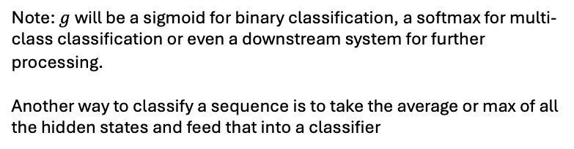

Recurrent Neural Networks
RNN schema for Sequence Classification
Example with the sentence: “The dog looked guilty”
Only the last input is labelled
The intermediates outputs are ignored, and we only use the final output considered as the embedding for the whole sequence
$${\hat{y}}_{t=4}$$
$$g=sigmoid$$
$$h_{t=1}$$
$$h_{t=2}$$
$$h_{t=3}$$
Note: $g$will be a sigmoid for binary classification, a softmax for multi-class classification or even a downstream system for further processing.
Another way to classify a sequence is to take the average or max of all the hidden states and feed that into a classifier
$$X_{t=1}$$
$$X_{t=2}$$
$$X_{t=3}$$
$$X_{t=4}$$
“The”
[0.00154, 0.58..]
“dog”
[0.0445, 0.078..]
“looked”
[0.0021, 0.008..]
“guilty”
[0.1821, 0.082..]

Slide 9











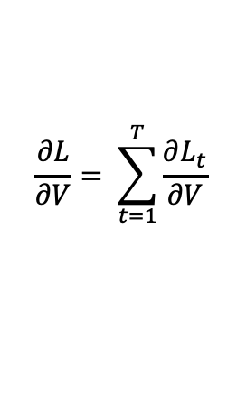





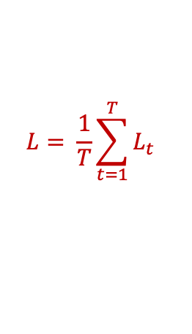










Recurrent Neural Networks
Backpropagation Through Time (BPTT)
Example with a sequence labelling such as POS tagging with the sentence: “The dog looked guilty”
All the inputs are labelled
$$y_{t=1}$$
$$y_{t=2}$$
$$y_{t=3}$$
$$y_{t=4}$$
$$L= \frac{1}{T}\sum_{t=1}^{T}{L_{t}}$$
$$L_{t=1}$$
$$+$$
$$L_{t=2}$$
$$+$$
$$L_{t=3}$$
$$+$$
$$L_{t=4}$$
$$⟹$$
Loss for the whole sequence with T the number of time steps and CCE for Categorical Cross Entropy
$$Loss at t=1$$
$${\hat{y}}_{t=1}$$
$${\hat{y}}_{t=2}$$
$${\hat{y}}_{t=3}$$
$${\hat{y}}_{t=4}$$
$$o_{t=1}$$
$$o_{t=2}$$
$$o_{t=3}$$
$$o_{t=4}$$
$$\frac{∂L}{∂V}= \sum_{t=1}^{T}{\frac{∂L_{t}}{∂V}}$$
V
V
V
V
$$0$$
$$0$$
$$0$$
$$0$$
$$h_{t=0}$$
$$h_{t=1}$$
$$h_{t=1}$$
$$h_{t=2}$$
$$h_{t=2}$$
$$h_{t=3}$$
$$h_{t=3}$$
$$h_{t=4}$$
W
W
W
U
U
U
U
$$X_{t=1}$$
$$X_{t=2}$$
$$X_{t=3}$$
$$X_{t=4}$$
“The”
[0.00154, 0.58..]
“dog”
[0.0445, 0.078..]
“looked”
[0.0021, 0.008..]
“guilty”
[0.1821, 0.082..]

Slide 10

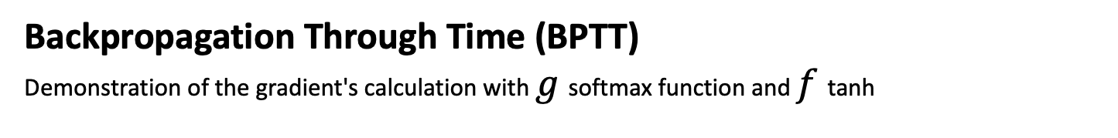





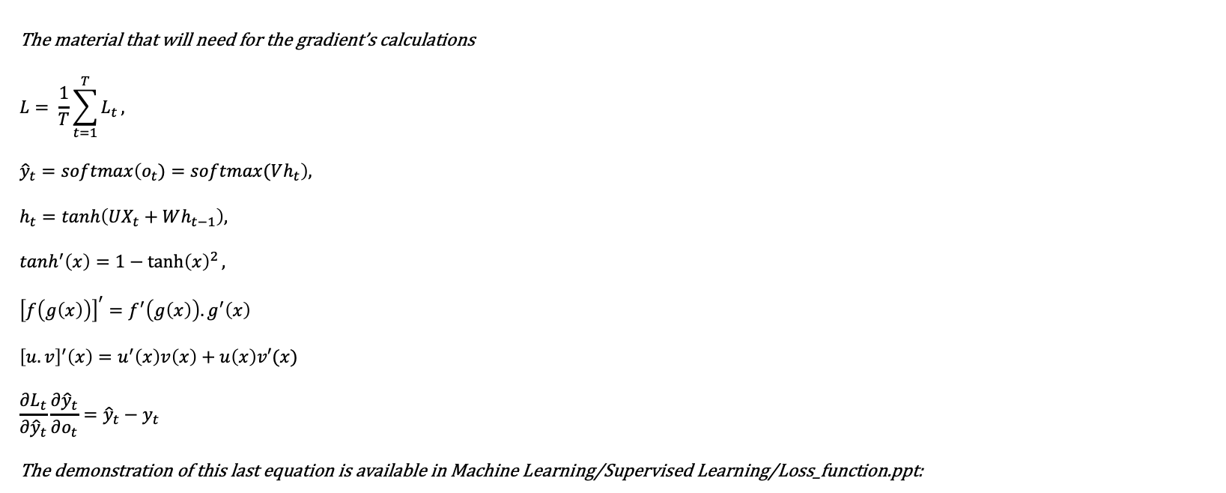

Recurrent Neural Networks
Backpropagation Through Time (BPTT)
Demonstration of the gradient's calculation with $g$ softmax function and $f$ tanh
$$y_{t}$$
The material that will need for the gradient’s calculations
$$L= \frac{1}{T}\sum_{t=1}^{T}{L_{t}},$$
$${\hat{y}}_{t}=softmax\left(o_{t})=softmax(Vh_{t}\right),$$
$$h_{t}=tanh\left(UX_{t}+Wh_{t−1}\right),$$
$$tanh^{′}\left(x\right)=1−{\tanh\left(x\right)}^{2},$$
$${\left[f\left(g\left(x\right)\right)\right]}^{′}=f^{′}\left(g\left(x\right)\right).g^{′}\left(x\right)$$
$${\left[u.v\right]}^{′}\left(x\right)=u^{′}\left(x\right)v\left(x\right)+u\left(x\right)v′(x)$$
$$\frac{∂L_{t}}{∂{\hat{y}}_{t}}\frac{∂{\hat{y}}_{t}}{∂o_{t}}={\hat{y}}_{t}−y_{t}$$
The demonstration of this last equation is available in Machine Learning/Supervised Learning/Loss_function.ppt:
$$L_{t}$$
$${\hat{y}}_{t}$$
$$o_{t}$$
V
$$h_{t−1}$$
$$h_{t}$$
W
U
$$X_{t}$$

Slide 11
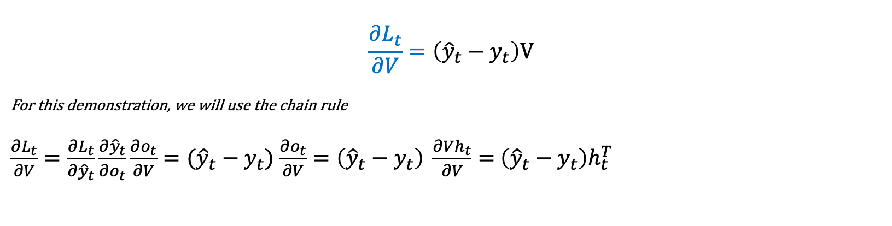
Recurrent Neural Networks
Backpropagation Through Time (BPTT)
Demonstration of the gradient's calculation with $g$ softmax function and $f$ tanh
$$\frac{∂L_{t}}{∂V}=\left({\hat{y}}_{t}−y_{t}\right)\text{V}$$
For this demonstration, we will use the chain rule
$\frac{∂L_{t}}{∂V}=\frac{∂L_{t}}{∂{\hat{y}}_{t}}\frac{∂{\hat{y}}_{t}}{∂o_{t}}\frac{∂o_{t}}{∂V}=({\hat{y}}_{t}−y_{t})$ $\frac{∂o_{t}}{∂V}=\left({\hat{y}}_{t}−y_{t}\right) \frac{∂Vh_{t}}{∂V}=$ $\left({\hat{y}}_{t}−y_{t}\right)h_{t}^{T}$
$$y_{t}$$
$$L_{t}$$
$${\hat{y}}_{t}$$
$$o_{t}$$
V
$$h_{t−1}$$
$$h_{t}$$
W
U
$$X_{t}$$

Slide 12
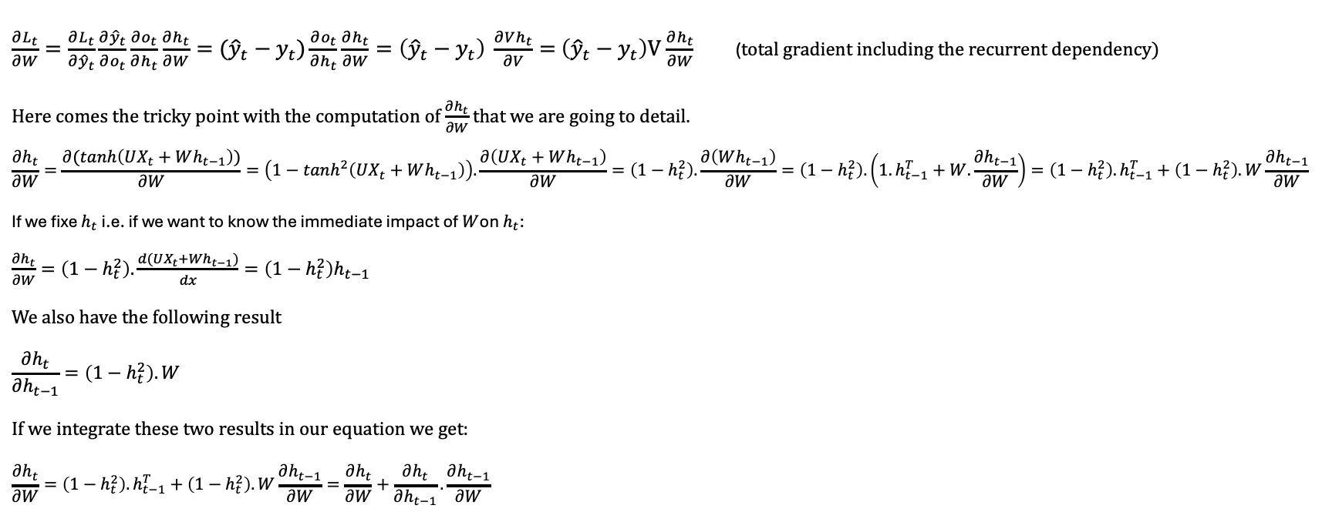
Recurrent Neural Networks
Backpropagation Through Time (BPTT)
Demonstration of the gradient's calculation with $g$ softmax function and $f$ tanh
$\frac{∂L_{t}}{∂W}=\frac{∂L_{t}}{∂{\hat{y}}_{t}}\frac{∂{\hat{y}}_{t}}{∂o_{t}}\frac{∂o_{t}}{∂h_{t}}\frac{∂h_{t}}{∂W}=({\hat{y}}_{t}−y_{t})\frac{∂o_{t}}{∂h_{t}}\frac{∂h_{t}}{∂W}=\left({\hat{y}}_{t}−y_{t}\right) \frac{∂Vh_{t}}{∂V}=$ $\left({\hat{y}}_{t}−y_{t}\right)\text{V}$ $\frac{∂h_{t}}{∂W}$ (total gradient including the recurrent dependency)
Here comes the tricky point with the computation of $\frac{∂h_{t}}{∂W}$ that we are going to detail.
$$\frac{∂h_{t}}{∂W}=\frac{∂(tanh\left(UX_{t}+Wh_{t−1}\right))}{∂W}=\left(1−tanh^{2}\left(UX_{t}+Wh_{t−1}\right)\right).\frac{∂\left(UX_{t}+Wh_{t−1}\right)}{∂W}=\left(1−h_{t}^{2}\right).\frac{∂\left(Wh_{t−1}\right)}{∂W}=\left(1−h_{t}^{2}\right).\left({1.h}_{t−1}^{T}+W.\frac{∂h_{t−1}}{∂W}\right)=\left(1−h_{t}^{2}\right).h_{t−1}^{T}+\left(1−h_{t}^{2}\right).W\frac{∂h_{t−1}}{∂W}$$
If we fixe $h_{t}$i.e. if we want to know the immediate impact of $W$on $h_{t}$:
$\frac{∂h_{t}}{∂W}=\left(1−h_{t}^{2}\right).\frac{d(UX_{t}+Wh_{t−1})}{dx}=\left(1−h_{t}^{2}\right)h_{t−1}$
We also have the following result
$$\frac{∂h_{t}}{∂h_{t−1}}=\left(1−h_{t}^{2}\right).W$$
If we integrate these two results in our equation we get:
$$\frac{∂h_{t}}{∂W}=\left(1−h_{t}^{2}\right).h_{t−1}^{T}+\left(1−h_{t}^{2}\right).W\frac{∂h_{t−1}}{∂W}=\frac{∂h_{t}}{∂W}+\frac{∂h_{t}}{∂h_{t−1}}.\frac{∂h_{t−1}}{∂W}$$
$$y_{t}$$
$$L_{t}$$
$${\hat{y}}_{t}$$
$$o_{t}$$
V
$$h_{t−1}$$
$$h_{t}$$
W
U
$$X_{t}$$

Slide 13
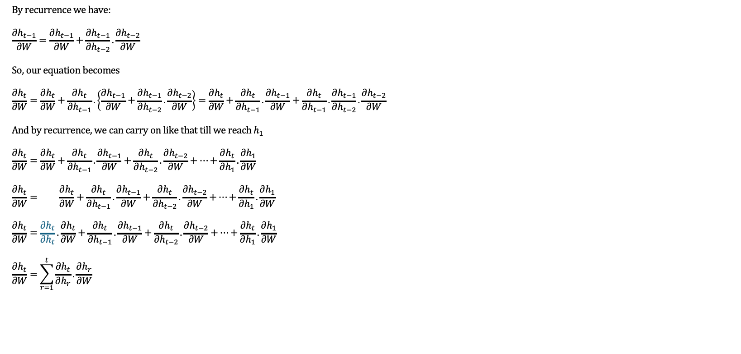
Recurrent Neural Networks
Backpropagation Through Time (BPTT)
Demonstration of the gradient's calculation with $g$ softmax function and $f$ tanh
By recurrence we have:
$$\frac{∂h_{t−1}}{∂W}=\frac{∂h_{t−1}}{∂W}+\frac{∂h_{t−1}}{∂h_{t−2}}.\frac{∂h_{t−2}}{∂W}$$
So, our equation becomes
$$\frac{∂h_{t}}{∂W}=\frac{∂h_{t}}{∂W}+\frac{∂h_{t}}{∂h_{t−1}}.\left\{\frac{∂h_{t−1}}{∂W}+\frac{∂h_{t−1}}{∂h_{t−2}}.\frac{∂h_{t−2}}{∂W}\right\}=\frac{∂h_{t}}{∂W}+\frac{∂h_{t}}{∂h_{t−1}}.\frac{∂h_{t−1}}{∂W}+\frac{∂h_{t}}{∂h_{t−1}}.\frac{∂h_{t−1}}{∂h_{t−2}}.\frac{∂h_{t−2}}{∂W}$$
And by recurrence, we can carry on like that till we reach $h_{1}$
$$\frac{∂h_{t}}{∂W}=\frac{∂h_{t}}{∂W}+\frac{∂h_{t}}{∂h_{t−1}}.\frac{∂h_{t−1}}{∂W}+\frac{∂h_{t}}{∂h_{t−2}}.\frac{∂h_{t−2}}{∂W}+…+\frac{∂h_{t}}{∂h_{1}}.\frac{∂h_{1}}{∂W}$$
$$\frac{∂h_{t}}{∂W}= \frac{∂h_{t}}{∂W}+\frac{∂h_{t}}{∂h_{t−1}}.\frac{∂h_{t−1}}{∂W}+\frac{∂h_{t}}{∂h_{t−2}}.\frac{∂h_{t−2}}{∂W}+…+\frac{∂h_{t}}{∂h_{1}}.\frac{∂h_{1}}{∂W}$$
$$\frac{∂h_{t}}{∂W}=\frac{∂h_{t}}{∂h_{t}}.\frac{∂h_{t}}{∂W}+\frac{∂h_{t}}{∂h_{t−1}}.\frac{∂h_{t−1}}{∂W}+\frac{∂h_{t}}{∂h_{t−2}}.\frac{∂h_{t−2}}{∂W}+…+\frac{∂h_{t}}{∂h_{1}}.\frac{∂h_{1}}{∂W}$$
$$\frac{∂h_{t}}{∂W}=\sum_{r=1}^{t}{\frac{∂h_{t}}{∂h_{r}}.\frac{∂h_{r}}{∂W}}$$
$$y_{t}$$
$$L_{t}$$
$${\hat{y}}_{t}$$
$$o_{t}$$
V
$$h_{t−1}$$
$$h_{t}$$
W
U
$$X_{t}$$

Slide 14
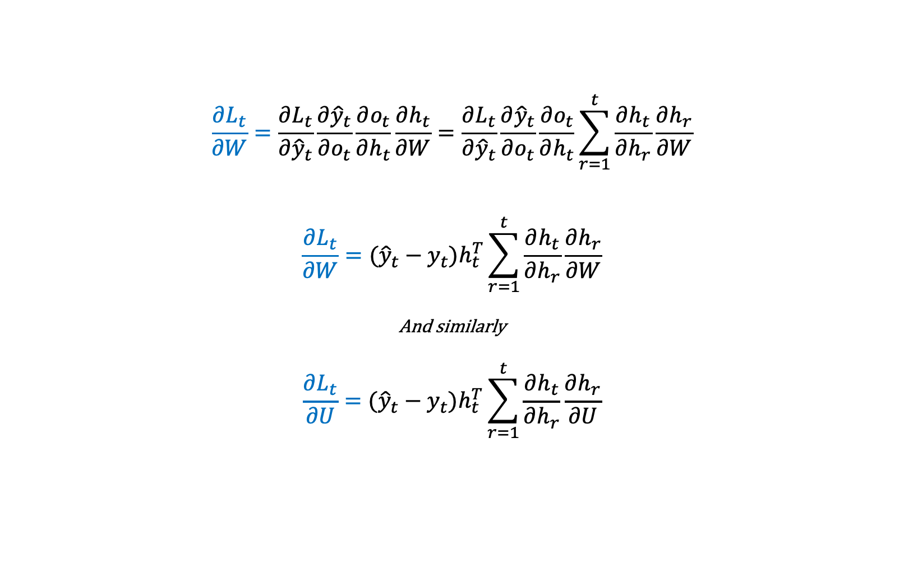
Recurrent Neural Networks
Backpropagation Through Time (BPTT)
Demonstration of the gradient's calculation with $g$ softmax function and $f$ tanh
$$\frac{∂L_{t}}{∂W}=\frac{∂L_{t}}{∂{\hat{y}}_{t}}\frac{∂{\hat{y}}_{t}}{∂o_{t}}\frac{∂o_{t}}{∂h_{t}}\frac{∂h_{t}}{∂W}=\frac{∂L_{t}}{∂{\hat{y}}_{t}}\frac{∂{\hat{y}}_{t}}{∂o_{t}}\frac{∂o_{t}}{∂h_{t}}\sum_{r=1}^{t}{\frac{∂h_{t}}{∂h_{r}}\frac{∂h_{r}}{∂W}}$$
$$\frac{∂L_{t}}{∂W}=({\hat{y}}_{t}−y_{t})h_{t}^{T}\sum_{r=1}^{t}{\frac{∂h_{t}}{∂h_{r}}\frac{∂h_{r}}{∂W}}$$
And similarly
$$\frac{∂L_{t}}{∂U}=({\hat{y}}_{t}−y_{t})h_{t}^{T}\sum_{r=1}^{t}{\frac{∂h_{t}}{∂h_{r}}\frac{∂h_{r}}{∂U}}$$
$$y_{t}$$
$$L_{t}$$
$${\hat{y}}_{t}$$
$$o_{t}$$
V
$$h_{t−1}$$
$$h_{t}$$
W
U
$$X_{t}$$

Slide 15






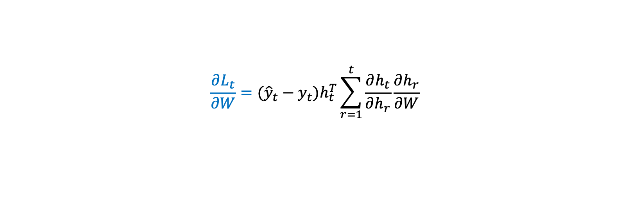

Recurrent Neural Networks
Backpropagation Through Time (BPTT)
Demonstration of the gradient's calculation with $g$ softmax function and $f$ tanh
$$\frac{∂L_{t}}{∂W}=({\hat{y}}_{t}−y_{t})h_{t}^{T}\sum_{r=1}^{t}{\frac{∂h_{t}}{∂h_{r}}\frac{∂h_{r}}{∂W}}$$
$$y_{t}$$
$$L_{t}$$
$${\hat{y}}_{t}$$
$$o_{t}$$
V
$$h_{t−1}$$
$$h_{t}$$
Direct impact of W
Recurrent term which shows that dependency accumulates through the time steps
W
U
$$X_{t}$$
In Backpropagation Through Time, gradients accumulate themselves through the time steps.
In other words, the gradients propagate backward through time – this is the principle of BPTT

Slide 16


Recurrent Neural Networks (RNN)
Benefits
 | RNN | Hidden Markov Models | Plain Feedforward NN
Model sequential information
Handle variable length inputs
Takes entire sequence into account

Slide 17


















Recurrent Neural Networks (RNN)
Stacked (Multilayers) RNNs
Build network which can learn patterns maybe too complex for single RNN
$${\hat{y}}_{t=1}$$
$${\hat{y}}_{t=2}$$
$${\hat{y}}_{t=3}$$
$${\hat{y}}_{t=4}$$
$$h_{t=0}^{(2)}$$
$$h_{t=1}^{(2)}$$
$$h_{t=2}^{(2)}$$
$$h_{t=3}^{(2)}$$
$$h_{t=4}^{(2)}$$
$$h_{t=0}^{(1)}$$
$$h_{t=1}^{(1)}$$
$$h_{t=2}^{(1)}$$
$$h_{t=3}^{(1)}$$
$$h_{t=4}^{(1)}$$
$$X_{t=1}$$
$$X_{t=2}$$
$$X_{t=3}$$
$$X_{t=4}$$
Notes:
(+) Stacked RNNs have great success in neural machine translation.
(-) Training time increases quickly.

Slide 18
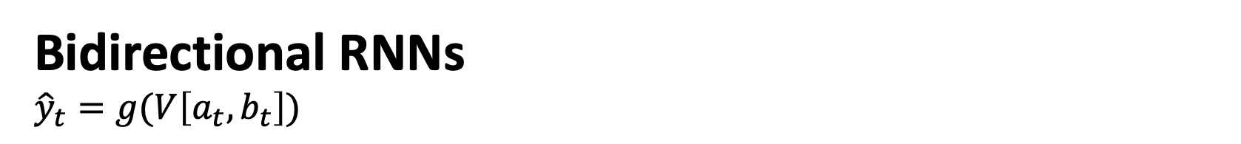





Recurrent Neural Networks (RNN)
Bidirectional RNNs
$${\hat{y}}_{t}=g(V\left[a_{t}, b_{t}\right])$$
$${\hat{y}}_{t=1}$$
$${\hat{y}}_{t=2}$$
$${\hat{y}}_{t=3}$$
$${\hat{y}}_{t=4}$$
$$X_{t=1}$$
$$X_{t=2}$$
$$X_{t=3}$$
$$X_{t=4}$$
Notes:
(+) Part-Of Speech tagging.
(-)

Slide 19























Recurrent Neural Networks (RNN)
Different RNN Setups
many-to-one
(classification)
$${\hat{y}}_{t=1}$$
$${\hat{y}}_{t=1}$$
$${\hat{y}}_{t=1}$$
$${\hat{y}}_{t=2}$$
$${\hat{y}}_{t=3}$$
$${\hat{y}}_{t=4}$$
$$X_{t=1}$$
one-to-one
(plain NN)
$$X_{t=1}$$
$$X_{t=2}$$
$$X_{t=3}$$
$$X_{t=4}$$
$$X_{t=1}$$
one-to-many
(captioning, decoders)
$${\hat{y}}_{t=1}$$
$${\hat{y}}_{t=2}$$
$${\hat{y}}_{t=3}$$
$${\hat{y}}_{t=4}$$
$${\hat{y}}_{t=1}$$
$${\hat{y}}_{t=1}$$
$$X_{t=1}$$
$$X_{t=2}$$
$$X_{t=3}$$
$$X_{t=4}$$
$$X_{t=1}$$
$$X_{t=2}$$
many-to-many
(sequence labelling, language models
many-to-many (variable)
(sequence-to-sequence for translation, summarization, Q&A, etc)
Notes:
One-to-one: image classification
One to many: image captioning
Many to one: sentimement classification
Many to many: machine translation, video classification.

Slide 20
Recurrent Neural Networks (RNN)
Pros and Cons
advantages | drawbacks
Possibility of processing input of any length Model size not increasing with size of input Computation takes into account historical information Weights are shared across time | Computation being slow Difficulty of accessing information from a long time ago Cannot consider any future input for the current state
Source: Python engineer
Notes:
One-to-one: image classification
One to many: image captioning
Many to one: sentimement classification
Many to many: machine translation, video classification.

