Slide 1
Sequence to Sequence (Seq2Seq)
Notes:
Traitement automatique du language naturel

Slide 2
























Seq2Seq
Attending to What’s Important
many-to-one
(classification)
$${\hat{y}}_{t=1}$$
$${\hat{y}}_{t=1}$$
$${\hat{y}}_{t=1}$$
$${\hat{y}}_{t=2}$$
$${\hat{y}}_{t=3}$$
$${\hat{y}}_{t=4}$$
$$X_{t=1}$$
$$X_{t=1}$$
$$X_{t=2}$$
$$X_{t=3}$$
$$X_{t=4}$$
$$X_{t=1}$$
one-to-many
(captioning, decoders)
one-to-one
(plain NN)
$${\hat{y}}_{t=1}$$
$${\hat{y}}_{t=2}$$
$${\hat{y}}_{t=3}$$
$${\hat{y}}_{t=4}$$
$${\hat{y}}_{t=1}$$
$${\hat{y}}_{t=2}$$
$${\hat{y}}_{t=3}$$
$$X_{t=1}$$
$$X_{t=2}$$
$$X_{t=3}$$
$$X_{t=4}$$
$$X_{t=1}$$
$$X_{t=2}$$
many-to-many
(sequence labelling, language models
many-to-many (variable)
(sequence-to-sequence for translation, summarization, Q&A, etc)

Slide 3





Seq2Seq
Seq2Seq Consists of Two Sub models
Target / Output Sequence
$${\hat{y}}_{t=1}$$
$${\hat{y}}_{t=2}$$
$${\hat{y}}_{t=3}$$
$$X_{t=1}$$
$$X_{t=2}$$
Decoder
Source / Input Sequence
Encoder
many-to-many (variable)
(sequence-to-sequence for translation, summarization, Q&A, etc)

Slide 4
Seq2Seq
Seq2Seq Consists of Two Sub models
Target / Output Sequence
$${\hat{y}}_{t=1}$$
$${\hat{y}}_{t=2}$$
$${\hat{y}}_{t=3}$$
$$X_{t=1}$$
$$X_{t=2}$$
Decoder
Source / Input Sequence
Encoder
Can be LSTMs, Stacked GRUs, Transformers…

Slide 5







Seq2Seq
Neural Machine Translation (NMT)
English => Hungarian
Take the most probable word.
Decoder
Target / Output Sequence
The change here compared to RNN seen before is that at the first step the decoder is fed with the encoding of the source sentence rather than with the 0 vector.
$lemeur$ült
$$az$$
$$akkumulàtor$$
$$\text{<}\text{end}\text{>}$$
$$The$$
$$battery$$
$$is$$
$$dead$$
<start>
$lemeur$ült
$$az$$
$$akkumulàtor$$
[0.00154, 0.58..]
[0.0445, 0.078..]
[0.0021, 0.008..]
[0.1821, 0.082..]
[0.0704, 0.18..]
[0.0636, 0.55..]
[0.0114, 0.06..]
[0.0012, 0.035..]
Some type of RNN
Conditional Language Model
(output is conditioned on encoding)
Encoder
Final hidden state from the encoder RNN can be viewed as a “thought” vector or an embedding of the source sentence.

Slide 6



Seq2Seq
Neural Machine Translation (NMT)
The decoder is trained to produce the correct target sentence given in encoding.
The encoder is trained to produce a better encoding to help the decoder.
And the word embeddings are trained as well if they’re set up to do so.
$lemeur$ült
$$az$$
$$akkumulàtor$$
$$\text{<}\text{end}\text{>}$$
$$The$$
$$battery$$
$$is$$
$$dead$$
<start>
$lemeur$ült
$$az$$
$$akkumulàtor$$
[0.00154, 0.58..]
[0.0445, 0.078..]
[0.0021, 0.008..]
[0.1821, 0.082..]
[0.0704, 0.18..]
[0.0636, 0.55..]
[0.0114, 0.06..]
[0.0012, 0.035..]
Some type of RNN
Conditional Language Model
(output is conditioned on encoding)
Trained end-to-end as a single system

Slide 7
Seq2Seq
Neural Machine Translation (NMT) Challenges
1. Alignments
many-to-one
one-to-many
“The battery is dead”
“Memerült az akkumulàtor”
“He got away with cheating at the exam.”
“Megùszta a puskàzàst a vizsgàn.”
“She is fluent in English.”
“Folyékonyan beszél angolul.”
2. Structure
English Structure is Subject, Verb, Object (SVO)
“The battery is dead”
“Memerült az akkumulàtor”
“He got away with cheating at the exam.”
“Megùszta a puskàzàst a vizsgàn.”
“She is fluent in English.”
“Folyékonyan beszél angolul.”
Hungarian Structure is here Verb, Subject
(but “az akkumulàtor Memerült” is also admitted)
3. Bias
4. Low-resource languages

Slide 8










Seq2Seq
Effective Decoding
Greedy Decoding: At each time step the word with the higher probability (from softmax distribution) is chosen as the output this is greedy decoding and does not necessarily lead to the best outcome.
$Prob=0.$55
docked
The sentence chosen with Greedy Decoding
$$Prob_{sentence}=1 ×1 ×1 ×0.60 × 0.55=0.33$$
has
$$Prob=0.60$$
sunk
$$Prob=0.45$$
$$Prob=1.00$$
the
$$Prob=1.00$$
the
<start>
$$Prob=0.90$$
home
While the most probable sentence is this one.
$Prob_{sentence}=1 ×1 ×1 ×0.40 × 0.90=0.3$6
$$Prob=0.40$$
sailed
away
$$Prob=0.10$$
When greedy decoding will go up at a time step (0.60), it does not obtain the most probable sentence.
We could think about computing all the possible sentences and choose the most probable but there are too many words to do it. So, we will keep the k most probable branches at each time step.

Slide 9
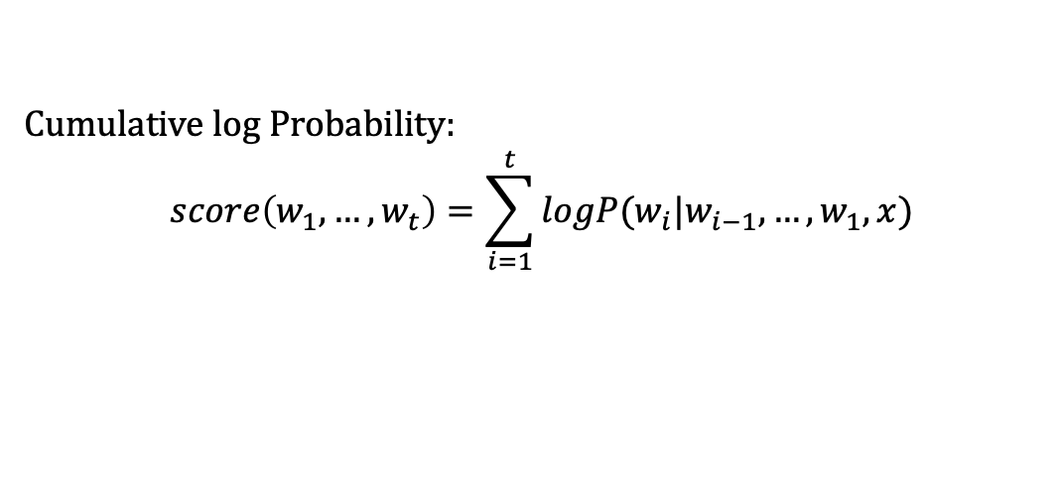
Seq2Seq
Effective Decoding With Beam Search
Track the cumulative log probability of each branch and continue with the top k branches.
Cumulative log Probability:
$$score\left(w_{1},…,w_{t}\right)=\sum_{i=1}^{t}{logP(w_{i}|w_{i−1},…,w_{1},x)}$$

Slide 10




























Seq2Seq
Effective Decoding With Beam Search
Beam Width (k) = 2
docked
At this point we have our two top branches which are also known as hypotheses. We can now either pass both to a downstream system for further evaluation or just pick the one with the highest probability and return that as the result. That’s Beam search which is intuitive.
$−0.$6
<end>
has
$$−1.6$$
$−1.$8
sunk
$−0.$8
$−0.$5
$$−1.0$$
home
ship
$−0.$1
<end>
$$−0.3$$
$−1.$4
sailed
$−1.$5
the
$−0.$5
$−0.$9
$−3.$7
$−1.$6
$−2.$3
shark
$$−0.2$$
$$−1.4$$
boat
$−0.$2
has
$$−0.2$$
$−1.$8
<start>
$−3.$2
$$−1,.6$$
$−1.$6
sailed
$$−1,.6$$
fire
$$−0.9$$
sunk
$−2.$5
$−2.$1
the
$−0.$5

Slide 11



Seq2Seq
Effective Decoding With Beam Search
Beam Width (k) = 2
docked
$$0.0$$
$−0.$6
<end>
has
$$−1.6$$
$−1.$8
sunk
$−0.$8
$−0.$5
$$−1.0$$
at
home
$−0.$15
ship
$−0.$1
$$−0.3$$
$−1.$4
sailed
$−1.$5
the
$−0.$5
$−0.$9
$−3.$7
$−1.$6
$−2.$3
shark
One think to keep in mind is that Beam search will bias in favour of shorter sentences.
If one of the hypotheses were longer than the other and we will pick only the single most probable branch in the end, then the shorter one maybe chosen despite the longer one maybe being more adequate or more fluent.
To avoid penalizing longer sentences, the score is normalized by the length (the number of words T):
$$score\left(w_{1},…,w_{t}\right)=\frac{1}{T}\sum_{i=1}^{t}{logP(w_{i}|w_{i−1},…,w_{1},x)}$$
$$−0.2$$
$$−1.4$$
boat
$−0.$2
has
$$−0.2$$
$−1.$8
<start>
$−3.$2
$$−1,.6$$
$−1.$6
sailed
$$−1,.6$$
fire
$$−0.9$$
sunk
$−2.$5
$−2.$1
the
$−0.$5

Slide 12
Seq2Seq
Effective Decoding With Beam Search
Beam search does not guarantee to find the most probable. As we track only a subset of branches at any point in time. To have a better chance of finding it we can widen the beam but of course that costs more time so, it’s It is a trade-off to be made between narrow versus wide beam.

Slide 13
Seq2Seq
NMT Evaluation with Bilingual Evaluation Understudy (BLEU)
To have a better evaluation, we could have humans looking at the results.
Like this is expensive see infeasible, the most popular automatic method is called BLEU.
There is a set of sources translations provided by humans (two below).
The plane took off from Istanbul.
References (human provided)
The plane departed from Istanbul.
The plane flew in from Istanbul.
Candidate (machine translation)
The intuition is to count the number of overlapping N-grams between the candidate and the reference translations.

Slide 14
Seq2Seq
NMT Evaluation with Bilingual Evaluation Understudy (BLEU)
Intuition: measure similarity using n-gram overlap.
Compare the Bigrams of the candidate sentence (below) with the bigrams of the reference sentences
The plane
plane flew
flew in
in from
from Istanbul
The plane took off from Istanbul.
2 / 5
The plane departed from Istanbul.
2 / 5
The plane flew in from Istanbul.
In our case there is equality (2/5) between the two reference sentences.
The actual BLEU formula is a little bit different.

Slide 15
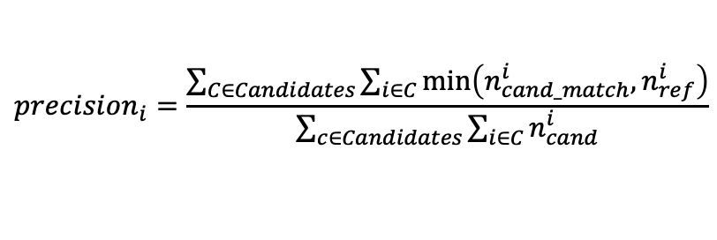
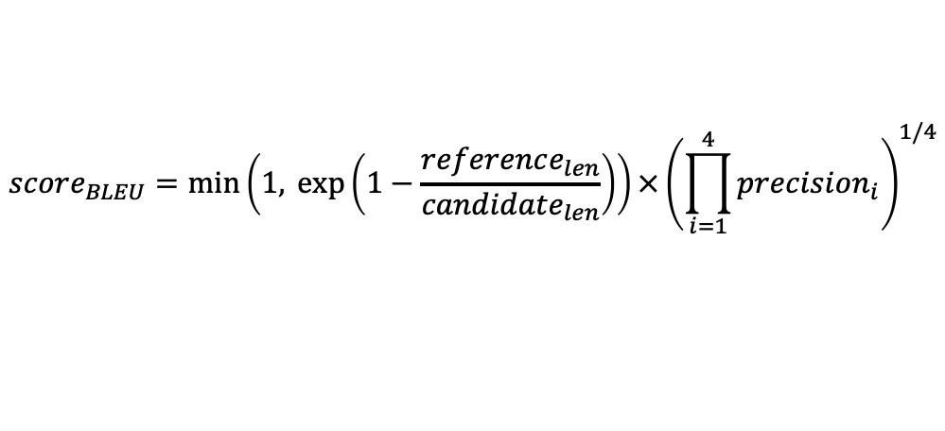
Seq2Seq
NMT Evaluation with Bilingual Evaluation Understudy (BLEU)
Intuition: measure similarity using n-gram overlap.
1-gram, 2-gram, 3-gram, 4-gram
$$score_{BLEU}=\min\left(1,\exp\left(1−\frac{reference_{len}}{candidate_{len}}\right)\right)×{\left(\prod_{i=1}^{4}{precision_{i}}\right)}^{1/4}$$
Brevity Penalty
N-gram overlap
For every candidate sentence…
Frequency of same i-gram in reference.
Frequency of matching i-gram occurring in candidate.
Frequency of same i-gram in reference.
$$precision_{i}=\frac{\sum_{C∈Candidates}{\sum_{i∈C}{\min\left(n_{cand_match}^{i}, n_{ref}^{i}\right)}}}{\sum_{c∈Candidates}{\sum_{i∈C}{n_{cand}^{i}}}}$$
Number of i-grams in the candidates.

Slide 16
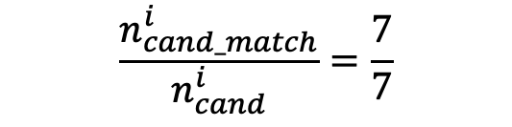
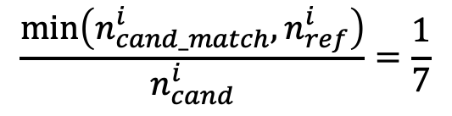
Seq2Seq
NMT Evaluation with Bilingual Evaluation Understudy (BLEU)
Why is there a mininmum in the formula ?
e.g. Unigrams
My dog is dating the fire hydrant
Reference (human provided)
dog dog dog dog dog dog dog
Candidate (machine translation)
With minimum:
1
Without minimum:
7
7
$$\frac{\min\left(n_{cand_match}^{i}, n_{ref}^{i}\right)}{n_{cand}^{i}}=\frac{1}{7}$$
$$\frac{n_{cand_match}^{i}}{n_{cand}^{i}}=\frac{7}{7}$$
7
7

Slide 17
Seq2Seq
NMT Evaluation with Bilingual Evaluation Understudy (BLEU)
Brevity Penalty is there to penalize candidate translations which are short relative to the reference translations.
1-gram, 2-gram, 3-gram, 4-gram
$$score_{BLEU}=\min\left(1,\exp\left(1−\frac{reference_{len}}{candidate_{len}}\right)\right)×{\left(\prod_{i=1}^{4}{precision_{i}}\right)}^{1/4}$$
Brevity Penalty
N-gram overlap
For every candidate sentence…
Frequency of same i-gram in reference.
Frequency of matching i-gram occurring in candidate.
Frequency of same i-gram in reference.
$$precision_{i}=\frac{\sum_{C∈Candidates}{\sum_{i∈C}{\min\left(n_{cand_match}^{i}, n_{ref}^{i}\right)}}}{\sum_{c∈Candidates}{\sum_{i∈C}{n_{cand}^{i}}}}$$
Number of i-grams in the candidates.

Slide 18
Seq2Seq
BLEU Shortcomings
Doesn’t take word meaning into account.
A candidate translation can be adequate and fluent but share no n-grams with the reference translations because it uses different words in which case the BLEU score will be low
Doesn’t take word order into account.
So, it’s possible to have a good BLEU score despite the n-grams being out-of-order.
That’s being said, it’s probably the most popular automated way to measure translation system performance.

Slide 19
Seq2Seq
$${\hat{y}}_{t=1}$$
Target / Output Sequence
$${\hat{y}}_{t=2}$$
$${\hat{y}}_{t=3}$$
$$X_{t=1}$$
$$X_{t=2}$$
Decoder
Source / Input Sequence
Encoder
The Information Bottleneck
A critical weakness remains in the RNNs based Seq2Seq model and that's from the transition from encoding to decoding.
What the encoder must do is compress the entire source sequence into a single fixed length vector.
This vector must somehow carry information about complex phrase structures and long-distance relationships between words.
There's so much the model can do when it's forced to cram all this information into a lower dimension.
This leads to an information bottleneck.
And while using architectures such as LSTMs can help when the sequences are still short, model's performance drops dramatically as the sequences get longer because the vector carries more information about the later parts of the sequences than the earlier parts.
Notes:
Sans le mécanisme d'attention, un LSTM (ou toute autre architecture RNN classique) doit encoder l'intégralité de l'information de la séquence source dans un seul vecteur de contexte (le hidden state final du LSTM).
C'est ce qu'on appelle le bottleneck d'information.
Pourquoi ce problème se produit ?
Perte d'information : Plus la séquence d'entrée est longue, plus il devient difficile pour le LSTM de condenser toutes les informations pertinentes dans un seul vecteur. Certaines informations importantes peuvent être oubliées ou déformées.
Dépendance à long terme : Même avec des mécanismes comme les portes de mémoire dans le LSTM, l'information provenant des premiers tokens peut être trop affaiblie lorsque le modèle traite les derniers tokens.
Difficulté d'apprentissage : Le modèle doit apprendre à compresser toute la séquence d'entrée dans un seul vecteur, ce qui est une tâche difficile, en particulier pour des textes longs ou complexes.

Slide 20

Seq2Seq
Introduction to Attention
Intuitively when we as humans transform a sequence into another sequence this is not how we do it.
When transforming a sequence ourselves (e.g. summarization), we are constantly referring to source sequence...
A human translator often refers to the source sequence while translating.
If we were to summarize a document, we would certainly keep looking back at the source document to extract and paraphrase the key passages.
What we do is focus on certain parts of the input, depending on where we are generating the output.
This is where a powerful mechanism called attention comes in.
Attention Mechanism
At each decoding timestep, the decoder accesses the encoder’s hidden states
$lemeur$ült
$$az$$
$$akkumulàtor$$
$$\text{<}\text{end}\text{>}$$
$$The$$
$$battery$$
$$is$$
$$dead$$
<start>
$lemeur$ült
$$az$$
$$akkumulàtor$$
The model learns which part of the input to focus on at each time step.
Notes:
Comment l'attention résout ce problème de goulet d’information ?
Le mécanisme d'attention permet au modèle de regarder dynamiquement différentes parties de l'entrée à chaque étape de la génération de la sortie, au lieu de tout stocker dans un seul vecteur.
Cela réduit considérablement la perte d'information et améliore la qualité de la traduction ou du résumé.
Avec l'attention, au lieu d’un seul vecteur de contexte statique, le modèle a accès à toutes les représentations de l'entrée et peut pondérer leur importance à chaque instant.
C'est cette avancée qui a mené aux modèles comme Transformers, où l'attention devient centrale et remplace complètement les RNN/LSTM.

Slide 21
Seq2Seq
Introduction to Attention
Rather than throwing away the encoder's hidden states and forcing all available information into a single vector,
instead at each decoding time step, give the decoder access to the encoder's hidden states.
In other words, let the decoder looks back at the source and learn at each time step which part of the input to focus on.
In a way NN have a bit of implicit attention built into them by a design.
Through iterations, NN learn what to give greater weight to and what to give less weight to.
In contrast the attention mechanism here is deliberate and explicit.
We’ll see how it works !
Attention Mechanism
At each decoding timestep, the decoder accesses the encoder’s hidden states
$lemeur$ült
$$az$$
$$akkumulàtor$$
$$\text{<}\text{end}\text{>}$$
$$The$$
$$battery$$
$$is$$
$$dead$$
<start>
$lemeur$ült
$$az$$
$$akkumulàtor$$
The model learns which part of the input to focus on at each time step.
Notes:
L'attention est un mécanisme puissant qui permet de se concentrer sur certaines parties d'une séquence source lors de sa transformation, comme le ferait un humain en traduisant ou en résumant un texte.

