Slide 1
Introduction to Neural Network

Slide 2

Weights initialization
At this stage, weights have been initialized to small random values between $−0.5$ and $0.5$
The power of the NN is to associate different inputs to different weights.
If we initialize all the weights with a same value, we break this rule, and the signals propagated are the same.
But can we do better than a random initialization ?

Slide 3
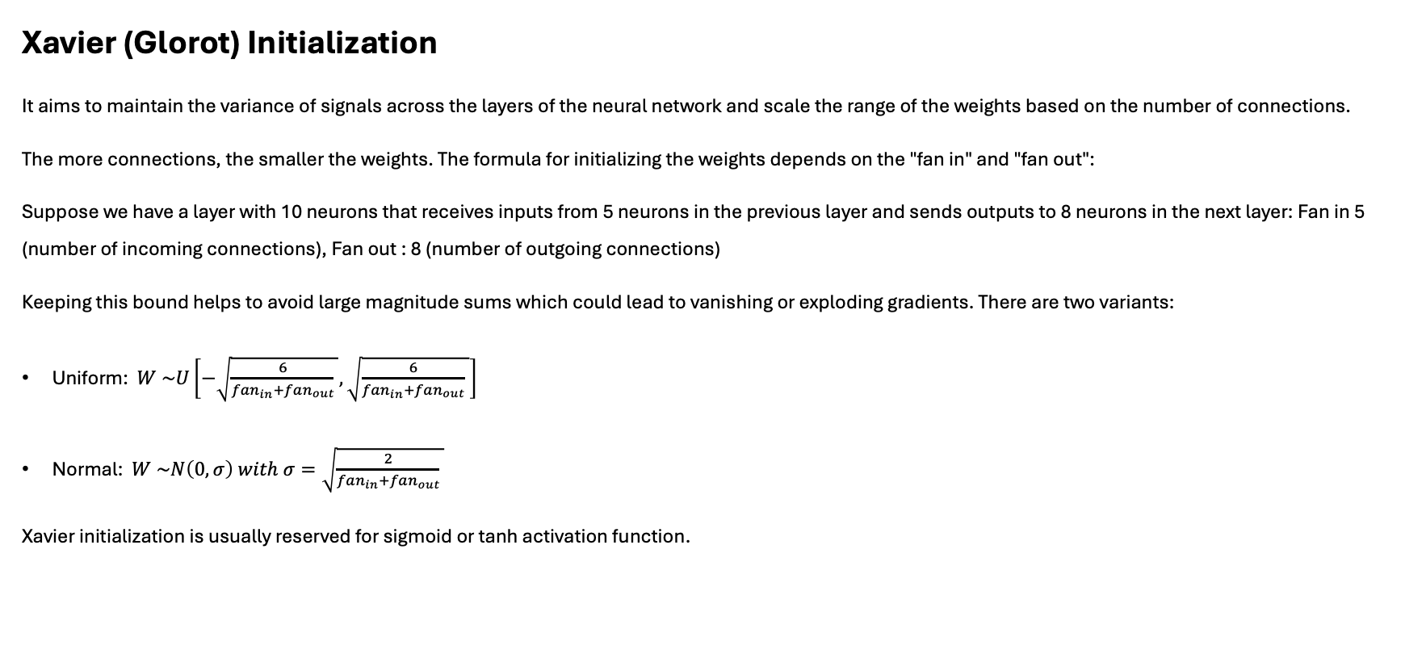
Weights initialization
Xavier (Glorot) Initialization
It aims to maintain the variance of signals across the layers of the neural network and scale the range of the weights based on the number of connections.
The more connections, the smaller the weights. The formula for initializing the weights depends on the "fan in" and "fan out":
Suppose we have a layer with 10 neurons that receives inputs from 5 neurons in the previous layer and sends outputs to 8 neurons in the next layer: Fan in 5 (number of incoming connections), Fan out : 8 (number of outgoing connections)
Keeping this bound helps to avoid large magnitude sums which could lead to vanishing or exploding gradients. There are two variants:
Uniform: $W \sim U\left[−\sqrt{\frac{6}{fan_{in}+fan_{out}} },\sqrt{\frac{6}{fan_{in}+fan_{out}} }\right]$
Normal: $W \sim N\left(0, σ\right) with σ=\sqrt{\frac{2}{fan_{in}+fan_{out}} }$
Xavier initialization is usually reserved for sigmoid or tanh activation function.

Slide 4

Weights initialization
He Initialization
Same principle as Xavier (Glorot) initialization based on $fan_{in}$only. Usually reserved for Relu activation function:
Uniform: $W \sim U\left[−\sqrt{\frac{6}{fan_{in}} },\sqrt{\frac{6}{fan_{in}} }\right]$
Normal: $W \sim N\left(0, σ\right) with σ=\sqrt{\frac{2}{fan_{in}} }$

Slide 5
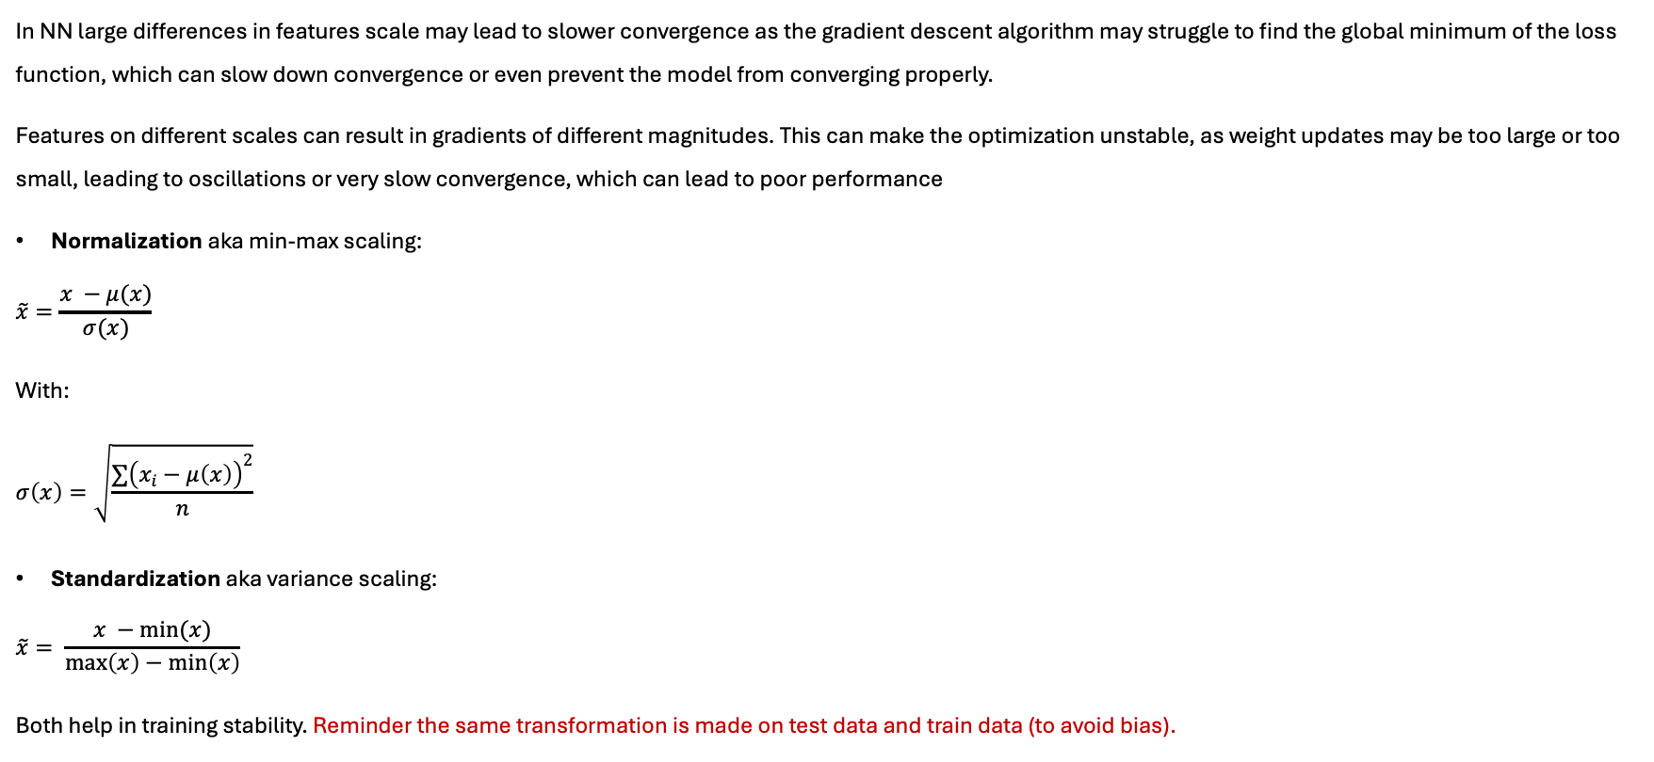
Features scaling
In NN large differences in features scale may lead to slower convergence as the gradient descent algorithm may struggle to find the global minimum of the loss function, which can slow down convergence or even prevent the model from converging properly.
Features on different scales can result in gradients of different magnitudes. This can make the optimization unstable, as weight updates may be too large or too small, leading to oscillations or very slow convergence, which can lead to poor performance
Normalization aka min-max scaling:
$$\tilde{x}=\frac{x −μ(x)}{σ(x)}$$
With:
$$σ\left(x\right)=\sqrt{\frac{∑{\left(x_{i}−μ\left(x\right)\right)}^{2}}{n}}$$
Standardization aka variance scaling:
$$\tilde{x}= \frac{x −min(x)}{\max\left(x\right)−\min\left(x\right)}$$
Both help in training stability. Reminder the same transformation is made on test data and train data (to avoid bias).

Slide 6
Batch normalization
Despite of features scaling, when we pass the first layer, the distributions can still change within the network and still potentially leads to instability. This is where technique called Batch Normalization can help.
Batch normalization standardizes the output of each layer either before or after the activation function. In the fact it should be called batch standardization.
The aims are to stabilize the training, to increase the accuracy and allowing for higher learning rates.
It is called batch normalization because the layer’s output is standardized using the whole batch’s mean and variance.

Slide 7
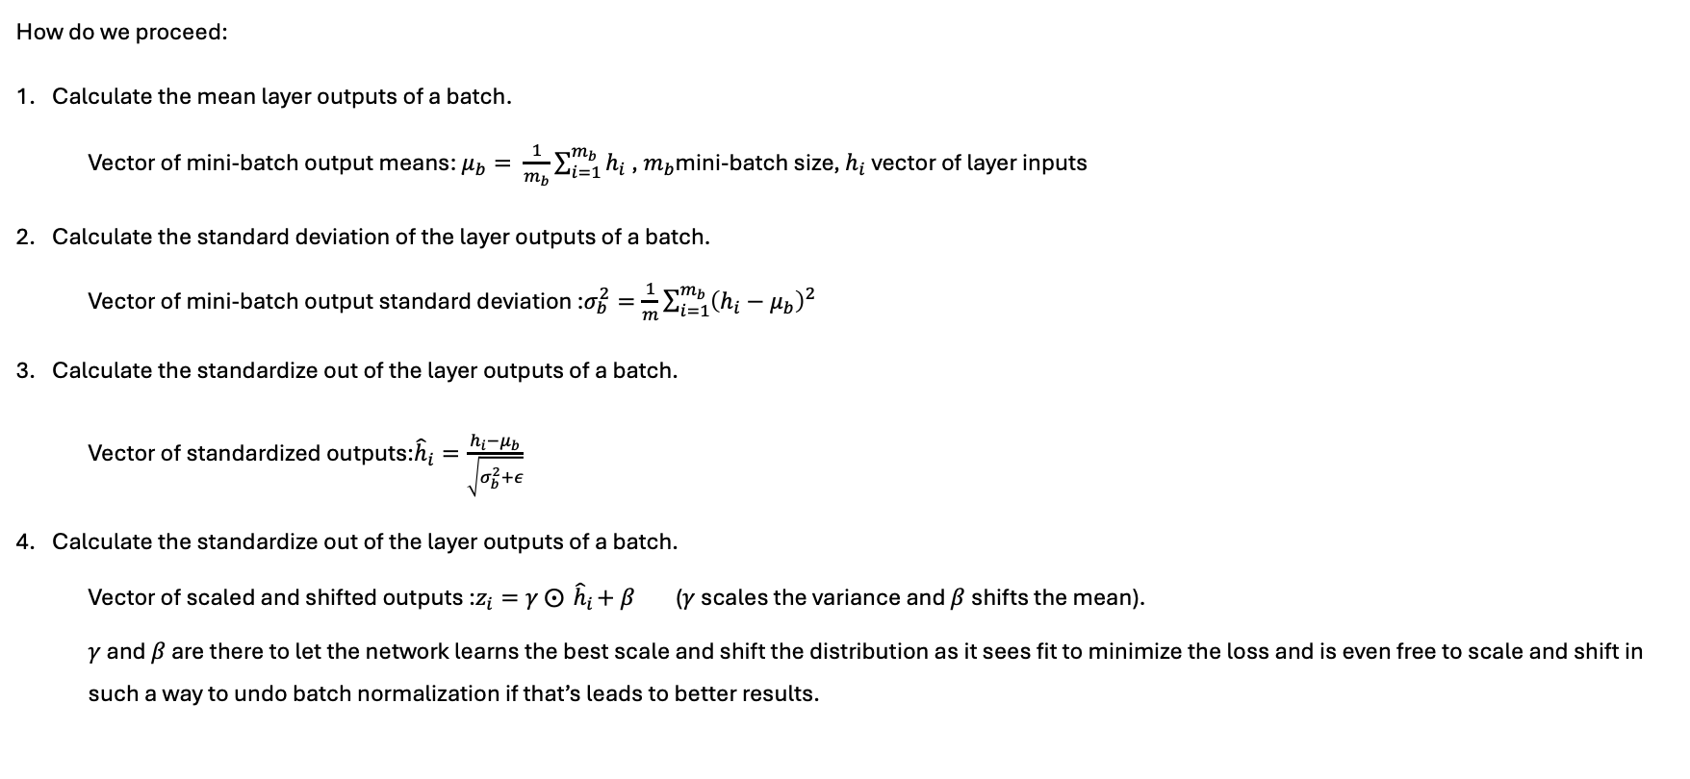
Batch normalization
How do we proceed:
Calculate the mean layer outputs of a batch.
Vector of mini-batch output means: $μ_{b}= \frac{1}{m_{b}}\sum_{i=1}^{m_{b}}{h_{i}}$, $m_{b}$mini-batch size, $h_{i}$ vector of layer inputs
Calculate the standard deviation of the layer outputs of a batch.
Vector of mini-batch output standard deviation :$σ_{b}^{2}=\frac{1}{m}\sum_{i=1}^{m_{b}}{{\left(h_{i}−μ_{b}\right)}^{2}}$
Calculate the standardize out of the layer outputs of a batch.
Vector of standardized outputs:${\hat{h}}_{i}=\frac{h_{i}−μ_{b}}{\sqrt{σ_{b}^{2}+ε}}$
Calculate the standardize out of the layer outputs of a batch.
Vector of scaled and shifted outputs :$z_{i}=γ ⨀{ \hat{h}}_{i}+β$ ($γ$ scales the variance and $β$shifts the mean).
$γ$ and $β$ are there to let the network learns the best scale and shift the distribution as it sees fit to minimize the loss and is even free to scale and shift in such a way to undo batch normalization if that’s leads to better results.

Slide 8
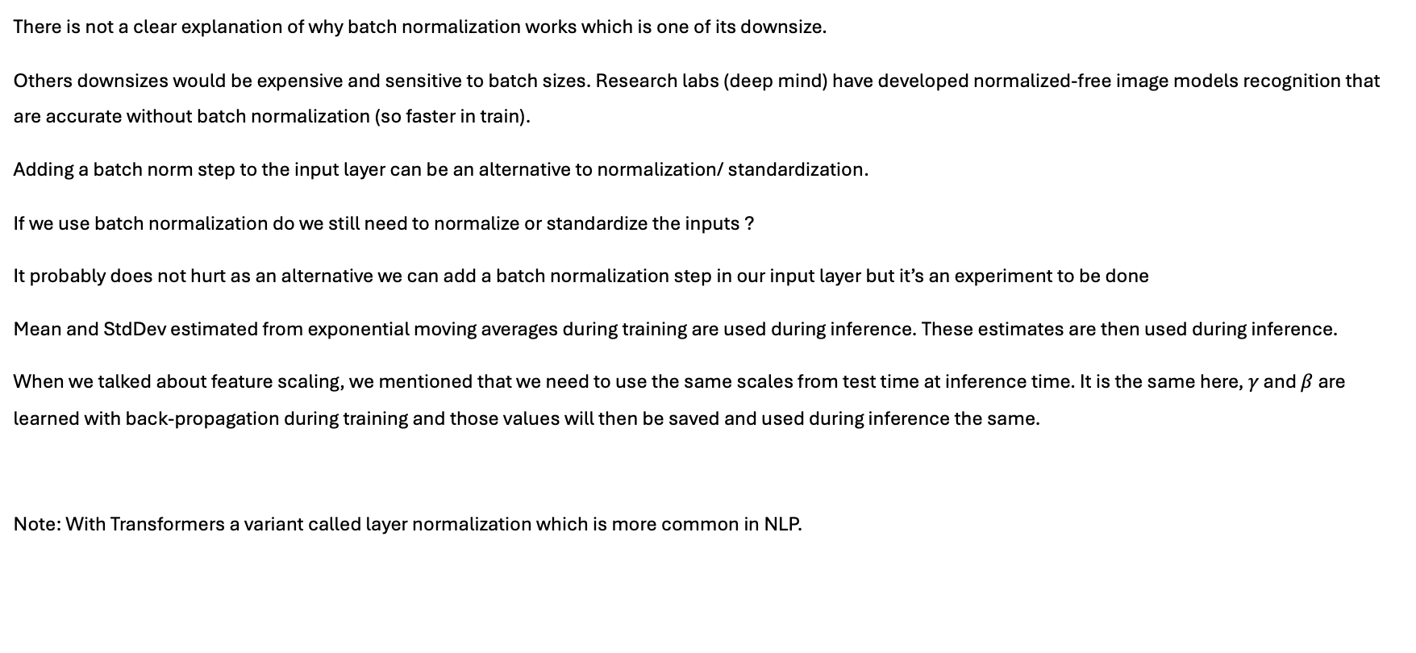
Batch normalization
There is not a clear explanation of why batch normalization works which is one of its downsize.
Others downsizes would be expensive and sensitive to batch sizes. Research labs (deep mind) have developed normalized-free image models recognition that are accurate without batch normalization (so faster in train).
Adding a batch norm step to the input layer can be an alternative to normalization/ standardization.
If we use batch normalization do we still need to normalize or standardize the inputs ?
It probably does not hurt as an alternative we can add a batch normalization step in our input layer but it’s an experiment to be done
Mean and StdDev estimated from exponential moving averages during training are used during inference. These estimates are then used during inference.
When we talked about feature scaling, we mentioned that we need to use the same scales from test time at inference time. It is the same here, $γ$ and $β$are learned with back-propagation during training and those values will then be saved and used during inference the same.
Note: With Transformers a variant called layer normalization which is more common in NLP.

Slide 9
Regularization
Umbrella term for technics to force the learning algorithm to build a less complex model, and hopefully preventing overfitting:
Early stopping
L1, L2,
Dropout,
…
In a perfect situation, the training loss and the validation loss should decrease the same way i.e. with the same distance between the two.
At a certain point if the training loss and the validation loss start to diverge this indicates that the model starts overfitting.

Slide 10
Regularization Early stopping
Early stopping stop training as soon as validation reaches a minimum
Early stopping is simply taking the version of the model at the point just before the validation loss and the training loss diverge. Modern frameworks make it simple by saving a snapshot of the model at each epochs.
In NN a little bit of overfitting has shown to be OK.

Slide 11
Regularization Early stopping
import tensorflow as tf from tensorflow.keras.models
import Sequential from tensorflow.keras.layers
import Dense from tensorflow.keras.callbacks
import EarlyStopping
model = Sequential() model.add(Dense(64, input_dim=20, activation='relu’))
model.add(Dense(64, activation='relu’))
model.add(Dense(10, activation='softmax’))
model.compile(loss='categorical_crossentropy', optimizer='adam', metrics=['accuracy’])
# Define the early stopping
early_stopping = EarlyStopping(monitor='val_loss', patience=5, restore_best_weights=True)
# Train the model with early stopping
model.fit(X_train, y_train, epochs=100, batch_size=32, validation_data=(X_val, y_val), callbacks=[early_stopping])

Slide 12
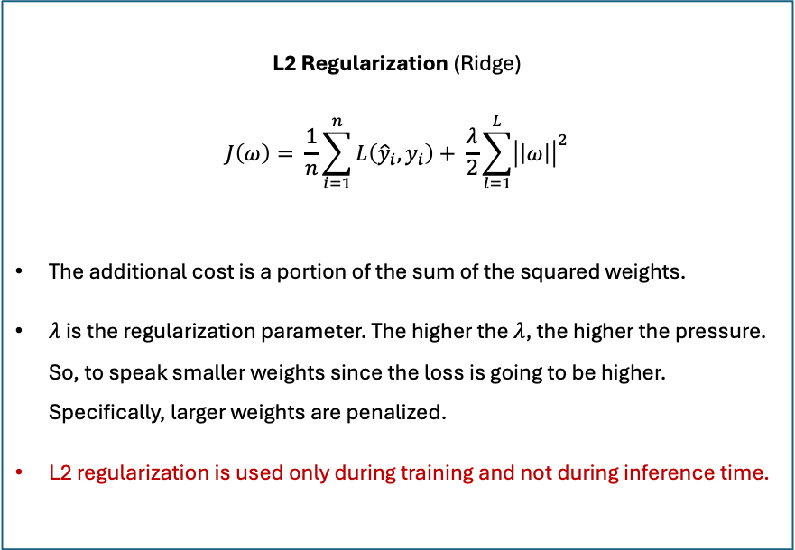
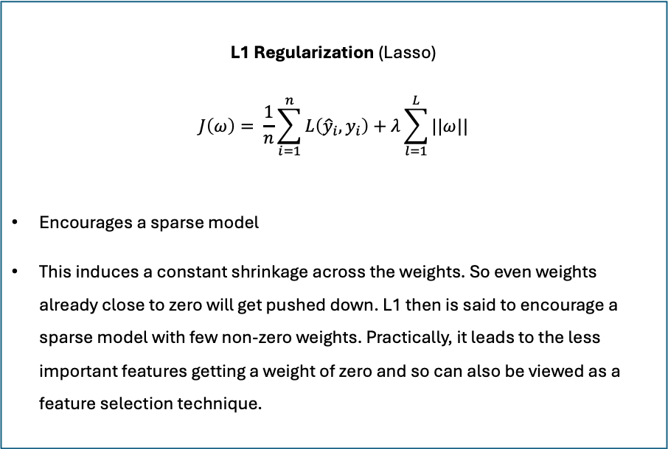
Regularization Loss function + additional cost
L2 Regularization (Ridge)
$$J\left(ω\right)= \frac{1}{n}\sum_{i=1}^{n}{L\left({\hat{y}}_{i},y_{i}\right)+ \frac{λ}{2}\sum_{l=1}^{L}{{\left|\left|ω\right|\right|}^{2}}}$$
The additional cost is a portion of the sum of the squared weights.
$λ$ is the regularization parameter. The higher the $λ$, the higher the pressure. So, to speak smaller weights since the loss is going to be higher. Specifically, larger weights are penalized.
L2 regularization is used only during training and not during inference time.
L1 Regularization (Lasso)
$$J\left(ω\right)= \frac{1}{n}\sum_{i=1}^{n}{L\left({\hat{y}}_{i},y_{i}\right)+λ\sum_{l=1}^{L}{||ω||}}$$
Encourages a sparse model
This induces a constant shrinkage across the weights. So even weights already close to zero will get pushed down. L1 then is said to encourage a sparse model with few non-zero weights. Practically, it leads to the less important features getting a weight of zero and so can also be viewed as a feature selection technique.
The objective is to minimize the total cost (loss function + additional cost) which leads to a minimization of the weights. L2 penalize the large weights more severely than the small ones, while L1 penalize all the weights the same linear way. Thus, L1 can force some weights to be exactly equal to zero, which is not the case with L2.
NB: When features are correlated, in a classical regression, their coefficients will be large. L2 regularization reduces those weights and thus, reduce the impact of collinearity but does not make it disappear.
Notes:
On models such as transformers that have millions, trillioins of weights, regularization will not have much effect.

Slide 13
Regularization Loss function + additional cost
import tensorflow as tf from tensorflow.keras.models
import Sequential from tensorflow.keras.layers
import Dense from tensorflow.keras.regularizers import l1
model = Sequential()
model.add(Dense(64, input_dim=20, activation='relu', kernel_regularizer=l1(0.01)))
model.add(Dense(64, activation='relu', kernel_regularizer=l1(0.01)))
model.add(Dense(10, activation='softmax’))
model.compile(loss='categorical_crossentropy', optimizer='adam', metrics=['accuracy'])
Notes:
On models such as transformers that have millions, trillioins of weights, regularization will not have much effect.

Slide 14
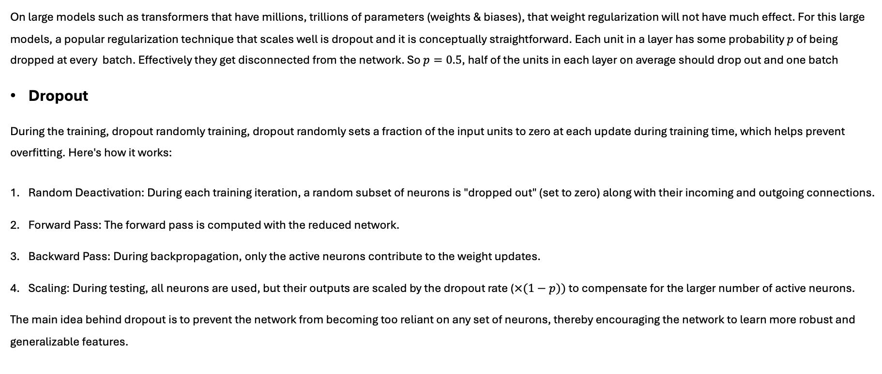
Regularization Dropout
On large models such as transformers that have millions, trillions of parameters (weights & biases), that weight regularization will not have much effect. For this large models, a popular regularization technique that scales well is dropout and it is conceptually straightforward. Each unit in a layer has some probability $p$ of being dropped at every batch. Effectively they get disconnected from the network. So $p=0.5$, half of the units in each layer on average should drop out and one batch
Dropout
During the training, dropout randomly training, dropout randomly sets a fraction of the input units to zero at each update during training time, which helps prevent overfitting. Here's how it works:
Random Deactivation: During each training iteration, a random subset of neurons is "dropped out" (set to zero) along with their incoming and outgoing connections.
Forward Pass: The forward pass is computed with the reduced network.
Backward Pass: During backpropagation, only the active neurons contribute to the weight updates.
Scaling: During testing, all neurons are used, but their outputs are scaled by the dropout rate ($×(1−p))$to compensate for the larger number of active neurons.
The main idea behind dropout is to prevent the network from becoming too reliant on any set of neurons, thereby encouraging the network to learn more robust and generalizable features.

Slide 15
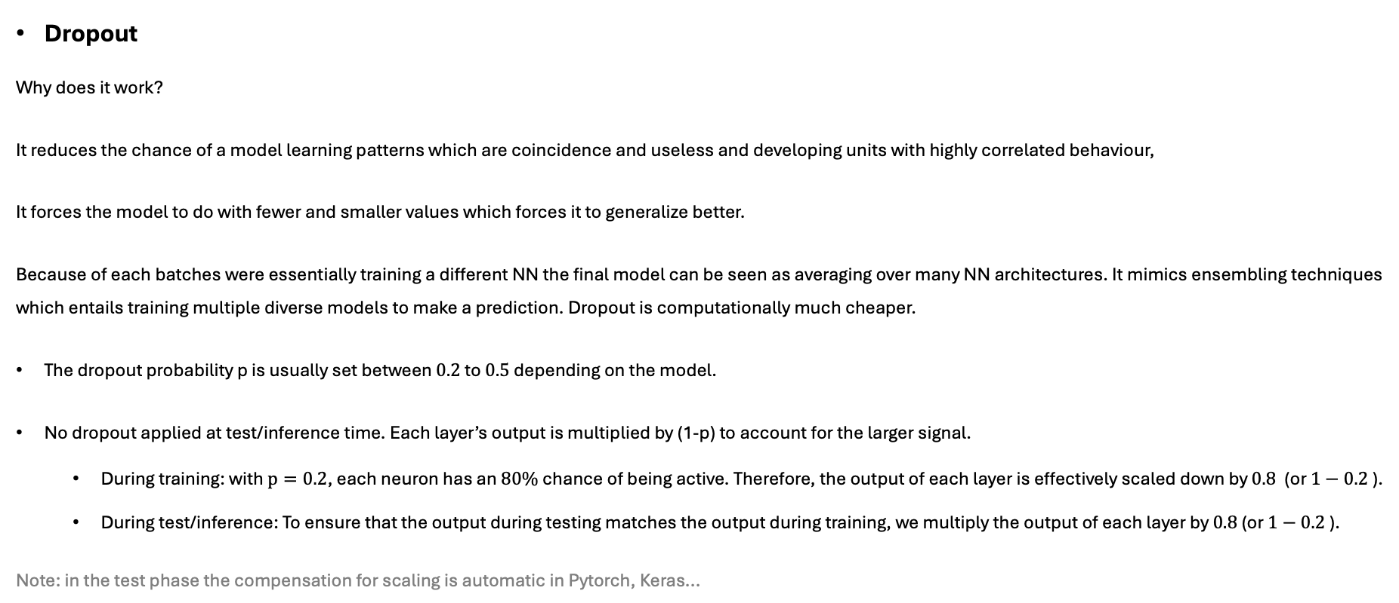
Regularization Dropout
Dropout
Why does it work?
It reduces the chance of a model learning patterns which are coincidence and useless and developing units with highly correlated behaviour,
It forces the model to do with fewer and smaller values which forces it to generalize better.
Because of each batches were essentially training a different NN the final model can be seen as averaging over many NN architectures. It mimics ensembling techniques which entails training multiple diverse models to make a prediction. Dropout is computationally much cheaper.
The dropout probability p is usually set between $0.2$ to $0.5$ depending on the model.
No dropout applied at test/inference time. Each layer’s output is multiplied by (1-p) to account for the larger signal.
During training: with $p=0.2$, each neuron has an $80\%$chance of being active. Therefore, the output of each layer is effectively scaled down by $0.8$ (or $1−0.2$).
During test/inference: To ensure that the output during testing matches the output during training, we multiply the output of each layer by $0.8$ (or $1−0.2$).
Note: in the test phase the compensation for scaling is automatic in Pytorch, Keras...

Slide 16
Sensible defaults for deep learning
Activation function for hidden layers | Relu
Weight initialization | He
Normalization | Batch norm
Regularization | Dropout + Early stopping
Optimizer | Adam / RMSProp
Learning schedule | 1 cycle

