Slide 1
Introduction to Word Vectors

Slide 2
Word Vectors
Capturing Word Meaning With Static Embeddings
The simplest way to vectorize words is the One-Hot Encoding.
Represent each word using a vector of length |V| with 0 except a 1 in the alphabetic order where the word stands.
Vocabulary: bus, car, cat, dog, feline, road, swim, swimming.
”cat”: [0,0,1,0,0,0,0,0]
Problems:
(-) Sparse representation
(-) Does not capture meaning between the words
If we take swim and swimming their dot product will be zero.
It would be nice to have short and dense representations which capture some meaning of words.
This is where embedding comes in.

Slide 3
Word Vectors
Capturing Word Meaning With Static Embeddings
Embedding:
Representing a discrete item as a vector of real numbers.
For example, if we have a collection of movies and we choose to represent each movie with a 5-dimensional vector:
[<action>, <comedy>, <drama>, <horror>, <romance>]
”Action-ness” from 0 to 1,…
The Godfather: [.5, .2, .9, .3 , .2]
The Big Lebowski: [.3, .8, .5, .1, .3]
We can check the cosine similarity between the Godfather and the Big Lebowski.
We can cluster movies based on these factors
The point representing with these coordinates is called Embedding.

Slide 4
Word Vectors
Capturing Word Meaning With Static Embeddings
Embedding:
We can do the same with words:
”swim” and “swimming” will be close (syntactic similarity)
“feline” and “cat” will be close (semantic similarity)
“car”, “bus”, “road” will be close (semantic relatedness)

Slide 5
Word Vectors
Word Embeddings: Distributional Hypothesis
Fundamental idee of the Natural Language Processing:
Words which occur in similar contexts (i.e. share similar surrounding words) have similar meanings.
“The cat sat on the mat”
Words “The”, “sat”, “mat” form the context of the word “cat”. If words appear frequently in a similar context, they have a high probability of being similar meaning.
Another example:
“The king sat on the throne.”
“The queen sat on the throne.”
“king” and “queen” have similar meanings.

Slide 6
Word Vectors
Static Embedding
Static embeddings are fixed vector representations of words that do not depend on the context in which the word appears. Each word has a single vector representation pre-calculated, regardless of its context. Examples of static embedding methods include:
Word2Vec:
Word2Vec uses models like Skip-gram and CBOW (Continuous Bag of Words) to learn word embeddings from large text corpora. Each word is represented by a unique vector.
GloVe (Global Vectors for Word Representation):
GloVe learns word embeddings using word co-occurrence statistics in a corpus. Each word is represented by a unique vector based on its co-occurrences with other words.
FastText:
FastText is an extension of Word2Vec that considers sub words (n-grams) to improve the representation of rare or unknown words. Each word is represented by a unique vector, but this vector is influenced by the sub words.

Slide 7
Word Vectors
Word2vec
Learn dense representations that capture word relationships
Possible example of a dense word vector (or embedding or distributed representations) learned for the word "cat”
cat_embedding = np.array([
0.0213, -0.1289, 0.0547, 0.0123, -0.0345, 0.0678, -0.0890, 0.0234,
-0.0123, 0.0456, -0.0789, 0.0234, -0.0345, 0.0567, -0.0890, 0.0123,
-0.0234, 0.0345, -0.0456, 0.0567, -0.0678, 0.0789, -0.0890, 0.0901,
-0.1012, 0.1123, -0.1234, 0.1345, -0.1456, 0.1567, -0.1678, 0.1789,
-0.1890, 0.1901, -0.2012, 0.2123, -0.2234, 0.2345, -0.2456, 0.2567,
-0.2678, 0.2789, -0.2890, 0.2901, -0.3012, 0.3123, -0.3234, 0.3345,
-0.3456, 0.3567, -0.3678, 0.3789, -0.3890, 0.3901, -0.4012, 0.4123,
-0.4234, 0.4345, -0.4456, 0.4567, -0.4678, 0.4789, -0.4890, 0.4901,
-0.5012, 0.5123, -0.5234, 0.5345, -0.5456, 0.5567, -0.5678, 0.5789,
-0.5890, 0.5901, -0.6012, 0.6123, -0.6234, 0.6345, -0.6456, 0.6567,
-0.6678, 0.6789, -0.6890, 0.6901, -0.7012, 0.7123, -0.7234, 0.7345,
-0.7456, 0.7567, -0.7678, 0.7789, -0.7890, 0.7901, -0.8012, 0.8123,
-0.8234, 0.8345, -0.8456, 0.8567, -0.8678, 0.8789, -0.8890, 0.8901
])
The embedding of the word "cat" with Word2Vec is a numerical vector of fixed dimension that captures semantic and contextual information about the word.
This representation is learned from the text corpus on which the Word2Vec model was trained and can be used in various natural language processing tasks.

Slide 8
Word Vectors
Word2vec
Learn dense representations that capture word relationships
cat_embedding = np.array([0.0213, -0.1289, 0.0547, …, 0.8789, -0.8890, 0.8901])
We do not really know how it was generated.
If 0.0213 is related to anilmness for instance but what matters is that related words should have vectors which are closer in this d-dimensional space.
Word2vec has two algorithm options:
Continuous Bag of Words (CBOW)
Skip-grams
Both algorithms learn word vectors indirectly through a word prediction task?

Slide 9
Word Vectors
Word2vec
Learn dense representations that capture word relationships
Word2vec has two algorithm options:
Continuous Bag of Words (CBOW)
Skip-Gram
We will focus n Skip-Gram and specifically on Skip-Gram with Negative Sampling (SGNS).
Its goal is to create word vectors which:
Maximize similarity between Words which appears in similar contexts.
Minimize similarity between Words which do not appears in similar contexts.

Slide 10
Word Vectors
Word2vec
CBOW : how to get word embeddings from scratch ?
Take a fake problem: fill in missing word in a sentence
Solve it using Neural Network
You get word embeddings as a side effect
The document:
There lived a king called Ashoka in India. After Kalinga war,
he converted to Buddhist. This mighty king ordered this
ministers to put together a peaceful treaty with there
neighbouring kingdoms. The emperor ordered his ministers to
also build stupa, a monument with Buddhas teachings.'
Source: Code basic [YouTube channel]

Slide 11
Word Vectors
Word2vec
CBOW : how to get word embeddings from scratch ?
Take a fake problem: fill in missing word in a sentence
Solve it using Neural Network
You get word embeddings as a side effect
The fake problem consists in filling missing word in a sentence.
There lived a king called Ashoka in India. After Kalinga war,
he converted to Buddhist. This mighty king ordered this
ministers to put together a peaceful treaty with there
neighbouring kingdoms. The emperor ordered his ministers to
also build stupa, a monument with Buddhas teachings.'
Self supervised learning
Training samples for a window of 3 words:
Contextual words
Features (X) | Target (y)
lived, a | There
a, king | lived
king, called | a
called, Ashoka | king
…
ordered, this | king
…
Buddhas, teachings | with
Source: Code basic [YouTube channel]

Slide 12




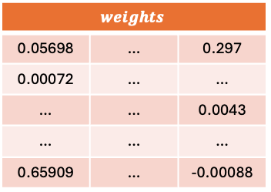
Word Vectors
$$X$$
$$y$$
ordered
0
0
0
0
…
1
0
…
0
this
0
0
0
0
…
0
1
…
0
king
0
0
0
…
1
0
…
…
0
One-hot encode
(Nb rows = size of the vocabulary)
Word2vec
CBOW : how to get word embeddings from scratch ?
Take a fake problem: fill in missing word in a sentence
Solve it using Neural Network
You get word embeddings as a side effect
The NN model
Self supervised learning
Embeddings of the word “ordered”
Training samples for a window of 3 words:
Contextual words
$$weights$$
0.05698 | … | 0.297
0.00072 | … | …
… | … | 0.0043
… | … | …
0.65909 | … | -0.00088
ordered
0
0
0
0
…
1
0
…
0
ordered
0.0023
0.05064
…
…
…
…
--0.15674
…
0.12546
Features (X) | Target (y)
lived, a | There
a, king | lived
king, called | a
called, Ashoka | king
…
ordered, this | king
…
Buddhas, teachings | with
$$.$$
$$=$$
The number of units of the hidden layer is equal to the size of the embedding vector.
(The number of rows of this matrix of weights)
Source: Code basic [YouTube channel]

Slide 13
Word Vectors
Word2vec
CBOW : how to get word embeddings from scratch ?
Words are one-hot-encoded using the vocabulary
def get_one_hot_vector(word, vocab):
'''Obtain the corresponding one-hot vector for a given word'’’
if word in vocab:
one_hot_vector = np.zeros(len(vocab))
word_index = vocab.tolist().index(word)
one_hot_vector[word_index] = 1
return one_hot_vector
else:
print(f"The word '{word}' is not in the vocabulary.")
return None
# The input layer
context_word1 = get_one_hot_vector("ordered", vocab)
context_word2 = get_one_hot_vector("this", vocab)
# Concatenate the one-hot vectors of the context words
X = np.concatenate((context_word1, context_word2)).reshape(1, -1)
print(X)
print(X.shape)
y = get_one_hot_vector("king", vocab)
y = np.array([y])

Slide 14
Word Vectors
Word2vec
CBOW : how to get word embeddings from scratch ?
Words are one-hot-encoded using the vocabulary
from tensorflow.keras.models import Sequential
from tensorflow.keras.layers import Dense, Input
from tensorflow.keras.optimizers import SGD
n_hidden_units = 4
n_output_units = len(vocab)
n_inputs = 2 * n_output_units # 2 words after the target word
print(f"n_inputs: {n_inputs}")
hidden_layer_size = 4 # Number of neurons in the hidden layer
output_layer_size = len(vocab) # Number of neurons in the output layer
# Define the model
model = Sequential()
model.add(Input(shape=(n_inputs,)))
model.add(Dense(hidden_layer_size, activation='relu'))
model.add(Dense(output_layer_size, activation='softmax'))
# Compile the model
model.compile(optimizer=SGD(learning_rate=0.1), loss='categorical_crossentropy', metrics=['accuracy'])
# Train the model
model.fit(X, y, epochs=100, verbose=0)
# Predict the output
out = model.predict(X)
print(f"Output (out): \n {out}")

Slide 15
Word Vectors
Word2vec
CBOW : how to get word embeddings from scratch ?
Words are one-hot-encoded using the vocabulary
# Evaluate the model
loss, accuracy = model.evaluate(X, y, verbose=0)
print(f"Final Loss (categorical_crossentropy): {loss}")
print(f"Final Accuracy: {accuracy}")
# Get the weights of the hidden layer
hidden_layer_weights = model.layers[1].get_weights()[0]
print(f"Hidden layer weights (embeddings): \n {hidden_layer_weights}")
# To get the embeddings for each word in the vocabulary
embeddings = {}
for word in vocab:
one_hot_vector = get_one_hot_vector(word, vocab)
if one_hot_vector is not None:
embedding = np.dot(hidden_layer_weights, one_hot_vector)
embeddings[word] = embedding
print(f"Word embeddings: \n {embeddings}")
This code could be generalized with the pairs (context words, target) build at the beginning of the code…etc

Slide 16
Word Vectors
Word2vec embeddings
CBOW : how to train a Word2Vec model from a corpus ?
# We take the previous corpus, but we transform it into a list of lists of words for each sentence
sentences = [phrase.split() for phrase in corpus]
print(sentences)
[['There', 'lived', 'a', 'king', 'called', 'Ashoka', 'in', 'India'], ['After', 'Kalinga', 'war,', 'he', 'converted', 'to', 'Buddhist'], ['This', 'mighty', 'king', 'ordered', 'this', 'ministers', 'to', 'put', 'together', 'a', 'peaceful', 'treaty', 'with', 'their', 'neighboring', 'kingdoms'], ['The', 'emperor', 'ordered', 'his', 'ministers', 'to', 'also', 'build', 'stupa,', 'a', 'monument', 'with', 'Buddhas', 'teachings']]
from gensim.models import Word2Vec
# Configuration of Word2Vec with CBOW
model_cbow = Word2Vec(sentences, vector_size=4, window=5, min_count=1, sg=0)
# sentences : The corpus of sentences / vector_size=4 : The dimension of the vectors of words (embeddings) /
# window=5 : The size of the context window surrounding the target / min_count=1 : The minimum number of occurrences of a word to be included in the model.
# sg=0 : Use the CBOW (Continuous Bag of Words) algorithm. If sg=1, the algorithme used is Skip-gram.
# Display the words vectors
for word in model_cbow.wv.index_to_key:
print(f"{word}: {model_cbow.wv[word]}")

Slide 17
Word Vectors
Embeddings with en_core_web_sm + SpaCy
import spacy
# !python -m spacy download en_core_web_md
# Load the model
nlp = spacy.load("en_core_web_sm")
pizza = nlp("pizza")
print(f'Vector dimension: {pizza.vector.shape}')
# The embedding for the word "pizza" is a 300-dimensional vector
# print(pizza.vector)
# Test similarities:
tomato = nlp("tomato")
tree = nlp("tree")
yoga = nlp("yoga")
# With the model en_core_web_sm, we can calculate the similarity between words but based on the tagger, the parser and the NER which is less accurate than the word2vec model
pizza.similarity(tomato), pizza.similarity(tree), pizza.similarity(yoga)

Slide 18
Word Vectors
Embeddings with en_core_web_sm + SpaCy
# Reload the model + change the model medium rather than small and disable tagger, ner and parser which bias the influence of the similarity:
nlp = spacy.load("en_core_web_md", disable=["tagger", "parser", "ner"])
# Number of words in the vocabulary
vocab_size = len(nlp.vocab)
print(f"The model 'en_core_web_md' contains {vocab_size} tokens in its vocabulary.")
pizza = nlp("pizza")
tomato = nlp("tomato")
tree = nlp("tree")
yoga = nlp("yoga")
# compute similarities
pizza.similarity(tomato), pizza.similarity(tree), pizza.similarity(yoga)
# Similarity between two sentences
sentence1 = nlp("dog bites man")
sentence2 = nlp("canine nips human")
sentence1.similarity(sentence2)
# The vector corresponding to a sentence is the average of the vectors of the words in the sentence !!! Bam !!!

Slide 19
Word Vectors
Embeddings with GloVe + Gensim
# download the embeddings model
# !curl -L -o glove.6B.zip http://nlp.stanford.edu/data/glove.6B.zip
# !unzip glove.6B.zip
# conversion of the GloVe format to Word2Vec
from gensim.scripts.glove2word2vec import glove2word2vec
glove_embedding_file = '/Users/davidtbo/Documents/Data_Science/99_Data/glove.6B.50d.txt' # Input file
word2vec_output_file = '/Users/davidtbo/Documents/Data_Science/99_Data/glove.6B.50d.word2vec.txt' # Output file
glove2word2vec(glove_embedding_file, word2vec_output_file)
# Load the Word2Vec model with GenSim
word_vectors = KeyedVectors.load_word2vec_format(word2vec_output_file, binary=False)
# Test similarity between two words:
similarity = word_vectors.similarity('dog', 'cat')
print(f"Similarity between 'dog' and 'cat': {similarity}")
try:
word_vectors['genance']
except KeyError as e:
print(e)
Notes:
try:
word_vectors['genance']
except KeyError as e:
print(e)

Slide 20
Word Vectors
Embeddings with GloVe + Gensim
word_vectors.most_similar(positive=['phone', 'communication'], negative=['cellphone’]) # Find words which are similar to cellphone and communication but not to phone
word_vectors.n_similarity("dog bites man".split(),"canine nips human".split()) # cosine similarity between two sentences
word_vectors.doesnt_match("breakfast cereal dinner lunch".split())
# Visualize the word embeddings using Principal Component Analysis (PCA) and t-Distributed Stochastic Neighbor Embedding (t-SNE)
# PCA reduces the dimensionality of the data while preserving the maximum variance
def display_pca_scatterplot(model, words=None, sample=0):
if words == None:
if sample > 0:
words = np.random.choice(list(model.vocab.keys()), sample)
else:
words = [ word for word in model.vocab ]
word_vectors = np.array([model[w] for w in words])
twodim = PCA().fit_transform(word_vectors)[:,:2]
plt.figure(figsize=(6,6))
plt.scatter(twodim[:,0], twodim[:,1], edgecolors='k', c='r’)
for word, (x,y) in zip(words, twodim):
plt.text(x+0.05, y+0.05, word)
plt.show()
display_pca_scatterplot(word_vectors,['swimming', 'surfing', 'diving', 'fishing', 'sailing', 'feline', 'road', 'car', 'bus'])

Slide 21
Word Vectors
Using Word Vectors in Models
Three scenarios:
Use pretrained word vectors as model inputs and keep the vectors fixed during training.
If we don’t have lots of data to create a words embeddings.
Same as scenario (1) but this time we simultaneously tune (adjust) the word vectors as the model is trained.
The vectors may change during the training of the model
Train word embeddings from scratch alongside the model.
Embeddings matrix will be initialized randomly
The training algorithm will adjust the embeddings
Embeddings will be optimized for model metric (e.g. classification accuracy) rather than similarity
This option can be considered if there is enough data or the domain is specific.

Slide 22
Word Vectors
Static Embedding Use case
the 0.418 0.24968 -0.41242 0.1217 0.34527 -0.044457 -0.49688 -0.17862 -0.00066023 -0.6566 0.27843 -0.14767 -0.55677 0.14658 -0.0095095 0.011658 0.10204 -0.12792 -0.8443 -0.12181 -0.016801 -0.33279 -0.1552 -0.23131 -0.19181 -1.8823 -0.76746 0.099051 -0.42125 -0.19526 4.0071 -0.18594 -0.52287 -0.31681 0.00059213 0.0074449 0.17778 -0.15897 0.012041 -0.054223 -0.29871 -0.15749 -0.34758 -0.045637 -0.44251 0.18785 0.0027849 -0.18411 -0.11514 -0.78581
, 0.013441 0.23682 -0.16899 0.40951 0.63812 0.47709 -0.42852 -0.55641 -0.364 -0.23938 0.13001 -0.063734 -0.39575 -0.48162 0.23291 0.090201 -0.13324 0.078639 -0.41634 -0.15428 0.10068 0.48891 0.31226 -0.1252 -0.037512 -1.5179 0.12612 -0.02442 -0.042961 -0.28351 3.5416 -0.11956 -0.014533 -0.1499 0.21864 -0.33412 -0.13872 0.31806 0.70358 0.44858 -0.080262 0.63003 0.32111 -0.46765 0.22786 0.36034 -0.37818 -0.56657 0.044691 0.30392

Slide 23
Word Vectors
Contextual Embedding
Contextual embeddings, on the other hand, generate vector representations of words that depend on the context in which the word appears. This means that the same word can have different vector representations in different contexts. Examples of contextual embedding methods include:
BERT (Bidirectional Encoder Representations from Transformers):
BERT uses a transformer model to generate word embeddings that consider the bidirectional context (both left and right contexts of the word). Each word is represented by a vector that depends on its context in the sentence.
ELMo (Embeddings from Language Models):
ELMo uses a bidirectional language model to generate word embeddings that consider the context. Each word is represented by a vector that depends on its context in the sentence.
RoBERTa, XLNet, and other BERT variants:
These models are variants of BERT that use similar techniques to generate contextual embeddings.

Slide 24
Word Vectors
Static Embedding or Contextual Embedding
Consider the following sentences:
"The bank will not accept the check."
"The river bank was eroded by the flood."
In static embeddings, the word "bank" would have a single vector representation, regardless of its context. This can be problematic because "bank" has different meanings in the two sentences.
In contextual embeddings, the word "bank" would have different vector representations in the two sentences, reflecting its different meanings.
Conclusion
The idea that words appearing in similar contexts have similar meanings is used in static embeddings to learn fixed vector representations of words. However, contextual embeddings go further by generating vector representations that depend on the context, allowing for more nuanced and context-dependent meanings of words. So, if you are using methods like Word2Vec or GloVe, you are dealing with static embeddings. If you are using models like BERT or ELMo, you are dealing with contextual embeddings.

Slide 25
Word Vectors
Using Word Vectors in Models
Download a pretrained word vectors as model inputs and keep the vectors fixed during training

Slide 26
Word Vectors
Appendices

Slide 27
Word Vectors
Word2vec
Learn dense representations that capture word relationships
Skip-Gram with Negative Sampling (SGNS)
Training dataset:
Positive Samples
(for, Miami)
(the, Miami)
(grand, Miami)
(prix, Miami)
Negative Samples
(mountain, Miami)
(elephant, Miami)
(rice, Miami)
(prix, Miami)
Note: No manual labelling. All the data are generated from the Corpus itself (self-supervised learning)
This training set will be used to optimize a binary prediction task that is given two words are they likely to occur close to each other in the text

Slide 28
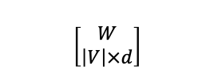

Word Vectors
Word2vec
Learn dense representations that capture word relationships
Skip-Gram with Negative Sampling (SGNS)
Generate two matrices (initialized randomly)
$$\left[\begin{aligned}W \\ \left|V\right|×d\end{aligned}\right]$$
$$\left[\begin{aligned}C \\ \left|V\right|×d\end{aligned}\right]$$
The matrices W will hold embeddings for our target words and C will hold embeddings for our context words.
When “Miami” is a target word, W will be updated and when “Miami” is a context word, the matrix C will be updated.
V is the vocabulary, and d is the dimension of embeddings we want (let’s say 300). W and C will be each $10000×300$

Slide 29

Word Vectors
Word2vec
Learn dense representations that capture word relationships
Skip-Gram with Negative Sampling (SGNS)
Represent each word in the vocabulary with a one-hot-vector:
“I” $\left[0,0,0,1,0,0,0,0,0,0\right]$
“have” $\left[0,0,1,0,0,0,0,0,0,0\right]$
“passes” $\left[0,0,0,0,0,1,0,0,0,0\right]$
“for” $\left[0,0,0,0,0,0,0,1,0,0\right]$
“the” $\left[1,0,0,0,0,0,0,0,0,0\right]$
“Miami” $\left[0,1,0,0,0,0,0,0,0,0\right]$
“grand” $\left[0,0,0,0,1,0,0,0,0,0\right]$
“prix” $\left[0,0,0,0,0,0,0,0,0,1\right]$

Slide 30
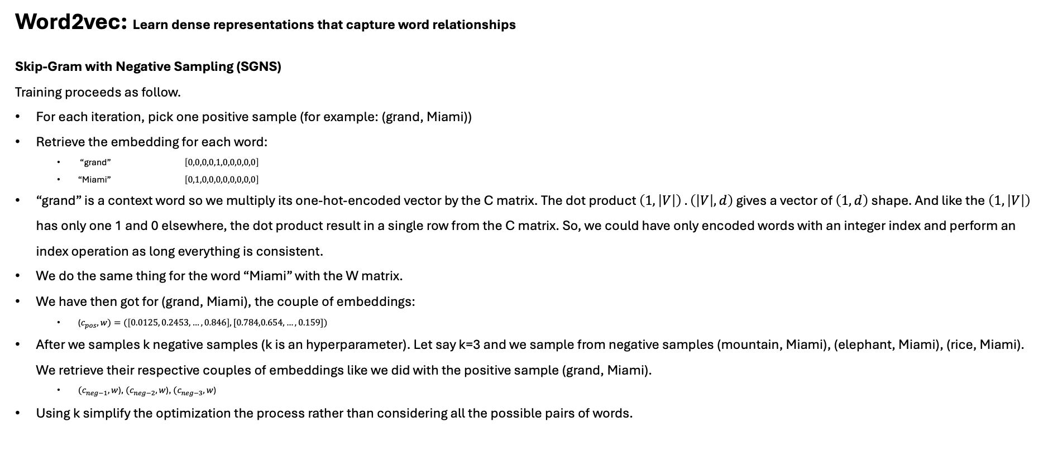
Word Vectors
Word2vec: Learn dense representations that capture word relationships
Skip-Gram with Negative Sampling (SGNS)
Training proceeds as follow.
For each iteration, pick one positive sample (for example: (grand, Miami))
Retrieve the embedding for each word:
“grand” $\left[0,0,0,0,1,0,0,0,0,0\right]$
“Miami” $\left[0,1,0,0,0,0,0,0,0,0\right]$
“grand” is a context word so we multiply its one-hot-encoded vector by the C matrix. The dot product $\left(1,\left|V\right|\right) . \left(\left|V\right|, d\right)$ gives a vector of $\left(1, d\right)$ shape. And like the $\left(1,\left|V\right|\right)$ has only one 1 and 0 elsewhere, the dot product result in a single row from the C matrix. So, we could have only encoded words with an integer index and perform an index operation as long everything is consistent.
We do the same thing for the word “Miami” with the W matrix.
We have then got for (grand, Miami), the couple of embeddings:
($c_{pos}, w)=(\left[0.0125, 0.2453, …,0.846\right], [0.784,0.654,…,0.159])$
After we samples k negative samples (k is an hyperparameter). Let say k=3 and we sample from negative samples (mountain, Miami), (elephant, Miami), (rice, Miami). We retrieve their respective couples of embeddings like we did with the positive sample (grand, Miami).
$(c_{neg−1}, w$), $(c_{neg−2}, w$), $(c_{neg−3}, w$)
Using k simplify the optimization the process rather than considering all the possible pairs of words.

Slide 31
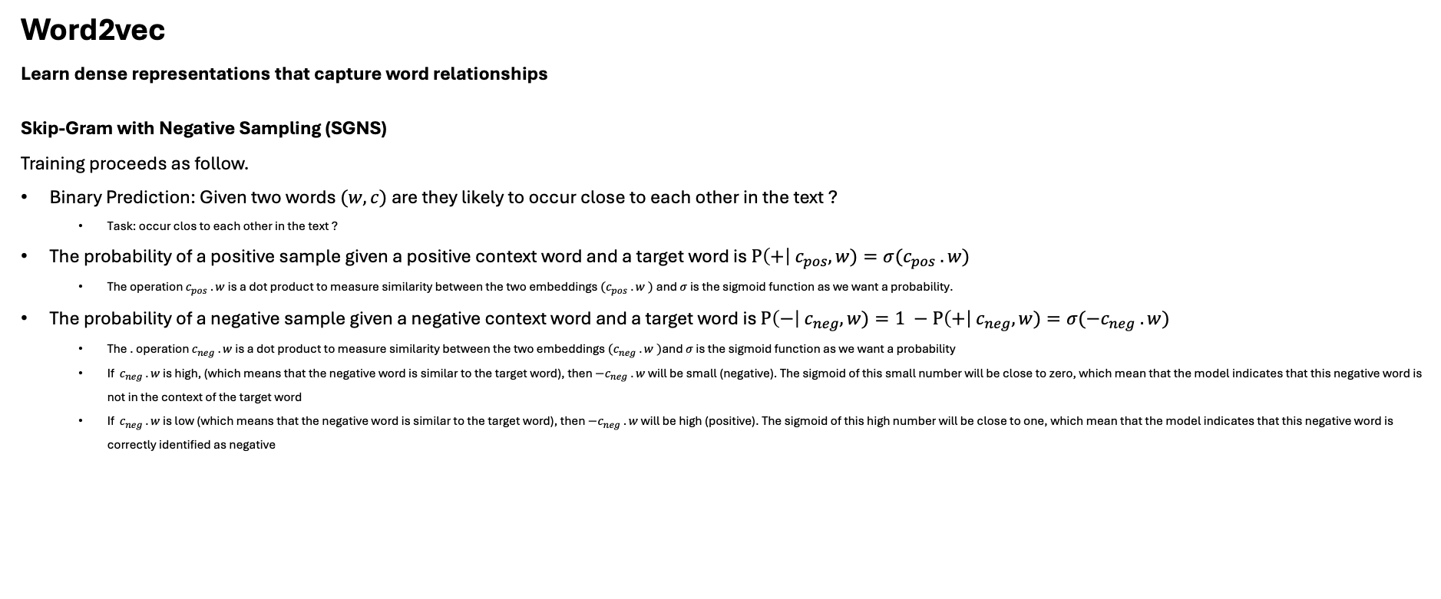
Word Vectors
Word2vec
Learn dense representations that capture word relationships
Skip-Gram with Negative Sampling (SGNS)
Training proceeds as follow.
Binary Prediction: Given two words $(w,c)$ are they likely to occur close to each other in the text ?
Task: occur clos to each other in the text ?
The probability of a positive sample given a positive context word and a target word is $P\left(+\right| c_{pos}, w)=σ(c_{pos} . w)$
The operation $c_{pos} . w$is a dot product to measure similarity between the two embeddings ${(c}_{pos} . w )$and $σ$ is the sigmoid function as we want a probability.
The probability of a negative sample given a negative context word and a target word is $P\left(−\right| c_{neg}, w)=1 −P\left(+\right| c_{neg}, w)=σ({−c}_{neg} . w)$
The . operation $c_{neg} . w$is a dot product to measure similarity between the two embeddings ${(c}_{neg} . w )$and $σ$ is the sigmoid function as we want a probability
If $c_{neg} . w$ is high, (which means that the negative word is similar to the target word), then ${−c}_{neg} . w$ will be small (negative). The sigmoid of this small number will be close to zero, which mean that the model indicates that this negative word is not in the context of the target word
If $c_{neg} . w$ is low (which means that the negative word is similar to the target word), then ${−c}_{neg} . w$ will be high (positive). The sigmoid of this high number will be close to one, which mean that the model indicates that this negative word is correctly identified as negative

Slide 32
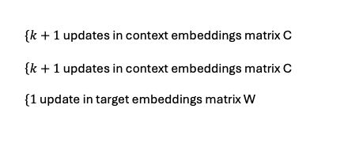
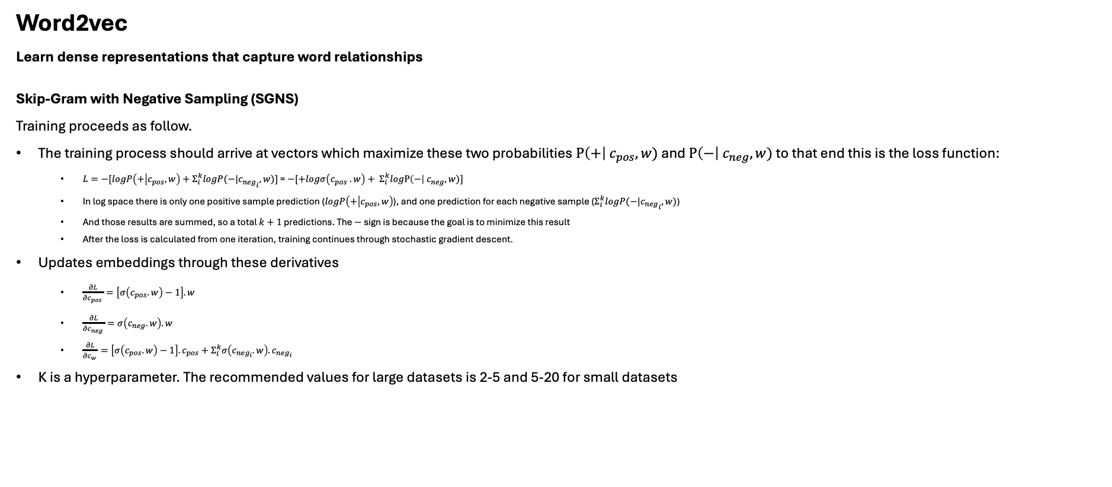
Word Vectors
Word2vec
Learn dense representations that capture word relationships
Skip-Gram with Negative Sampling (SGNS)
Training proceeds as follow.
The training process should arrive at vectors which maximize these two probabilities$P\left(+\right| c_{pos}, w)$ and $P\left(−\right| c_{neg}, w)$ to that end this is the loss function:
$L=−[logP\left(+ | c_{pos},w\right)+Σ_{i}^{k}logP(−|{c_{neg}}_{i},w)]$ = $−[+logσ\left(c_{pos} . w\right)+ Σ_{i}^{k}logP\left(−\right| c_{neg}, w)]$
In log space there is only one positive sample prediction ($logP\left(+ | c_{pos},w\right)$), and one prediction for each negative sample ($Σ_{i}^{k}logP(−|{c_{neg}}_{i},w)$)
And those results are summed, so a total $k+1$ predictions. The $−$ sign is because the goal is to minimize this result
After the loss is calculated from one iteration, training continues through stochastic gradient descent.
Updates embeddings through these derivatives
$\frac{∂L}{∂c_{pos} }=\left[σ\left(c_{pos}.w\right)−1\right].w$
$\frac{∂L}{∂c_{neg} }=σ\left(c_{neg}.w\right).w$
$\frac{∂L}{∂c_{w} }=\left[σ\left(c_{pos}.w\right)−1\right].c_{pos}+Σ_{i}^{k}σ\left(c_{neg_{i}}.w\right).c_{neg_{i}}$
K is a hyperparameter. The recommended values for large datasets is 2-5 and 5-20 for small datasets
$\left\{k+1\right.$ updates in context embeddings matrix C
$\left\{k+1\right.$ updates in context embeddings matrix C
$\left\{1\right.$ update in target embeddings matrix W

Slide 33
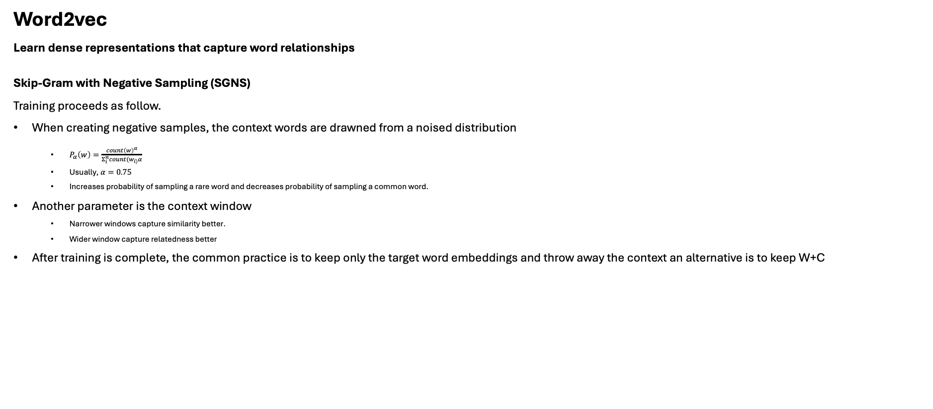
Word Vectors
Word2vec
Learn dense representations that capture word relationships
Skip-Gram with Negative Sampling (SGNS)
Training proceeds as follow.
When creating negative samples, the context words are drawned from a noised distribution
$P_{α}\left(w\right)=\frac{count{\left(w\right)}^{α}}{Σ_{i}^{n}count(w_{i)}α}$
Usually, $α=0.75$
Increases probability of sampling a rare word and decreases probability of sampling a common word.
Another parameter is the context window
Narrower windows capture similarity better.
Wider window capture relatedness better
After training is complete, the common practice is to keep only the target word embeddings and throw away the context an alternative is to keep W+C

