Slide 1
Logistic Regression

Slide 2
Introduction
The logistic regression is a linear model used to estimate probabilities rather than predicting specific values, as in a simple linear regression.
Notes:
net est le signal d’entrée
out est le signal de sortie

Slide 3



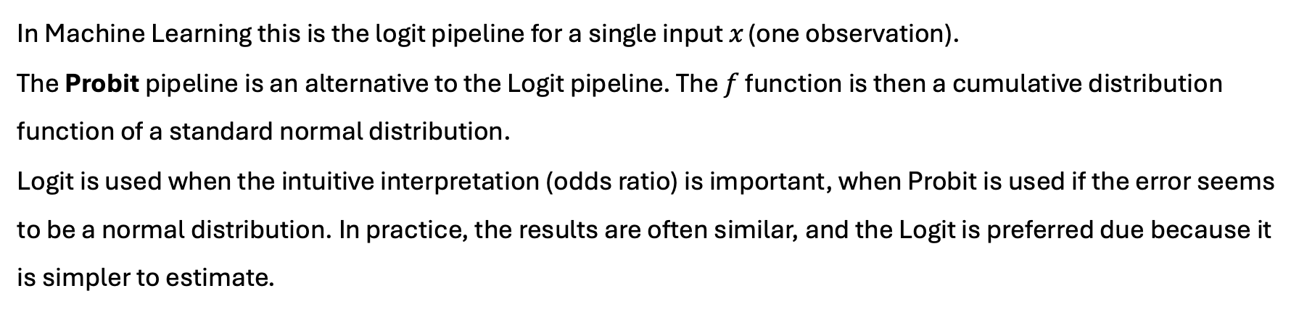
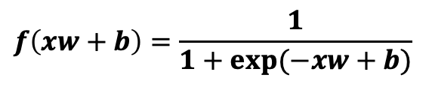





Logistic Regression: Logit pipeline
$$g$$
$$f$$
$$Loss$$
$$x$$
$$f\left(xw+b\right)=\frac{1}{1+exp⁡(−xw+b)}$$
$$=\hat{y}$$
$$y$$
$g_{x}\left(w,b\right)=xw+b$
$$−ylog(\hat{y})−(1−y)log⁡(1−\hat{y})$$
linear
sigmoid
cross-entropy
David Thébault
In Machine Learning this is the logit pipeline for a single input $x$ (one observation).
The Probit pipeline is an alternative to the Logit pipeline. The $f$ function is then a cumulative distribution function of a standard normal distribution.
Logit is used when the intuitive interpretation (odds ratio) is important, when Probit is used if the error seems to be a normal distribution. In practice, the results are often similar, and the Logit is preferred due because it is simpler to estimate.
Notes:
net est le signal d’entrée
out est le signal de sortie

Slide 4
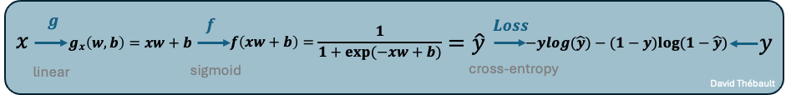
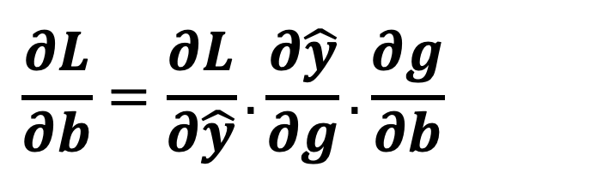
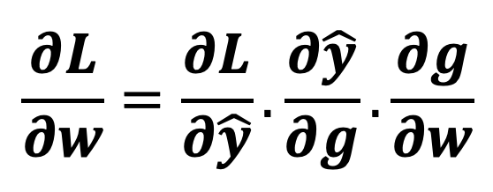
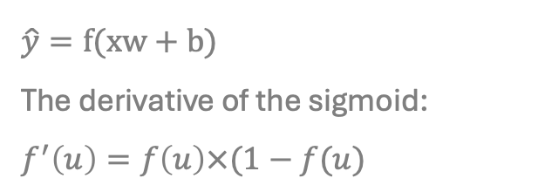
Logistic regression: Machine learning
As often in machine learning, the updates of the weights and bias is made using the gradient descent and the chain rule.
$$\frac{∂L}{∂w}=\frac{∂L}{∂\hat{y}}.\frac{∂\hat{y}}{∂g}.\frac{∂g}{∂w}$$
$$\hat{y}=f(xw+b)$$
The derivative of the sigmoid:
$$f^{′}\left(u\right)=f\left(u\right)×(1−f(u)$$
$$\frac{∂L}{∂b}=\frac{∂L}{∂\hat{y}}.\frac{∂\hat{y}}{∂g}.\frac{∂g}{∂b}$$

Slide 5
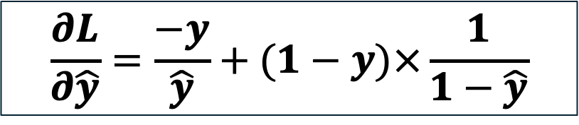
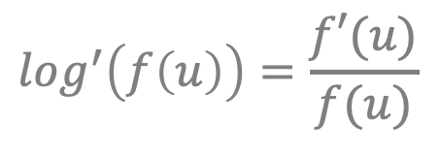
Logistic regression: Machine learning
Let’s do some maths to solve the chain rule…
$$\frac{∂L}{∂\hat{y}}=−y×\frac{∂\log\left(\hat{y}\right)}{∂\hat{y}}−\left(1−y\right)×\frac{∂\log\left(1−\hat{y}\right)}{∂\hat{y}}=−y×\frac{\frac{∂\hat{y}}{∂\hat{y}}}{\hat{y}}−\left(1−y\right)×\frac{\frac{∂\left(1−\hat{y}\right)}{∂\hat{y}}}{1−\hat{y}}=−y×\frac{1}{\hat{y}}−(1−y)×\frac{(−1)}{1−\hat{y}}$$
$$log^{′}\left(f\left(u\right)\right)=\frac{f′(u)}{f(u)}$$
$$\frac{∂L}{∂\hat{y}}=\frac{−y}{\hat{y}}+(1−y)×\frac{1}{1−\hat{y}}$$

Slide 6
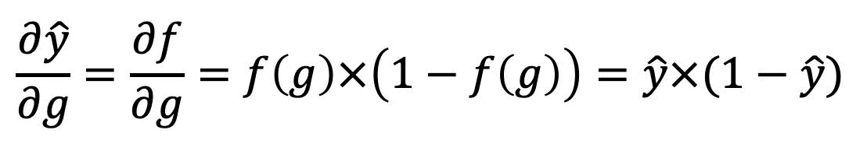
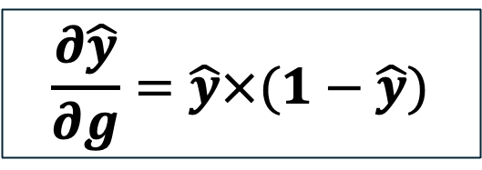

Logistic regression: Machine learning
Let’s do some maths to solve the chain rule…
$${\left(f∘g\right)}^{′}\left(u\right)=f′(g\left(u\right))×g′(u)$$
$$sigmoid^{′}\left(u\right)=sigmoid(u)×\left(1−sigmoid\left(u\right)\right)$$
$$\frac{∂\hat{y}}{∂g}=\frac{∂f}{∂g}=f\left(g\right)×\left(1−f\left(g\right)\right)=\hat{y}×(1−\hat{y})$$
$$\frac{∂\hat{y}}{∂g}=\hat{y}×(1−\hat{y})$$

Slide 7
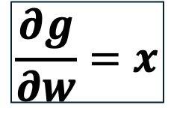
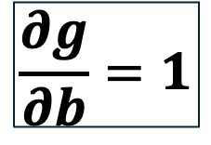
Logistic regression: Machine learning
Let’s do some maths to solve the chain rule…
$$\frac{∂g}{∂w}=x$$
$$\frac{∂g}{∂b}=1$$

Slide 8
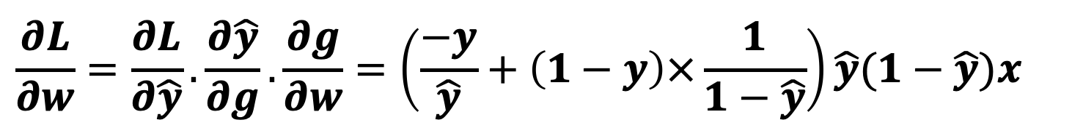
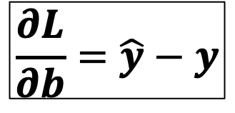
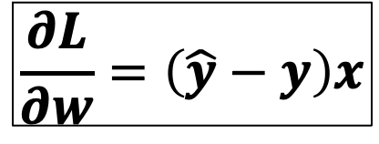
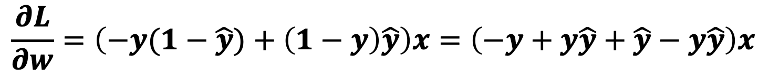
Logistic regression: Machine learning
Let’s do some maths to solve the chain rule…
$$\frac{∂L}{∂w}=\frac{∂L}{∂\hat{y}}.\frac{∂\hat{y}}{∂g}.\frac{∂g}{∂w}=\left(\frac{−y}{\hat{y}}+\left(1−y\right)×\frac{1}{1−\hat{y}}\right)\hat{y}(1−\hat{y})x$$
$$\frac{∂L}{∂w}=\left(−y(1−\hat{y})+\left(1−y\right)\hat{y}\right)x=\left(−y+y\hat{y}+\hat{y}−y\hat{y}\right)x$$
$$\frac{∂L}{∂w}=\left(\hat{y}−y\right)x$$
$$\frac{∂L}{∂b}=\hat{y}−y$$

Slide 9
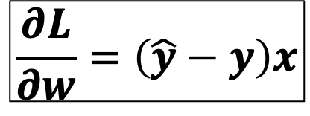
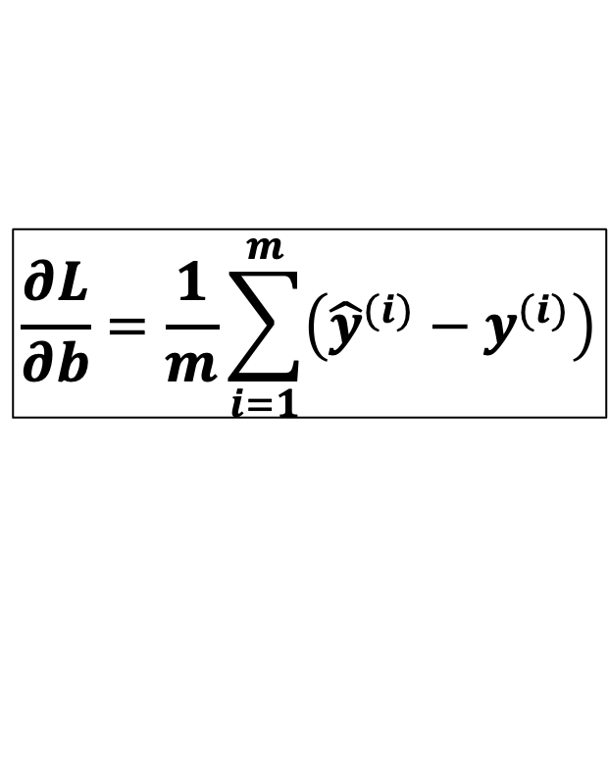
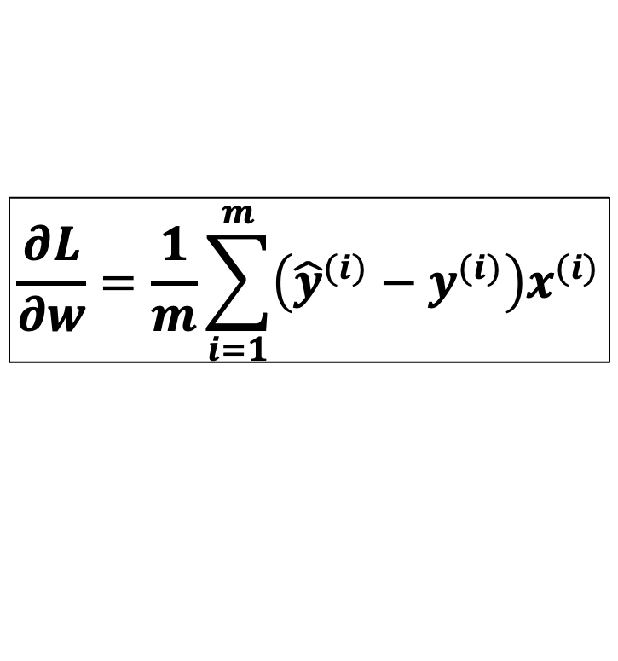
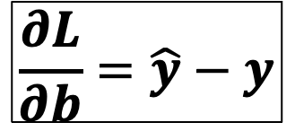
Logistic regression: Machine learning
Generalization to m inputs (examples) by averaging the gradients.
$$\frac{∂L}{∂w}=\frac{1}{m}\sum_{i=1}^{m}{\left({\hat{y}}^{(i)}−y^{(i)}\right)x^{(i)}}$$
$$\frac{∂L}{∂w}=\left(\hat{y}−y\right)x$$
One sample:
m samples :
$$\frac{∂L}{∂b}=\hat{y}−y$$
$$\frac{∂L}{∂b}=\frac{1}{m}\sum_{i=1}^{m}{\left({\hat{y}}^{(i)}−y^{(i)}\right)}$$

Slide 10




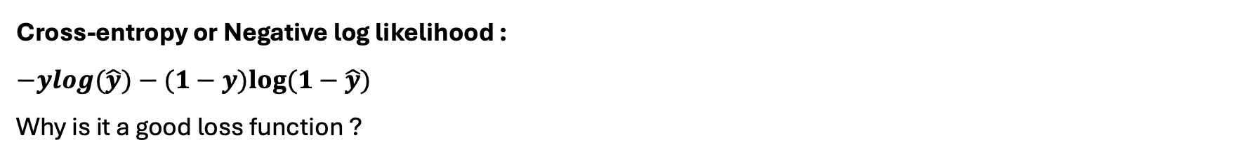



Logistic regression: Cross-entropy
Cross-entropy or Negative log likelihood :
$$−ylog(\hat{y})−(1−y)log⁡(1−\hat{y})$$
Why is it a good loss function ?
Case 1
$$−ylog\left(\hat{y}\right)=−0×\log\left(\hat{y}\right)=0, −\left(1−y\right)\log\left(1−\hat{y}\right)=−\log\left(0^{+}\right)→+∞$$
$$y=0,\hat{y}→1$$
$$L→+∞$$
Case 2
$−ylog\left(\hat{y}\right)=−0×\log\left(\hat{y}\right)=0, −\left(1−y\right)\log\left(1−\hat{y}\right)=−\log\left(1^{−}\right)→$ 0
$$L→0$$
$$y=0,\hat{y}→0$$
Case 3
$$−ylog\left(\hat{y}\right)=−\log\left(\hat{y}\right)→+∞, −\left(1−y\right)\log\left(1−\hat{y}\right)=−0×\log\left(1−\hat{y}\right)=0$$
$$y=1,\hat{y}→0$$
$$L→+∞$$
Case 4
$$−ylog\left(\hat{y}\right)=−\log\left(\hat{y}\right)→0, −\left(1−y\right)\log\left(1−\hat{y}\right)=−0×\log\left(1−\hat{y}\right)=0$$
$$L→0$$
$$y=1,\hat{y}→1$$

Slide 11


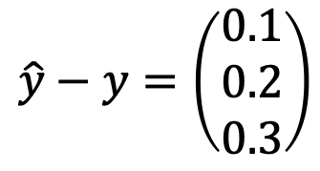
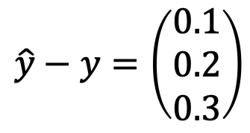
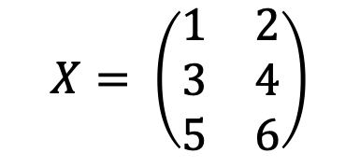
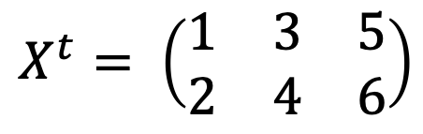
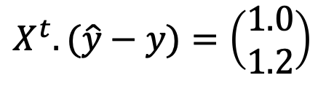




Logistic regression: Algebra
Focus on the weight's dimensions
If we have 3 examples with 2 characteristics:
To make the dot product works we need to transpose
$$X= \left(\begin{matrix}1 & 2 \\ 3 & 4 \\ 5 & 6\end{matrix}\right)$$
$$\hat{y}−y=\left(\begin{matrix}0.1 \\ 0.2 \\ 0.3\end{matrix}\right)$$
$$X^{t}= \left(\begin{matrix}1 & 3 & 5 \\ 2 & 4 & 6\end{matrix}\right)$$
$$(3,2)$$
Assuming we know that error:
$$(2,3)$$
$$(3,1)$$
$$\hat{y}−y=\left(\begin{matrix}0.1 \\ 0.2 \\ 0.3\end{matrix}\right)$$
$$X^{t}.(\hat{y}−y)=\left(\begin{aligned}1.0 \\ 1.2\end{aligned}\right)$$
$$(2,1)$$
$$(3,1)$$

Slide 12
Logistic regression: Python from scratch
class Logistic_Regression:
def sigmoid(self, x):
return 1 / (1 + np.exp(-x))
def __init__(self, learning_rate=0.001, n_iter=1000):
self.n_iter = n_iter
self.learning_rate = learning_rate
self.weights = None
self.bias = None
def fit(self, X, y):
n_samples, n_features = X.shape
self.weights = np.zeros(n_features)
self.bias = 0
for _ in range(n_features):
linear_model = np.dot(X, self.weights) + self.bias
y_hat = self.sigmoid(linear_model)
dw = (1 / n_samples) * np.dot(X.T, (y - y_hat))
db = (1 / n_samples) * np.sum(y - y_hat)
self.weights -= self.learning_rate * dw
self.bias -= self.learning_rate * db
def predict(self, X):
linear_model = np.dot(X, self.weights) + self.bias
y_predict = self.sigmoid(linear_model)
y_predict_class = [1 if i > 0.5 else 0 for i in y_predict]
return y_predict_class

Slide 13
Logistic Regression with sklearn
# Import the packages:
import numpy as np
import matplotlib.pyplot as plt
from sklearn.datasets import load_breast_cancer
from sklearn.model_selection import train_test_split
from sklearn.preprocessing import StandardScaler
from sklearn.linear_model import LogisticRegression
from sklearn.metrics import accuracy_score, confusion_matrix, classification_report

Slide 14
Logistic Regression with sklearn
# Load the Breast Cancer dataset
data = load_breast_cancer()
X, y = data.data, data.target # Features and target (0 = malignant, 1 = benign)
# Split the dataset into training and test sets
X_train, X_test, y_train, y_test = train_test_split(X, y, test_size=0.2, random_state=42, stratify=y)
# Standardize the features (important for logistic regression)
scaler = StandardScaler()
X_train = scaler.fit_transform(X_train)
X_test = scaler.transform(X_test)
# Train the logistic regression model
model = LogisticRegression(max_iter=10000) # Increase max_iter to ensure convergence
model.fit(X_train, y_train)
# Make predictions on the test set
y_pred = model.predict(X_test)
# Evaluate the model
accuracy = accuracy_score(y_test, y_pred)
conf_matrix = confusion_matrix(y_test, y_pred)
report = classification_report(y_test, y_pred)
print(f"Model accuracy: {accuracy:.2f}")
print("Confusion Matrix:\n", conf_matrix)
print("Classification Report:\n", report)

Slide 15
Logistic Regression with sklearn
# Plot feature importance (coefficients)
plt.figure(figsize=(10, 5))
plt.barh(data.feature_names, model.coef_[0])
plt.xlabel("Coefficient value")
plt.ylabel("Feature")
plt.title("Feature Importance in Logistic Regression")
plt.show()

