Slide 1
Introduction to Neural Network

Slide 2

Neural Network as a function
Input
f
Output
Where f is the function
Notes:
See the neural networks as a function.

Slide 3

Neural Network as a function
X = 3
f(x , w) = x . w
3
10
W = 1
f(x , w) – Target =
3 – 10 = -7
The goal is to adjust W to match the target value or get as close as possible.
Notes:
Imagine you have two input values x and w respectively equal to 3 and 1. Your function makes the product and so result in 3. But your target is to get 10. Are your close ? No so you will need to modify your parameter which is W.

Slide 4
Neural Network as a function
X = 3
f(x , w) = x . w
3
10
W = 1
f(x , w) – target = 3 – 10 = -7
X is the feature given by the experience
W is the weight
The goal is to adjust W to match the target value or get as close as possible.
Notes:
Imagine you have two input values x and w respectively equal to 3 and 1. Your function makes the product and so result in 3. But your target is to get 10. Are your close ? No so you will need to modify your parameter which is W.

Slide 5


Perceptron with a single input
Perceptron is a model composed a single neuron that takes one or several inputs (below on input) and weight and sum the input(s) and then apply an activation function $σ$in order to produce an output.
x
_{w}
$Loss= \frac{1}{2}(out−target)$²
net
out
_{b}
Forward Pass
net = $X × w$ + b out $=σ\left(net\right)$
A neuron is also called a unit or a node.
Note: in general, we have more than one input feature.

Slide 6
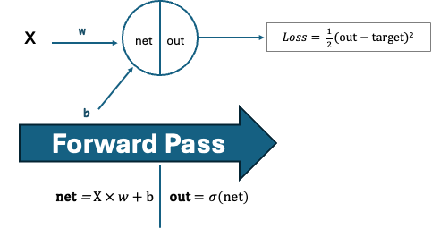
Perceptron with a single input
The output of a Neural Network (NN) is just a function
It means that we can chain and compose layers of units into NN to approximate even more complex functions.
If a function transform input into outputs, then layers of units working together can help us to find more complex transformations between input and outputs.
For example: transformation of an input image into a label output describing what's the image.

Slide 7
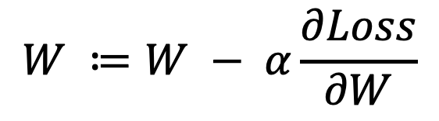
Perceptron
How do we find the optimal w and b that minimize the loss ?
In our simplified example we could test different values, but the computer needs a rule and an ending step for every cases.
If we can figure out how changing W affects the Loss and specifically how it can lower the Loss then, we can use this information to adjust W accordingly.
We do have this information ☺
We can use the derivative of the Loss function with respect to W to measure its sensitivity to W.
This fundamental of Artificial Intelligence is called the Gradient descent and we will see an example just after.
$$W ≔W − α\frac{∂Loss}{∂W}$$

Slide 8
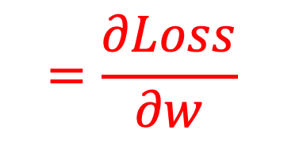
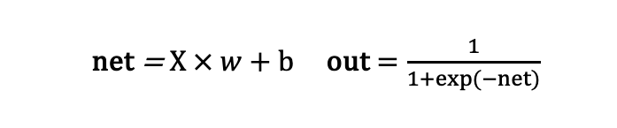
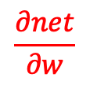
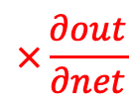
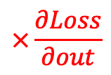
Perceptron with a single input
How do we find the optimal w and b that minimize the loss ?
In the case of NN the Gradient is computed thanks to the Chain rule
x
_{w}
$Loss= \frac{1}{2}(out−target)$²
net
out
_{b}
$$=\frac{∂Loss}{∂w}$$
$$\frac{∂net}{∂w}$$
$$×\frac{∂out}{∂net}$$
$$×\frac{∂Loss}{∂out}$$
BACKPROPAGATION
net = $X × w$ + b out $=\frac{1}{1+exp⁡(−net)}$

Slide 9
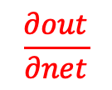
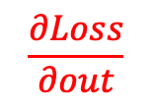
Perceptron with a single input
How do we find the optimal w and b that minimize the loss ?
Gradient descent
x
_{w}
$Loss= \frac{1}{2}(out−target)$²
net
out
_{b}
?
?
?
$$\frac{∂net}{∂w}$$
$$\frac{∂out}{∂net}$$
$$\frac{∂Loss}{∂out}$$
BACKPROPAGATION
net = $X × w$ + b out $=\frac{1}{1+exp⁡(−net)}$

Slide 10









Perceptron with a single input
How do we find the optimal w and b that minimize the loss ?
Gradient descent
x
_{w}
$Loss= \frac{1}{2}(out−target)$²
net
out
_{b}
$$\frac{∂Loss}{∂out}$$
$$out −target$$
?
?
?
$$\frac{∂net}{∂w}$$
$$\frac{∂out}{∂net}$$
$$\frac{∂Loss}{∂out}$$
$$\frac{∂out}{∂net}$$
$$out(1 −out)$$
BACKPROPAGATION
$$=$$
$$\frac{∂net}{∂w}$$
$$x$$
net = $X × w$ + b out $=\frac{1}{1+exp⁡(−net)}$
$$\frac{∂net}{∂b}$$
$$1$$

Slide 11
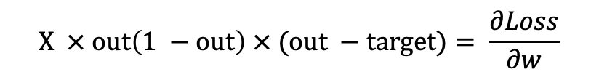
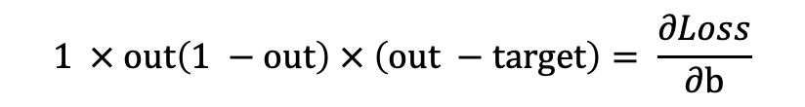
Perceptron with a single input
How do we find the optimal w and b that minimize the loss ?
In the case of NN the Gradient is computed thanks to the Chain rule
x
_{w}
$Loss= \frac{1}{2}(out−target)$²
net
out
_{b}
$$=\frac{∂Loss}{∂w}$$
$$\frac{∂net}{∂w}$$
$$×\frac{∂out}{∂net}$$
$$×\frac{∂Loss}{∂out}$$
$$X × out\left(1 −out\right) × (out −target)= \frac{∂Loss}{∂w}$$
$$1 × out\left(1 −out\right) × \left(out −target\right)= \frac{∂Loss}{∂b}$$

Slide 12
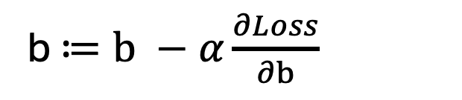
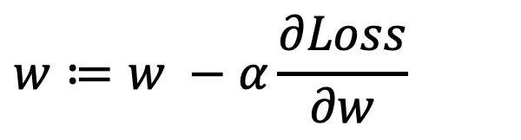
Perceptron with a single input
Now we update W and b
x
_{w}
$Loss= \frac{1}{2}(out−target)$²
net
out
_{b}
$$w≔w −α\frac{∂Loss}{∂w}$$
b $≔b −α\frac{∂Loss}{∂b}$

Slide 13
Perceptron with a single input
We repeat the Forward Pass with the new W and b
x
_{w}
$Loss= \frac{1}{2}(out−target)$²
net
out
_{b}
Forward Pass
net = $X × w$ + b out $=σ\left(net\right)$
BACKPROPAGATION
The loss has decreased, and we iterate the updates of the weights and bias and the Forward Pass.

Slide 14
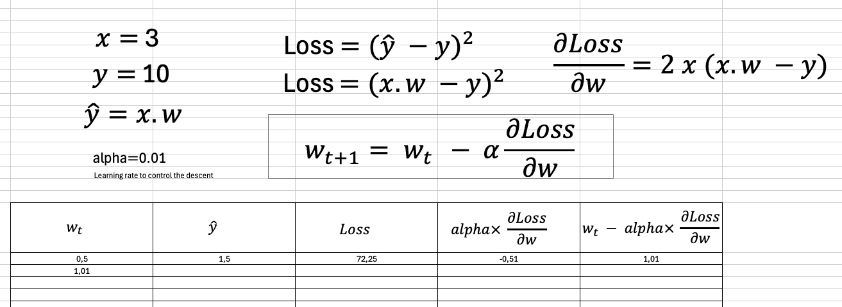
Perceptron with a single input
How do we find¹ the optimal w that minimize the loss ?
Gradient descent
¹ For simplicity, we have only taken w and not b

Slide 15
Perceptron with two inputs

Slide 16
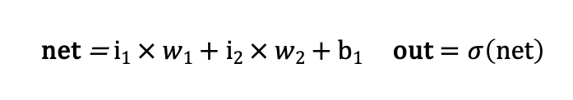
Perceptron
Two inputs and a single neuron with an activation function sigma
i₁
_{w1}
net
out
$Loss= \frac{1}{2}(out−target)$²
i₂
_{w2}
_{b1}
Forward Pass
net = $i1 × w1$ + $i2 × w2$ + b₁ out $=σ\left(net\right)$
A neuron is also called a unit or a node.

Slide 17
Perceptron
How do we find the optimal w₁, w₂ and b₁ that minimize the loss ?
i₁
_{w1}
net
out
$Loss= \frac{1}{2}(out−target)$²
i₂
_{w2}
_{b1}
BACKPROPAGATION

Slide 18
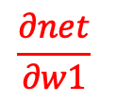
Perceptron
How do we find the optimal w₁, w₂ and b₁ that minimize the loss ?
i₁
_{w1}
net
out
$Loss= \frac{1}{2}(out−target)$²
i₂
_{w2}
_{b1}
?
?
?
$$\frac{∂net}{∂w1}$$
$$\frac{∂out}{∂net}$$
$$\frac{∂Loss}{∂out}$$
Gradient
BACKPROPAGATION

Slide 19
Perceptron
How do we find the optimal w₁, w₂ and b₁ that minimize the loss ?
i₁
_{w1}
net
out
$Loss= \frac{1}{2}(out−target)$²
i₂
_{w2}
_{b1}
?
?
?
$$\frac{∂net}{∂w1}$$
$$\frac{∂out}{∂net}$$
$$\frac{∂Loss}{∂out}$$
Gradient
BACKPROPAGATION

Slide 20






Perceptron
How do we find the optimal w₁, w₂ and b₁ that minimize the loss ?
i₁
_{w1}
net
out
$Loss= \frac{1}{2}(out−target)$²
i₂
_{w2}
_{b1}
?
?
?
$$\frac{∂net}{∂w1}$$
$$\frac{∂out}{∂net}$$
$$\frac{∂Loss}{∂out}$$
Gradient
$$\frac{∂Loss}{∂out}$$
$$out −target$$
BACKPROPAGATION
$$\frac{∂out}{∂net}$$
$$out(1 −out)$$
$$\frac{∂net}{∂w1}$$
$$x$$

Slide 21
Perceptron
How do we find the optimal w₁, w₂ and b₁ that minimize the loss ?
i₁
_{w1}
net
out
$Loss= \frac{1}{2}(out−target)$²
i₂
_{w2}
The process
_{b1}
set w to some initial value(s)

Slide 22
Neural Networks with multiple layers I

Slide 23
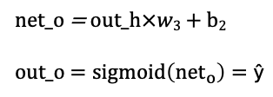
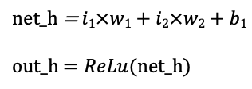

Neural Network
i₁
_{w1}
_{w3}
net_h
out_h
net_o
out_o
$Loss= \frac{1}{2}(out_{o}−target_{o})$²
i₂
_{w2}
_{b1}
_{b2}
Input layer
Hidden layer
Output layer
net_h = $i1×w1+i2×w2+b1$
out_h $=ReLu(net_h)$
net_o = $out_h×w3$ + b₂
out_o $=sigmoid\left({net}_{o}\right)=\text{ŷ}$
Forward Pass

Slide 24
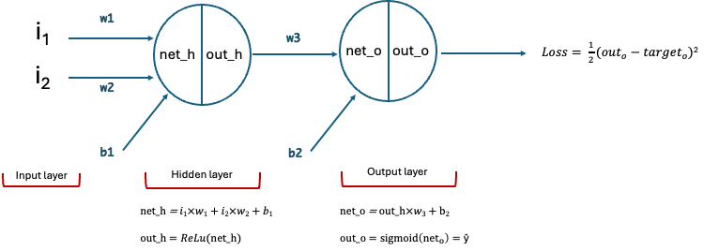



Neural Network
Gradient
$$\frac{∂Loss}{∂out_o} =out_o−target$$
$\frac{∂out_o}{∂net_o}$= out_o$\left(1−{out}_{o}\right)$
$\frac{∂net_o}{∂w3}$ = out_h
THE CHAIN RULE
$\frac{∂Loss}{∂w3}= \frac{∂Loss}{∂out_o} ×\frac{∂out_o}{∂net_o}×\frac{∂net_o}{∂w3}$ = ($out_o−target$) $× \text{out}\text{_}\text{o} (1−out_o)$ $× out_h$
$\frac{∂Loss}{∂b2}= \frac{∂Loss}{∂out_o} ×\frac{∂out_o}{∂net_o}×\frac{∂net_o}{∂b2}\text{= }\text{(}out_o−target\text{) }× \text{out}\text{_}\text{o} (1−out_o) ×$ 1

Slide 25
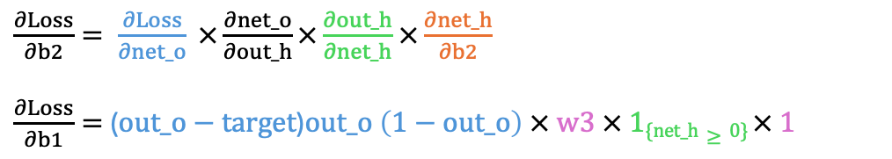

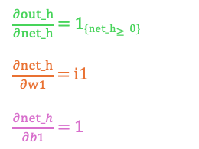
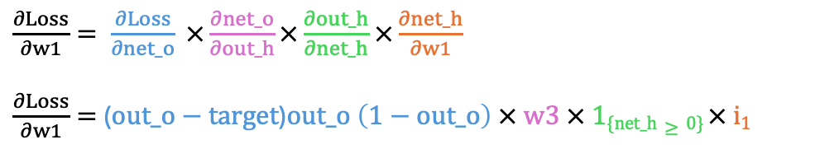
Neural Network
Gradient
CHAIN RULE
$\frac{∂Loss}{∂w1}= \frac{∂Loss}{∂net_o} ×\frac{∂net_o}{∂out_h}×\frac{∂out_h}{∂net_h}$ $×\frac{∂net_h}{∂w1}$
$\frac{∂Loss}{∂w1}=$($out_o−target$)$\text{out}\text{_}\text{o} \left(1−out_o\right) × w3 × \text{1}\text{\{}\text{net}\text{_}\text{h}≥0\text{\}} × i1$
$\frac{∂out_h}{∂net_h}$ = 1_{{net_h}$≥0$}
$\frac{∂net_h}{∂w1}$ = i1
$\frac{∂net_h}{∂b1}$ = 1
$$\frac{∂net_o}{∂out_h}=w3$$
$\frac{∂Loss}{∂w2}=$($out_o−target$)$\text{out}\text{_}\text{o} \left(1−out_o\right) × w3 × \text{1}\text{\{}\text{net}\text{_}\text{h}≥0\text{\}} × i2$
$\frac{∂Loss}{∂b2}= \frac{∂Loss}{∂net_o} ×\frac{∂net_o}{∂out_h}×\frac{∂out_h}{∂net_h}$ $×\frac{∂net_h}{∂b2}$
$\frac{∂Loss}{∂b1}=$($out_o−target$)$\text{out}\text{_}\text{o} \left(1−out_o\right) × w3 × \text{1}\text{\{}\text{net}\text{_}\text{h}≥0\text{\}} × 1$

Slide 26
Neural Networks with multiple layers II

Slide 27

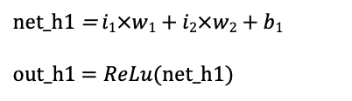


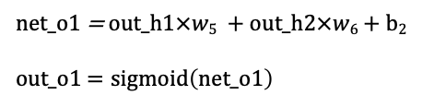
Neural Network
Layers
Combining neurons in a neural network. Vertical combination of units gives a layer.
i₁
_{w1}
_{w5}
net_o1
out_o1
$Loss1= \frac{1}{2}(out_{o1}−target_{o1})$²
net_h1
out_h1
_{w2}
_{w6}
_{w3}
_{w7}
i₂
_{w4}
_{w8}
$$Loss2= \frac{1}{2}\left(out_{o2}−target_{o2}\right)2$$
net_h2
out_h2
net_o2
out_o2
_{b1}
_{b2}
$$Loss=Loss1+Loss2$$
Input layer
Hidden layer with 2 units
Output layer
net_h1 = $i1×w1+i2×w2+b1$
out_h1 $=ReLu(net_h1)$
net_o1 = $out_h1×w5$ + $out_h2×w6$ + b₂
out_o1 $=sigmoid\left(net_o1\right)$

Slide 28
Neural Network
Layers
Combining neurons in a neural network. Vertical combination of units gives a layer.
i₁
_{w1}
_{w5}
net_o1
out_o1
$Loss1= \frac{1}{2}(out_{o1}−target_{o1})$²
net_h1
out_h1
_{w2}
_{w6}
_{w3}
_{w7}
i₂
_{w4}
_{w8}
$$Loss2= \frac{1}{2}\left(out_{o2}−target_{o2}\right)2$$
net_h2
out_h2
net_o2
out_o2
_{b1}
_{b2}
We only have two inputs features so each neuron of the hidden layer will have two weights.
In this example, the bias is the same for each neuron of the input hidden layer and the same for each neuron of the output hidden layer. Weights have been introduced for the output layer.
This is a "two-layer network" because by convention, the Input layer is not counted.

Slide 29
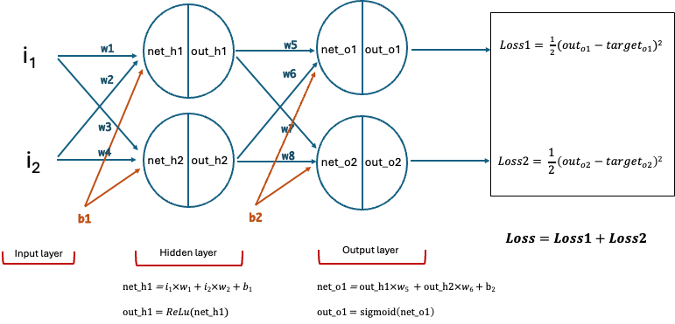

Neural Network
Gradient
$$\frac{∂Loss1}{∂w1}$$
BACKPROPAGATION + CHAIN RULE
$$\frac{∂Loss1}{∂w1}=\frac{∂Loss1}{∂out_o1} ×\frac{∂out_o1}{∂net_o1} ×\frac{∂net_o1}{∂out_h1} ×\frac{∂out_h1}{∂net_h1}×\frac{∂net_h1}{∂w1}$$
$$\frac{∂Loss1}{∂w1}=\text{(}out_o1−target_o1\text{)}×out_o1(1−out_o1)×\frac{∂net_o1}{∂out_h1} ×\frac{∂out_h1}{∂net_h1}×\frac{∂net_h1}{∂w1}$$
$$\frac{∂Loss1}{∂w1}=\text{(}out_o1−target_o1\text{)}×out_o1(1−out_o1)×\frac{∂net_o1}{∂out_h1} ×\frac{∂out_h1}{∂net_h1}×\frac{∂net_h1}{∂w1}$$
$$\frac{∂Loss1}{∂w1}=\text{(}out_o1−target_o1\text{)}×out_o1(1−out_o1)×w5 ×\frac{∂out_h1}{∂net_h1}×\frac{∂net_h1}{∂w1}$$
$$\frac{∂Loss1}{∂w1}=\text{(}out_o1−target_o1\text{)}×out_o1(1−out_o1)×w5 ×\frac{∂out_h1}{∂net_h1}×\frac{∂net_h1}{∂w1}$$
$\frac{∂Loss1}{∂w1}=\text{(}out_o1−target_o1\text{)}×out_o1(1−out_o1)×w5 ×$ $1_{\{net_h1>0\}}×i1$
$\frac{∂Loss1}{∂w1}=\text{(}out_o1−target_o1\text{)}×out_o1(1−out_o1)×w5 ×$ $1_{\{net_h1>0\}}×\frac{∂net_h1}{∂w1}$
Symmetrically
$\frac{∂Loss1}{∂w1}=\text{(}out_o1−target_o1\text{)}×out_o1(1−out_o1)×w5 ×$ $1_{\{net_h1>0\}}×\frac{∂net_h1}{∂w1}$
$\frac{∂Loss2}{∂w4}=\text{(}out_o2−target_o\text{2}\text{)}×out_o2(1−out_o2)×w8 ×$ $1_{\{net_h2>0\}}×i$2

Slide 30

Neural Network
Gradient
$$\frac{∂Loss1}{∂w2}$$
BACKPROPAGATION + CHAIN RULE
$\frac{∂Loss1}{∂w2}= \frac{∂Loss1}{∂net_h1} ×\frac{∂net_h1}{∂w2}$
$$\frac{∂Loss1}{∂w2}=\text{(}out_o1−target_o1\text{) }× out_o1(1−out_o1)×w5×1\{net_h1≥0\})×i2$$
Symmetrically
$\frac{∂Loss2}{∂w3}=\text{(}out_o2−target_o\text{2}\text{) }× out_o2(1−out_o2)×w8×1\{net_h2≥0\})×i$₁
From previously we know that:
$$\frac{∂Loss1}{∂net_h1}=\text{(}out_o1−target_o1\text{) }× out_o1(1−out_o1)×w5×1\{net_h1≥0\}$$

Slide 31

Neural Network
Gradient
$$\frac{∂Loss1}{∂w3}$$
BACKPROPAGATION + CHAIN RULE
$\frac{∂Loss1}{∂w3}=\frac{∂Loss1}{∂net_o1} ×\frac{∂net_o1}{∂out_h2}×\frac{∂out_h2}{∂net_h2}$ $×\frac{∂net_h2}{∂w3}$
$\frac{∂Loss1}{∂w3}=\text{(}out_o1−target_o1\text{) }× out_o1(1−out_o1)×\frac{∂net_o1}{∂out_h2}×\frac{∂out_h2}{∂net_h2}$ $×\frac{∂net_h2}{∂w3}$
$\frac{∂Loss1}{∂w3}=\text{(}out_o1−target_o1\text{) }× out_o1(1−out_o1)×w6×\frac{∂out_h2}{∂net_h2}$ $×\frac{∂net_h2}{∂w3}$
$\frac{∂Loss1}{∂w3}=\text{(}out_o1−target_o1\text{) }× out_o1(1−out_o1)×w6×1\{net_h2$ $>0\}$ $×\frac{∂net_h2}{∂w3}$
$\frac{∂Loss1}{∂w3}=\text{(}out_o1−target_o1\text{) }× out_o1(1−out_o1)×w6×1\{net_h2$ $>0\}$ $× i1$
Symmetrically
$\frac{∂Loss2}{∂w2}=\text{(}out_o2−target_o\text{2}\text{) }× out_o2(1−out_o2)×w7×1\{net_h$₁ $>0\}$ $× i2$

Slide 32

Neural Network
Gradient
$$\frac{∂Loss1}{∂w4}$$
BACKPROPAGATION + CHAIN RULE
$\frac{∂Loss1}{∂w4}= \frac{∂Loss1}{∂net_o1} ×\frac{∂net_o1}{∂out_h2}×\frac{∂out_h2}{∂net_h2}$ $×\frac{∂net_h2}{∂w4}$
$$\frac{∂Loss1}{∂w4}=\text{(}out_o1−target_o1\text{) }× out_o1(1−out_o1)×w6×1\{net_h2 >0\} ×i2$$
Symmetrically
$\frac{∂Loss2}{∂w1}=\text{(}out_o2−target_o\text{2}\text{) }× out_o2(1−out_o2)×w7×1\{net_h\text{1} >0\} ×i$₁

Slide 33

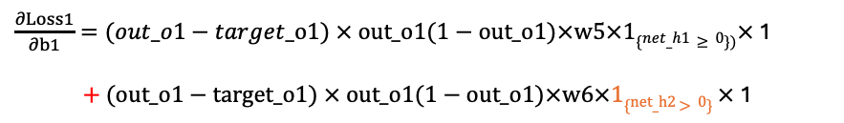

Neural Network
Gradient
$$\frac{∂Loss1}{∂b1}$$
BACKPROPAGATION + CHAIN RULE
$$\frac{∂Loss1}{∂b1}= \frac{∂Loss1}{∂net_h1} ×\frac{∂net_h1}{∂b1}+\frac{∂Loss1}{∂net_h2} ×\frac{∂net_h2}{∂b1}$$
$\frac{∂Loss1}{∂b1}=\text{(}out_o1−target_o1\text{) }× out_o1(1−out_o1)×w5×1\{net_h1≥0\})×$1
$+$ $\text{(}out_o1−target_o1\text{) }× out_o1(1−out_o1)×w6×1\{net_h2$ $>0\}$ $×$ 1
$\frac{∂Loss1}{∂b1}=\text{(}out_o1−target_o1\text{) }× out_o1(1−out_o1)×(w5×1\{net_h1≥0\}) +w6×1\{net_h2$ $>0\}$ $)$
Symmetrically
$\frac{∂Loss2}{∂b1}=\text{(}out_o2−target_o\text{2}\text{) }× out_o2(1−out_o2)×(w8×1\{net_h2≥0\}) +w7×1\{net_h$₁ $>0\}$ $)$

Slide 34



Neural Network
Gradient
$$\frac{∂Loss1}{∂w1}$$
BACKPROPAGATION + CHAIN RULE
$$\frac{∂Loss1}{∂w5}=\frac{∂Loss1}{∂out_o1} ×\frac{∂out_o1}{∂net_o1} ×\frac{∂net_o1}{∂w5}$$
$$\frac{∂Loss1}{∂w5}=\text{(}out_o1−target_o1\text{)}×out_o1(1−out_o1)×out_h1$$
$$\frac{∂Loss1}{∂w5}=\text{(}out_o1−target_o1\text{)}×out_o1(1−out_o1)×out_h1$$
Symmetrically
$\frac{∂Loss2}{∂w8}=\text{(}out_o2−target_o\text{2}\text{)}×out_o2(1−out_o2)×out_h$2

Slide 35
Neural Network
Gradient
$$\frac{∂Loss1}{∂b1}$$
BACKPROPAGATION + CHAIN RULE
$$\frac{∂Loss1}{∂w6}=\frac{∂Loss1}{∂out_o1} ×\frac{∂out_o1}{∂net_o1} ×\frac{∂net_o1}{∂w6}$$
$$\frac{∂Loss1}{∂w6}=\text{(}out_o1−target_o1\text{)}×out_o1(1−out_o1)×out_h2$$
$$\frac{∂Loss1}{∂w6}=\text{(}out_o1−target_o1\text{)}×out_o1(1−out_o1)×out_h2$$
Symmetrically
$\frac{∂Loss2}{∂w7}=\text{(}out_o2−target_o\text{2}\text{)}×out_o2(1−out_o2)×out_h$1

Slide 36


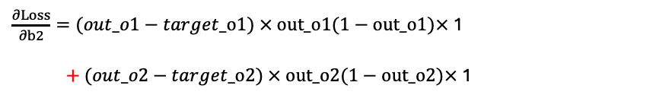

Neural Network
Gradient
$$\frac{∂Loss}{∂b2}$$
BACKPROPAGATION + CHAIN RULE
$$\frac{∂Loss}{∂b2}= \frac{∂Loss1}{∂b2}+\frac{∂Loss2}{∂b2}$$
$$\frac{∂Loss}{∂b2}= \frac{∂Loss1}{∂net_o1} ×\frac{∂net_o1}{∂b2}+\frac{∂Loss2}{∂net_o2} ×\frac{∂net_o2}{∂b2}$$
$\frac{∂Loss}{∂b2}=\text{(}out_o1−target_o1\text{) }× out_o1(1−out_o1)×$1
$+$ $\text{(}out_o2−target_o\text{2}\text{) }× out_o2(1−out_o2)×$1
$\frac{∂Loss}{∂b2}=\text{(}out_o1−target_o1\text{) }× out_o1(1−out_o1) +$ $\text{(}out_o2−target_o\text{2}\text{) }× out_o2(1−out_o2)$

Slide 37
Neural Network
Gradient
BACKPROPAGATION SUMMARY
$\frac{∂Loss1}{∂w1}=\text{(}out_o1−target_o1\text{)}×out_o1(1−out_o1)×w5 ×$ $1_{\{net_h1>0\}}×i1$
$$\frac{∂Loss1}{∂w2}=\text{(}out_o1−target_o1\text{) }× out_o1(1−out_o1)×w5×1\{net_h1≥0\})×i2$$
$\frac{∂Loss1}{∂w3}=\text{(}out_o1−target_o1\text{) }× out_o1(1−out_o1)×w6×1\{net_h2$ $>0\}$ $× i1$
$$\frac{∂Loss1}{∂w4}=\text{(}out_o1−target_o1\text{) }× out_o1(1−out_o1)×w6×1\{net_h2 >0\} ×i2$$
$\frac{∂Loss1}{∂b1}=\text{(}out_o1−target_o1\text{) }× out_o1(1−out_o1)×(w5×1\{net_h1≥0\}) +w6×1\{net_h2$ $>0\}$ $)$
$$\frac{∂Loss1}{∂w5}=\text{(}out_o1−target_o1\text{)}×out_o1(1−out_o1)×out_h1$$
$\frac{∂Loss2}{∂w1}=\text{(}out_o2−target_o\text{2}\text{) }× out_o2(1−out_o2)×w7×1\{net_h\text{1} >0\} ×i$₁
$$\frac{∂Loss1}{∂w6}=\text{(}out_o1−target_o1\text{)}×out_o1(1−out_o1)×out_h2$$
$\frac{∂Loss2}{∂w2}=\text{(}out_o2−target_o\text{2}\text{) }× out_o2(1−out_o2)×w7×1\{net_h$₁ $>0\}$ $× i2$
$\frac{∂Loss2}{∂w8}=\text{(}out_o2−target_o\text{2}\text{)}×out_o2(1−out_o2)×out_h$2
$\frac{∂Loss2}{∂w3}=\text{(}out_o2−target_o\text{2}\text{) }× out_o2(1−out_o2)×w8×1\{net_h2≥0\})×i$₁
$\frac{∂Loss2}{∂w7}=\text{(}out_o2−target_o\text{2}\text{)}×out_o2(1−out_o2)×out_h$1
$\frac{∂Loss2}{∂w4}=\text{(}out_o2−target_o\text{2}\text{)}×out_o2(1−out_o2)×w8 ×$ $1_{\{net_h2>0\}}×i$2
$\frac{∂Loss}{∂b2}=\text{(}out_o1−target_o1\text{) }× out_o1(1−out_o1) +$ $\text{(}out_o2−target_o\text{2}\text{) }× out_o2(1−out_o2)$
$\frac{∂Loss2}{∂b1}=\text{(}out_o2−target_o\text{2}\text{) }× out_o2(1−out_o2)×(w8×1\{net_h2≥0\}) +w7×1\{net_h$₁ $>0\}$ $)$

Slide 38
Appendices

Slide 39
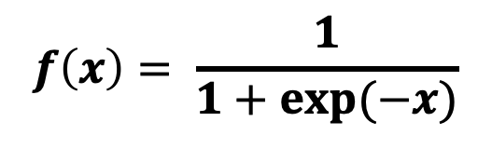
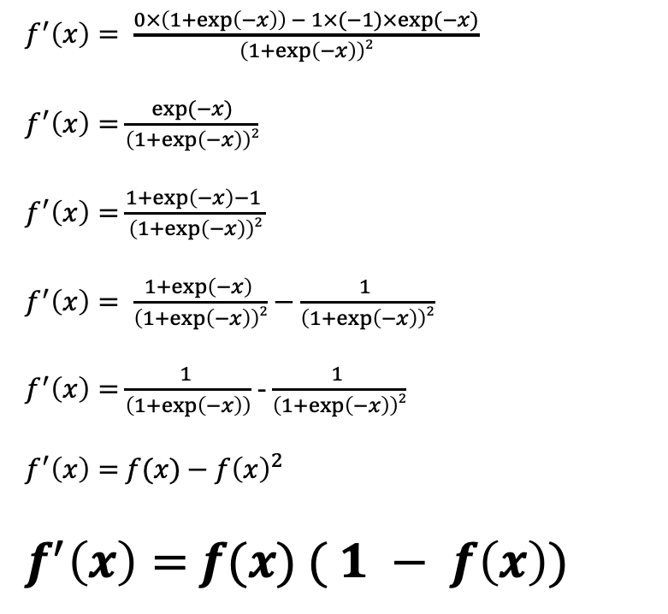
Neural Network
Sigmoid Gradient
$f^{′}\left(x\right)= \frac{0×\left(1+\exp\left(−x\right)\right) − 1×(−1)×exp⁡(−x)}{\left(1+\exp\left(−x\right)\right)2}$
$f^{′}\left(x\right)=$ $\frac{exp⁡(−x)}{\left(1+\exp\left(−x\right)\right)2}$
$f^{′}\left(x\right)=$ $\frac{1+\exp\left(−x\right)−1 }{\left(1+\exp\left(−x\right)\right)2}$
$f^{′}\left(x\right)= \frac{1+\exp\left(−x\right) }{\left(1+\exp\left(−x\right)\right)2}$ $−$ $\frac{1 }{\left(1+\exp\left(−x\right)\right)2}$
$f^{′}\left(x\right)=$ $\frac{1 }{\left(1+\exp\left(−x\right)\right)}$ - $\frac{1 }{\left(1+\exp\left(−x\right)\right)2}$
$f^{′}\left(x\right)=$ $f(x)$ $− f{\left(x\right)}^{2}$
$f^{′}\left(x\right)=$ $f(x)$ $( 1 − f\left(x\right))$
$$f\left(x\right)= \frac{1}{1+exp⁡(−x)}$$

Slide 40


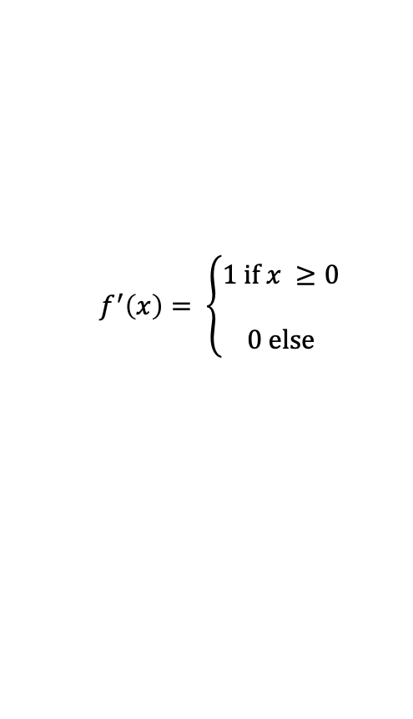
Neural Network
Relu Gradient
$$f^{′}\left(x\right)= \left\{\begin{aligned}1 if x ≥0 \\ \\ 0 else\end{aligned}\right.$$
$$f\left(x\right)=max(0, x)$$
$$f^{′}\left(x\right)=1_{\{x ≥0\}}$$

