Slide 1
Introduction to Neural Network

Slide 2

Neural Network as a function
Input
f
Output
Where f is the function

Slide 3

Neural Network as a function
X = 3
f(x , w) = x . w
3
10
W = 1
f(x , w) – Target =
3 – 10 = -7
The goal is to adjust W to match the target value or get as close as possible.
Notes:
Imagine you have two input values x and w respectively equal to 3 and 1. Your function makes the product and so result in 3. But your target is to get 10. Are your close ? No so you will need to modify your parameter which is W.

Slide 4
Neural Network as a function
X = 3
f(x , w) = x . w
3
10
W = 1
f(x , w) – target = 3 – 10 = -7
X is the feature given by the experience
W is the weight
The goal is to adjust W to match the target value or get as close as possible.
Notes:
Imagine you have two input values x and w respectively equal to 3 and 1. Your function makes the product and so result in 3. But your target is to get 10. Are your close ? No so you will need to modify your parameter which is W.

Slide 5

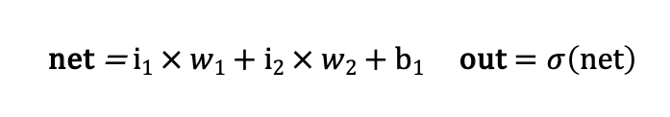
Perceptron
Two inputs and a single neuron with an activation function sigma
i₁
_{w1}
net
out
$Loss= \frac{1}{2}(out−target)$²
i₂
_{w2}
_{b1}
Forward Pass
net = $i1 × w1$ + $i2 × w2$ + b₁ out $=σ\left(net\right)$

Slide 6
Perceptron
How do we find the optimal w₁, w₂ and b₁ that minimize the loss ?
i₁
_{w1}
net
out
$Loss= \frac{1}{2}(out−target)$²
i₂
_{w2}
_{b1}
BACKPROPAGATION

Slide 7
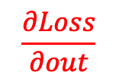
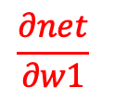
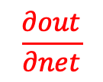
Perceptron
How do we find the optimal w₁, w₂ and b₁ that minimize the loss ?
i₁
_{w1}
net
out
$Loss= \frac{1}{2}(out−target)$²
i₂
_{w2}
_{b1}
?
?
?
$$\frac{∂net}{∂w1}$$
$$\frac{∂out}{∂net}$$
$$\frac{∂Loss}{∂out}$$
BACKPROPAGATION

Slide 8
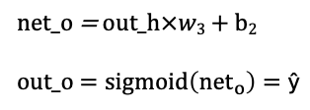
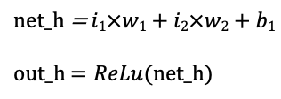

Neural Network
i₁
_{w1}
_{w3}
net_h
out_h
net_o
out_o
$Loss= \frac{1}{2}(out_{o}−target_{o})$²
i₂
_{w2}
_{b1}
_{b2}
Input layer
Hidden layer
Output layer
net_h = $i1×w1+i2×w2+b1$
out_h $=ReLu(net_h)$
net_o = $out_h×w3$ + b₂
out_o $=sigmoid\left({net}_{o}\right)=\text{ŷ}$
Forward Pass

Slide 9
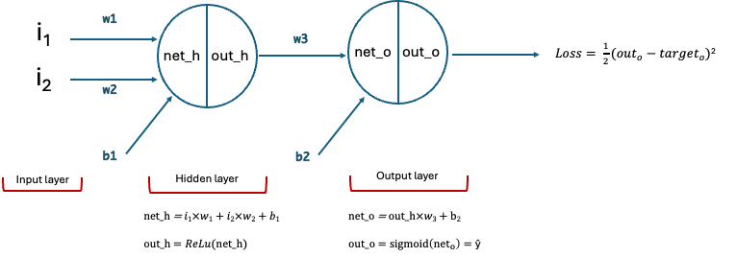
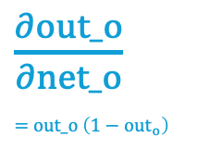
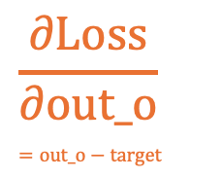
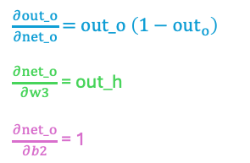
Neural Network
$\frac{∂Loss}{∂w3}= \frac{∂Loss}{∂out_o} ×\frac{∂out_o}{∂net_o}×\frac{∂net_o}{∂w3}$ = ($out_o−target$) $× \text{out}\text{_}\text{o} (1−out_o)$ $× out_h$
Gradient
$\frac{∂Loss}{∂b2}= \frac{∂Loss}{∂out_o} ×\frac{∂out_o}{∂net_o}×\frac{∂net_o}{∂b2}\text{= }\text{(}out_o−target\text{) }× \text{out}\text{_}\text{o} (1−out_o) ×$ 1
$\frac{∂out_o}{∂net_o}$ = out_o$\left(1−{out}_{o}\right)$
$\frac{∂net_o}{∂w3}$ = out_h
$\frac{∂net_o}{∂b2}$ = 1
$\frac{∂out_o}{∂net_o}$
= out_o$\left(1−{out}_{o}\right)$
$$\frac{∂Loss}{∂out_o}$$
$$=out_o−target$$
THE CHAIN RULE

Slide 10
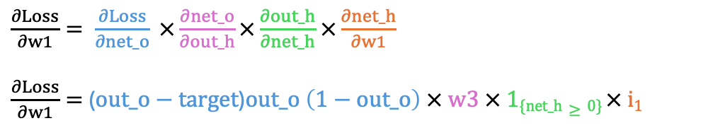
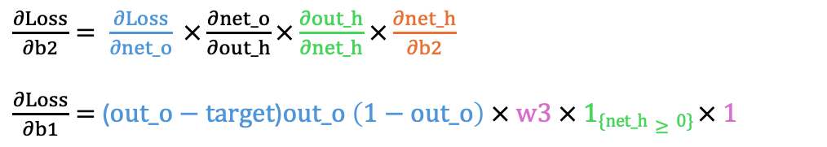

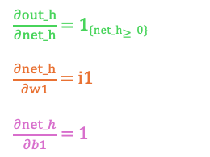
Neural Network
Gradient
CHAIN RULE
$\frac{∂Loss}{∂w1}= \frac{∂Loss}{∂net_o} ×\frac{∂net_o}{∂out_h}×\frac{∂out_h}{∂net_h}$ $×\frac{∂net_h}{∂w1}$
$\frac{∂Loss}{∂w1}=$($out_o−target$)$\text{out}\text{_}\text{o} \left(1−out_o\right) × w3 × \text{1}\text{\{}\text{net}\text{_}\text{h}≥0\text{\}} × i1$
$\frac{∂out_h}{∂net_h}$ = 1_{{net_h}$≥0$}
$\frac{∂net_h}{∂w1}$ = i1
$\frac{∂net_h}{∂b1}$ = 1
$$\frac{∂net_o}{∂out_h}=w3$$
$\frac{∂Loss}{∂w2}=$($out_o−target$)$\text{out}\text{_}\text{o} \left(1−out_o\right) × w3 × \text{1}\text{\{}\text{net}\text{_}\text{h}≥0\text{\}} × i2$
$\frac{∂Loss}{∂b2}= \frac{∂Loss}{∂net_o} ×\frac{∂net_o}{∂out_h}×\frac{∂out_h}{∂net_h}$ $×\frac{∂net_h}{∂b2}$
$\frac{∂Loss}{∂b1}=$($out_o−target$)$\text{out}\text{_}\text{o} \left(1−out_o\right) × w3 × \text{1}\text{\{}\text{net}\text{_}\text{h}≥0\text{\}} × 1$

Slide 11

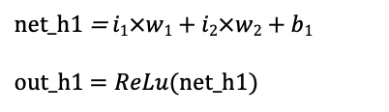


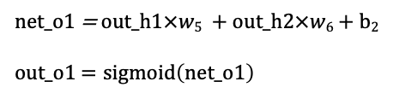
Neural Network
Forward Pass
i₁
_{w1}
_{w5}
net_o1
out_o1
$Loss1= \frac{1}{2}(out_{o1}−target_{o1})$²
net_h1
out_h1
_{w2}
_{w6}
_{w3}
_{w7}
i₂
_{w4}
_{w8}
$$Loss2= \frac{1}{2}\left(out_{o2}−target_{o2}\right)2$$
net_h2
out_h2
net_o2
out_o2
_{b1}
_{b2}
$$Loss=Loss1+Loss2$$
Input layer
Hidden layer
Output layer
net_h1 = $i1×w1+i2×w2+b1$
out_h1 $=ReLu(net_h1)$
net_o1 = $out_h1×w5$ + $out_h2×w6$ + b₂
out_o1 $=sigmoid\left(net_o1\right)$

Slide 12
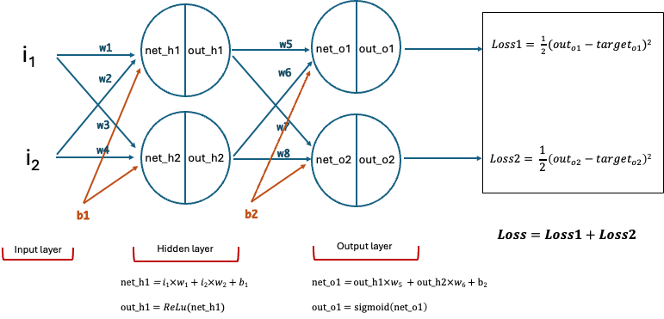

Neural Network
Gradient
$$\frac{∂Loss1}{∂w1}$$
BACKPROPAGATION + CHAIN RULE
$$\frac{∂Loss1}{∂w1}=\frac{∂Loss1}{∂out_o1} ×\frac{∂out_o1}{∂net_o1} ×\frac{∂net_o1}{∂out_h1} ×\frac{∂out_h1}{∂net_h1}×\frac{∂net_h1}{∂w1}$$
$$\frac{∂Loss1}{∂w1}=\text{(}out_o1−target_o1\text{)}×out_o1(1−out_o1)×\frac{∂net_o1}{∂out_h1} ×\frac{∂out_h1}{∂net_h1}×\frac{∂net_h1}{∂w1}$$
$$\frac{∂Loss1}{∂w1}=\text{(}out_o1−target_o1\text{)}×out_o1(1−out_o1)×\frac{∂net_o1}{∂out_h1} ×\frac{∂out_h1}{∂net_h1}×\frac{∂net_h1}{∂w1}$$
$$\frac{∂Loss1}{∂w1}=\text{(}out_o1−target_o1\text{)}×out_o1(1−out_o1)×w5 ×\frac{∂out_h1}{∂net_h1}×\frac{∂net_h1}{∂w1}$$
$$\frac{∂Loss1}{∂w1}=\text{(}out_o1−target_o1\text{)}×out_o1(1−out_o1)×w5 ×\frac{∂out_h1}{∂net_h1}×\frac{∂net_h1}{∂w1}$$
$\frac{∂Loss1}{∂w1}=\text{(}out_o1−target_o1\text{)}×out_o1(1−out_o1)×w5 ×$ $1_{\{net_h1>0\}}×i1$
$\frac{∂Loss1}{∂w1}=\text{(}out_o1−target_o1\text{)}×out_o1(1−out_o1)×w5 ×$ $1_{\{net_h1>0\}}×\frac{∂net_h1}{∂w1}$
Symmetrically
$\frac{∂Loss1}{∂w1}=\text{(}out_o1−target_o1\text{)}×out_o1(1−out_o1)×w5 ×$ $1_{\{net_h1>0\}}×\frac{∂net_h1}{∂w1}$
$\frac{∂Loss2}{∂w4}=\text{(}out_o2−target_o\text{2}\text{)}×out_o2(1−out_o2)×w8 ×$ $1_{\{net_h2>0\}}×i$2

Slide 13

Neural Network
Gradient
$$\frac{∂Loss1}{∂w2}$$
BACKPROPAGATION + CHAIN RULE
$\frac{∂Loss1}{∂w2}= \frac{∂Loss1}{∂net_h1} ×\frac{∂net_h1}{∂w2}$
$$\frac{∂Loss1}{∂w2}=\text{(}out_o1−target_o1\text{) }× out_o1(1−out_o1)×w5×1\{net_h1≥0\})×i2$$
Symmetrically
$\frac{∂Loss2}{∂w3}=\text{(}out_o2−target_o\text{2}\text{) }× out_o2(1−out_o2)×w8×1\{net_h2≥0\})×i$₁
From previously we know that:
$$\frac{∂Loss1}{∂net_h1}=\text{(}out_o1−target_o1\text{) }× out_o1(1−out_o1)×w5×1\{net_h1≥0\}$$

Slide 14

Neural Network
Gradient
$$\frac{∂Loss1}{∂w3}$$
BACKPROPAGATION + CHAIN RULE
$\frac{∂Loss1}{∂w3}=\frac{∂Loss1}{∂net_o1} ×\frac{∂net_o1}{∂out_h2}×\frac{∂out_h2}{∂net_h2}$ $×\frac{∂net_h2}{∂w3}$
$\frac{∂Loss1}{∂w3}=\text{(}out_o1−target_o1\text{) }× out_o1(1−out_o1)×\frac{∂net_o1}{∂out_h2}×\frac{∂out_h2}{∂net_h2}$ $×\frac{∂net_h2}{∂w3}$
$\frac{∂Loss1}{∂w3}=\text{(}out_o1−target_o1\text{) }× out_o1(1−out_o1)×w6×\frac{∂out_h2}{∂net_h2}$ $×\frac{∂net_h2}{∂w3}$
$\frac{∂Loss1}{∂w3}=\text{(}out_o1−target_o1\text{) }× out_o1(1−out_o1)×w6×1\{net_h2$ $>0\}$ $×\frac{∂net_h2}{∂w3}$
$\frac{∂Loss1}{∂w3}=\text{(}out_o1−target_o1\text{) }× out_o1(1−out_o1)×w6×1\{net_h2$ $>0\}$ $× i1$
Symmetrically
$\frac{∂Loss2}{∂w2}=\text{(}out_o2−target_o\text{2}\text{) }× out_o2(1−out_o2)×w7×1\{net_h$₁ $>0\}$ $× i2$

Slide 15

Neural Network
Gradient
$$\frac{∂Loss1}{∂w4}$$
BACKPROPAGATION + CHAIN RULE
$\frac{∂Loss1}{∂w4}= \frac{∂Loss1}{∂net_o1} ×\frac{∂net_o1}{∂out_h2}×\frac{∂out_h2}{∂net_h2}$ $×\frac{∂net_h2}{∂w4}$
$$\frac{∂Loss1}{∂w4}=\text{(}out_o1−target_o1\text{) }× out_o1(1−out_o1)×w6×1\{net_h2 >0\} ×i2$$
Symmetrically
$\frac{∂Loss2}{∂w1}=\text{(}out_o2−target_o\text{2}\text{) }× out_o2(1−out_o2)×w7×1\{net_h\text{1} >0\} ×i$₁

Slide 16

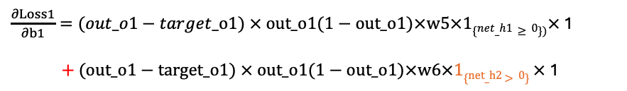

Neural Network
Gradient
$$\frac{∂Loss1}{∂b1}$$
BACKPROPAGATION + CHAIN RULE
$$\frac{∂Loss1}{∂b1}= \frac{∂Loss1}{∂net_h1} ×\frac{∂net_h1}{∂b1}+\frac{∂Loss1}{∂net_h2} ×\frac{∂net_h2}{∂b1}$$
$\frac{∂Loss1}{∂b1}=\text{(}out_o1−target_o1\text{) }× out_o1(1−out_o1)×w5×1\{net_h1≥0\})×$1
$+$ $\text{(}out_o1−target_o1\text{) }× out_o1(1−out_o1)×w6×1\{net_h2$ $>0\}$ $×$ 1
$\frac{∂Loss1}{∂b1}=\text{(}out_o1−target_o1\text{) }× out_o1(1−out_o1)×(w5×1\{net_h1≥0\}) +w6×1\{net_h2$ $>0\}$ $)$
Symmetrically
$\frac{∂Loss2}{∂b1}=\text{(}out_o2−target_o\text{2}\text{) }× out_o2(1−out_o2)×(w8×1\{net_h2≥0\}) +w7×1\{net_h$₁ $>0\}$ $)$

Slide 17



Neural Network
Gradient
$$\frac{∂Loss1}{∂w1}$$
BACKPROPAGATION + CHAIN RULE
$$\frac{∂Loss1}{∂w5}=\frac{∂Loss1}{∂out_o1} ×\frac{∂out_o1}{∂net_o1} ×\frac{∂net_o1}{∂w5}$$
$$\frac{∂Loss1}{∂w5}=\text{(}out_o1−target_o1\text{)}×out_o1(1−out_o1)×out_h1$$
$$\frac{∂Loss1}{∂w5}=\text{(}out_o1−target_o1\text{)}×out_o1(1−out_o1)×out_h1$$
Symmetrically
$\frac{∂Loss2}{∂w8}=\text{(}out_o2−target_o\text{2}\text{)}×out_o2(1−out_o2)×out_h$2

Slide 18
Neural Network
Gradient
$$\frac{∂Loss1}{∂b1}$$
BACKPROPAGATION + CHAIN RULE
$$\frac{∂Loss1}{∂w6}=\frac{∂Loss1}{∂out_o1} ×\frac{∂out_o1}{∂net_o1} ×\frac{∂net_o1}{∂w6}$$
$$\frac{∂Loss1}{∂w6}=\text{(}out_o1−target_o1\text{)}×out_o1(1−out_o1)×out_h2$$
$$\frac{∂Loss1}{∂w6}=\text{(}out_o1−target_o1\text{)}×out_o1(1−out_o1)×out_h2$$
Symmetrically
$\frac{∂Loss2}{∂w7}=\text{(}out_o2−target_o\text{2}\text{)}×out_o2(1−out_o2)×out_h$1

Slide 19


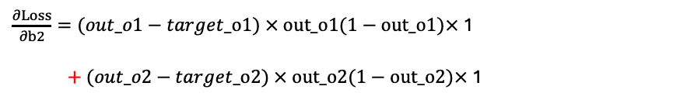

Neural Network
Gradient
$$\frac{∂Loss}{∂b2}$$
BACKPROPAGATION + CHAIN RULE
$$\frac{∂Loss}{∂b2}= \frac{∂Loss1}{∂b2}+\frac{∂Loss2}{∂b2}$$
$$\frac{∂Loss}{∂b2}= \frac{∂Loss1}{∂net_o1} ×\frac{∂net_o1}{∂b2}+\frac{∂Loss2}{∂net_o2} ×\frac{∂net_o2}{∂b2}$$
$\frac{∂Loss}{∂b2}=\text{(}out_o1−target_o1\text{) }× out_o1(1−out_o1)×$1
$+$ $\text{(}out_o2−target_o\text{2}\text{) }× out_o2(1−out_o2)×$1
$\frac{∂Loss}{∂b2}=\text{(}out_o1−target_o1\text{) }× out_o1(1−out_o1) +$ $\text{(}out_o2−target_o\text{2}\text{) }× out_o2(1−out_o2)$

Slide 20
Neural Network
Gradient
BACKPROPAGATION SUMMARY
$\frac{∂Loss1}{∂w1}=\text{(}out_o1−target_o1\text{)}×out_o1(1−out_o1)×w5 ×$ $1_{\{net_h1>0\}}×i1$
$$\frac{∂Loss1}{∂w2}=\text{(}out_o1−target_o1\text{) }× out_o1(1−out_o1)×w5×1\{net_h1≥0\})×i2$$
$\frac{∂Loss1}{∂w3}=\text{(}out_o1−target_o1\text{) }× out_o1(1−out_o1)×w6×1\{net_h2$ $>0\}$ $× i1$
$$\frac{∂Loss1}{∂w4}=\text{(}out_o1−target_o1\text{) }× out_o1(1−out_o1)×w6×1\{net_h2 >0\} ×i2$$
$\frac{∂Loss1}{∂b1}=\text{(}out_o1−target_o1\text{) }× out_o1(1−out_o1)×(w5×1\{net_h1≥0\}) +w6×1\{net_h2$ $>0\}$ $)$
$$\frac{∂Loss1}{∂w5}=\text{(}out_o1−target_o1\text{)}×out_o1(1−out_o1)×out_h1$$
$\frac{∂Loss2}{∂w1}=\text{(}out_o2−target_o\text{2}\text{) }× out_o2(1−out_o2)×w7×1\{net_h\text{1} >0\} ×i$₁
$$\frac{∂Loss1}{∂w6}=\text{(}out_o1−target_o1\text{)}×out_o1(1−out_o1)×out_h2$$
$\frac{∂Loss2}{∂w2}=\text{(}out_o2−target_o\text{2}\text{) }× out_o2(1−out_o2)×w7×1\{net_h$₁ $>0\}$ $× i2$
$\frac{∂Loss2}{∂w8}=\text{(}out_o2−target_o\text{2}\text{)}×out_o2(1−out_o2)×out_h$2
$\frac{∂Loss2}{∂w3}=\text{(}out_o2−target_o\text{2}\text{) }× out_o2(1−out_o2)×w8×1\{net_h2≥0\})×i$₁
$\frac{∂Loss2}{∂w7}=\text{(}out_o2−target_o\text{2}\text{)}×out_o2(1−out_o2)×out_h$1
$\frac{∂Loss2}{∂w4}=\text{(}out_o2−target_o\text{2}\text{)}×out_o2(1−out_o2)×w8 ×$ $1_{\{net_h2>0\}}×i$2
$\frac{∂Loss}{∂b2}=\text{(}out_o1−target_o1\text{) }× out_o1(1−out_o1) +$ $\text{(}out_o2−target_o\text{2}\text{) }× out_o2(1−out_o2)$
$\frac{∂Loss2}{∂b1}=\text{(}out_o2−target_o\text{2}\text{) }× out_o2(1−out_o2)×(w8×1\{net_h2≥0\}) +w7×1\{net_h$₁ $>0\}$ $)$

Slide 21
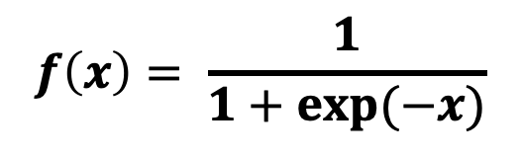
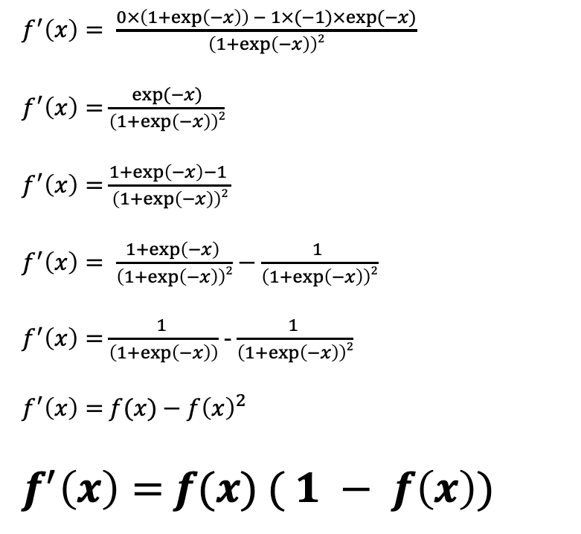
Neural Network
Sigmoid Gradient
$f^{′}\left(x\right)= \frac{0×\left(1+\exp\left(−x\right)\right) − 1×(−1)×exp⁡(−x)}{\left(1+\exp\left(−x\right)\right)2}$
$f^{′}\left(x\right)=$ $\frac{exp⁡(−x)}{\left(1+\exp\left(−x\right)\right)2}$
$f^{′}\left(x\right)=$ $\frac{1+\exp\left(−x\right)−1 }{\left(1+\exp\left(−x\right)\right)2}$
$f^{′}\left(x\right)= \frac{1+\exp\left(−x\right) }{\left(1+\exp\left(−x\right)\right)2}$ $−$ $\frac{1 }{\left(1+\exp\left(−x\right)\right)2}$
$f^{′}\left(x\right)=$ $\frac{1 }{\left(1+\exp\left(−x\right)\right)}$ - $\frac{1 }{\left(1+\exp\left(−x\right)\right)2}$
$f^{′}\left(x\right)=$ $f(x)$ $− f{\left(x\right)}^{2}$
$f^{′}\left(x\right)=$ $f(x)$ $( 1 − f\left(x\right))$
$$f\left(x\right)= \frac{1}{1+exp⁡(−x)}$$

Slide 22


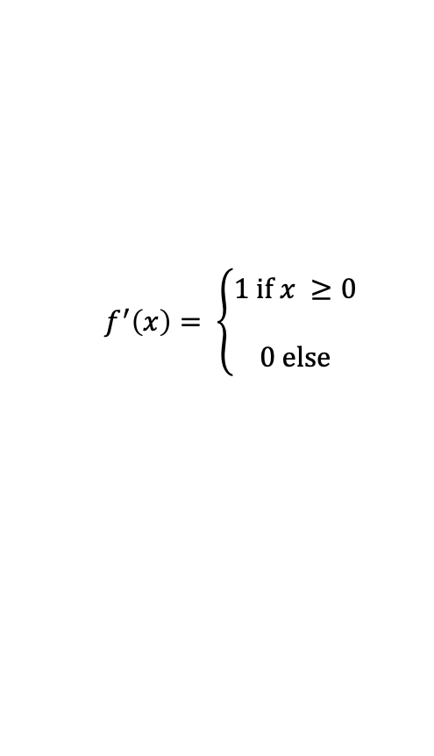
Neural Network
Relu Gradient
$$f^{′}\left(x\right)= \left\{\begin{aligned}1 if x ≥0 \\ \\ 0 else\end{aligned}\right.$$
$$f\left(x\right)=max(0, x)$$
$$f^{′}\left(x\right)=1_{\{x ≥0\}}$$

