Slide 1
Using GitHub with VSCode
Git Integration, Collaboration, and Best Practices
GitHub with VSCode — Author: David Thébault

Slide 2
Why GitHub + VSCode?
Smooth integration with GitHub
Powerful UI for commits, branches, and pull requests
Extensions available for deeper Git control
GitHub with VSCode — Author: David Thébault

Slide 3
Installing Git & VSCode
Download Git from https://git-scm.com
Install VSCode from https://code.visualstudio.com
Ensure Git is in your PATH
GitHub with VSCode — Author: David Thébault
Notes:
Include a screenshot of VSCode about page and terminal running 'git --version'.

Slide 4
Open a Project Folder
Use File > Open Folder to load your project directory
Recommended: Open the root folder of your repo
GitHub with VSCode — Author: David Thébault
Notes:
Add a screenshot of File > Open Folder in VSCode.

Slide 5
Initialize a Git Repository
Click 'Initialize Repository' in the Source Control panel if no Git repo exists
Python Example: ```python import os os.system('git init') ```
GitHub with VSCode — Author: David Thébault
Notes:
Screenshot: Source Control panel with 'Initialize Repository' button.

Slide 6
View Source Control
Click the Git icon on the left sidebar
View changes, commits, branches in one place
GitHub with VSCode — Author: David Thébault
Notes:
Add screenshot of Source Control panel with staged/unstaged files.

Slide 7
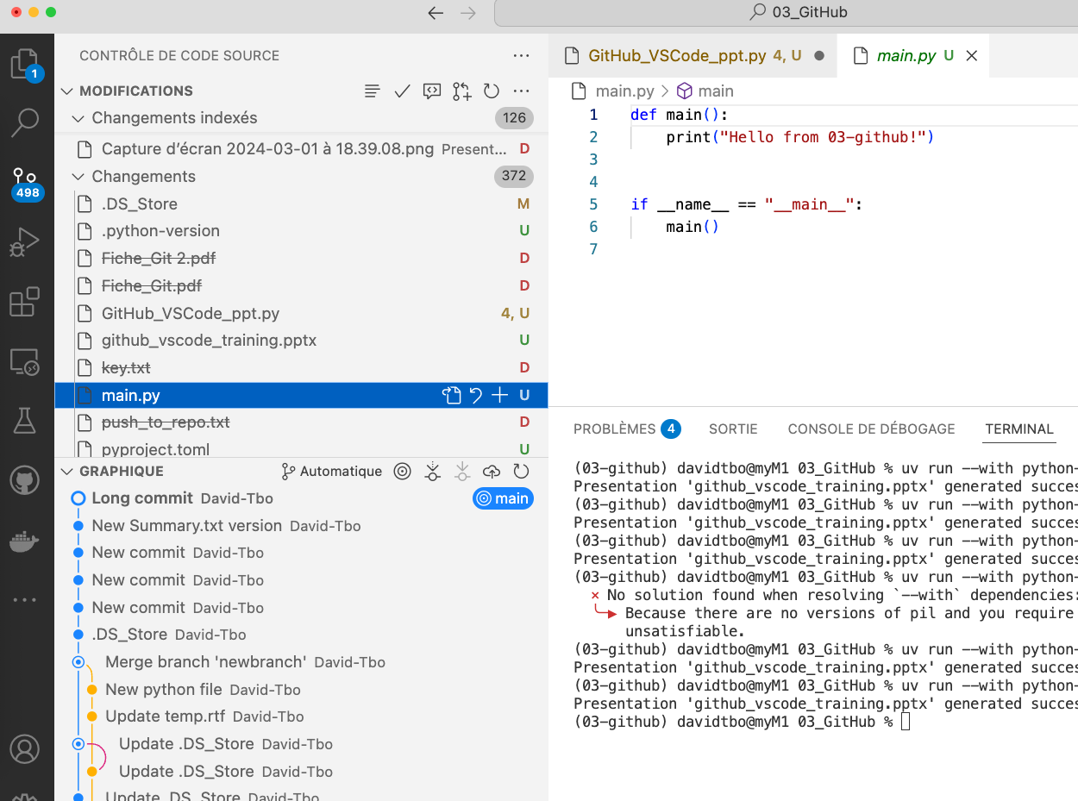
Stage & Commit Changes
Use '+' icon to stage files
Write a commit message and click ✓ to commit
Python Example: ```python import os os.system('git add .') os.system('git commit -m "Initial commit"') ```
GitHub with VSCode — Author: David Thébault
Notes:
Include screenshot of commit message input and stage area.

Slide 8
Connect to GitHub
Sign in with GitHub via VSCode's GitHub extension
You may be prompted to authorize via browser
GitHub with VSCode — Author: David Thébault
Notes:
Screenshot of GitHub sign-in modal.

Slide 9
Push to GitHub
Click 'Publish Branch' or use terminal:
git remote add origin ...
git push -u origin main
Python Example: ```python import os os.system('git remote add origin https://github.com/yourusername/your-repo.git') os.system('git push -u origin main') ```
GitHub with VSCode — Author: David Thébault
Notes:
Screenshot: publish branch button and terminal with push command.

Slide 10
Clone a GitHub Repository
From GitHub: copy repo URL
In VSCode: Ctrl+Shift+P > Git: Clone
Python Example: ```python import os os.system('git clone https://github.com/yourusername/your-repo.git') ```
GitHub with VSCode — Author: David Thébault
Notes:
Screenshot of command palette with 'Git: Clone' selected.

Slide 11
Branching in VSCode
Use bottom-left status bar to switch/create branches
GitLens or built-in features show branch tree
Python Example: ```python import os os.system('git checkout -b new-feature') ```
GitHub with VSCode — Author: David Thébault
Notes:
Screenshot of branch selection dropdown in bottom bar.

Slide 12
Create a Pull Request
Click 'Create Pull Request' from Source Control panel (GitHub extension)
Fill title and description
GitHub with VSCode — Author: David Thébault
Notes:
Screenshot of PR creation dialog in VSCode.

Slide 13
Review a Pull Request
Fetch PRs from remote
Open in editor and comment directly on lines
Approve or request changes
GitHub with VSCode — Author: David Thébault
Notes:
Screenshot of a PR review inside VSCode.

Slide 14
GitHub Panel in VSCode
GitHub tab lets you see issues, PRs, and discussions
Great for collaboration from within the IDE
GitHub with VSCode — Author: David Thébault
Notes:
Show GitHub tab in the sidebar and active issues.

Slide 15
Working with GitLens
GitLens extension enhances Git in VSCode
Blame view, history, file annotations, etc.
GitHub with VSCode — Author: David Thébault
Notes:
Show GitLens sidebar panel and blame view.

Slide 16
Resolve Merge Conflicts
VSCode provides visual tools to accept changes
Highlight conflict markers, click Accept Incoming/Current
GitHub with VSCode — Author: David Thébault
Notes:
Screenshot of a conflict with action buttons.

Slide 17
Use the Terminal for Git
Access terminal inside VSCode
Run any git command (add, commit, push, etc.)
Python Example: ```python import os os.system('git status') ```
GitHub with VSCode — Author: David Thébault
Notes:
Show integrated terminal with git commands in use.

Slide 18
Settings and Extensions
Search for 'Git' or 'GitHub' in extensions panel
Configure user name, email in settings.json
Python Example: ```python import json settings = { "git.user": "Your Name", "git.email": "your.email@example.com" } with open('settings.json', 'w') as f: json.dump(settings, f) ```
GitHub with VSCode — Author: David Thébault
Notes:
Screenshot of extensions tab with GitHub extension installed.

Slide 19
Common Issues & Fixes
Authentication issues → Re-authenticate GitHub
Push rejected → Pull first
Permission denied → SSH key or token needed
GitHub with VSCode — Author: David Thébault
Notes:
Show error message example and link to fix.

Slide 20
Best Practices
Commit frequently with meaningful messages
Create branches for features
Pull before pushing
Review PRs before merging
GitHub with VSCode — Author: David Thébault

Slide 21
Resources
https://code.visualstudio.com/docs
https://docs.github.com
https://learngitbranching.js.org
https://git-scm.com/book
GitHub with VSCode — Author: David Thébault

