Slide 1
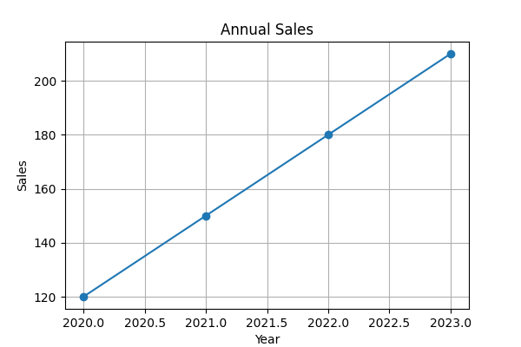
Sales Over the Years

