Slide 1
UV
The new pip?

Slide 2
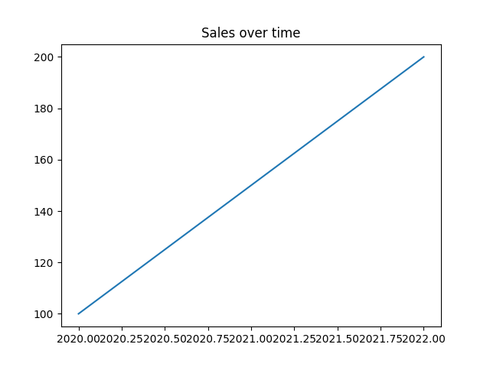
Sales Graph

Slide 3
Revenue Table
Year | Revenue
2020 | 120
2021 | 150

