Slide 1


Procedure to update the Read the Docs website
From GitHub to online publishing

Slide 2
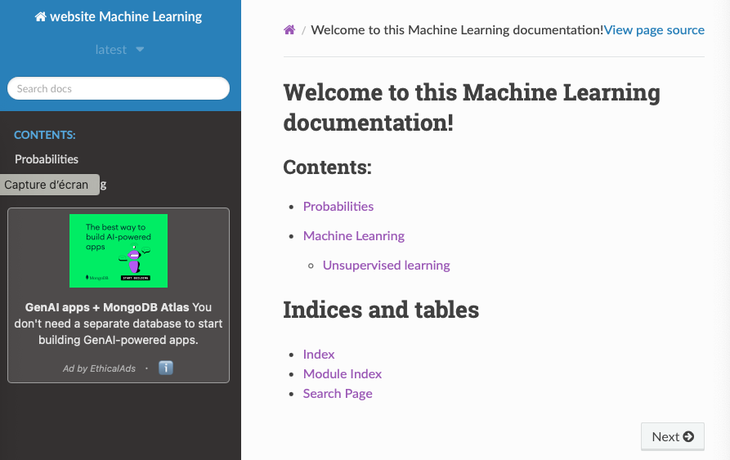
Introduction
Project Overview:
This project features a technical documentation website hosted on Read the Docs, built from a GitHub repository. The site consolidates educational and technical content, including Jupyter notebooks (.ipynb) and structured documentation files (.rst), organized using Sphinx and the nbsphinx extension.
Objective:
Efficiently update the website by:
Adding/editing Jupyter notebooks (practical examples, tutorials).
Enhancing structure via .rst files (table of contents, navigation).
Automating deployment from GitHub to Read the Docs.
.
├── build
│ ├── doctrees
│ └── html
├── make.bat
├── Makefile
├── Read_The_Docs.pptx
├── requirements.txt
└── source
├── _static
├── _templates
├── conf.py
├── index.rst
├── machine_learning
├── probabilities
└── statistic

Slide 3
Pre-requisites
Have an open terminal
Be placed in the folder project
Have Git and Python installed
cd "/Users/davidtbo/Library/Mobile Documents/com~apple~CloudDocs/website_rtd"

Slide 4
Local Repository Update
Pulls (retrieves) the latest changes from GitHub.
This assumes that the local branch is called main, that the remote repository (origin) points to the GitHub repository (David-Tbo/website_RTD)and thirdly that there is no conflict which can be verified by running:
git pull origin main
git branch
git remote –v
git status
Notes:
Pulls the latest changes from the remote main branch and updates your local repository.
If files are changed, either you commit them before the pull, or you set them aside with git stash.

Slide 5
Modify/Add content
Add/modify notebooks in source/machine_learning/.
Update the .rst files to organize the structure.
Add a new section in source/machine_learning/index.rst :
cp /path/to/new_notebook.ipynb source/machine_learning/supervised_learning/
.. toctree::
:maxdepth: 2
:caption: Contents:
supervised_learning/new_notebook
unsupervised_learning/other_notebook

Slide 6
Test locally
Install the dependencies:
Build the documentation:
Check the result:
pip install -r requirements.txt
cd source
make clean # clean the old builds
make html # build the documentation
open _build/html/index.html

Slide 7
Push changes to GitHub
Commands:
git add .
git commit -m "Update notebooks and the web site structure"
git push origin main

Slide 8
Trigger Build on Read the Docs
Construction is usually automatic: Read the Docs should detect the push and initiate a build.
Otherwise, go to Read the Docs and click on "Build Version".

Slide 9
Check the result
Wait for the end of the construction (a few minutes).
Refresh the site:
https://website-rtd.readthedocs.io.

Slide 10
Troubleshooting
Check the logs on Read the Docs in case of errors.
Make sure that notebooks are referenced in a toctree.
Update requirements.txt if necessary.

Slide 11
Conclusion
Summary of key steps.
Reminder of important orders.
Useful resources (links to Read the Docs, Sphinx documentation, etc.).

