Slide 1

9
E-Business and E-Commerce

Slide 2
Overview of E-Business and E-Commerce
Business-to-Consumer (B2C) Electronic Commerce
Business-to-Business (B2B) Electronic Commerce
Ethical and Legal Issues in E-Business

Slide 3
Describe the six common types of electronic commerce.
Describe the various online services of business-to-consumer (B2C) commerce, providing specific examples of each.
Describe the three business models for business-to-business electronic commerce.
Identify the ethical and legal issues related to electronic commerce, along with examples.

Slide 4
Thumbtack
Consider the highly competitive nature of the local services marketplace. Which of the companies discussed in this case has the best chance of “winning” in this marketplace? Support your answer.
What competitive advantages does Thumbtack have in the local services marketplace? Provide examples to support your answer.
What competitive advantages does Amazon have in the local services marketplace? Provide examples to support your answer.

Slide 5
ABOUT BUSINESS 9.1
Japan’s Largest E-Commerce Company, Rakuten, Competes Globally
Discuss the reasons why founder and CEO Mikitani feels it is imperative for Rakuten to expand beyond the boundaries of Japan. Provide examples to support your answer.
How should Amazon and Alibaba combat the global expansion of Rakuten? Provide examples to support your answer.
Describe any competitive advantages that Rakuten has in its competition with Amazon and Alibaba.

Slide 6
9.1
Overview of E-Business and E-Commerce
Definitions and Concepts
Types of E-Commerce
Major E-Commerce Mechanisms
Electronic Payment Mechanisms
Benefits and Limitations of E-Commerce

Slide 7
Definitions and Concepts
Electronic Commerce (EC or e-commerce)
Electronic Business (e-business)
Degree of Digitization
Brick-and-Mortar Organizations
Virtual (or pure-play) Organizations
Clicks-and-Mortar (or Clicks-and-Bricks)
Notes:
Electronic Commerce (EC or e-commerce): the process of buying, selling, transferring, or exchanging products, services, or information via computer networks, including the Internet.
Electronic Business (e-business): in addition to the buying and selling of goods and services, e-business (a broader concept) refers to servicing customers, collaborating with business partners, and performing electronic transactions within an organization.
Degree of Digitization: the extent to which the commerce has been transformed from physical to digital which can relate to both the product or service being sold and the delivery agent or intermediary. In other words, the product can be either physical or digital, and the delivery agent can also be either physical or digital.
Brick-and-Mortar Organizations: organizations that exist as purely physical organizations.
Virtual (or pure-play) Organizations: all dimensions of the organization are digital and they engage in pure electronic commerce only.
Clicks-and-Mortar (or Clicks-and-Bricks): organizations that are partial electronic commerce (EC) combining both virtual and physical dimensions.

Slide 8
Types of E-Commerce
Business-to-Consumer (B2C)
Business-to-Business (B2B)
Consumer-to-Consumer (C2C)
Business-to-Employee (B2E)
E-government
Government-to-Citizen (G2C)
Government-to-Business (G2B)
Mobile Commerce (m-commerce)
Notes:
Business-to-Consumer (B2C): the sellers are organizations, and the buyers are individuals.
Business-to-Business (B2B): both the sellers and the buyers are business organizations. B2B comprises the vast majority of EC volume.
Consumer-to-Consumer (C2C): an individual sells products or services to other individuals.
Business-to-Employee (B2E): an organization uses EC internally to provide information and services to its employees.
E-government: E-government is the use of Internet technology in general and e-commerce in particular to deliver information and public services to citizens.
Government-to-Citizen (G2C): government to individual citizens.
Government-to-Business (G2B): G2B EC is much like B2B EC, usually with an overlay of government procurement regulations.
Mobile Commerce (m-commerce): e-commerce that is conducted entirely in a wireless environment.

Slide 9
Major E-Commerce Mechanisms
Electronic catalogs
Electronic auctions
E-storefronts
E-malls
E-marketplaces
Notes:
Auction: a competitive buying and selling process in which prices are determined dynamically by competitive bidding.
Forward Auctions: sellers solicit bids from many potential buyers and prices tend to increase over time.
Reverse Auctions: one buyer, usually an organization, wants to purchase a product or a service and buyer posts a request for quotation (RFQ) on its Web site or on a third party site. Prices tend to decrease over time.
Electronic Storefront: a Web site that represents a single store.
Electronic Mall: (also known as a cybermall or an e-mall) a collection of individual shops consolidated under one Internet address and they are closely associated with B2C electronic commerce.
Electronic Marketplace (e-marketplace): a central, virtual market space on the Web where many buyers and many sellers can conduct e-commerce and e-business activities.

Slide 10
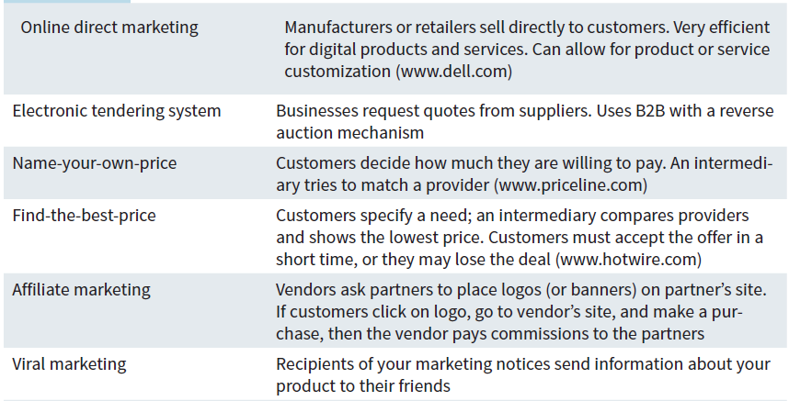
Table 9.1: E-Commerce Business Models

Slide 11
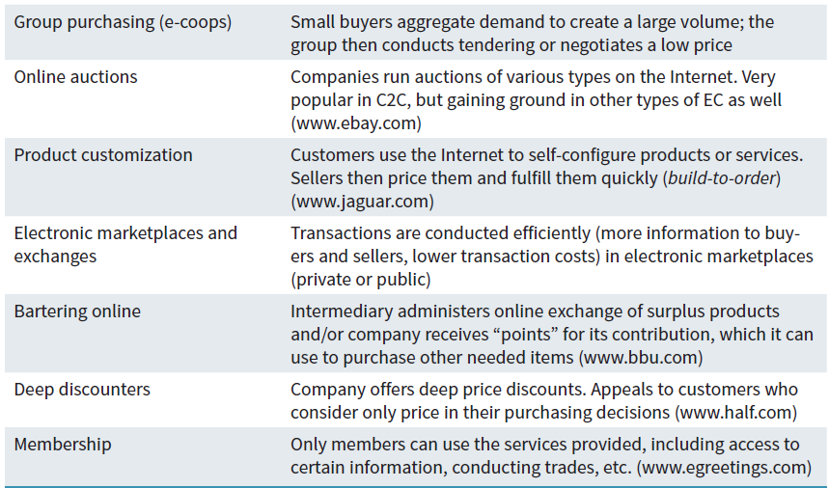
Table 9.1: E-Commerce Business Models (Continued)

Slide 12
Electronic Payment Mechanisms
Electronic Checks
Electronic Cards
Virtual Credit Cards
Purchasing Cards
Stored-Value Money Cards
Smart Cards
Digital Wallet
Bitcoin
Notes:
Electronic Payment Mechanisms: enable buyers to pay for goods and services electronically, rather than writing a check or using cash.
Electronic Checks: (e-checks), which are used primarily in B2B, are similar to regular paper checks.
Electronic Cards: There are a variety of electronic cards, and they are used for different purposes. The most common types are electronic credit cards, virtual credit cards, purchasing cards, stored-value money cards, and smart cards.
Virtual Credit Cards: allow customers to shop online and can be used only once in order to thwart criminals by using a different, random card number every time you shop online.
Purchasing Cards: are the B2B equivalent of electronic credit cards and in some countries, purchasing cards are the primary form of payment between companies.
Stored-Value Money Cards: allow you to store a fixed amount of prepaid money and then spend it as necessary and each time you use the card, the amount is reduced by the amount you spent.
Smart Cards: contain a chip that can store a considerable amount of information—more than 100 times the amount contained on a stored-value money card and are frequently multipurpose. That is, you can use them as a credit card, a debit card, a stored-value money card, or a loyalty card.
Person-to-Person Payments: enable two individuals, or an individual and a business, to transfer funds without using a credit card (e.g., PayPal).
Digital Wallet: an application (app) used for making financial transactions. These apps can be on users’ desktops or on their smartphones. When the app is on a smartphone, it becomes a mobile payment system. Digital wallets replace the need to carry physical credit and debit cards, gift cards, and loyalty cards, as well as boarding passes and other forms of identification.
Bitcoin: a type of digital currency in which encryption techniques are used to regulate the generation of units of currency and verify the transfer of funds, operating independently of any central bank.

Slide 13
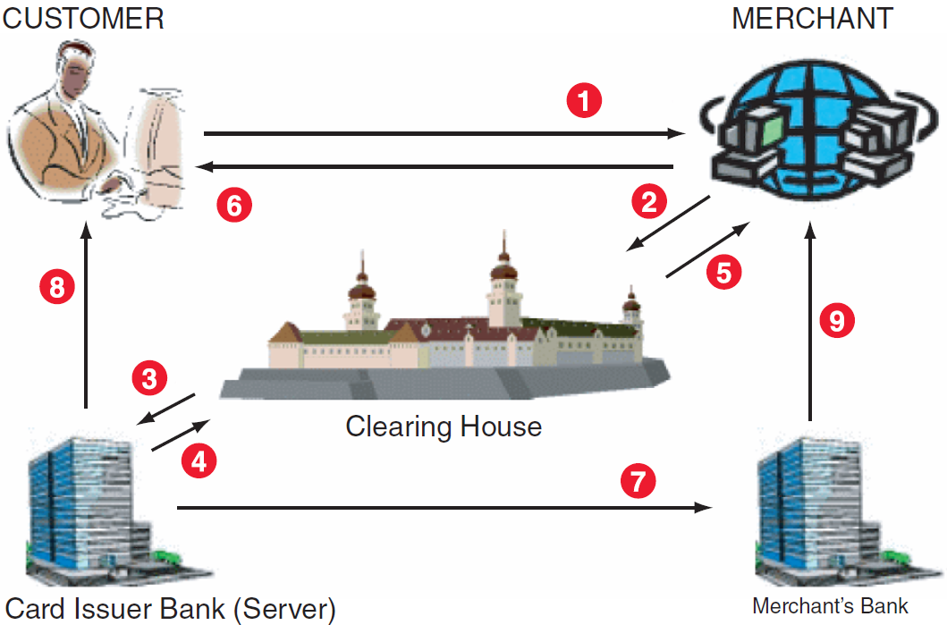
Figure 9.1: How e-credit cards work

Slide 14
Benefits of E-Commerce
Organization Benefits
Customer Benefits
Benefits to Society
Notes:
Organization Benefit: national and international markets more accessible by lowering the costs of processing, distributing, and retrieving information.
Customer Benefit: by being able to access a vast number of products and services, around the clock.
Benefit to Society: the ability to easily and conveniently deliver information, services, and products to people in cities, rural areas, and developing countries.

Slide 15
Limitations of E-Commerce
Technological Limitations
Non-technological Limitations
Notes:
Technological Limitations:
Lack of universally accepted security standards
In less-developed countries, telecommunications bandwidth often is insufficient, and accessing the Web is expensive.
Non-technological Limitations of E-Commerce:
Perceptions that EC is insecure
EC has unresolved legal issues
EC lacks a critical mass of sellers and buyers.

Slide 16
9.2
Business-to-Consumer (B2C) Electronic Commerce
Electronic Storefronts and Malls
Electronic Malls
Online Service Industries
Issues in E-Tailing
Notes:
Electronic Storefront: a Web site that represents a single store.
Electronic Mall: (also known as a cybermall or an e-mall) a collection of individual shops grouped under a single Internet address.
Online Advertising: the practice of using the Internet and WWW to disseminate information in an attempt to influence a buyer–seller transaction through the direct response approach which personalizes advertising and marketing making the advertising process media rich, dynamic, and interactive.

Slide 17
ABOUT BUSINESS 9.2
Swipely
Describe the advantages that Swipely off ers merchants that help it maintain a competitive advantage in the marketplace.
Refer back to Chapter 2. Does Swipely function as a strategic information system for a merchant? Why or why not?

Slide 18
Electronic Storefronts and Malls
Electronic Retailing (e-tailing)
Electronic Storefront
Electronic Mall
Two Types of Electronic Malls
Notes:
Electronic Retailing (e-tailing): the direct sale of products and services through electronic storefronts or electronic malls, usually designed around an electronic catalog format and/or auctions.
Electronic Storefront: a Web site that represents a single store.
Electronic Mall: (also known as a cybermall or an e-mall) a collection of individual shops grouped under a single Internet address.
Two Types of Cybermalls:
Referral Malls: (e.g., www.hawaii.com), you cannot buy anything, but instead, you are transferred from the mall to a participating storefront.
A Cybermall (e.g., http://shopping .google.com) where you can actually make a purchase. You might shop from several stores, but you make only one purchase transaction at the end.

Slide 19
Online Service Industries
Disintermediation
Cyberbanking
Online Securities Trading
The Online Job Market
Travel Services
Online Advertising
Online Advertising Methods
Notes:
Disintermediation: a process whereby intermediaries are eliminated.
Intermediaries (or middlemen) Have Two Functions:
they provide information, and this function can be fully automated and most likely will be assumed by e-marketplaces and portals that provide information for free.
they perform value-added services such as consulting.
Cyberbanking (or Electronic Banking): involves conducting various banking activities from home, at a place of business, or on the road instead of at a physical bank location. It include capabilities ranging from paying bills to applying for a loan.
Online Securities Trading: the use of computers to trade stocks, bonds, and other financial instruments. (e.g., E*Trade, Ameritrade, etc.) which is cheaper than a full-service or discount broker.
Online Job Market: Companies and government agencies advertise available positions, accept resumes, and take applications via the Internet while job seekers use the online job market to reply online to employment ads, to place resumes on various sites, and to use recruiting firms (e.g., www.monster.com, www.simplyhired.com, www.linkedin.com, and www.truecareers.com).
Travel Services: use of the Internet and WWW to plan, explore, and arrange almost any trip economically allowing customers to purchase airline tickets, reserve hotel rooms, and rent cars.
Online Advertising: the practice of using the Internet and WWW to disseminate information in an attempt to influence a buyer–seller transaction through the direct response approach which personalizes advertising and marketing making the advertising process media rich, dynamic, and interactive.

Slide 20
Online Advertising
Advantages of Online Advertising:
Updated any time at minimal cost
Reach very large numbers of potential buyers all over the world
Generally cheaper than radio, television, and print ads
Interactive and targeted to specific interest groups and/or individuals
Notes:
Online Advertising: the practice of using the Internet and WWW to disseminate information in an attempt to influence a buyer–seller transaction through the direct response approach which personalizes advertising and marketing making the advertising process media rich, dynamic, and interactive.
Advantages of Online Advertising:
Updated any time at minimal cost
Reach very large numbers of potential buyers all over the world
Generally cheaper than radio, television, and print ads
Interactive and targeted to specific interest groups and/or individuals

Slide 21
Advertising Methods
Banner Ads
Pop-Up Ad
Pop-Under Ad
Spam
Permission Marketing
Viral Marketing
Notes:
Banner Ads: electronic billboards containing a short text, graphics, video clips, or sound to promote a product or a vendor.
Characteristics of Banner Ads:
the most common form of advertising on the Internet
customized to a target audience
convey only limited information because of their small size
many viewers simply ignore them
Pop-Up Ad: an Internet ad that appears in front of the current browser window.
Pop-Under Ad: an Internet ad appears underneath the active window; when users close the active window, they see the ad.
Spam: indiscriminate distribution of electronic ads without the permission of the receiver.
Permission Marketing: asks consumers to give their permission to voluntarily accept online advertising and e-mail.
Viral Marketing: online word-of-mouth marketing including messages forwarded to friends, family members, and other acquaintances suggesting they “check this out" which enables companies to build brand awareness at a minimal cost without having to spam millions of uninterested users.

Slide 22
Issues in E-Tailing
Channel Conflict
Multi-channeling (Omni-channeling)
Showrooming
Order Fulfillment
Notes:
Two Most Significant E-Tailing Issues:
Channel Conflict
Fulfillment
Channel Conflict: a situation in which clicks-and-mortar companies face a conflict with their regular distributors when they begin selling directly to customers online. These conflicts can arise in areas such as pricing, resource allocation (e.g., how much money to spend on advertising).
Multichanneling (or omni-channeling): a process in which companies integrate their online and offline channels creating the opportunity for 'showrooming.'
Showrooming: occurs when shoppers visit a brick-and-mortar store to examine a product in person then conduct research about the product on their smartphones. In these situations customers often purchase the product from the Web site of a competitor of the store they are visiting.
Order Fulfillment: when a company sells directly to customers, it is involved in various order-fulfillment activities including: quickly finding the products to be shipped; packing orders; arranging for the packages to be delivered speedily to the customer’s door; collect the money from each customer; handle the return of unwanted or defective products.

Slide 23
ABOUT BUSINESS 9.3
The Omni-Channel Customer Experience
Why is an “omni-channel” strategy such an important component of retailers’ missions today?
Describe the problems retailers face in implementing a ship-from-store strategy.
Identify some strategies that Amazon could employ to counter the ship-from-store strategy from traditional bricks-andmortar retailers.
Discuss the diff erences between the ship-from-store and click-and-collect processes.

Slide 24
9.3
Business-to-Business (B2B) Electronic Commerce
Sell-Side Marketplaces
Buy-Side Marketplaces
Electronic Exchanges
Notes:
Sell-Side Marketplace Model: organizations attempt to sell their products or services to other organizations electronically from their own private e-marketplace Web site and/or from a third-party Web site. In the B2B sell-side marketplace the buyer is an organization.
Buy-Side Marketplaces Model: a model in which organizations attempt to procure needed products or services from other organizations electronically. Procurement is the overarching function that describes the activities and processes to acquire goods and services.

Slide 25
Sell-Side Marketplaces
Key Mechanisms:
Forward auctions
Customized electronic catalogs for large buyers
Third-Party Auction Sites
Notes:
Sell-Side Marketplace Model: organizations attempt to sell their products or services to other organizations electronically from their own private e-marketplace Web site and/or from a third-party Web site. In the B2B sell-side marketplace the buyer is an organization.
Key Mechanisms in the Sell-Side Marketplace Model:
Forward auctions
Electronic catalogs customized for each large buyer
Third-Party Auction Sites (e.g., eBay)

Slide 26
Buy-Side Marketplaces
Procurement
Purchasing
Reverse Auctions
E-Procurement
Group Purchasing
Notes:
Buy-Side Marketplaces Model: a model in which organizations attempt to procure needed products or services from other organizations electronically. Procurement is the overarching function that describes the activities and processes to acquire goods and services.
Procurement: involves the activities necessary to establish requirements, sourcing activities such as market research and vendor evaluation, and negotiation of contracts.
Purchasing: the process of ordering and receiving goods and services and it is a subset of the procurement process.
Reverse Auction: A major method of procuring goods and services in the buy-side model is the reverse auction.
E-procurement: uses reverse auctions, particularly group purchasing.
Group Purchasing: multiple buyers combine their orders so that they constitute a large volume and therefore attract more seller attention and when buyers place their combined orders on a reverse auction, they can negotiate a volume discount.

Slide 27
Electronic Exchanges
Private Exchanges
Public Exchanges
Three Basic Types of Public Exchanges
Notes:
Private Exchanges: have one buyer and many sellers.
Public Exchanges: Electronic marketplaces that are independently owned by a third party, and they connect many sellers with many buyers which are open to all business organizations and frequently owned and operated by a third party.
Electronic Exchanges: deal in both direct and indirect materials.
Direct Materials: inputs to the manufacturing process, such as safety glass used in automobile windshields and windows.
Indirect Materials: those items, such as office supplies, that are needed for maintenance, operations, and repairs (MRO).
Three Basic Types of Public Exchanges:
Vertical Exchanges: connect buyers and sellers in a given industry.
Horizontal Exchanges: connect buyers and sellers across many industries.
Functional Exchanges: needed services such as temporary help/labor or extra office space are traded on an “as-needed” basis.

Slide 28
Three Basic Types of Public Exchanges
Vertical Exchanges
Horizontal Exchanges
Functional Exchanges
Notes:
Public Exchanges: Electronic marketplaces that are independently owned by a third party, and they connect many sellers with many buyers which are open to all business organizations and frequently owned and operated by a third party.
Three Basic Types of Public Exchanges:
Vertical Exchanges: connect buyers and sellers in a given industry.
Horizontal Exchanges: connect buyers and sellers across many industries.
Functional Exchanges: needed services such as temporary help/labor or extra office space are traded on an “as-needed” basis.

Slide 29
ABOUT BUSINESS 9.4
Amazon Moves into the B2B Marketplace
Consider Tulsa Community College (www.tulsacc.edu), which is using Amazon Business to order test tubes, basketballs, off ice supplies, and other goods instead of having employees buy them from local retailers or specialty sellers. The daily needs of the college’s 15,000 students translate into about $10,000 of orders per month.
What is the impact of Amazon Business on local wholesalers and retailers in Tulsa?
How could local businesses in Tulsa compete with Amazon Business?
Provide other methods for wholesalers to compete with Amazon Business.

Slide 30
9.4
Ethical and Legal Issues in E-Business
Ethical Issues
Legal and Ethical Issues Specific to E-Commerce

Slide 31
Ethical Issues
Threats to Privacy
Potential Job Loss
Notes:
Threats to Privacy:
Business makes it easier to store and transfer personal information
To protect the buyers’ identities businesses must frequently use encryption to provide this protection
Tracking: individuals’ activities on the Internet can be tracked by cookies that store a user's browsing history on their PC’s hard drive
Antivirus software packages must routinely search for potentially harmful cookies.
The use of EC may eliminate the need for some of a company’s employees, as well as brokers and agents.
How should the company handle the layoffs?
Should companies be required to retrain employees for new positions?
Should the company compensate or otherwise assist the displaced workers?

Slide 32
Legal and Ethical Issues Specific to E-Commerce
Fraud on the Internet
Domain Names
Cybersquatting
Taxes and Other Fees
Copyright
Notes:
Domain Names: considered legal when the person or business who owns the name has operated a legitimate business under that name for some time.
Cybersquatting: the practice of registering or using domain names for the purpose of profiting from the goodwill or the trademark that belongs to someone else. The Anti-Cybersquatting Consumer Protection Act (1999) permits trademark owners in the United States to sue for damages in such cases.
Domain Tasting: lets registrars profit from the complex money trail of pay-per-click advertising. companies register domain names that are very similar to their competitors’ domain names in order to generate traffic from people who misspell Web addresses. Domain tasters exploit this policy by claiming Internet domains for five days at no cost.
-----------
Taxes and Other Fees:
Federal, state, and local authorities are now scrambling to create some type of taxation policy for e-business within their jurisdictions.
Based on location, should electronic businesses pay business license taxes, franchise fees, gross receipts taxes, excise taxes, privilege taxes, and utility taxes?
How should tax collection be controlled?
-----------
Copyright: intellectual property is protected by copyright laws and cannot be used freely which is difficult to enforce online.

Slide 33
Fraud on the Internet
Stock promoters spread positive false rumors to boost stock prices
Auctions by both sellers and buyers.
Selling bogus investments
Setting up phantom business opportunities

Slide 34
Domain Names
Cybersquatting
Domain Tasting
Notes:
Domain Names: considered legal when the person or business who owns the name has operated a legitimate business under that name for some time.
Cybersquatting: the practice of registering or using domain names for the purpose of profiting from the goodwill or the trademark that belongs to someone else. The Anti-Cybersquatting Consumer Protection Act (1999) permits trademark owners in the United States to sue for damages in such cases.
Domain Tasting: lets registrars profit from the complex money trail of pay-per-click advertising. companies register domain names that are very similar to their competitors’ domain names in order to generate traffic from people who misspell Web addresses. Domain tasters exploit this policy by claiming Internet domains for five days at no cost.

Slide 35
Taxes and Other Fees
Federal, state, and local authorities are now scrambling to create some type of taxation policy for e-business within their jurisdictions.
Based on location, should electronic businesses pay business license taxes, franchise fees, gross receipts taxes, excise taxes, privilege taxes, and utility taxes?
How should tax collection be controlled?

