Slide 1
Explanation to dataset
2021/Jan/12 - nagypup@gmail.com

Slide 2
InBound / OutBound activities
InBound activities:
Normal / Classic receiving of raw materials
Handling reverse receipts (send back materials to supplier)
Usually there is a specific subinventory for handling and measure InBound activities in applied enterprise resource system (ERP), and the defined ERP locations are same with physical docking systems (best practice), ie: WHS_RECEIVING
WAREHOUSE
OutBound activities:
Normal / Classic shipping of eighter raw materials (DC/HUB warehouses) or finished goods
Handling reverse shipments (goes back materials from customer)
Usually there is a specific subinventory for handling and measure OutBound activities in applied enterprise resource system (ERP), and the defined ERP locations are same with physical docking systems (best practice), ie: WHS_SHIPPING

Slide 3
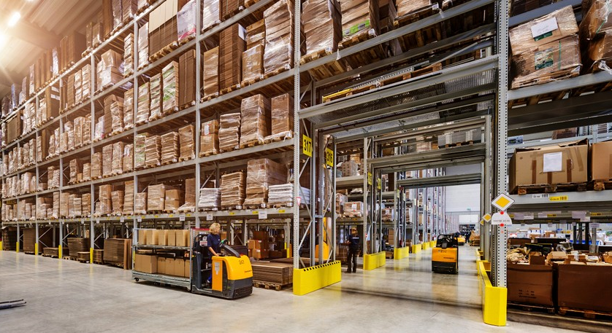
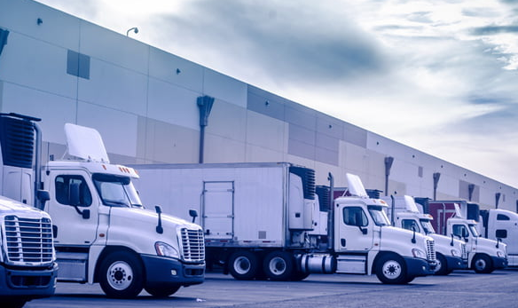
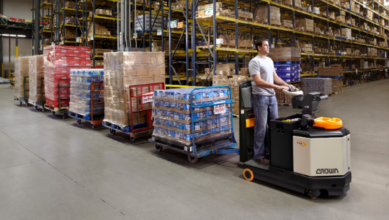
Buildings layout @industrial park
Tug/Tow Stations
Production building
(25th sq(m)
Warehouse building
(25th sqm)
Production flow
1
5
2
3
4

Slide 4
Stock segregation
MFGRECEIVE
default receiving subinventory
MFGHUB
normal HUB, default stock locations, rack locations, locations for tug/tow load/unloads, separate location(s) for handling HighValue parts (mainly closed and well secured area [with surveillance cameras] against theft
DMC (subinventory for Damaged Materials Collection : production scrapping, warehouse bad material handling, received materials in bad condition, improper receiving unload, improper shipping loading, etc.)
MFGFG
Default shipping (truck to customer), except stock locations the locations are associated to docks/gates

Slide 5
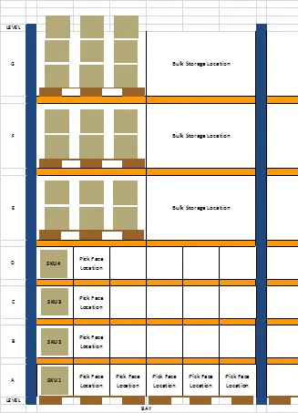
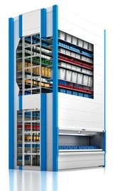
Special processes / technics
Pick Face
Kardex
Supermarket : subinventory for quick replenishment
DMC (Damaged Materials Collection) and attached CP’s (Collection Points) for handling this kind of parts and QS processes.
KIT, RECONFIG production processes, having dedicated locations for a given operation
Secured parts : processors, HDD’s, other computer parts and/or earthquake sensors, LED lights, etc.

