Slide 1
The Trust Layer
An agentic trust check for small-data biology models
Point it at a dataset and analysis notebook. It audits for data leakage, re-runs an
honest cross-validation, and tells a biologist what their model is really worth.
Data-leakage audit
Leakage-safe CV
Calibrated LogReg
Plain-language report
Notes:
[0:00-0:20 . HOOK]
"Every biologist here has trained a classifier that scored 0.95 - and then never replicated. I built a tool that tells you, before you publish, whether that number is real."
The Trust Layer: point it at a dataset AND the analysis notebook, and it returns the honest performance in one call.
-> Transition: "First, why this keeps happening."

Slide 2
The quiet reproducibility problem
A bench scientist builds a classifier, sees 0.95 AUC — and it never replicates.
Small n, huge p
Subject leakage
Datasets are often n < 200 with thousands of features. Selecting the 'best' features on the full data manufactures signal from noise.
Repeated measures from one patient straddle the train/test split. The model memorises the subject, not the biology.
Batch confounding
Leaky preprocessing
A plate or site variable correlates with the outcome. The model reads batch signatures instead of disease.
Scaling or feature selection fit on the whole dataset lets test rows inform the pipeline — before any prediction is made.
Trust Layer — honest ML for small-data biology
2
Notes:
[0:20-0:45 . THE PROBLEM]
The reason isn't sloppiness - it's the shape of biology data. Small n, thousands of features.
Three leaks do the damage: (1) preprocessing/feature-selection fit on the WHOLE dataset before the split; (2) replicate samples from one patient landing on both sides; (3) a batch/plate variable that tracks the outcome. Each silently inflates the score.
Key line: "With more features than samples, you can hit 0.9 AUC on pure noise. That's not a bug in the biology - it's a bug in the evaluation."
-> Transition: "So we automated catching all three."

Slide 3
What we built: an automated trust layer
One call runs the whole pipeline — the scientist never has to self-declare their mistakes.
1
2
3
4
AUDIT THE CODE
AUDIT THE DATA
HONEST CV
TRUST REPORT
→
→
→
Static AST scan of the notebook flags preprocessing, feature selection, or resampling fit before the split.
Checks p/n regime, class balance, duplicate rows, subject leakage, and batch–outcome confounding.
Re-runs cross-validation with every step fit inside folds and GroupKFold on subjects. The gap = the leakage.
A calibrated logistic-regression model with reliable uncertainty, plus a plain-language report a non-ML biologist can act on.
Design principle: naive performance − honest performance = the leakage.
Trust Layer — honest ML for small-data biology
3
Notes:
[0:45-1:05 . WHAT WE BUILT]
Four stages, one call: (1) audit the CODE - read the notebook statically, no execution; (2) audit the DATA against a leakage taxonomy; (3) re-run honest, group-aware cross-validation; (4) return a plain-language report.
Emphasize: "The scientist never has to self-declare 'I think I leaked.' We read their code and answer for them."
-> Transition: "And it really is one call."

Slide 4
The whole thing is one function call
A scientist points it at their data and their notebook — no ML expertise required.
What comes back
result = trust_audit(
X, y, # samples x features, labels
groups = subject_ids, # -> subject-safe CV
batch = plate_labels, # -> batch-confound check
notebook = "analysis.ipynb", # -> static code audit
)
print(result["report_md"])
Code audit
leaks found in the notebook, by line
Data audit
taxonomy findings, critical / warning
CV ladder
naive → honest, step by step
Honest model
AUC + calibrated Brier score
Plain report
what to trust, what to fix
Trust Layer — honest ML for small-data biology
4
Notes:
[1:05-1:20 . THE API]
Show the call. X, y, optional patient IDs, plate labels, and the notebook path.
"That's the entire interface. A bench scientist with no ML background runs this and gets back: the real AUC, what inflated the reported one, and how confident the model actually is."
-> Transition: "Does it work? Four results."

Slide 5
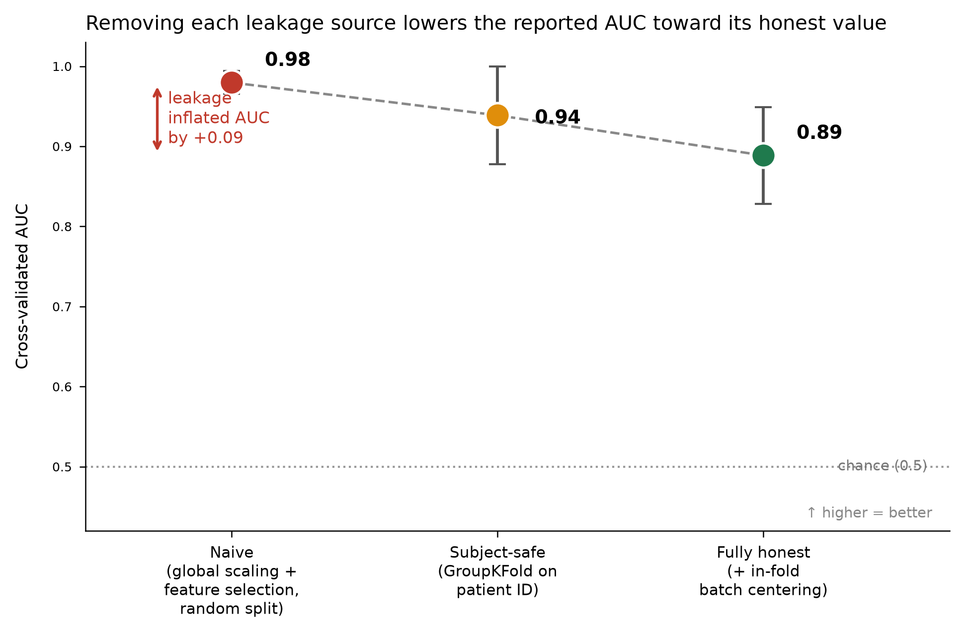
Result 1 — we catch the inflation and quantify it
Synthetic benchmark with known ground truth: 160 samples, 800 features, 40 subjects.
The ladder
Naive pipeline
0.98
feature selection + scaling on full data
+ subject-safe CV
0.94
GroupKFold keeps patients intact
+ batch correction
0.89
fully honest, in-fold centering
Leakage inflated AUC by +0.09
Trust Layer — honest ML for small-data biology
5
Notes:
[1:20-1:45 . RESULT 1 - QUANTIFY]
Synthetic benchmark, known ground truth. Walk the ladder top-to-bottom:
- Naive pipeline: 0.98
- Fix subject leakage (GroupKFold): 0.94
- Fix batch + preprocessing (fully honest): 0.89
"Each rung is one leak switched off. The tool doesn't just say 'you leaked' - it shows HOW MUCH each leak was worth. Here, 0.08 AUC was pure artifact."
-> Transition: "Synthetic is nice. Here's real biology."

Slide 6
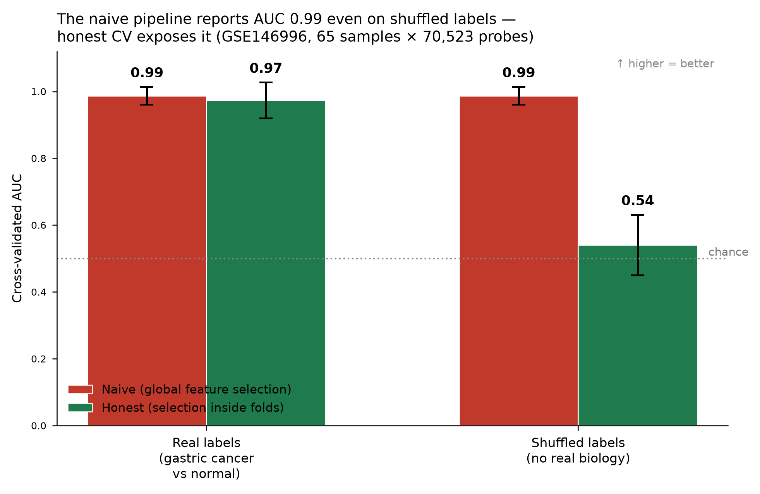
Result 2 — proof on real biology (GEO GSE146996)
Gastric cancer vs normal, 65 samples × 70,523 probes — a real p ≫ n dataset.
The killer demo
Shuffle the labels so NO biology remains. The naive pipeline still reports AUC 0.99 — on pure noise.
Naive, shuffled labels
AUC 0.99 → pure artifact
Honest CV, shuffled labels
AUC 0.54 → chance (correct)
Trust Layer — honest ML for small-data biology
6
Notes:
[1:45-2:15 . RESULT 2 - THE KILLER DEMO]
Real GEO dataset: gastric cancer vs normal, 65 samples, 70,000 probes. Textbook p >> n.
THE moment: "We shuffled the labels so there is ZERO biology left. The naive pipeline STILL reported AUC 0.99 - on random noise. Our honest CV dropped it to 0.54, coin-flip, exactly where it should be. And on the REAL labels, honest performance stayed high - 0.97 - because that signal is real."
"That's the whole thesis in one slide: the naive number looks identical whether the signal is real or noise. Ours tells them apart."
-> Transition: "It's not just binary classifiers."

Slide 7
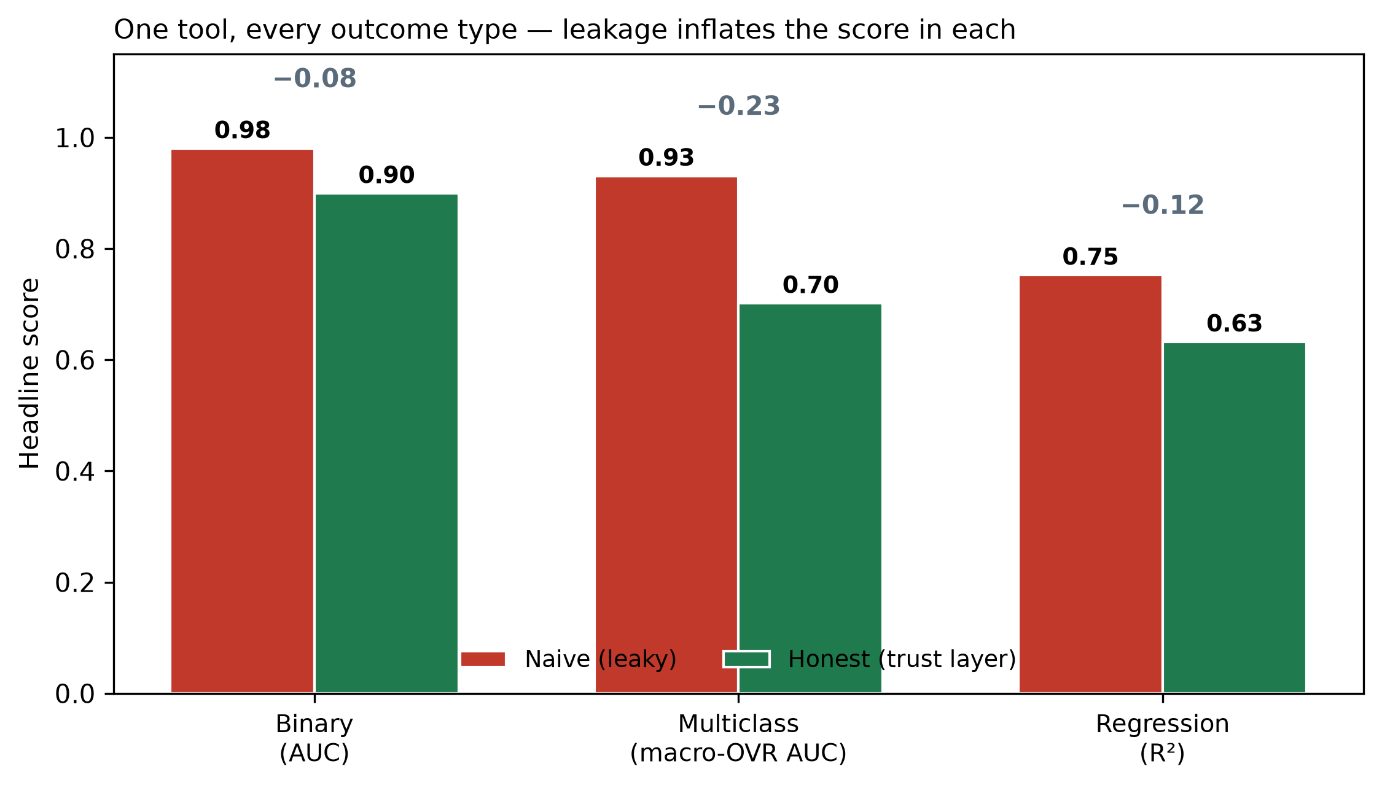
Result 3 — one tool, every outcome type
Auto-detects the task from the labels. Same leakage story holds throughout.
Coverage
Binary
AUC 0.98 → 0.90 (naive → honest)
Calibrated LogReg
Multiclass
AUC 0.93 → 0.70 (naive → honest)
macro-OVR, balanced acc.
Regression
R² 0.75 → 0.63 (naive → honest)
Ridge, RMSE / MAE
+ nested CV for tuning honesty
Trust Layer — honest ML for small-data biology
7
Notes:
[2:15-2:30 . RESULT 3 - GENERALITY]
Auto-detects the task: binary, multiclass, regression. Same leakage story, same honest ladder throughout. Nested CV also checks hyperparameter-tuning optimism.
"One tool covers the outcome types a real lab actually has - not just the toy binary case."
-> Transition: "But a trust tool has to earn trust the other way too."

Slide 8
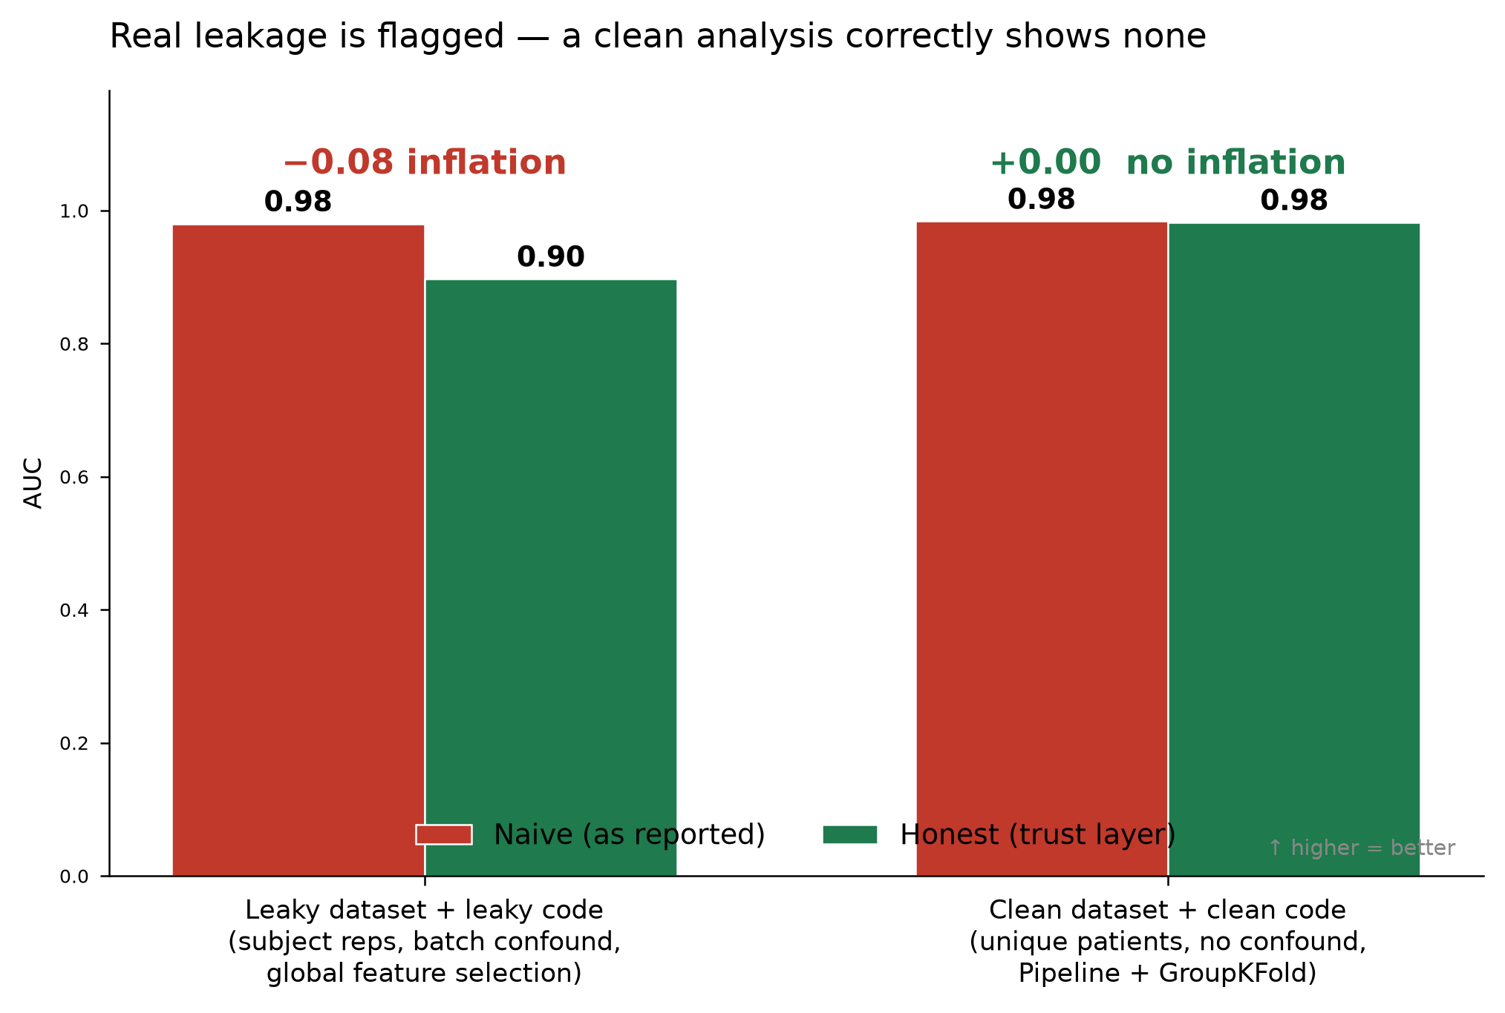
Result 4 — it doesn't cry wolf
The real test of a trust tool: does it stay quiet when the analysis is actually sound?
Leaky data + leaky code
4 critical findings
naive 0.98 → honest 0.90
Inflation flagged: +0.08
Clean data + clean code
0 critical findings
naive 0.98 → honest 0.98
No inflation: +0.00
Trust Layer — honest ML for small-data biology
8
Notes:
[2:30-2:50 . RESULT 4 - NO FALSE ALARMS]
The real test: does it stay quiet when the analysis is clean?
Two datasets, same tool: leaky one -> 4 critical findings, flags +0.08 inflation. Clean one (Pipeline + GroupKFold, no confound) -> 0 critical findings (just a benign p>n dimensionality note), reports 'no inflation.'
"A smoke alarm that goes off when you make toast is useless. This one doesn't cry wolf."
-> Transition: "So why does it matter?"

Slide 9
Why it matters
✓
Catches what humans miss
The two hardest leaks to self-report — preprocessing and feature selection before the split — are found automatically by reading the code.
✓
Honest, not alarmist
On real signal it reports near-zero inflation. It distinguishes genuine biology from artifact instead of crying wolf.
✓
Built for the bench
A non-ML biologist gets a plain-language verdict: here is your real performance, here is what inflated it, here is how confident the model actually is.
✓
Shipped as a reusable skill
Binary / multiclass / regression + nested CV, one call, validated on real GEO data — ready to run on the next dataset.
The Trust Layer — because a 0.95 AUC should mean something.
Notes:
[2:50-3:00 . CLOSE]
Land it: "The two hardest leaks to self-report - preprocessing and feature selection before the split - are exactly the ones we catch automatically, by reading the code. This is a trust layer for a field with a quiet reproducibility problem."
"One call. Honest number, what inflated it, calibrated confidence. Thank you - happy to go deep in the appendix."
[STOP - natural end. Appendix is Q&A backup only.]

Slide 10
Appendix
Detailed data analysis — leakage taxonomy, calibration, and methods
Trust Layer — honest ML for small-data biology
10
Notes:
[APPENDIX - only if judges ask for detail]
Divider. "Everything from here is backup: the taxonomy, calibration curves, and full methods. What do you want to see?"

Slide 11
Appendix A — leakage audit on the benchmark
Synthetic dataset: 160 samples, 800 features, 40 subjects × 4 replicates. 4 critical, 1 warning.
Check | Severity | Finding
subject_leakage | CRITICAL | 40 subjects, 160 rows (4 reps each). A random split puts the same subject on both sides.
batch_confound | CRITICAL | Batch confounded with outcome (Cramér's V = 0.67, p = 1.4e-17).
leaky_feature_selection | CRITICAL | Selection on full data before split — with p ≫ n manufactures 0.9+ AUC from noise.
leaky_preprocessing | CRITICAL | Scaling fit on full dataset; test rows informed the transform.
dimensionality | WARNING | 800 features vs 160 samples (p/n = 5.0). Nested CV mandatory.
class_balance | OK | Minority class 40% — reasonably balanced.
duplicate_rows | OK | No exact duplicate feature rows.
Trust Layer — honest ML for small-data biology
11
Notes:
[APPENDIX A . leakage taxonomy]
The full audit table on the synthetic benchmark. Point to batch_confound: Cramer's V = 0.67, p = 1.4e-17 - statistically detected, not guessed. 4 critical + 1 dimensionality warning.

Slide 12
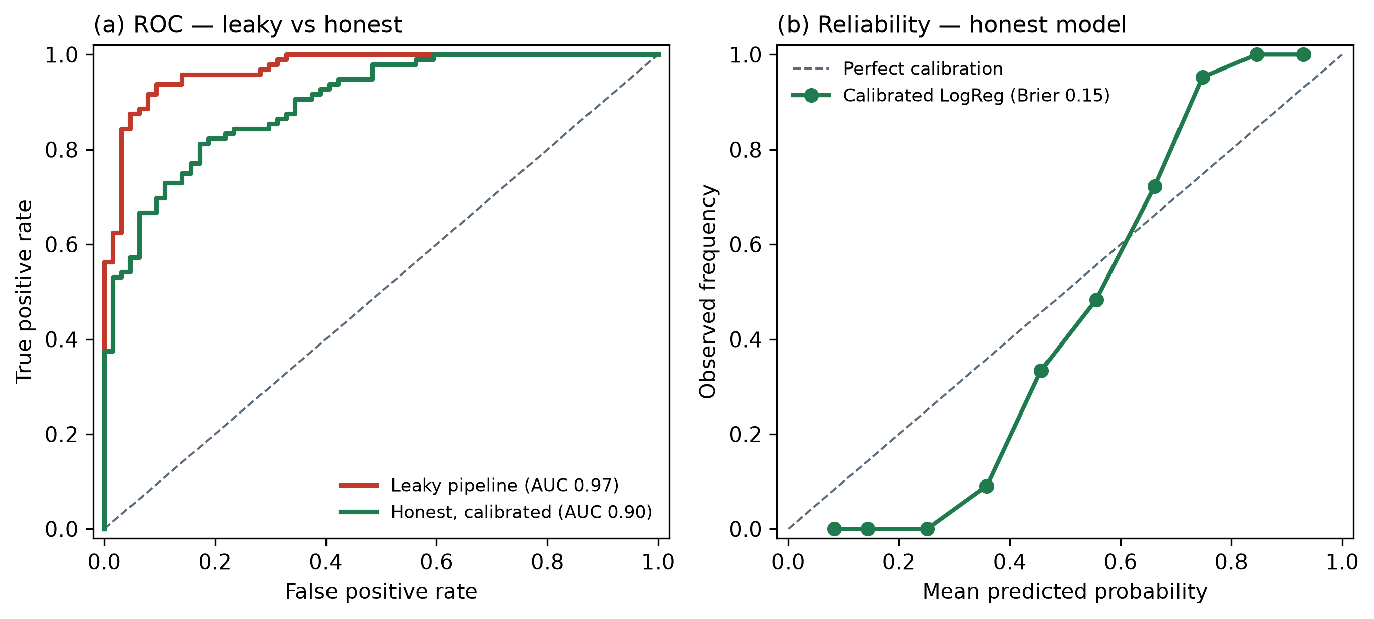
Appendix B — honest performance & calibration
Calibrated logistic regression, leakage-safe out-of-fold predictions on the benchmark.
Calibrated LogReg (honest)
Honest AUC
0.899
Leaky AUC
0.970
Brier (honest)
0.146
Brier (leaky)
0.072
Log-loss (honest)
0.456
Probabilities calibrated inside each fold — Brier-reliable, leakage-safe.
Trust Layer — honest ML for small-data biology
12
Notes:
[APPENDIX B . calibration]
Left: ROC, leaky vs honest. Right: reliability curve - the model's stated probabilities match observed frequencies (Brier 0.15). "Calibrated means a 0.8 prediction is right about 80% of the time - the biologist can trust the confidence, not just the label."
If asked about the model: calibrated logistic regression is the default; the tool also fits a nonlinear gradient-boosted model and auto-picks the better one, with a nested check so the selection itself stays honest.

Slide 13
Appendix C — method & reproducibility
Every number in this deck is reproducible from saved artifacts.
Honest cross-validation
Model & calibration
• Scaling, feature selection, and per-batch centering fit INSIDE each training fold only
• GroupKFold on subject ID — no subject spans train and test
• Naive pipeline fits the same steps on the full data (the deliberate leak)
• Calibrated logistic regression for binary; Ridge / multinomial LogReg otherwise
• Out-of-fold probabilities give unbiased AUC + Brier calibration
• Nested CV measures the optimism of hyperparameter selection
Notebook static analysis
Validation data
• AST parse of .ipynb / .py — no code executed
• Flags fits before the split; recognises Pipeline + GroupKFold as safe
• Synthetic benchmark with known ground truth (25 true features)
• Real: GEO GSE146996 — gastric cancer vs normal, 65 × 70,523
Trust Layer — honest ML for small-data biology
13
Notes:
[APPENDIX C . reproducibility]
Every number is reproducible from saved artifacts. Honest CV = scaling + feature selection + per-batch centering all fit INSIDE each training fold; GroupKFold keeps subjects intact. No notebook code is ever executed - the code audit is purely static (AST). Packaged as a reusable skill + a one-command demo script.

