Slide 1
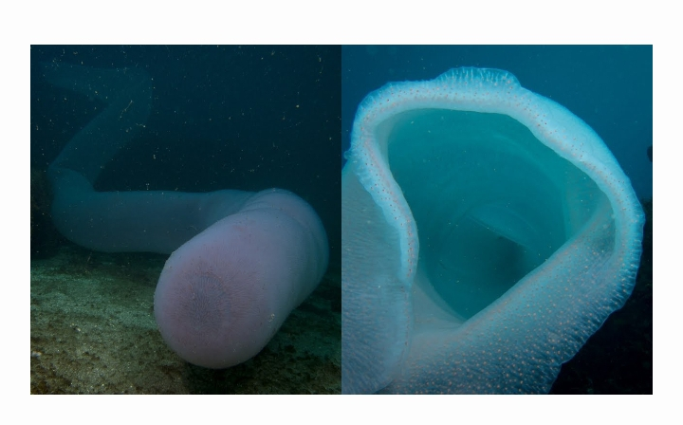
The Pyrosom

Slide 2
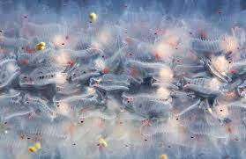
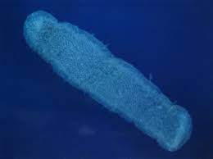
Global idea
It’s more than meets the eye!
Each pyrosom is not a single creature, instead, a pyrosom is a colony made up of many individual creatures called “Zooids”, that are just a few millimeters long. All of them joined and are jelly as man brain. The tiny creatures that make a whole pyrosom can number in hundreds or even in thousands. Some pyrosoms are one centimeter long while others can reach eighteen meters.

Slide 3
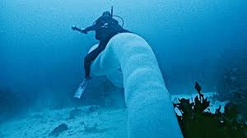
The pyrosom is also known as “sea pickles” or “unicorn of the sea” or even “fire bodies”
Despite the appearances, the Pyrosom is not actually a giant sea worm. It is actually made up of thousands of organisms called Zooids as we said before, to form a large cylinder or cone closed at one end and opened at the other as a mouth.

Slide 4
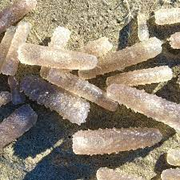
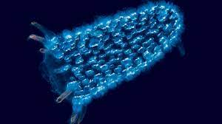
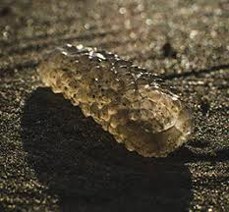
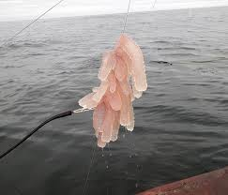
But what are Zooids ?
Zooids are microorganisms about few millimeters in size, but are embedded in a common gelatinous tunic that joins all of the individuals. Each zooid opens both to the inside and outside of the “tube”, drawing in ocean water from the outside to its internal filtering mesh called the branchial basket, extracting the microscopic plant cells on which it feeds, and then expelling the filtered water to the inside of the cylinder of the colony.
The colony is bumpy on the outside, each bump representing a single zooid, but nearly smooth, although perforated with holes for each zooid, on the inside.

Slide 5
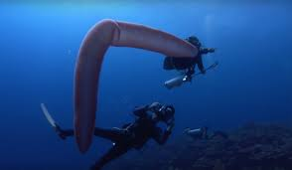
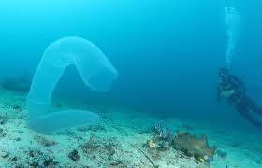
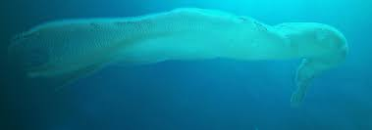
Pyrosoms are “Planktonic”, which means their movements are largely controlled by currents, tides, and waves in the ocean.
On a smaller scale, however, each colony can move itself slowly by the process of jet propulsion, created by the coordinated beating of cilia in the branchial baskets of all zooids, which also create feeding currents.

Slide 6
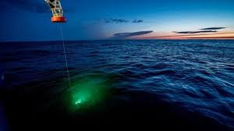
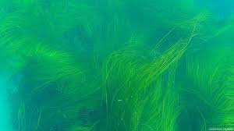
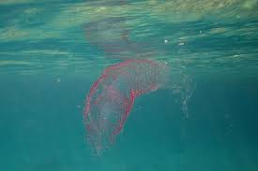
One mysterious info:
Pyrosoms are brightly bioluminescent, they actually get their names from this feature: “pyro” means “fire” in Greeks, and “soma” means “body”. Fire bodies. Their blue-green light can been seen more than 100 feet away. At night, many sailors have detected them and observed pyrosoms.
when disturbed, pyrosoms have the ability of being able to emit bright-blue light.

Slide 7
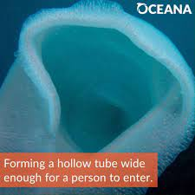
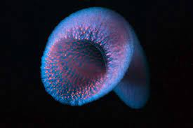
Reproduction
Biologically, pyrosoms are invertebrates belonging to the marine zooplankton. They are hermaphroditic animals that have both a testicle and an ovary. Like many invertebrates they multiply by applying a type of reproduction called “budding”. This process is similar to cloning. Indeed, each individual has the same characteristics as its parents. The planktons or one pyrosom remains attached via a gelatinous coat. According to Rebecca Helm, a specialist in marine biology, said:” pyrosoms have a silky and delicate texture. The diameter of the largest specimen would also be able of swallowing up a man.”

Slide 8
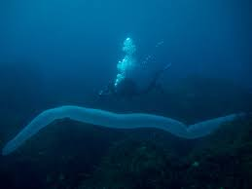
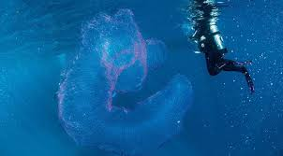
What is the function of the pyrosom ?
Pyrosoms migrate up and down the water column daily to feed in the productive upper marine layers at night. At dusk, they migrate back to the deep water layers. During this migration, the actively transport their feces to these depths while also releasing carbon through reparations.

Slide 9
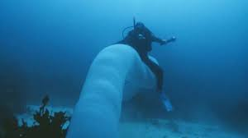
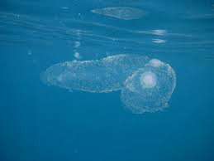
Are pyrosoms dangerous ?
They are not dangerous at all, are pacific organisms that travels through water. But, can be danger to the unwary. Based on one researcher’s observations, a creature that gets stuck inside a pyrosom may to reemerge and certainly may die.

Slide 10
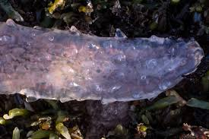
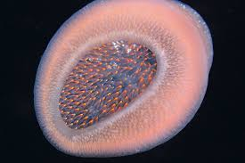
Are pyrosoms poisonous ?
Pyrosoms are gelatinous as we said, while they are completely harmless, they are curious site.
. Thus, pyrosoms are nor poisonous nor toxic

Slide 11
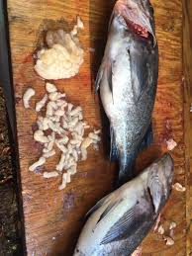
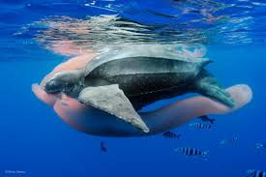
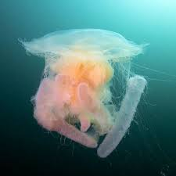
Which are the enemies of the pyrosom ?
Pyrosoms have many predators as the sea turtles, sea birds, sea urchins, whales, dolphins, some fish species and crabs

Slide 12
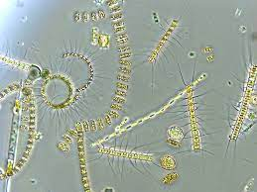
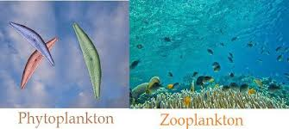
What do pyrosoms eat ?
Even if what we know about these mysterious creatures, scientists discovered that pyrosoms feed on “phytoplankton” by catching them in a mucus net as they float in the water.
N.W:
Pyrosoms themselves can’t swim fully against the current and are therefore considered as “ joined planktons”

Slide 13
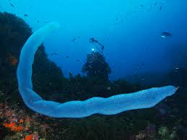
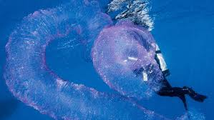
Where does pyrosom live and how deep can he go ?
Usually, pyrosoms live in warm water, in tropical regions. But for several years, it is possible to observe them, sporadically, in Atlantic and Mediterranean coasts.
The colony can sink to more than 500 meters deep. In the darkness, it becomes easily identifiable during the period of bioluminescence.

Slide 14

Importance of pyrosom for the ecosystem
Pyrosoms are affecting other sea creatures, ultimately us. Up till now, we don’t know too much about them but we deduced that pyrosoms are affecting fishing. These fire bodies have broken fishing nets and fishermen are finding more sea pickles or pyrosom in the shrimp they catch. Currently, researchers are studying how pyrosom’s population is affecting the areas. Well, trying to figure out their impact on the ecosystem. While others are trying to find their economical impact.

Slide 15

Lighting up the sea
exploding in numbers
that’s what pyrosoms do
That’s what makes them
CRAZY CREATURES

