Slide 1
Pando data science project -Organization top 10 prospects prediction
David Li

Slide 2
Data analysis
Objective - Binary Decision Problem.
Understanding the Problem.
Analyzed 2017 Top 10 Prospects relative to Leagues, Levels and Teams.

Slide 3
Objective
Binary decision problem determining whether a prospect is a organizational top 10 prospect.
Output is a predicted list of players who are in their respective organizational top 10 prospect list

Slide 4
Understanding the Problem

Slide 5
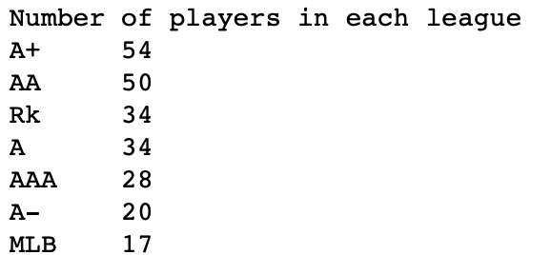
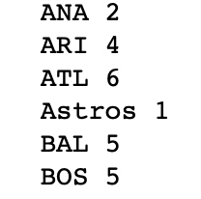
Analyzing 2017 top 10 prospects with respect to leagues, levels, and teams
Examined the number of “Top 10 Prospects” from each level.
Evenly distributed – no need to distinguish between levels.
Verified that there are no organizations with more than 10 ”Top 10 Prospects in a given year (reference attached Jupyter notebook for full list).

Slide 6
Reasoning

Slide 7
Solution
Every row in given data frame as a data point
Selected specific features
Preprocess every feature vector with normalization, standardization, one-hot, or raw transformations
Split data into train, validation, and test (2018 data) datasets
Train a number of models on this input transformed data
Evaluate on Validation Dataset

Slide 8
Every row in given data frame as a data point
Since every row has an associated top 10 metric, each row is used as a data point.

Slide 9
Selected specific features
Specific features (statistics of a player) are selected for modeling.
Features included are: 'rel_app', 'era', 'hits9', 'hr9', 'bb9', 'so9', 'so_bb', 'whip', 'gs_pct', 'ip_gm', 'hgt_inches', 'wgt', 'wins', 'gs', 'gm', 'sv', 'gf', 'sho’, 'mlb_binary', 'ba100_post’, 'org_top10_post’
These features are selected based on

Slide 10
Preprocess every feature vector
Vectors are preprocessed with normalization, standardization, one-hot, or raw transformations.

Slide 11
Split data into train, validation, and test (2018 data) datasets

Slide 12
Train a number of models on this input transformed data
Models tested:
Nearest Neighbors
Linear SVM
RBF SVM
SVC Gamma
Decision Tree
Random Forest
Neural Net
Naïve Bayes
QDA

Slide 13
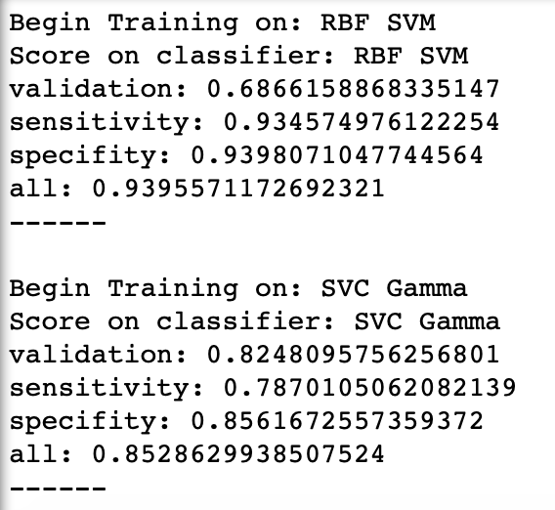
Evaluate on Validation Dataset
Each model is tested on a validation dataset, looking at validation, sensitivity and specificity values.
Example:
*full list found in attached Jupyter notebook “Modelling.ipynb”

Slide 14
Problems during project
Unbalanced Dataset
NA Values

Slide 15
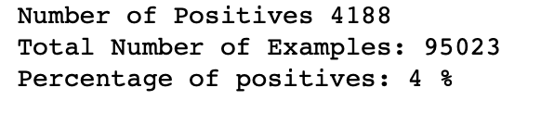
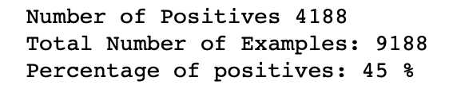
Unbalanced dataset
Only 4% of samples were negative
Used Random Undersampling to resolve the problem

Slide 16
Na values
Since the number of rows with NA values were negligibly small compared to total rows, did not include any rows with NA values.

Slide 17
Library used
Pandas, NumPy, and SciPy Libraries

