Slide 1
Car Classification with CNN
Sirui Wang

Slide 2
Project Idea & Inspiration
My project idea is to use Convolutional Neural Networks to classify different cars including different brands, models, and years
Want to do a project with image classification & CNN
Something I am interested in

Slide 3
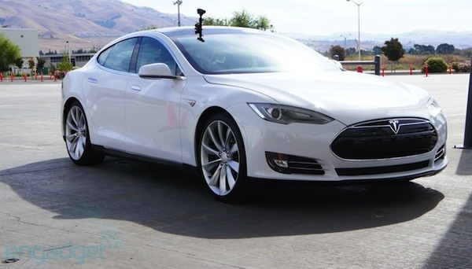
Data
Dataset: Stanford Car Dataset
https://ai.stanford.edu/~jkrause/cars/car_dataset.html
Classes: 196 of different car brand, model and year
Training Data: 8144
Testing Data: 8041
ImageDataGenerator flow: batch size 32
Example Image: Tesla Model S Sedan 2012

Slide 4
My training implementation
Generate Data with ImageDataGenerator and flow function since not enough data
Convert images to the same size (256, 256)
Add Conv2D Layer(s) with MaxPooling, BatchNormalization and Dropout
Comparison with different number of Conv2D Layers
Add optimizer
Experiment with different number of layers
FC layers for input and output
Train & validating with data

Slide 5
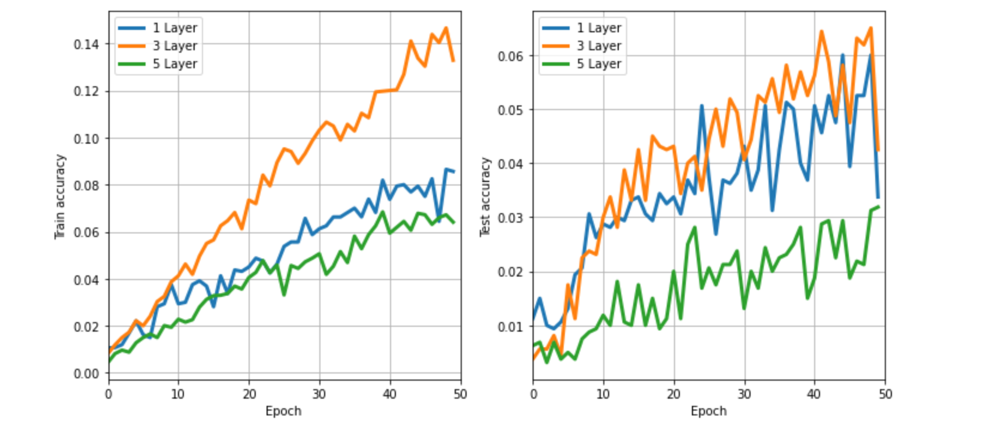

Slide 6
Learning online model
Small yet effective model
MobileNetV2 network
Use with my data to train the model, validating & testing

Slide 7
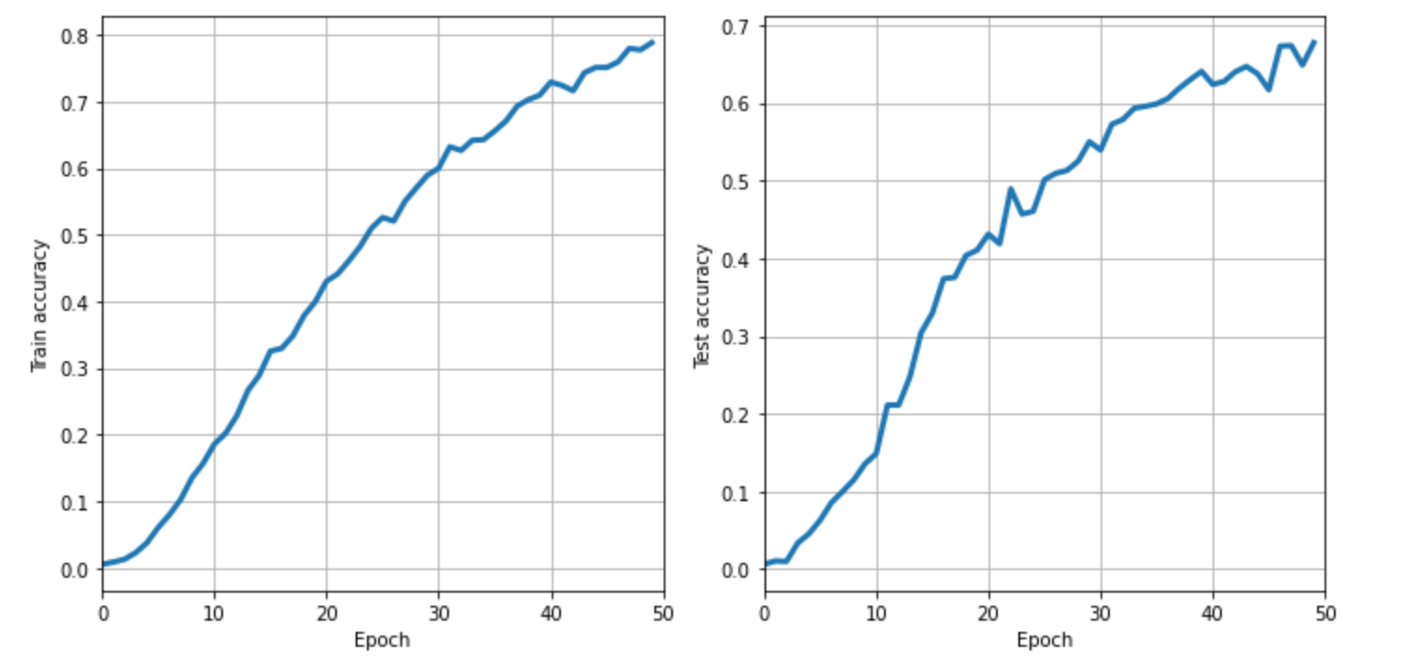

Slide 8
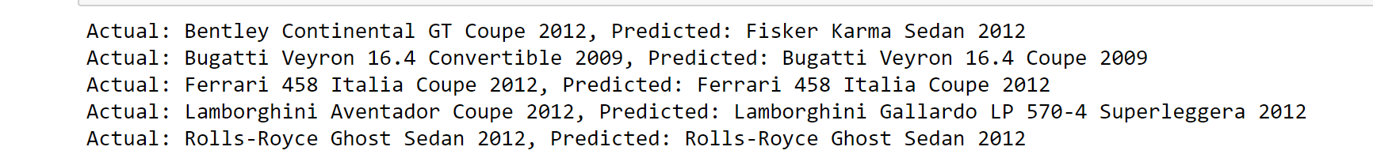
Testing
Validating
Predict with a few pictures from testing data for visualization
Predict with a few pictures found online

Slide 9
Difficulties/Future Improvements
Number of data is small for each class & too many classes
Dataset is relatively old
Not enough time
Technical difficulty with multithread fitting (generator not thread safe) – slow fitting

Slide 10
Insights
Getting a lot more familiar with CNN and image classification
Layers, Optimizers, other details
Learn to build a model
Used comparing different layers
From models found online, had a better idea on how to better build model based on the limited data

Slide 11
References
Dataset: https://ai.stanford.edu/~jkrause/cars/car_dataset.html
Online model: https://www.kaggle.com/elmahy/tiny-models-with-the-cars-dataset-70-accuracy

