Slide 1
Welcome!
I am Luka,
And this is my idea for a student magazine!

Slide 2
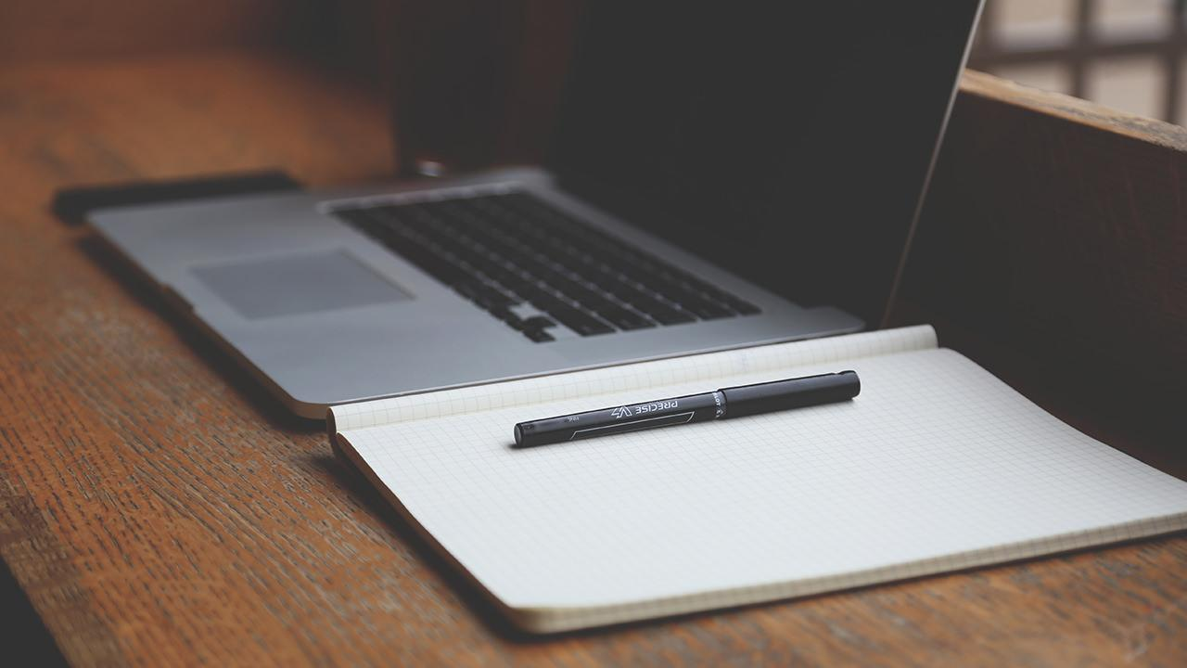
International student in Aarhus !?

Slide 3
1.
Introduction
name, ideas, plans

Slide 4
“No book or magazine article is for "everyone" so know your audience, then target them with your writing.”
W. Terry Whalin, Book Proposals That Sell: 21 Secrets to Speed Your Success

Slide 5
Idea for magazine
Personal experience.
Stories of other students.
Desire to help others to: save time, money, and to focus on their studies!

Slide 6
Name of magazine
It is powerful
Gives the general idea of content
Targets the audience group
Popularity change

Slide 7
2.
The main!
Plans, days, work, website, design, pole, interviews…

Slide 8
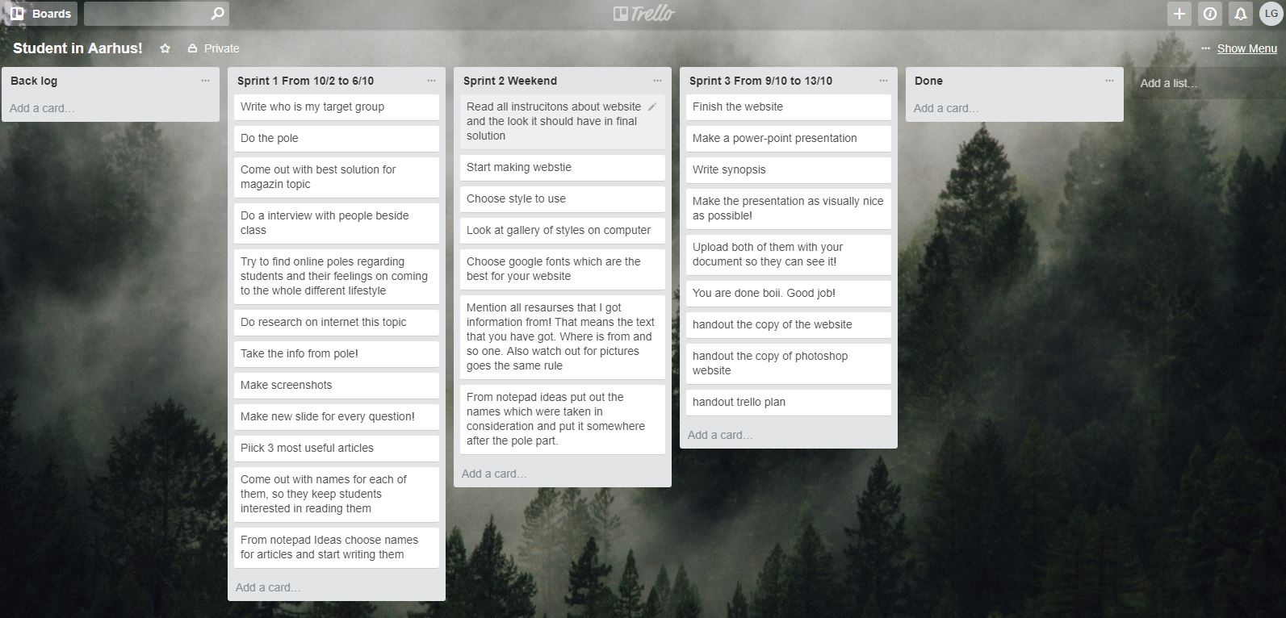
Trello plans;

Slide 9
The pole

Slide 10
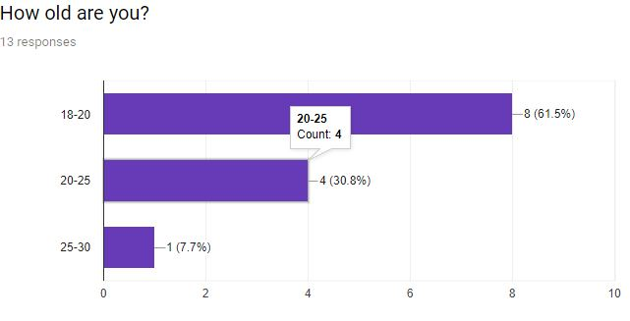
Question 1:

Slide 11
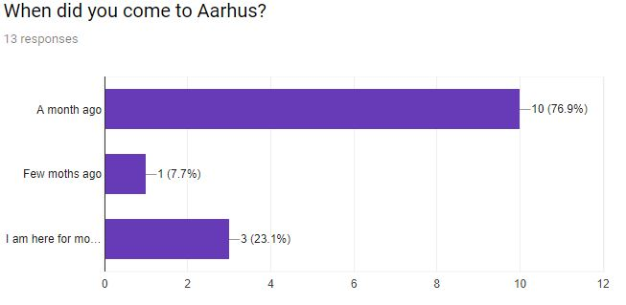
Question 2:

Slide 12
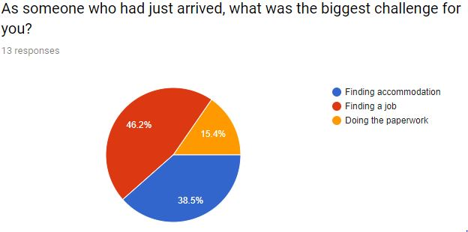
Question 3:

Slide 13
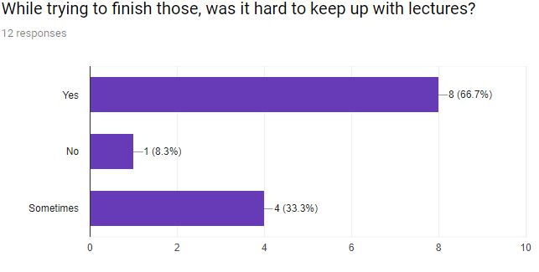
Question 4:

Slide 14
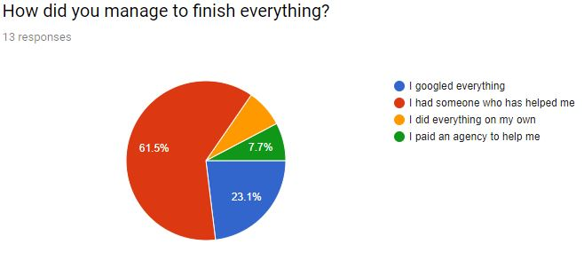
Question 5:

Slide 15
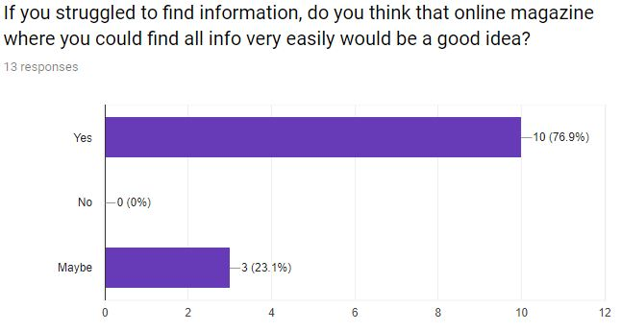
Question 6:

Slide 16
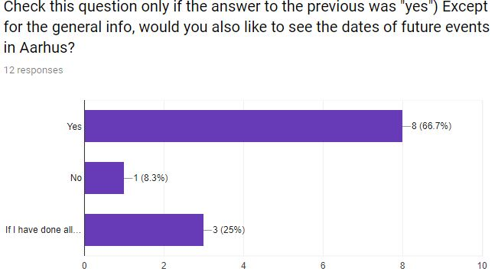
Question 7:

Slide 17
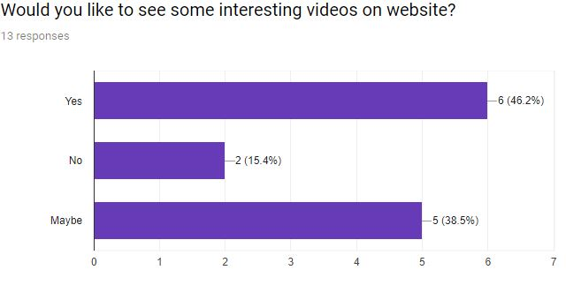
Question 8:

Slide 18
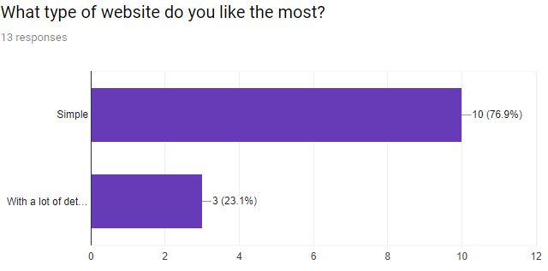
Question 9:

Slide 19
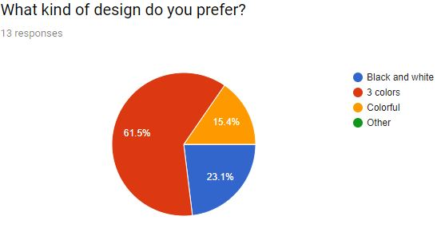
Question 10:

Slide 20

Website !

Slide 21
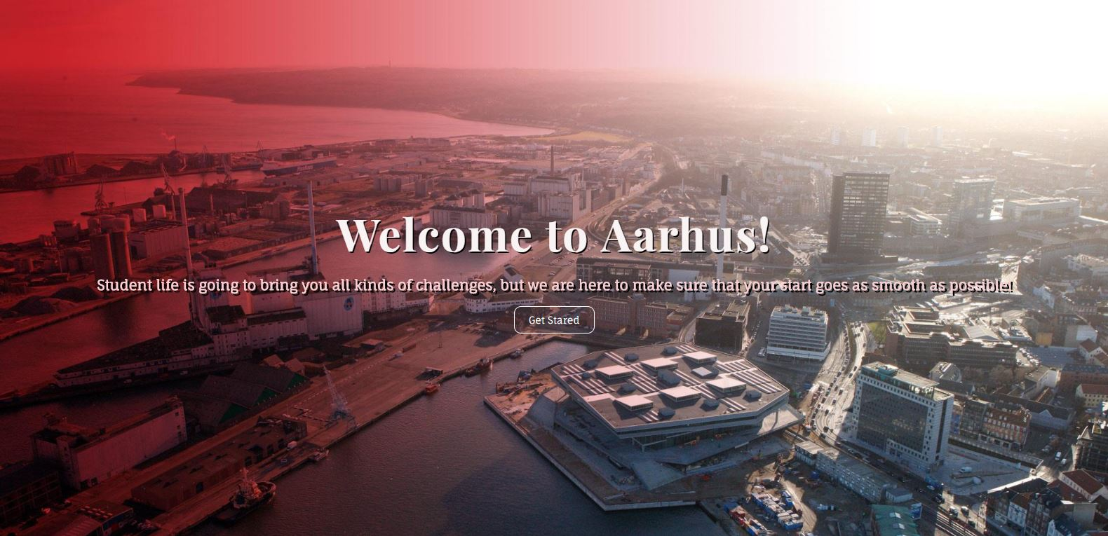
DESKTOP PROJECT
Place your screenshot here

Slide 22
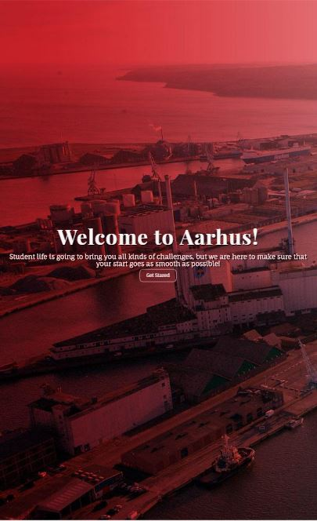
PHONE
PROJECT
Website is fully responsive, so you can enjoy content on your smartphone!
Place your screenshot here

Slide 23
THANKS!
Any questions?
Feel free to ask me @luka.gurovic98@gmail.com

Slide 24
Credits
Special thanks to all the people who made and released these awesome resources for free:
Presentation template by SlidesCarnival
Photographs by Startupstockphotos

Slide 25
Presentation design
This presentation uses the following typographies and colors:
Titles: Dosis
Body copy: Roboto
You can download the fonts on these pages:
https://www.fontsquirrel.com/fonts/dosis
https://material.google.com/resources/roboto-noto-fonts.html
Orange #ff8700
You don’t need to keep this slide in your presentation. It’s only here to serve you as a design guide if you need to create new slides or download the fonts to edit the presentation in PowerPoint®

Slide 26
SlidesCarnival icons are editable shapes.
This means that you can:
Resize them without losing quality.
Change line color, width and style.
Isn’t that nice? :)
Examples:

Slide 27
😉
Now you can use any emoji as an icon!
And of course it resizes without losing quality and you can change the color.
How? Follow Google instructions https://twitter.com/googledocs/status/730087240156643328
✋👆👉👍👤👦👧👨👩👪💃🏃💑❤😂😉😋😒😭👶😸🐟🍒🍔💣📌📖🔨🎃🎈🎨🏈🏰🌏🔌🔑 and many more...

