Slide 1
Agenda
Objects
Arrays
JSON
Functions
Closures
Scopes (advanced) ,
Arrow functions (from ES6)
Number methods
String methods
Array methods
Date methods

Slide 2
Objects mutable collection of properties, which are key value pairs, keys have string or symbol type, values can be everything even functions
Object literals
let book = { id: 5,
name: “JS”,
author : { id: 6 }
}
Objects with new
let date = new Date()
let string = new String() Object.create(prototype)

Slide 3
Creating Objects
Object literals
let book = { id: 5,
name: “JS”,
author : { id: 6 }
}
let empty = {};
let point = { x: 0, y: 0 };

Slide 4
Objects with new
let date = new Date()
let string = new String()
let o = new Object(); // Create an empty object: same as {}.
let a = new Array(); // Create an empty array: same as [].
let d = new Date(); // Create a Date object representing the current time
let r = new Map(); // Create a Map object for key/value mapping

Slide 5
Prototypes
let o1 = Object.create({x: 1, y: 2});
let o2 = Object.create(null); // o2 inherits no props or methods.
let o3 = Object.create(Object.prototype); // o3 is like {} or new Object().

Slide 6
Querying and Setting Properties
Getting properties
let author = book.author;
let name = author.surname;
let title = book["main title"];
Setting properties
book.edition = 7;
book["main title"] = "ECMAScript";

Slide 7
Inheritance
let o = {}; // o inherits object methods from Object.prototype
o.x = 1; // and it now has an own property x.
let p = Object.create(o); // p inherits properties from o and Object.prototype
p.y = 2; // and has an own property y.
let q = Object.create(p); // q inherits properties from p, o, and...
q.z = 3; // ...Object.prototype and has an own property z.
let f = q.toString(); // toString is inherited from Object.prototype
q.x + q.y // => 3; x and y are inherited from o and p

Slide 8
Property Access Errors
book.subtitle // => undefined: property doesn't exist
let len = book.subtitle.length; // !TypeError: undefined doesn't have length
let surname = book?.author?.surname;

Slide 9
Deleting Properties
delete book.author; // The book object now has no author property.
delete book["main title"]; // Now it doesn't have "main title", either.

Slide 10
Testing Properties
let o = { x: 1 };
"x" in o // => true: o has an own property "x“
"y" in o // => false: o doesn't have a property "y"
"toString" in o // => true: o inherits a toString property
let o = { x: 1 };
o.hasOwnProperty("x") // => true: o has an own property x
o.hasOwnProperty("y") // => false: o doesn't have a property y
o.hasOwnProperty("toString") // => false: toString is an inherited property
o.propertyIsEnumerable("x") // => true: o has an own enumerable property x
o.propertyIsEnumerable("toString") // => false: not an own property
Object.prototype.propertyIsEnumerable("toString") // => false: not enumerable

Slide 11
Enumerating Properties
let o = {x: 1, y: 2, z: 3}; // Three enumerable own properties
o.propertyIsEnumerable("toString") // => false: not enumerable
for ( let p in o ) {
console.log(p); // Prints x, y, and z, but not toString
}

Slide 12
Object.keys() returns an array of the names of the enumerable own properties of an object. It does not include nonenumerable properties, inherited properties, or properties whose name is a Symbol (see §6.10.3).
Object.getOwnPropertyNames() works like Object.keys() but returns an array of the names of nonenumerable own properties as well, as long as their names are strings.
Object.getOwnPropertySymbols() returns own properties whose names are Symbols, whether or not they are enumerable.
Reflect.ownKeys() returns all own property names, both enumerable and non-enumerable, and both string and Symbol.

Slide 13
Object Methods
toString()
toLocaleString()
valueOf()
toJSON()

Slide 14
Spread Operator
let position = { x: 0, y: 0 };
let dimensions = { width: 100, height: 75 };
let rect = { ...position, ...dimensions };
rect.x + rect.y + rect.width + rect.height // => 175

Slide 15
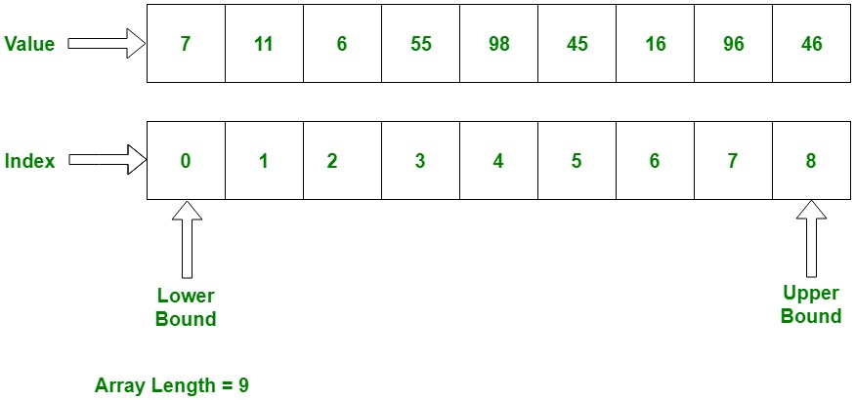
Arrays arrays are objects, which keys are numbers

Slide 16
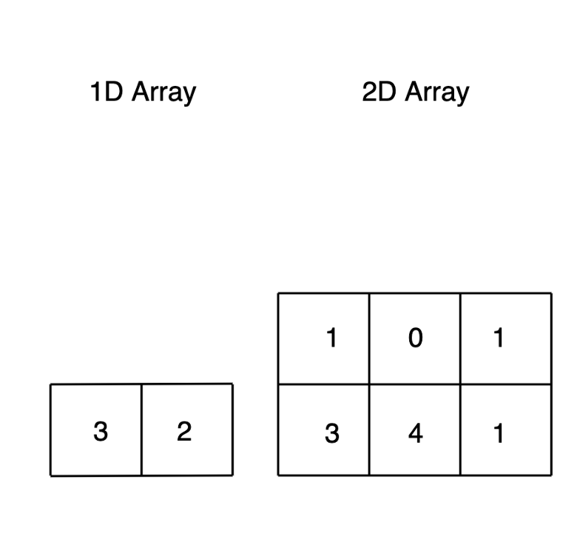
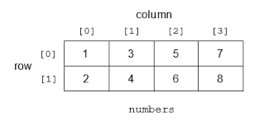
Arrays

Slide 17
Creating Arrays
Array literals
The ... spread operator on an iterable object
The Array() constructor
The Array.of() and Array.from() factory methods

Slide 18
Array Literals
let empty = []; // An array with no elements
let primes = [2, 3, 5, 7, 11]; // An array with 5 numeric elements
let misc = [ 1.1, true, "a", ];
let base = 1024;
let table = [base, base+1, base+2, base+3];
let b = [[1, {x: 1, y: 2}], [2, {x: 3, y: 4}]];
let count = [1,,3]; // Elements at indexes 0 and 2. No element at index 1
let undefs = [,,]; // An array with no elements but a length of 2

Slide 19
The Spread Operator
let a = [1, 2, 3];
let b = [0, ...a, 4]; // b == [0, 1, 2, 3, 4]
let digits = [..."0123456789ABCDEF"];
digits // => ["0","1","2","3","4","5","6","7","8","9","A","B","C","D","E","F" ]

Slide 20
The Array() Constructor
Call it with no arguments:
let a = new Array();
Call it with a single numeric argument, which specifies a length:
let a = new Array(10);
Explicitly specify two or more array elements or a single nonnumeric element for the array:
let a = new Array(5, 4, 3, 2, 1, "testing, testing");

Slide 21
Array.of()
Array.from()
Array.of() // => []; returns empty array
Array.of(10) // => [10];
Array.of(1,2,3) // => [1, 2, 3]
let copy = Array.from(original);

Slide 22
Reading and Writing Array Elements
let a = ["world"]; // Start with a one-element array
let value = a[0]; // Read element 0
a[1] = 3.14; // Write element 1
let i = 2;
a[i] = 3; // Write element 2
a[i + 1] = "hello"; // Write element 3
a[a[i]] = a[0];
a.length

Slide 23
Sparse Arrays
let a = new Array(5); // No elements, but a.length is 5.
a = []; // Create an array with no elements and length = 0.
a[1000] = 0; // Assignment adds one element but sets length to 1001.

Slide 24
Adding and Deleting Array Elements
let a = []; // Start with an empty array.
a[0] = "zero"; // And add elements to it.
a[1] = "one";
OR
a.push("zero"); // Add a value at the end. a = ["zero"]
a.push("one", "two");
delete a[2];
2 in a // => false

Slide 25
Iterating Arrays
let letters = [..."Hello world"]; // An array of letters
let string = "";
for(let letter of letters) {
string += letter;
}
string
let everyother = "";
for (let [index, letter] of letters.entries()) {
if (index % 2 === 0) everyother += letter;
}
everyother //=> "Hlowrd"

Slide 26
Multidimensional Arrays
// Initialize the array
for(let row = 0; row < table.length; row++) {
let num = 1;
for(let col = 0; col < table[row].length; col++) {
table[row][col] = row+col+num;
num++;
}
}

Slide 27
Array Methods
forEach
let data = [1,2,3,4,5], sum = 0; // Compute the sum of the elements of the array data.forEach(value => { sum += value; });
filter()
let a = [5, 4, 3, 2, 1]; a.filter(x => x < 3)
find() and findIndex()
a.findIndex(x => x === 3) // => 2 the value 3 appears at index 2
a.find(x => x % 5 === 0) // 5
evry()
a.every(x => x < 10) // => true: all values are < 10.
a.every(x => x % 2 === 0) // => false: not all values are even
map()
let a = [1, 2, 3];
a.map(x => x*x) // => [1, 4, 9]: the function takes input x and returns x*x

Slide 28
Subarrays
splice()
let a = [1,2,3,4,5,6,7,8];
a.splice(4) // => [5,6,7,8]; a is now [1,2,3,4]
a.splice(1,2) // => [2,3]; a is now [1,4]
slice()
let a = [1,2,3,4,5];
a.slice(0,3); // Returns [1,2,3]

Slide 29
Array Searching and Sorting Methods
let a = [0,1,2,1,0];
a.indexOf(1) // => 1: a[1] is 1
a.lastIndexOf(1) // => 3: a[3] is 1
a.indexOf(3) // => -1: no element has value 3
a.includes(2) // true
let a = ["banana", "cherry", "apple"];
a.sort(); // a == ["apple", "banana", "cherry"]

Slide 30
Array to String Conversions
let a = [0,1,2,1,0];
a.join() // => "1,2,3“
a.join(" ") // => "1 2 3"
[1,2,3].toString() // => "1,2,3"

Slide 31
Static Array Functions
Array.of()
Array.from()
Array.isArray([]) // => true

Slide 32
Strings as Arrays
let s = "test";
s.charAt(0) // => "t"
s[1]

Slide 33
JSON (JavaScript Object Notation)
let book = {
id:5,
name: “JS”,
authors: [ {
id: 1 }
]
}
JSON.stringify(object)
JSON.parse(objectString)

Slide 34
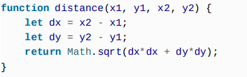
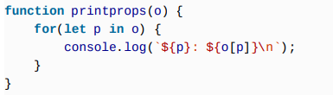
Functions functions are callable objects

Slide 35
Functions functions are callable objects
Functions expression – function name(parameters){}
Functions statements – var f = function(){}
With new - let sum = new Function('a', 'b', 'return a + b');
Call function like f()
Hoisting of function
f(); // TypeError
g();
var f = function(){}
function g(){}

Slide 36
Function Expressions
const f = function fact(x) {
if (x <= 1) return 1;
else return x*fact(x-1);
};
Call function like f()
[3,2,1].sort( function(a,b) { return a-b; } );

Slide 37
Hoisting of function
f(); // TypeError
g();
var f = function(){}
function g(){}

Slide 38
IIFE (Immediately Invoked Function Expression) and Anonymous Functions
var f = function(){} - anonymous
IIFE
(
function(){
console.log(‘lll’)
}
) ()

Slide 39
Arrow functions (ES6) () => {}
let test = () => {
console.log(this);
}
test();
let a = {}
a.func = test;
a.func();
// Make a copy of an array with null elements removed.
let filtered = [1,null,2,3].filter(x => x !== null); // filtered == [1,2,3]

Slide 40
Function Invocation
let total = distance(0,0,2,1) + distance(2,1,3,5);
let probability = factorial(5)/factorial(13);
Method Invocation
let calculator = { // An object literal
operand1: 1,
operand2: 1,
add() {
this.result = this.operand1 + this.operand2;
}
};
calculator.add(); // A method invocation to compute 1+1. or calculator[“add”]()
calculator.result

Slide 41
Constructor Invocation
o = new Object();
o = new Object;
Method Invocation
let calculator = { // An object literal
operand1: 1,
operand2: 1,
add() {
this.result = this.operand1 + this.operand2;
}
};
calculator.add(); // A method invocation to compute 1+1. or calculator[“add”]()
calculator.result

Slide 42
Function parameters parameters vs arguments
functions can be passed as arguments
function f(){}
function b(a){
a();
}
b(f);
function f(x, y, z){
arguments.length // arguments is array like object
arguments[5]
}
f(5)
f(5, 6, 7, 8, 9)
functions can be object property values
let a = {
b: function(){}
}

Slide 43
Function parameters
function getPropertyNames(o, a = []) {
for(let property in o)
a.push(property);
return a;
}
function max(first=-Infinity, ...rest) {
let maxValue = first;
for(let n of rest) {
if (n > maxValue) {
maxValue = n;
}
}
return maxValue; }
max(1, 10, 100, 2, 3, 1000, 4, 5, 6) // => 1000

Slide 44
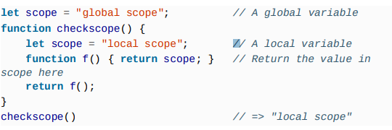
Closures

Slide 45
Closures
function count (){
let count = 0;
return function(){
return ++count;
}
}
let countCalls = count();
countCalls();
countCalls();
countCalls();
function countCalls(){
let count = 0;
return ++count;
}
countCalls();
countCalls();
countCalls();
let count = 0;
function countCalls(){
return ++count;
}
countCalls();
countCalls();
countCalls();

Slide 46
Number methods
Number.parseInt(radix?) or global parseInt(radix?)
Number.parseFloat() or parseFloat()
Number.isNaN() or isNaN()
Number.isFinite()
Number.MAX_VALUE
Number.MIN_VALUE
…
let x =5;
x.toFixed(5)
x.toString(radix?)
x.toString(2) // “101”
…

Slide 47
String methods
let x = ‘string’
x.charAt(4)
x.concat(‘ other string’)
x.indexOf(‘s’), x.lastIndexOf(‘s’)
x.length
x.slice(1,3)
x.split(‘’)
x.substr(2,2)
x.toLowerCase()
x.toUpperCase()

Slide 48
Array methods
let x = [1, 2, 3, “string”]
x.length
x.concat(4, 5, [“string”])
x.every((item) => {return item > 5})
x.filter((item) => {return item > 5})
x.forEach(console.log)
x.indexOf()
x.lastIndexOf()
x.join(‘ - ’)
x.map(item => item * 2)
x.pop(), x.push(value)
x.shift(), x.unshift(value)
x.reverse()
x.slice(2, 2)
x.splice(2, 2)
x.sort((item1, item2) => item1 - item2) or x.sort()
x.reduce((accumulator, currentValue) => { return accumulator + currentValue;
}, 6)
x.find(x => x.id === 9);
...

Slide 49
Date methods
let x = new Date()
x.getTime() and x.valueOf()
let y = new Date(x.getTime())

