Slide 1

Credit Card Fraud Detection
By
David Onyeali
Michael David

Slide 2

Introduction
Credit card fraud is the unauthorized use of a credit or debit card or a similar payment tool, to fraudulently obtain money or property.
In 2018, money lost from fraud involving credit cards worldwide reached $27.85 billion. It is important that credit card companies are able to detect and decline fraudulent credit card transactions so that their customers are not wrongly charged.
This aim of this project is to create a model to detect such fraudulent transactions using data from previous transactions, gotten from [Credit Card Fraud Detection | Kaggle].

Slide 3

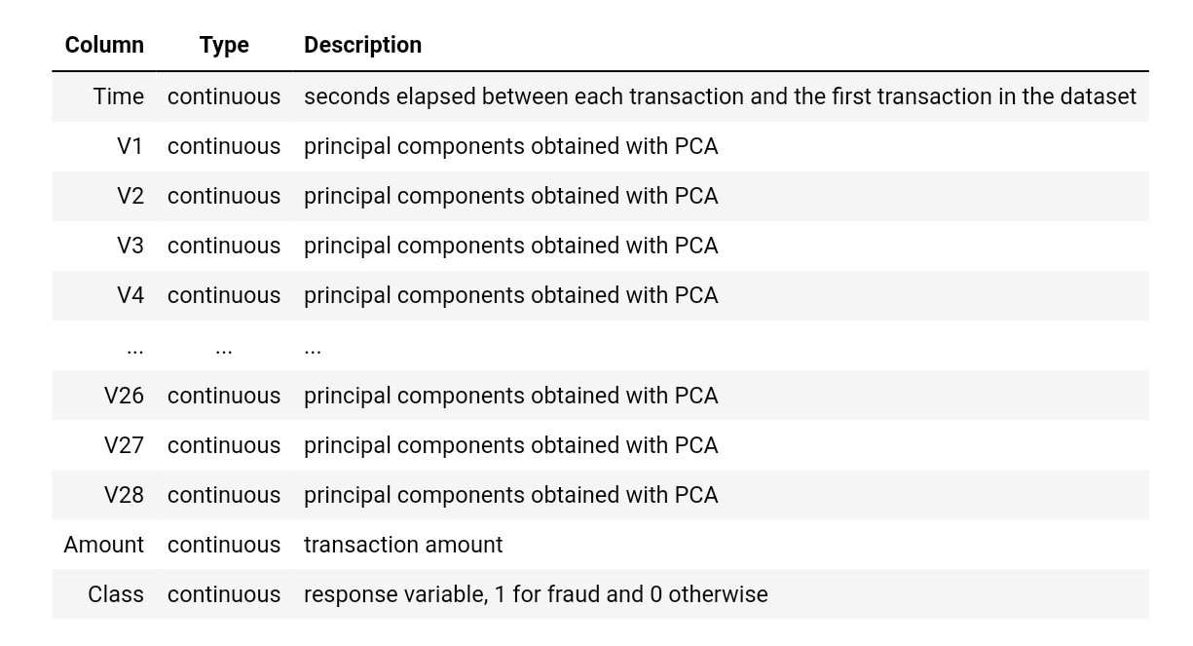
Dataset Description
The Dataset contains transactions made in September 2013 by European cardholders.
It contains 284,807 instances, each representing a transaction. It contains 30 features. It contains only numerical input variables which are the result of a PCA transformation.

Slide 4
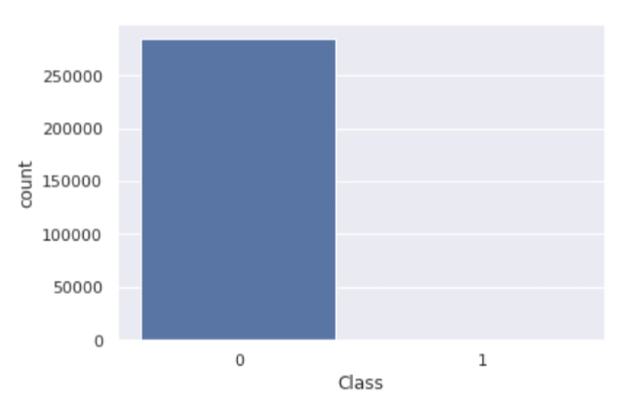
Dataset Description
Of the 284, 807 instances, only 492 are positive cases of fraud. This means less than 2% of the entire dataset are fraudulent transactions.
Due to this imbalanced nature of the dataset the evaluation metrics we chose to use for the trained models is the f1_score and Matthew's correlation coefficient (mcc).

Slide 5

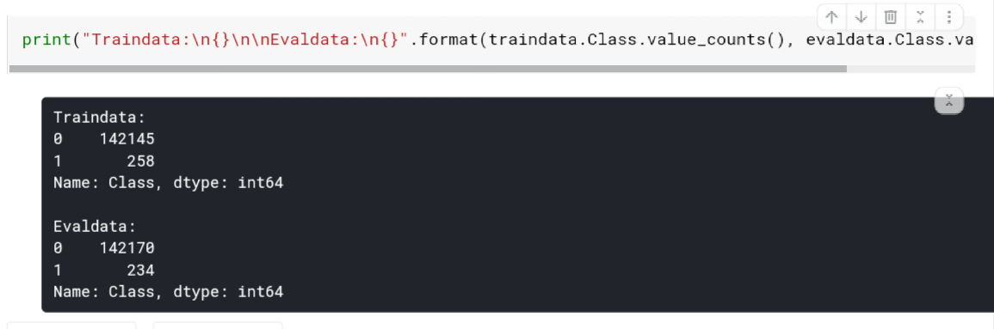
Data Preprocessing
The dataset was scaled using sklearn.preprocessing.StandardScaler and split into training and evaluation data. The training data was used to train and test the models while the evaluation data was used to evaluate the final model.

Slide 6

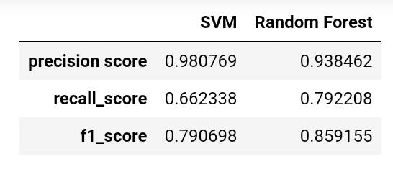
Training
The Support Vector Machine (SVM) AND Random Forest algorithms were trained with the data, using all the features, and cross validated using Kfold cross validation to reduce error due to generalization.
The models performed well with slight hyperparameter tuning.

Slide 7

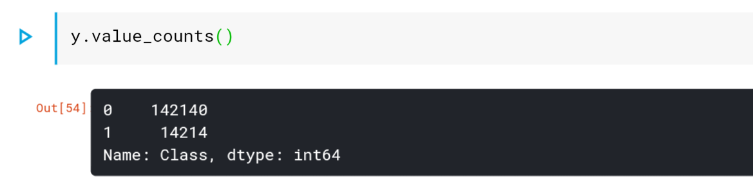
Handling Imbalance
The dataset was resampled using the SMOTE and RandomUnderSampler from the imbalanced learn library.
SMOTE was used for oversampling the positive cases and the RandomUnderSampler for undersampling the negative cases.

Slide 8
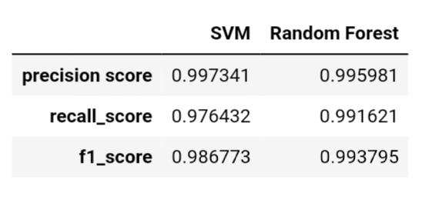
Handling Imbalance
The resampled dataset performed very well on cross validation.

Slide 9

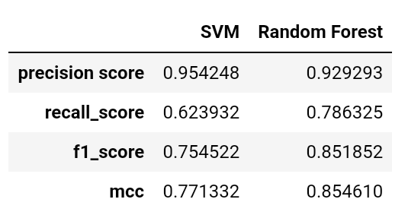
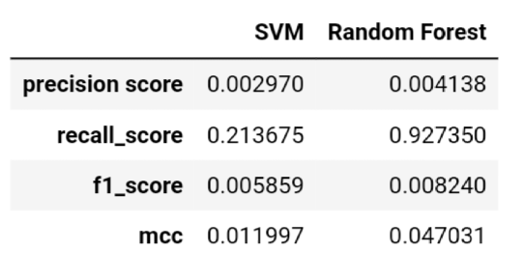
Model Evaluation
The Model was evaluated using the other half of the dataset and the results are as follows.
With original data
With resampled data

Slide 10
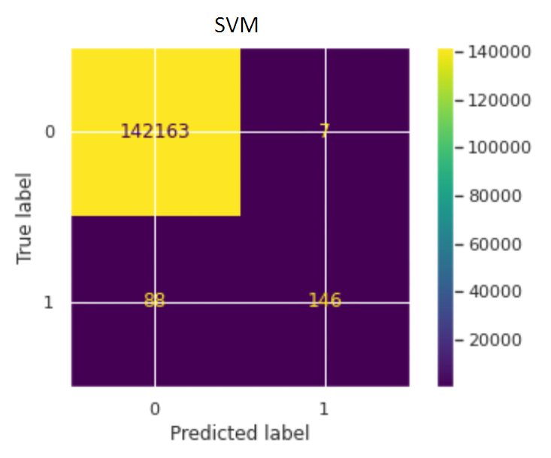
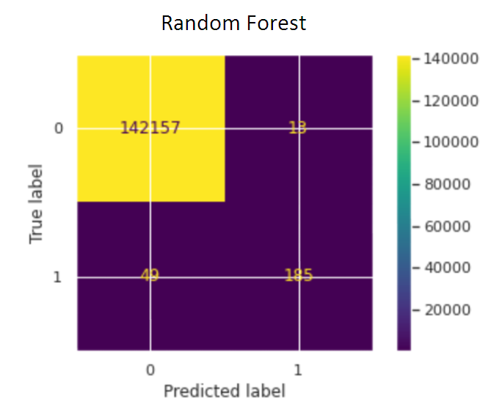
Model Evaluation
Confusion Matrices for models created with the original dataset.

Slide 11
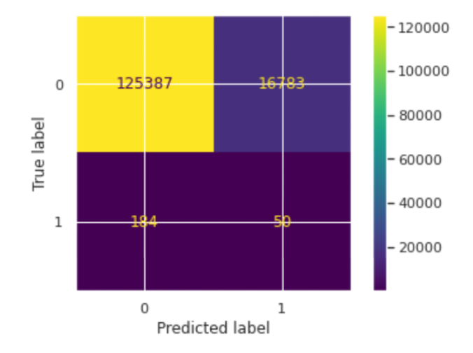
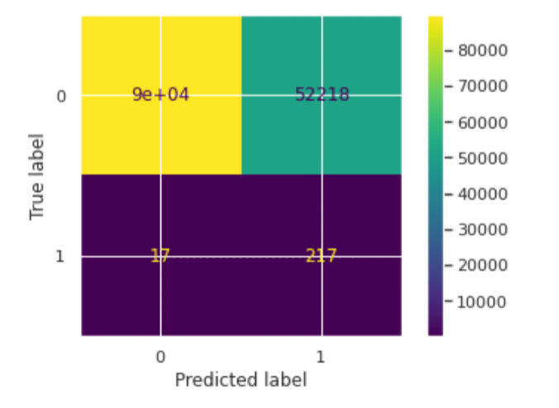
Model Evaluation
Confusion Matrices using model created with the resampled dataset.
SVM
Random Forest

Slide 12

Conclusions
The Random forest model trained with the original data gave the best results on evaluation with an f1_score of 0.86 and Matthew's correlation coefficient of 0.85.
The following recommendations would help to improve the performance of the model:
Get more data for the positive cases.
Use GridSearchCV or RandomizedSearchCV to search for the best hyperparameters for the models.
Use more advanced algorithms like xgboost, lightgbm, etc
Try more resampling techniques.

Slide 13
Thank You!

